Slide 1
HOW IT WORKS
The Pipeline — Clinical Question to Answer
Index built once offline (10,000 articles · 46,853 chunks)
Chunking
emmbedding
1
2a
2b
3
4
5
Query
Keyword
Search
+
Fusion
Top-K
Articles
LLM
Answer
Semantic
Search
plain-language
clinical question
tokenised ·
scored
against 46k chunks
both lists merged
· remove duplicates/deduping
highest-scoring
excerpts as context
cited answer · context
only · no general training
query embedded · biomedical
model · nearest-neighbour

Slide 2
HOW THE SYSTEM IMPROVED
Iterative Evaluation of Models: From Simple to Complex
Iteration 1 - First Prototype
Iteration 2 - Semantic Search
Iteration 3 - Full Pipeline
Query → [BM25 only] → Small AI (flan-t5-s)
Query → BM25 | FAISS (MiniLM)
→ RRF → Llama 8B
Query → BM25 | PubMedBERT + FAISS → RRF → Llama 70B
BM25 is used for retrieval, scoring docs on term frequency; context is being built
LLM Prompt: gets context & query
Small LLM produces an answer
BM25 and FAISS work in parallel
FAISS used for semantical likeliness
Both outputs: merged by RRF
LLM: gets query & RRF output
PubMedBERT: specialized LLM
Used for the medical and biological fields likeliness.
converts medical and biological tokens into embeddings
Trained on PubMed documents.
Bigger LLM (Llama 70b)
No paper retrieved.
LLM answered from general
training only.
no context, no citations.
A paper retrieved.
Not very specific.
Answer partially grounded. Key words missing.
Relevant papers retrieved. Specific, grounded, citable. Covers major aspects of query.

Slide 3
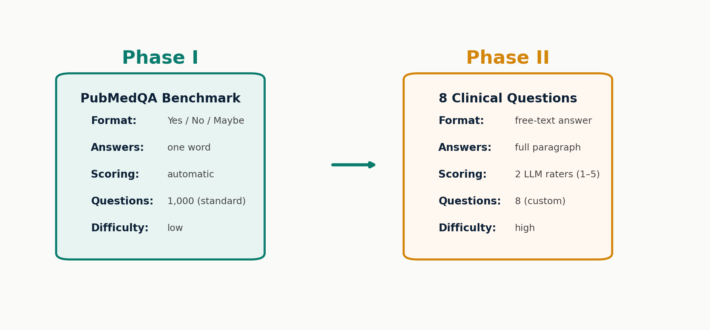
EVALUATION DESIGN
Two phases — benchmark to clinical test
Standard metrics don't match free-text Q&A — we designed a harder test
Phase I checks if the system works at all — Phase II checks if answers are actually useful
Notes:
SPEAKER NOTES — Slide 1: Two Phases of Evaluation
WHY THIS SLIDE:
We need to explain why we didn't just use standard benchmarks. PubMedQA is a well-known biomedical benchmark, but it only tests yes/no/maybe classification. Our system produces full free-text answers — a much harder task.
WHAT YOU SEE:
Left box: Phase I — PubMedQA benchmark. 1,000 yes/no/maybe questions, automatic scoring, easy comparison with published results.
Right box: Phase II — Our custom evaluation. 8 real clinical questions, free-text answers, scored by two independent LLM raters on a 1-5 scale.
KEY POINT:
Phase I is a sanity check (does the system work?). Phase II is the real test (are answers clinically useful?). Most published systems only do Phase I.
CONCLUSION:
Going beyond yes/no benchmarks is harder but gives a more honest picture of real-world performance.

Slide 4
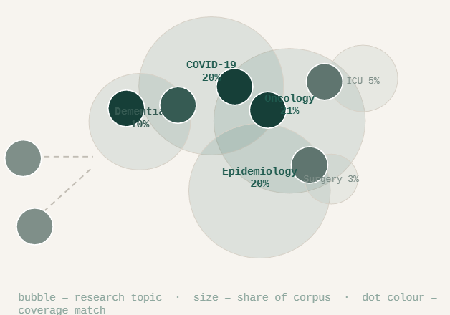
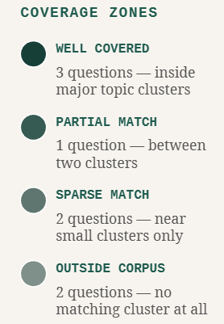

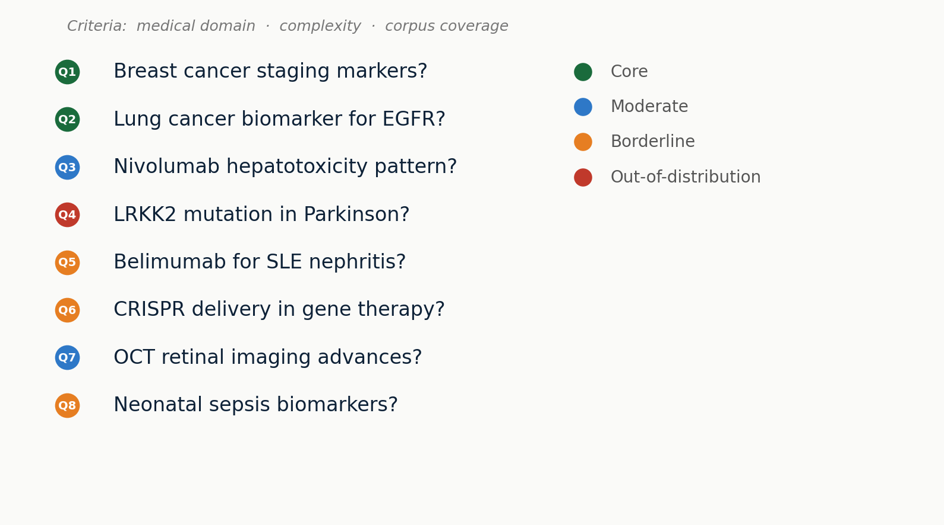
QUESTION DESIGN
8 questions — testing different strengths
Notes:
SPEAKER NOTES — Slide 2: 8 Clinical Questions
WHY THIS SLIDE:
We need to show how the evaluation questions were chosen. They're not random — each one tests a different aspect of the system.
WHAT YOU SEE:
8 questions listed with color-coded dots:
- Green (Core): Q1, Q2 — Oncology topics well represented in our 10k article corpus
- Blue (Moderate): Q3, Q7 — Topics partially covered, some relevant articles exist
- Orange (Borderline): Q5, Q6, Q8 — Edge of corpus coverage, few matching articles
- Red (Out-of-distribution): Q4 — LRKK2/Parkinson, no matching cluster in training data
CRITERIA FOR SELECTION:
1. Medical domain — cover different specialties (oncology, neurology, immunology, etc.)
2. Complexity — mix of simple lookups and multi-hop reasoning
3. Corpus coverage — deliberately include topics the system hasn't seen
KEY POINT:
We intentionally included questions the system can't answer well. This tests limits honestly, not just best-case scenarios.

Slide 5
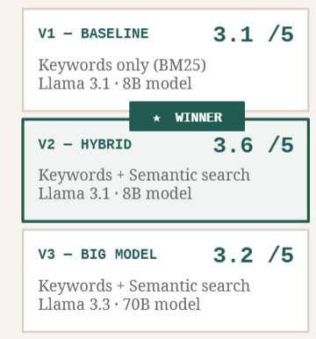

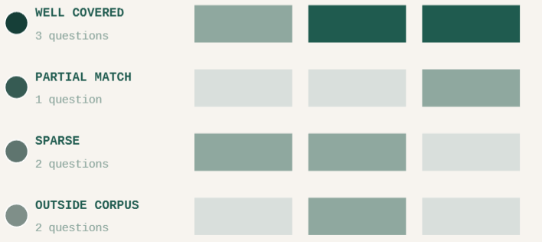

PIPELINE EVALUATION
Better Retrieval Beats a Bigger Model
3 pipeline variants · 8 questions · scored by 2 LLM raters
V1
V2
V3
Notes:
SPEAKER NOTES — Slide 5: Pipeline Comparison
WHY THIS SLIDE:
We tested three pipeline variants to see which combination of search method and language model works best.
WHAT YOU SEE:
Bar chart with 3 variants, each showing scores from both LLM raters:
- V1: BM25 + 8B model — keyword search only, small model → Combined 3.12
- V2: Hybrid + 8B model — keyword + semantic search, small model → Combined 3.61 (best)
- V3: Hybrid + 70B model — keyword + semantic search, large model → Combined 3.22
Orange bars = ChatGPT ratings (tends to rate lower)
Blue bars = Claude ratings (tends to rate higher)
Yellow outline = Combined average
SURPRISING FINDING:
The bigger model (70B) doesn't beat the smaller one (8B). Why? The bottleneck isn't the language model — it's the retrieved articles. If the search doesn't find the right passages, even a better model can't fix that.
KEY POINT:
Hybrid search (combining keywords and meaning) matters more than model size. The retrieval step is the bottleneck.

Slide 6
LIVE DEMO · PMC RESEARCH ASSISTANT
● DEMO
Demo runs live at presentation time
Biomarkers for EGFR-mutated NSCLC?
Cardiotoxicity with checkpoint inhibitors?
Immunotherapy melanoma phase II trials?
PD-L1 expression and treatment response?
Enter a clinical question…
→ Ask
Ask a clinical question to see a live response…
Note — this interface calls a language model directly. It does not connect to the retrieval index at runtime. For a full demonstration including live retrieval, run the backend locally. Requires an Anthropic API key.

Slide 7
NEXT STEPS
What could come next
01
Better Evaluation
Expert panel instead of LLM raters — medical professionals scoring answers gives ground truth
02
Larger Model
70B parameter model with more compute — our results show retrieval matters more, but a bigger model could still help
03
More Services
Drug interactions, multi-turn dialogue, patient-friendly summaries — beyond single-question Q&A
04
Bigger Corpus
Expand from 10k to 4M+ articles — fill the coverage gaps that cause most failures today
Notes:
SPEAKER NOTES — Slide 9: Outlook
WHY THIS SLIDE:
End with concrete next steps, not a "done" checklist. Show you understand what's missing and what would make the system better.
WHAT YOU SEE:
Four numbered items, each with a short title and one-line explanation:
01 Better Evaluation — Replace LLM raters with a panel of medical experts. LLM raters are a pragmatic first step, but only domain experts can truly judge clinical accuracy.
02 Larger Model — Try a 70B parameter model with proper compute. Our results suggest retrieval matters more than model size, but with better retrieval a larger model might help.
03 More Services — Go beyond single-question Q&A: drug interaction checks, multi-turn conversations, patient-friendly summaries. Make it a real clinical tool.
04 Bigger Corpus — The single biggest improvement: expand from 10,000 to 4+ million articles. Most failures we observed were data coverage problems, not model problems. More data = fewer blind spots.
KEY POINT:
These are ordered by impact. Better evaluation gives confidence. A bigger corpus fixes the root cause of most failures.

Slide 8
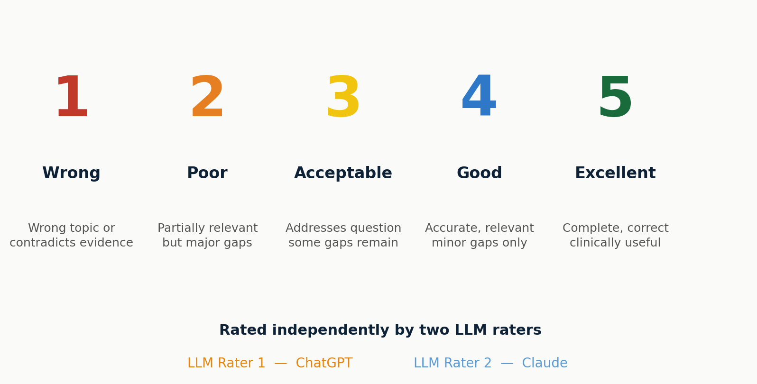
SCORING METHOD
How we rate answers — a 5-point scale
Each answer scored independently by two LLM raters
Two independent raters reduce bias — if they disagree strongly, we know the answer is ambiguous
Notes:
SPEAKER NOTES — Slide 3: Scoring Method
WHY THIS SLIDE:
Explain what the 1-5 scores mean and who does the rating. This is the foundation for all results that follow.
WHAT YOU SEE:
5-point scale from 1 (Wrong) to 5 (Excellent):
1 = Wrong topic or contradicts evidence
2 = Partially relevant but major gaps
3 = Acceptable — addresses question, some gaps remain
4 = Good — accurate and relevant, minor gaps only
5 = Excellent — complete, correct, clinically useful
Two raters:
- LLM Rater 1 = ChatGPT (evaluates each answer independently)
- LLM Rater 2 = Claude (evaluates each answer independently)
WHY LLM RATERS:
Using two different large language models as raters is a pragmatic approach. A medical expert panel would be ideal but wasn't feasible in this project scope. Two independent LLMs from different providers reduce single-model bias.
KEY POINT:
The combined score (average of both raters) is our primary metric. Where both raters agree, we're more confident.

Slide 9
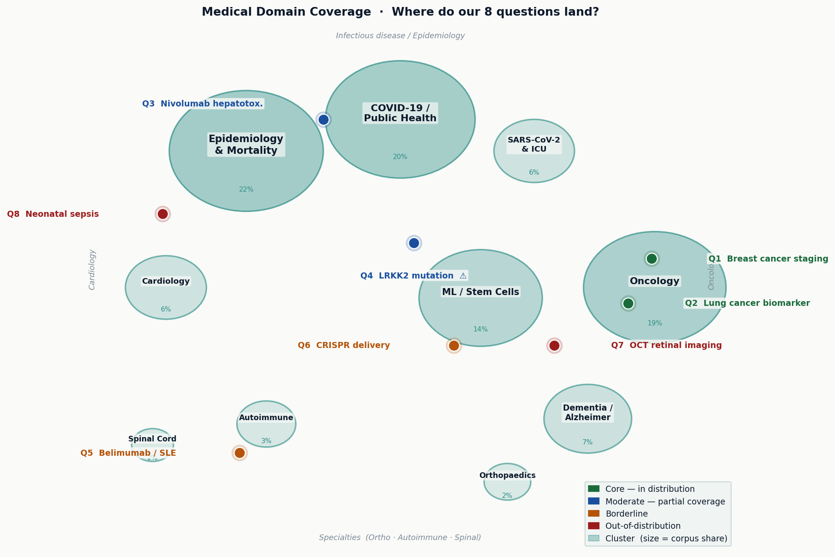
DATA COVERAGE
Where do our 8 questions land in the training data?
Bubble size = share of articles in that medical domain
Only 2 of 8 questions sit inside a well-covered cluster — 6 questions test the system at its limits
Notes:
SPEAKER NOTES — Slide 4: Cluster Coverage Map
WHY THIS SLIDE:
Before looking at scores, we need to understand what the training data covers. Not all medical topics are equally represented in our 10,000-article corpus.
WHAT YOU SEE:
A bubble map of 10 medical domain clusters found in the corpus:
- Bubble size represents the percentage of articles in that cluster
- Largest clusters: COVID-19/Public Health (21%), Oncology (20%), Epidemiology (20%)
- Smallest: Orthopedics (3%), Spinal Cord (3%)
The 8 questions are placed near their best-matching cluster:
- Q1, Q2 (green dots) sit inside the Oncology bubble — core topics
- Q3 (blue) near Epidemiology — moderate match
- Q4 (red) floats between clusters — LRKK2/Parkinson has no matching domain
- Q5-Q8 at various edges
KEY POINT:
This map predicts where the system will perform well (inside bubbles) and where it will struggle (between or outside bubbles). Q4 is the key test case — there's simply no Parkinson data in the corpus.

