Slide 1
NEUE FISCHE · CAPSTONE I · 2025/26
PMC Research
Assistant
Access to millions of biomedical research papers
Thomas
Viktor
Markus

Slide 2
THE DATA SOURCE
3–5k
What is PubMed ?
new biomedical papers
published daily
PUBMED / PMC
(ResearchGate / SciReader 2018)
— largest biomedical literature database
- 30+ million research articles
- 9+ million open access full-text articles
— Covers journals worldwide, going back to 1965
~4 h
literature reading per clinician
per week — 63% abstracts only
(Saint et al., J Gen Intern Med 2000)
ARTICLE STRUCTURE: SECTIONS
Title & Abstract
17 yr
— Each section indexed
— Retrieved as PDF, XML , …
Introduction
Methods
average: research finding
→ clinical practice
Results
Discussion
(Morris et al., J R Soc Med 2011)

Slide 3
THE PROBLEM
CLINICAL QUESTION – Real World:
WHY DIRECT SEARCH OFTEN FAILS
— Requires boolean syntax — AND, OR, standardized Keywords
— Returns full papers to read — not answers
- synonyme nicht erfasst, abkürzungen (chem.)
— No synthesis across multiple sources: (multi hopping)
"Three of my patients on nivolumab developed severe liver inflammation within 4 weeks. Is this pattern documented? Are there predictive markers?”
Why the question is hard?
Complexity
Needs linking of many papers
Clinical language for answer required
  Article A → Method 1
  Article B → Method 2
  …
— PubMed returns zero results for this exact question.
— If simplified: thousands of unrelated papers.
No appropriate answer either way.

Slide 4
THE SOLUTION
From hours to seconds —
Answerable questions instead of hundreds of results.
PMC ASSISTENT
Query → PMC Assistant → structured answer + evidence strength + citable sources → 30 seconds

Slide 5
THE CORE
Why RAG? Retrieval? Erklärung… Probleme LLMs: halluzinationen, unsicherunge, Verbesserung durch RAG
Language Model + Retrieval — why both?
LANGUAGE MODEL ALONE
LANGUAGE MODEL + RETRIEVAL PIPELINE
Strong at language generation, but trained on general corpora — not on current biomedical literature. Answers may sound plausible but cite no real source and can diverge from current evidence.
At query time the model receives the most relevant passages from 44,393 PubMed articles. It synthesises an answer grounded exclusively in that retrieved evidence — with citable sources and measurable accuracy.
WHAT THE RETRIEVAL ADDS
KNOWN LIMITS
Top-5 passages ranked by biomedical semantic similarity · Source article, year, and journal visible · Grounding measurable on held-out benchmark [68% on PubMedQA golden-69]
Retrieval gap: −35 percentage points vs. direct paper access · Index covers Open Access articles only · Answers are not a substitute for clinical judgement
The language model receives the most relevant passages from the index before each response — and grounds its answer in citable evidence rather than general training.

Slide 7
HOW IT WORKS
The Pipeline — Clinical Question to Answer
Index built once offline (10,000 articles · 46,853 chunks)
Chunkg / emmbedding ..
1
2a
2b
3
4
5
Query
›
Keyword
Search
+
Semantic
Search
›
Fusion
›
Top-K
Articles
›
LLM
Answer
[Llama-3 70B]
plain-language
clinical question
tokenised · scored
against 46k chunks
query embedded · biomedical
model · nearest-neighbour
both lists merged
· deduped to article
highest-scoring
excerpts as context
cited answer · context
only · no general training
Suchmech: wörter findet…
Hintergrund -> Blöcke

Slide 8
HOW THE SYSTEM IMPROVED
Iterative Evaluation of Models: From Simple to Complex
Stage 1 · First Prototype
Stage 2 · Semantic Search
Stage 3 · Full Pipeline
Query → [BM25 only] → Small AI (flan-t5-s)
Query → BM25 + FAISS (MiniLM) → Llama 8B
Query → PubMedBERT + BM25 → FAISS + RRF → Llama 70B
↳ No paper retrieved. LLM answered from general training only — no context, no citations.
↳ A paper retrieved, but not the most specific. Answer partially grounded; key markers missing.
↳ Biomedical embeddings surface the right papers. Grounded, citable answer covering all three aspects.
1. Entwicklungsphase: - ja/nein: welche chunks -> F1… quantifizierbare Metrik - classification

Slide 9
Einführung 8 Q&A Fragen

Slide 10
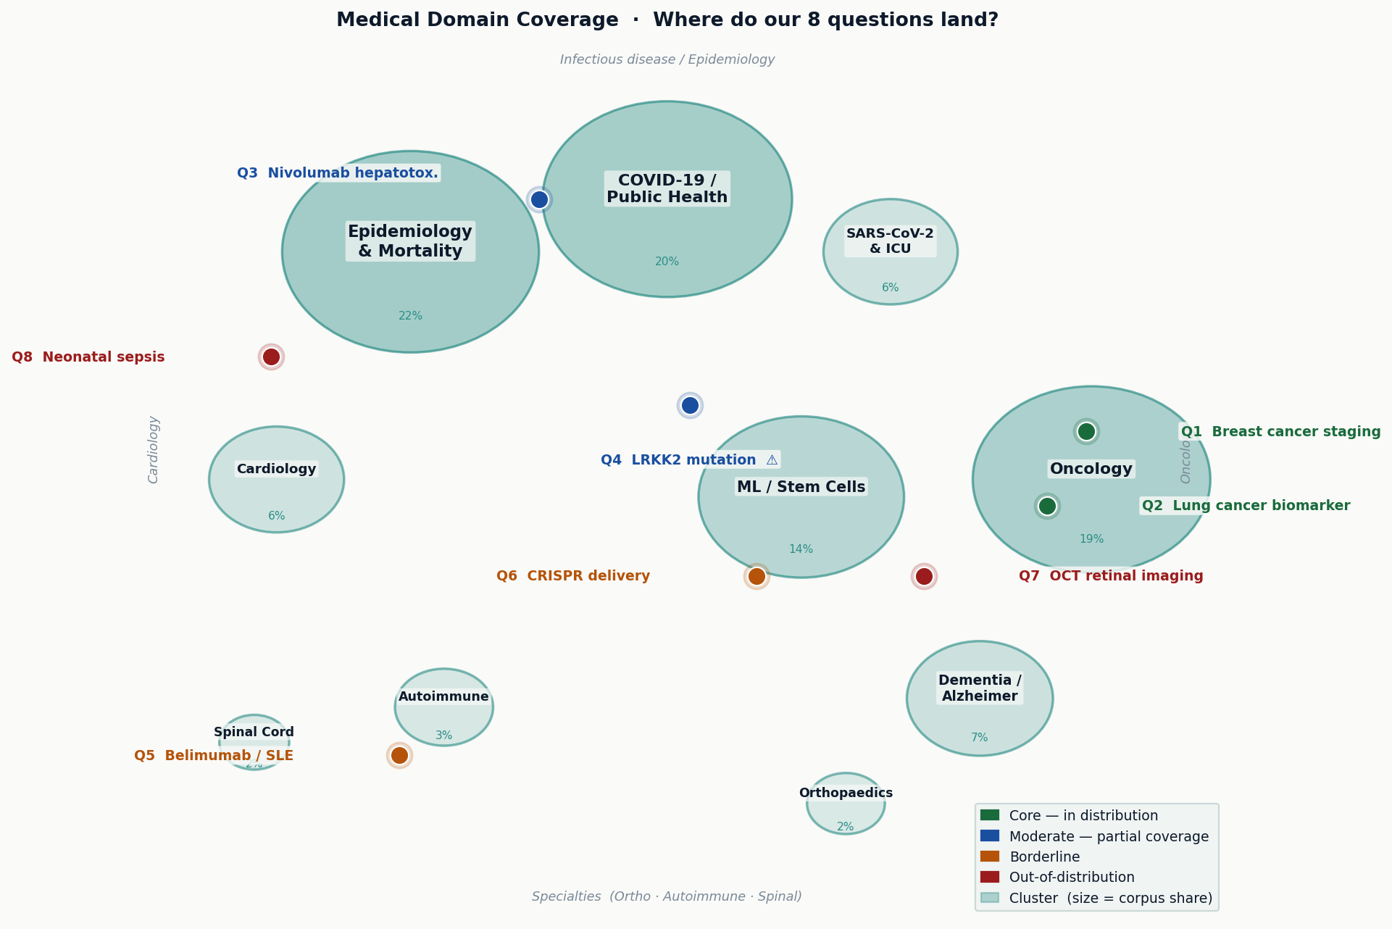
DATA COVERAGE
2 of 8 questions fit the corpus — 6 at the edge
Q1 & Q2 land in the largest cluster (Oncology) — Q4 (LRKK2 / Parkinson) has no matching domain in the training data

Slide 11
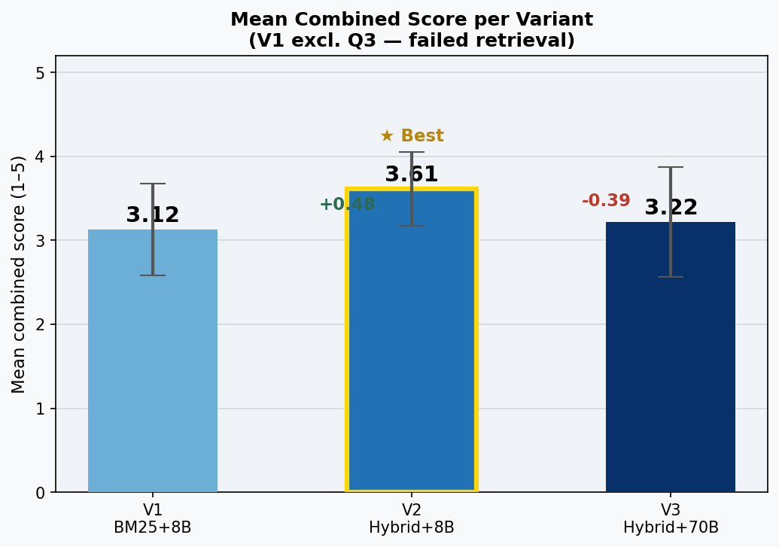
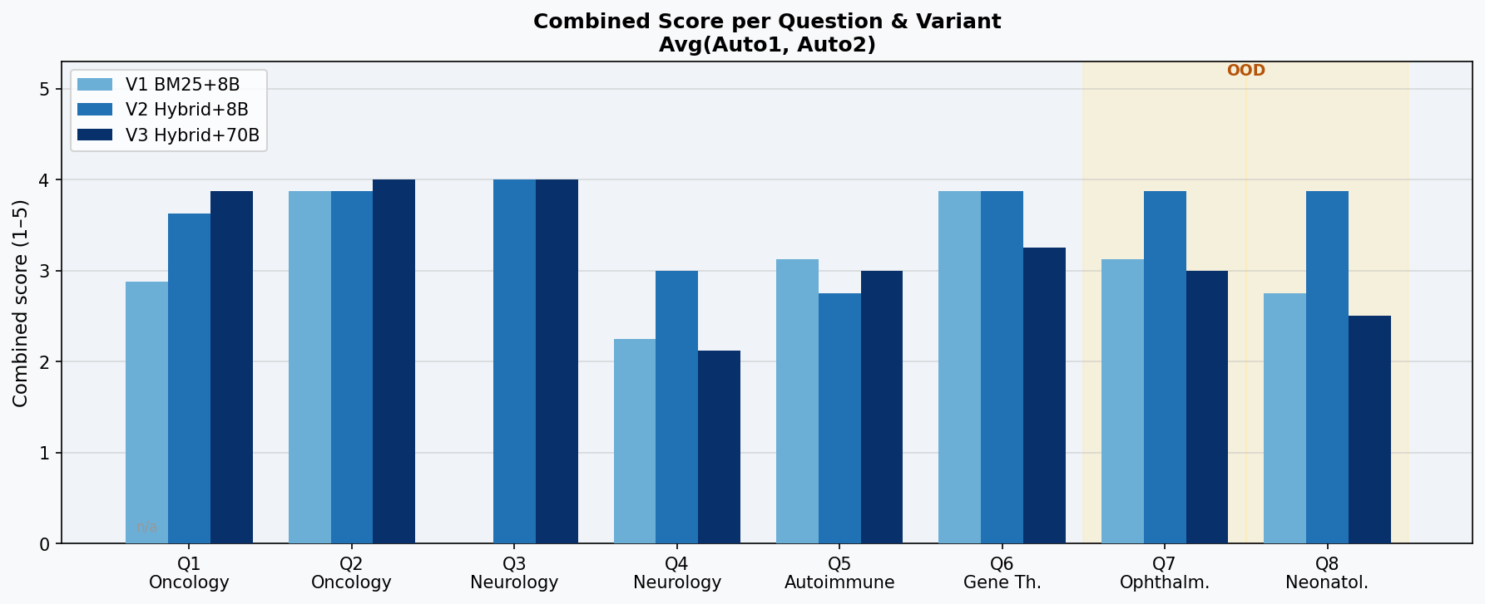
PIPELINE EVALUATION
Which pipeline answers best?
8 clinical questions • scored by 2 independent raters (Auto1 + Auto2) • scale 1–5
- 2. Stufe: Q&A = proof of concept Evaluation um RAG als geanzes zu testen -> difficult ->
V2 Hybrid + 8B wins (3.61 / 5)
Q4 (LRRK2) weak across all — topic gap in corpus

Slide 12
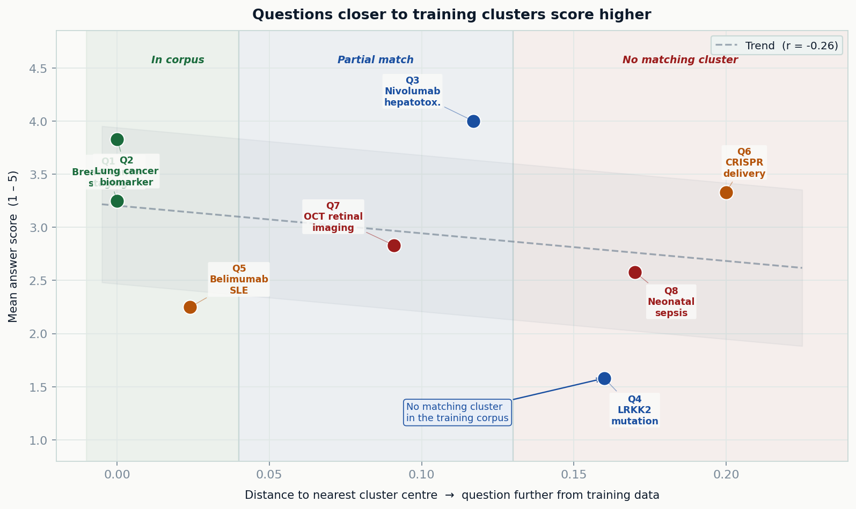
DATA COVERAGE
Closer to the training data = better answers
The further a question sits from a known cluster, the lower the answer quality — not a model problem, a data coverage problem

Slide 13
LIVE DEMO · PMC RESEARCH ASSISTANT
● LIVE
Demo runs live at presentation time — requires local backend + API key.
Biomarkers for EGFR-mutated NSCLC?
Cardiotoxicity with checkpoint inhibitors?
Immunotherapy melanoma phase II trials?
PD-L1 expression and treatment response?
Enter a clinical question…
→ Ask
Ask a clinical question to see a live response…
Note — this interface calls a language model directly. It does not connect to the retrieval index at runtime. For a full demonstration including live retrieval, run the backend locally. Requires an Anthropic API key.

Slide 14
NEXT STEPS
Status & Outlook
01
Retrieval quality improvement — closing the gap between retrieved-context accuracy and upper-bound accuracy is the next measurable step
02
Potential extensions — real-time index updates, specialty-specific fine-tuning, multi-language support, integration into clinical workflow tools
03
Evaluation - LLM

