Slide 1

XGBoost for Predicting Kubernetes Issues
Team Envision Trails presents XGBoost for predicting Kubernetes issues. Kubernetes complexity leads to unpredictable failures and downtime. We use XGBoost to forecast potential issues and improve system stability.

Slide 2
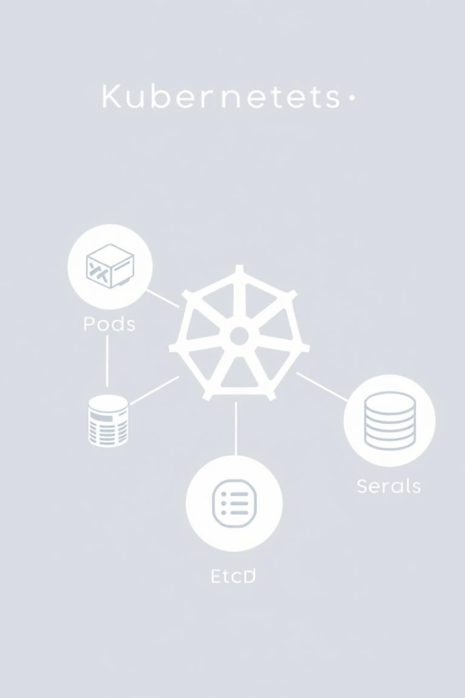
Problem Statement: Kubernetes Challenges
Increased Downtime
Reactive Firefighting
Application downtime impacts revenue and user experience. Average downtime costs $5,600 per minute.
Difficult to predict and prevent failures proactively, leading to reactive firefighting.
Over-provisioning
Over-provisioning resources to avoid failures increases infrastructure costs by up to 30%.

Slide 3
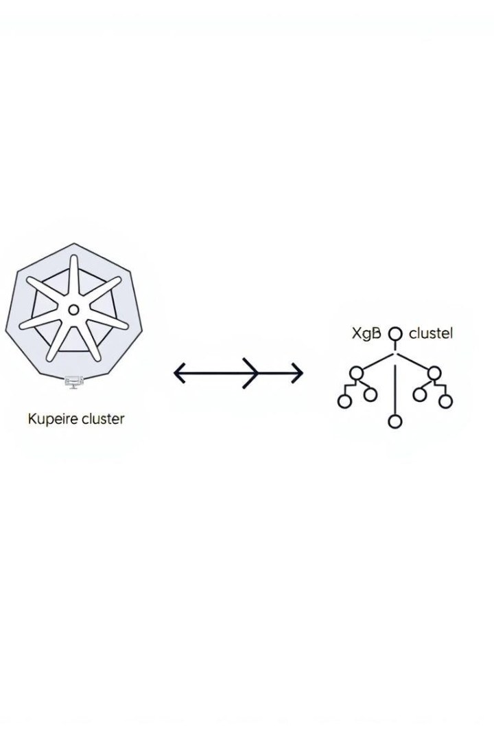



Solution Overview: XGBoost Prediction
Data Collection
Feature Engineering
Model Training
Collect real-time metrics and logs from Kubernetes clusters using Prometheus and Fluentd.
Train an XGBoost model to predict potential issues like pod failures.
Preprocess data and engineer relevant features like CPU utilization and memory usage.

Slide 4
Data Handling: Feature Engineering
Data Sources
Feature Engineering
Preprocessing
Kubernetes API
Rolling average of CPU/Memory usage
Handling missing values
Prometheus (metrics)
Scaling numerical features
Fluentd (logs)
Rate of change of key metrics
Data Cleaning
Categorical encoding of pod status

Slide 5
Model Training: XGBoost
XGBoost Algorithm
1
Gradient boosting framework for classification/regression.
Hyperparameter Tuning
2
GridSearchCV for optimal parameters.
Evaluation Metrics
3
Precision, Recall, F1-score.

Slide 6
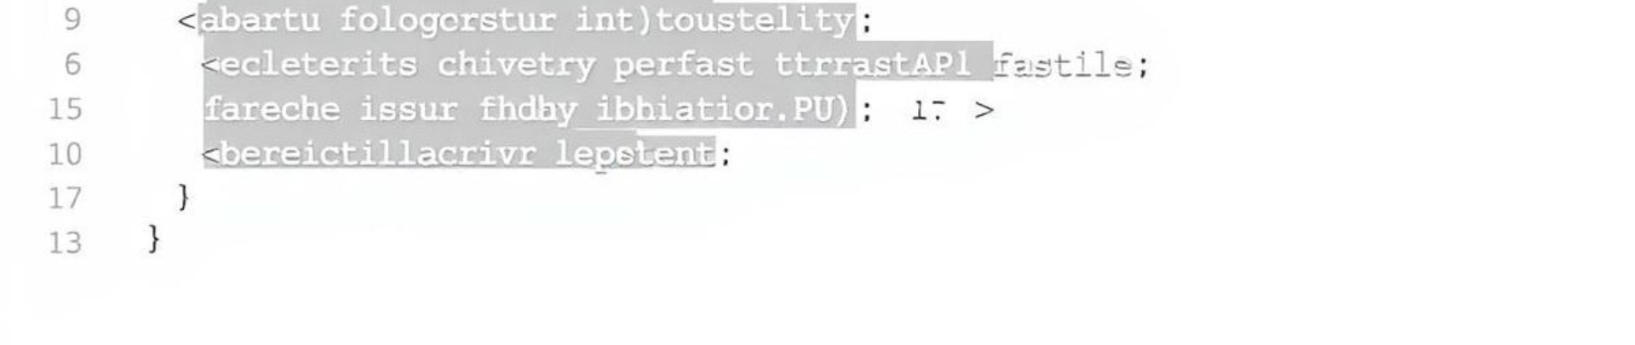
FastAPI Inference: Real-time Prediction
FastAPI
Endpoint
Output
Lightweight Python framework for building APIs.
/predict for receiving JSON data containing metrics.
Return a JSON response with the predicted probability and alert status.

