Slide 1
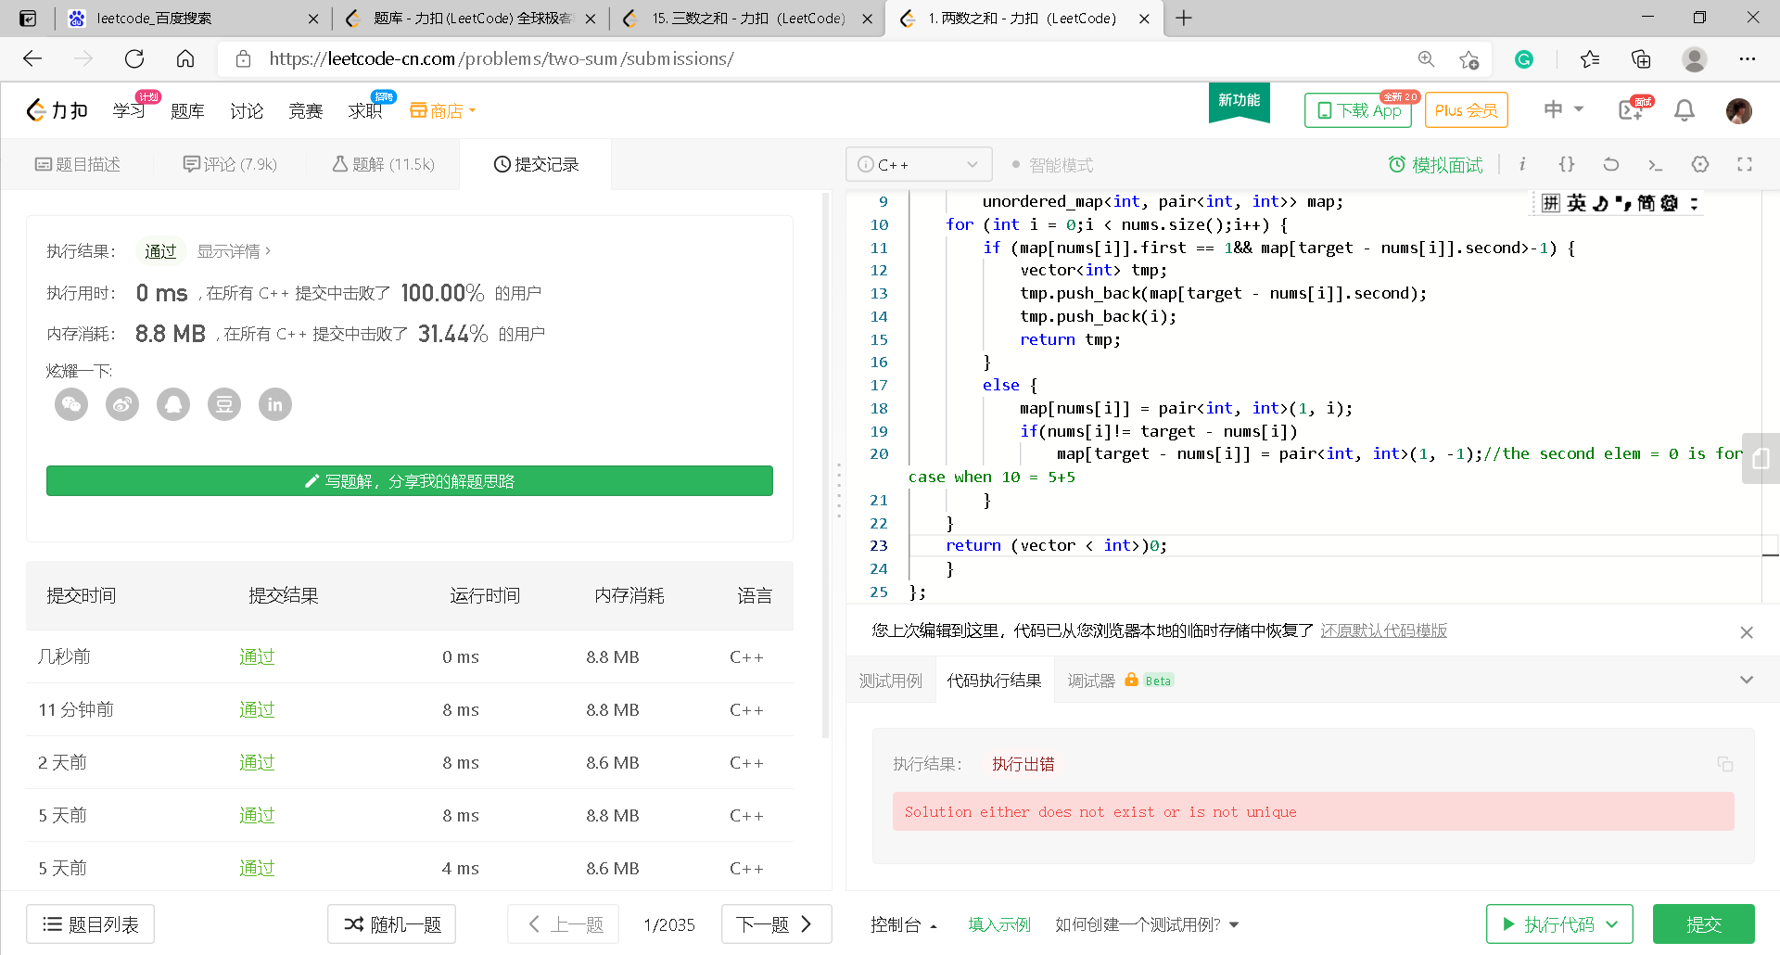
1. Two sum

Slide 2
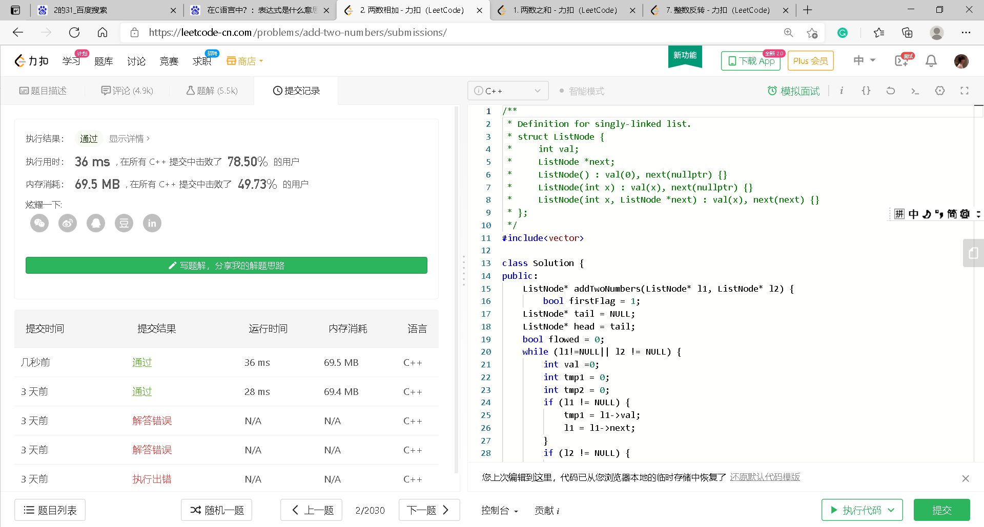
2. Add Two Numbers

Slide 3
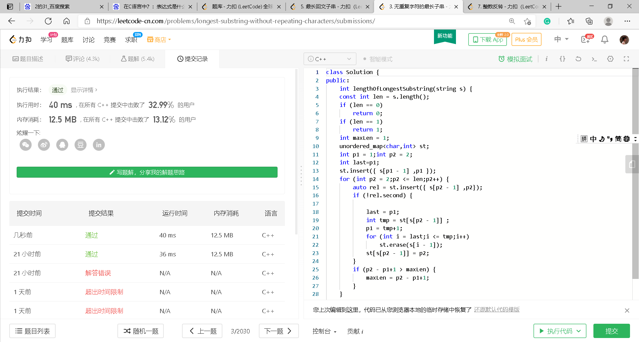
3. Longest Substring Without Repeating Characters

Slide 5
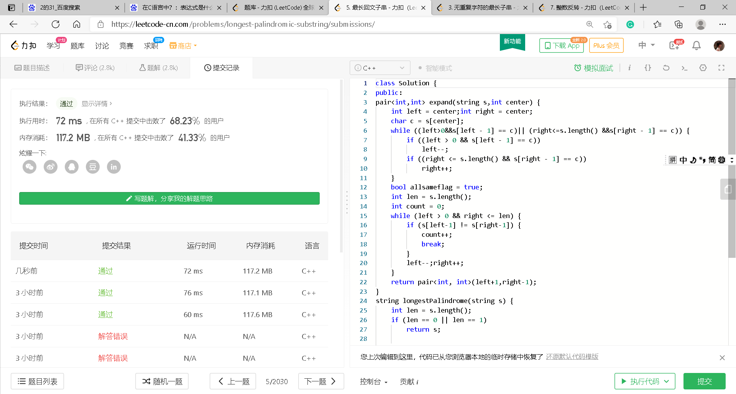
5. Longest Palindromic Substring

Slide 6
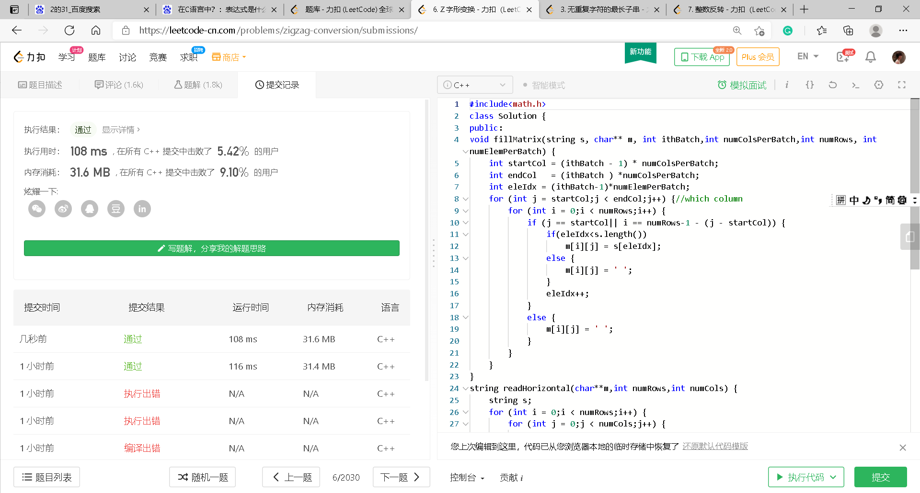
6. ZigZag Conversion

Slide 7
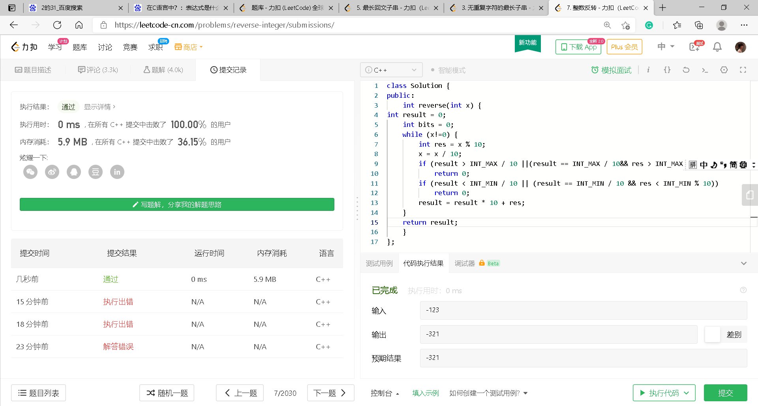
7. Reverse Integer

Slide 8
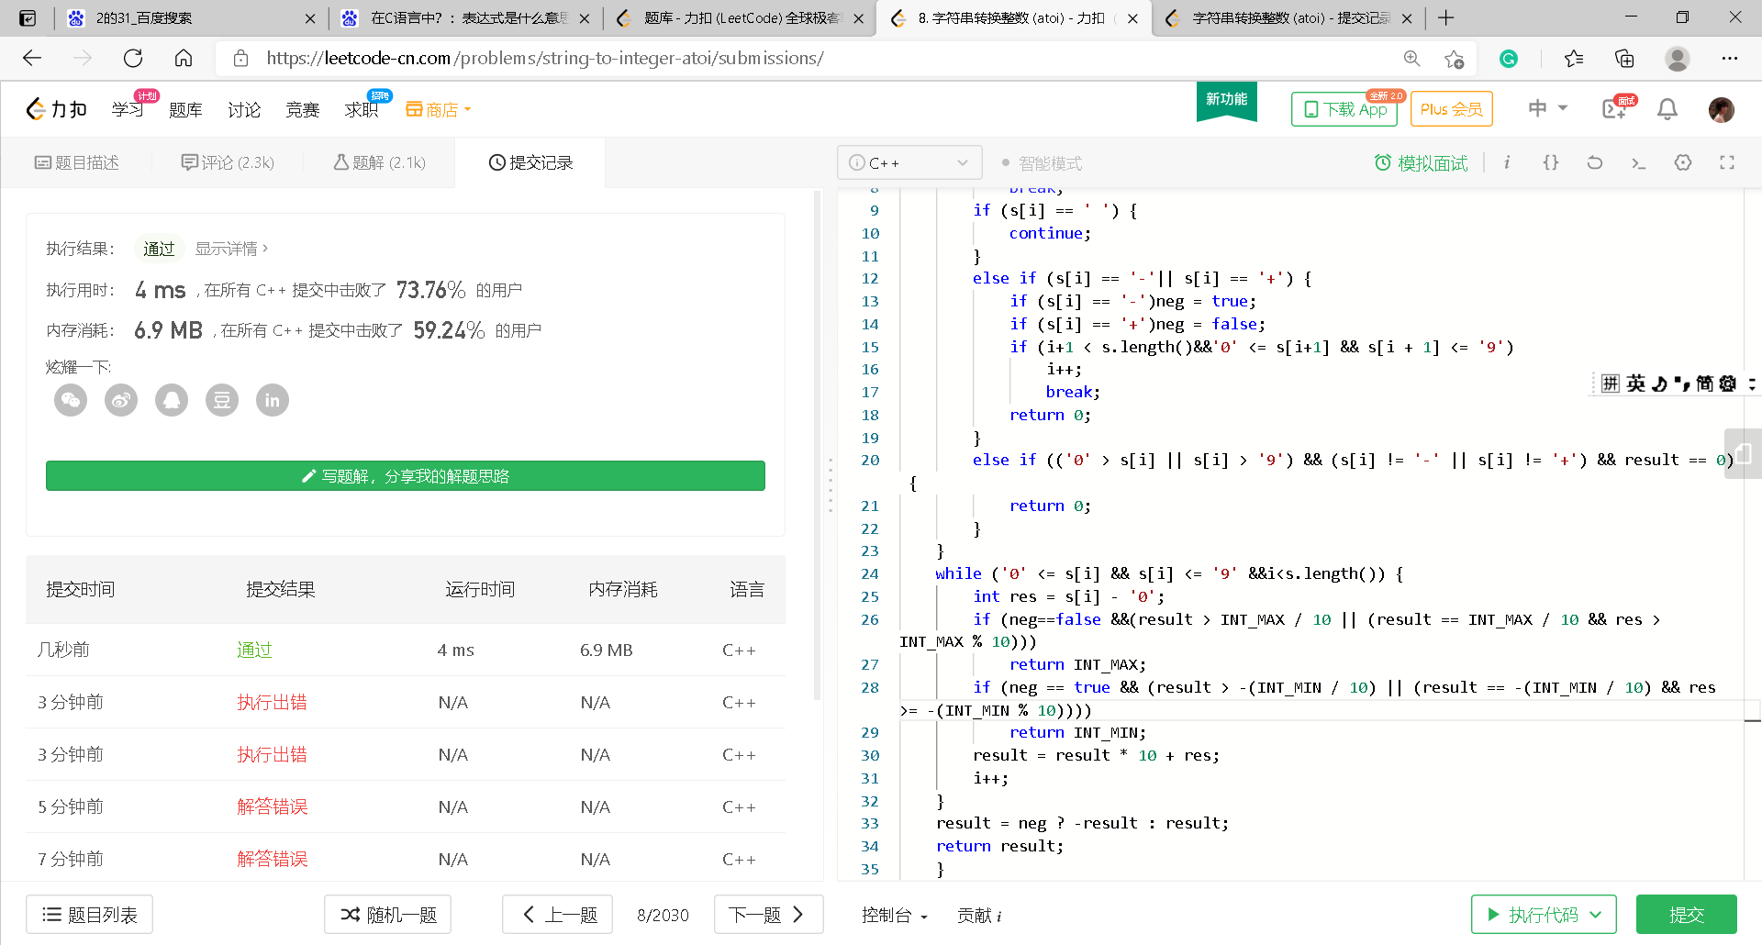
8. String to Integer (atoi)

Slide 9
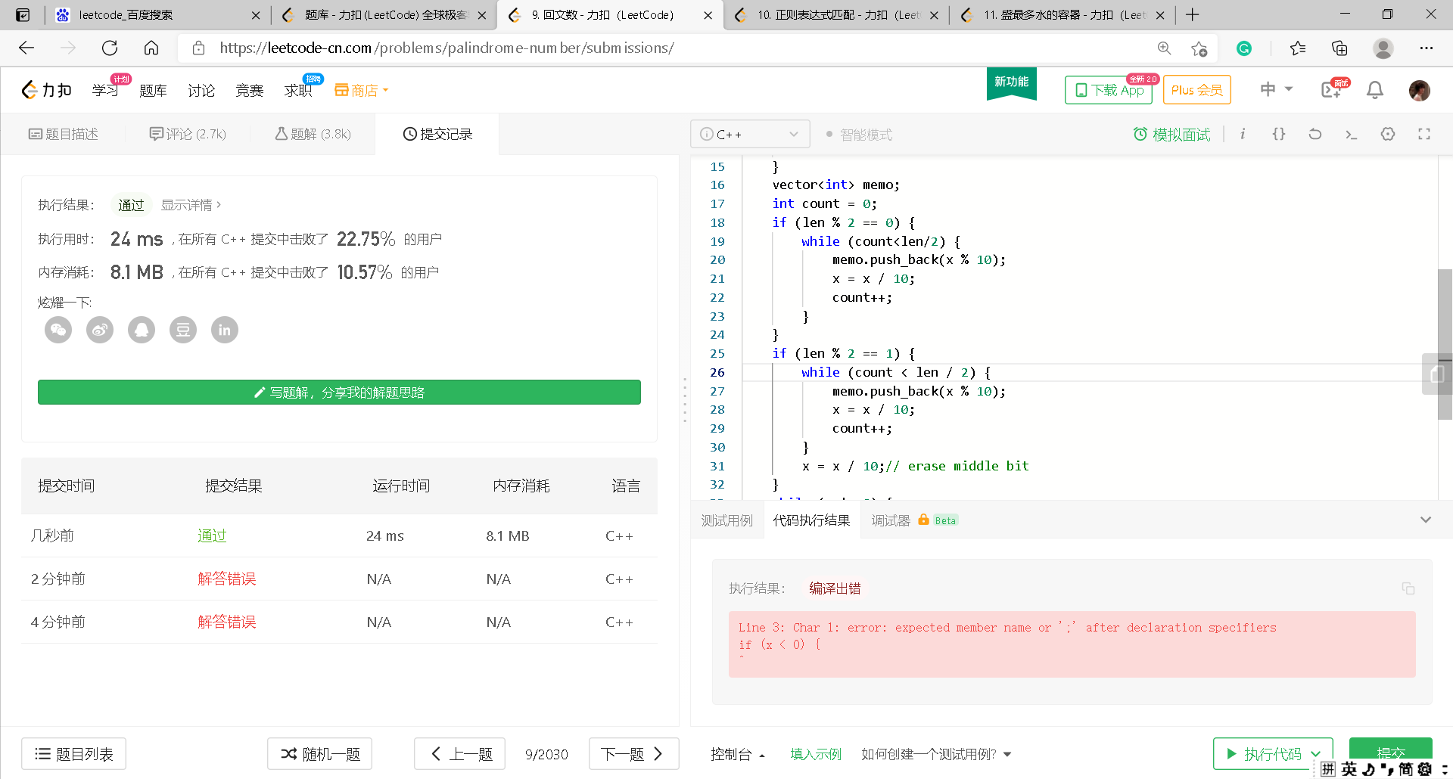
9. Palindrome Number

Slide 10
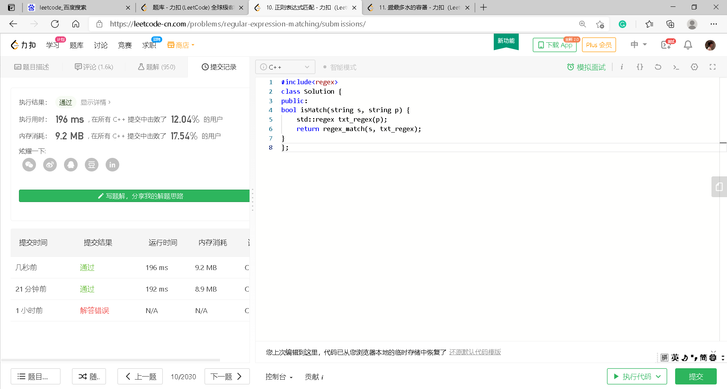
10. Regular Expression Matching

Slide 11
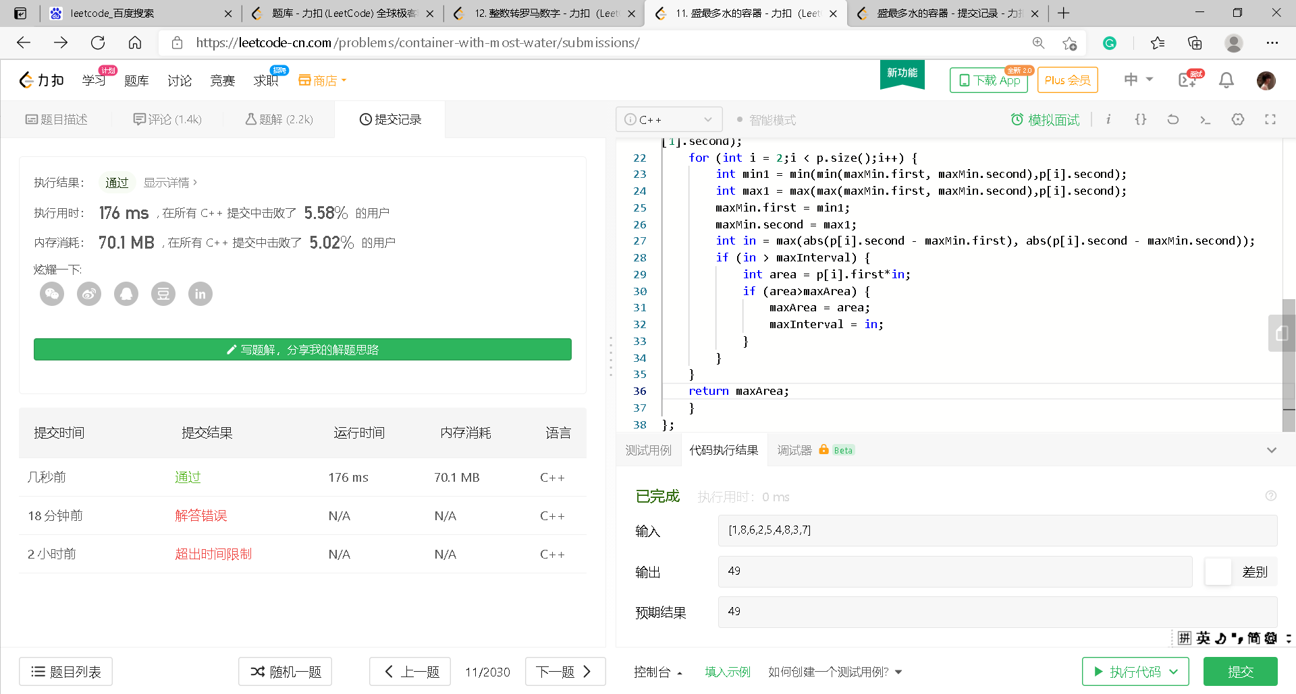
11.Container With Most Water

Slide 14
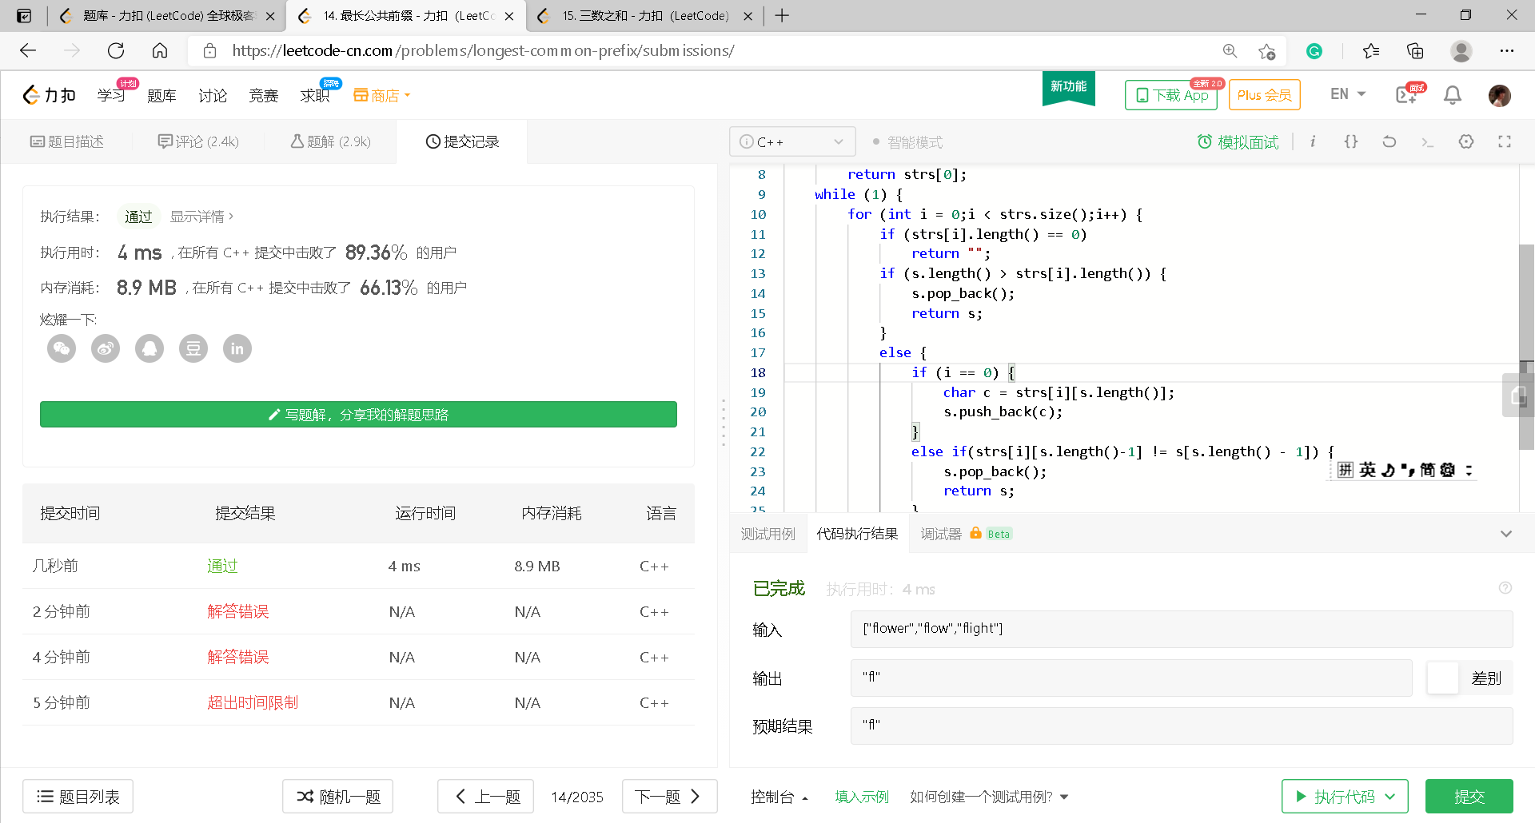
14. Longest Common Prefix

Slide 17
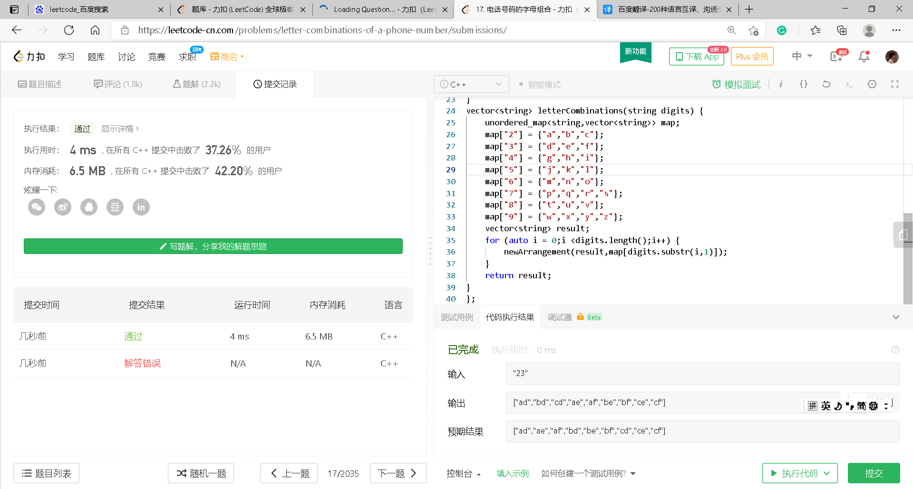
17. Letter Combinations of a Phone Number

Slide 19
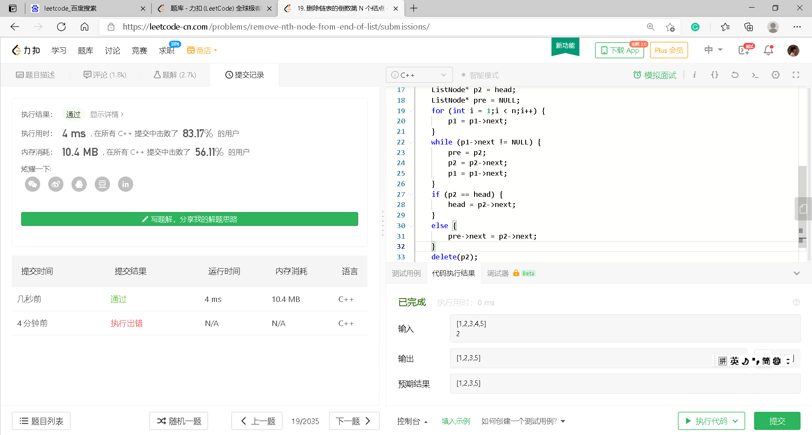
19. Remove Nth Node From End of List

Slide 20
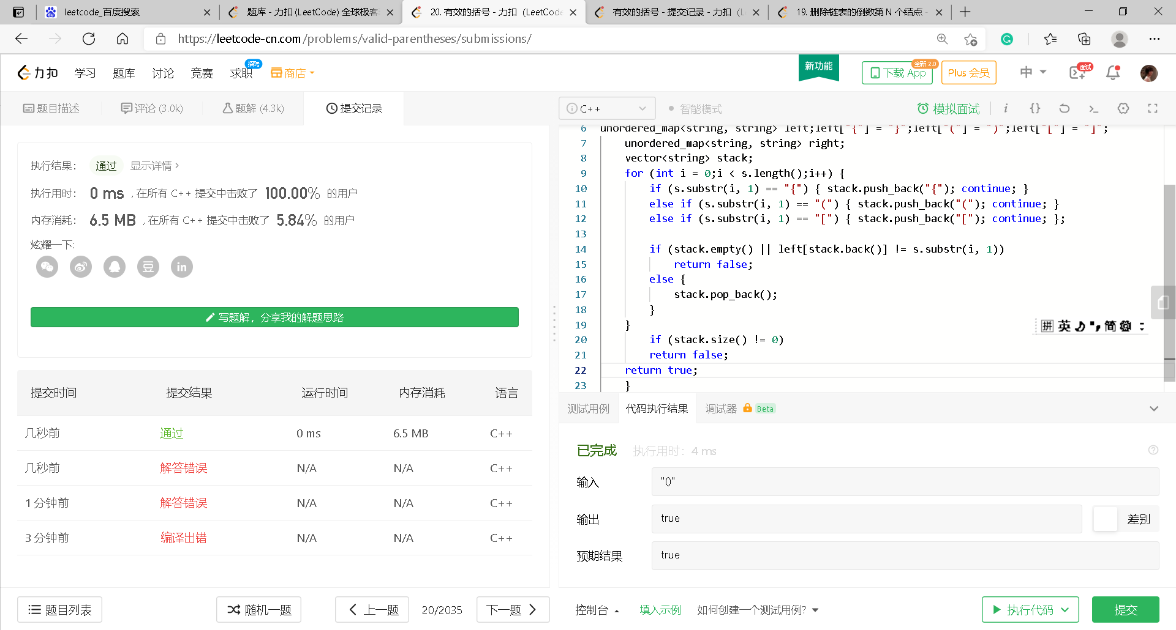
20. Valid Parentheses

Slide 21
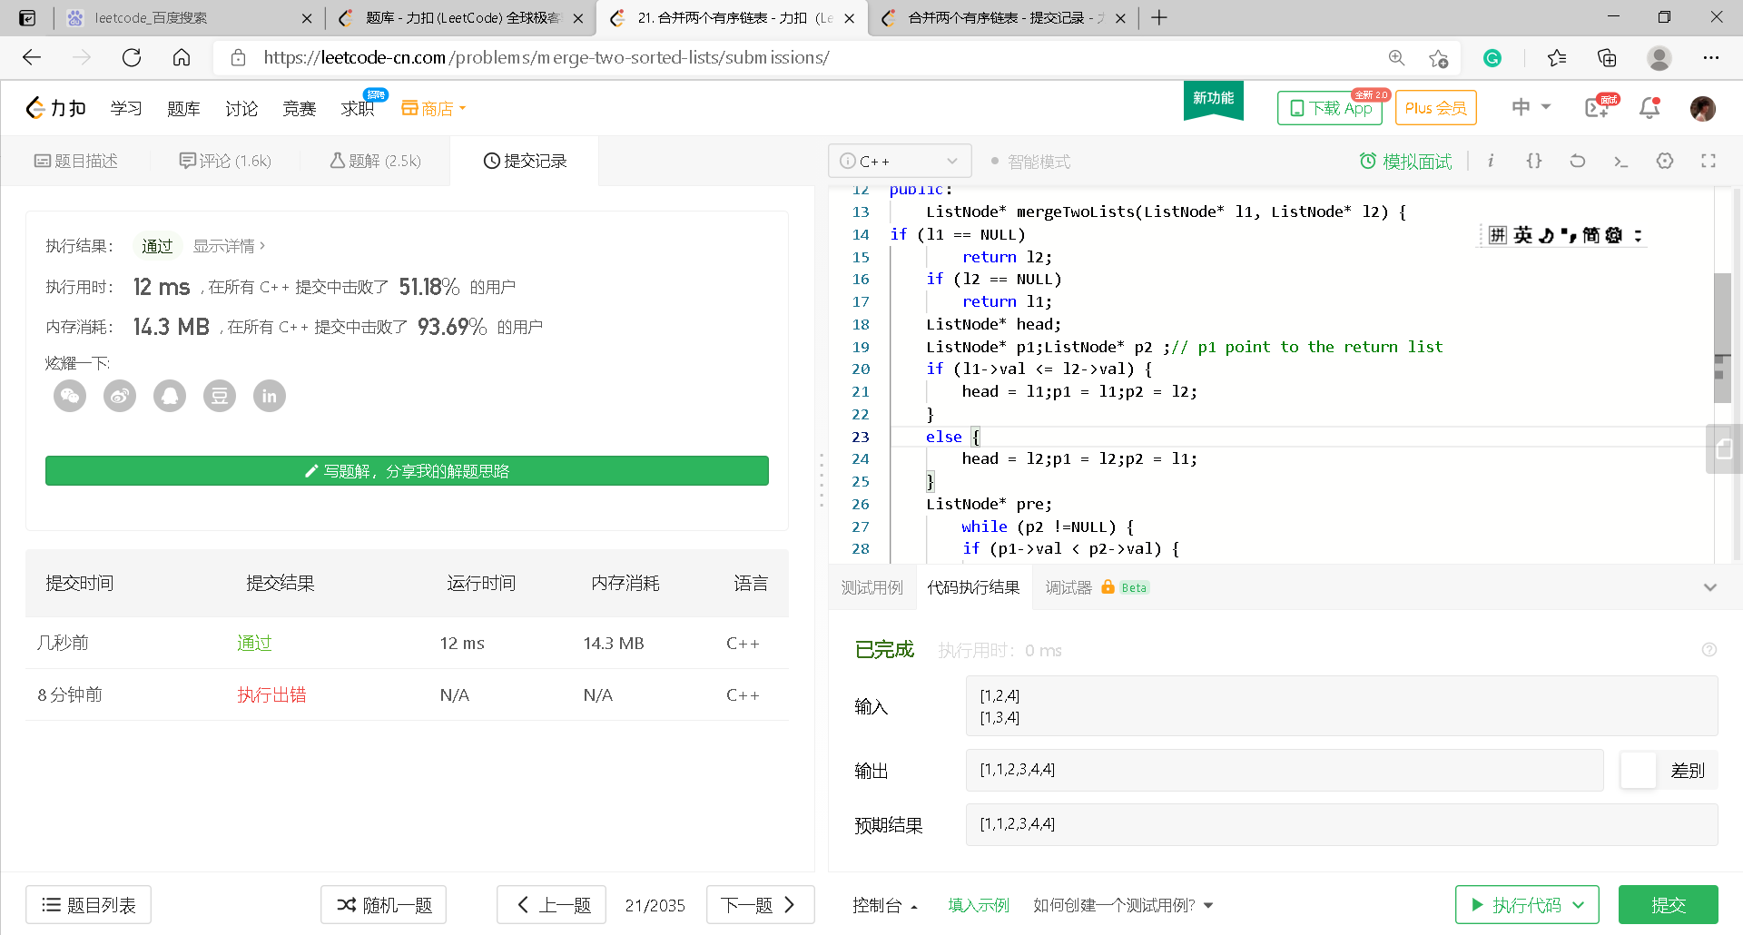
21. Merge Two Sorted Lists

Slide 23
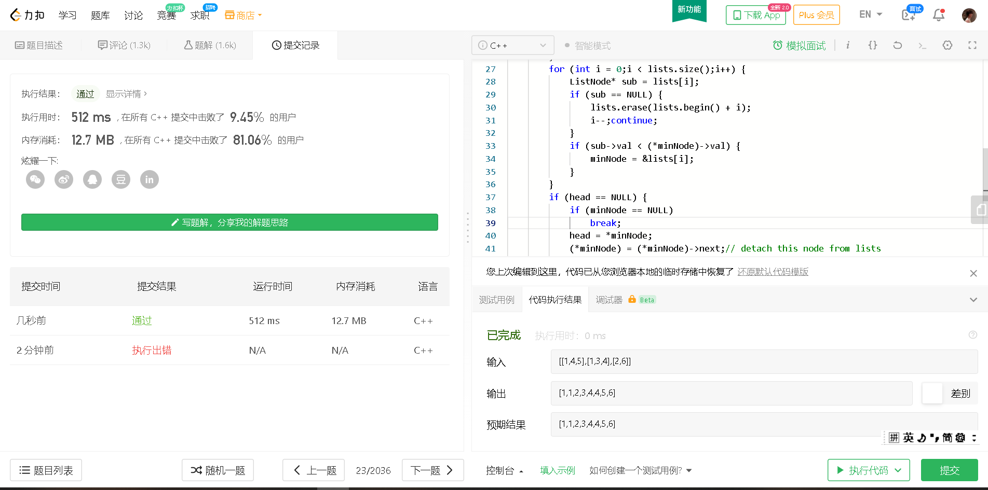
23. Merge k Sorted Lists

Slide 24
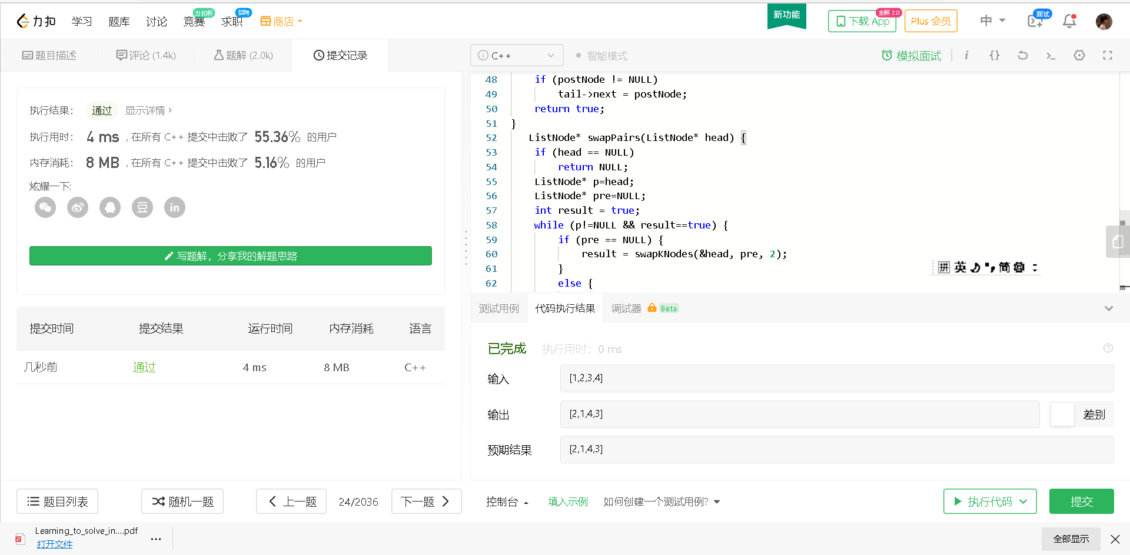
24. Swap Nodes in Pairs

Slide 25
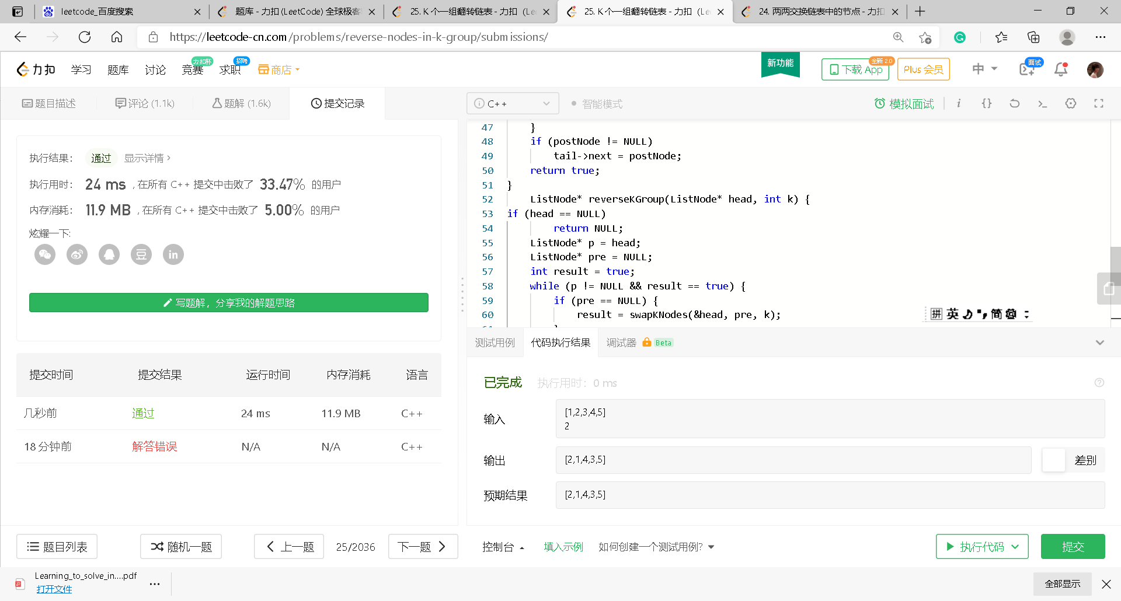
25. Reverse Nodes in k-Group

Slide 26
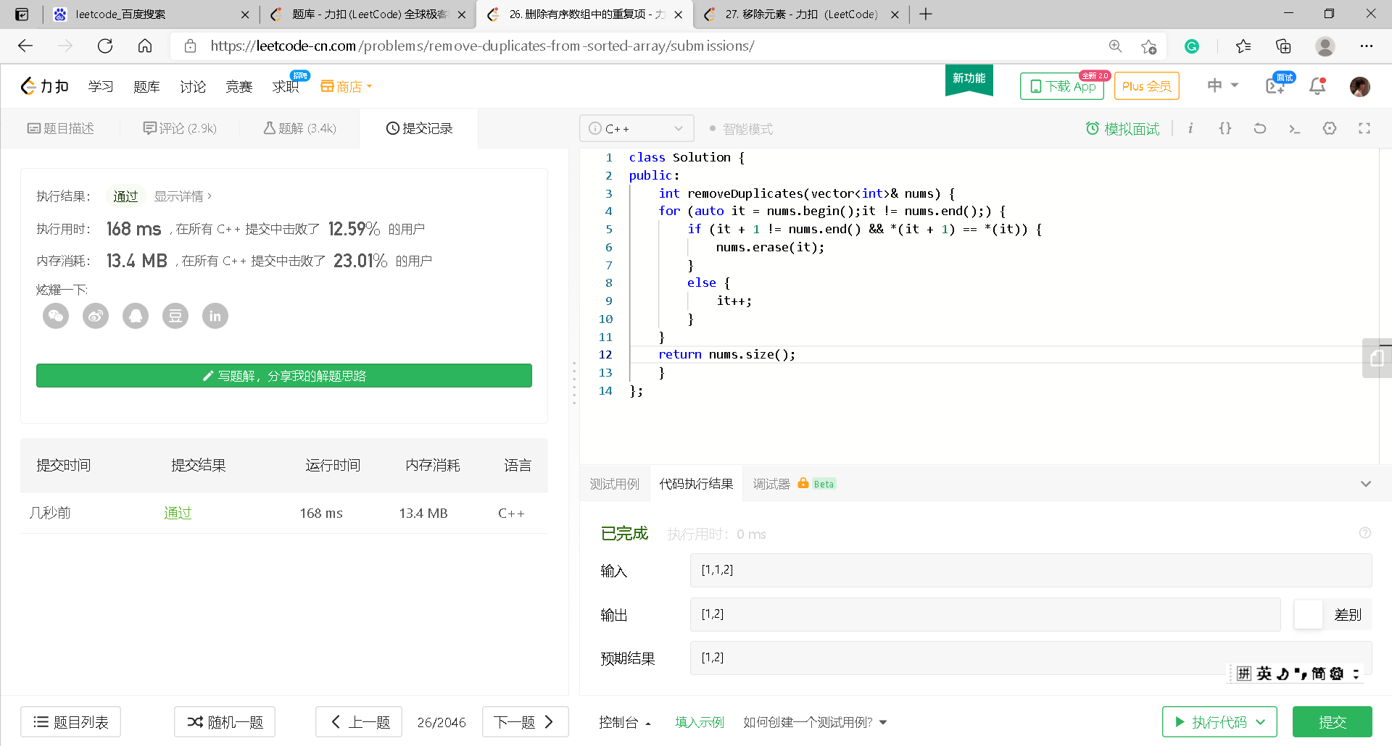
26. Remove Duplicates from Sorted Array

Slide 27
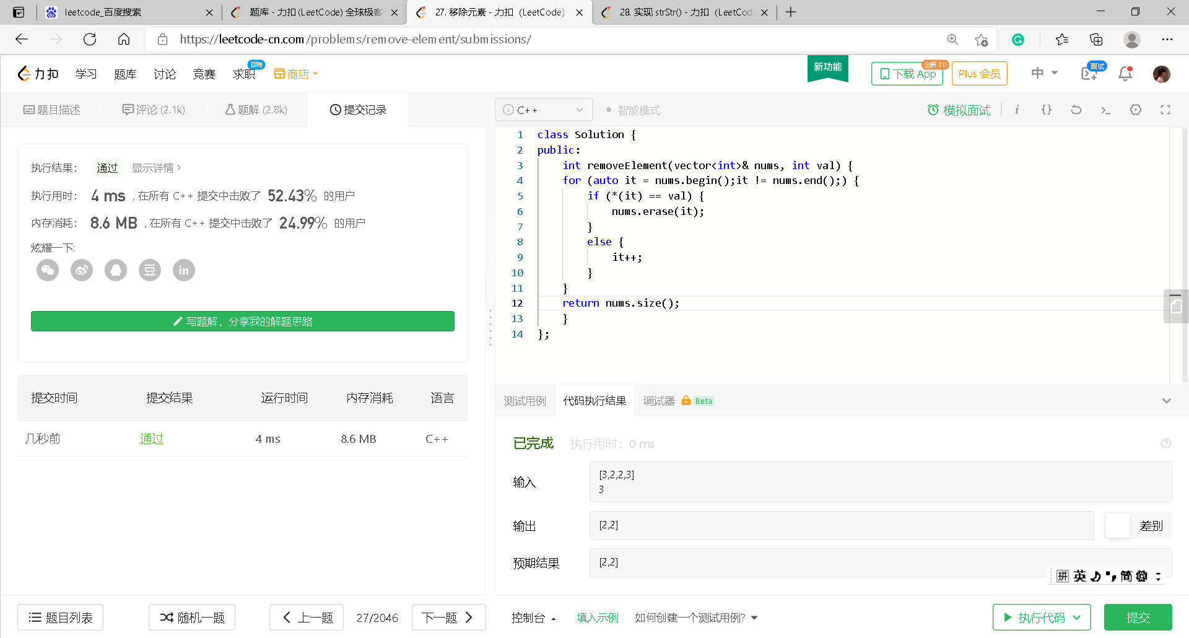
27. Remove Element

Slide 28
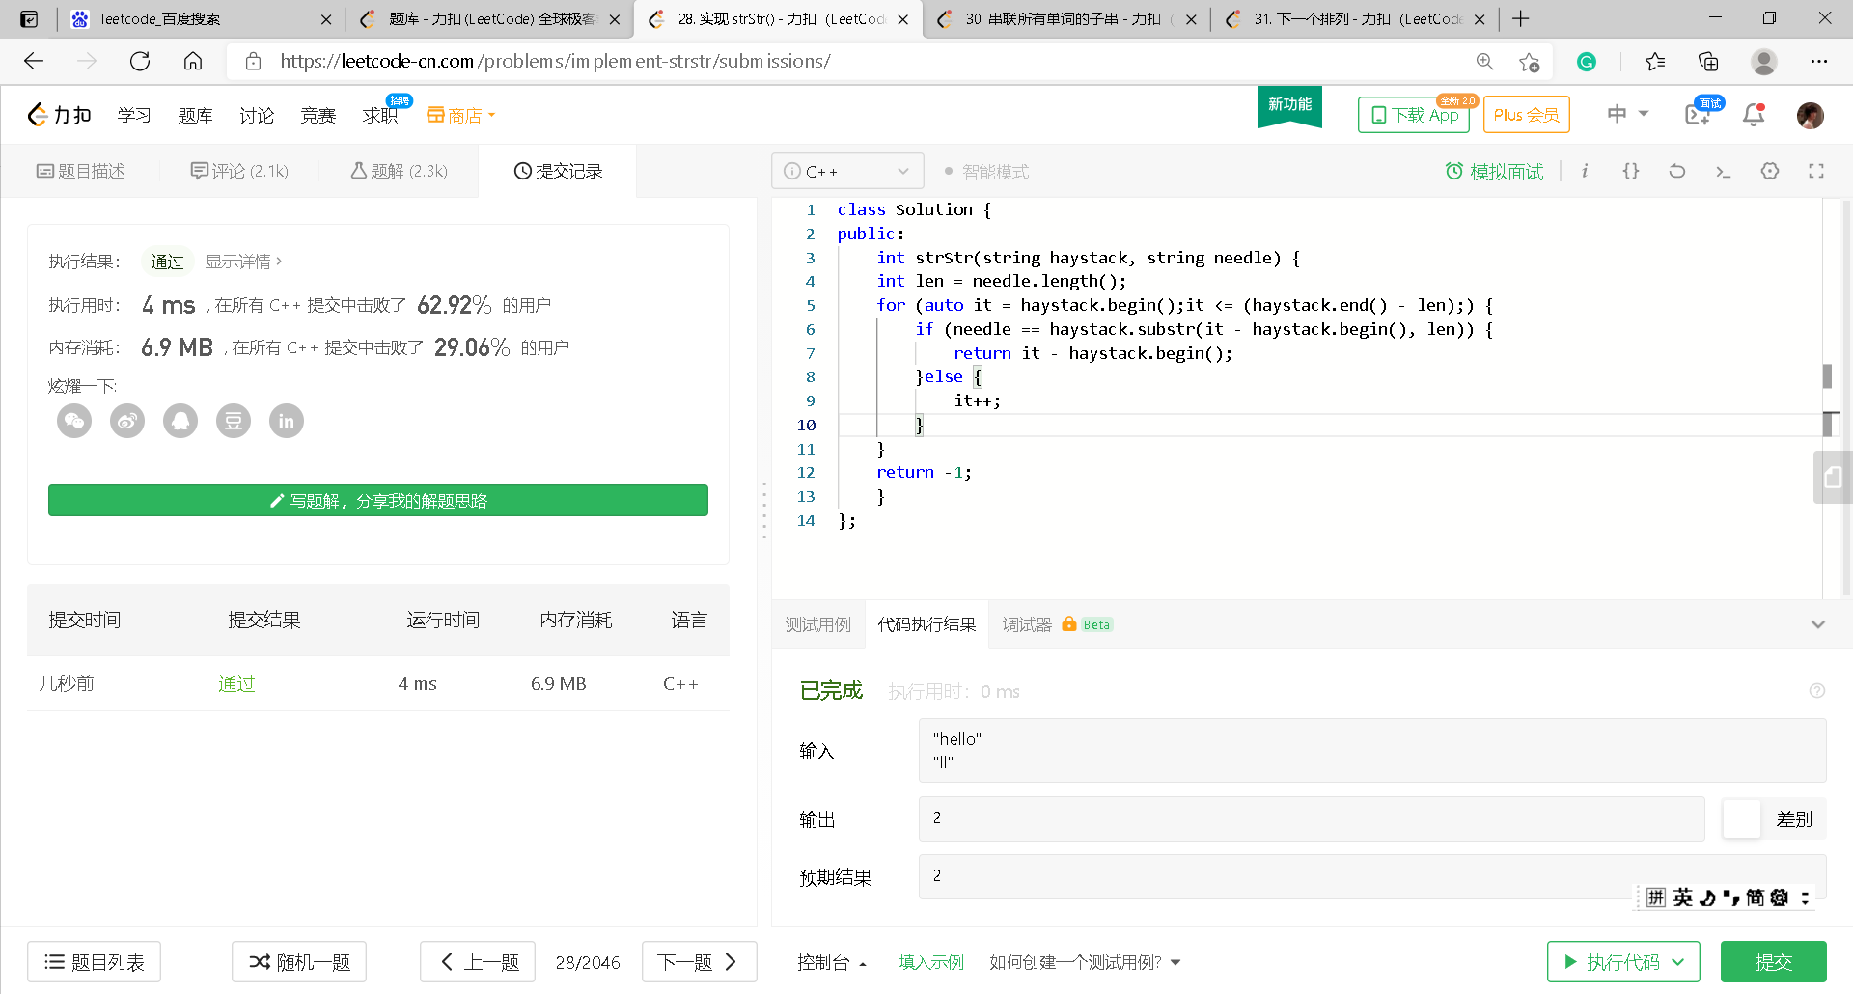
28. Implement strStr()

Slide 31
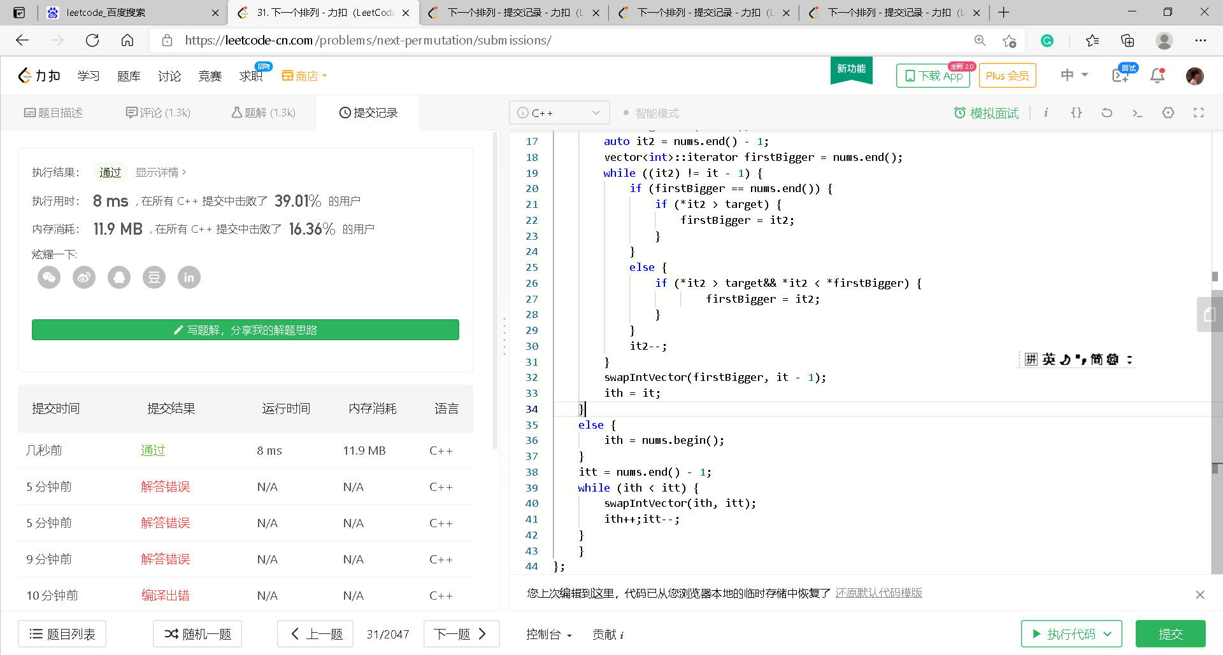
31. Next Permutation

Slide 33
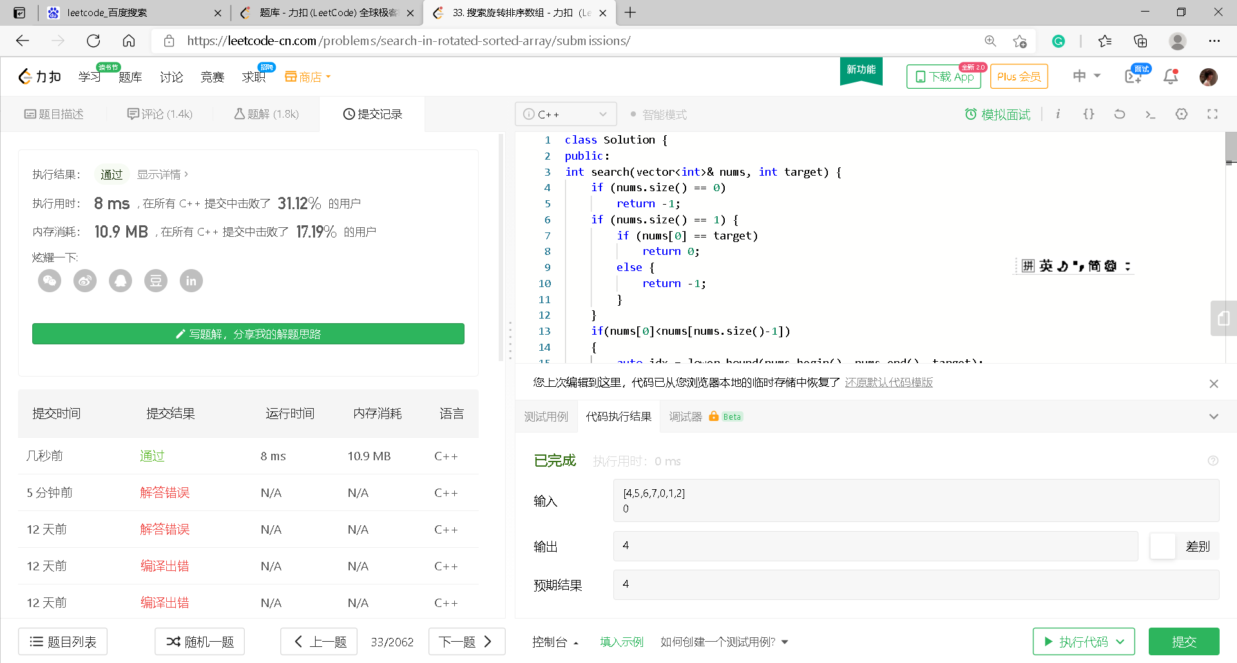
33. Search in Rotated Sorted Array

Slide 34
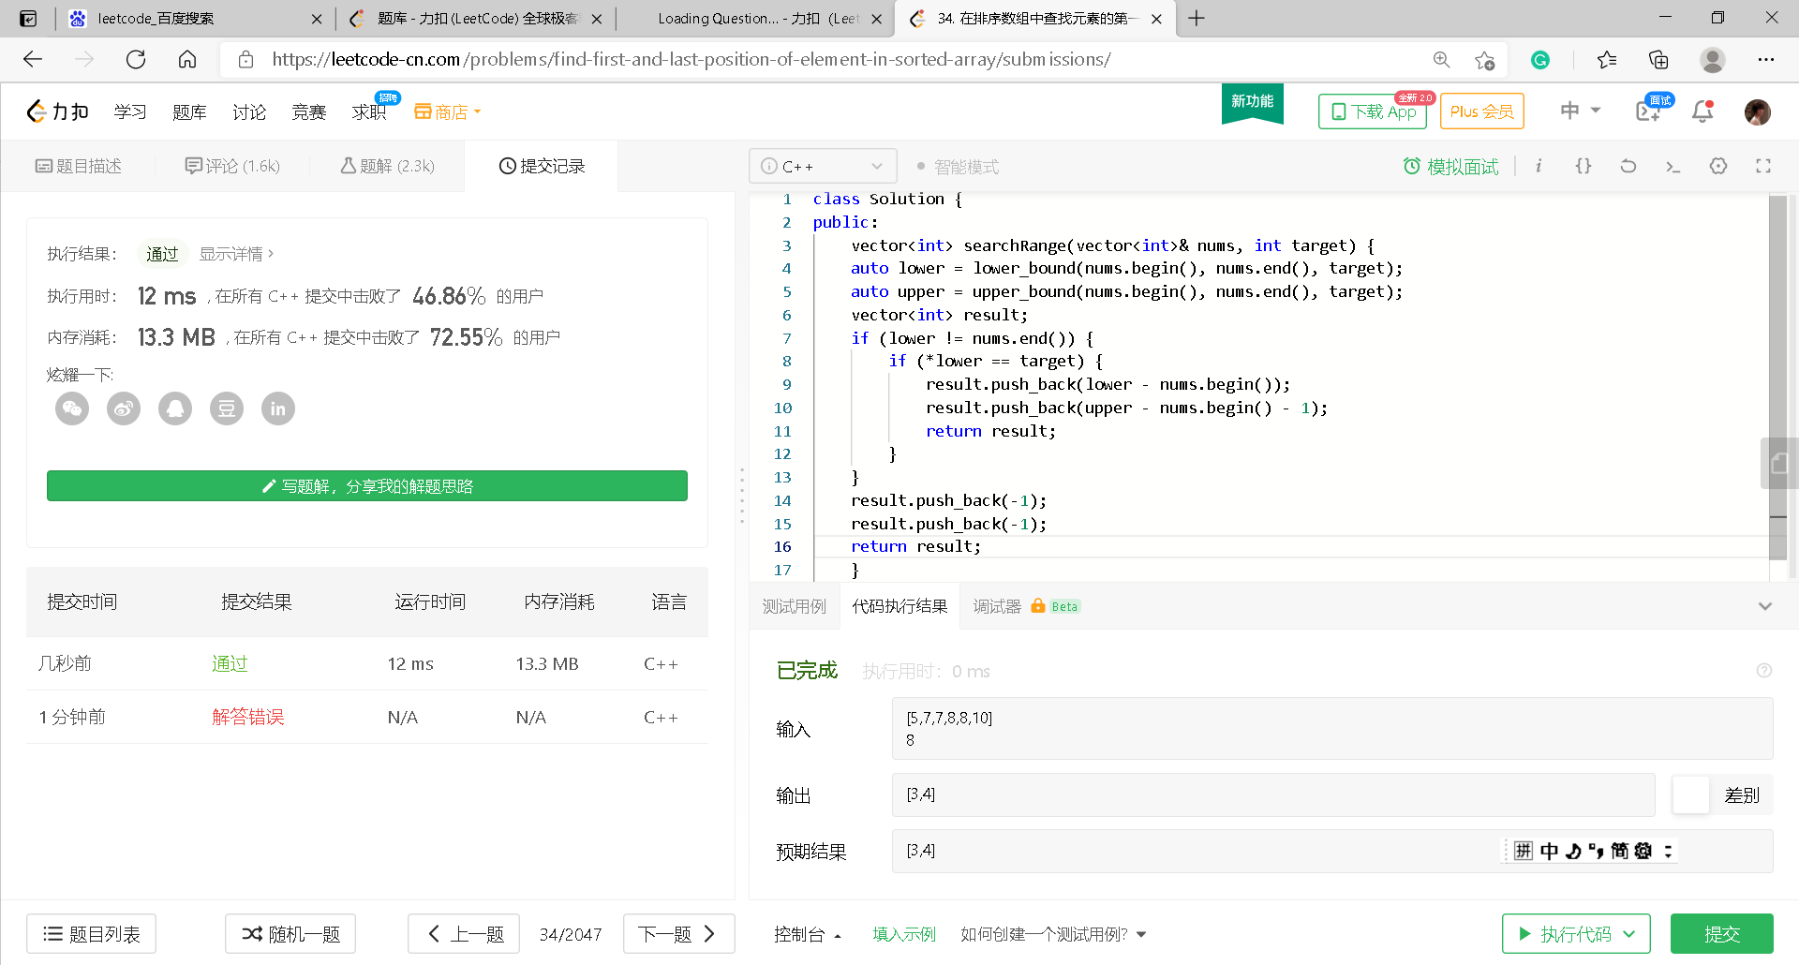
34. Find First and Last Position of Element in Sorted Array

Slide 35
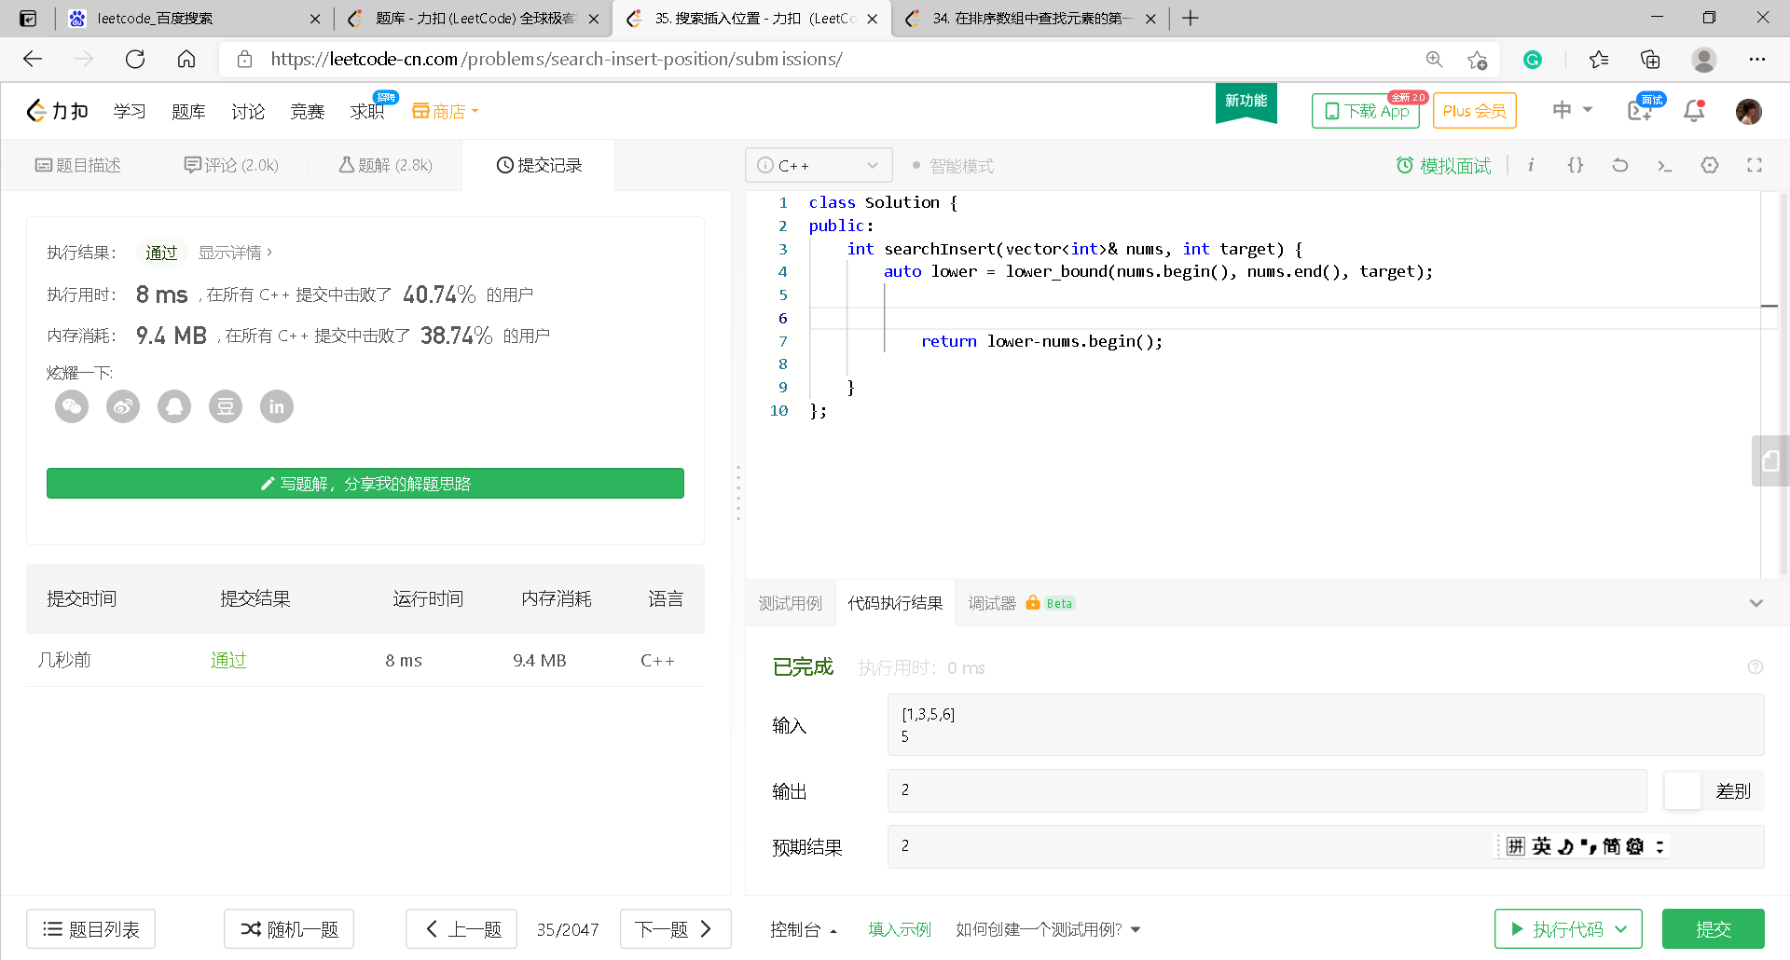
35. Search Insert Position

Slide 41
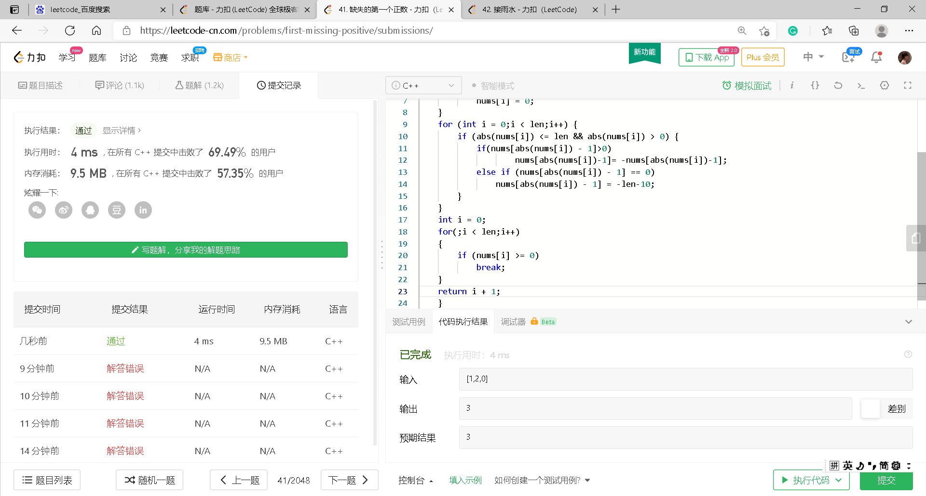
41. First Missing Positive

Slide 42
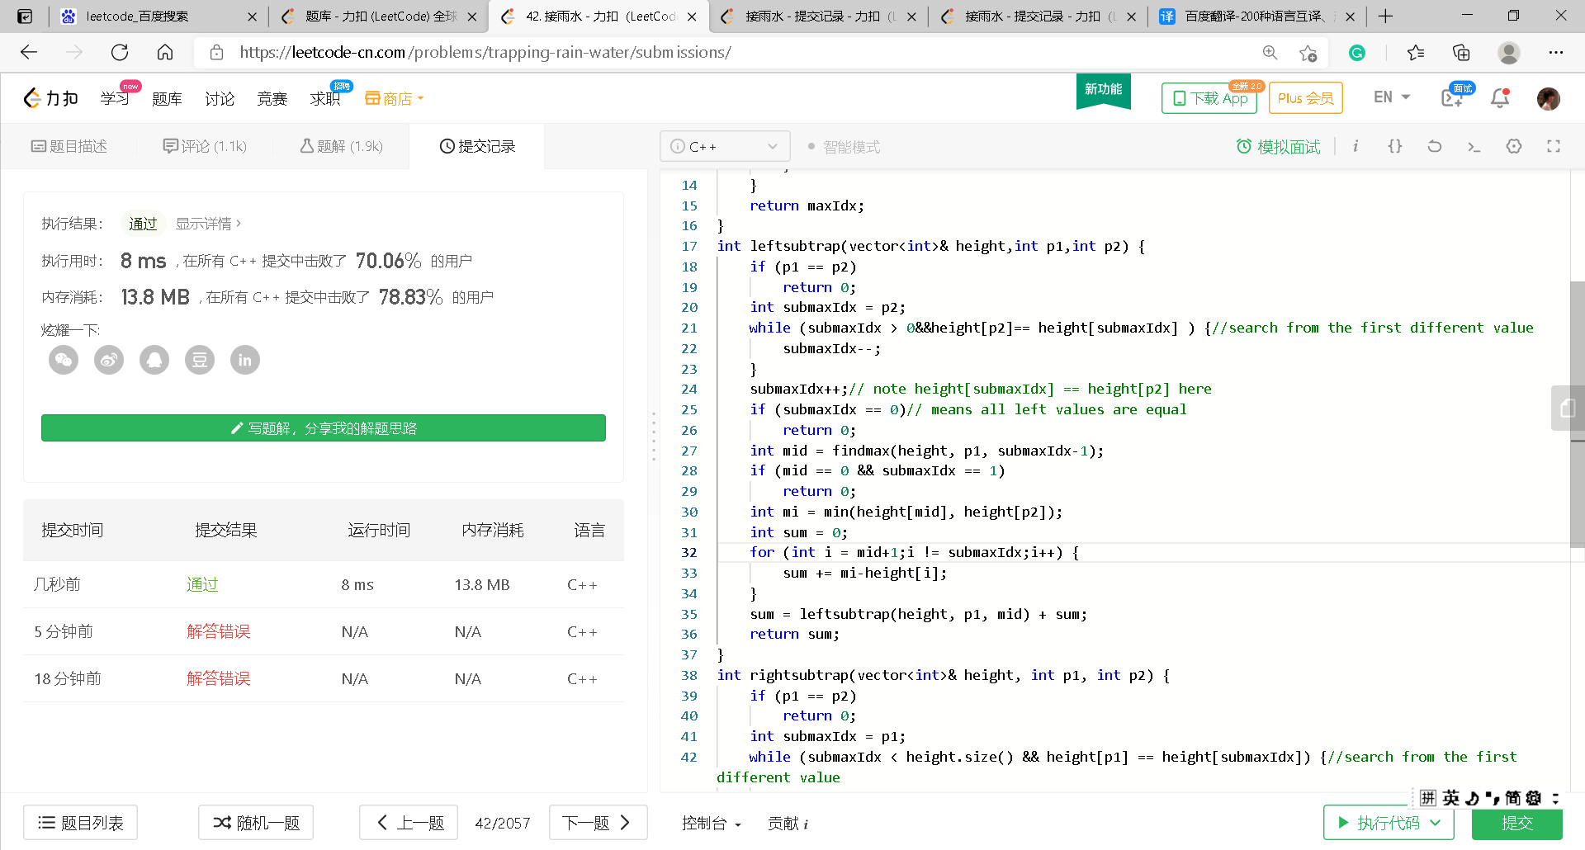
42. Trapping Rain Water

Slide 50
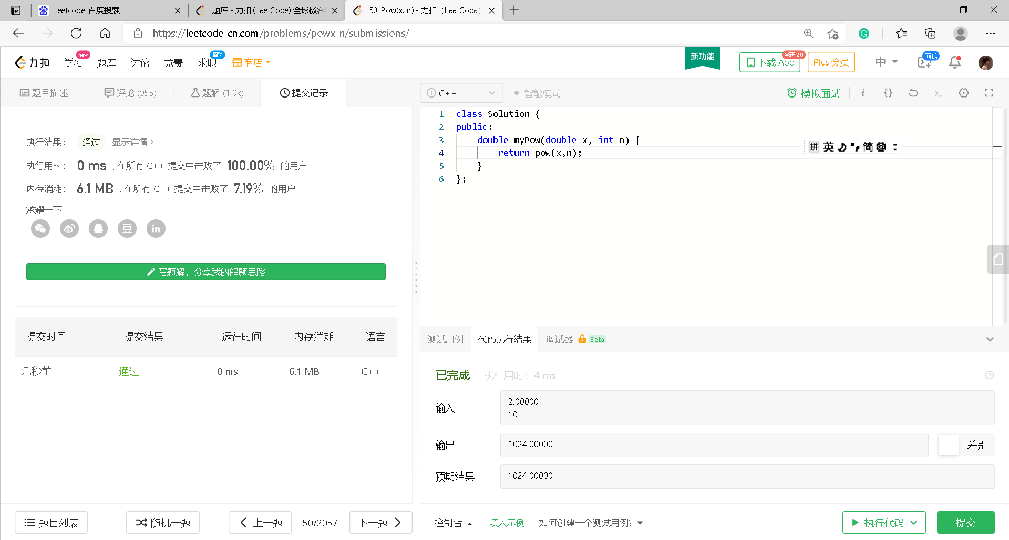
50. Pow(x, n)

Slide 55
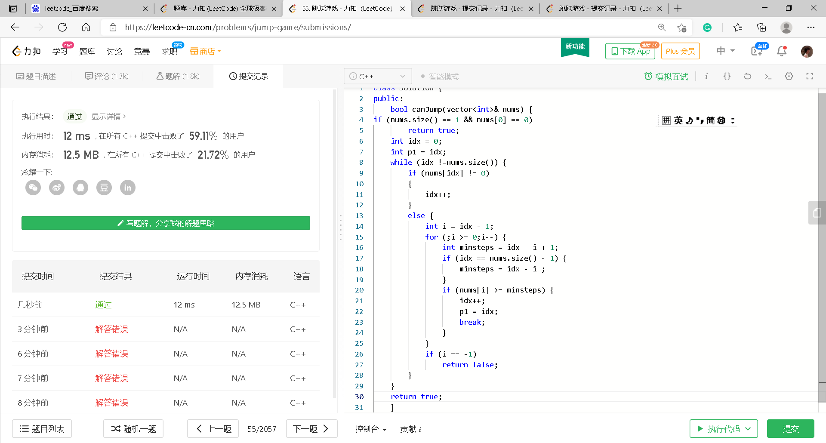
55. Jump Game

Slide 58
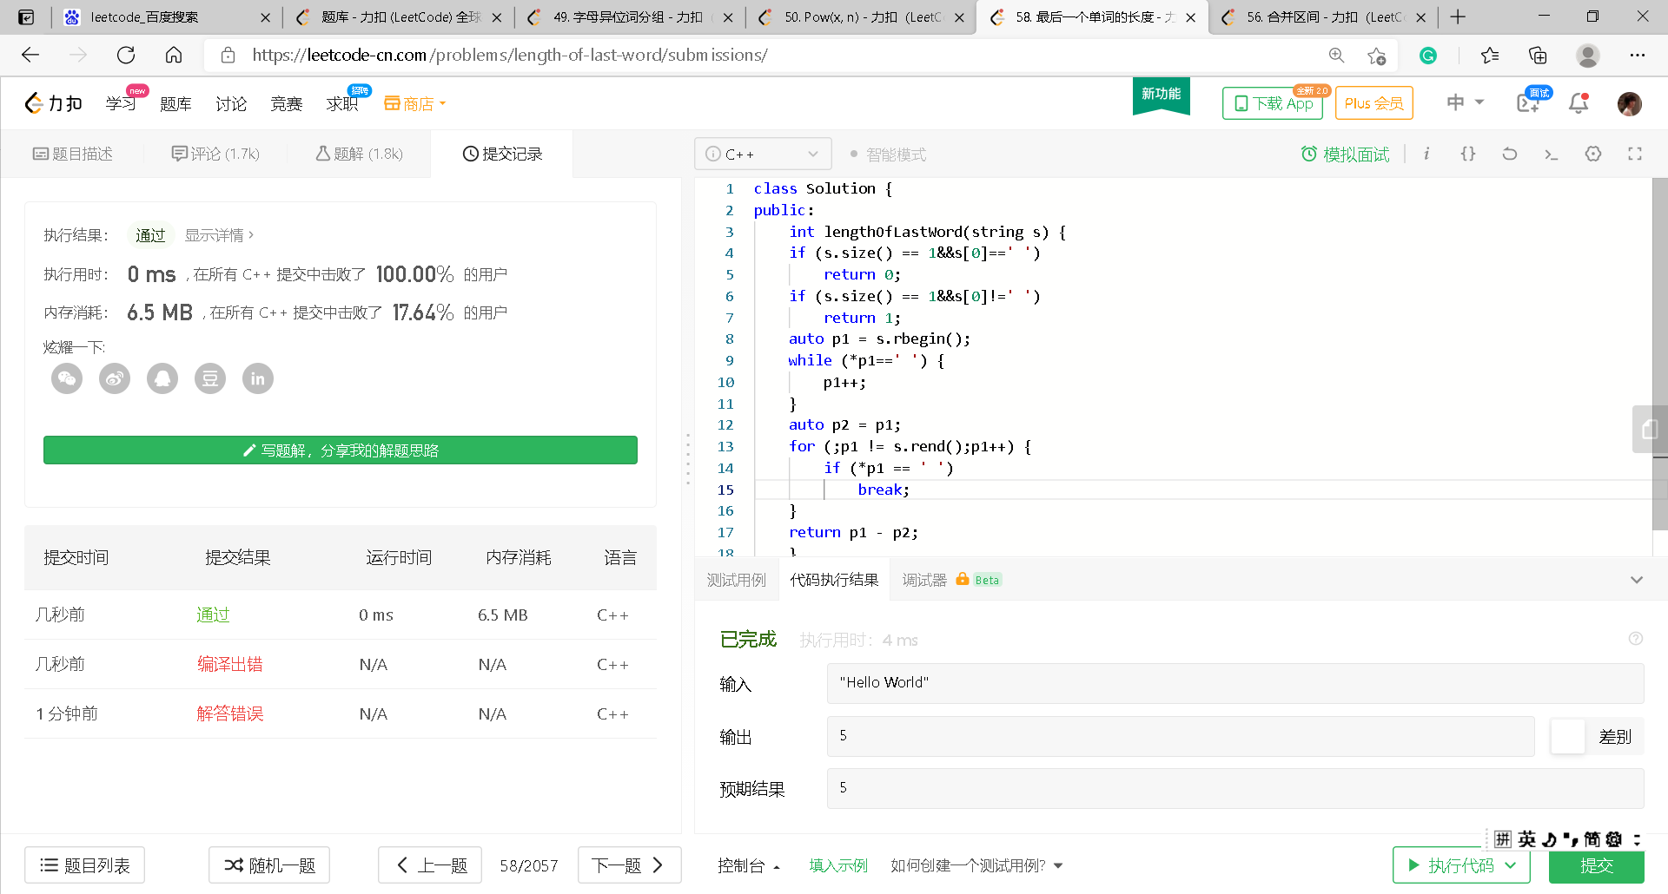
58. Length of Last Word

Slide 66
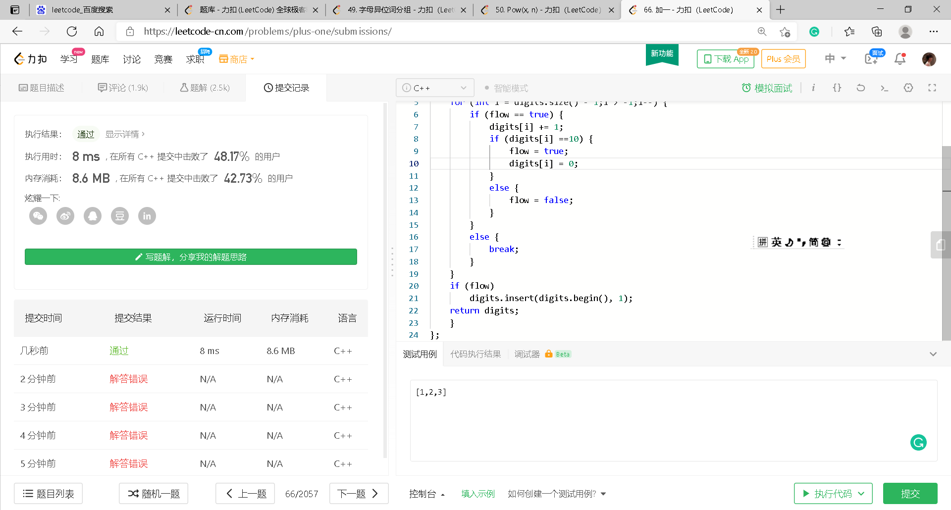
66. Plus One

Slide 68
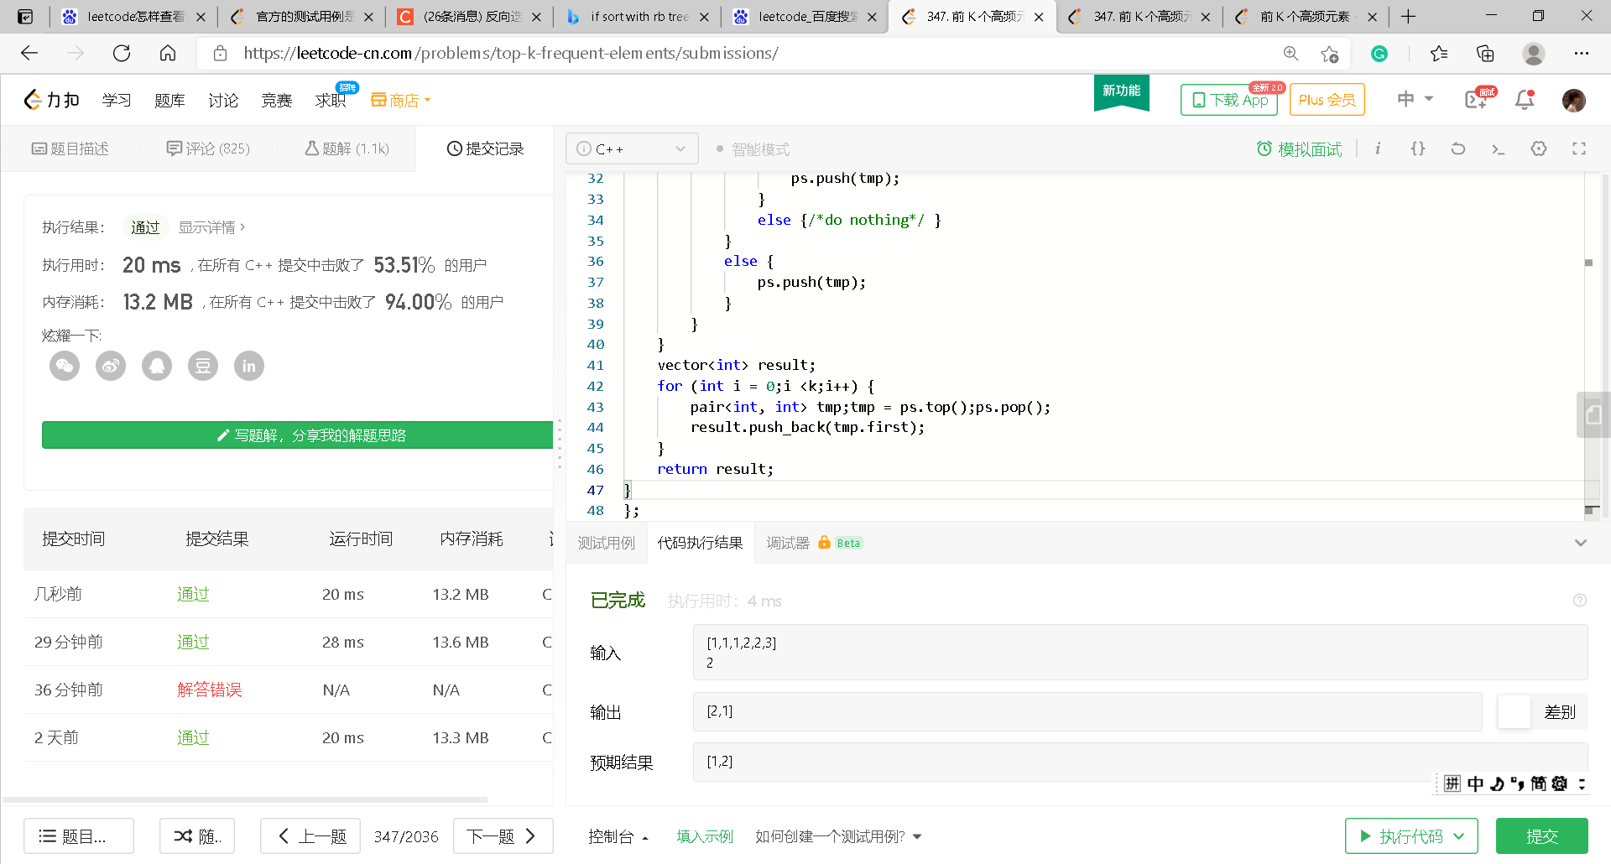
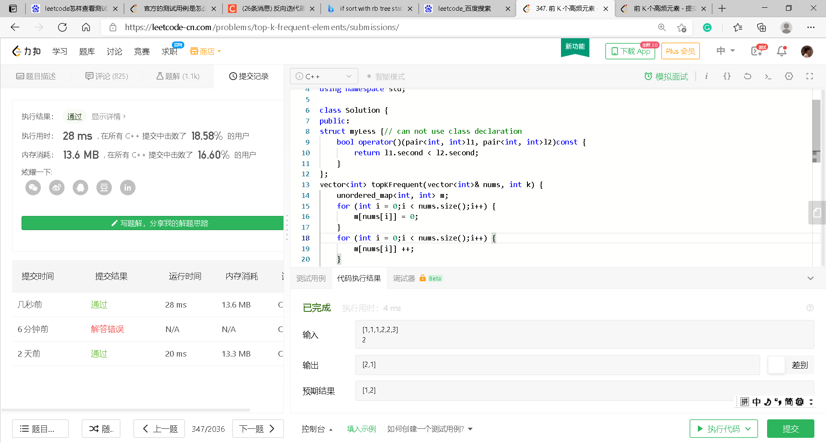
347. Top K Frequent Elements
Priority_queue
RBtree

