Slide 1
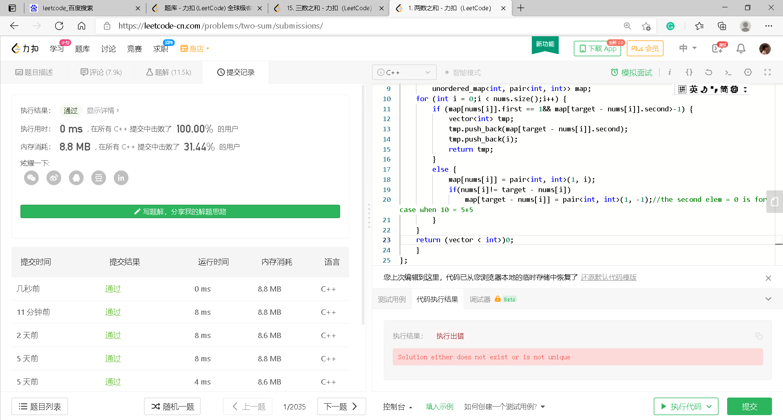
1. Two sum

Slide 2
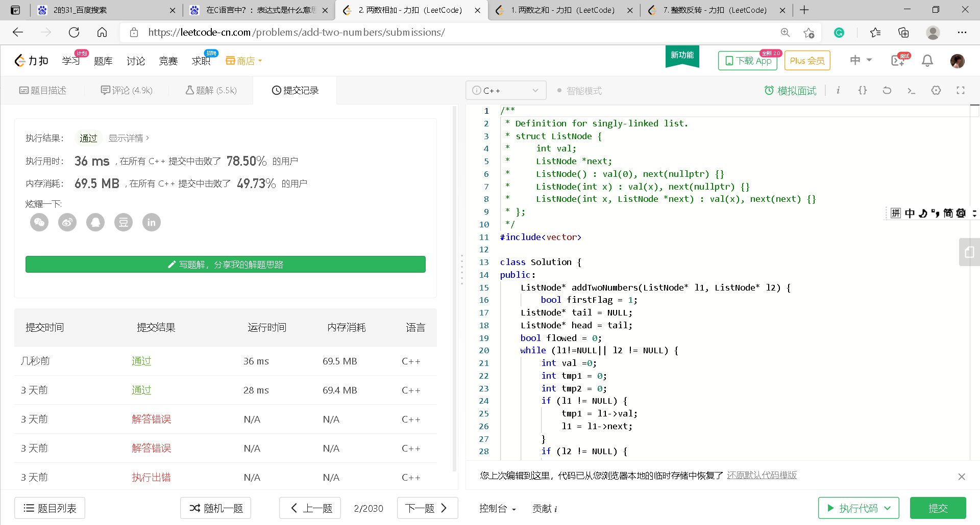
2. Add Two Numbers

Slide 3
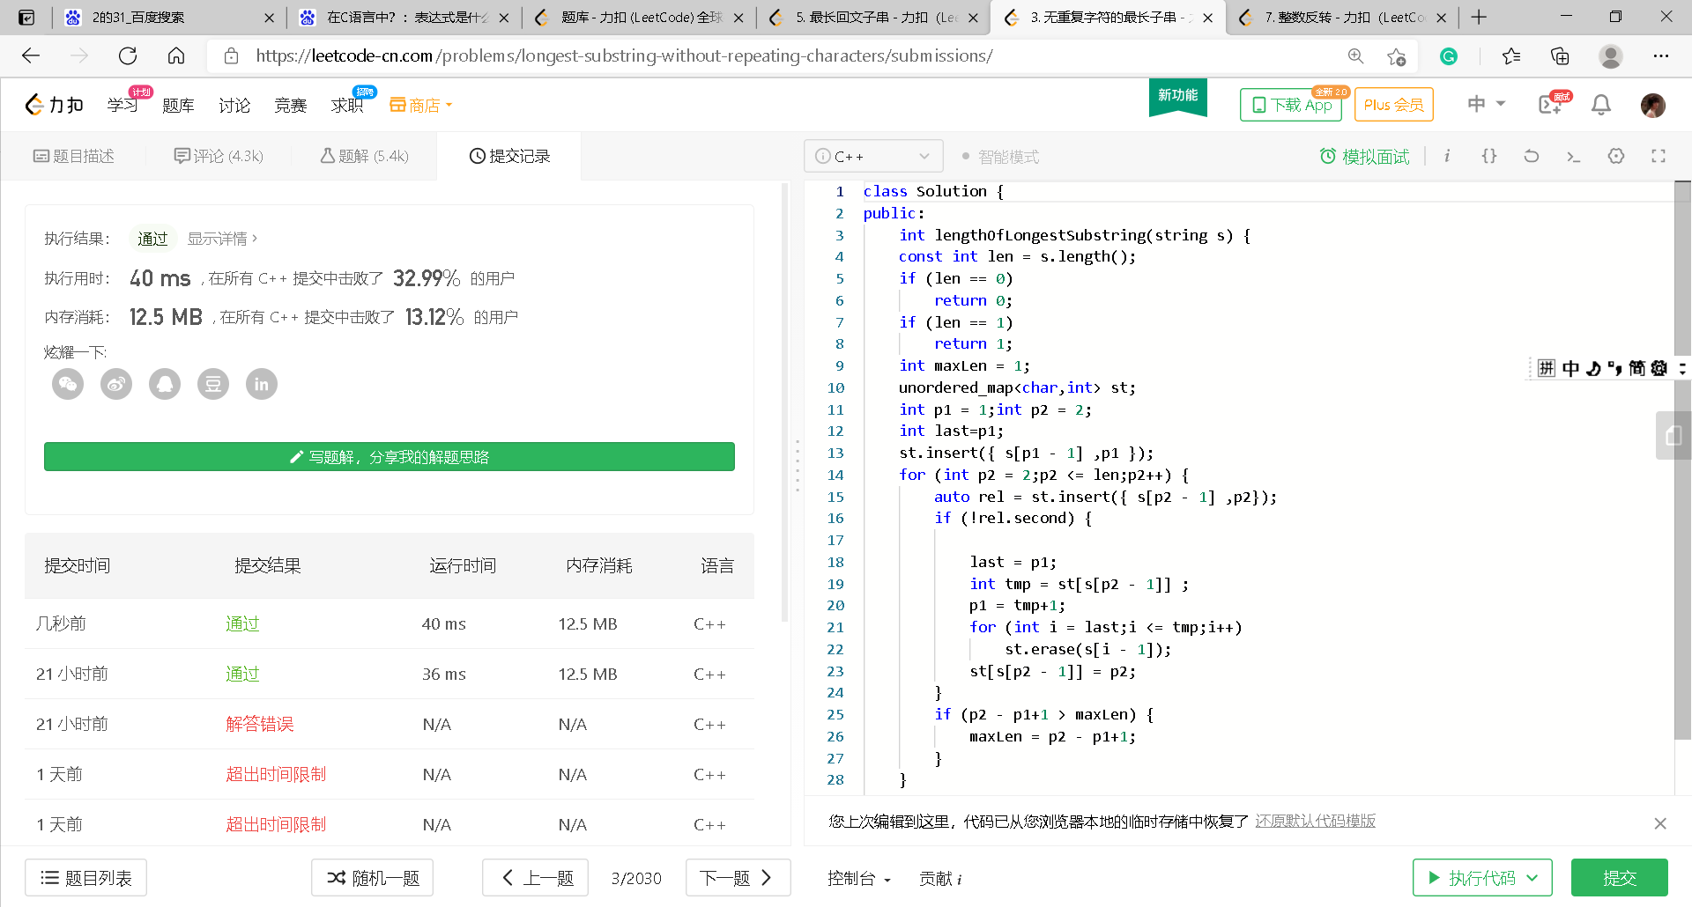
3. Longest Substring Without Repeating Characters

Slide 5
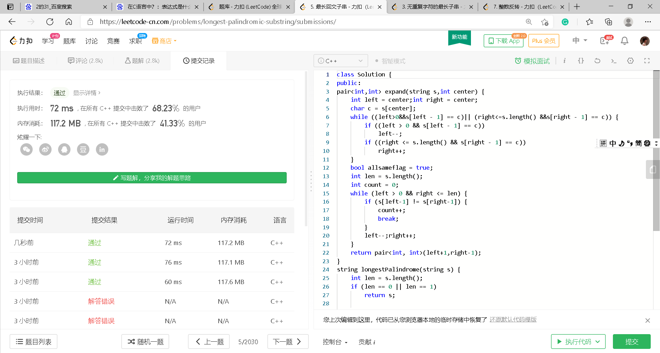
5. Longest Palindromic Substring

Slide 6
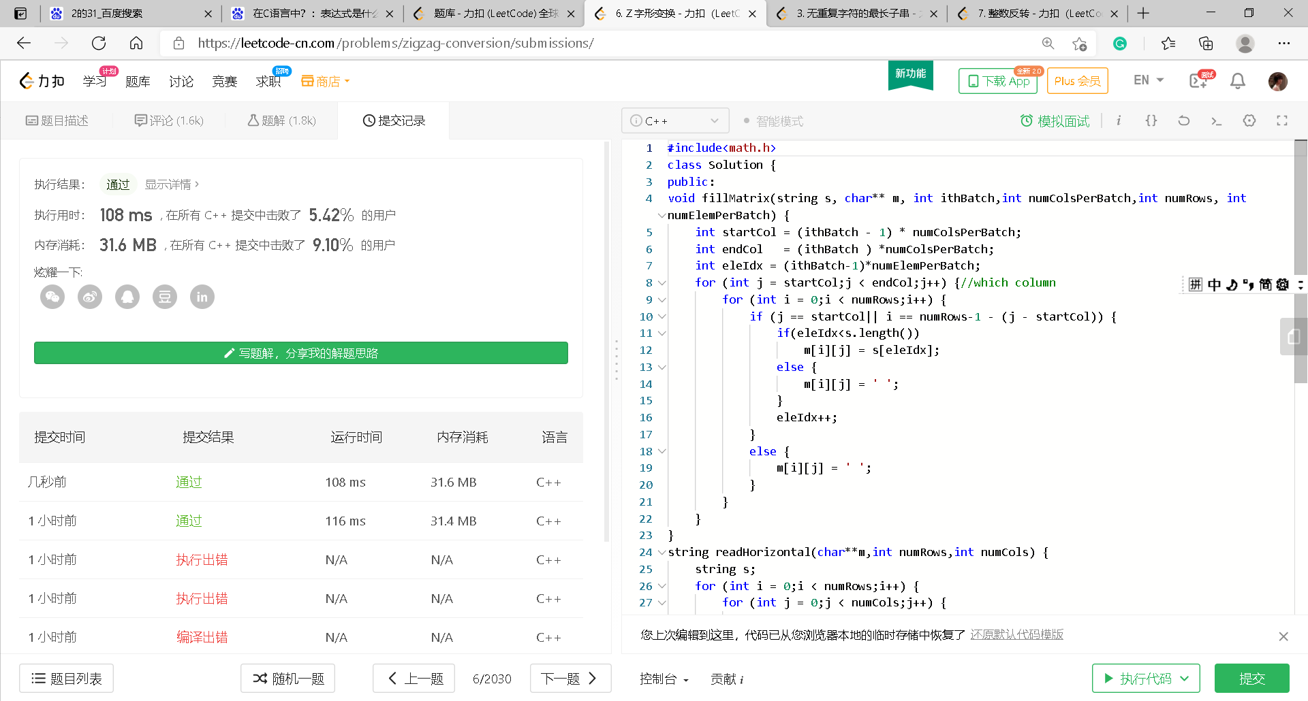
6. ZigZag Conversion

Slide 7
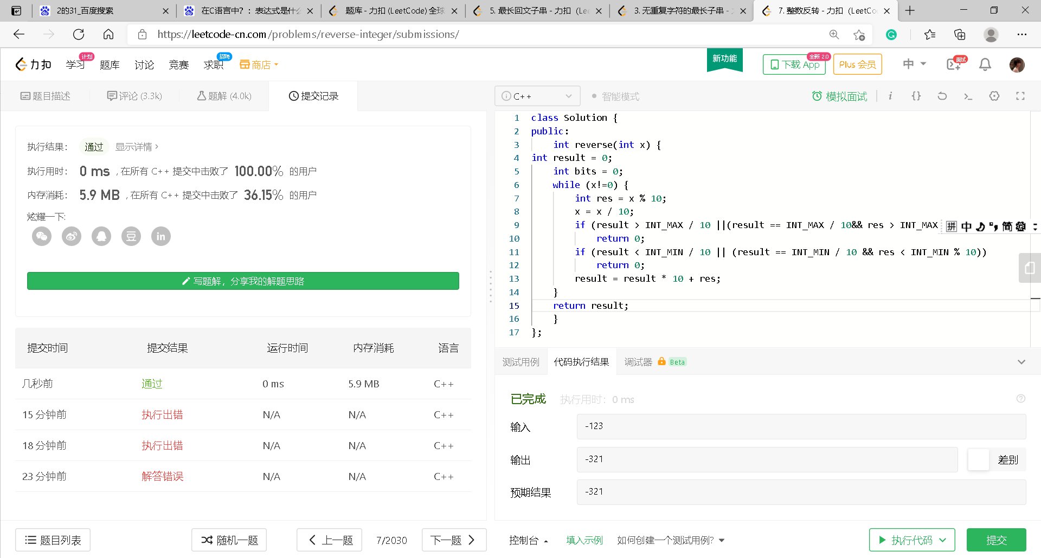
7. Reverse Integer

Slide 8
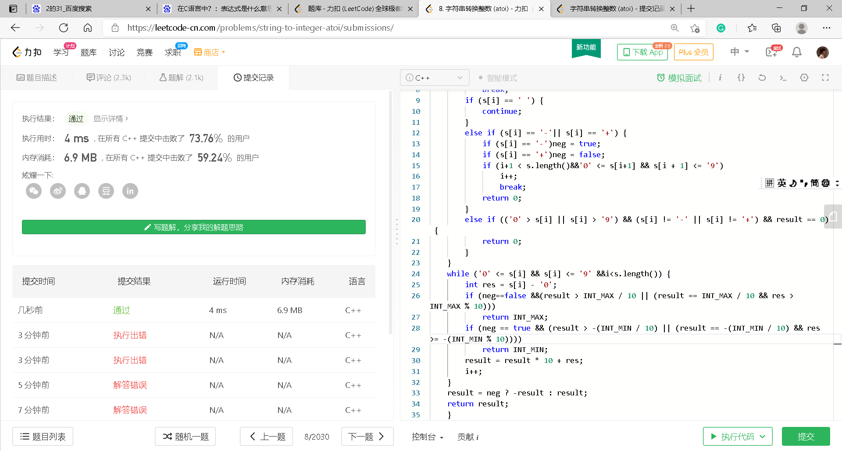
8. String to Integer (atoi)

Slide 9
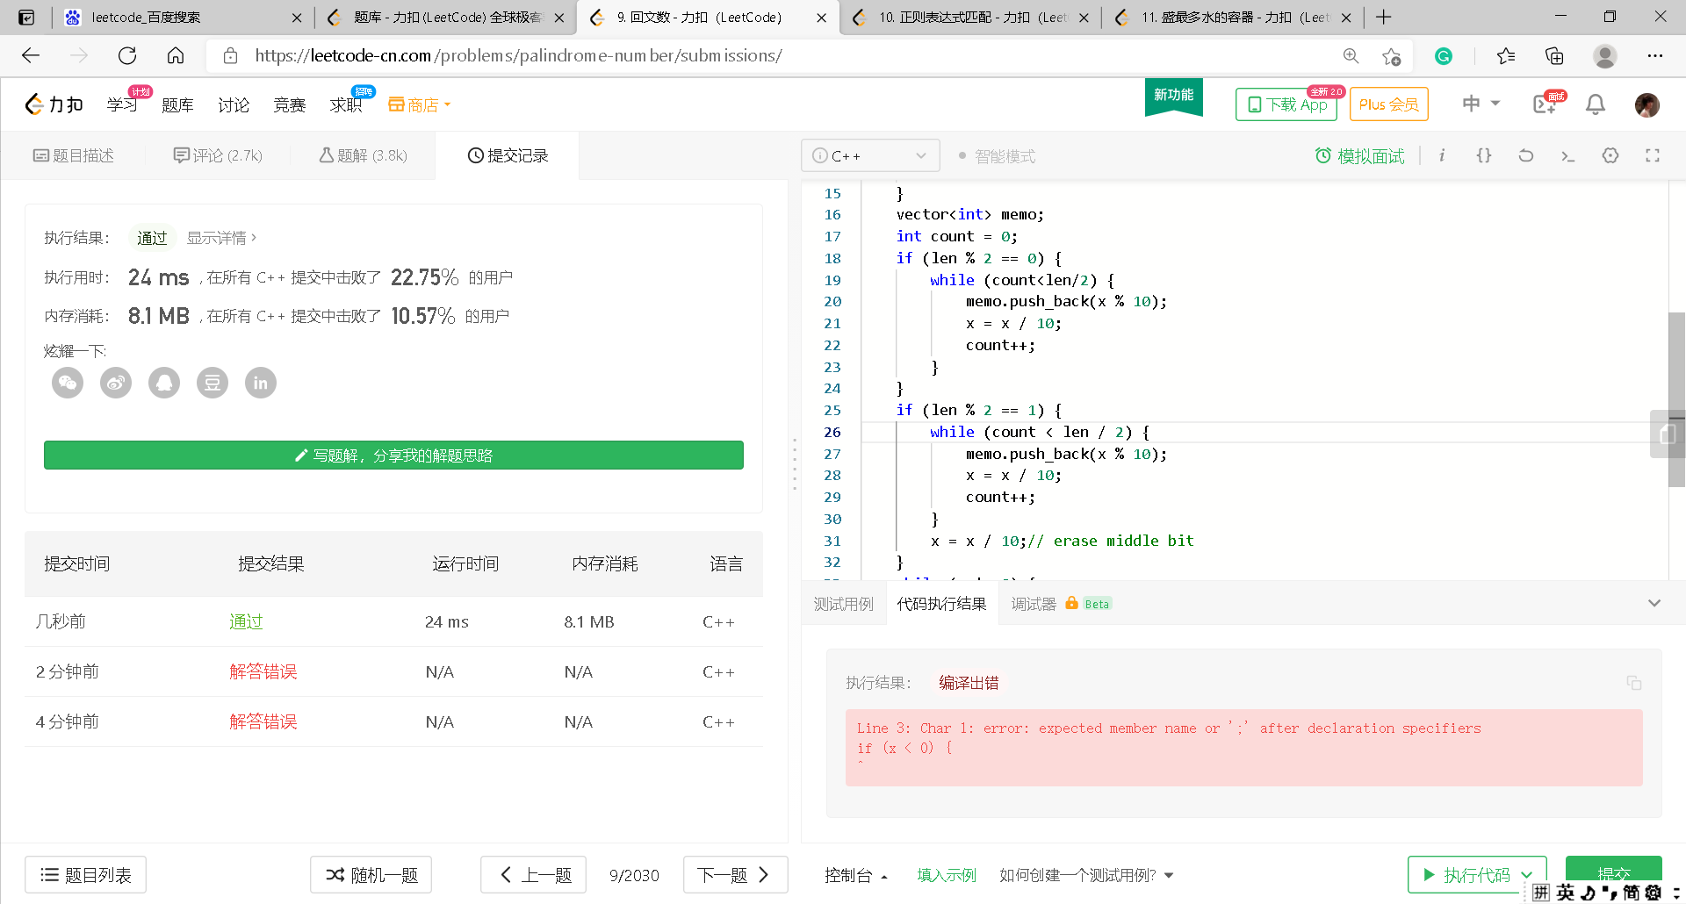
9. Palindrome Number

Slide 10
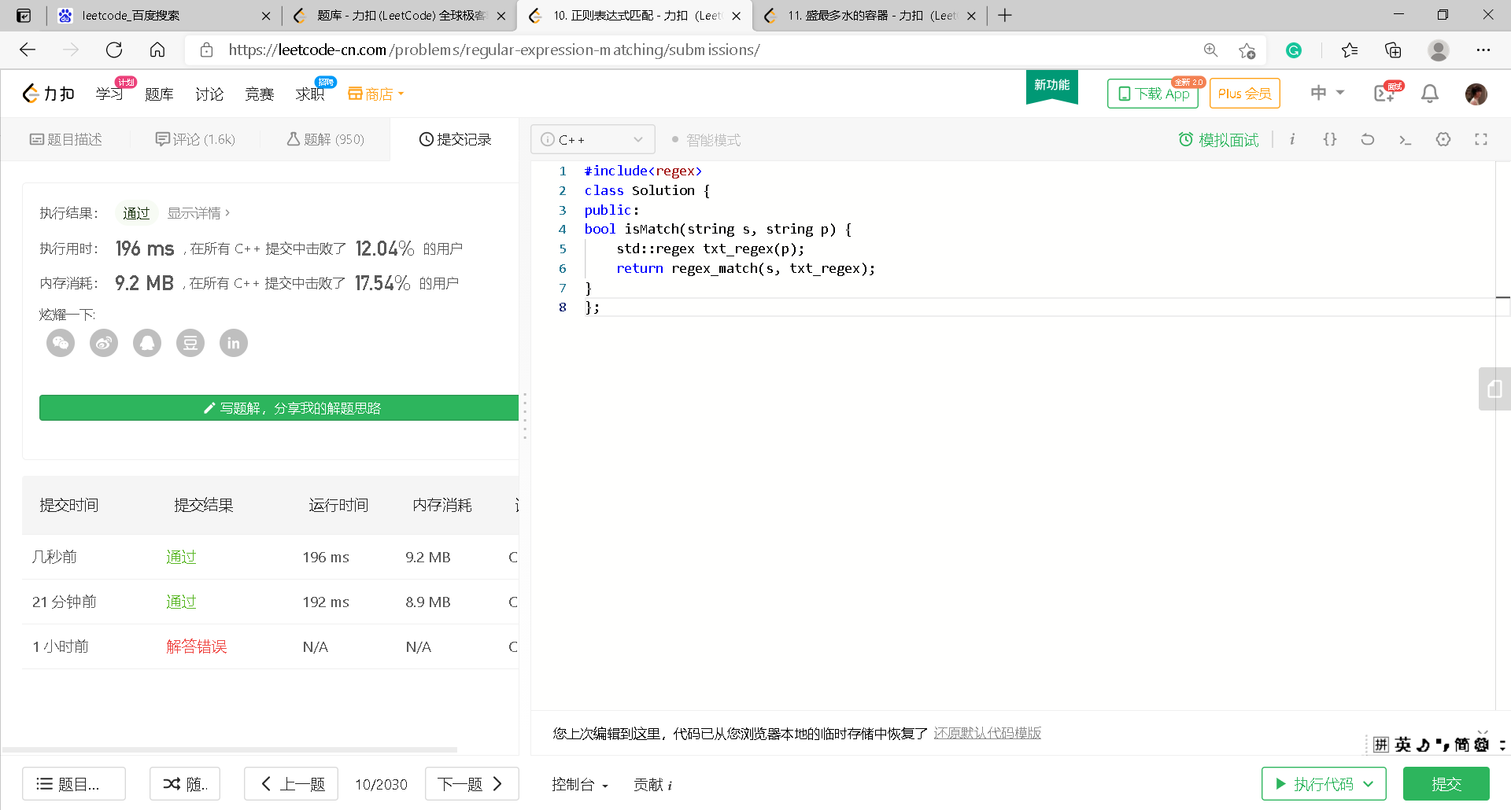
10. Regular Expression Matching

Slide 11
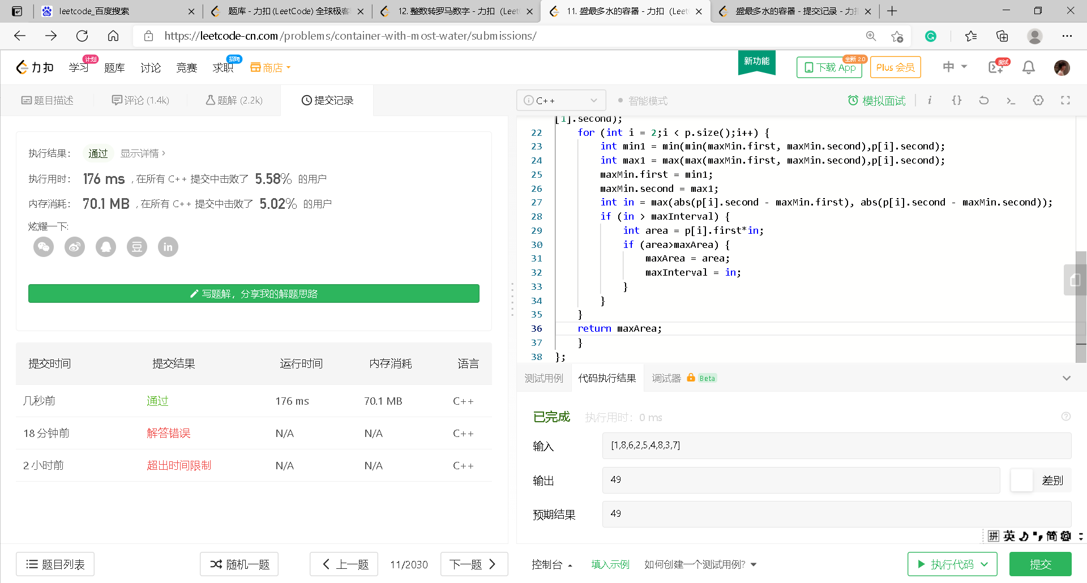
11.Container With Most Water

Slide 14
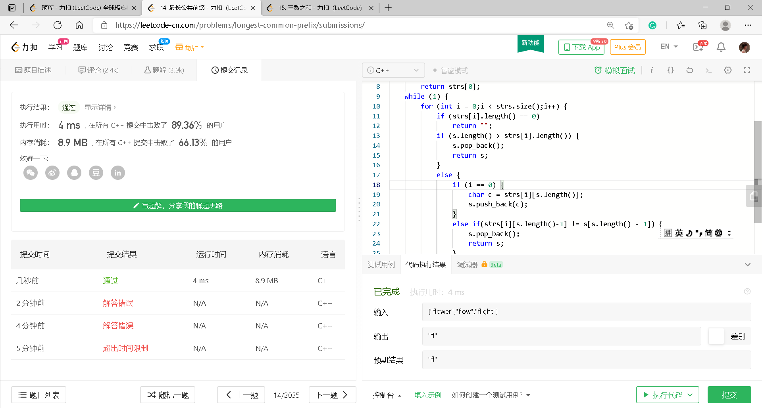
14. Longest Common Prefix

Slide 17
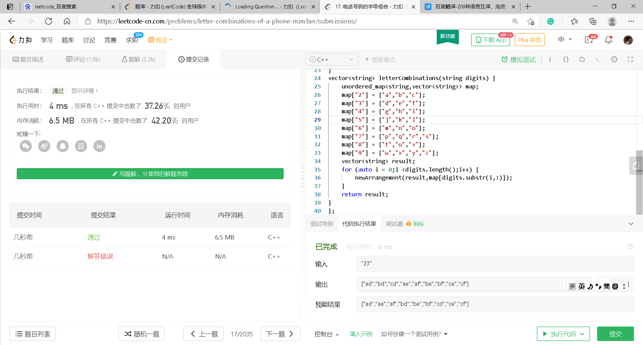
17. Letter Combinations of a Phone Number

Slide 19
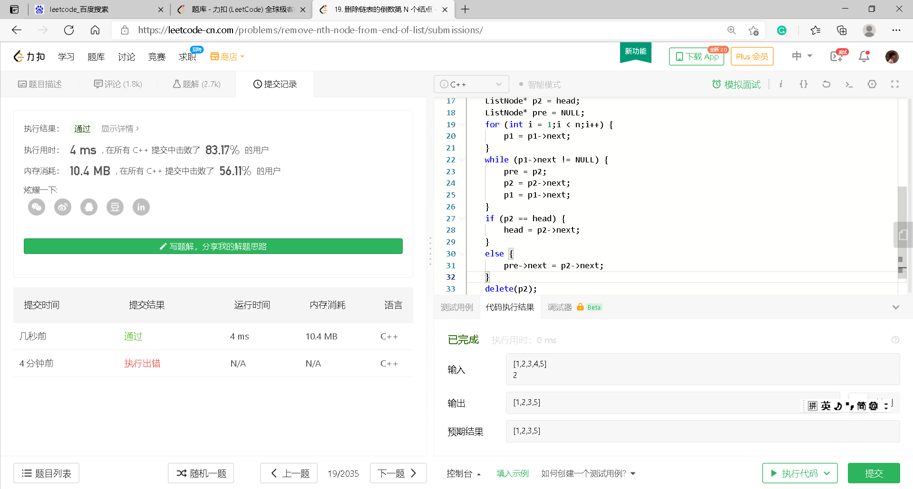
19. Remove Nth Node From End of List

Slide 20
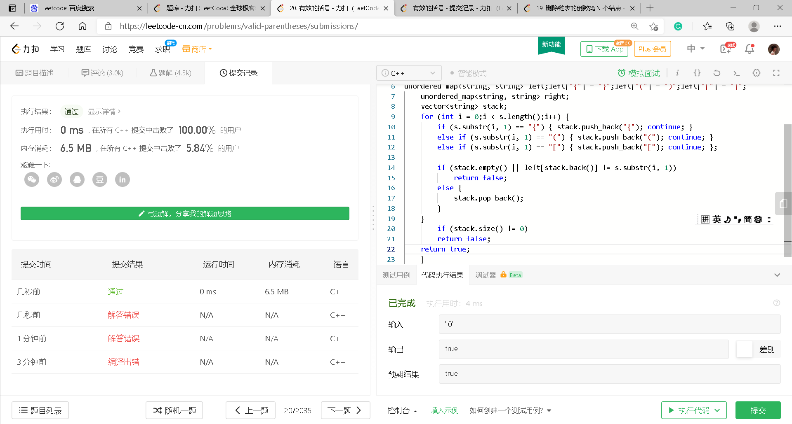
20. Valid Parentheses

Slide 21
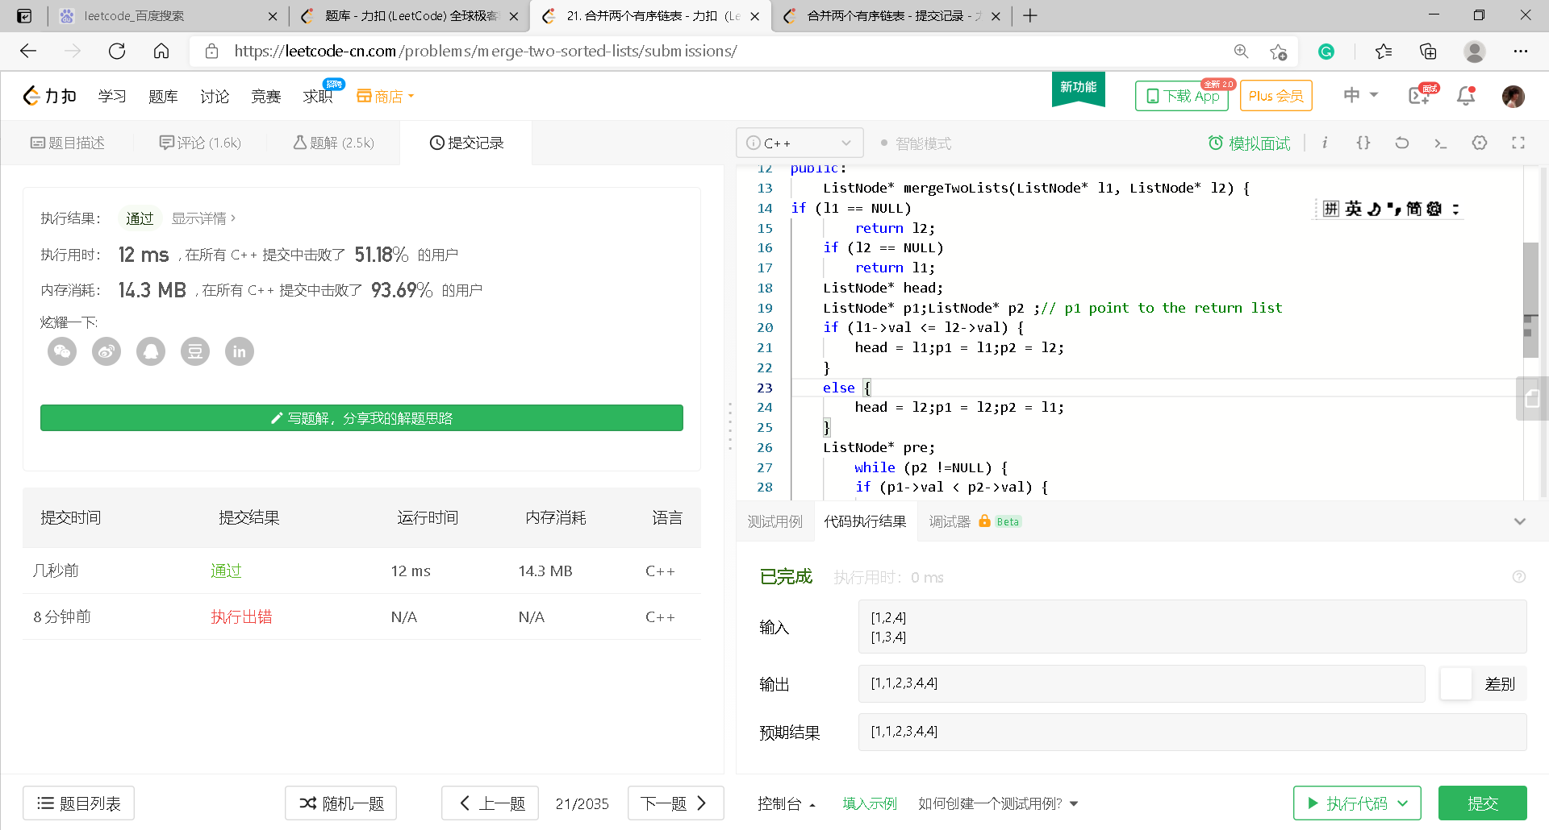
21. Merge Two Sorted Lists

Slide 24
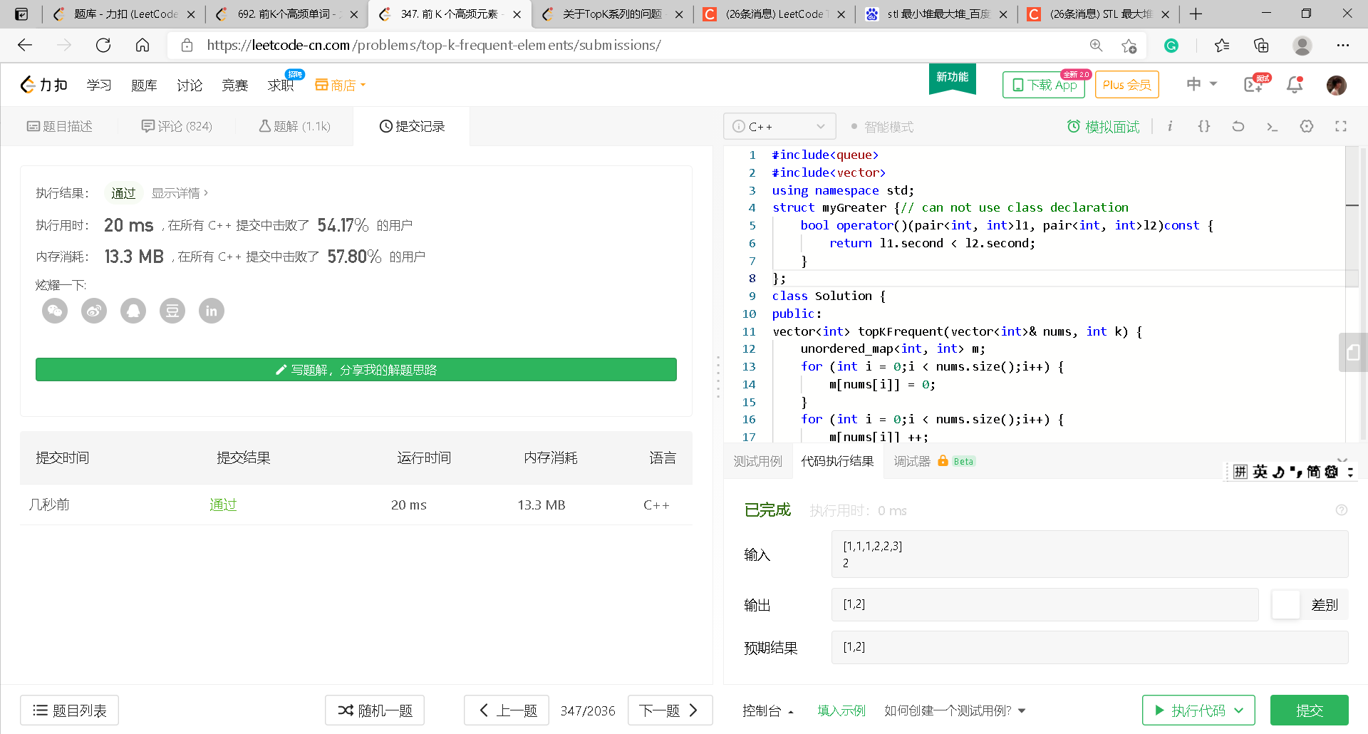
347. Top K Frequent Elements

