Slide 1
Replication of “The Term Structure of Currency Carry Trade Risk Premia”
Original Author: Lustig, Stathopoulos, Verdelhan (2019, AER)
Yizhou Qian, Kairui Chen, Zhengshen Shi

Slide 2
Research Question & Main Findings
Core Questions
At a fixed investment horizon (e.g., 1 month / 1 quarter), if we implement carry trade strategies using bonds of different maturities: 1. Short-term (T-bill) carry trades → large and significant positive risk premia (classic UIP puzzle). 2. As the bond maturity increases, the USD-denominated carry return declines and converges toward zero. Why does this produce a downward-sloping “term structure of carry premia”?
Main empirical findings
Long-term local-currency bond term premia rise with maturity. But from the US investor’s perspective, local term premia largely offset currency risk premia ⇒ almost no carry premium at long maturities.

Slide 3
Replication Goals
Data & Construction
Rebuild G10 sovereign bond and FX data. Reconstruct short rates, yield-curve slopes, zero-coupon bond prices, etc.
Core Empirical Results
Time-series regressions: Table 1 Strategy Sharpe ratios: Table 2 Cross-sectional portfolios: Table 3 Main figures: Figure 1 and Figure 2
Validation & Insights
Compare: original vs our results (coefficients, R², Sharpe ratios, term structures). Discuss: do we reproduce the key facts? Where do we see differences? What did we learn?

Slide 4

Carry Trades & the UIP Puzzle
UIP Condition (log form)
Under risk neutrality, expected carry returns should be zero.
Empirical fact
Borrow low-interest-rate currency, lend high-interest-rate currency (using short-maturity T-bills) ⇒ Positive, significant excess returns (carry trades).
New angle of this paper
Not only short rates, but the entire term structure of carry at a fixed horizon: If we implement the same carry idea using 10-year bonds, or a full set of zero-coupon bonds, what happens?

Slide 5

Decomposing Foreign Bond Returns
USD excess return of a foreign k-period bond
Currency excess return (FX carry premium)
Local-currency bond excess return (local term premium)
The difference between short and long maturities is not just about FX;
Long-maturity foreign bonds also load heavily on local term structure risk. The local term premia can systematically offset FX premia.

Slide 6
Data & Sample Design
Countries
G10: Australia, Canada, Germany, Japan, New Zealand, Norway, Sweden, Switzerland, UK.
Sample Periods
Coupon bond indices: 1951:1–2015:12 (monthly). Main sample: 1975:1–2015:12 (post-Bretton Woods). Zero-coupon bonds: roughly 1985:4–2015:12 (for Figure 2).
Assets
Short-end: T-bills (1M/3M). Long-end: 10-year government bond indices (coupon), plus multiple-maturity zero-coupon bonds.

Slide 7

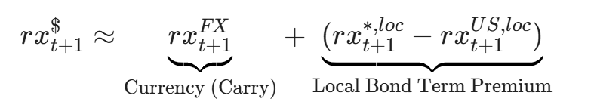
Key Variables & Our Implementation
Regression Function
Key Identity

Slide 8
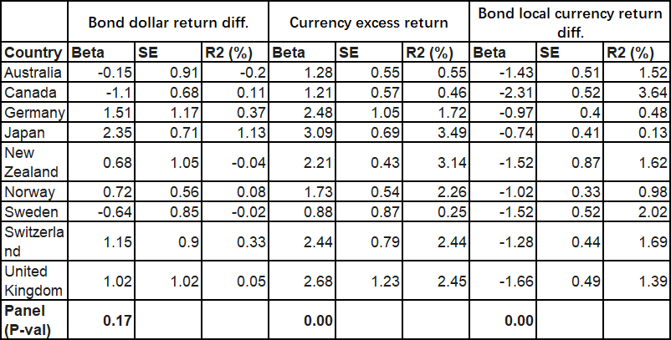
Results: Interest Rate Differentials (Table 1 Panel A)

Slide 9
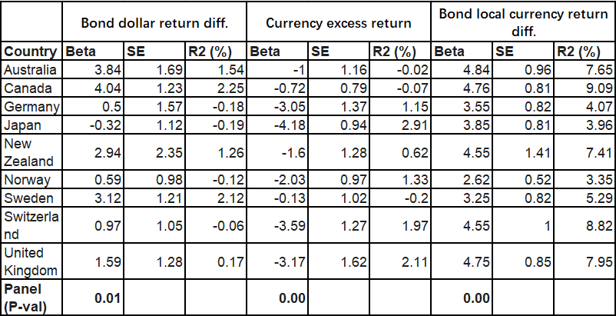
Results: Slope Differentials (Table 1 Panel B)

Slide 10
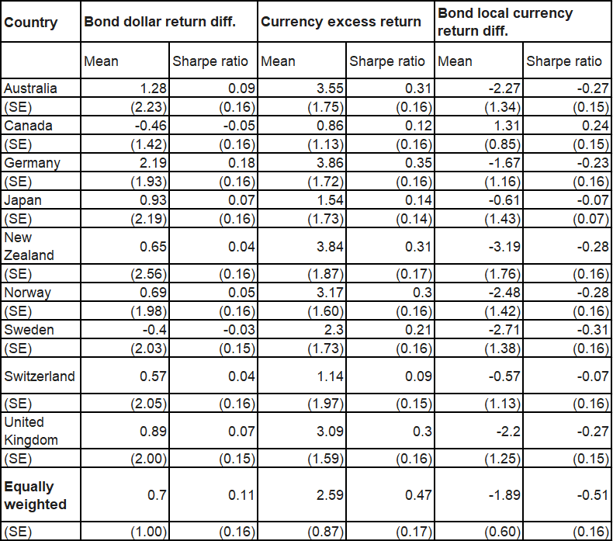
Economic Significance: Sharpe Ratios (Table 2) - Panel A. Short-term interest rates
Short Rate & Slope
Construct simple long–short strategies based on short-rate and slope differentials (e.g., long high-rate, short low-rate portfolios). Compute: Mean, volatility, and Sharpe ratio for FX carry. Mean, volatility, and Sharpe ratio for local bond term premia. Same for USD foreign bond excess returns.

Slide 11
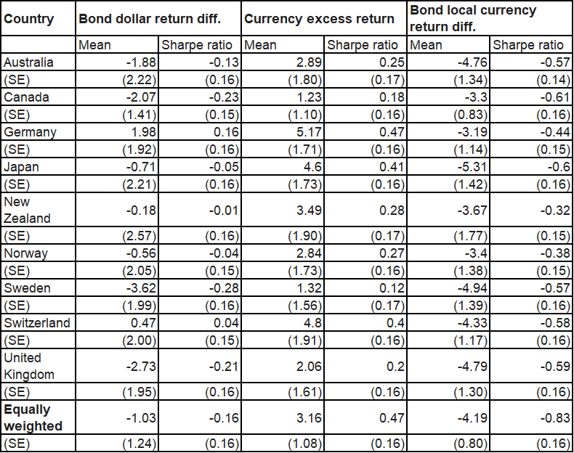
Economic Significance: Sharpe Ratios (Table 2) - Panel B. Yield curve slopes
Short Rate & Slope
Construct simple long–short strategies based on short-rate and slope differentials (e.g., long high-rate, short low-rate portfolios). Compute: Mean, volatility, and Sharpe ratio for FX carry. Mean, volatility, and Sharpe ratio for local bond term premia. Same for USD foreign bond excess returns.

Slide 12
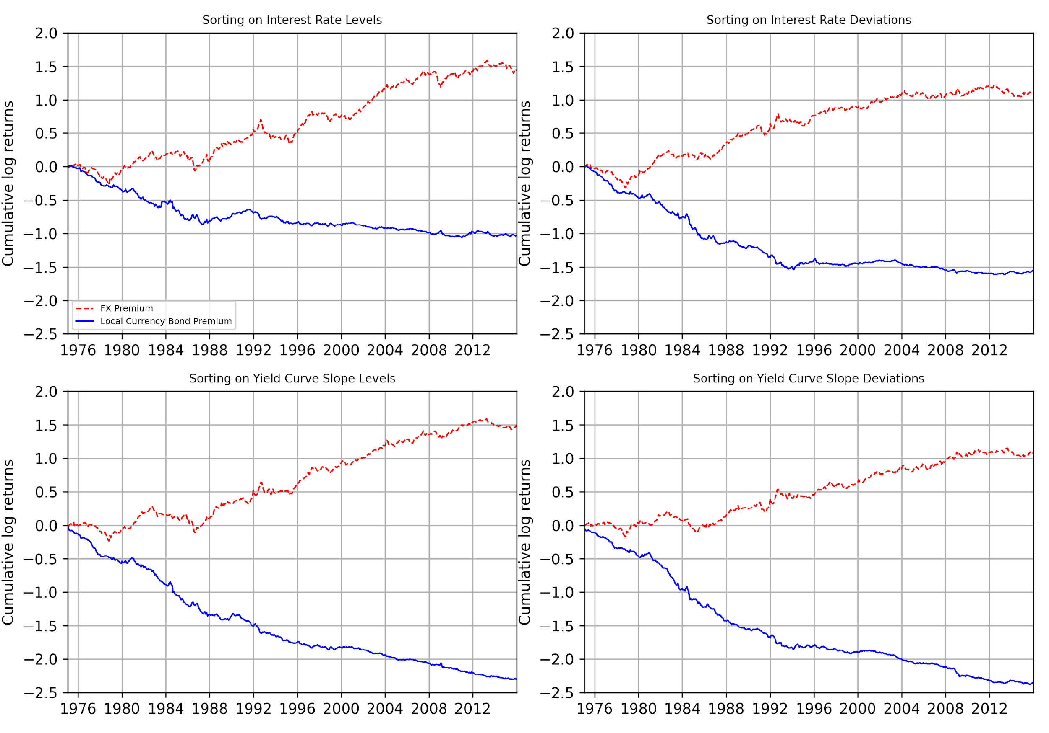
Figure 1: Cumulative Returns Decomposition
3 Observations
The FX cumulative return is positive overall (carry trade makes money). The local bond cumulative return is negative overall (term premia offset FX). The combined USD foreign bond cumulative return is roughly flat or slowly drifting ⇒ little long-run trend in USD foreign bond excess returns.

Slide 13
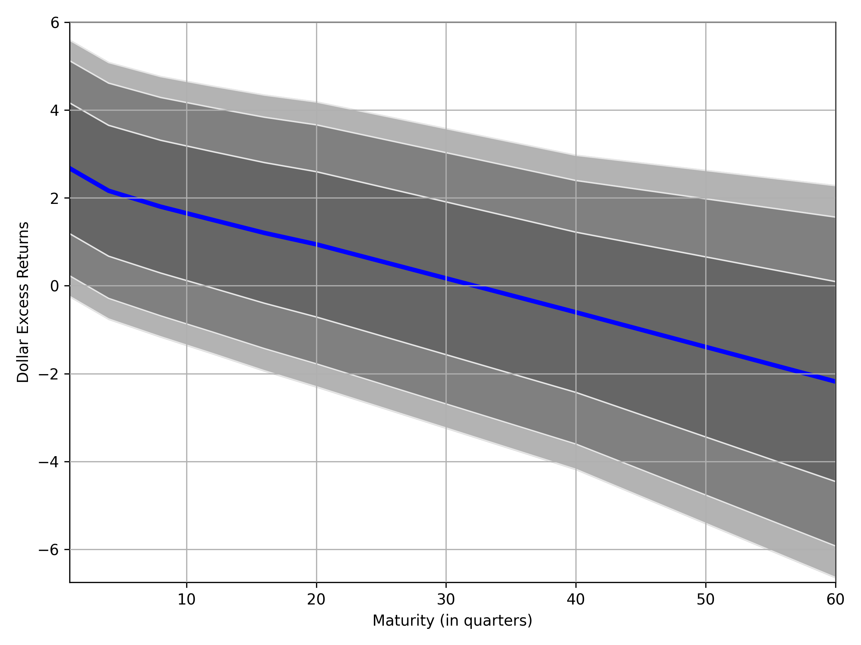
Figure 2: Term Structure of Carry Premia
3 Observations
Short maturities (3M–1Y) have significantly positive carry premia. As maturity increases, expected returns decline monotonically. At long maturities (around 15 years), point estimates are close to zero; confidence intervals include zero ⇒ no significant carry premium.

Slide 14
Theory Highlight: Preference-Free Condition
Key theoretical idea
In complete markets, the stochastic discount factor (SDF) can be decomposed into a permanent component and a transitory component. Long-maturity local-currency bond risk premia are mainly determined by the risk of the transitory component. The empirical finding that long-maturity foreign bonds in local currency have almost no carry implies that the permanent components of SDFs across currencies must be aligned in a specific way.

Slide 15
Expansion: Compare with Volatility

Slide 16
Final Conclusion & Future Work
Summary
Short-end foreign bond returns differ strongly across countries. Long-maturity returns converge, producing a downward-sloping carry term structure. Models must match equal permanent kernel volatility across countries.
Future Work
Extend the analysis to more recent data and a broader set of countries (including EM). Extend the analysis to more recent time period (from 2016-now, data available on Reuters)

