Slide 1
Data Classification in Medical/Healthcare Sectors:
Classification Methods Comparison
under Class Imbalance
Institute of Computer Science, University of Göttingen
Mengru Ji

Slide 2
CONTENTS
Literature Review
Experiments Results
Introduction
Methodology
Conclusion
Background
Overview of Class Imbalance Problem
Implementation of Algorithms
Overall Comparison
Summary
Related Work on Topic Class Imbalance Classification
Research on the impact of factors
Shortcomings
Related Evaluation Metrics
Research on the effectiveness of the algorithm

Slide 3
Introduction
Background

Slide 4
Background
Prevalent
Classification is one of the most popular topic of machine learning in 21 century. Many researchers have paid attention to binary class classification [2].
Class Imbalance Classification
Pervasive
In the real-word, the data from many fields are imbalanced, such as medical diagnosis, fraud detection and text classification [1].
Severity
Class imbalance may cause the decrease of classification accuracy. Wrong Classification may leads to catastrophe, for instance, the waste of resources, time or money, even can endanger the lives [3, 4].
[1] Guo, X., Yin, Y., Dong, C., Yang, G., & Zhou, G. (2008, October). On the class imbalance problem. In 2008 Fourth international conference on natural computation (Vol. 4, pp. 192-201). IEEE.
[2] Castro, C. L., & Braga, A. P. (2013). Novel cost-sensitive approach to improve the multilayer perceptron performance on imbalanced data. IEEE transactions on neural networks and learning systems, 24(6), 888-899.
[3] Elkan, C. (2001, August). The foundations of cost-sensitive learning. In International joint conference on artificial intelligence (Vol. 17, No. 1, pp. 973-978). Lawrence Erlbaum Associates Ltd.
[4] Sammut, C., & Webb, G. I. (Eds.). (2011). Encyclopedia of machine learning. Springer Science & Business Media.

Slide 5
Literature Review
Overview of Class Imbalance Problem
Related Work on Topic Class Imbalance Classification
Related Evaluation
Metrics

Slide 6
Theoretical Basis
Overall Theory related to Imbalanced Medical Dataset
Class Imbalance Problem：the differences between the size of minority and majority are relative substantial [5].
Imbalance Ratio(IR) = #Majority / #Minority
The data from medical field is easy to be imbalanced due to the low prevalence of a specific disease, such as cancer [4, 5].
Example:
Age-standardized cancer(all sorts of cancer) incidence rates per 100,000 populations in China in 2018 is 201.7 [6].
→ IR=495.786
The collection process is time-consuming, and may be last for a long period of time [2].
The complexity of medical data itself: high-dimensional, incompleteness, inherent heterogeneity…
Heterogeneous due to the various type of patient recordings, such as real and integer with different ranges, and text types [3].
[1] Chawla, N. V., Japkowicz, N., & Kotcz, A. (2004). Special issue on learning from imbalanced data sets. ACM SIGKDD explorations newsletter, 6(1), 1-6.
[2] Mazurowski, M. A., Habas, P. A., Zurada, J. M., Lo, J. Y., Baker, J. A., & Tourassi, G. D. (2008). Training neural network classifiers for medical decision making: The effects of imbalanced datasets on classification performance. Neural networks, 21(2-3), 427-436.
[3] Huda, S., Yearwood, J., Jelinek, H. F., Hassan, M. M., Fortino, G., & Buckland, M. (2016). A hybrid feature selection with ensemble classification for imbalanced healthcare data: A case study for brain tumor diagnosis. IEEE access, 4, 9145-9154.
[4] Gao, L., Zhang, L., Liu, C., & Wu, S. (2020). Handling imbalanced medical image data: A deep-learning-based one-class classification approach. Artificial Intelligence in Medicine, 108, 101935.
[5] He, H., & Garcia, E. A. (2009). Learning from imbalanced data. IEEE Transactions on knowledge and data engineering, 21(9), 1263-1284.
[6] Chin J Cancer Res. 2020 Apr; 32(2): 129–139. https://www.ncbi.nlm.nih.gov/pmc/articles/PMC7219092/

Slide 7
Theoretical Basis
Overall Theory related to Imbalanced Medical Dataset
S. Huda et al. addressed the problems of imbalanced healthcare data on the diagnosis of a brain tumor. In this study, a new approach to data mining is adopted, combining the feature selection and the ensemble classification [1].
M. Zhu et al. introduced a novel voting class weight algorithm called CWsRF based on random forest algorithm (RF), which focuses on the challenge of identifying the minority class sufficiently in medical applications and can be applied to disease detection, such as breast cancer, or medical images classification [2].
Classification models developed for medical diagnosis in recent years
[1] Huda, S., Yearwood, J., Jelinek, H. F., Hassan, M. M., Fortino, G., & Buckland, M. (2016). A hybrid feature selection with ensemble classification for imbalanced healthcare data: A case study for brain tumor diagnosis. IEEE access, 4, 9145-9154.
[2] Zhu, M., Xia, J., Jin, X., Yan, M., Cai, G., Yan, J., & Ning, G. (2018). Class weights random forest algorithm for processing class imbalanced medical data. IEEE Access, 6, 4641-4652.

Slide 8
Theoretical Basis
Related Work on Imbalanced Classification
Sampling Methods
Three Main Aspects of Class Imbalance Classification Methods
Cost-sensitive Learning
Ensemble Learning
Distance Metric Learning Technique

Slide 9
Theoretical Basis
Related Work on Imbalanced Classification
Oversampling
Random Oversampling
SMOTE
Sampling Methods
Under-sampling
Random Under-sampling
BalanceCasade
Hybrid Methods
Fernández, A., García, S., Galar, M., Prati, R. C., Krawczyk, B., & Herrera, F. (2018). Learning from imbalanced data sets (pp. 1-377). Berlin: Springer.

Slide 10
Theoretical Basis
Related Work on Imbalanced Classification
Confusion Matrix for Binary Classification
Cost-sensitive Learning
 | Actual negative | Actual positive
Predict negative | C(0,0) | C(0,1)
Predict positive | C(1,0) | C(1,1)

Slide 11
Theoretical Basis
Related Work on Imbalanced Classification
Meta-learning
MetaCost
Weighting
Cost-sensitive Learning
Direct Methods
Cost-sensitive Decision Tree
Ling, C. X., & Sheng, V. S. (2008). Cost-sensitive learning and the class imbalance problem. Encyclopedia of machine learning, 2011, 231-235.

Slide 12

Theoretical Basis
Related Work on Imbalanced Classification
Idea: Major Voting
Ensemble Learning
Ask multiple ‘Experts’ for help in order to make the final decision
Train multiple classifiers and combine them to achieve an overall classification [1]
[1] Rokach, L. (2010). Pattern classification using ensemble methods.

Slide 13
Theoretical Basis
Related Work on Imbalanced Classification
Bagging [1]
Random forest
Ensemble Learning
Boosting [1]
AdaBoost
XGBoost
[1] Breiman, L. (1996). Bagging predictors. Machine learning, 24(2), 123-140.

Slide 14
Theoretical Basis
Overview of Algorithms on Imbalanced Classification
AdaBoost
RUSBoost
CAdaMEC
MWMOTE
Classical Models
MetaCost
SMOTE
Cost-sensitive DecisionTree

Slide 15
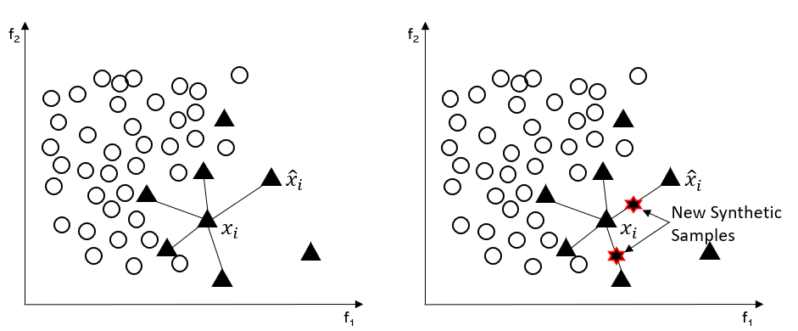
Theoretical Basis
Overview of Algorithms on Imbalanced Classification
SMOTE[1]
Source: [3]
MWMOTE [2]
Assign weights to the minority samples that are difficult to learn according to the distance from the majority samples
uses clustering algorithm to synthesize samples from the weighted minority samples to ensure that these new synthetic samples are located in the minority region
[1] Chawla, N. V., Bowyer, K. W., Hall, L. O., & Kegelmeyer, W. P. (2002). SMOTE: synthetic minority over-sampling technique. Journal of artificial intelligence research, 16, 321-357.
[2] Barua, S., Islam, M. M., Yao, X., & Murase, K. (2012). MWMOTE--majority weighted minority oversampling technique for imbalanced data set learning. IEEE Transactions on Knowledge and Data Engineering, 26(2), 405-425.
[3] J. F. Kong, “What is a class imbalance classification problem?” https://ecole-itn.eu/ ecole-blog/#1574339393650-53e7d5da-805b, 2009.

Slide 16
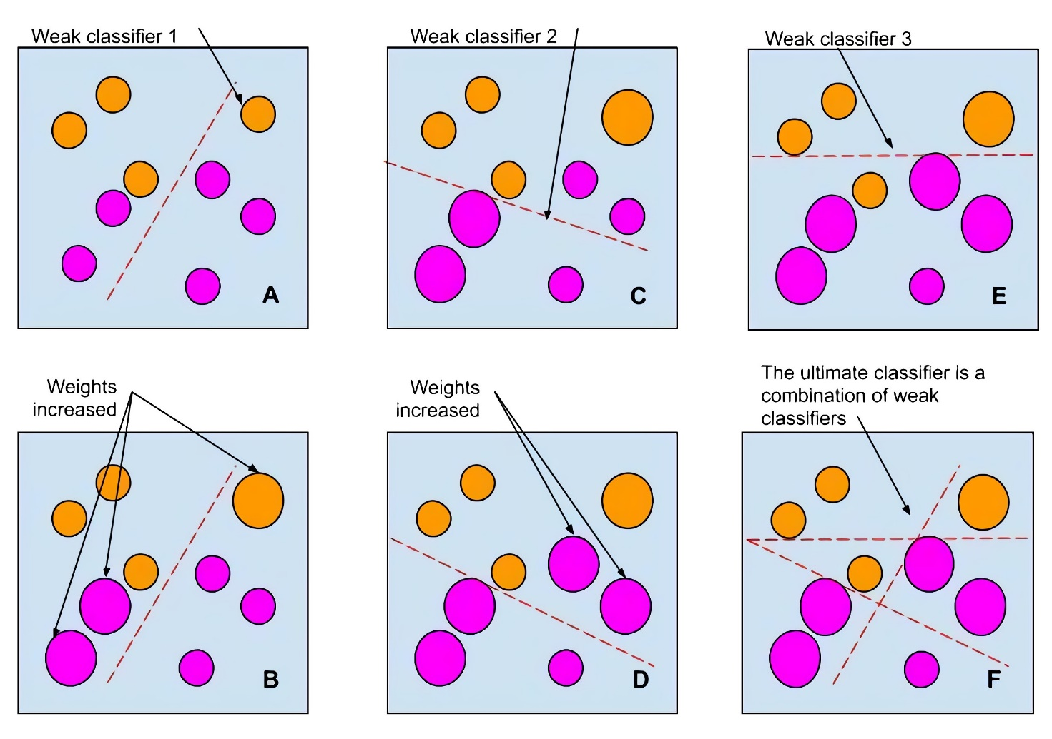
Theoretical Basis
Overview of Algorithms on Imbalanced Classification
AdaBoost [1]
[1] Freund, Y., & Schapire, R. E. (1997). A decision-theoretic generalization of on-line learning and an application to boosting. Journal of computer and system sciences, 55(1), 119-139.

Slide 17
Theoretical Basis
Overview of Algorithms on Imbalanced Classification
RUSBoost [1]
RUS → Random Under-sampling
Boost → AdaBoost.M2
CAdaMEC [2]
Calibrated AdaMEC is proposed upon AdaMEC. Platt scaling is applied to calibrate it
[1] C. Seiffert, T. M. Khoshgoftaar, J. Van Hulse, and A. Napolitano, “Rusboost: A hybrid approach to alleviating class imbalance,” IEEE Transactions on Systems, Man, and Cybernetics-Part A: Systems and Humans, vol. 40, no. 1, pp. 185–197, 2009.
[2] Nikolaou, N., Edakunni, N., Kull, M., Flach, P., & Brown, G. (2016). Cost-sensitive boosting algorithms: Do we really need them?. Machine Learning, 104(2-3), 359-384.

Slide 18
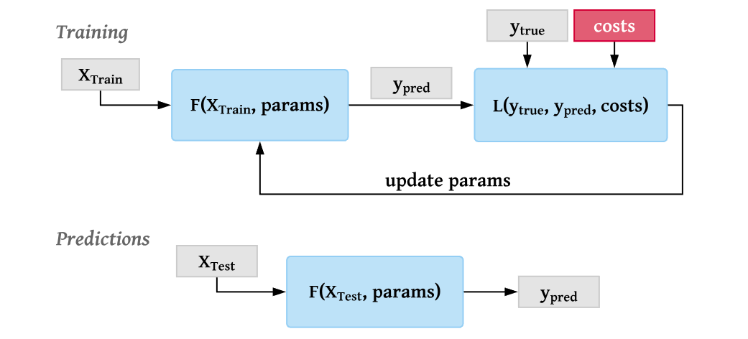
Theoretical Basis
Overview of Algorithms on Imbalanced Classification
Loss Function
MetaCost [1]
Idea: Bayesian Decision Theory
→ Minimum Error Decision
[1] Domingos, P. (1999, August). Metacost: A general method for making classifiers cost-sensitive. In Proceedings of the fifth ACM SIGKDD international conference on Knowledge discovery and data mining (pp. 155-164).

Slide 19
Theoretical Basis
Overview of Algorithms on Imbalanced Classification
The cost-sensitive decision tree considers two different costs:
the test cost of the a-th feature tc(a) and the misclassification cost of the sample mc(x).
The cost of both aspects should be minimized, thereby the bias towards the majority class can be eliminated, while the cost of using features can be reduced.
Cost-sensitive Decision Tree(csDCT) [1]
[1] Fernández, A., García, S., Galar, M., Prati, R. C., Krawczyk, B., & Herrera, F. (2018). Learning from imbalanced data sets (pp. 1-377). Berlin: Springer.

Slide 20
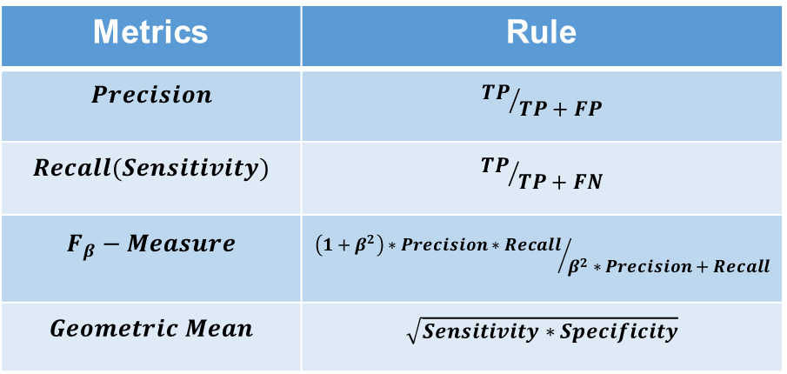
Theoretical Basis
Evaluation Metrics for Imbalance Classification
Confusion Matrix for Binary Classification [1]
Evaluation Metrics based on Confusion Matrix
 | Actual negative | Actual positive
Predict negative | TN | FN
Predict positive | FP | TP
Metrics | Rule
$$Precision$$ | $${TP}/{TP+FP}$$
$$Recall(Sensitivity)$$ | $${TP}/{TP+FN}$$
$$F_{β}−Measure$$ | $${\left(1+β^{2}\right)∗Precision∗Recall}/{β^{2}∗Precision+Recall}$$
$$Geometric Mean$$ | $$\sqrt{Sensitivity∗Specificity}$$
Provides a deeper understanding of predictive model performance through the results of the predictions.
→ The types of errors can be more obviously observed
$β$ =1 in this paper → $F_{1}−Measure$ is denoted as F1
[1] A. Luque, A. Carrasco, A. Martín, and A. de las Heras, “The impact of class imbalance in classification performance metrics based on the binary confusion matrix,” Pattern Recognition, vol. 91, pp. 216–231, 2019.

Slide 21
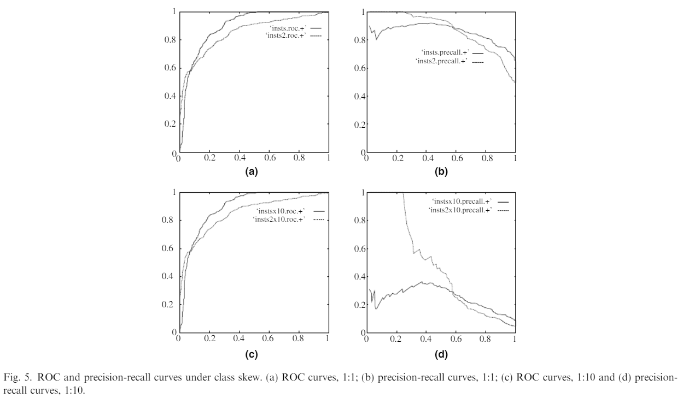
Theoretical Basis
Overview of Algorithms on Imbalanced Classification
Why chose PRC to evaluate the performance of models in this paper?
Source: [1]
[1] Fawcett, T. (2006). An introduction to ROC analysis. Pattern recognition letters, 27(8), 861-874.

Slide 22
Methodology
Implementation Process of
DDAE and IML in detail

Slide 23
Theoretical Basis
Overview of Algorithms on Imbalanced Classification
Self-paced Ensemble Classifier
DDAE
Iterative Metric Learning(IML)
State-of-art Models

Slide 24
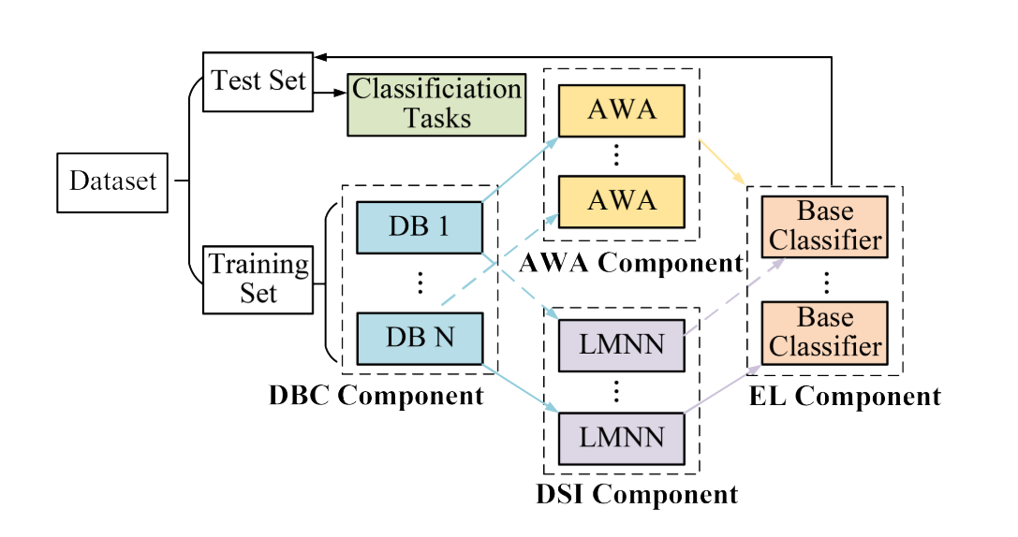
DDAE
Adaptive Weight Adjustment
Data Block Construction
Ensemble Learning
Data Space Improvement
Source: [1, Fig 1]
[1] J. Yin, C. Gan, K. Zhao, X. Lin, Z. Quan, and Z.-J. Wang, “A novel model for imbalanced data classification,” in Proceedings of the AAAI Conference on Artificial Intelligence, vol. 34, no. 04, 2020, pp. 6680–6687.

Slide 25
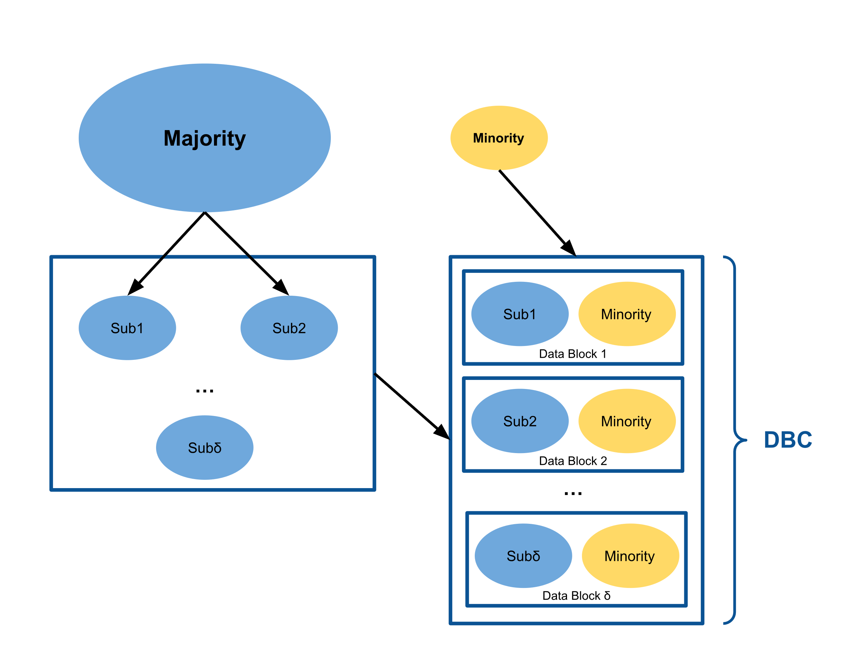
DDAE
Training set
Data Block Construction(DBC) [1]
Dividing the majority in the training set into several data blocks and copy all the minority samples in the training set into each data block
[1] J. Yin, C. Gan, K. Zhao, X. Lin, Z. Quan, and Z.-J. Wang, “A novel model for imbalanced data classification,” in Proceedings of the AAAI Conference on Artificial Intelligence, vol. 34, no. 04, 2020, pp. 6680–6687.

Slide 26
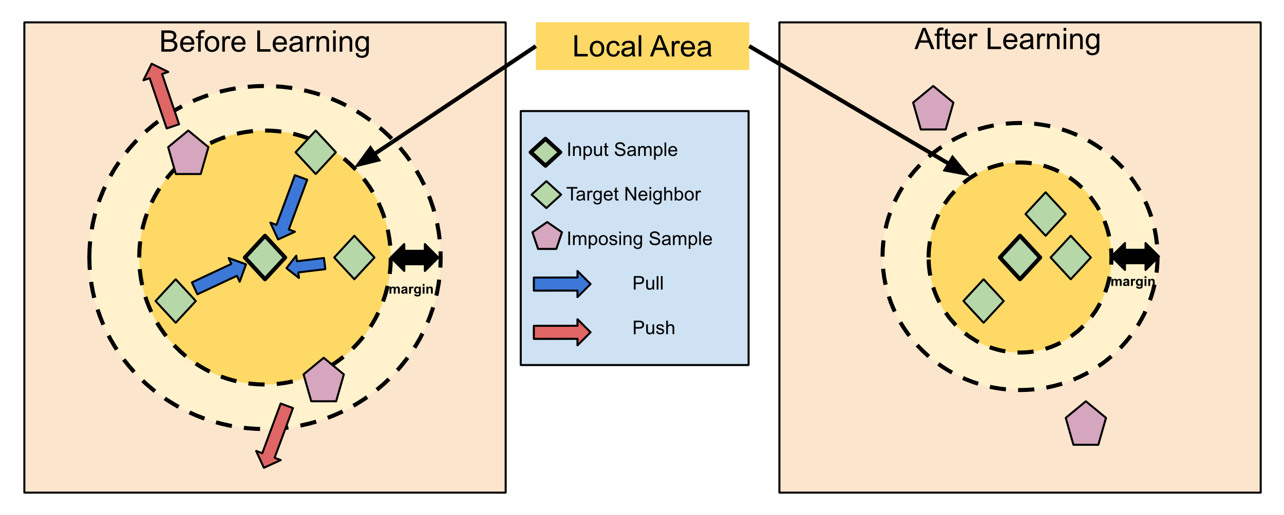
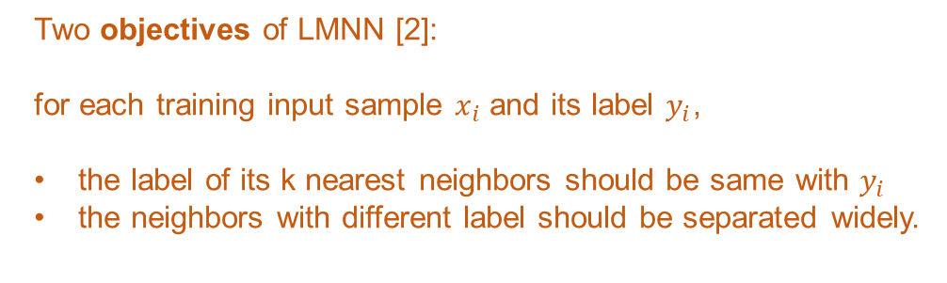
DDAE
Data Space Improvement(DSI) [1]
Apply Large Margin Nearest Neighbor(LMNN) to improve the data space for training samples in each data block
Two objectives of LMNN [2]:
for each training input sample $x_{i}$ and its label $y_{i}$,
the label of its k nearest neighbors should be same with $y_{i}$
the neighbors with different label should be separated widely.
[1] J. Yin, C. Gan, K. Zhao, X. Lin, Z. Quan, and Z.-J. Wang, “A novel model for imbalanced data classification,” in Proceedings of the AAAI Conference on Artificial Intelligence, vol. 34, no. 04, 2020, pp. 6680–6687.
[2] Weinberger, K. Q., & Saul, L. K. (2009). Distance metric learning for large margin nearest neighbor classification. Journal of Machine Learning Research, 10(2).

Slide 27
DDAE
Overall loss function [1]
Data Space Improvement(DSI) [1]
$$ε\left(L\right)=\left(1−ω\right){ ε}_{pull}\left(L\right) +{ ω ε}_{push}\left(L\right)$$
Apply Large Margin Nearest Neighbor(LMNN) to improve the data space for training samples in each data block
Penalize large distances in the neighboring
→ Pulling samples with same class label closer to each other
Penalize small distances in the neighboring
→ Separate samples with different class label with a large distance
Relative weight between push and pull term
[1] J. Yin, C. Gan, K. Zhao, X. Lin, Z. Quan, and Z.-J. Wang, “A novel model for imbalanced data classification,” in Proceedings of the AAAI Conference on Artificial Intelligence, vol. 34, no. 04, 2020, pp. 6680–6687.
[2] Weinberger, K. Q., & Saul, L. K. (2009). Distance metric learning for large margin nearest neighbor classification. Journal of Machine Learning Research, 10(2).

Slide 28
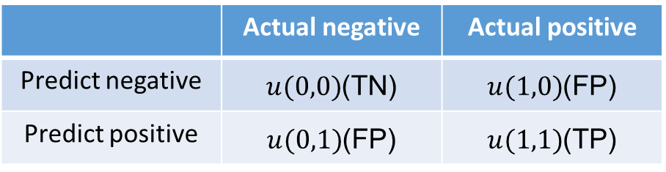
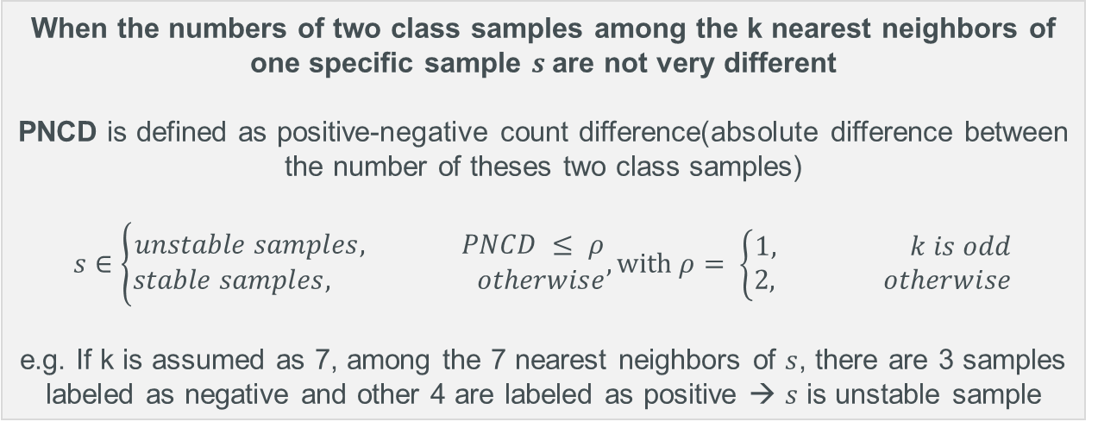
DDAE
What is the meaning of an unstable sample?
When the numbers of two class samples among the k nearest neighbors of one specific sample $s$are not very different
PNCD is defined as positive-negative count difference(absolute difference between the number of theses two class samples)
$$s∈\left\{\begin{aligned}unstable samples, PNCD ≤ ρ \\ stable samples, otherwise\end{aligned},with ρ= \left\{\begin{aligned}1, k is odd \\ 2, otherwise\end{aligned}\right.\right.$$
e.g. If k is assumed as 7, among the 7 nearest neighbors of $s$, there are 3 samples labeled as negative and other 4 are labeled as positive → $s$ is unstable sample
Adaptive Weight Adjustment(AWA) [1]
Find an appropriate overall class-weight generated basically on the data coming from each data block
→
Unstable Confusion Matrix for Binary Classification [1]
 | Actual negative | Actual positive
Predict negative | $u(0,0)$(TN) | $u(1,0)$(FP)
Predict positive | $u(0,1)$(FP) | $u(1,1)$(TP)
[1] J. Yin, C. Gan, K. Zhao, X. Lin, Z. Quan, and Z.-J. Wang, “A novel model for imbalanced data classification,” in Proceedings of the AAAI Conference on Artificial Intelligence, vol. 34, no. 04, 2020, pp. 6680–6687.

Slide 29
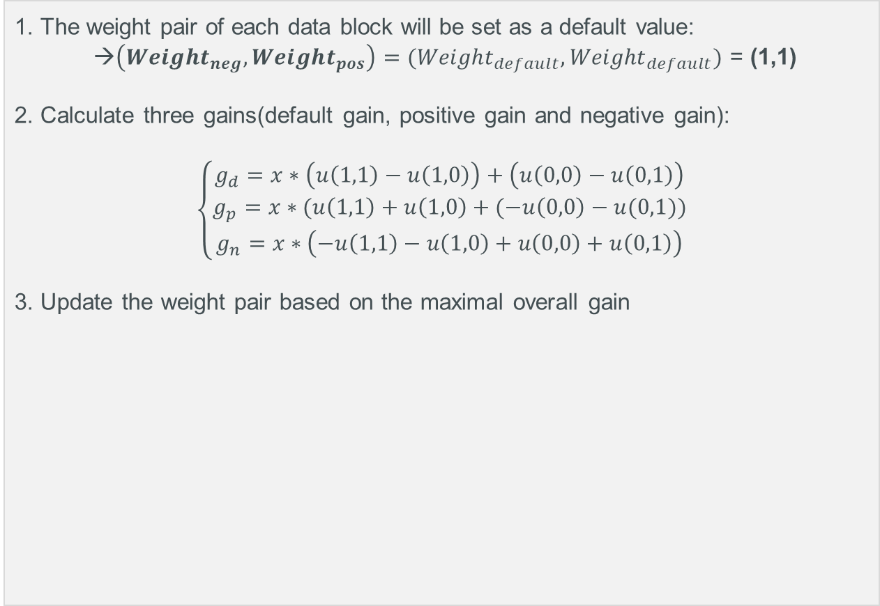
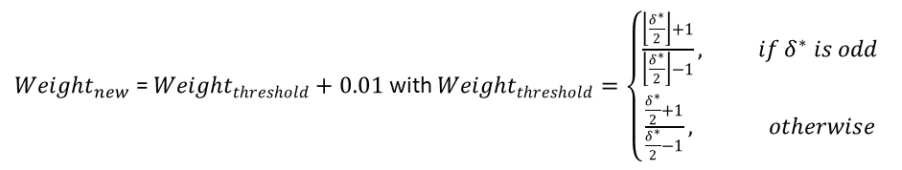
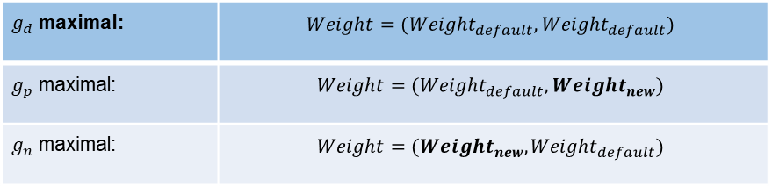
Get the maximal overall gain based on the unstable confusion matrix
Update the corresponding class weight
1. The weight pair of each data block will be set as a default value:
→$\left({Weight}_{neg},{Weight}_{pos}\right)=({Weight}_{default},{Weight}_{default})$ = (1,1)
2. Calculate three gains(default gain, positive gain and negative gain):
$$\left\{\begin{aligned}g_{d}=x∗\left(u\left(1,1\right)−u\left(1,0\right)\right)+\left(u\left(0,0\right)−u\left(0,1\right)\right) \\ g_{p}=x∗(u\left(1,1\right)+u\left(1,0\right)+(−u\left(0,0\right)−u(0,1)) \\ g_{n}=x∗\left(−u\left(1,1\right)−u\left(1,0\right)+u\left(0,0\right)+u\left(0,1\right)\right)\end{aligned}\right.$$
3. Update the weight pair based on the maximal overall gain
Cost ratio
Adaptive Weight Adjustment(AWA)
Find an appropriate overall class-weight generated basically on the data coming from each data block
$g_{d}$ maximal: | $$Weight=({Weight}_{default},{Weight}_{default})$$
$g_{p}$ maximal: | $$Weight=({Weight}_{default},{Weight}_{new})$$
$g_{n}$ maximal: | $$Weight=({Weight}_{new},{Weight}_{default})$$
${Weight}_{new}$ = ${Weight}_{threshold}+0.01$ with ${Weight}_{threshold}=\left\{\begin{aligned}\frac{\left\lfloor \frac{δ^{∗}}{2}\right\rfloor +1}{\left\lfloor \frac{δ^{∗}}{2}\right\rfloor −1}, if δ^{∗} is odd \\ \frac{\frac{δ^{∗}}{2}+1}{\frac{δ^{∗}}{2}−1}, otherwise\end{aligned}\right.$
J. Yin, C. Gan, K. Zhao, X. Lin, Z. Quan, and Z.-J. Wang, “A novel model for imbalanced data classification,” in Proceedings of the AAAI Conference on Artificial Intelligence, vol. 34, no. 04, 2020, pp. 6680–6687.

Slide 30
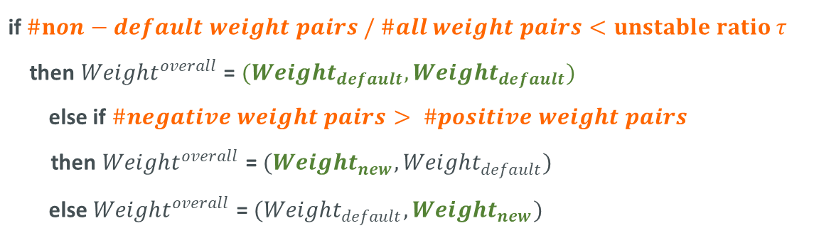
DDAE
Determination of the Overall Weight Pair [1]
Calculate the number of default weight pair, positive weight pair and negative weight pair
Adaptive Weight Adjustment(AWA) [1]
Find an appropriate overall class-weight generated basically on the data coming from each data block
if $\#non−default weight pairs / \#all weight pairs<unstable ratio τ$
then ${Weight}^{overall}$ = $({Weight}_{default},{Weight}_{default})$
else if $\#negative weight pairs> \#positive weight pairs$
then ${Weight}^{overall}$ = $({Weight}_{new},{Weight}_{default})$
else ${Weight}^{overall}$ = $({Weight}_{default},{Weight}_{new})$
[1] J. Yin, C. Gan, K. Zhao, X. Lin, Z. Quan, and Z.-J. Wang, “A novel model for imbalanced data classification,” in Proceedings of the AAAI Conference on Artificial Intelligence, vol. 34, no. 04, 2020, pp. 6680–6687.

Slide 31



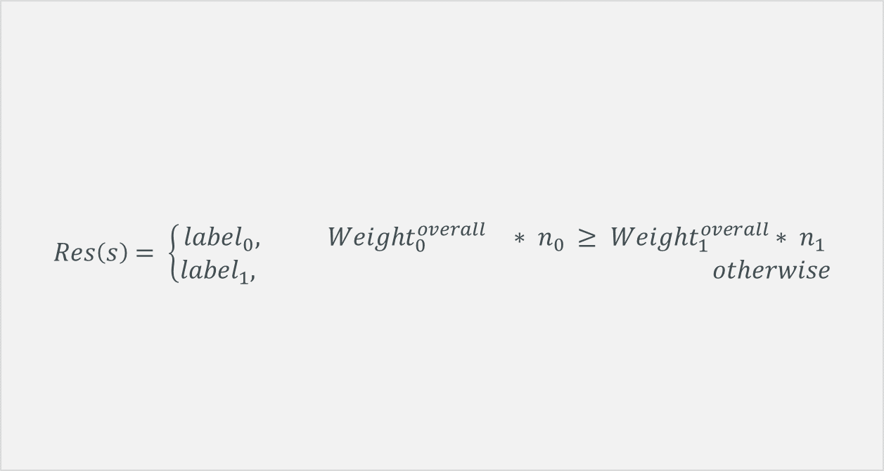
DDAE
Final Classification for sample $s$ [1]
$$Res\left(s\right)= \left\{\begin{aligned}{label}_{0}, { Weight}_{0}^{overall}∗ n_{0} ≥ {Weight}_{1}^{overall}∗ n_{1} \\ {label}_{1}, otherwise\end{aligned}\right.$$
Ensemble Learning(EL) [1]
Term ${( n}_{1}{ , n}_{0} )$
Apply weighted major voting to make the decision
$n_{1}$ base classifiers has
predicted $s$ as positive(1)
${ n}_{0}$ base classifiers has
predicted $s$ as negative(0)
Overall weight for negative class
Overall weight for positive class
[1] J. Yin, C. Gan, K. Zhao, X. Lin, Z. Quan, and Z.-J. Wang, “A novel model for imbalanced data classification,” in Proceedings of the AAAI Conference on Artificial Intelligence, vol. 34, no. 04, 2020, pp. 6680–6687.

Slide 32
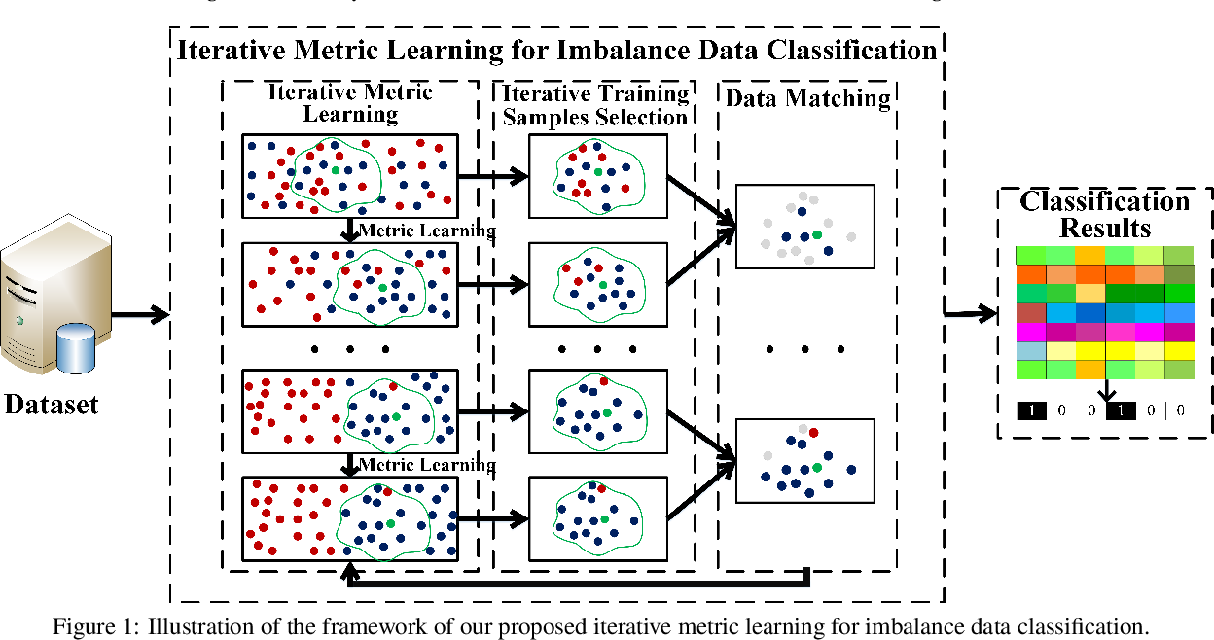
Iterative Metric Learning(IML)
The data used for the metric learning are based on the previous iteration
Source: [1, Figure1]
[1] N. Wang, X. Zhao, Y. Jiang, Y. Gao, and K. BNRist, “Iterative metric learning for imbalance data classification.” in IJCAI, 2018, pp. 2805–2811.

Slide 33
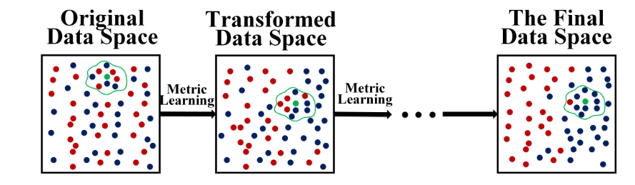
Iterative Metric Learning(IML)
Iterative Metric Learning [1]
Apply LMNN iteratively to improve the data space
Source: [1, Figure 2]
[1] N. Wang, X. Zhao, Y. Jiang, Y. Gao, and K. BNRist, “Iterative metric learning for imbalance data classification.” in IJCAI, 2018, pp. 2805–2811.

Slide 34
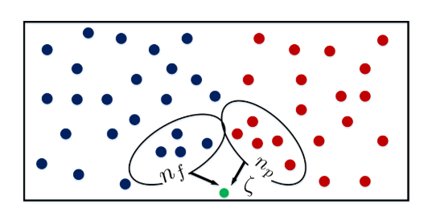
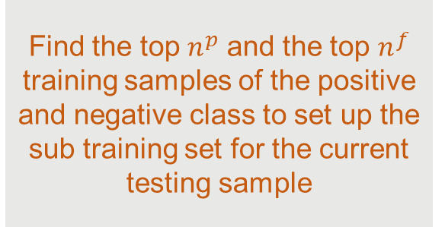
Iterative Metric Learning(IML)
Iterative Training Sample Selection [1]
Find the top $n^{p}$ and the top $n^{f}$ training samples of the positive and negative class to set up the sub training set for the current testing sample
Source: [1, Figure 3]
[1] N. Wang, X. Zhao, Y. Jiang, Y. Gao, and K. BNRist, “Iterative metric learning for imbalance data classification.” in IJCAI, 2018, pp. 2805–2811.

Slide 35
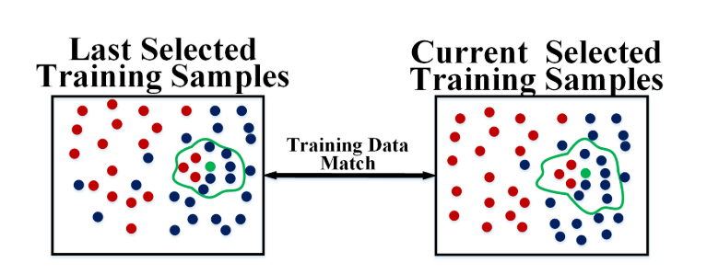
Iterative Metric Learning(IML)
Determined through the ratio of training data matching
If the selected training data in two adjacent iterations are similar, then the iteration will be stopped and the current selected samples will be used for classification [1].
Otherwise, the above two steps should be repeated until the most appropriate training samples are found [1].
Data Matching [1]
Find a relatively stable neighborhood for the current testing sample
Source: [1, Figure 4]
[1] N. Wang, X. Zhao, Y. Jiang, Y. Gao, and K. BNRist, “Iterative metric learning for imbalance data classification.” in IJCAI, 2018, pp. 2805–2811.

Slide 36
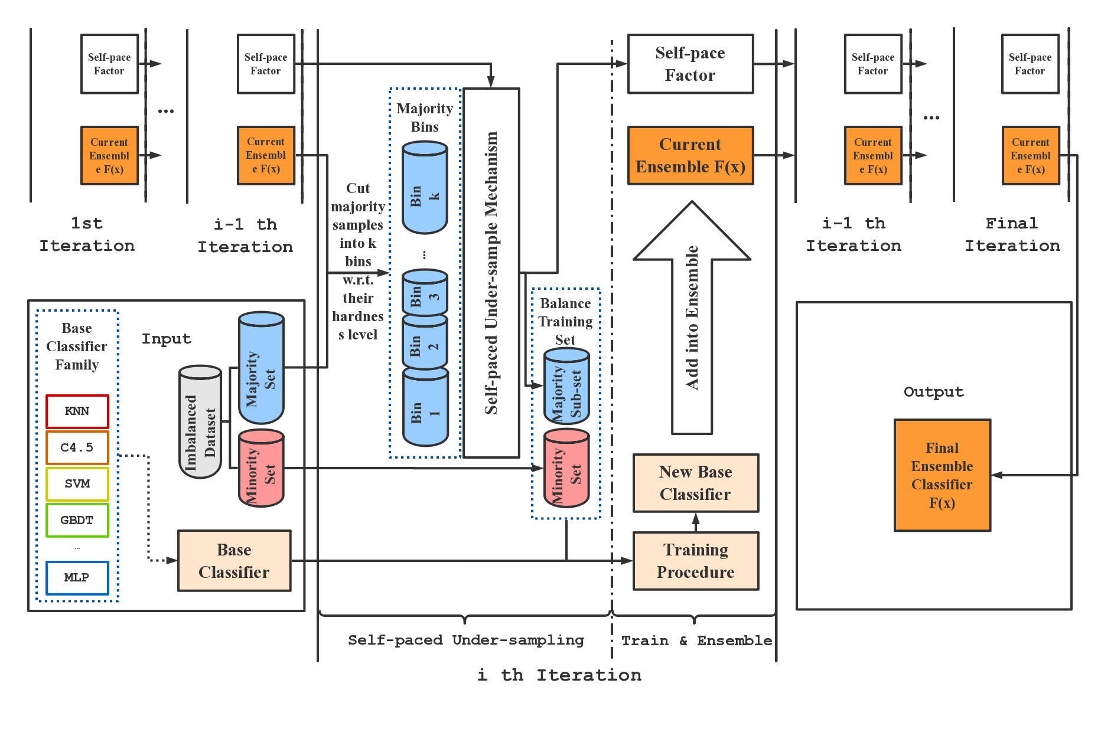
Self-paced Ensemble Classifier(SPE)
Source: [1, Fig. 1]
[1] Liu, Z., Cao, W., Gao, Z., Bian, J., Chen, H., Chang, Y., & Liu, T. Y. (2020, April). Self-paced ensemble for highly imbalanced massive data classification. In 2020 IEEE 36th International Conference on Data Engineering (ICDE) (pp. 841-852). IEEE.

Slide 37
Experiments and Results
Research on the impact factors
Research on the effectiveness of the algorithm
Overall Comparison

Slide 38
Data as Input
Dataset | #Class | #Instances | #F | IR
Euthyroid Sick | 2 | 3,163 | 42 | 9.795
Thyroid Sick | 2 | 3,772 | 52 | 15.329
PH1 | 2 | 11,274 | 74 | 7.699
PH2 | 2 | 31,296 | 74 | 23.148
OPDD | 2 | 5,620 | 65 | 9.144
MGC | 2 | 11,183 | 6 | 42.012
Cm1 | 2 | 497 | 21 | 9.354
Mw1 | 2 | 403 | 37 | 12
Pc1 | 2 | 1109 | 21 | 13.4
Pc3 | 2 | 1563 | 37 | 8.769
Pc4 | 2 | 1458 | 37 | 7.191
Yeast1vs7 | 2 | 459 | 7 | 14.3
Poker89vs6 | 2 | 1485 | 10 | 58.4
Poker8vs6 | 2 | 1477 | 10 | 85.882
WDBC | 2 | 768 | 8 | 1.866
PID | 2 | 568 | 32 | 1.684
UCI Repository [1]
KEEL [2]
OpenML [3]
[1] Dua, D. and Graff, C. (2019). UCI Machine Learning Repository [http://archive.ics.uci.edu/ml]. Irvine, CA: University of California, School of Information and Computer Science.
[2] J. Alcalá-Fdez, A. Fernandez, J. Luengo, J. Derrac, S. García, L. Sánchez, F. Herrera. KEEL Data-Mining Software Tool: Data Set Repository, Integration of Algorithms and Experimental Analysis Framework. Journal of Multiple-Valued Logic and Soft Computing 17:2-3 (2011) 255-287.
[3] Joaquin Vanschoren, Jan N. van Rijn, Bernd Bischl, and Luis Torgo. OpenML: networked science in machine learning. SIGKDD Explorations 15(2), pp 49-60, 2013.

Slide 39
Data-Preprocessing
Make data more acceptable as input for models since most of the models prefer to process numerical data
Data
Cleaning [1]
Feature
Encoding [2]
Data
Normalization [3]
Handling missing value, wrong data and same data with non-standard representation
Handling the variations in the scales of different data features and that in the differences between the values
[1] García, S., Luengo, J., & Herrera, F. (2015). Data preprocessing in data mining.
[2] Géron, A. (2019). Hands-on machine learning with Scikit-Learn, Keras, and TensorFlow: Concepts, tools, and techniques to build intelligent systems. O'Reilly Media.
[3] Yang, H. (2018). Data preprocessing.

Slide 40
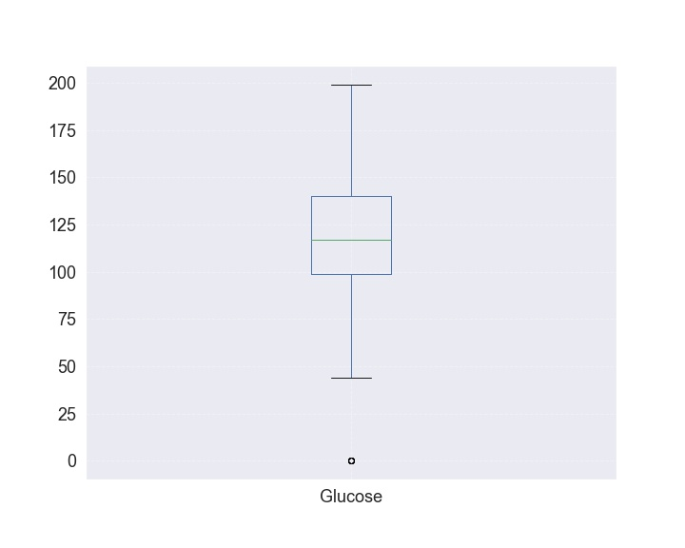
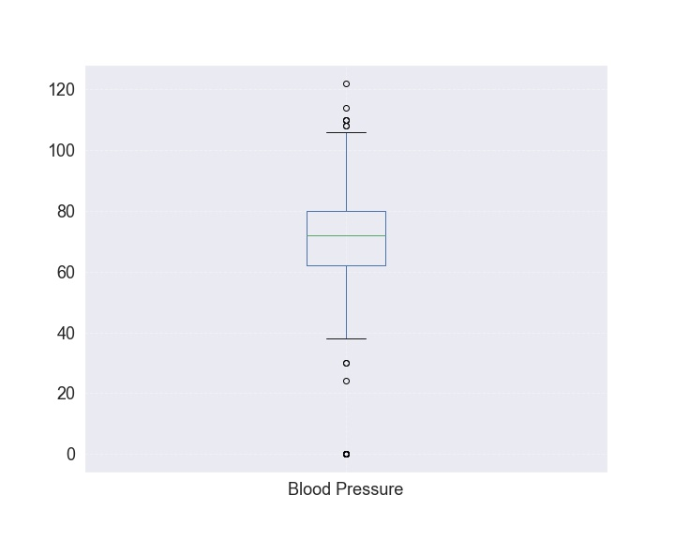
Data-Preprocessing
Data
Cleaning
Can be replaced with the median of this attribute
Can be converted into dummy variable:
IS_SEX_MALE, IS_SEX_FEMALE, IS_SEX_NA for M, F and ?, respectively
Outliers: Delete this sample or replace this value with the median of this attribute or deleted directly

Slide 41
Data-Preprocessing
Categories Type
Raw Number | Referral Source |  | RSource1 | RSource2 | RSource3 | RSource4
1 | SVI | → | 1 | 0 | 0 | 0
2 | STMW |  | 0 | 0 | 1 | 0
3 | SVHD |  | 0 | 0 | 0 | 1
4 | SVHC |  | 0 | 1 | 0 | 0
5 | other |  | 0 | 0 | 0 | 0
Feature
Encoding
Yang, H. (2018). Data preprocessing.

Slide 42
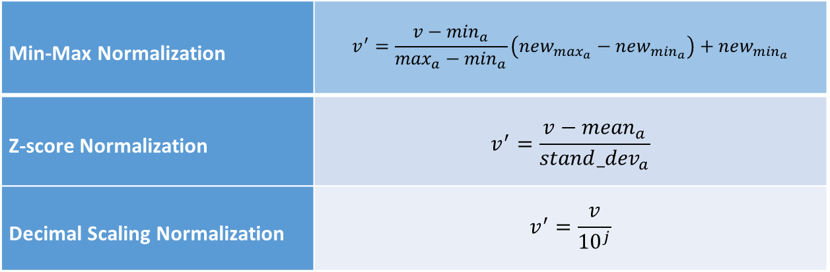
Data-Preprocessing
Min-Max Normalization | $$v^{′}=\frac{v−\min_{a}}{\max_{a}−\min_{a}}\left(new_{\max_{a}}−new_{\min_{a}}\right)+new_{\min_{a}}$$
Z-score Normalization | $$v^{′}=\frac{v−{mean}_{a}}{stand_{dev}_{a}}$$
Decimal Scaling Normalization | $$v^{′}=\frac{v}{{10}^{j}}$$
Data
Normalization
Source: [1, 2, 3]
For example:
the attribute ‘area_mean’ ranges from 143.5 to 2,501 and
the attribute ‘smoothness_mean’ only ranges from 0.053 to 0.163
[1] García, S., Luengo, J., & Herrera, F. (2015). Data preprocessing in data mining.
[2] Géron, A. (2019). Hands-on machine learning with Scikit-Learn, Keras, and TensorFlow: Concepts, tools, and techniques to build intelligent systems. O'Reilly Media.
[3] Yang, H. (2018). Data preprocessing.

Slide 43
Experiments
01
02
02
03
Overall Comparison
Impact of Imbalance Ratio
Impact of the Size of Dataset
Effectiveness of DDAE
15 datasets are used for the comparison
Investigate the impact of the imbalance ratio on the performance of these models
Investigate the impact of the size of datasets on the performance of these models
Effectiveness of components and the parameters tuning process

Slide 44
Overall Comparison
Dataset | Recall
 | DDAE | MWMOTE | SMOTE | RUSBoost | AdaBoost | MetaCost | csDCT | CAdaMEC | SPE | IML
Euthyroid Sick | 0.929 | 0.737 | 0.725 | 0.888 | 0.898 | 0.898 | 0.867 | 0.776 | 0.847 | 0.763
Thyroid Sick | 0.833 | 0.558 | 0.494 | 0.844 | 0.779 | 0.169 | 0.805 | 0.701 | 0.844 | 0.383
PH1 | 0.956 | 0.926 | 0.913 | 0.900 | 0.887 | 0.741 | 0.867 | 0.877 | 0.887 | 0.831
PH2 | 0.990 | 0.946 | 0.939 | 0.992 | 0.990 | 0.787 | 1 | 0.990 | 0.997 | 0.931
OPDD | 0.994 | 0.977 | 0.971 | 0.953 | 0.929 | 0.759 | 0.847 | 0.947 | 0.935 | 0.965
MGC | 0.834 | 0.651 | 0.675 | 0.506 | 0.675 | 0.675 | 0.663 | 0.410 | 0.795 | 0.169
WDBC | 0.894 | 0.950 | 0.960 | 0.865 | 0.894 | 0.818 | 0.909 | 0.833 | 0.864 | 0.864
PID | 0.810 | 0.824 | 0.869 | 0.512 | 0.548 | 0.774 | 0.690 | 0.631 | 0.524 | 0.524
Yeast1vs7 | 0.750 | 0.750 | 0.750 | 0.375 | 0.250 | 0.125 | 0 | 0.750 | 0.750 | 0.375

Slide 45
Overall Comparison
Dataset | Euthyroid Sick(IR=9) | Euthyroid Sick(IR=9)
 | Recall | G-mean | F1 | AUCPRC
DDAE | 0.929 | 0.880 | 0.552 | 0.587
MWMOTE | 0.737 | 0.832 | 0.658 | 0.616
SMOTE | 0.725 | 0.829 | 0.667 | 0.621
RUSBoost | 0.888 | 0.911 | 0.725 | 0.779
AdaBoost | 0.827 | 0.904 | 0.862 | 0.901
MetaCost | 0.898 | 0.935 | 0.846 | 0.723
csDCT | 0.867 | 0.960 | 0.846 | 0.723
CAdaMEC | 0.776 | 0.876 | 0.831 | 0.865
SPE | 0.847 | 0.971 | 0.856 | 0.861
IML | 0.763 | 0.867 | 0.809 | 0.836
Average | 0.826 | 0.897 | 0.765 | 0.751
Dataset | Thyroid Sick(IR=15) | Euthyroid Sick(IR=9)
 | Recall | G-mean | F1 | AUCPRC
DDAE | 0.883 | 0.883 | 0.506 | 0.622
MWMOTE | 0.558 | 0.735 | 0.558 | 0.342
SMOTE | 0.494 | 0.694 | 0.535 | 0.323
RUSBoost | 0.844 | 0.908 | 0.783 | 0.805
AdaBoost | 0.779 | 0.879 | 0.828 | 0.882
MetaCost | 0.169 | 0.413 | 0.280 | 0.342
csDCT | 0.805 | 0.891 | 0.811 | 0.700
CAdaMEC | 0.701 | 0.835 | 0.794 | 0.901
SPE | 0.844 | 0.915 | 0.861 | 0.893
IML | 0.383 | 0.615 | 0.474 | 0.335
Average | 0.646 | 0.777 | 0.643 | 0.615

Slide 46
Impact of the Imbalance Ratio

Slide 47
Impact of the Size of Dataset

Slide 48
Effectiveness of the components in DDAE
DDAE-DBC
DDAE-DSI
DDAE-AWA
Variants

Slide 49
Impact of parameters on DDAE
Parameters
# data blocks
Parameters
relative weight between push and pull term

Slide 50
Impact of parameters on DDAE
Parameters
unstable ratio
Parameters
cost ratio

Slide 51
Conclusion

Slide 52
Conclusion
Others
Cost-sensitive
Learning
Models utilized distance metric learning are based on the data distribution in the feature space. If the dataset is small but highly imbalance, the performance can also be unsatisfactory.
Hard to set an appropriate cost matrix for each dataset, which may lead to the fluctuations of models’ performance.
Sampling Methods
Ensemble
Learning
Under-sampling may discards most of the majority samples when the IR is high, causing information loss.
Oversampling generates huge amount of data when the amount of samples and IR is high, which requires additional computing resources. This methods may also cause the model overfit to minority.
The performance can be satisfactory most of the time, but it absorbs not only the advantages of used techniques but also the disadvantages.

Slide 53
Conclusion
The selection of the algorithm should come according to the actual situation
Since each algorithm has different characteristics, it is very important to select the appropriate algorithm according to the actual situation.
For instance:
Stocks prediction → pay more attention to the precision of the algorithm
Disease diagnosis/Earthquake prediction → pay more attention to the recall of the algorithm

Slide 54
Shortcomings
Analysis
Data Pre-processing
Implementation of Algorithms
Lack of experience in related fields may lead to insufficient accuracy in the process of analyzing results
Data preprocessing takes the most time in the process of processing data, and different processing methods will also have different effects on the performance of the classifier. Insufficient preprocessing may also lead to deviations in the results of the experiment.
Inadequate understanding of the literature may lead to negligence in the process of implementing the algorithm, leading to deviations in results.

Slide 55
Thanks for Listening
Institute of Computer Science, University of Göttingen
Mengru Ji

