Slide 1
©
Contributors:
Ann Schulte
Brad Nolan
Carrie Dowling
Brian Clark
helps
hikers
hike
higher.
https://tinyurl.com/trailangel

Slide 2

About Trail Angel
In hiking lingo, a “Trail Angel” is someone who helps hikers along the way.
Trail Angel, the app, does the same thing! Our app provides hikers with up-to-date information such as trail conditions and useful information about surrounding tails that are searchable by zip code.
Notes:
Carrie

Slide 3
An Angelic Idea
Brad moved here 4 years ago. Brian, 2 years ago. Carrie, 6 months ago. And, Ann... well, her first day of class was her first day in Colorado. As newcomers, sometimes it is hard to pick the right trail…
Trail Angel was created to provide newbies and newcomers like us with quick information about the various hikes available in our wonderful state.
Notes:
Carrie

Slide 4
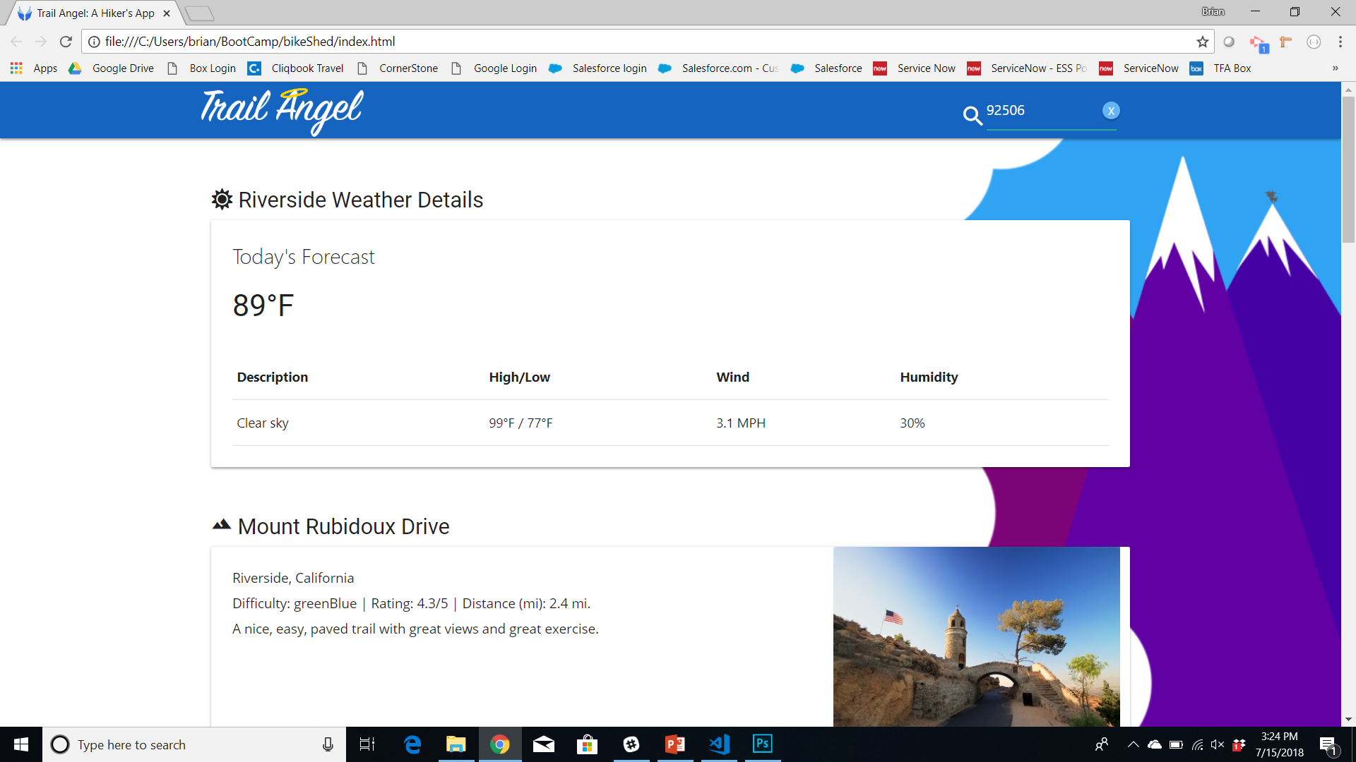
On the Trail
Search by Zip
https://tinyurl.com/trailangel
Notes:
Brian

Slide 5
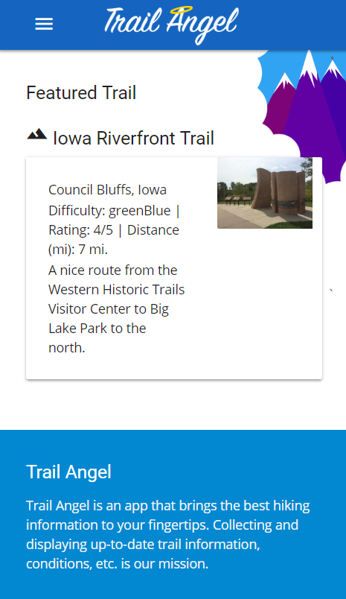
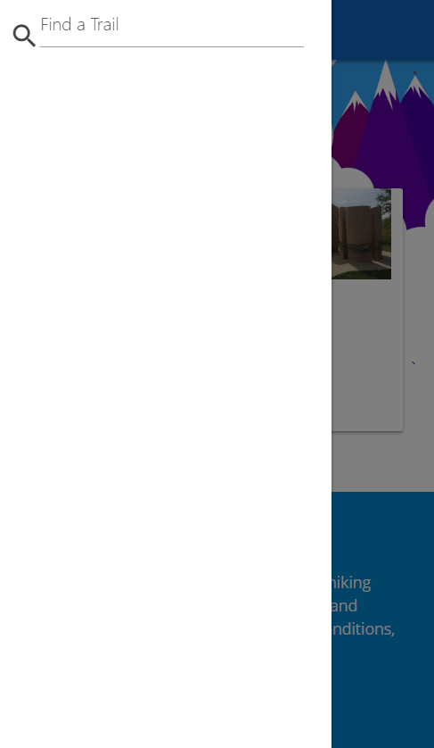
On the Trail: Mobile
https://tinyurl.com/trailangel
Search Tool
Notes:
Brian

Slide 6
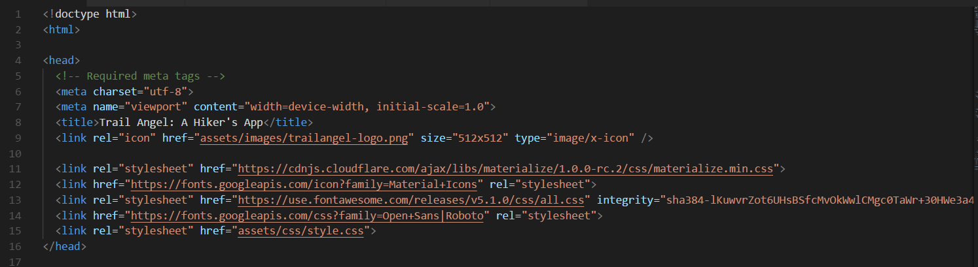
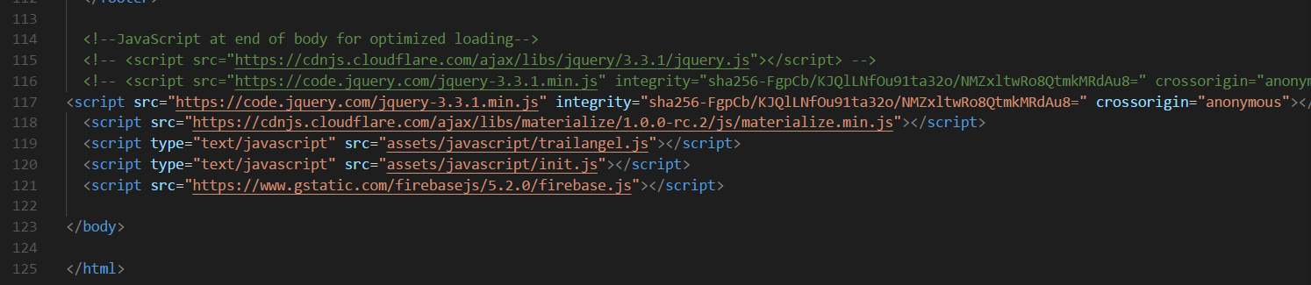
On the Trail: HTML
Materialize
Firebase
Google Fonts
Notes:
Brian

Slide 7
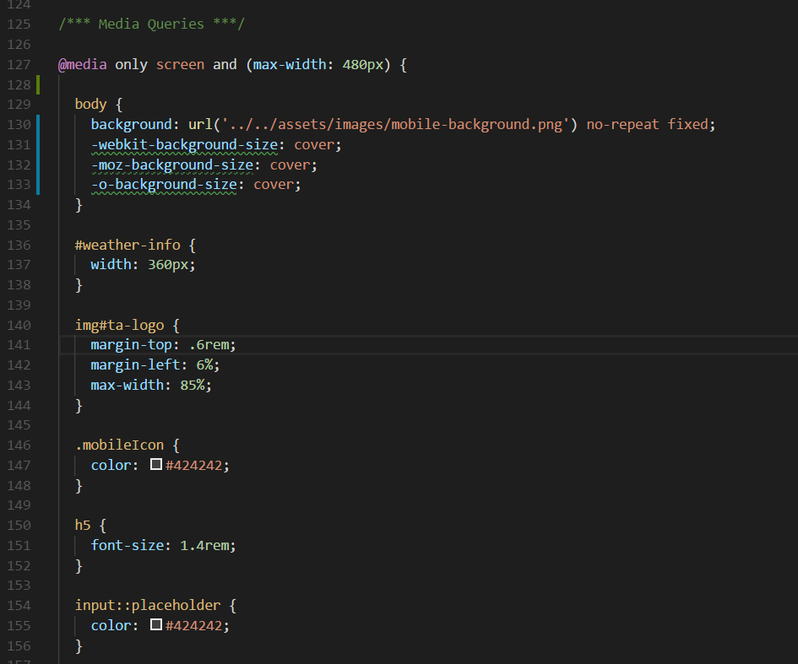
On the Trail: CSS
Notes:
Brian

Slide 8
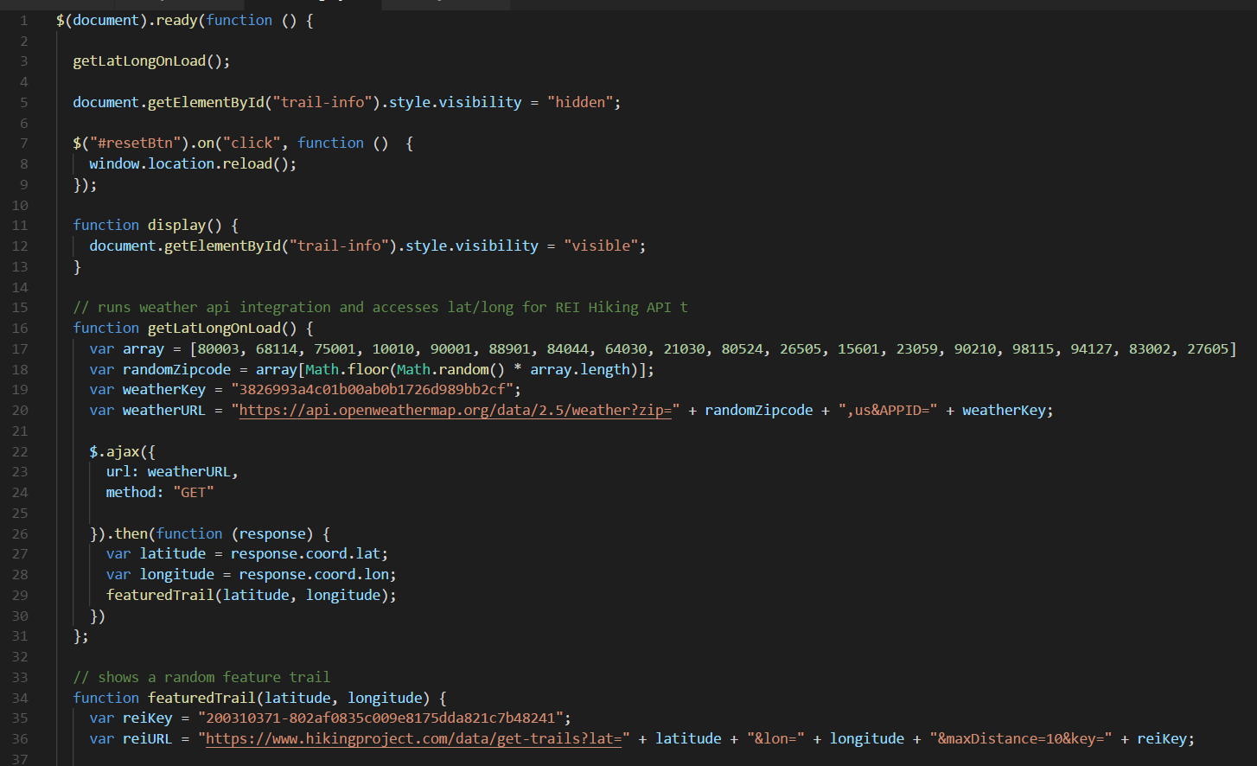
On the Trail: JavaScript
Notes:
Brian

Slide 9
Angelic Efforts
Team Ann & Brad: Worked together to create the functionality of the app by integrating the Hiker Project API through REI as well as the Open Weather Map.
Team Brian & Carrie: The team decided to experiment with Materialize. As the owner of the master branch, Carrie helped to troubleshoot github issues. Brian focused on UI, creating the “look” and brand. Lastly, Carrie and Brian worked together to create the presentation.
Notes:
Ann

Slide 10
Challenges on the Trail
Github merges.
Github merges.
Github merges.
Mobile search functionality.
Displaying dynamically on the DOM.
Notes:
Brad

Slide 11
Future Trails
Directions to trail heads
Ability to upload photos from trails
Ability to add reviews, including tips
Notes:
Brad

Slide 12


Bah?

