Slide 1
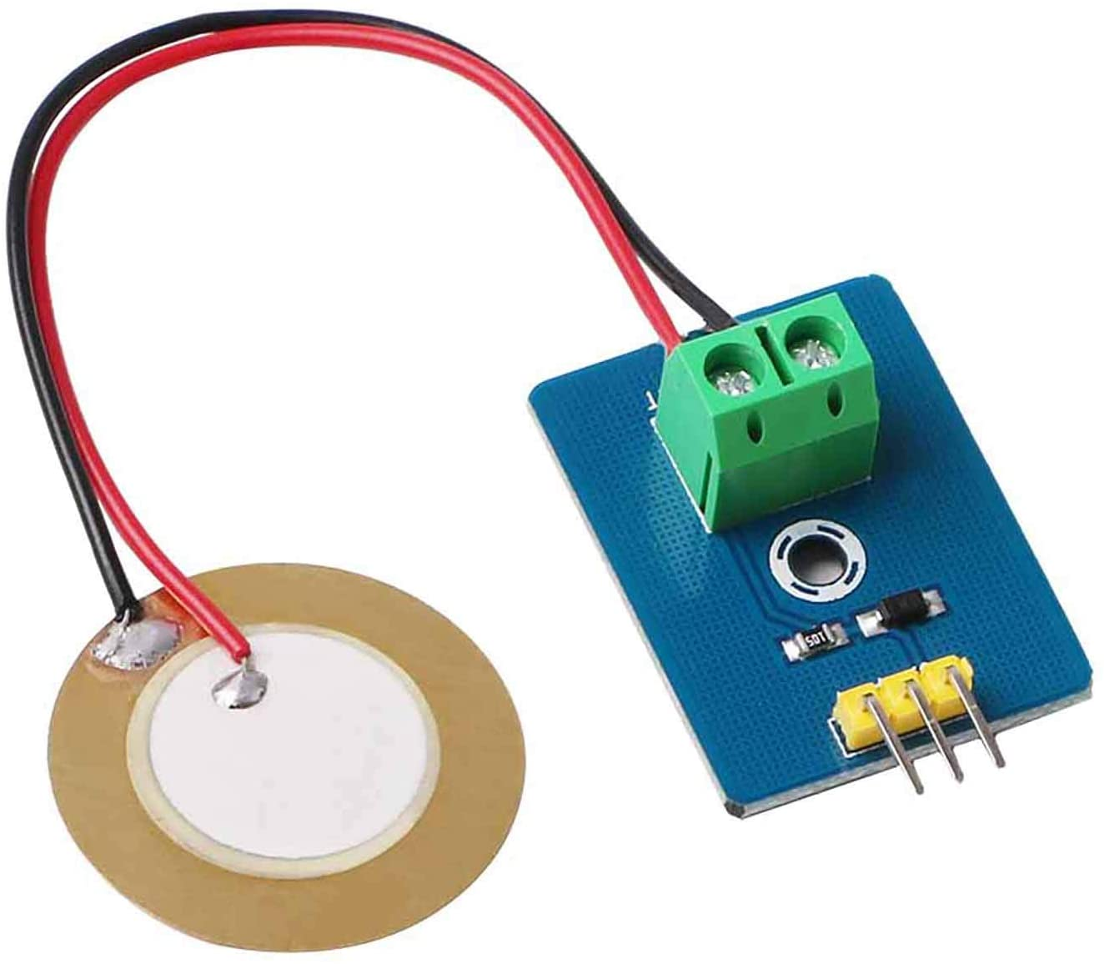
GND
INPUT
S: signal output
Piezoelectric ceramics
+: VCC
-: GND
Electrode
Metal plate
Adhesive

