Slide 2
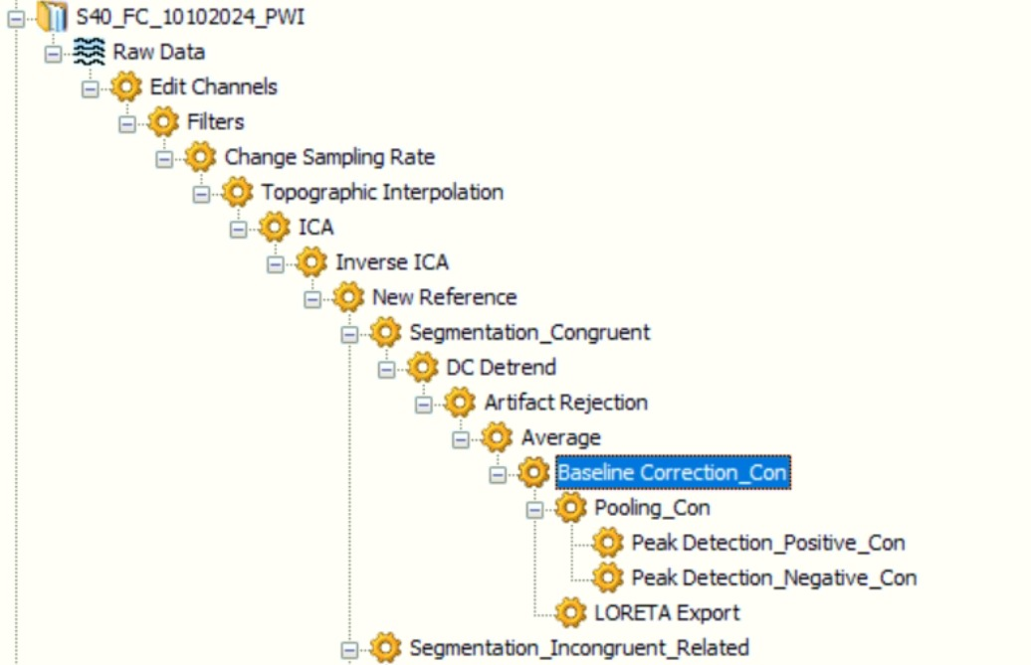
Pipeline
Preprocesamiento
Grand Average
Loreta
Detección de Peak
Ventanas Iguales
Sujeto 1
Sujeto 2
Sujeto 40
Loreta
Estadística
Detección de Peak

Slide 3
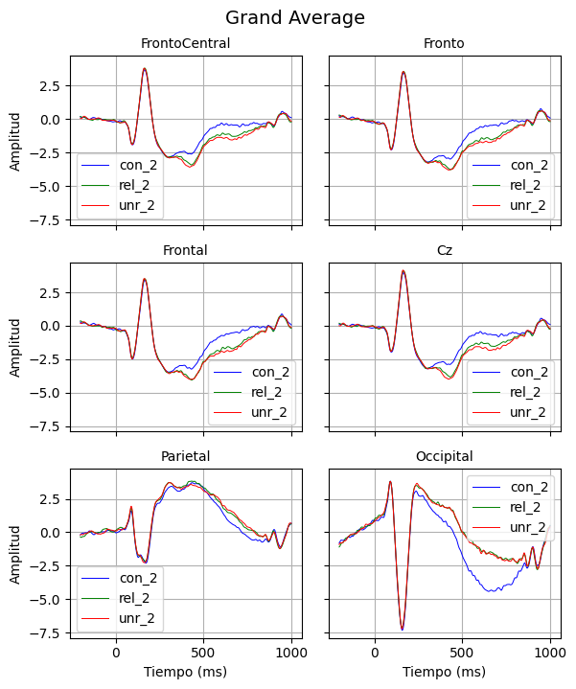
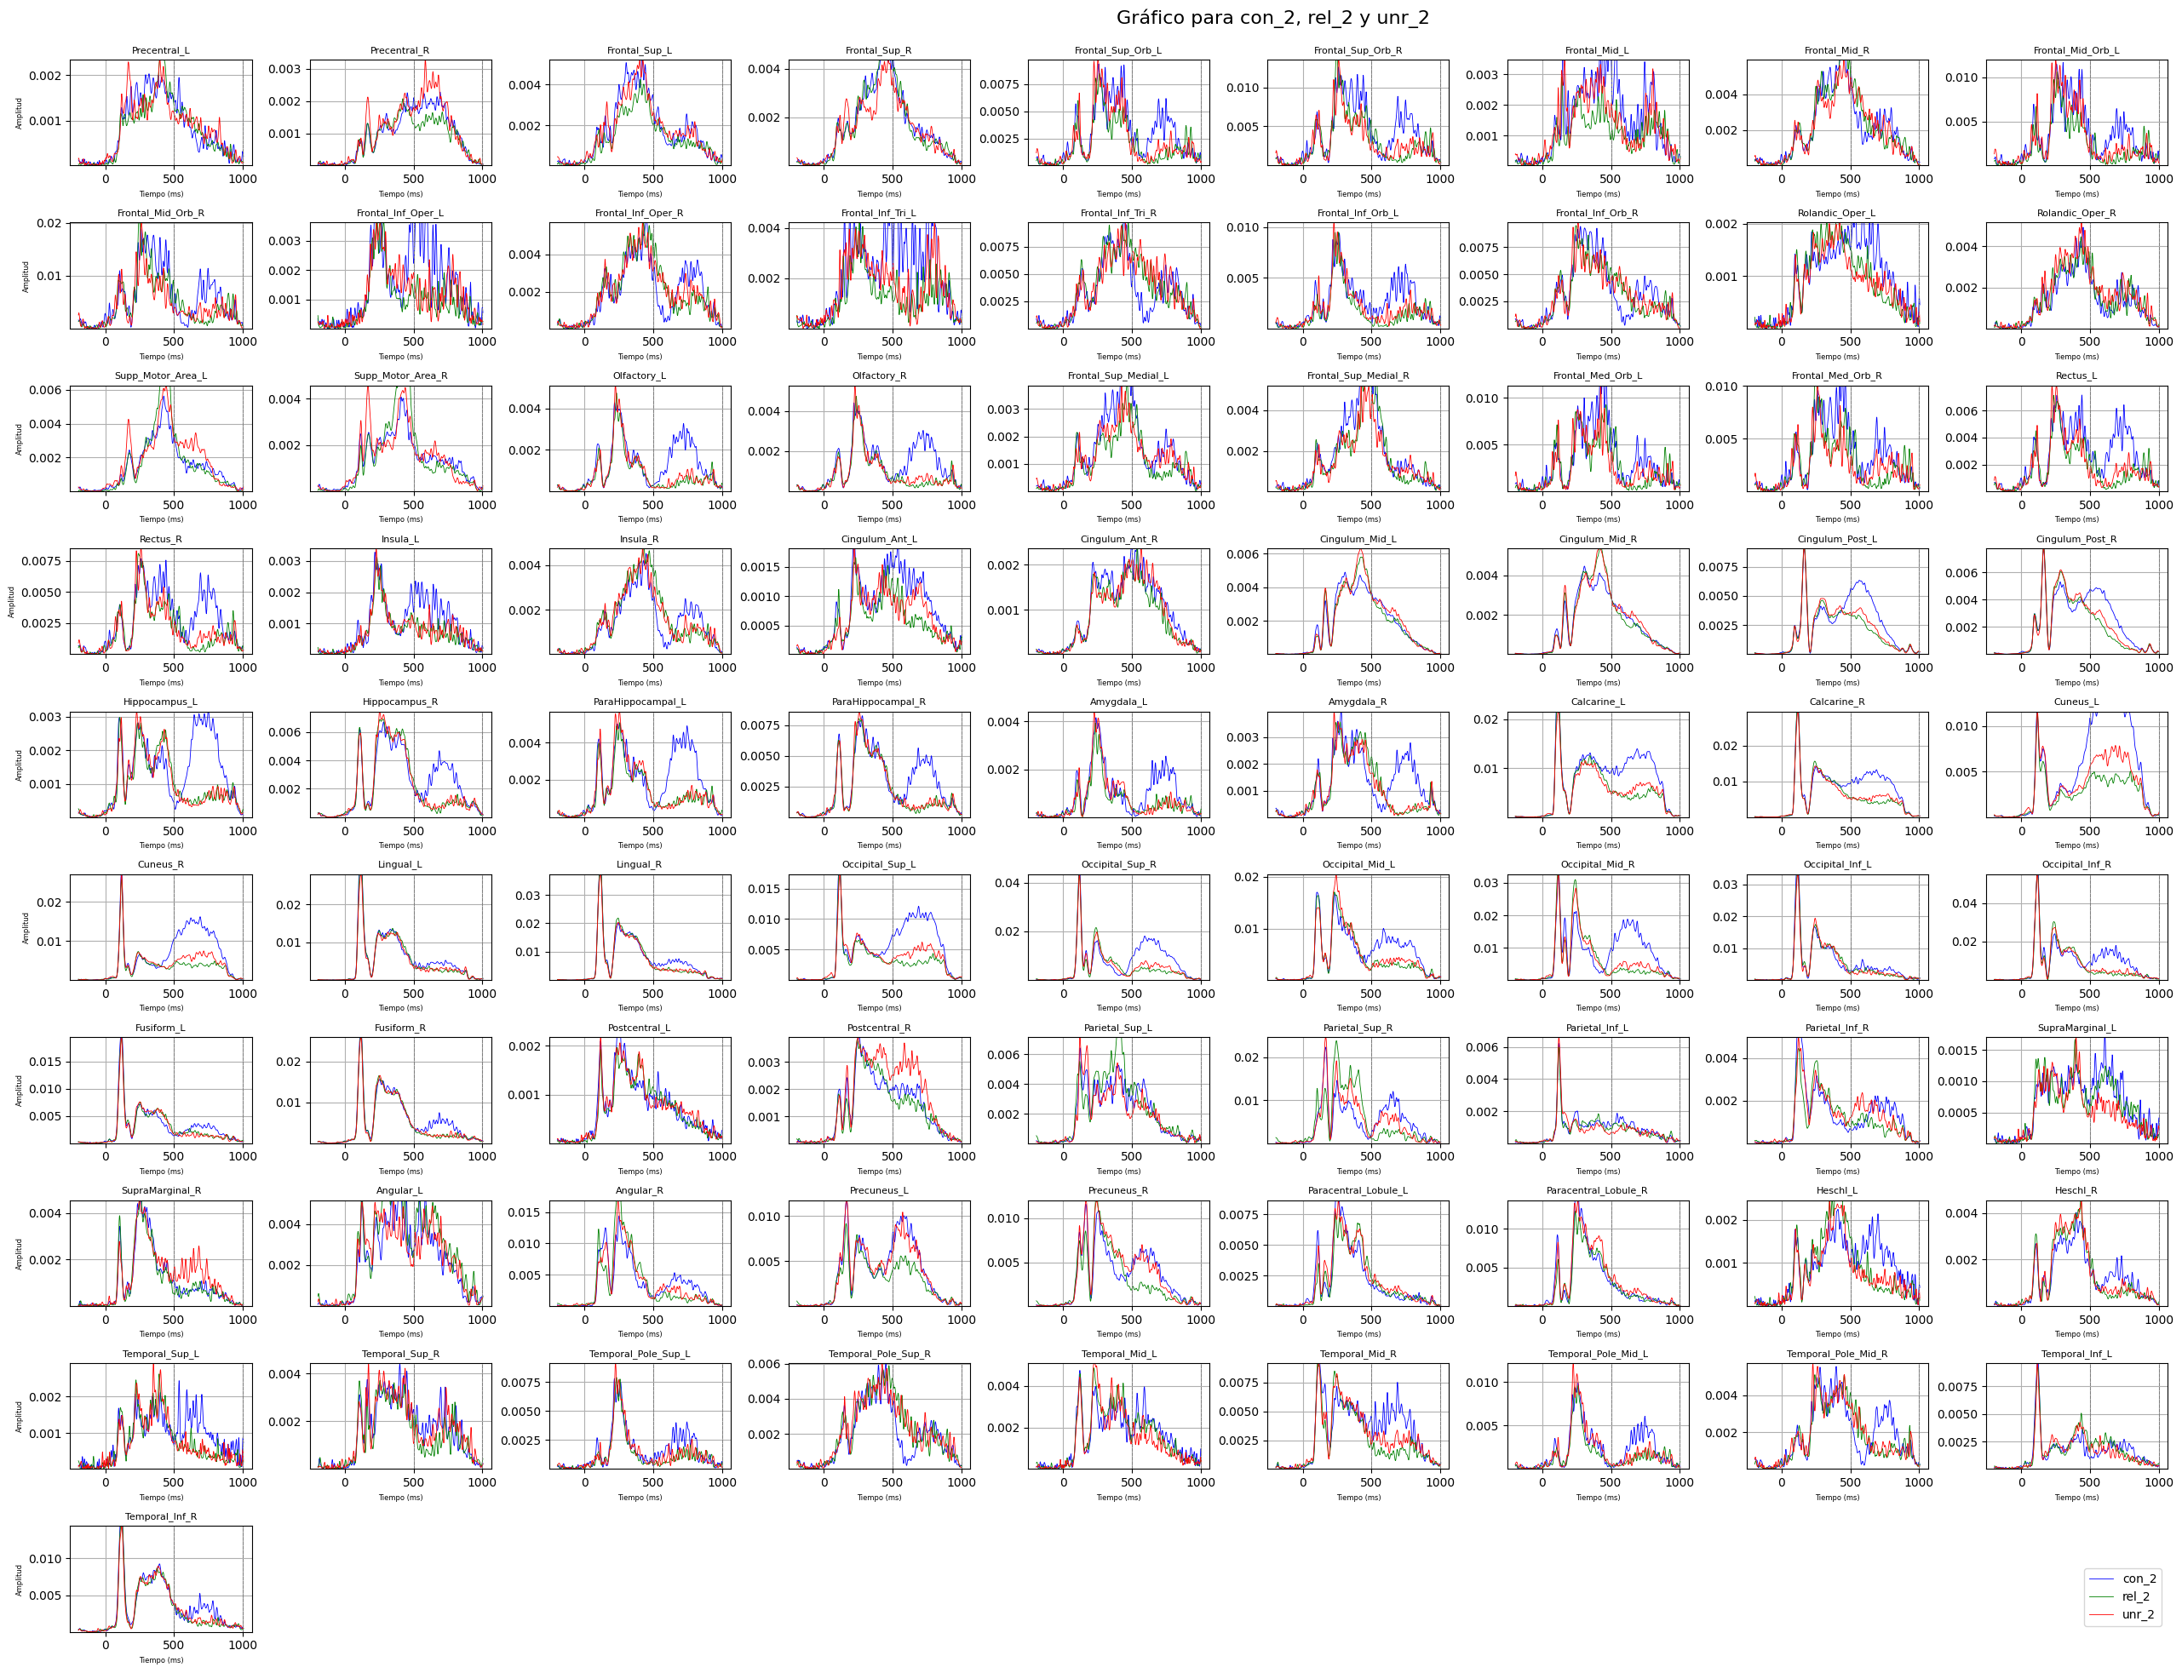
Grand Average

Slide 4
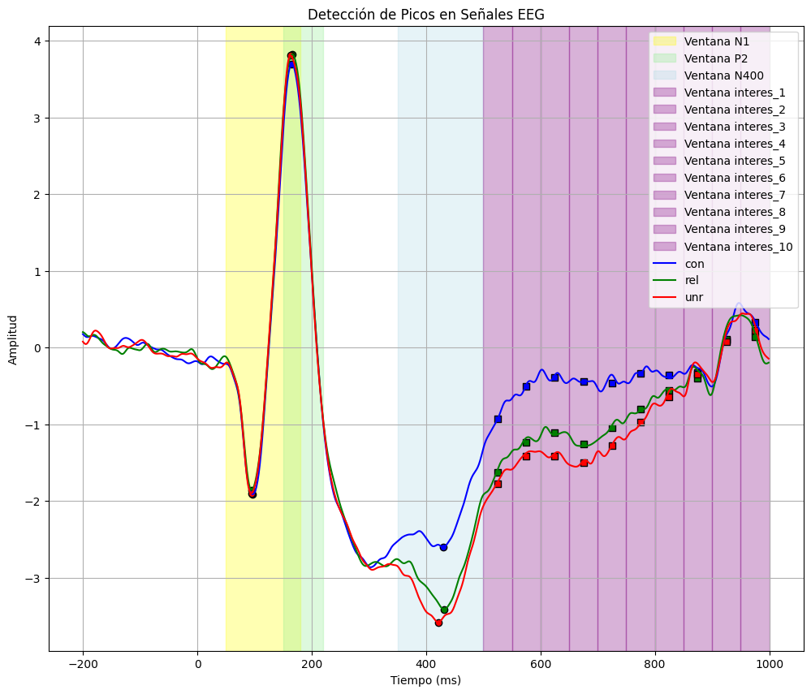
Ventanas constantes
interes_1: Latency = 525.0
interes_2: Latency = 575.0
interes_3: Latency = 625.0
interes_4: Latency = 675.0
interes_5: Latency = 725.0
interes_6: Latency = 775.0
interes_7: Latency = 825.0
interes_8: Latency = 875.0
interes_9: Latency = 925.0
interes_10: Latency = 975.0
interes_4: {'Hippocampus_L': 0.04027526244251308, 'Olfactory_R': 0.04345778800295459, 'Olfactory_L': 0.04693144173151426, 'ParaHippocampal_L': 0.06724542530448216,
interes_5: {'SupraMarginal_L': 0.01658543012138913, 'Hippocampus_L': 0.023658260497128228, 'ParaHippocampal_L': 0.030053113992588743, 'Frontal_Mid_L': 0.030461160164319396, 'Olfactory_L': 0.03366757590976617, 'Fusiform_R': 0.03871700489802664, 'Olfactory_R': 0.03924528727607384, 'Amygdala_L': 0.043280892979361614, 'Temporal_Pole_Mid_L': 0.04765608292058463, 'Fusiform_L': 0.060859589690285244,
interes_6: {'Fusiform_L': 0.0069488355767725095, 'Temporal_Inf_L': 0.010755482258743631, 'Fusiform_R': 0.017837058667695704, 'SupraMarginal_L': 0.022736353589720905, 'Hippocampus_L': 0.024343577213862263, 'Temporal_Mid_L': 0.04690586825866116, 'ParaHippocampal_L': 0.06174687104476645,
interes_7: {'SupraMarginal_L': 0.02057577151570544, 'Fusiform_R': 0.06904942349260576,

Slide 5
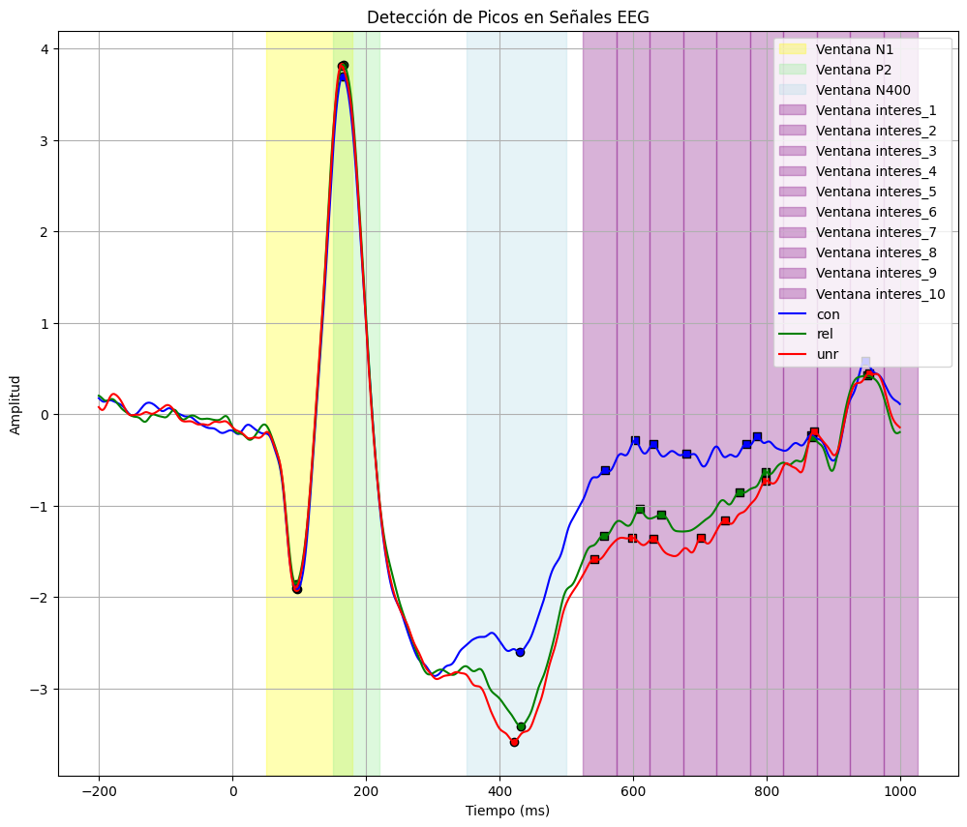
# 10 Ventanas calculo de Peaks positivos
interes_5: {'Fusiform_R': 0.02433073339778264, 'Fusiform_L': 0.061967344995359754, 'Hippocampus_L': 0.06538348755168119,
interes_6: {'Fusiform_L': 0.003156574872470473, 'Temporal_Inf_L': 0.009639686907709206, 'Fusiform_R': 0.01768572415203778, 'Hippocampus_L': 0.02236877043279903, 'ParaHippocampal_L': 0.04131890768403225, 'SupraMarginal_L': 0.04239941656469975, 'Parietal_Inf_L': 0.06113471254360135,

Slide 6
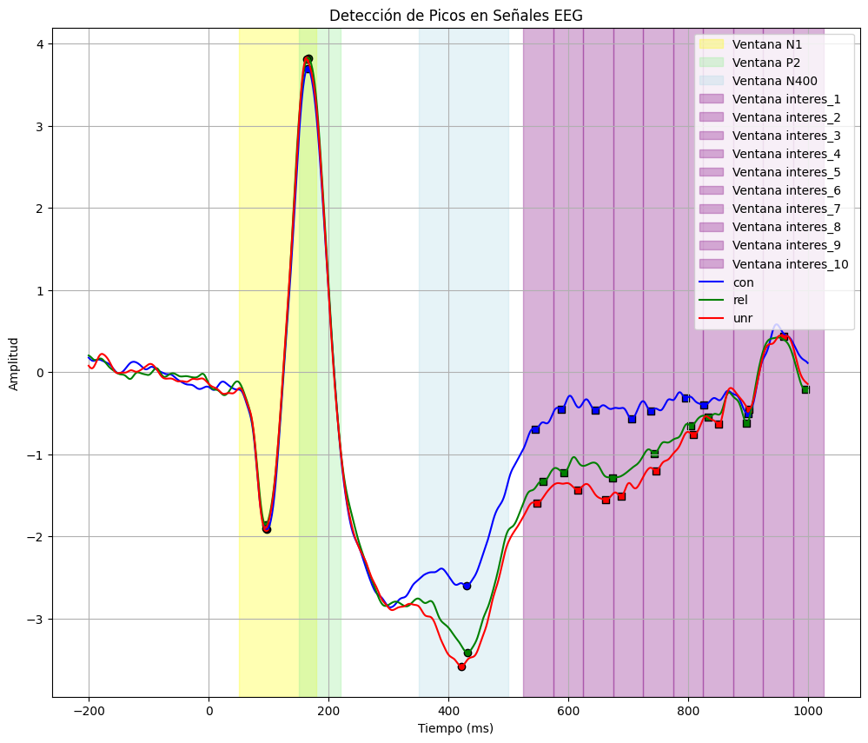
# 10 Ventanas calculo de Peaks negativos
interes_3: {'Olfactory_R': 0.031564396651240584, 'Olfactory_L': 0.03349879068726153, 'Hippocampus_L': 0.03499063816982981, 'ParaHippocampal_L': 0.04324370204034103, 'SupraMarginal_L': 0.059806610232727035
interes_5: {'SupraMarginal_L': 0.007978356570250948, 'Cingulum_Ant_L': 0.0257638887707808, 'Hippocampus_L': 0.026832328245870795, 'Fusiform_R': 0.036090457667492075, 'Temporal_Mid_L': 0.03787440268190103, 'Temporal_Inf_L': 0.03842072955334284, 'Parietal_Inf_L': 0.04001996241854893, 'Fusiform_L': 0.04142563913552604, 'Lingual_R': 0.046761484550955495, 'Postcentral_L': 0.05146947539036205,
interes_6: {'Temporal_Inf_L': 0.008094740925770052, 'Fusiform_L': 0.012963639979168327, 'SupraMarginal_L': 0.014843824513358467, 'Postcentral_L': 0.015493486992830909, 'Hippocampus_L': 0.027659034952759155, 'Precentral_L': 0.0316734658992767, 'Frontal_Inf_Oper_L': 0.03413913018184712, 'Parietal_Inf_L': 0.03913143411805454, 'Frontal_Mid_L': 0.04668881400204799, 'Fusiform_R': 0.055460033704155524,
interes_7: {'SupraMarginal_L': 0.004847272592272913, 'Fusiform_R': 0.019572821424036702, 'Cingulum_Ant_R': 0.02049285498300498, 'Parietal_Inf_R': 0.028279023442036012, 'Postcentral_L': 0.035472452709566664, 'Rolandic_Oper_L': 0.05251073329094274,

Slide 7
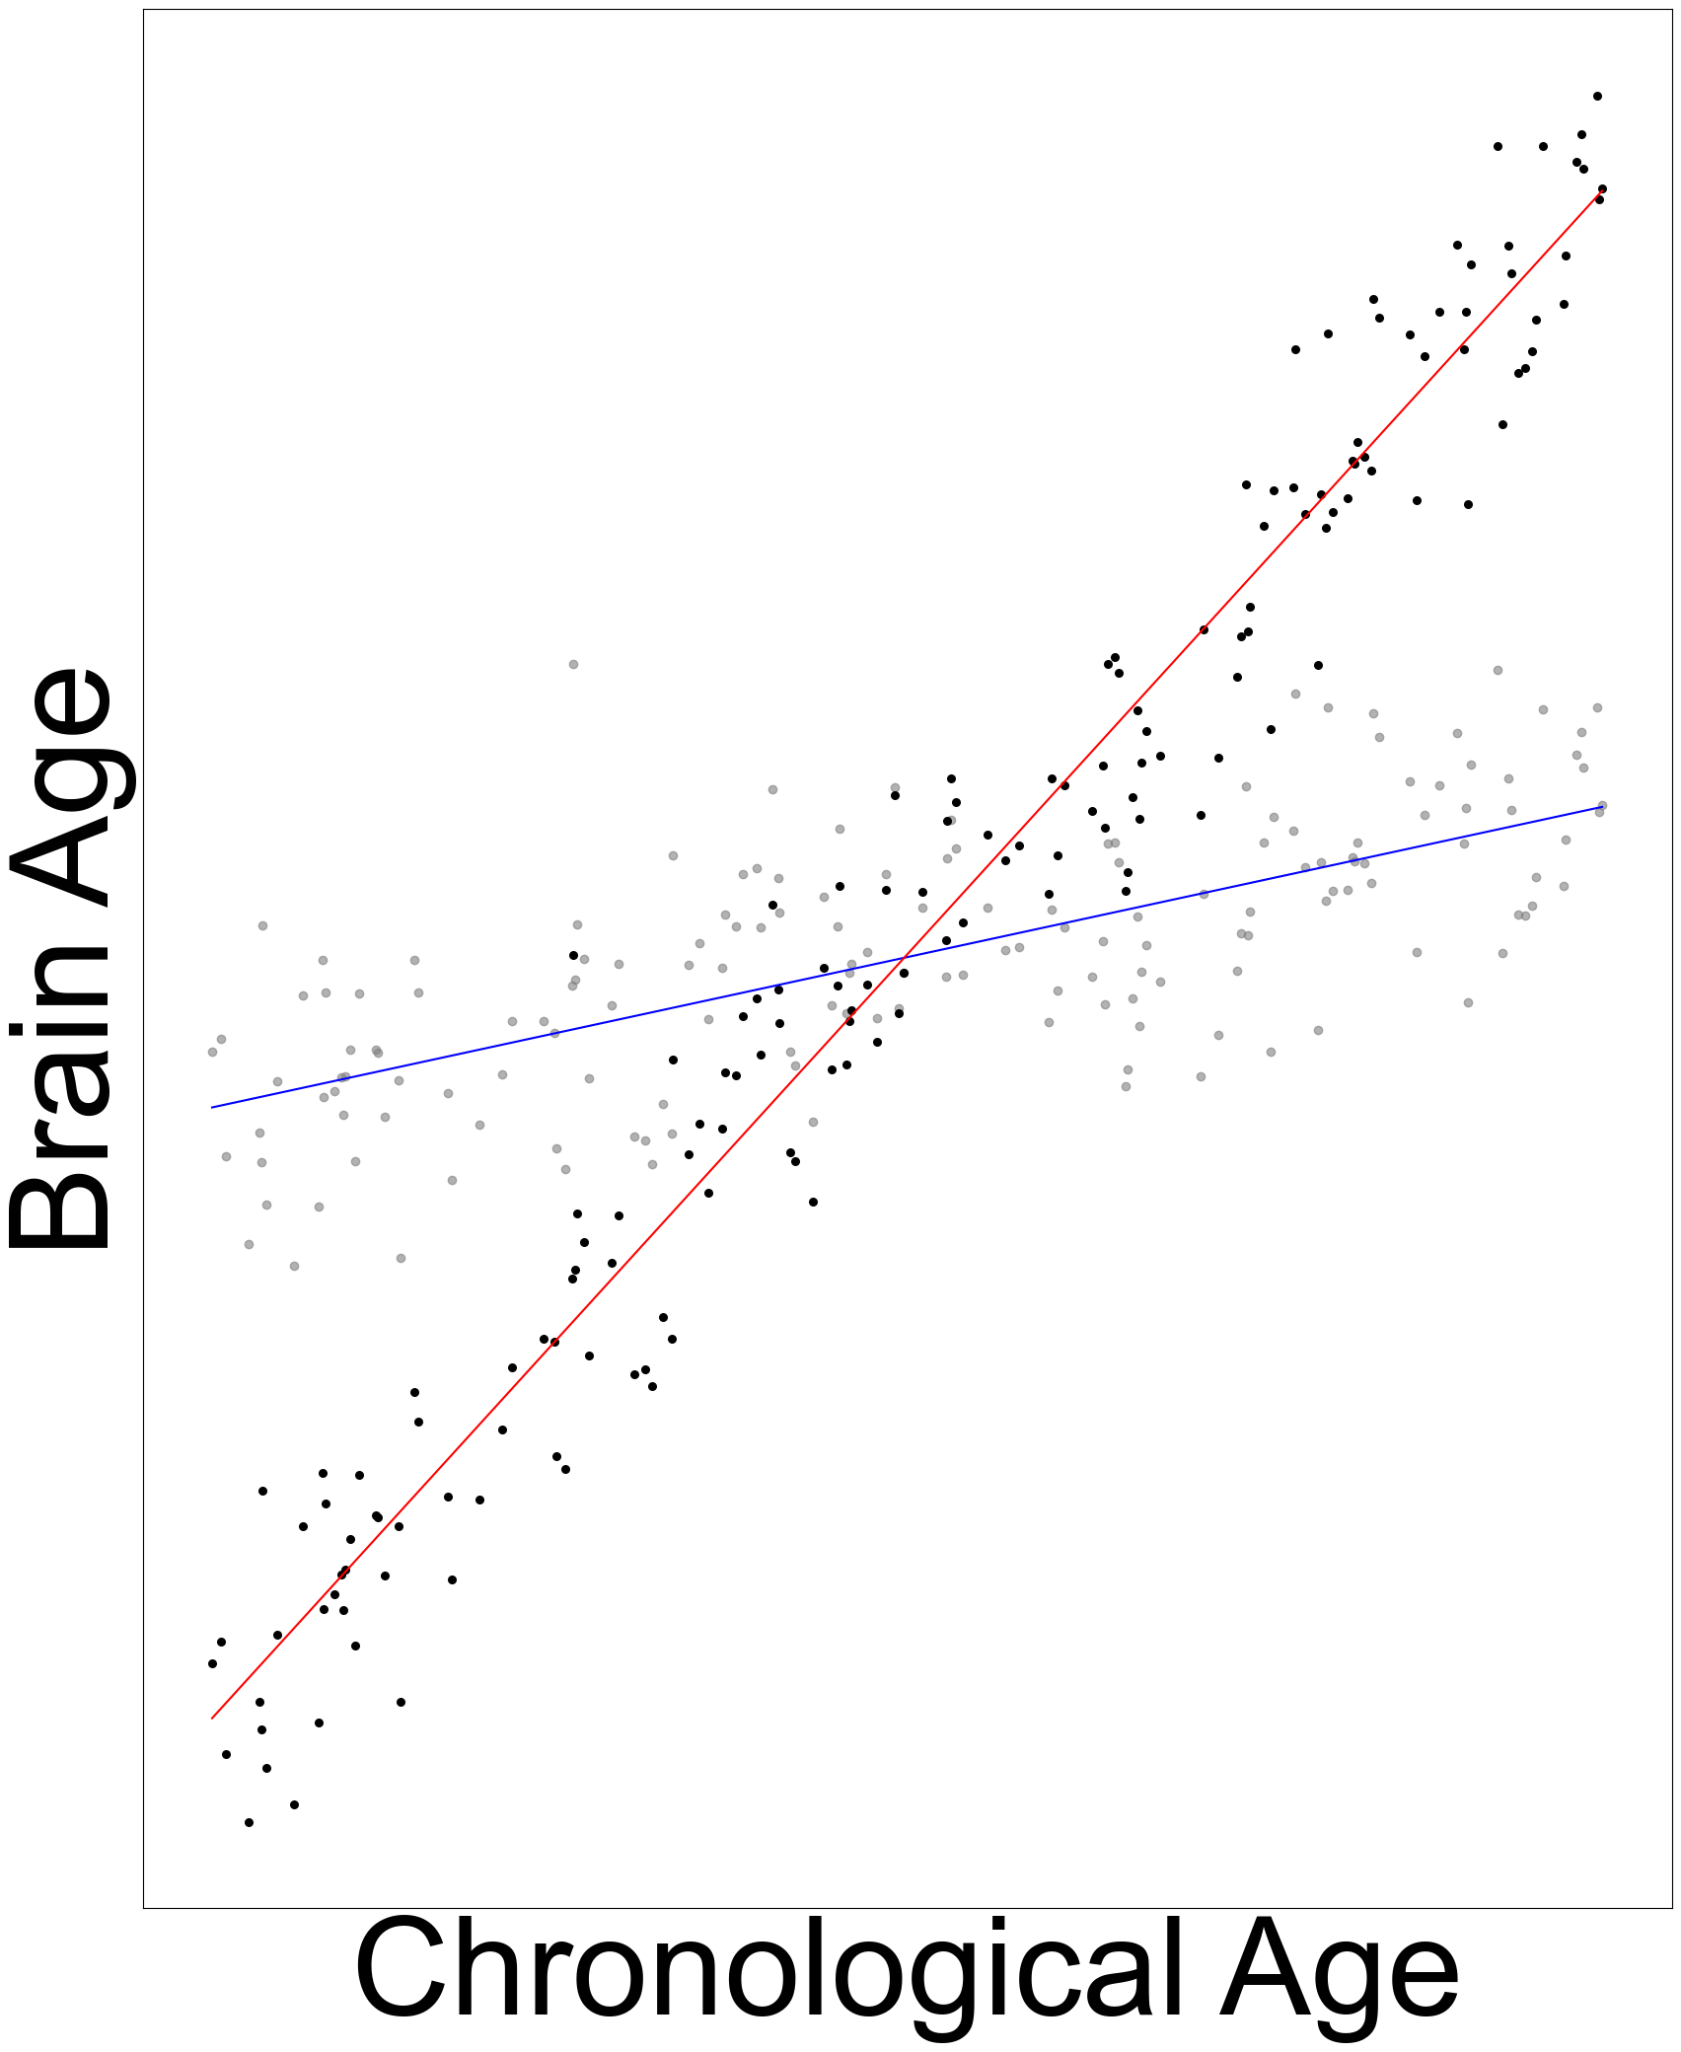
dff
ar

