Slide 1
NETWORK THREAT DEFENDER FOR MANAGED NETWORKS
Richard antiabong, cody eilrich, rohit malaga

Slide 2
BACKGROUND
DOS/DDOS – Denial of Service is a malicious attempt to make a server or resource unavailable to legitimate users.
Known types of DOS/DDOS:
Volume Based Attacks e.g. ICMP, UDP
Protocol Attacks – SYN floods, ping of death, smurf attacks.
Application Layer Attacks – DNS attacks,

Slide 3
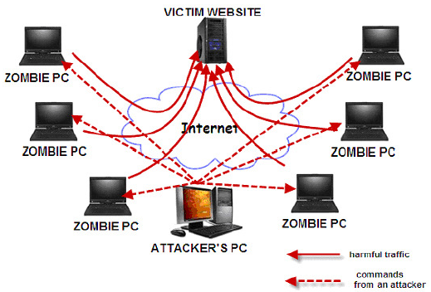
DISTRIBUTED DENIAL OF SERVICE

Slide 4
MOTIVATION
SNMP lacks support to defend against denial of service attacks.
The security features in SNMPv3 are limited to only protecting SNMP traffic.
Processing large amounts of network traffic is resource intensive so we developed a low cost solution incorporating Apache Storm that supports distributed real-time processing and remote management over the Internet.
Our solution equips enterprises with geographically dispersed datacenters with a centralized traffic analysis, threat detection, and response platform.

Slide 5
ARCHITECTURE/DESIGN
tcpdump was used to collect network traffic and send it into a remote Storm spout via a named pipe.
The tcpdump data stream was piped via SSH for encryption and message integrity.
The spout in turn feeds the data stream received from the named pipe into the bolt.
The bolt filters the data stream, analyzes the packets, and creates JSON traffic threat reports which are sent to CouchDB for storage each second.
The Manager queries CouchDB at intervals for the JSON messages, interprets and displays them on a chart/table and provides options for blocking malicious traffic.

Slide 6
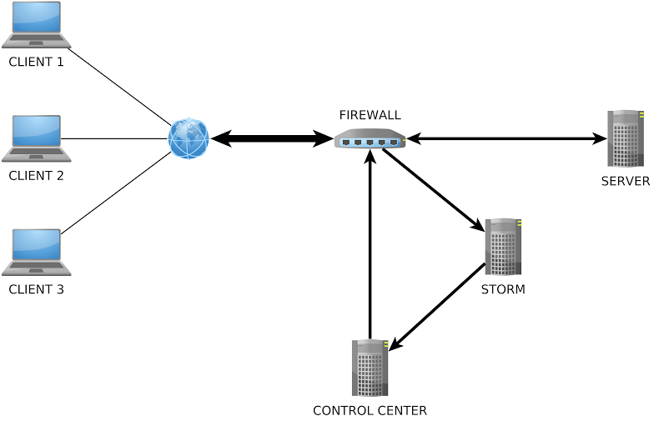
PHYSICAL ARCHITECTURE

Slide 7
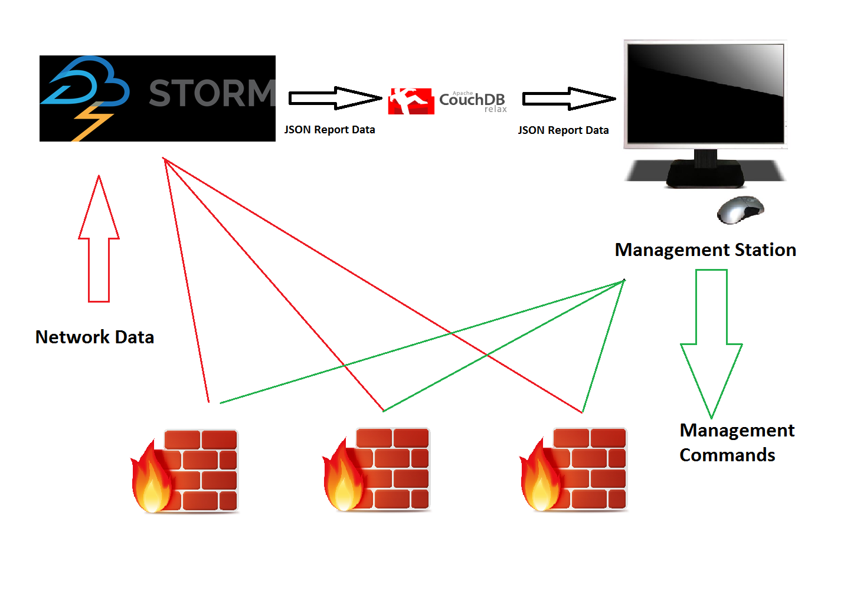
HIGH-LEVEL SOFTWARE DESIGN

Slide 8
IMPLEMENTATION
The system was implemented on a high performance server.
VirtualBox was used to create different virtual machines and virtual networks all connected to realize our desired topology.
Tcpdump was installed on the router for capturing data on all its interfaces and piping them out to the storm server.
Three Virtual Machines were setup as servers; Storm Server, Web Server (Under attack) and the Web Manager.
Another three virtual machines were setup as attack clients with attack tools such as hping3 and nping installed.

Slide 9
LIMITATIONS OF OUR DESIGN
In the following situations how do you block malicious senders.
Hosts behind a NAT
Block by IP address? Then other hosts sharing the same public IP address will be hurt
Block by source port number? Then the malicious sender can switch to different random ports, this may require up to 2^{^16} entries, unless aggregation is used.

Slide 10
POSSIBLE FUTURE IMPROVEMENTS
Integrating an automated learning algorithm for dynamically detecting malicious traffic and mitigating the threats.
Add support for detecting and neutralizing additional attacks.
Add support for displaying graphs for each source address and overall statistics in the management dashboard.
SNMP integration: standardized iptables/alternatives MIBs

Slide 11
THANK YOU

