Slide 1
MySQL Workbench

Slide 2
MySQL Work Bench
Visual aid
Development Tool
Server
Download Link: https://dev.mysql.com/downloads/windows/installer/8.0.html
Notes:
MySQL Workbench is where we will be writing all our MySQL scripts, it has a huge amount of visual tools but it is important to understand the moving parts behind the tools so we will not be using them. Do feel free to explore them some of the more impressive ones are tools to create ERD diagrams from your database and vice-versa.
MySQL Workbench is also going to host a server for us.

Slide 3
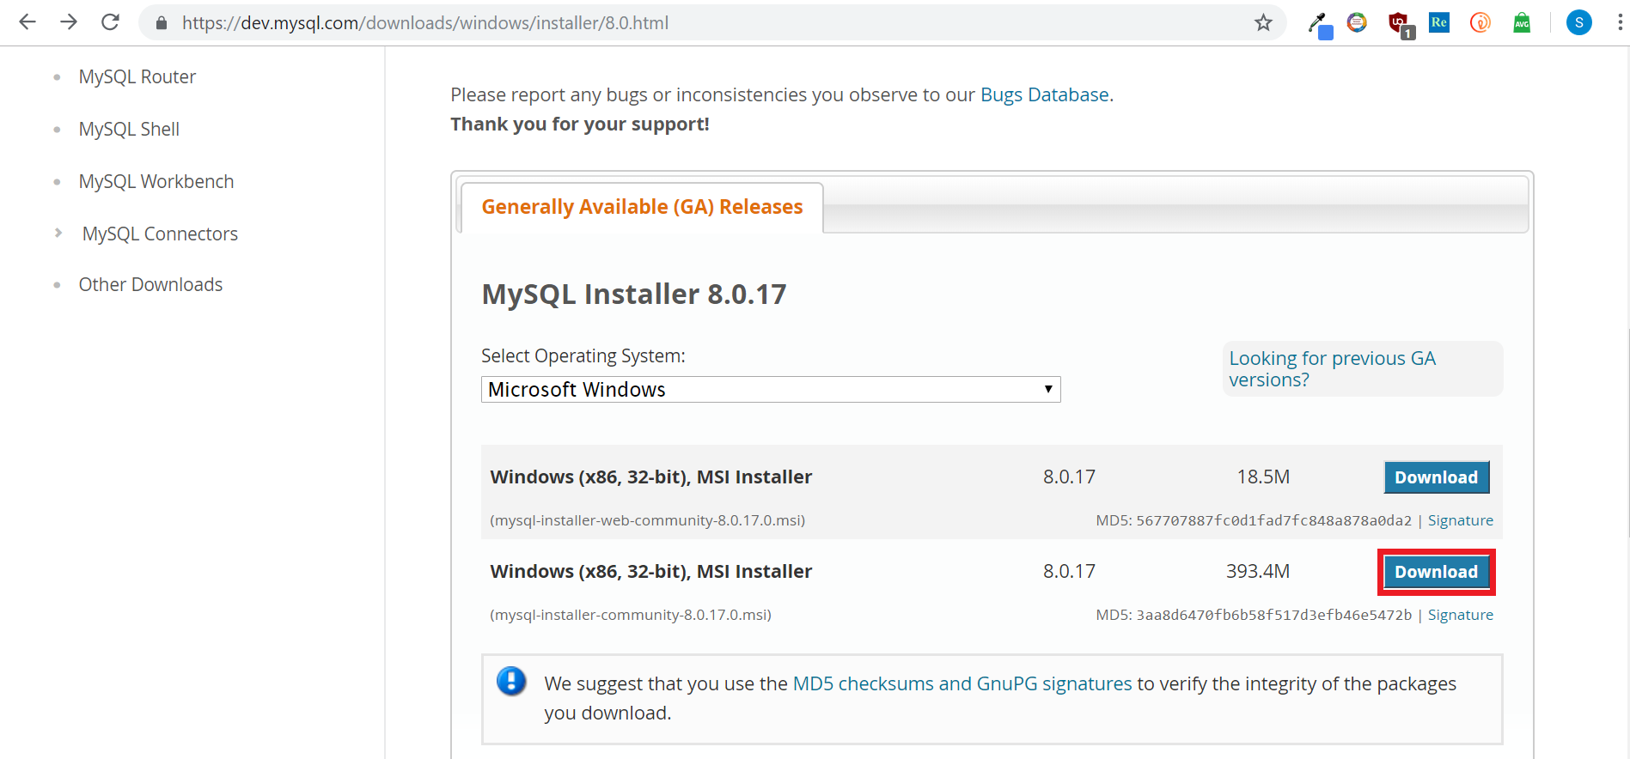
MySQL Work Bench Download
Notes:
We’ll go with the full install here, hit the highlighted button.

Slide 4
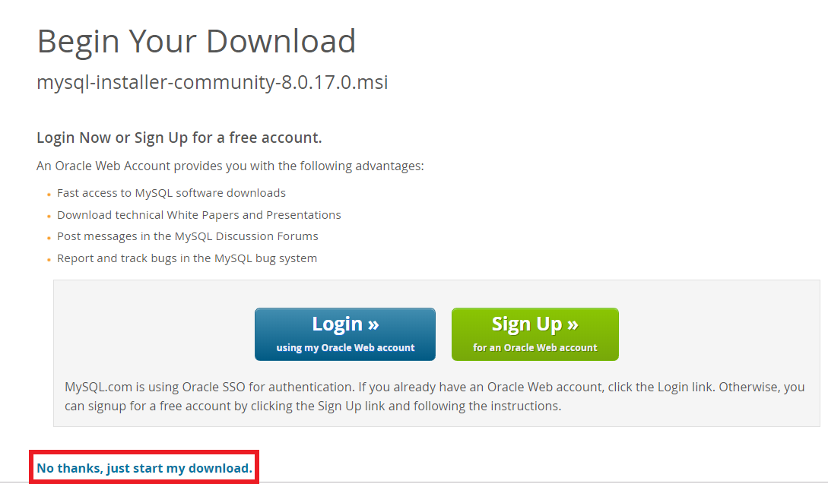
MySQL Work Bench Download
Notes:
Feel free to make an account later, but for now we will just get the installer.

Slide 5
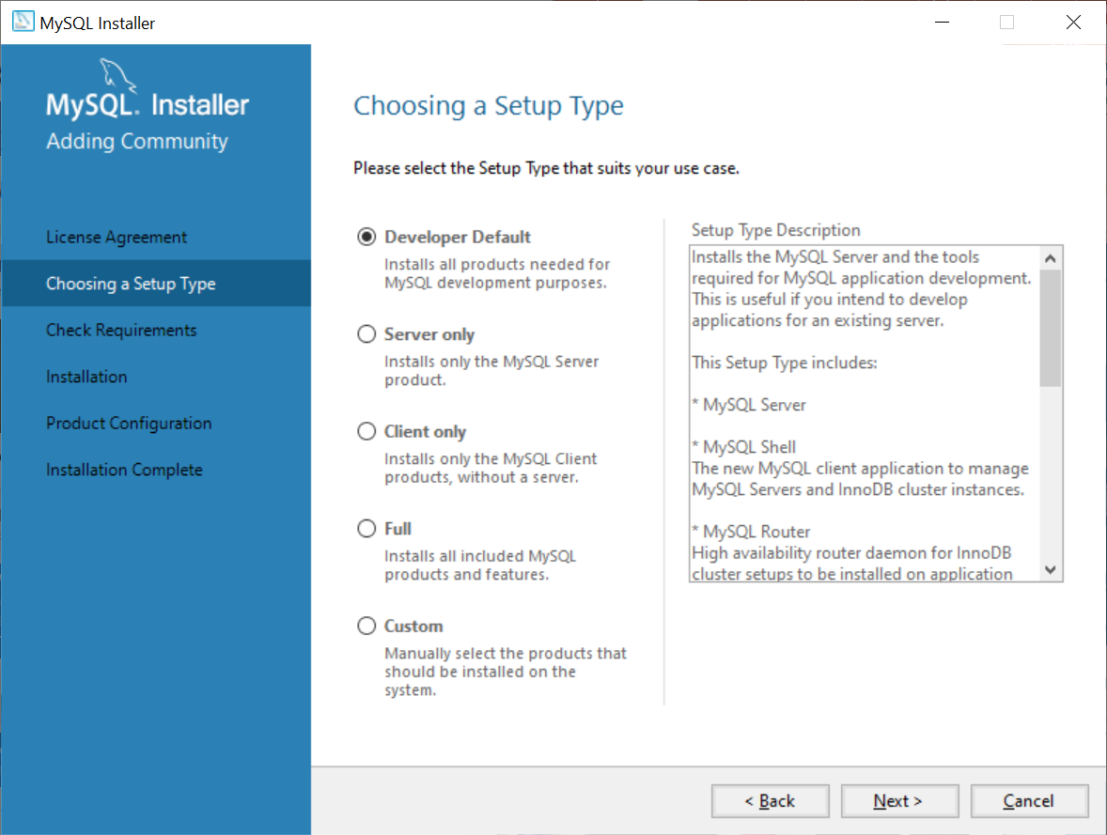
MySQL Work Bench Install
Notes:
Once you launch the installer you’ll be asked exactly how much you want to install, we will pick up the Developer Default options.

Slide 6
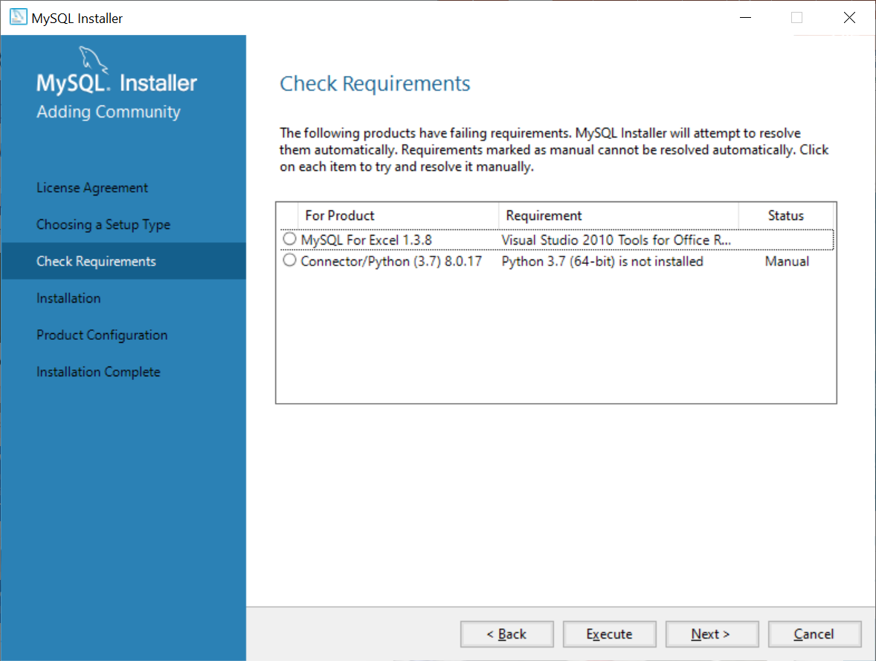
MySQL Work Bench Install
Notes:
We’re not going to grab the Excel or Python extensions, hit Next followed by Confirm when the popup appears.

Slide 7
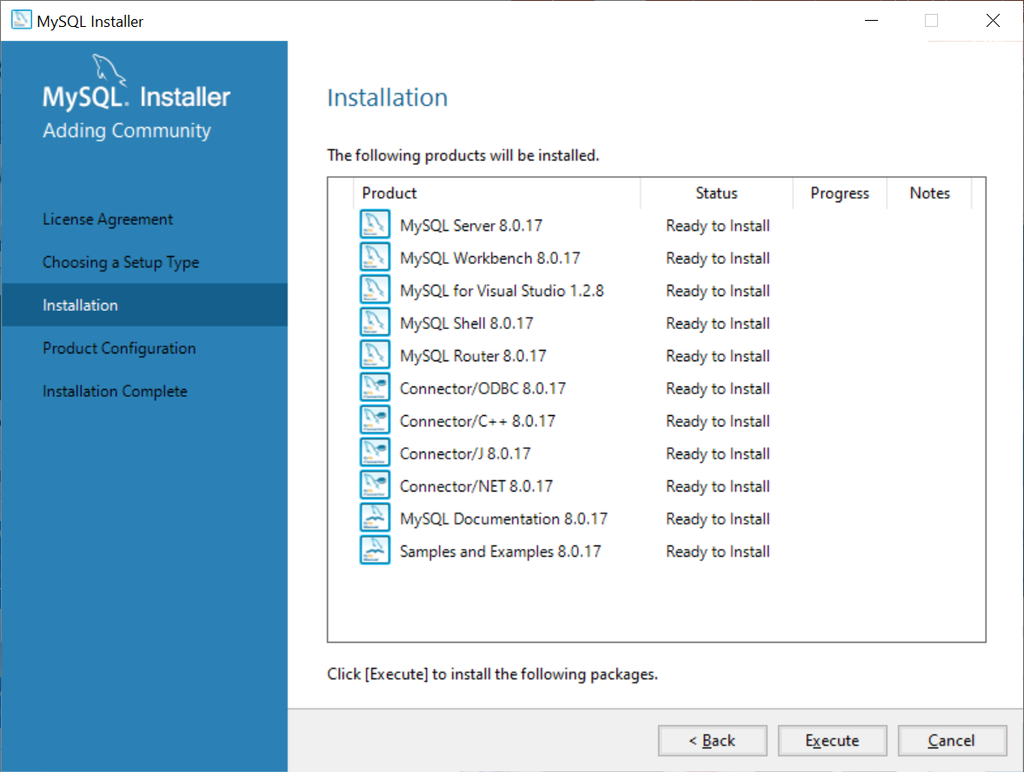
MySQL Work Bench Install
Notes:
Ensure that your product list looks like mine and hit Execute. Should take about 5 minutes. Hit Next -> Next

Slide 8
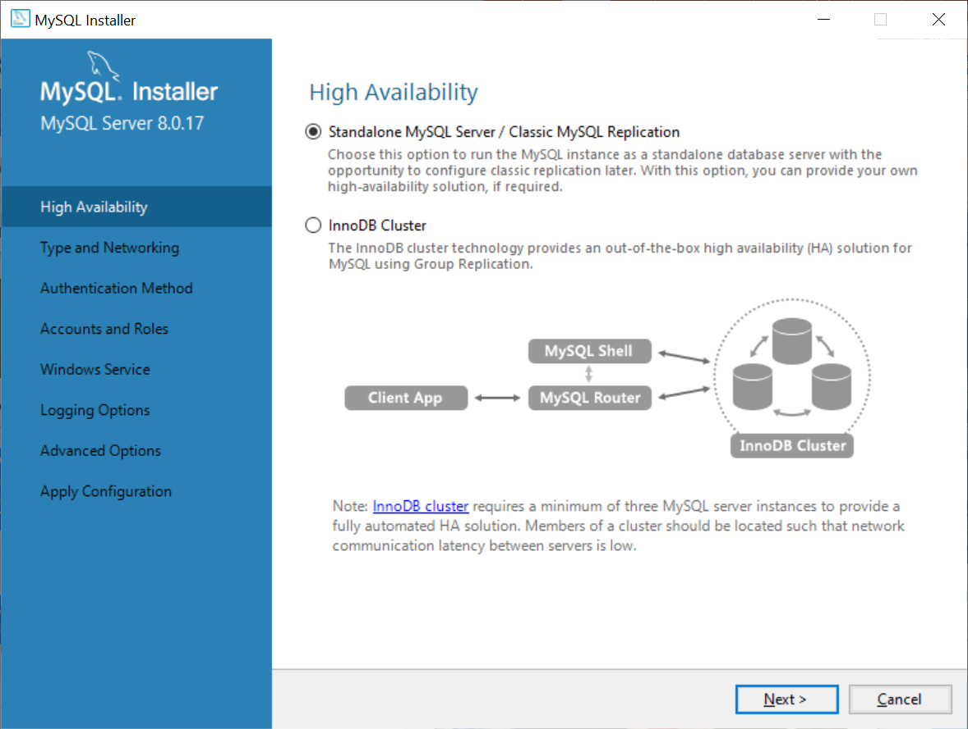
Server Configuration
Notes:
We’re going to choose a standalone server hit Next

Slide 9
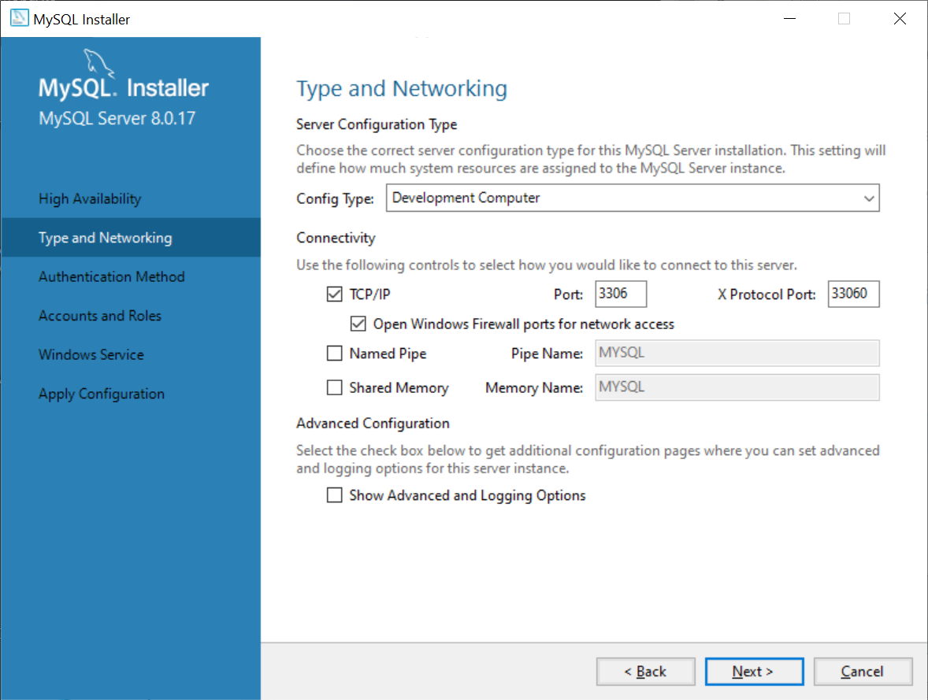
Server Configuration
Notes:
Leave your server configured like this, no need for any changes here click Next

Slide 10
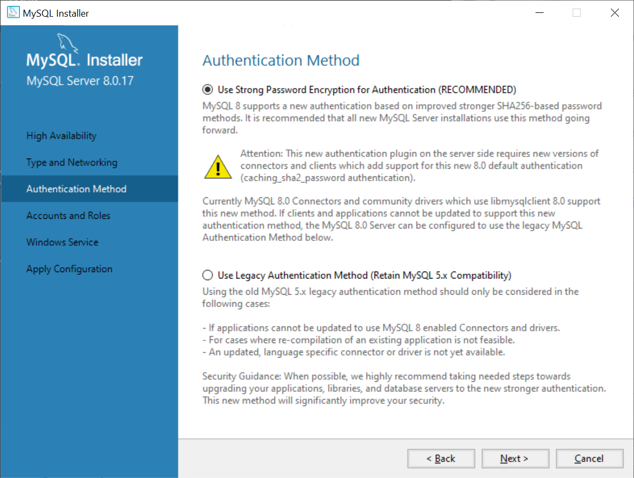
Authentication
Notes:
We’re good to go with Strong Password Authentication here, Next

Slide 11
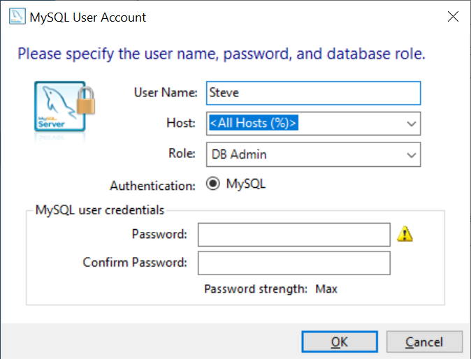

Accounts and Roles
Notes:
Set a root password and be sure to remember it, we also need to create an admin account for ourselves on the server so use your name and set another password. You can leave the Host and Role Parameters the way they are in the dialog box. Next

Slide 12
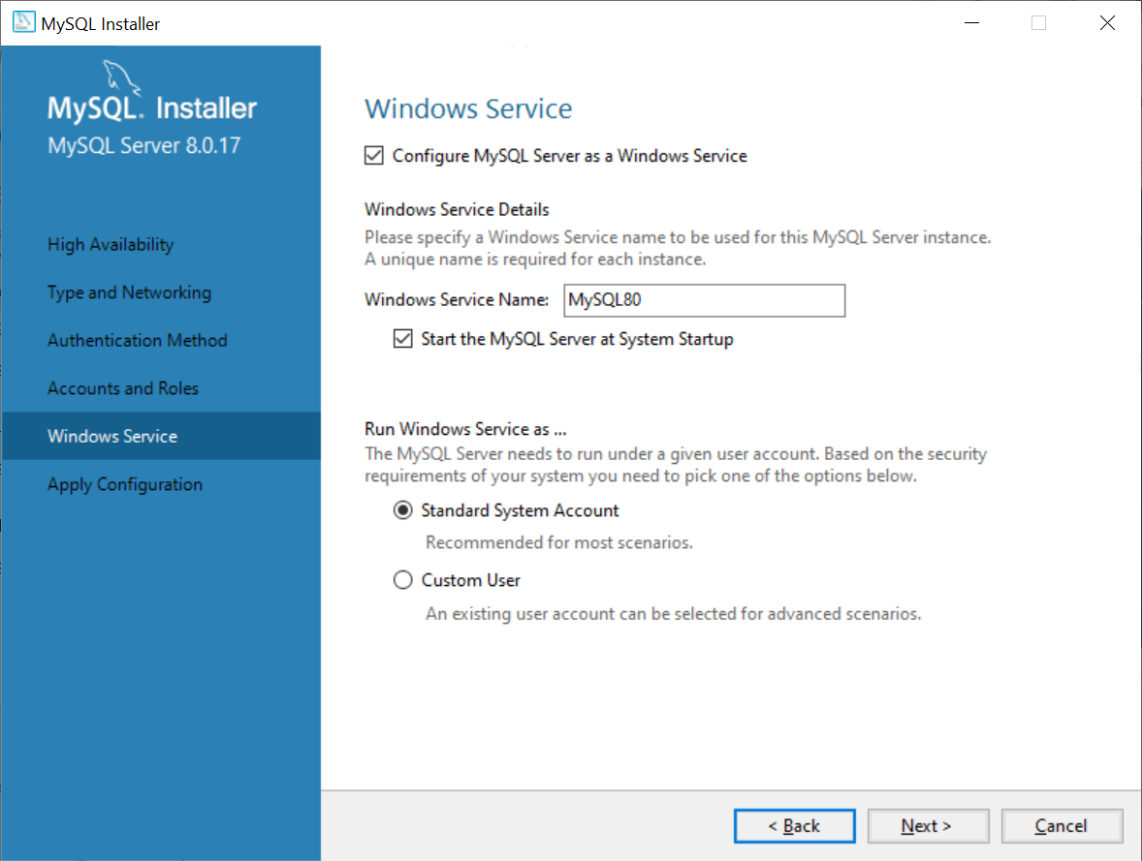
Windows Service
Notes:
Another page we can click next on, this name here is what you can kill using windows task manager if it becomes unresponsive. Next

Slide 13
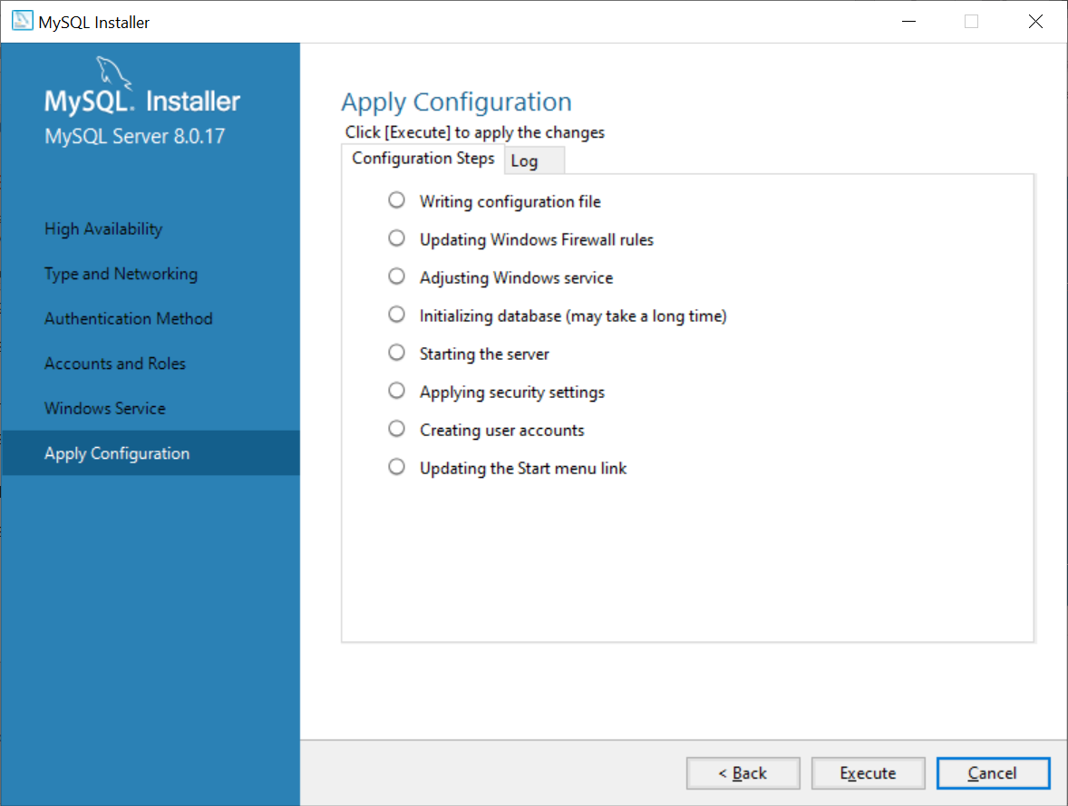
Apply Configuration
Notes:
Hit Execute and wait a few minutes for everything to get setup. Hit Finish when you can.

Slide 14
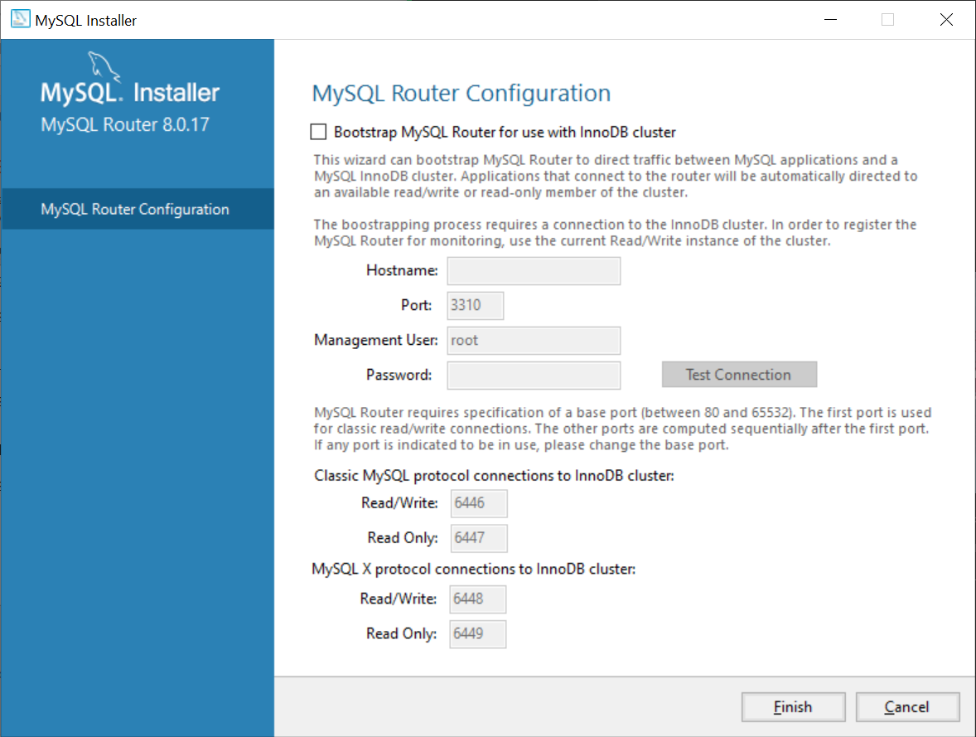
Cluster Configuration
Notes:
We are not using clustering so hit Finish

Slide 15
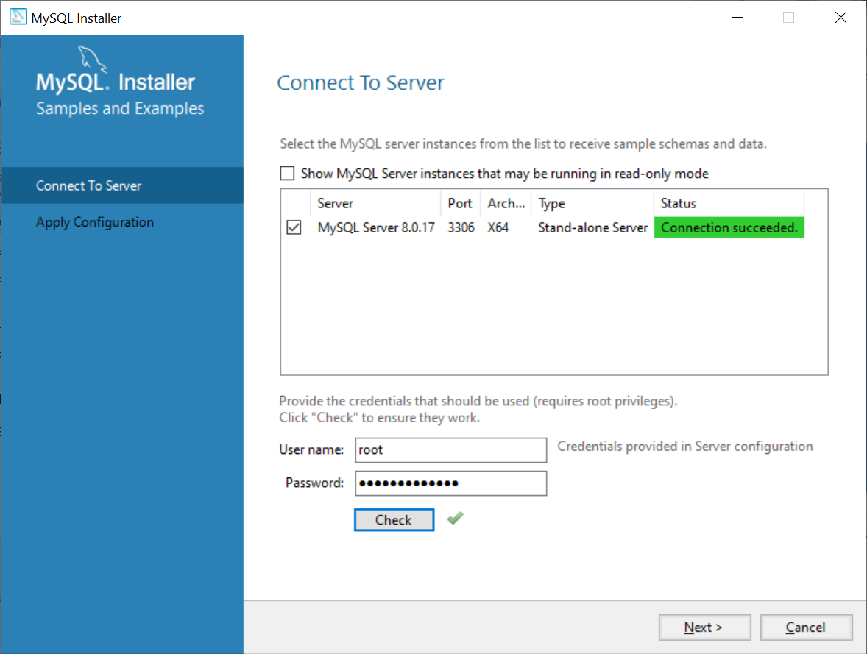
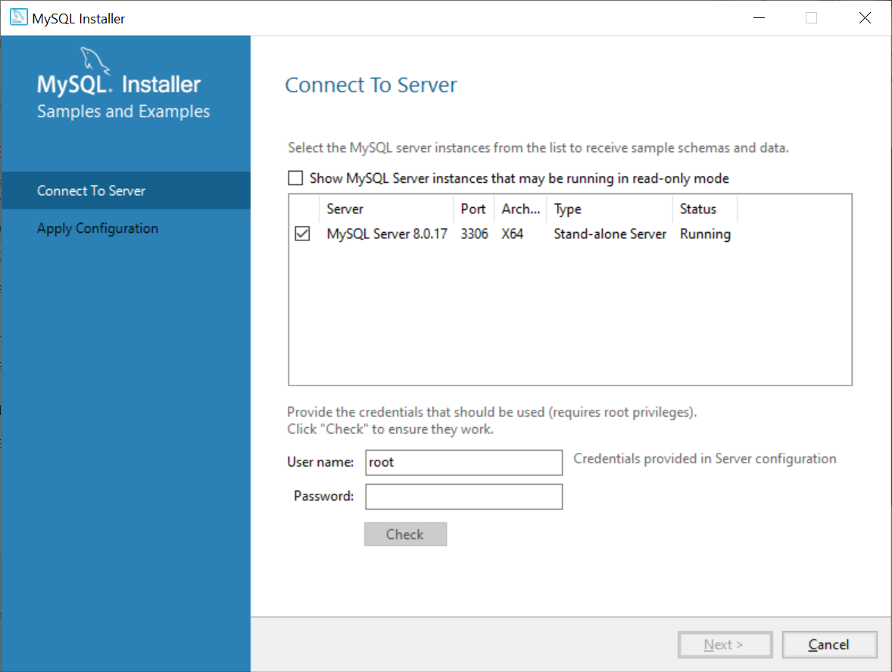
Connecting to our Server
Notes:
Type in the password you set for the root user on the Accounts and Roles slide, hit Check and provided you remembered it hit Next

Slide 16
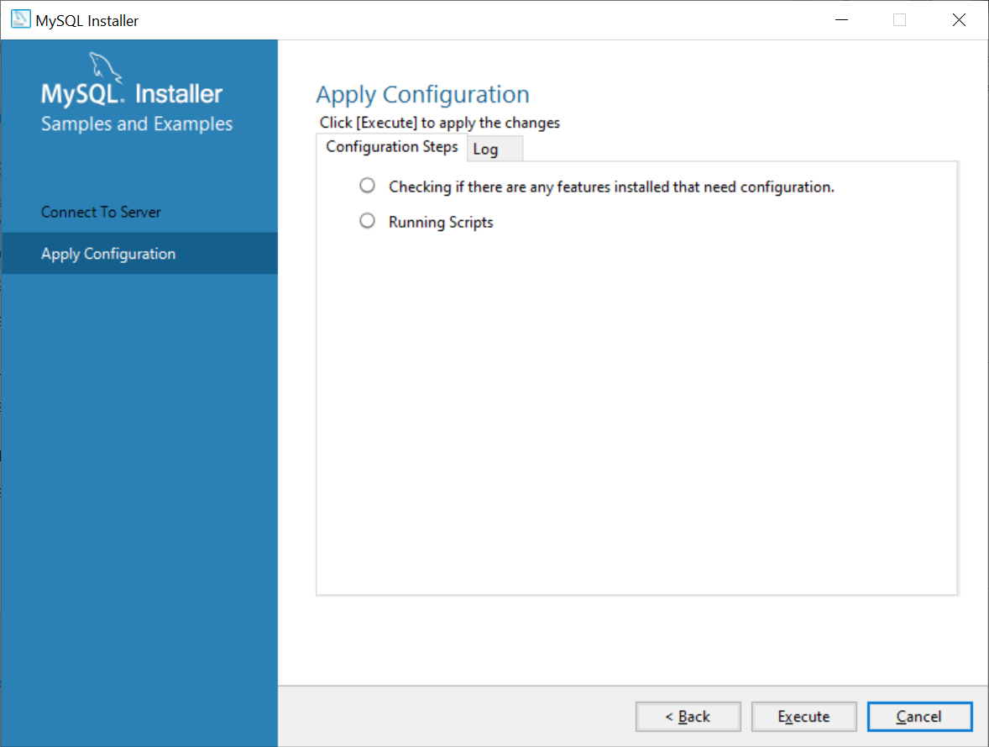
Tests
Notes:
The next Execute will run a number of test scripts on your server generating a sample database, this is a quick way to confirm everything is working. When done hit Finish.

Slide 17
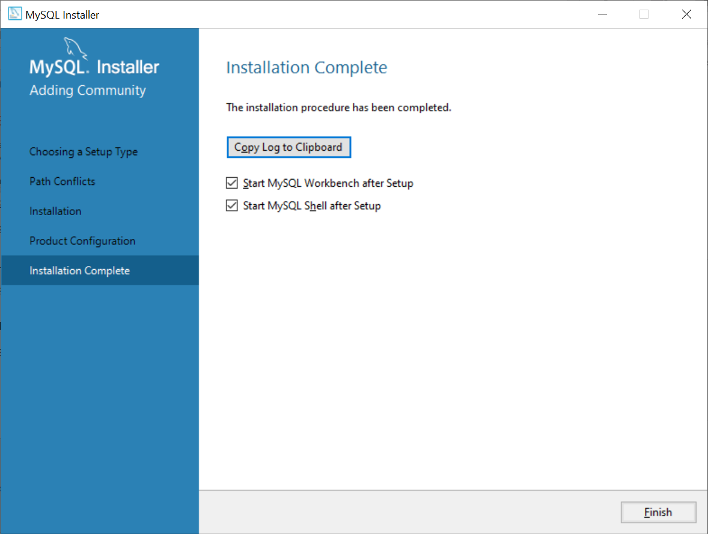
Complete
Notes:
Deselect the MySQL Shell option and hit Finish

Slide 18
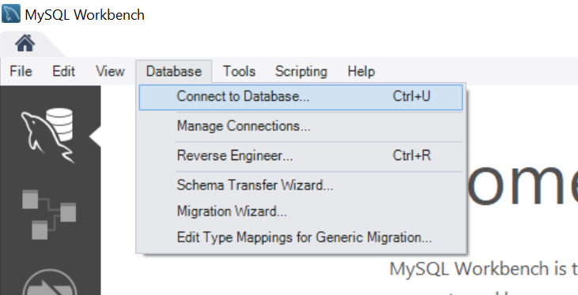
Ensuring it Works
Notes:
Inside the Workbench click Database -> Connect to Database

Slide 19
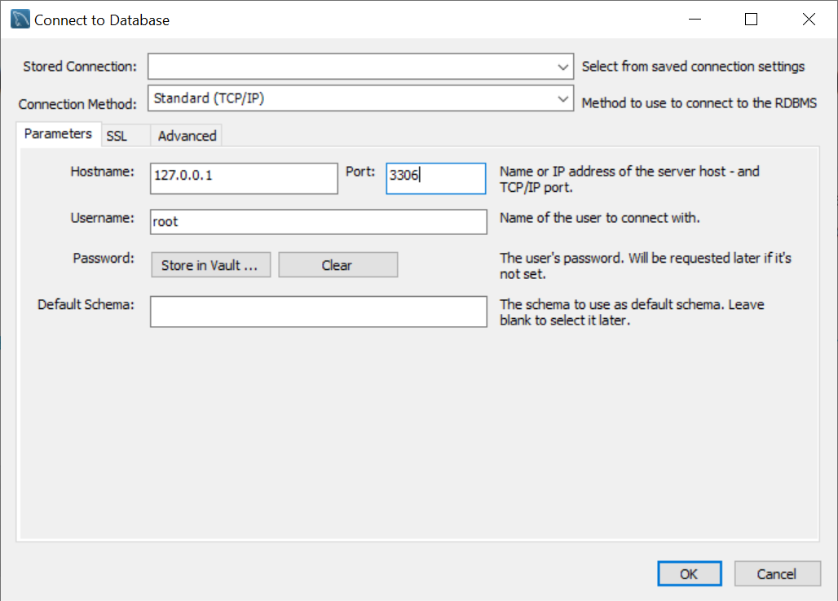
Ensuring it Works
Notes:
Alter the popup to select the port you are running your server on (usually 3307 needs to be changed to 3306)

Slide 20
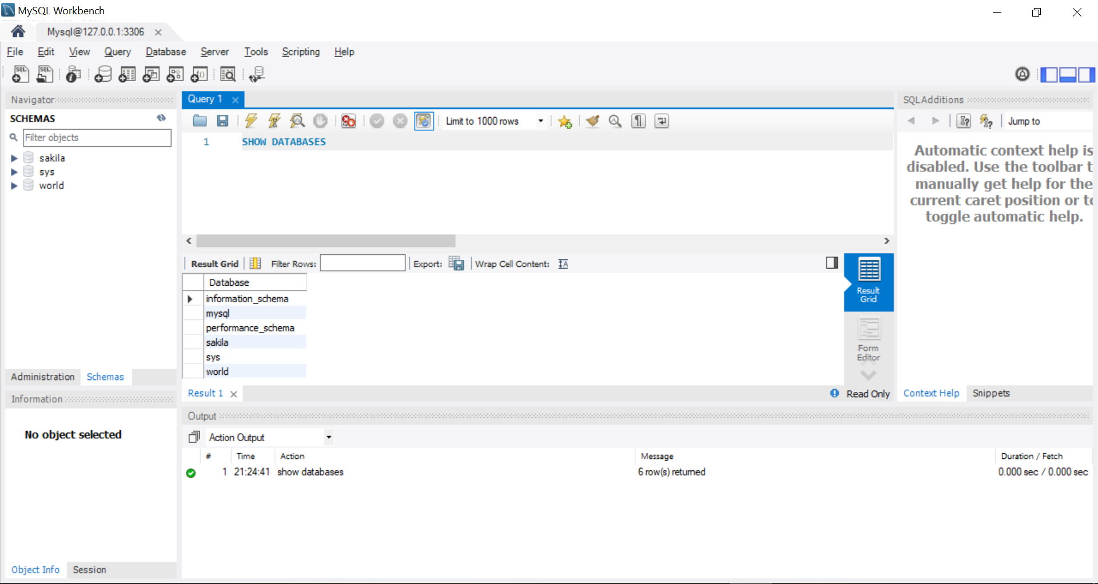
Ensuring it Works
Notes:
After workbench has connected to the server type “SHOW DATABASES” into the query editor, highlight it and then click the lightning bolt symbol above it, if the setup has successful the Result Grid should show all the example/default databases that we had run during the Setup.

