Slide 1
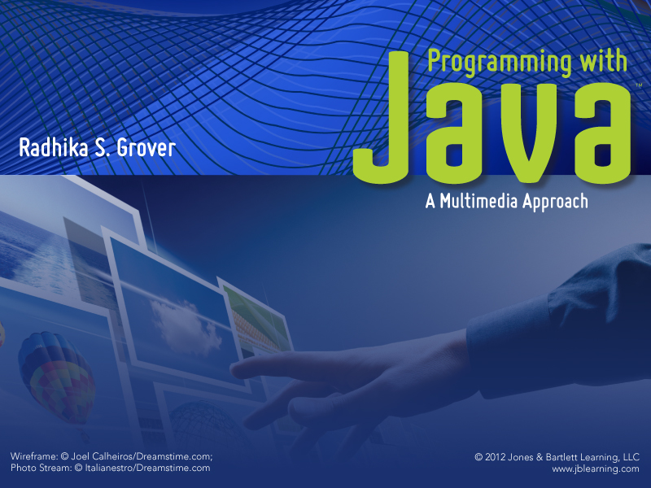
Chapter 1
Introduction

Slide 2
Introductions
Instructor: Heath Carroll
Teaching Assistants
Mr. Lewis Cawthorne (cawthorn@email.sc.edu)
Mr. Lingxi Zhou (zhou44@email.sc.edu)
Mr. Jun Zhou (zhou23@email.sc.edu)
Supplemental Instruction
Mr. Amadeo Bellotti (bellotta@email.sc.edu)

Slide 3
Tools for the Course
Course information is on the web at www.cse.sc.edu/~carrollh/CSCE145/index.html
Access to course information requires access to the World Wide Web
Access from home requires a computer and an Internet Service Provider (AOL, Roadrunner, Earthlink, BellSouth DSL, etc.)
Access at USC requires a login name and password

Slide 4
Course Information
Be certain that you read the information at the course website very carefully
Attendance regulations
Late program policy
How grades will be determined
Honor code
Other information available there
Course calendar
Instructor and TA contact information
How to get useful software
Access to the publisher’s website

Slide 5
Objectives
Understand how computers work, including their capabilities and limitations
Understand the architecture of a computer system in terms of its hardware and software
Understand program design and object-oriented programming
Learn the Java programming language
Learn Eclipse, a software development environment
Learn JavaScript (some)

Slide 6
Objectives
Overview of computer hardware and software
Introduce program design and object-oriented programming
Overview of the Java programming language
Introduce applets and graphics basics

Slide 7
Outline
What Is a Program?
How Computers Work
Compiling and Running a Java Program
The Software Development Method
Parts of a Java Program
Errors in Programs
Summary

Slide 8
What Is a Program?
Program
A set of instructions that tells the computer what to do.
Used to solve a specific problem.
Algorithm
A particular sequence of operations.
Written using a computer language (such as Java, Pascal, FORTRAN, COBOL, and Lisp) to create a program.

Slide 9
Parts of a Computer
One or more processors (CPU)
Memory (RAM or main memory)
Stores programs temporarily while they are running.
Volatile
Secondary memory such as hard drives
Non-volatile
Input devices (keyboard and mouse)
Output devices (monitors and speakers)

Slide 10
Machine Languages vs. High-level Languages
Machine languages:
Composed of two digits 0 and 1 (called bits)
A set of 8 bits is called a byte (example: 11011101)
Specific to a processor
Tedious and error prone to use
High-level languages:
Contain instructions that consist of words taken from English and algebraic expressions
Not specific to any processor
Easier to use than machine language

Slide 11
Compilers
Compilers
Convert a high-level language program into an intermediate language or a machine language program.
Java Compilers
Translate Java programs into a special binary code called Java bytecode.
Java bytecode does not depend on what type of processor is used in the computer.

Slide 12
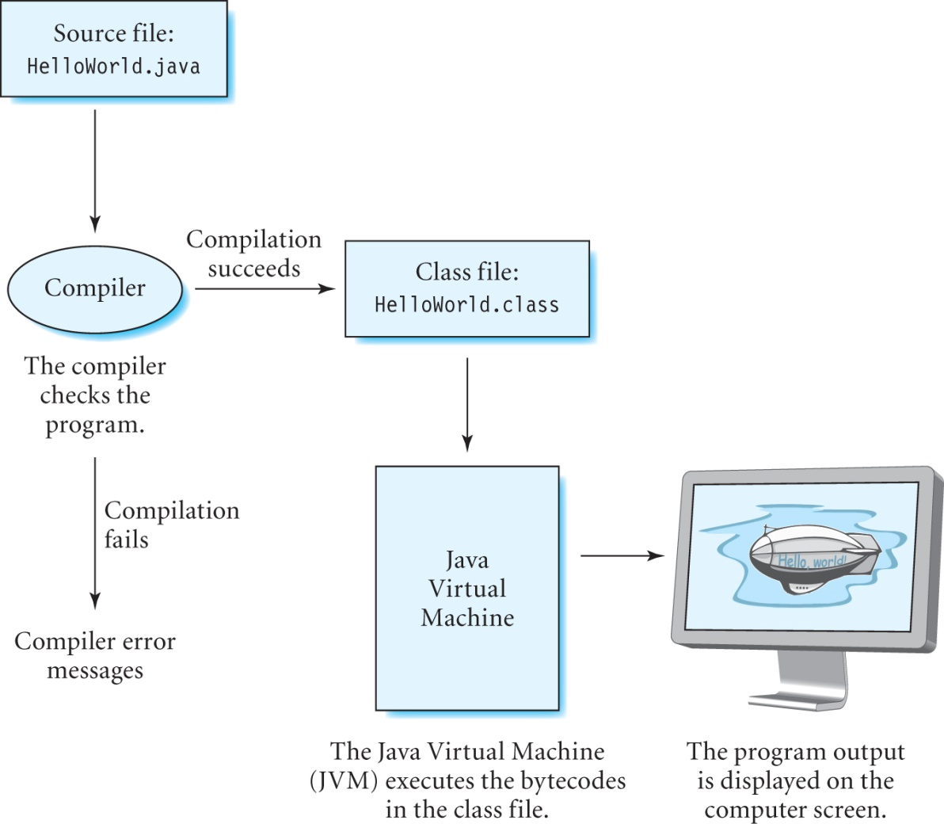
Compiling and Running a Java Program

Slide 13
Source and Class Files
Source file
Contains the text for the program.
Named with a .java extension.
Class file
Compiler generates this file if it does not find any errors in the program.
Contains Java bytecode.
Named with a .class extension

Slide 14
Java Virtual Machine (JVM)
JVM
Contains a Class loader for loading program into memory.
Contains an Interpreter for executing Java bytecode.
Must be installed on the computer where you want to run Java programs.
Platform-specific
Java bytecode can be run on any platform that has a JVM installed on it (Java is “compile once, run anywhere” language)

Slide 15
Software Development Method
Define the problem.
Design an algorithm to solve the problem.
Develop the program code from the algorithm.
Test the code and verify its correctness.
Maintain the code.

Slide 16
Java Program: HelloWorld
// Program HelloWorld
import javax.swing.*;
public class HelloWorld {
public static void main(String[] args) {
JFrame frame = new JFrame("My First Program");
frame.getContentPane().add(new JLabel(new ImageIcon("blimp.png")));
frame.pack();
frame.setVisible(true);
}
}

Slide 17
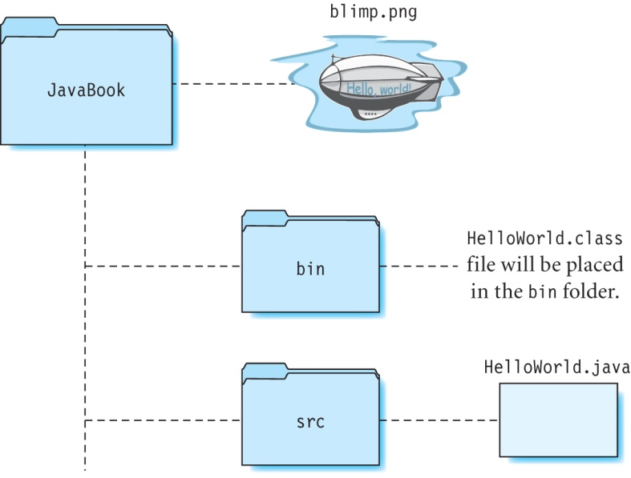
Directory Structure for Source and Class Files

Slide 18
Compiling and Running a Java Program (on a PC)
Set the working directory (say, JavaBook)
C:\> cd JavaBook
Compile HelloWorld.java
C:\JavaBook> javac -d bin src\HelloWorld.java
Run the program
C:\JavaBook> java -classpath bin HelloWorld

Slide 19
Compiling and Running a Java Program (on a Macintosh)
Set the working directory (say, JavaBook)
computer:~YourName$ cd JavaBook
Compile HelloWorld.java
computer:~/JavaBook YourName$ javac -d bin src/HelloWorld.java
Run the program
computer:~/JavaBook YourName$ java -classpath bin HelloWorld

Slide 20
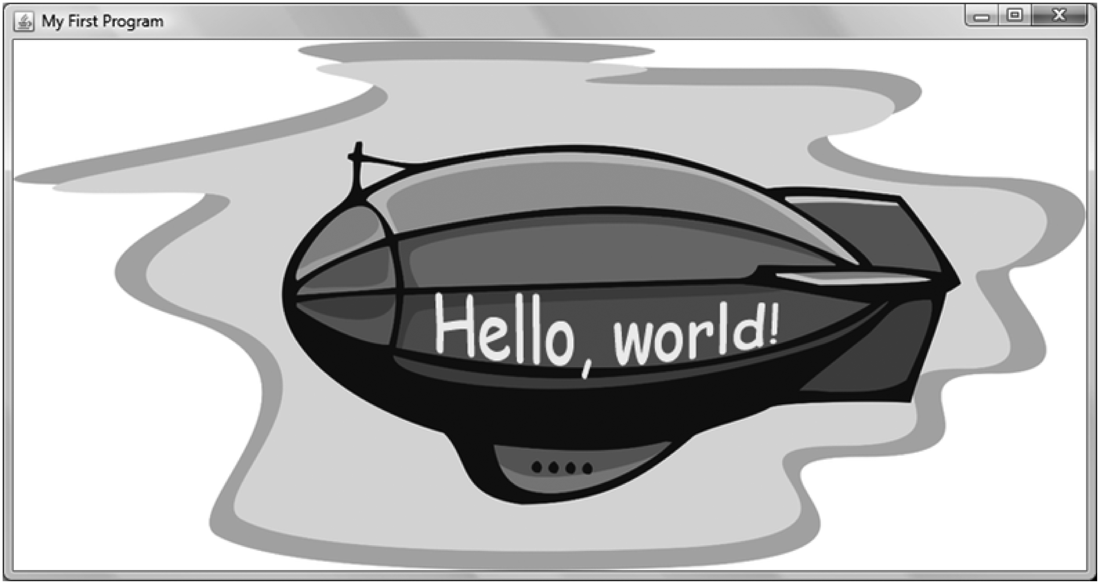
Output of the HelloWorld Program
blimp.png, Courtesy of iclipart.com

Slide 21
Parts of a Java Program
Class
All your code goes here.
Contains methods and statements.
Keywords
Reserved words used to create a program.
Must be in lowercase.
Method
Group of statements enclosed within braces.
Statement
Specifies an action to be performed.
Comments
Statements ignored by the compiler.

Slide 22
Class
An empty class named HelloWorld:
Declared using keyword class.
Contains one or more methods.
public class HelloWorld {
}

Slide 23
Statements
Specifies an action to be performed.
Each statement is ended with a semicolon.
Words are usually separated by a single space.
There should not be a space within a word.
Examples:
JFrame frame = new JFrame("My First Program");
frame.pack();
frame.setVisible(true);

Slide 24
Methods
Consist of a group of statements enclosed within braces { }.
There can be any number of methods in a class.
Every program contains one main method:
The main method is always executed before any other method in the class.
public static void main(String[] args) {
// statements
}

Slide 25
Comments
There are two types of comments:
Single line //
Multi-line /* */
Single line comments:
// compiler ignores the words in this line
but not the words in this line
Multi-line comments:
/* compiler ignores all the
words in these
three lines */

Slide 26
Errors in Programs
Compiler Errors
Run-time errors and
Logic errors

Slide 27
Compiler Errors
Examples of compiler errors:
Incorrect punctuation, such as missing semi-colon at the end of a statement.
Comments formed incorrectly.
Misspelled keywords, class and method names.

Slide 28
Program With Errors
/ * Program with errors */
import javax.swing.*;
public class HelloWorld {
public static void main(String[] args) {
JFrame frame = new JFrame(My First Program");
frame.getContentPane().add(new JLabel(new ImageIcon("blimp.png")))
frame.pack();
frame.setVisible(true);
}

Slide 29
Compiler Output 1
src\HelloWorld.java:1: class, interface, or enum expected
/ * Program with errors */
What you should do:
Correct the open-comment sequence that has been mistyped with a space between the / and *.

Slide 30
Compiler Output 2
src\HelloWorld.java:6: ')' expected
JFrame frame = new JFrame(My First Program");
src\HelloWorld.java:6: unclosed string literal
JFrame frame = new JFrame(My First Program");
src\HelloWorld.java:6: not a statement
JFrame frame = new JFrame(My First Program");
What you should do:
Insert a pair of quotes needed to begin the words My First Program is missing on line 6.

Slide 31
Compiler Output 3
src\HelloWorld.java:7: ';' expected
frame.getContentPane().add(new JLabel(new ImageIcon("blimp.png")))
What you should do:
Insert a semi-colon at the end of line 7.

Slide 32
Compiler Output 4
src\HelloWorld.java:10: reached end of file while parsing
}
What you should do:
Insert a closing brace after the last line of the program.

Slide 33
Run-time Errors
Error occurs while program is executing
Examples:
Files needed by the program are missing.
You forget to insert the square brackets in the following statement:
public static void main(String[] args)

Slide 34
Logic Errors
Occur when the algorithm used in the program is incorrect.
Program executes normally but its output is not correct.
Can be detected by manually computing the result and comparing it with the output of the program.
To identify where the error occurs, use a debugger or print out intermediate results at different points in the program.

Slide 35
Summary
We discussed:
The structure of a simple Java program.
How to compile and run a Java program.
Compiler errors, run-time errors, and logic errors.
What’s next:
Introduction to classes and objects.
Use existing Java 2D classes to construct graphics objects.

