Slide 1

Chapter 2
Introduction to Classes and Objects

Slide 2
Outline
What Is an Object?
Creating Objects
How Methods Work
Computer Screen
Creating a Rectangle Object
The DrawingKit Class
Creating and Displaying Graphics Objects
Writing to the Console

Slide 3
What Is an Object?
An object is something that is real or exists:
Has characteristics called states
Things it can do called behaviors
Objects exist while the program is running.
As the program runs, an object can change state depending on its behavior.

Slide 4
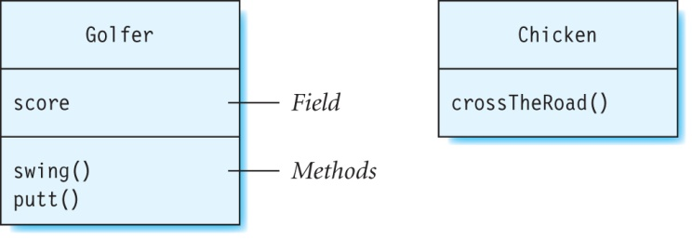
Creating Objects
A class contains information that is needed to create an object.
Java refers to states and behaviors as fields and methods.

Slide 5
Creating Objects (continued)
This creates an object (called chip) of the Golfer class:
Keyword new is reserved.
Constructor is a special method that knows how to create an object.
Name of the constructor is the same as the name of the class.
object reference variable
class name
constructor
Golfer chip = new Golfer();

Slide 6
Difference Between a Class and an Object
A class does not have specific values assigned to its fields, whereas an object does.
Different objects of the same class can have different field values.

Slide 7
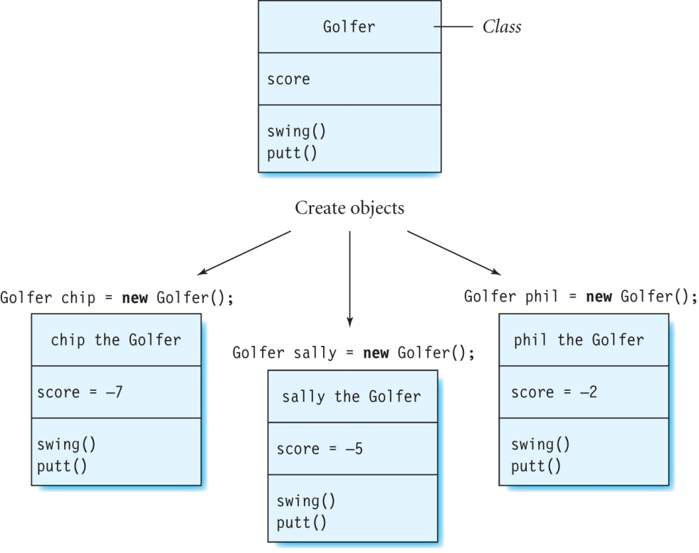
Example

Slide 8
Important Terms
Object reference variable or reference variable: name of an object.
Instance: An object of a class.
Instance variables: Another name for fields.
Heap: A part of the computer’s memory where objects are stored.

Slide 9
Java 2D Classes
These classes are used for drawing two-dimensional graphical shapes:
Rectangle2D.Float (draw rectangles)
RoundRectangle2D.Float (draw rectangles with rounded corners)
Line2D.Float (draw lines)
Ellipse2D.Float (draw ellipses)
BasicStroke (set the thickness of a stroke)
Font (set the font)

Slide 10
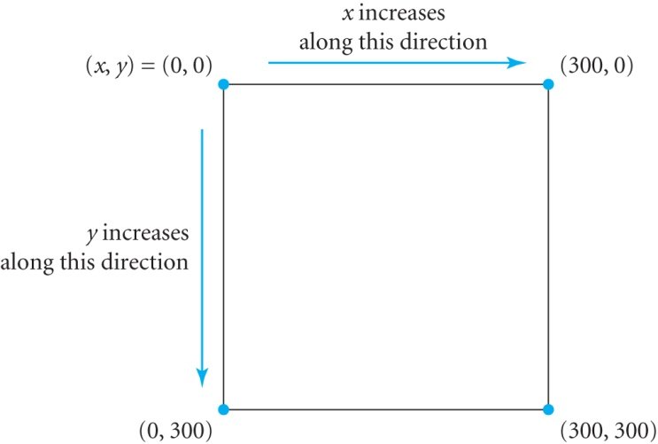
Window Coordinates
Window uses Cartesian coordinate system.
The top left corner of the window is the origin (0, 0).
Values of the x-coordinates increase from left to right.
Values of the y-coordinates increase from top to bottom.

Slide 11
Sizes of Graphics Shapes
Screen resolution: Number of pixels in a given area on the screen.
Size of window and graphics shapes depends on screen resolution.
Example:
300 pixels on a 25 pixels/inch screen is 12 inches
300 pixels on a 100 pixels/inch screen is 3 inches

Slide 12
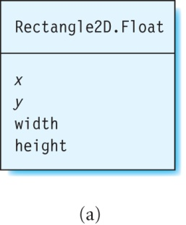
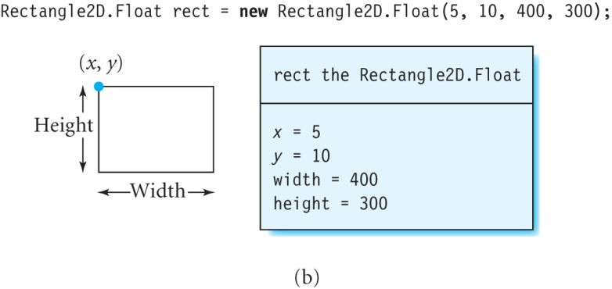
Creating a Rectangle Object
Can assign values to the fields when object is created.
Creates a rectangle with its top left corner at the point (5, 10), width 400, and height 300:
Rectangle2D.Float rect = new Rectangle2D.Float(5, 10, 400, 300);

Slide 13
Arguments
Values given as input to constructor (or method).
Rectangle2D.Float rect = new Rectangle2D.Float(50, 100, 200, 300);
Used to create rectangles of different sizes.
Order of arguments is very important:
First argument is the value of x
Second argument is the value of y
Third argument is width
Fourth argument is height

Slide 14
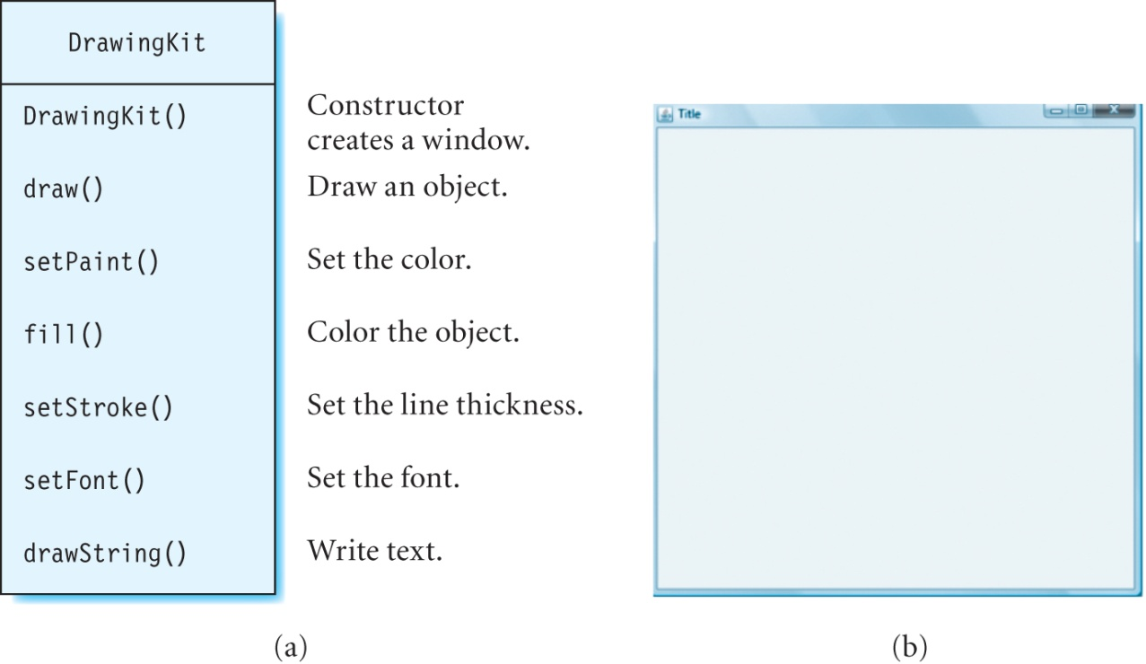
Class DrawingKit
Custom class to create a window and add graphics to it.
Located in the JavaBook\com\programwithjava\basic folder on the CD-ROM.

Slide 15
Drawing a Rectangle using DrawingKit
Create a window with the title “Rectangle”, and instance dk:
DrawingKit dk = new DrawingKit("Rectangle");
Create a rectangle called rect:
Rectangle2D.Float rect = new Rectangle2D.Float(50, 100, 200, 100);
Draw the rectangle named rect using the instance dk of class DrawingKit:
dk.draw(rect);
Note: We will use the draw method of DrawingKit to draw other graphics shapes such as lines, ellipses, and curves.

Slide 16
RectangleDemo.java
// Imports Java 2D classes such as Color and Font
import java.awt.*;
import java.awt.geom.*;
import com.programwithjava.basic.DrawingKit;
public class RectangleDemo {
public static void main(String[] args) {
DrawingKit dk = new DrawingKit("Rectangle");
Rectangle2D.Float rect = new Rectangle2D.Float(50, 100, 200, 100);
dk.draw(rect);
}
}
// Imports Java 2D classes that create geometrical shapes
// Imports class DrawingKit
// the class keyword declares a class
// every program must contain this method
// creates an instance of DrawingKit
// creates a rectangle
// draws the rectangle in the window
Note: Name of the file should match that of the class defined in it.

Slide 17
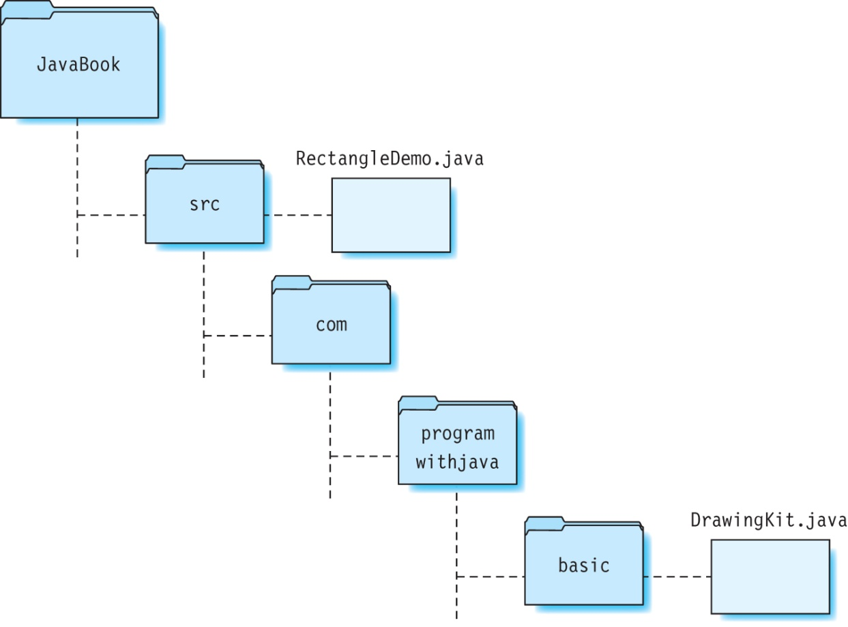
Directory Structure
Place your source files in the src directory, and DrawingKit.java in the com/programwithjava/basic directory.

Slide 18
Compiling and Running RectangleDemo (on a PC)
Compile RectangleDemo.java as follows:
C:\JavaBook> javac -d bin src\com\programwithjava\basic\DrawingKit.java src\RectangleDemo.java
Run the program RectangleDemo as follows:
C:\JavaBook> java -classpath bin RectangleDemo

Slide 19
Compiling and Running RectangleDemo (on a Macintosh)
Compile RectangleDemo.java as follows:
C:\JavaBook> javac -d bin src/com/programwithjava/basic/DrawingKit.java src/RectangleDemo.java
Run the program RectangleDemo as follows:
C:\JavaBook> java -classpath bin RectangleDemo

Slide 20
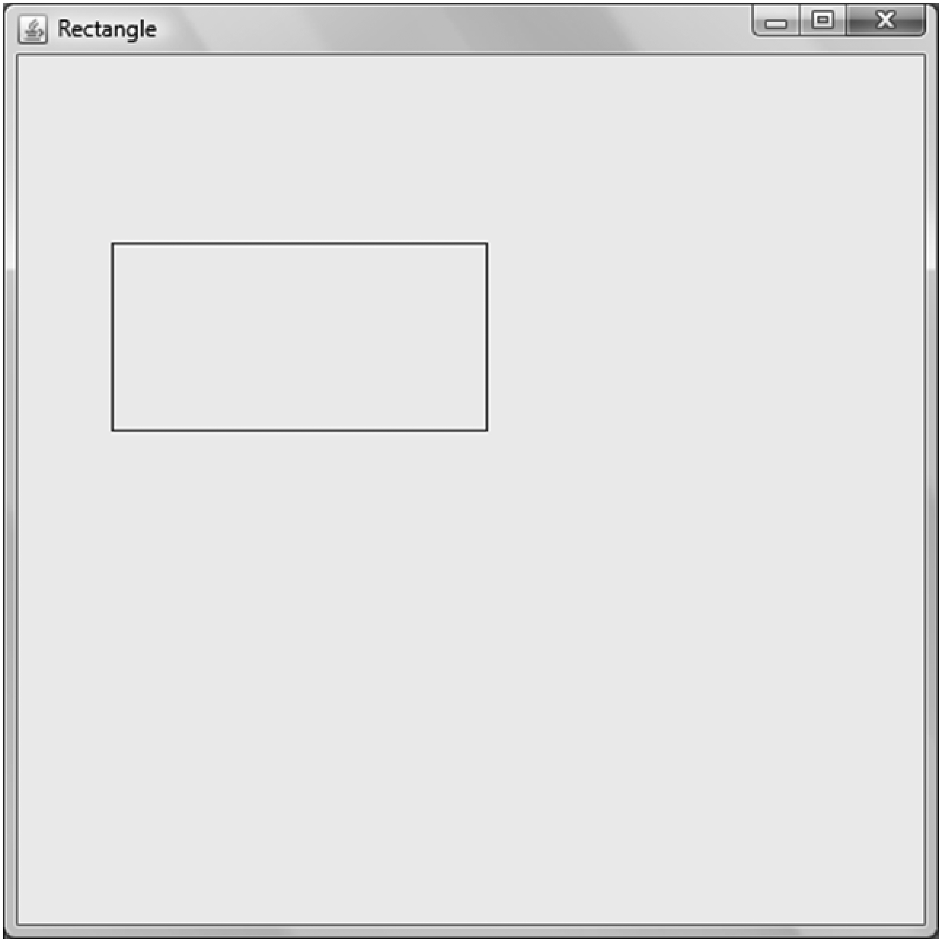
Output of Program RectangleDemo
Note that when you click at any point in a window created using DrawingKit, the x- and y-coordinates of that point will be displayed on the console.

Slide 21
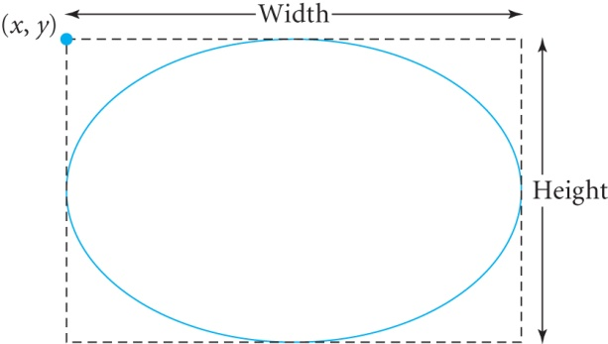
Drawing and Coloring an Ellipse
Create an ellipse with x = 50, y = 100, width = 300, and height =200:
Ellipse2D.Float myellipse = new Ellipse2D.Float(50, 100, 300, 200);
Draw an ellipse using the instance dk of DrawingKit:
dk.draw(myellipse);
Color the ellipse magenta:
dk.setPaint(Color.magenta);
dk.fill(myellipse);

Slide 22
Drawing and Coloring a Line
Use the Line2D.Float constructor to create a line.
Create a line joining the points (10, 20) and (40, 50):
Line2D.Float myLine = new Line2D.Float(10, 20, 40, 50);
Draw this line with magenta color:
dk.setPaint(Color.magenta);
dk.draw(myLine);
Note: Other colors include white, gray, lightGray, black, pink, yellow, green, orange, cyan, blue, darkGray.

Slide 23
Changing the Line Thickness
Use the BasicStroke class to set the thickness of lines to draw graphics shapes.
Example:
This sets the line thickness to 10:
If a thicker (thinner) line is desired, use a larger (smaller) number.
BasicStroke myStroke = new BasicStroke(10);
dk.setStroke(myStroke);

Slide 24
Writing Text
Use the drawString method of DrawingKit to write text.
Writes the word “Hello” starting at the point (50, 100) on the window:
dk.drawString("Hello", 50, 100);
To use a specific font (called myFont), create the new font using the Font constructor:
Font myFont = new Font("Times New Roman", Font.ITALIC, 12);
Set the font to this new font named myFont:
dk.setFont(myFont);

Slide 25
Drawing a Curve
Use the QuadCurve2D.Float class.
To draw a curve joining the points (10, 20) and (100, 200) through the point (80, 90):
QuadCurve2D.Float curve1 = new QuadCurve2D.Float();
curve1.setCurve(10, 20, 80, 90, 100, 200);
dk.draw(curve1);

Slide 26
Drawing an Image
Use the drawPicture method of DrawingKit.
This draws the picture in file clouds.jpg in the window:
dk.drawPicture("clouds.jpg");
This file should be present in the working directory, where you are compiling your program.
The working directory can be different on different computers but Java will pick up the file from the correct directory.

Slide 27
Changing the Window Size
The default window size is 500 by 500.
To create a window of a different size (say width 800 and height 200), use this DrawingKit constructor:
DrawingKit dk = new DrawingKit("title", 800, 200);

Slide 28
Writing to the Console
Use the System.out.print and System.out.println methods to write to the console.
Examples:
If there are multiple calls to System.out.println, each message is displayed on a new line.
Calls to System.out.print display the messages on a single line.
System.out.print("This is text output");
System.out.println("Text output is useful for debugging programs.");
System.out.println("Graphics are more fun, though.");

Slide 29
ConsoleOutputDemo.java
public class ConsoleOutputDemo {
public static void main(String[] args) {
System.out.println("Text output is useful for debugging programs.");
System.out.println("Graphics are more fun, though.");
}
}
Program output:
Text output is useful for debugging programs.
Graphics are more fun, though.
Note: You don’t need to use DrawingKit in this program because it displays data on the console.

Slide 30
Summary
We discussed how to:
Use Java 2D classes to create graphics objects and text in different fonts.
Create a window, and display and color graphical shapes using the DrawingKit class.
Compile and run Java programs.
Write to the console.
What’s next:
Basic constructs to create Java programs

