Slide 1

Chapter 3
Programming Basics

Slide 2
Outline
Primitive Data Types, Identifiers, Literals, Strings, Constants
Assignment Statements
Conversion and Casting
Using Constructors and Methods
The Scanner Class
Operators
Classes and Packages
Introduction to Digital Images

Slide 3
Primitive Data Types
Integers
int, byte, short, and long
Floating-point numbers
float and double
Characters
char
True/false values
boolean
Note: int is commonly used for integers, and double for floating-point numbers.

Slide 4
Declaring and Initializing Primitives
Declaration: reserves memory for the variable.
Initialization: an initial value given to the variable before it is used.
Example:
Declaring an integer variable called num1:
int num1;
Initializing num1 to 10:
num1 = 10;

Slide 5
Declaring and Initializing Primitives
Declaring and initializing a float:
float num2 = 1020.43f;
Declaring and initializing a double:
double num3 = 32.56;
Declaring and initializing a long:
long num4 = 9000000000L;
Declaring and initializing a char:
char ch1 = 'A';
A boolean variable can be either true or false.
boolean flag = true;

Slide 6
Identifiers
Identifier is the name given to a variable, class, method or package.
Rules for identifiers:
Cannot contain white spaces.
Should start with a letter and not a number or symbol; an exception is that it can begin with _ or $.
Can contain underscore characters, as in my_score.
Are case sensitive: upper is not the same as uPper.
Cannot be a Java keyword.
Conventions:
Use identifiers that are short and meaningful.
Do not use a $ or _ to start an identifier although this is allowed.
When you create an identifier by combining multiple words, capitalize the first letter of each of the following words.

Slide 7
Literals
A literal is a fixed value used in a program, such as a number or character.
Examples:
The values 10, 1033.45f, true, and % are literals.
int index = 10;
float win = 1033.45f;
boolean isCorrect = true;
char modulus = '%';

Slide 8
String Literals
A string literal is a set of characters on a single line that is enclosed within double-quotes.
Examples:
“Hello!”
“Current Score: 100”
“5 % 3”

Slide 9
Strings
A string is an instance of class String.
Can initialize a String object with a string literal:
Do not use the String constructor to create a string.
String firstName = "Joan";
String lastName = "Wright";

Slide 10
Concatenation Operator
Concatenation operator (+) combines multiple strings together:
Example:
Use + when a string does not fit on a single line:
String firstName = "Joan";
String lastName = "Wright";
String fullName = firstName + " " + lastName;
System.out.println(fullName); // prints out: Joan Wright
String fearOfLongWords = "Hippopotomonst" +
"rosesquipedaliophobia";

Slide 11
Constants
Have a fixed value that cannot be changed anywhere in the program.
Declared using the final and static keywords.
By convention, constant names are in upper case letters.
It is a compile-time error to declare a constant and not initialize it.
Example:
This initializes a constant called MAX_SIZE with the value 100:
static final int MAX_SIZE = 100;

Slide 12
Assignment Statements
Used to change the value stored in a variable.
General form:
variable = expression;
Examples:
length = 5; // length holds the value 5
5 = length; // error!
int width = length; // width gets the value in length
width = length = 20; // both width and length store 20

Slide 13
Conversion
Conversion occurs when a narrower type is converted to a wider type, and it takes place implicitly.
Examples:
short s = 10;
int num = s; // conversion of s from short to int
float f = num; // conversion of num from int to float
double d = f; // conversion of f from float to double

Slide 14
Casting
Casting is used to convert a wider type such as a double to a narrower type such as int.
A cast is a data type enclosed within parentheses:
double d = 100.5;
int i = (int) d; // i = 100

Slide 15
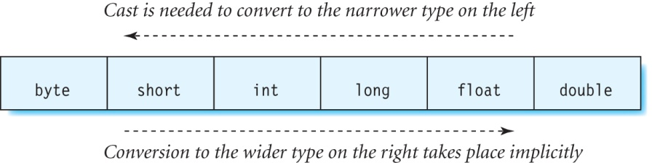
Conversion and Casting Rules

Slide 16
Parameters
Parameters are the variables used in a constructor or method declaration.
Example:
The Rectangle2D.Float constructor is declared as follows:
Rectangle2D.Float(float x, float y, float w, float h)
Here, x, y, w and h are parameters.

Slide 17
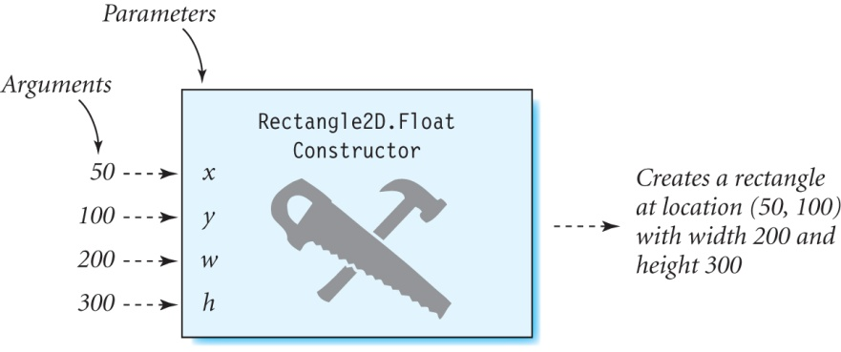
Passing Arguments
A Rectangle2D.Float object is created by passing arguments 50, 100, 200, and 300 to the constructor as follows:
Rectangle2D.Float rect = new Rectangle2D.Float (50, 100, 200, 300);
The arguments 50, 100, 200 and 300 are copied into the parameters x, y, w, and h.

Slide 18
Passing Arguments
You need to know the data type and order of the parameters in the constructor or method, and pass in arguments that match that type and order.
Besides primitive types, reference type arguments can also be passed into constructors and methods.

Slide 19
Using Variables as Arguments
Can pass variables instead of literals as arguments to a constructor or method.
Example:
float x = 50, y = 100, width = 200, height = 300;
Rectangle2D rect_same = new Rectangle2D.Float (x, y, width, height);

Slide 20
Methods That Return Values
A method can return either a single value or none at all to the calling method.
A method that does not return a result has a return type of void.
Constructors do not return any values, and so they do not have a return type.

Slide 21
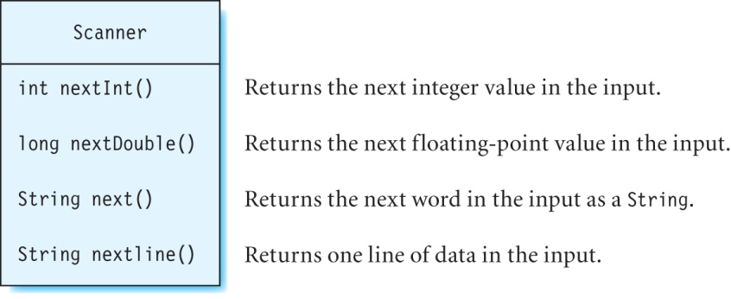
The Scanner Class

Slide 22
The Scanner Class
Used to read data from the console.
The nextShort, nextFloat, and nextLong methods in Scanner work similarly.
Each of these methods (except nextLine()) reads a set of consecutive characters until a whitespace (such as a blank or tab) is encountered.
The nextLine method reads all of the data that a user typed on a line.

Slide 23
Using the Scanner Class
Create a scanner:
Scanner scanner = new Scanner(System.in);
Read an integer from the console using scanner:
int number1 = scanner.nextInt();
(A runtime error occurs if a different data type is entered.)
Read a string from the console using scanner:
String string1 = scanner.next();

Slide 24
Operators
Arithmetic + − * / %
Increment ++
Decrement --
Assignment −= += *= /=

Slide 25
Calculator.java
import java.util.Scanner;
public class Calculator {
public static void main(String[] args) {
Scanner scanner = new Scanner (System.in);
System.out.print("Enter a number:");
// read the number from the console into variable number1
double number1 = scanner.nextDouble();
System.out.print("Enter another number:");
// read the number from the console into variable number2
double number2 = scanner.nextDouble();
System.out.println("The result is:" +(number1 - number2) )
}
}
The program output is:
Enter a number:10
Enter another number:30.5
The result is:-20.5

Slide 26
Unary Operators
Take a single operand:
++ increment
−− decrement
+ plus (has no effect)
− minus (negates the operand)
Increment operator is used to increase the value of a variable by 1:
++alpha; // increment operator used in prefix position
alpha++; // increment operator used in postfix position
Decrement operator decreases a variable’s value by 1:
--beta; // decrement operator used in prefix position
beta--; // decrement operator used in postfix position

Slide 27
Assignment Operators
−= += *= /= represent assignment statements in an abbreviated form.
Examples:
These two statements are equivalent:
length = length + 5;
length += 5; // increment length by 5
These two statements are also equivalent:
length = length * 10;
length *= 10; // multiply length by 10
Other operators are used similarly.

Slide 28
Operator Precedence
A mnemonic to remember operator precedence: PUMAS
P Parentheses (), Postfix a++ a--
U Unary operators (except postfix) + − ++a −−a
M Multiplication, division and Modulus * / %
A Addition & subtraction + −
S Special assignments = += −= *= /= %=
highest
lowest

Slide 29
Example
Evaluate: d = a * b++ + c;
The ++ operator is the most important of the operators in this expression. Add parentheses around b++:
d = a * (b++) + c;
Among the remaining operators (*, +, and =), * has greater importance. Add parentheses around *, and the two variables that use this operator:
d = (a * (b++)) + c;
Since + has higher importance than =, add parentheses:
d = ((a * (b++)) + c);
The expression is fully parenthesized now.
Evaluate values in the inner parentheses before those in the outer parentheses.

Slide 30
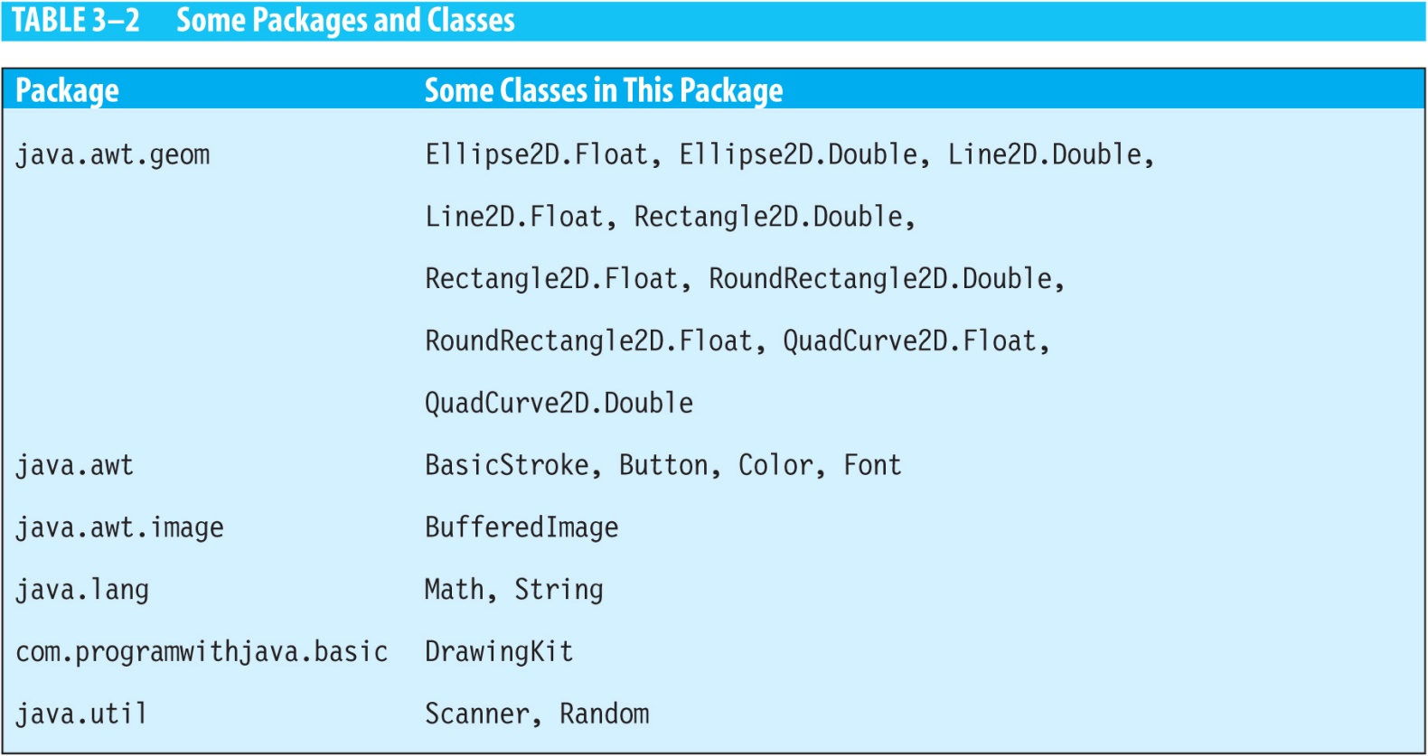
Packages
A package is a directory containing a group of Java source files.
A subpackage is a package that is inside another package.

Slide 31
Using Packages
You can use a class that is in a different package from your program in one of two ways:
Prefix the package name to the class name each time you use the class.
Example: java.awt.Rectangle2D.Float
Use an import statement at the start of the source code file.
Example: import java.awt.geom.Rectangle2D.Float;
Don’t need to prefix the class name Rectangle2D.Float with the package name java.awt anywhere else in that file.

Slide 32
Import Statements
Multiple import statements can also be specified in the same file.
A wildcard operator (*) can be used to import all classes in that package by using a single statement:
import java.awt.geom.*;
Does not import any of the classes in the subpackages.
The java.lang package containing the Math and String classes is loaded automatically by the JVM.

Slide 33
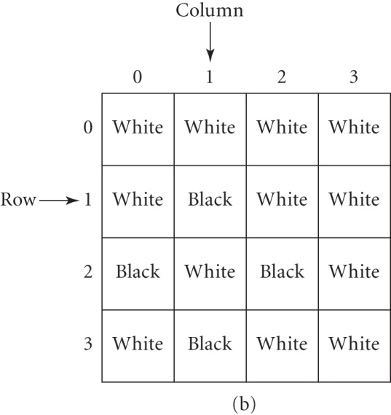
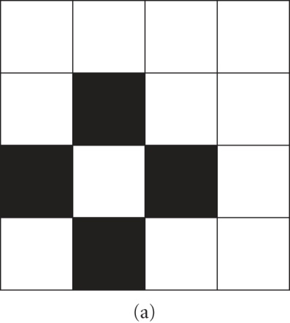
Digital Images
Digital images (photographs and graphics) are stored as two-dimensional arrays of color values.
Each color value is called a pixel.

Slide 34
RGB Color Model
How is the color information stored in the pixel of an image displayed as a color on a screen pixel?
A color model consists of a specific set of primary colors.
The RGB color model, used in computers and television, has red, green, and blue as its primary colors.
Combining these colors in different proportions produces other shades such as yellow, orange, brown, cyan, white and many others.

Slide 35
Digital Image Terminology
A sample is a value of the red, blue, or green components in a pixel.
An RGB color image has three samples for every pixel, whereas a gray scale image has one sample per pixel.
A channel refers to one particular component of every pixel in a picture.
An RGB image has three channels.
Some images can have a fourth channel known as alpha.
The alpha channel specifies the transparency of pixels an image.

Slide 36
ColorComponentDisplay.java
import java.awt.Color;
public class ColorComponentDisplay {
public static void main(String[] args) {
System.out.println("White: " +Color.WHITE);
System.out.println("Black: " +Color.BLACK);
System.out.println("Red: " +Color.RED);
System.out.println("Green: " +Color.GREEN);
System.out.println("Blue: " +Color.BLUE);
System.out.println("Yellow: " +Color.YELLOW);
System.out.println("Orange: " +Color.ORANGE);
System.out.println("Pink: " +Color.PINK);
}
}
Program Output:
White: java.awt.Color[r=255,g=255,b=255]
Black: java.awt.Color[r=0,g=0,b=0]
Red: java.awt.Color[r=255,g=0,b=0]
Green: java.awt.Color[r=0,g=255,b=0]
Blue: java.awt.Color[r=0,g=0,b=255]
Yellow: java.awt.Color[r=255,g=255,b=0]
Orange: java.awt.Color[r=255,g=200,b=0]
Pink: java.awt.Color[r=255,g=175,b=175]

Slide 37
Bit Depth
The number of bits needed to store a sample is called bit depth.
Each sample is a number in the range 0 to 255 and it can be stored in 8 bits.
For example, a white pixel in an 8-bit RGB color image has samples (255, 255, 255), and a black pixel has samples (0, 0, 0).
Since a pixel has three samples in an RGB image, a total of 24 bits is used to represent the color of each pixel.
If the alpha channel is also present, each pixel has 32 bits.

Slide 38
Exercise
A color image using the RGB color model has a bit depth of 8 bits per channel. What is the total number of colors that can be displayed using this model?

Slide 39
Image Resolution
Resolution is the total number of pixels in an image.
An image that is 300 pixels wide and 400 pixels high has a resolution of 120,000 pixels.
How are clarity and size affected if the number of pixels in an image is increased?

Slide 40
Exercise
Calculate the size of an RGB color image that has a resolution of 700 × 400. Assume that the bit depth is 8 bits, and the alpha channel is present.

Slide 41
File Formats
Some common formats:
GIF (Graphics Interchange Format)
JPEG (Joint Photographic Experts Group)
PNG (Portable Networks Graphics)
TIFF (Tagged Image File Format)

Slide 42
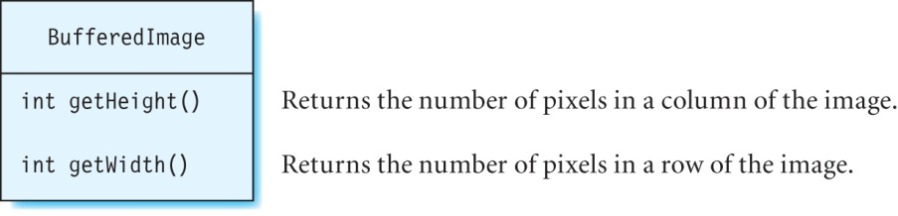
Class BufferedImage
Is a Java 2D class in the java.awt.image package.
Used to store images in the computer’s memory, and retrieve information about and manipulate these images.
The getRGB method returns an encoded value containing the values of the red, green, and blue samples.

Slide 43
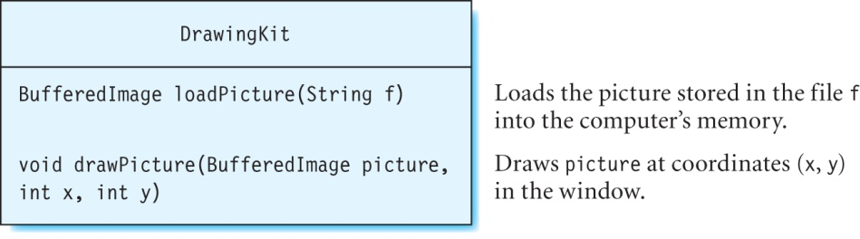
Displaying an Image With DrawingKit
Displaying an image is a two-step process:
1. Load the image from a file into the computer’s memory.
2. Transfer the image from memory on to the screen.
The image can be modified while it is stored in memory and before it is displayed.

Slide 44
DisplayPicture.java
import java.awt.image.*;
import com.programwithjava.basic.DrawingKit;
public class DisplayPicture {
public static void main(String[] args) {
DrawingKit dk = new DrawingKit("Daffodils", 850, 850);
// transfer the image from daffodils.jpg file into computer’s memory
BufferedImage pict = dk.loadPicture("image/daffodils.jpg");
// draw the image referenced by pict on the screen
dk.drawPicture(pict,25,50);
}
}

Slide 45
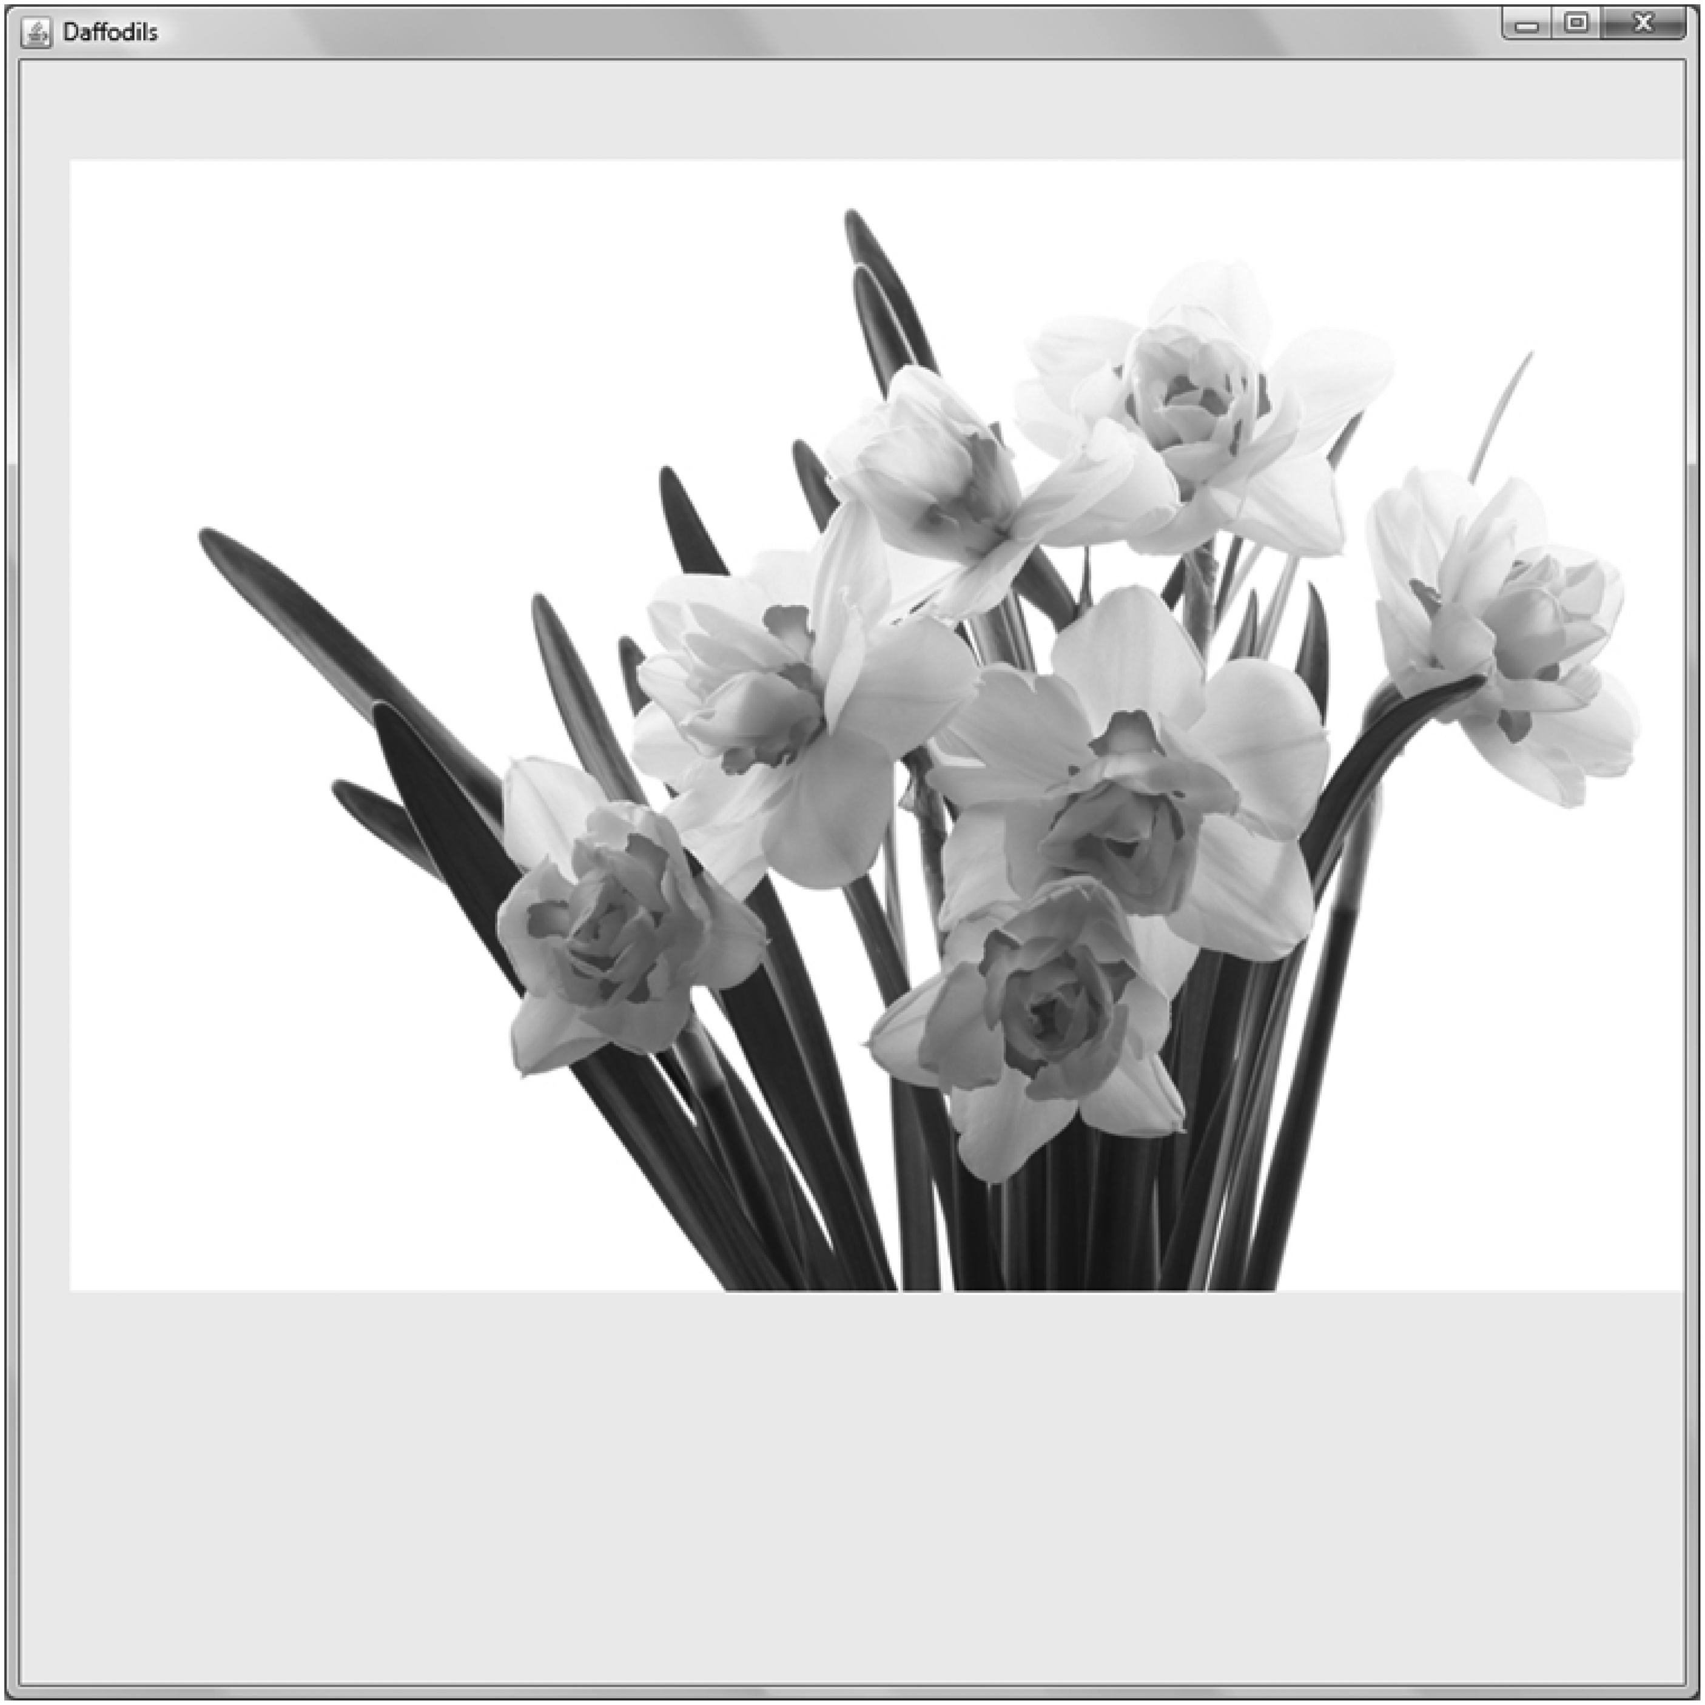
Output of DisplayPicture
daffodils.jpg, © Monika Adamczyk, 123RF.com

Slide 46
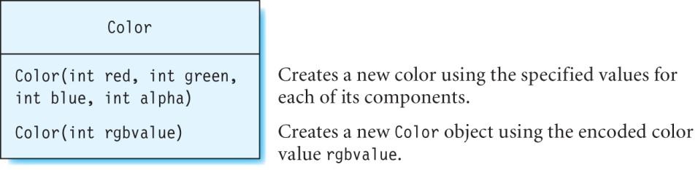
Class Color
Java 2D’s Color class is in the java.awt package.
You can create new colors using this class, determine the values of the various components of an existing color, and perform several other operations.

Slide 47
Retrieving Samples from an Image File
Use the getRGB method of class BufferedImage to retrieve the encoded value of a pixel.
Pass this encoded value to the Color(int rgbvalue) constructor to create a Color object.
Use this object to display the corresponding samples of a pixel.
For example, to display the pixel value at location (x, y):
int encodedPixelColor = pict.getRGB(x, y);
Color pixelColor = new Color(encodedPixelColor);
System.out.println(pixelColor);

Slide 48
GPS Receivers
Use 3D Trilateration to determine the location of a place.
2D Trilateration is similar, but simpler.
The basic idea behind 2D trilateration is that if the coordinates of three points (A, B and C) are known, and their distances from a fourth point U (with unknown coordinates) are also known, then we can determine the coordinates of point U (using simple geometry and algebraic manipulation).

Slide 49
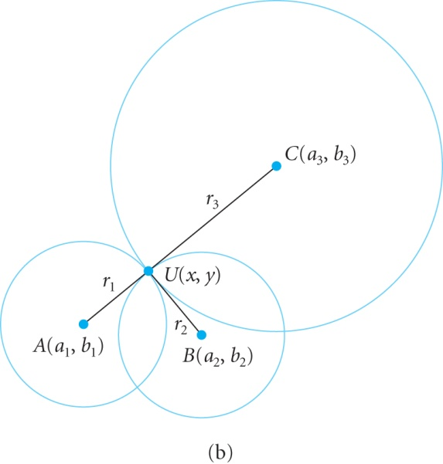
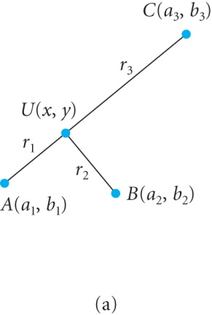



GPS Receivers continued
Using geometry, the equations of the three circles are given by:

Slide 50


2D Trilateration
Solving these three equations for x and y gives:

Slide 51
Exercise
Write the equations for x and y (on the previous slide) using Java statements.
Solution:
double a1Sq = a1 * a1, a2Sq = a2 * a2, a3Sq = a3 * a3, b1Sq = b1 * b1, b2Sq = b2 * b2, b3Sq = b3 * b3, r1Sq = r1 * r1, r2Sq = r2 * r2, r3Sq = r3 * r3;
double numerator1 = (a2 - a1) * (a3Sq + b3Sq - r3Sq) + (a1 - a3) * (a2Sq + b2Sq - r2Sq) + (a3 - a2) * (a1Sq + b1Sq - r1Sq);
double denominator1 = 2 * ( b3 * (a2 - a1) + b2 * (a1 - a3) + b1 * (a3 - a2));
y = numerator1/denominator1;
double numerator2 = r2Sq - r1Sq + a1Sq - a2Sq + b1Sq - b2Sq - 2 * (b1 - b2) * y;
double denominator2 = 2 * (a1 - a2);
x = numerator2/denominator2;

Slide 52
Algorithm for 2D Trilateration
The algorithm is shown below:
Prompt the user to enter coordinates of points A, B and C.
Read the coordinates of these three points and store them in variables.
Prompt the user to enter the distances of points A, B and C from point U.
Read the three distance values and store them in variables.
Calculate coordinates of U using the formulas for y and x.
Display the coordinates of point U.

Slide 53
Exercise
Using the algorithm on the preceding slide, write a program to calculate and display the coordinates of point U.

Slide 54
Summary
We discussed how to:
Write Java statements and simple programs.
Read data from the console.
Display an image from a file as well as the samples of a particular pixel in that image.
Write a program using the 2D Trilateration technique.
What’s next:
Control flow statements

