Slide 1

Chapter 4
Control Flow Statements

Slide 2
Outline
Selection Statements and Loops
Flowcharts
Conditions
Selection Statements
Scope of Variables
Loops
Conditions using Logical Operators
break and continue Statements
Nested for loops
Summary

Slide 3
Selection Statements and Loops
Alter the sequential flow of execution.
Selection statements are used to perform one out of many possible operations depending on which condition in a given set is true:
if, if-else, switch
Loops are useful when certain operations must be performed repeatedly:
while, do-while, for

Slide 4
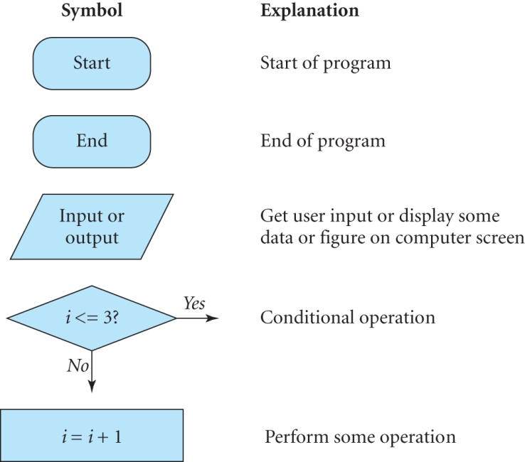
Flowcharts
Flowcharts use symbols to describe an algorithm.
Flowcharts are not unique; there can be different flowcharts for the same problem.

Slide 5
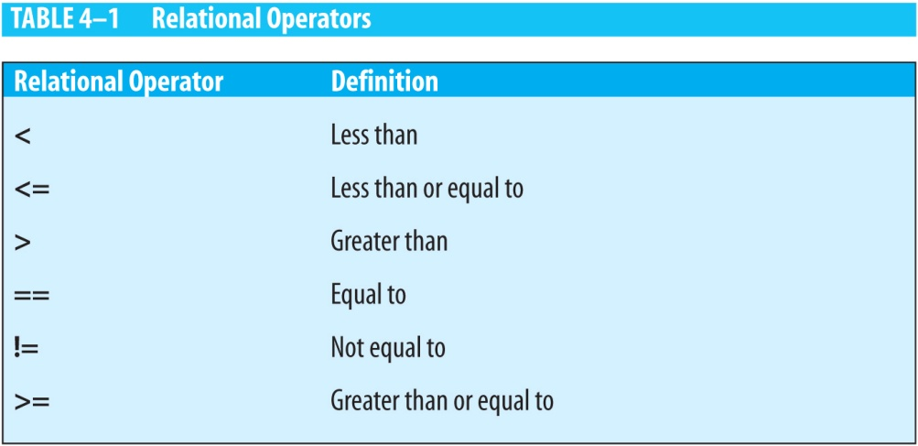
Conditions
A condition is a boolean expression that evaluates to either true or false.
Examples:
5 > 4 // true
3 < 1 // false
Relational operators are used to formulate a condition.

Slide 6
Examples of Conditions
x > 2 // true if x is greater than 2
y < z + 3 // true if y is less than z + 3
x >= 2 // true if x is greater than or equal to 2
y != z // true if y is not equal to z
w == g * 2 // true if w is equal to g * 2
m <= -3 // true if m is less than or equal to -3
x == 200 // true if x is equal to 200
x = 200 // error! not a condition

Slide 7
Selection Statements
if “book is available”
I will read it
if “it is raining”
I will drive
else
I will walk

Slide 8
The if Statement
Checks whether a condition is true or false, and executes a given set of statements if this condition is true:
Multiple statements following the “if” clause should be enclosed within braces {}.
A set of statements within braces is referred to as a block.
The braces are typically omitted if there is a single statement in a block.
if (condition) {
// statements
}

Slide 9
More on if Statements
Indent the statements inside the if block by a few spaces so that the program is easier to read.
Examples:
The statements in this block are executed only if ratio has a value greater than 1.0:
Omit the braces here:
if (ratio > 1.0) {
ratio = 1.0;
width++;
}
if (radius > 5.0)
height = 1.0;

Slide 10
The if-else Statement
Specifies alternate actions to be carried out when the “if” clause evaluates to false.
The general form is:
if (condition) {
// statements
} else {
// statements
}

Slide 11
The if-else Statement (continued)
A compilation error occurs if a statement is placed between the two blocks:
if (length != 550) {
// do something here
}
int y = 5; // error
else {
// do something else
}

Slide 12
Multiple else-if Clauses
Can use multiple else-if clauses, each of which specifies a different condition to be tested:
if (condition_1) {
// statements to be executed if condition_1 is true
} else if (condition_2) {
// statements to be executed if condition_2 is true
}
...
} else if (condition_i) {
// statements to be executed if condition_i is true
} else {
// statements to be executed if
// none of the above conditions is true
}

Slide 13
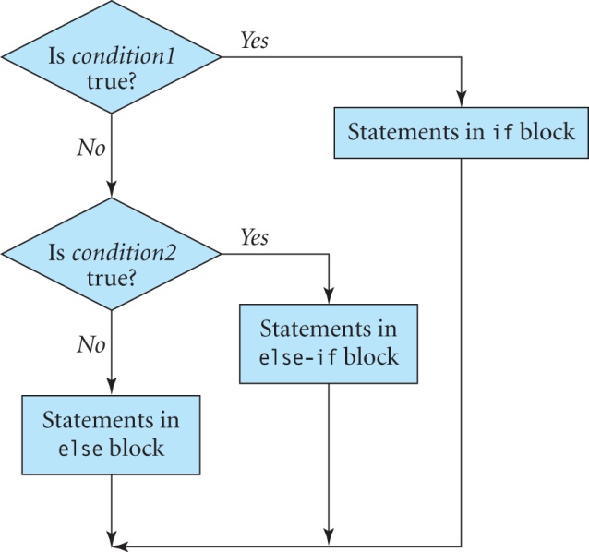
Flowchart of a statement with if, else-if, and else blocks.

Slide 14
MagicShapes.java
A code segment from the program MagicShapes:
if (magicColor == 0) {
// magicColor is 0, set color to red
dk.setPaint(Color.red);
} else if (magicColor == 1) {
// magicColor is 1, set color to cyan
dk.setPaint(Color.cyan);
} else {
// magicColor is 2, set color to magenta
dk.setPaint(Color.magenta);
}

Slide 15
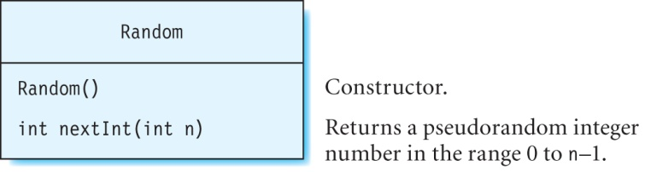
Class Random
The class Random is defined in the java.util package, and an instance of this class is used to generate pseudorandom numbers.
Example:
Random rand = new Random();
// magicColor gets a random integer value of 0, 1 or 2
int magicColor = rand.nextInt(3);

Slide 16
The switch Statement
Used to select one out of many conditions.
Case values cannot contain ranges, and cannot be double, float, a string, or an object.
General form :
switch(var) {
case value1:
// execute these statements if var is equal to value1
break;
case value2:
// execute these statements if var is equal to value2
break;
...
default:
// execute these statements if var does not match any value
break;
}

Slide 17
CrystalBall.java
A code segment from the program CrystalBall:
What
Random r = new Random();
// magicNumber gets a random integer value of 0, 1, 2 or 3.
int magicNumber = r.nextInt(4);
// Based on the value of magicNumber, one of the
// strings shown below is displayed on the screen.
switch(magicNumber) {
case 0: dk.drawString("Something surprising", x2, y2);
dk.drawString("will happen", x2 + w2, y2 + h1);
break;
case 1: dk.drawString("An exceptional event", x2, y2);
dk.drawString("has occurred", x2 + w1, y2 + h1);
break;
case 2: dk.drawString("Shake the ball", x2 + w2, y2);
dk.drawString("and focus harder", x2 + w1, y2 + h1);
break;
default: dk.drawString("Good fortune", x2 + w2, y2);
dk.drawString("comes your way", x2 + w1, y2 + h1);
break;
}
What is the output if the break statements are omitted?

Slide 18
Exercise
Rewrite the code segment on slide 14 using a switch statement.

Slide 19
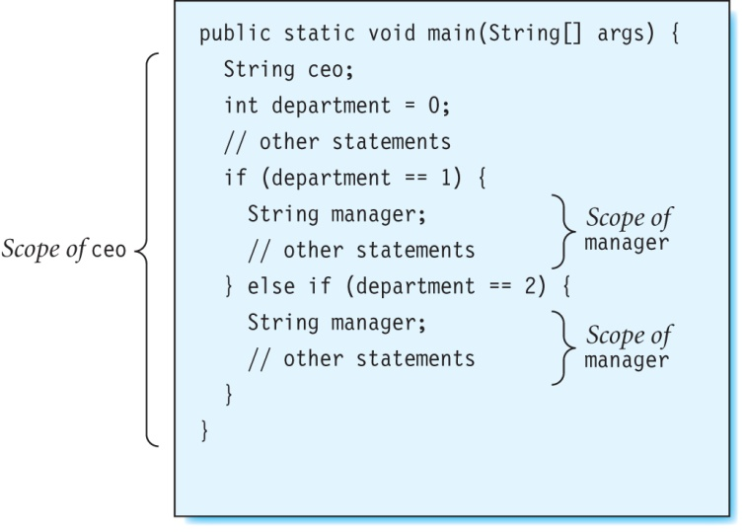
Scope of Variables
The scope of a variable refers to that portion of the program where the variable can be accessed.
A variable can only be accessed in the block where it is declared.

Slide 20
Loops
A loop is used when an action has to be repeated many times.
There are three types of loops:
while
do-while and
for

Slide 21
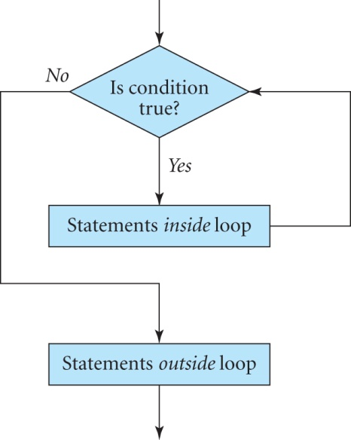
The while loop
A while loop executes statements repeatedly until the loop condition becomes false:
while (condition) {
// statements inside loop
}
// statements outside loop

Slide 22
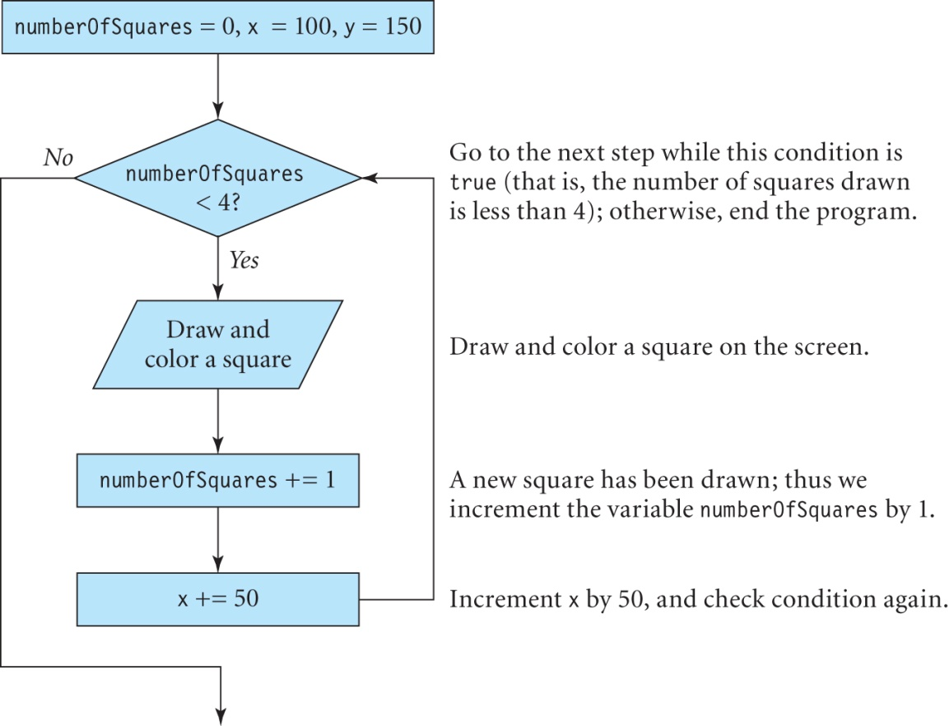
Squares.java
Using a while loop, draw four blue-colored squares with sides of length 30, at points (100, 150), (150, 150), (200, 150) and (250, 150).
Solution. The flowchart is drawn as follows:

Slide 23
Squares.java
import java.awt.*;
import java.awt.geom.*;
import com.programwithjava.basic.DrawingKit;
public class Squares {
public static void main(String[] args) {
DrawingKit dk = new DrawingKit("Squares");
int numberOfSquares = 0, x = 100, y = 150, width = 30, height = 30;
while (numberOfSquares < 4) {
// draw and color a square
Rectangle2D.Float rect_same = new Rectangle2D.Float (x, y, width, height);
dk.setPaint(Color.blue);
dk.fill(rect_same);
// increment number of squares drawn by 1
numberOfSquares += 1;
System.out.println(numberOfSquares);
// increment the x coordinate of the next square by 50
x += 50;
}
}
}

Slide 24
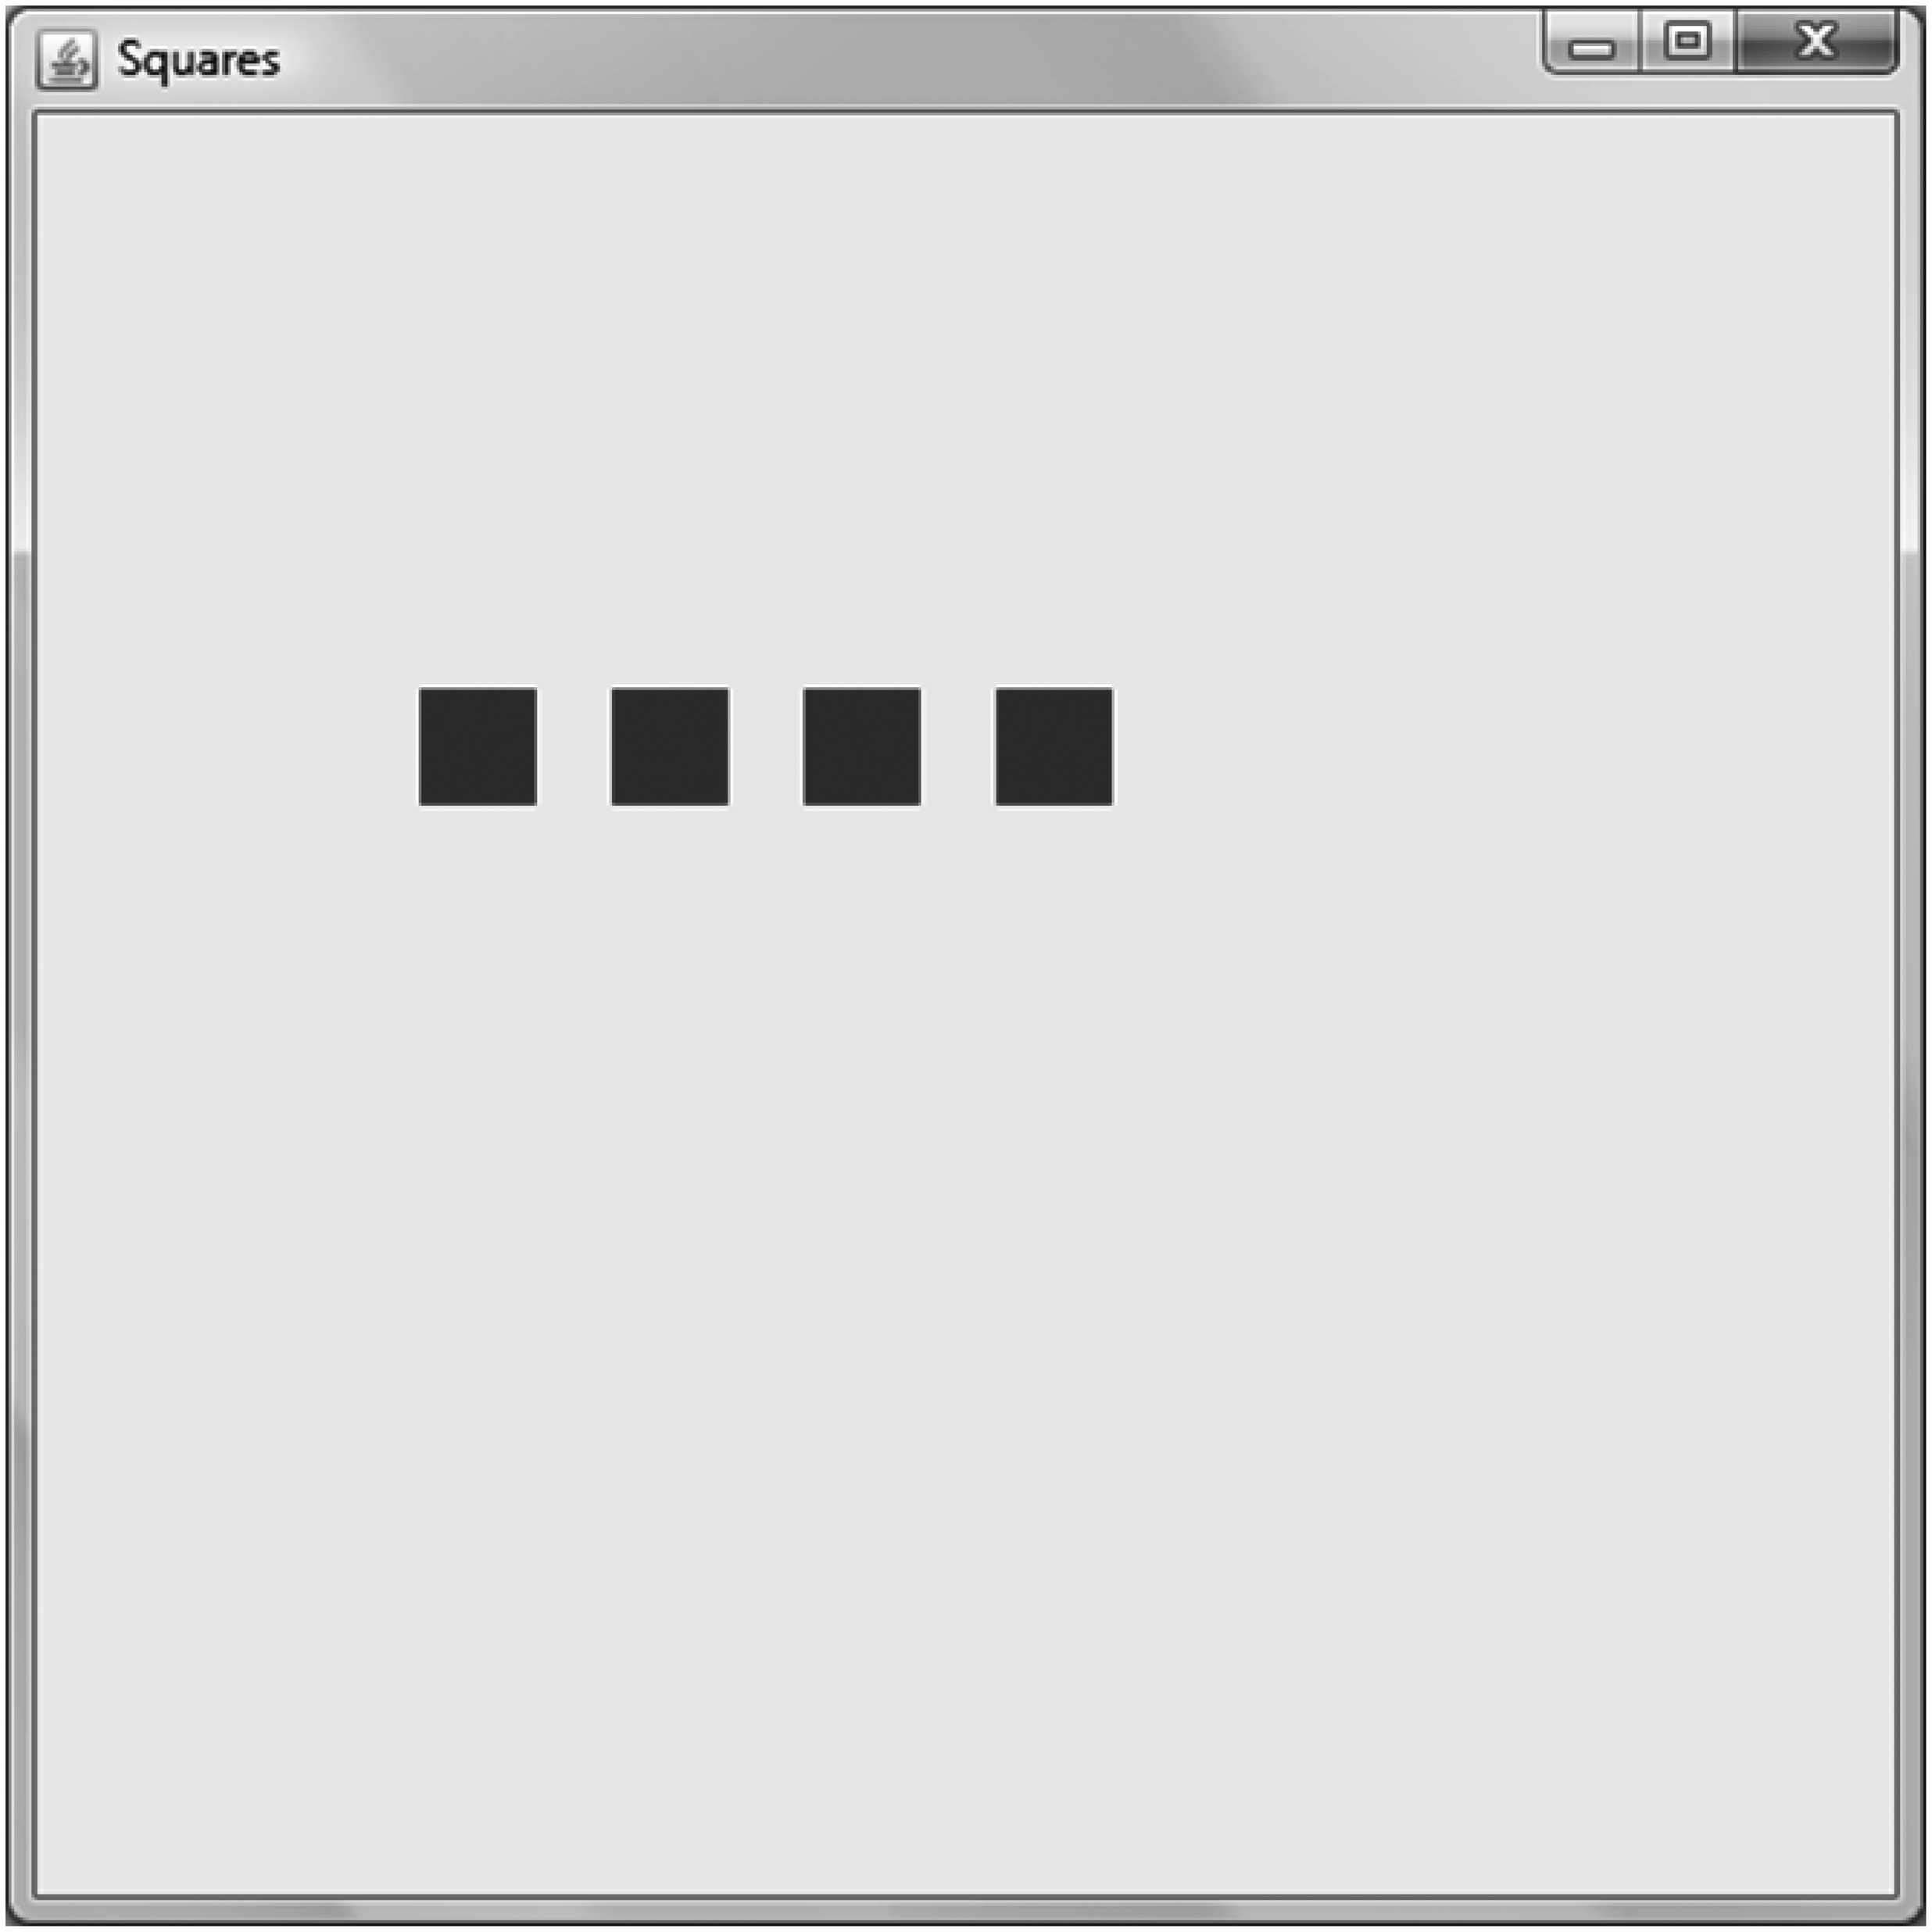
Output of Program Squares

Slide 25
Exercise
What is the problem in the loop below?
int x = 10, y = 5;
while (x < 50) {
y -= 1;
x -= 10;
System.out.println(x);
}
y += 2;

Slide 26
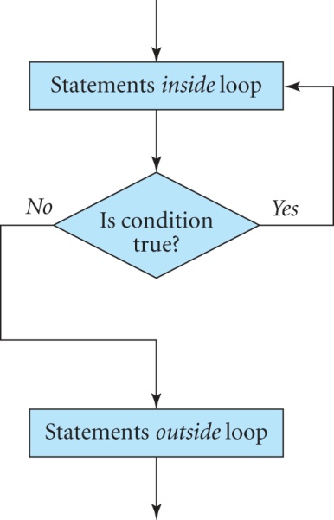
The do-while Loop
In the do-while loop the condition is tested at the end of the loop.
How is it different from the while loop?
General form:
do {
// statements inside loop
} while (condition);
// statements outside loop

Slide 27
Exercise
Rewrite the while loop in class Squares to draw 4 squares using a do-while loop.
Solution: The while loop is replaced with the following do-while loop:
do {
// draw and color a square
Rectangle2D.Float rect_same = new Rectangle2D.Float (x, y, width, height);
dk.setPaint(Color.blue);
dk.fill(rect_same);
// increment number of squares drawn by 1
numberOfSquares += 1;
System.out.println(numberOfSquares);
// increment the x coordinate of the next square by 50.
x += 50;
} while(numberOfSquares < 4);

Slide 28
The for Loop
The loop variable initialization and modification as well as the loop condition are specified in the for clause itself.
The statements inside the loop are executed only while the loop condition is true.
General form:
for (initialize loop variable; loop condition; modify loop variable) {
// statements inside loop
}
// statements outside loop

Slide 29
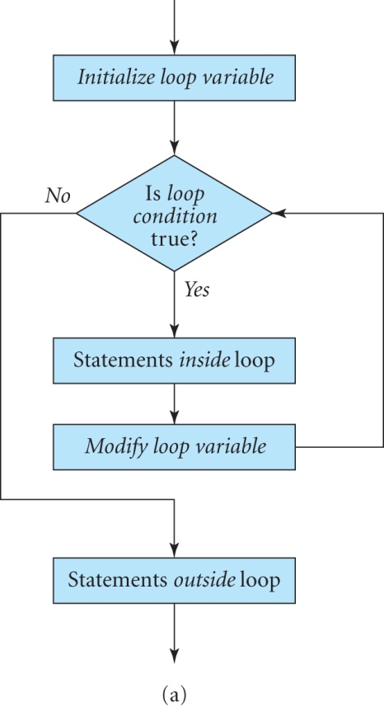
Flowchart of a for Loop

Slide 30
Exercise: ConcentricCircles.java
Use a for loop to draw 5 concentric circles with center at (225, 225). The radii of the circles are 100, 80, 60, 40, and 20.
Solution:
import java.awt.geom.*;
import com.programwithjava.basic.DrawingKit;
public class ConcentricCircles {
public static void main(String[] args) {
DrawingKit dk = new DrawingKit("Concentric Circles");
float x = 125, y = 125, r = 100;
for (int i = 0; i <= r; i = i+20) {
// draw a circle with diameter 2*(r-i)
Ellipse2D.Float circle = new Ellipse2D.Float (x+i, y+i, 2*(r-i), 2*(r-i));
dk.draw(circle);
}
}
}

Slide 31
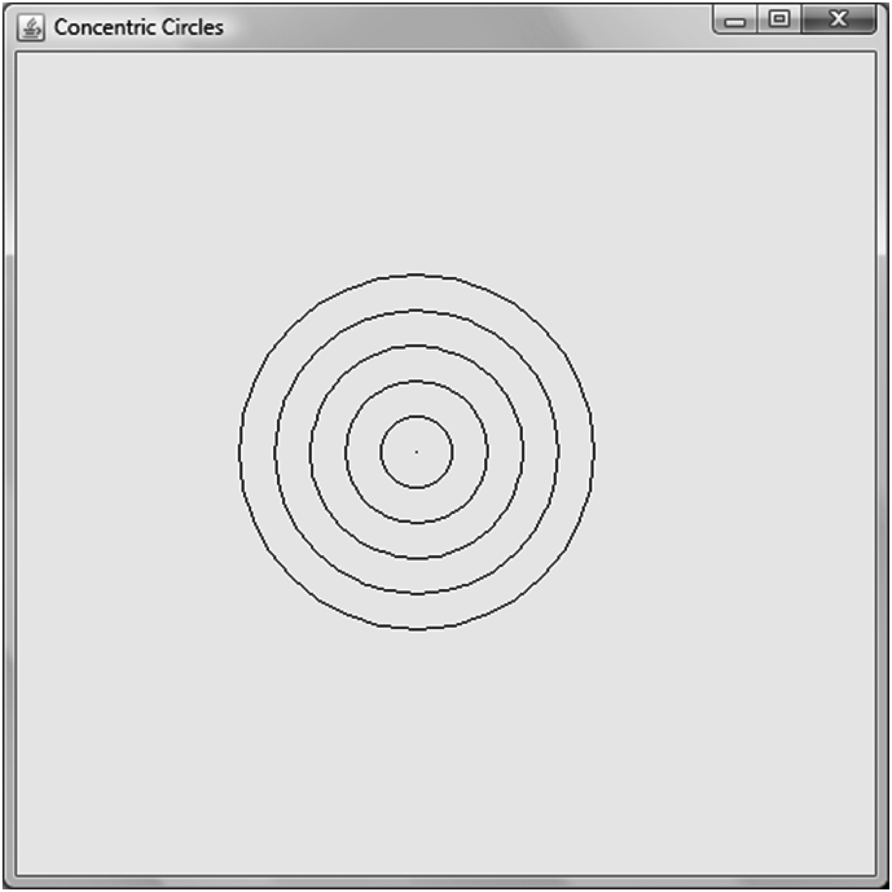
Output of Program ConcentricCircles

Slide 32
Logical Operators
Are also used in conditions:
Logical Operator What the symbol means
&& AND
|| OR
! NOT

Slide 33
&& Operator
Produces the boolean result of true only if both cond1 and cond2 are true in the expression:
cond1 && cond2
Examples:
7 > 5 && 3 < 10 // true because both conditions are true
a >= 5 && a <= 10 // true if a takes values from 5 to 10
x < 5 && x > 10 // false

Slide 34
|| Operator
Produces the boolean result of true if either one of cond1 or cond2 is true in the expression:
cond1 || cond2
For example:
7 > 5 || 11 < 10 // true because 7 > 5
3 > 5 || 11 < 10 // false because both conditions are false
a < 5 || a > 10 // false only if a is in the range 5 to 10.
a >= 5 || a <= 10 // true

Slide 35
! Operator
! operator: represents the negation of a condition.
If a condition is true, applying this operator will make it false.
This is a unary operator since it takes a single operand.
Example:
Suppose that we have a boolean variable bool and a condition E:
!bool // this condition is true only if bool is false.
!E // true only if E is false.

Slide 36
Operator Precedence Order
A mnenomic for operator precedence order :PUMA LEAPS
P for Parentheses, Post-fix ( ) a++ a−−
U for Unary operators (except post-fix) + − ++a −−a !
M for Multiplication & division, Modulus * / %
A for Addition & subtraction + −
L for Less than < <= > >=
E for Equality == !=
A for AND &&
P for Parallel lines ||
S for Special assignments = += −= *= /= %=
highest
lowest

Slide 37
The break Statement
Used in a loop to quit the loop immediately:
If condition2 is true, exit loop immediately and start executing statements outside loop.
while (condition1) {
// statements inside loop
if (condition2)
break;
}
// statements outside loop

Slide 38
The continue Statement
Terminates the current iteration of the loop and starts the next one:
If condition2 is true, skip statements after continue and start next loop iteration.
while (condition1) {
// statements inside loop
if (condition2)
continue;
// statements after continue
}
// statements outside loop

Slide 39
Exercise: BreakDemo.java
Write a program to generate 50 random numbers in the range 0 to 10. However, if the number 5 is generated, the program should terminate.
Solution: The random numbers are generated inside a for loop. A break statement is used to terminate the iteration when the number 5 is generated.
import java.util.*;
public class BreakDemo {
public static void main(String[] args) {
int number, x = 10, y = 50;
for (int i = 0; i < 50; i++) {
Random r = new Random();
number = r.nextInt(11);
System.out.println(number);
if (number == 5)
break;
}
}
}

Slide 40
Nested for Loops
A nested for loop consists of two for loops with one loop placed inside the other.
The outer and inner loops use different loop variables; each time the outer loop executes once, the inner loop executes with all values of its loop variable.
This is a nested for loop:
How many times do the outer and inner loops execute?
for (i = 0; i < 5; i++) {
for (j = 0 ; j < 3; j++) {
// statements inside loop
}
}

Slide 41
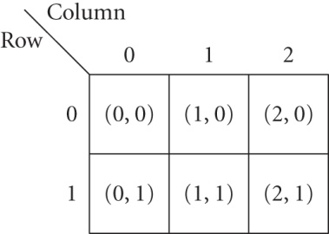
Using a Nested for Loop
Useful for iterating through of the elements of a two-dimensional array.
Example: An image is stored in a two dimensional array as follows:
What is the output of this loop?
for (int column = 0; column < 3; column++) {
for (int row = 0; row < 2; row++) {
System.out.println(column+"," +row);
}
}

Slide 42
Modifying Pictures
Use a nested for loop to iterate over all the pixels of a picture:
for (int x = 0; x < picture.getWidth(); x++) {
for (int y = 0; y < picture.getHeight(); y++) {
// get the color of a pixel at position (x, y)
// modify the color of this pixel
} // end inner for loop
} // end outer for loop

Slide 43
Getting the Color of a Pixel
Get the sample values of pixel at (x, y) in the BufferedImage called picture:
int colorValue = picture.getRGB(x, y);
Color pixelColor = new Color(colorValue);
int red = pixelColor.getRed() ;
int green = pixelColor.getGreen() ;
int blue = pixelColor.getBlue();

Slide 44
Changing the Color of a Pixel
Change the sample values of a pixel in a picture at position (x, y) to r, g, b for its red, green, and blue components, respectively by using:
The Color constructor, and
the getRGB method of class Color, and
the setRGB method of BufferedImage
Color newColor = new Color(r, g, b);
int newRgbvalue = newColor.getRGB();
picture.setRGB(x, y, newRgbvalue);

Slide 45
Changing the Transparency of a Pixel
Suppose that a pixel at location (x, y) has values r, g, and b for its red, green, and blue components, respectively, and a non-zero value of alpha.
To make a pixel fully transparent, set its alpha value to 0 in the Color(float r, float g, float b, float alpha) constructor:
int alpha = 0;
Color newColor = new Color(r, g, b, alpha);
int newRgbvalue = newColor.getRGB();
picture2.setRGB(x, y, newRgbvalue);

Slide 46
Checking the Transparency of a Picture
Pictures stored in the PNG file format may have an alpha channel that supports transparency.
This statement checks whether picture2 has an alpha channel or not:
picture2.getColorModel().hasAlpha();

Slide 47
The Ternary Operator ?:
Evaluates a condition, and assigns one of two values to a variable depending upon whether the condition is true or false.
This if-else statement can be written in a single line using the ?: operator:
If condition is true, the variable var is assigned value1; otherwise, it is assigned value2.
if (condition)
var = value1;
else
var = value2;
var = condition? value1 : value2;

Slide 48
Changing the Brightness of a Picture
If you multiply all the pixels in a picture with a value in the range 0 to 1, it will darken the picture.
If you multiply all the pixels with a value greater than 1, it will brighten the picture.

Slide 49
Exercise
Using the ternary operator, write a code segment to scale the value of the pixel sample by a factor of 1.75 only if it is less than or equal to 145; otherwise, set the value to 255.
Solution:
red = red <= 145? (int)(red * 1.75f): 255;
This is also repeated for the other two components.

Slide 50
Summary
We discussed:
Conditions
Selection statements
Loops
Nested for loops
The ternary operator
How to modify the colors, brightness, and transparency of a picture.
What’s next:
Writing custom classes

