Slide 1

Chapter 5
User-Defined Classes

Slide 2
Outline
Parts of a Class
Fields
Methods
Constructors
The this keyword
Organizing .java files in Packages
Access Modifiers
Static Fields and Methods
The DrawingKit Class
Documenting Programs
The Java API
Summary

Slide 3
Parts of a Class
A class has four important parts:
Fields
Methods
Constructors
Access modifiers

Slide 4
Fields
Fields are placed in the class body at the very beginning of the class definition.
The data type of each field must be placed before the field name.
Example:
Place each field declaration on a separate line so you can add comments to explain the purpose of each field.
class Lamp {
// fields
double diameter;
int wattage;
boolean lighted;
}

Slide 5
Assigning Values to Fields
Create a Lamp object called lamp:
Lamp lamp = new Lamp();
Assign a value of 3.0 to lamp’s diameter field:
lamp.diameter = 3.0;
Other fields can be assigned values similarly:
lamp.wattage = 50;
lamp.lighted = true;

Slide 6
Methods
Methods are added below the field declarations.
A method has a body, and it may return a value.
Example:
This method named doSomething returns a value of type int:
If a method does not return a value, the return type is void.
int doSomething() {
/* body of the method */
}

Slide 7
Adding Methods to Class Lamp
Add two methods turnOff and turnOn to Lamp:
class Lamp {
// fields
double diameter;
int wattage;
boolean lighted;
// methods
void turnOn() {
// do something here
}
void turnOff() {
// do something here
}
}

Slide 8
Method Body
Describes the actions that a method undertakes.
Contains statements that may change the fields, compute new results, or perform other operations such as drawing graphics.
Example:
Change the value of the field lighted to true:
void turnOn() {
lighted = true;
}

Slide 9
Returning Data From a Method
A method may return data to the calling method by using the keyword return followed by the name of the variable being returned.
A method can return only one value.
The return type of the method must match the data type of the variable being returned.
Example:
This method returns the value of field diameter in Lamp:
double getDiameter() {
return diameter;
}

Slide 10
Setter Methods vs. Getter Methods
Setter or mutator methods mutate or change field values.
Example: methods turnOff and turnOn
Getter or accessor methods return the values of an object’s fields without changing them.
Example: method getDiameter

Slide 11
Exercise
Add two methods to class Lamp called isLighted and getWattage that return the values of the fields lighted and wattage, respectively.
Solution:
Method isLighted determines if the lamp is lighted:
Method getWattage returns the lamp’s wattage:
boolean isLighted() {
return lighted;
}
int getWattage() {
return wattage;
}

Slide 12
Methods With Parameters
A method’s parameters are used inside its body to perform some computation or operation.
A method can have parameters of both primitive and reference data types.
For example, a method declared with three parameters:
int doSomething(int x, double y, float z) {
// body of the method
}

Slide 13
Scope of Parameters
The scope of a parameter is the entire method in which it is used.
A local variable is a variable that is declared and used only within the method.
Parameter names should be unique in a method.
Example:
// error, duplicate x and z
int doSomething(int x, double x, float z) {
int z;
}

Slide 14
Method Signature
Method signature is the name of a method along with the data types of its parameters.
Note that the method signature does not include the return type.
For example, the method doSomething has the following signature:
doSomething(int, double, float)

Slide 15
Overloaded Methods
Have the same name, but different parameter data types and/or number of parameters.
Perform similar operations but with different types of arguments.
For example, the println method is declared in all of these ways:
Method println is also defined to take arguments of type float, double, long, etc.
void println(boolean x) prints the boolean variable x.
void println(char x) prints the char variable x.
void println(String x) prints the String x.

Slide 16
Primitive Data Type Arguments
Java passes primitive type arguments to a method using a mechanism known as pass-by-value.
This means that Java copies the arguments into the corresponding parameters.
Only the parameters, and not the arguments, can change inside the method.
Arguments will have the same values after the method executes as they did at the start of the method.

Slide 17
Exercise
What is the value of original that will be printed out in the following program: 1 or 1000?
public class PrimitiveArgumentDemo {
void modifyVariable(int photocopy) {
photocopy = 1000;
}
public static void main(String[] args) {
PrimitiveArgumentDemo obj = new PrimitiveArgumentDemo();
int original = 1;
obj.modifyVariable(original);
System.out.println("original = " +original);
}
}

Slide 18
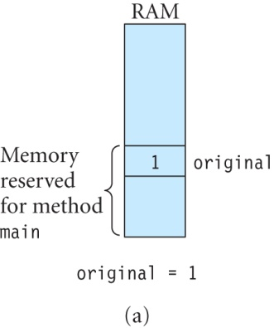
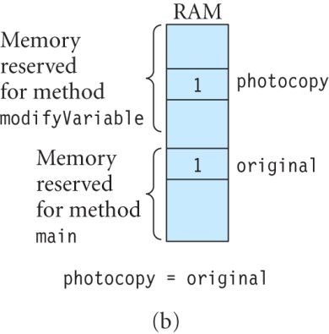
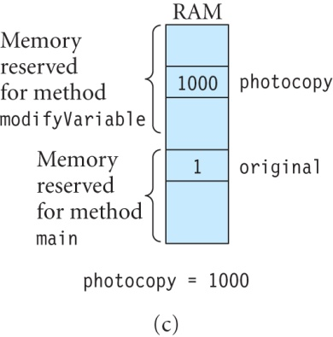
Exercise (continued)
Solution: original = 1

Slide 19
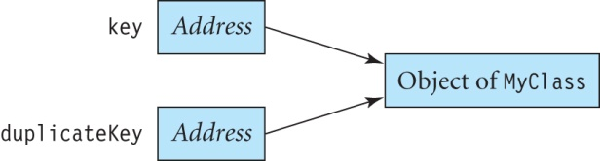
Reference Data Type Arguments
Java also uses pass-by-value for reference data type arguments.
Example:
Suppose that key references an object of MyClass:
MyClass key = new MyClass();
This statement copies the value in key into duplicateKey:
MyClass duplicateKey = key;
Now, both key and duplicateKey reference the same object.

Slide 20
Exercise
What value of field x of object key will be printed out?
class MyClass {
int x;
}
class ReferenceArgumentDemo {
// this method takes a reference type argument
void modifyField(MyClass duplicateKey ) {
duplicateKey.x = 100;
duplicateKey = new MyClass();
duplicateKey.x = 200;
}
public static void main(String[] args) {
ReferenceArgumentDemo demo = new ReferenceArgumentDemo();
MyClass key = new MyClass();
key.x = 10;
demo.modifyField(key);
System.out.println("key.x = " +key.x);
}
}

Slide 21
Exercise (continued)
Solution: The program output is:
key.x = 100
Initially, duplicateKey references the same object as key. Therefore, this statement in method modifyField changes the value of key’s x to 100:
duplicateKey.x = 100;
The next statement changes the object that is referenced by duplicateKey:
duplicateKey = new MyClass();
Now, duplicateKey cannot change the instance variable x in the object referenced by key.

Slide 22
Returning a Reference Type from a Method
Use the keyword return.
The return type in the method declaration should be the same as the data type of the object being returned.
For example, this shows the outline of a method to change the brightness of an image and return a reference to the modified image:
BufferedImage changeBrightness(BufferedImage inputImage, double brightnessValue) {
BufferedImage outputImage;
// create outputImage.
// Then multiply each pixel of inputImage by brightnessValue
// and store it in outputImage.
return outputImage;
}

Slide 23
Compositing
Compositing is manipulating and combining two or more images together to produce a new image.
One simple technique is to combine two images by adding their pixels together:
Suppose that (r₁, g₁, b₁) and (r₂, g₂, b₂) are the red, green and blue components of a pixel with coordinates (x, y) in the two input images.
After the program is executed, a pixel in the output image at the same location (x, y) has component values (r₁ + r₂, g₁ + g₂, b₁ + b₂).
Any component values that exceed 255 are truncated to 255 in the output image.

Slide 24
Class BufferedImage
BufferedImage(int width, int height, int type) constructor creates a BufferedImage having the specified width, height and type.
There are many constants defined in class BufferedImage to specify different types of images.
The constant TYPE_INT_ARGB represents an image in the RGB color space with an alpha channel.

Slide 25
Exercise
Write the code for method add that returns a new BufferedImage whose pixels are the sum of the pixels in image1 and image2:
public BufferedImage add(BufferedImage image1, BufferedImage image2)
Solution:
public BufferedImage add(BufferedImage image1,BufferedImage image2) {
int width = Math.min(image1.getWidth(), image2.getWidth());
int height = Math.min(image1.getHeight(), image2.getHeight());
// create a new BufferedImage called image3
BufferedImage image3 = new BufferedImage(width, height, BufferedImage.TYPE_INT_ARGB);
for (int x = 0; x < width; x++) {
for (int y = 0; y < height; y++) {
// get the samples of the pixel at (x, y) in image1
int colorValue1 = image1.getRGB(x, y);
Color pixelColor1 = new Color(colorValue1);
int red1 = pixelColor1.getRed() ;
int green1 = pixelColor1.getGreen() ;
int blue1 = pixelColor1.getBlue();

Slide 26
Solution to Exercise (continued)
// get the samples of the pixel at (x, y) in image2
int colorValue2 = image2.getRGB(x, y);
Color pixelColor2 = new Color(colorValue2);
int red2 = pixelColor2.getRed() ;
int green2 = pixelColor2.getGreen() ;
int blue2 = pixelColor2.getBlue();
// add the samples to create a new color
int red3 = Math.min(red1 + red2, MAX_VALUE);
int green3 = Math.min(green1 + green2, MAX_VALUE);
int blue3 = Math.min(blue1 + blue2, MAX_VALUE);
// set the color of a pixel in image3
Color newPixelColor = new Color(red3, green3, blue3);
int newRgbvalue = newPixelColor.getRGB();
image3.setRGB(x, y, newRgbvalue);
}
}
// returns a reference to the new image
return image3;
}
MAX_VALUE is a constant with value 255.

Slide 27
Constructors
Used to create an object from a class.
It has the same name as the class.
There are three types of constructors:
Constructor without parameters
Constructor with parameters
Default constructor
A constructor does not have a return type.

Slide 28
Constructors Without Parameters
Does not have any parameters.
Used to initialize the fields at the time the object is created.
All objects will be created with the same field values when this type of constructor is used.
A constructor for class Lamp:
Lamp() {
diameter = 6.0;
wattage = 60;
lighted = false;
}

Slide 29
Constructors With Parameters
Used to create multiple objects with differing field values.
There can be any number of parameters and the data type of each parameter should be specified.
For example:
To create a Lamp object with diameter= 6.2, wattage = 40 and lighted = false, use:
Lamp lamp2 = new Lamp(6.2, 40, false);
Lamp(double dia, int watt, boolean light) {
diameter = dia;
wattage = watt;
lighted = light;
}

Slide 30
Default Constructors
A default constructor is created by the compiler when a class does not contain a constructor.
The constructor initializes the object’s fields in the following manner:
Numeric types such as int, float, and others are set to 0.
Variables of type boolean are set to false.
Object references are set to null.
If we did not put in any constructors in Lamp, we could still create an object of Lamp (say, lamp3) in the following manner:
Lamp lamp3 = new Lamp();

Slide 31
Overloaded Constructors
A class can have only one constructor without arguments, but it can contain multiple constructors with arguments.
The signature of the constructor comprises of its name and data types of its parameters.
When there are many constructors in a class, Java determines which constructor is being called based on its signature.
The constructors in a class with different signatures are called overloaded constructors.
It is necessary that all constructors in a class have different signatures.

Slide 32
Exercise
The Rectangle2D.Double class in Java 2D is used to construct rectangles. This is similar to the Rectangle2D.Float class, except that the arguments are of type double instead of float.
This class contains two constructors:
Rectangle2D.Double() constructor creates a rectangle at the point (0, 0) with a width and height of 0.
Rectangle2D.Double(double x, double y, double width, double height) constructor creates a rectangle at the point (x, y) of the given width and height.
Show how you can create an instance using each constructor.

Slide 33
Solution to Exercise
One possible solution follows.
This statement creates an instance called rect1 using the first constructor:
Rectangle2D.Double rect1 = new Rectangle2D.Double();
This creates an instance called rect2 using the second constructor:
Rectangle2D.Double rect2 = new Rectangle2D.Double(10.0, 100.0, 50.0, 20.0);

Slide 34
Exercise
Java 2D contains a Color class, which is used to create different colors. There are several overloaded constructors in this class, one of which is shown below:
public Color(int red, int green, int blue) creates a new color. The values of red, green and blue should lie in the range (0-255).
Create an instance of this class called newColor where red = 127, green = 25, and blue = 50.
Color a rectangle using newColor, and display it in a window.

Slide 35
Solution to Exercise
This creates the instance called newColor:
Color newColor = new Color(127, 25, 50);
import java.awt.*;
import java.awt.geom.*;
import com.programwithjava.basic.DrawingKit;
public class TestColor {
public static void main(String[] args) {
DrawingKit dk = new DrawingKit("New Color");
Rectangle2D.Double r = new Rectangle2D.Double(100.0, 100.0, 250.0, 120.0);
Color newColor = new Color(127, 25, 50);
dk.setPaint(newColor);
dk.fill(r);
}
}

Slide 36
The this Keyword
The keyword this is used within a method or constructor to refer to the object that has invoked that method or constructor.
Use this when a method parameter shadows a field, that is, the parameter has the same name as the field:
Also, you can use this to invoke another constructor in the same class from within a different constructor.

Slide 37
The this Keyword continued
Use this when a method parameter shadows a field, that is, the parameter has the same name as the field:
Error because parameter name is same as field name:
To remove error, use this keyword to reference field name:
void setDiameter(double diameter) {
diameter = diameter; // logical error
}
void setDiameter(double diameter) {
this.diameter = diameter;
}

Slide 38
The this Keyword (continued)
Use this to call another constructor in same class.
Resembles a call to a method with parameters.
For example:
Lamp() {
// calls the Lamp(double, int, boolean) constructor
this(10, 100, false);
}

Slide 39
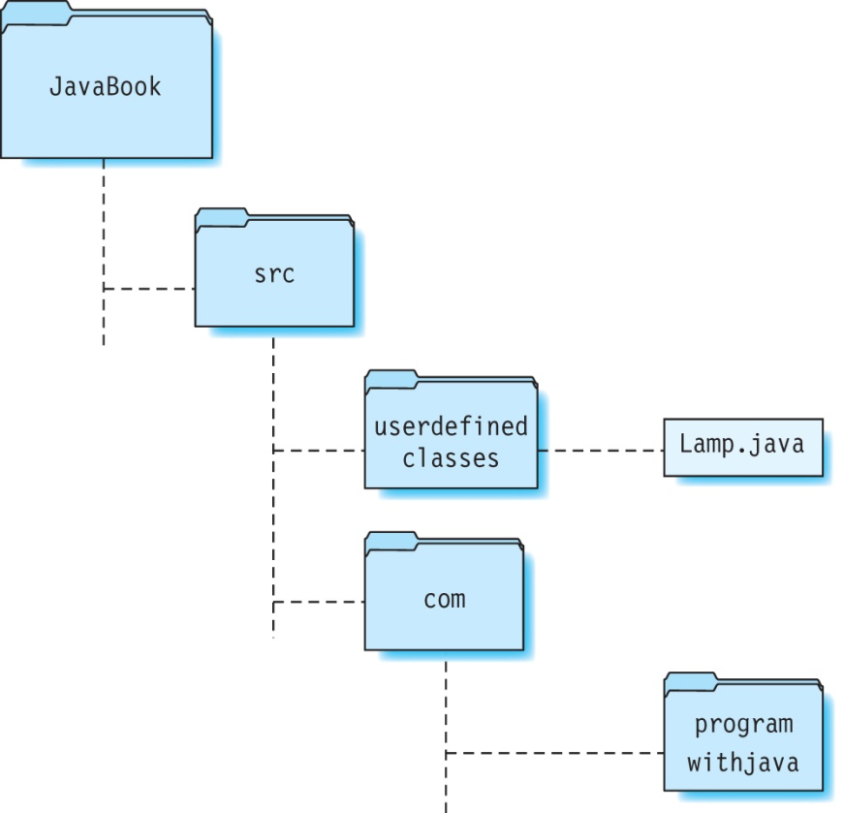
Packages
Better to organize files in subdirectories created inside the source directory (src).
These subdirectories are called packages.
Can you identify the packages in the following figure?

Slide 40
Creating Packages
This package statement comprises of the keyword package followed by the name of the package.
For example, if the Lamp.java file is in the userdefinedclasses directory, add this as the first statement in this file:
package userdefinedclasses;
There can be only one package statement in a file. Why?
The package statement must be the first statement in a file.
import statements are placed right after the package statement.

Slide 41
Naming Packages
Class names and package names must be distinct.
By prefixing the package name before the class name, collisions of class names can be prevented in a program.
However, package names must also be unique in order to prevent collisions.
One way to ensure this is by using the Internet domain name.
For example, if a company with the Internet domain xyz.com has provided a package called graphics, the package name becomes com.xyz.graphics.

Slide 42
Compiling Source Files in Packages
When you compile a file that is in a package, give the complete path name for the file starting from the src directory:
C:\JavaBook> javac -d bin src\com\programwithjava\basic\DrawingKit.java src\userdefinedclasses\Lamp.java
The class file is automatically placed inside the bin directory in a package hierarchy that is identical to that of the source code file.
To run this program, prefix the package name before the class file name using a dot as separator:
C:\JavaBook> java -classpath bin userdefinedclasses.Lamp

Slide 43
Access Modifiers
There are four types of access identifiers:
private
public
Package-private (also called default)
protected
A top-level class (that is, a class not inside another class) is declared using the public or package-private access modifiers only.
The members (fields and methods) and constructors in a class can be declared using any of the four modifiers.

Slide 44
The private Access Modifier
A private field, method or constructor in a class can only be accessed within that class and not by any other class.
Fields are usually declared as private.
Example:
private double diameter;

Slide 45
The public Access Modifier
When a field, method or constructor is declared as public, it can be accessed by all classes.
If we declare diameter as public inside Lamp, then we can access it and modify it in a different class:
public double diameter;

Slide 46
The package-private Access Modifier
When no access modifier is specified, the fields, methods and constructors of a class can be accessed only by classes that are in the same package as this class.
This type of modifier is also called package access modifier or default access modifier.
For example, this method printDiameter in Lamp has a default access modifier:
// method uses a default access modifier
void printDiameter() {
// some code
}

Slide 47
The protected Access Modifier
Members and constructors of a class declared as protected can be accessed by classes that are in the same package as this class.
Also, the protected keyword has a special significance when classes are related using inheritance (to be discussed later).

Slide 48
Exercise
Write a class called Ball that contains the following fields:
x, y: describe the current position of the ball
width: ball’s diameter
speedX, speedY: describe the speed of the ball (in pixels per second) along the x and y axis, respectively.
direction: current direction of the ball, which is either 1 for UP or 0 for DOWN.
Add the following method and constructor to Ball:
public void step(float timeInterval)—a method that updates the current position of the ball based on its speed and the distance traveled in the specified time interval.
A constructor without parameters to initialize x and y to 0; width to 40; speedX and speedY to 100; and direction to 1.

Slide 49
Solution to Exercise
public class Ball {
private float x; // x-coordinate of ball’s position
private float y; // y-coordinate of ball’s position
private float speedX; // speed of ball in pixels/second along x-axis
private float speedY; // speed of ball in pixels/second along y-axis
private int direction; // direction = 0 (UP) or 1 (DOWN)
private float width; // ball's width
// constructor without parameters
public Ball() {
setWidth(40);
x = y = 0;
speedX = 100;
speedY = 200;
direction = 1;
}
public void step(float timeInterval) {
x += speedX * timeInterval;
y += speedY * timeInterval;
}
}

Slide 50
Static Fields
A static field (also called a class variable) is a field that does not belong to any particular instance of a class; instead, it is shared among all instances of that class.
If an instance changes the value of a static field, all instances of that class see the same updated value.
The static keyword is used to declare a static field.
A common use for class variables is to keep track of the number of instances of a class.

Slide 51
Exercise
What is the output of the following program?
public class StaticDemo {
static int staticField; // static field
int instanceField; // instance field
public static void main(String [] args ){
StaticDemo sd1 = new StaticDemo();
StaticDemo sd2 = new StaticDemo();
sd1.staticField = 102; // sd1 modifies staticField
sd1.instanceField = 103; // sd1 modifies instanceField
System.out.println("sd2.staticField = "+sd2.staticField);
System.out.println("sd2.instanceField = "+sd2.instanceField);
}
}

Slide 52
Static Methods
Static methods or class methods are different in that they are not called by an object of the class.
A static method can be used to get the value of static fields.
Declare a static method by prefixing the static keyword before the return type in the method declaration:
static int someMethod () {
// code
}

Slide 53
Static Methods continued
For example, this returns the value of the static field numberOfObjects in Lamp:
Invoke static methods using the class name and not the instance name:
Lamp.getNumberOfObjects();
A static method cannot be used to modify instance fields or call other instance methods in that class.
static int getNumberOfObjects () {
return numberOfObjects;
}

Slide 54
String.format
A static method in the String class used for formatting data.
It can have any number of arguments, but the first argument is always a format string containing format specifiers.
The format specifier %f acts as a placeholder in the format string for the second argument val1.
When the program is run, the value of val1 will be substituted in the place of %f.
format specifier
String s = String.format("Value is = %f", val1);
format string

Slide 55
Format Specifiers
A format specifier starts with the symbol % and is followed by a conversion character such as:
d (for decimal numbers),
f (for floating-point numbers)
c (for character data)
s (for strings)

Slide 56
Examples of String.format
Given: double val1 = 10.5678; int val2 = 15;
Explain why each of the following result in errors:
String s1 = String.format("Val 1 = %f, Val 2 = %d", val1, val2);
System.out.println(s1);
The output is:
Val 1 = 10.567800, Val 2 = 15
String.format("val1 = %d, val2 = %f", val1, val2);
String.format("val1 = %f, val2 = %d %c", val1, val2);
String.format("val1 = , val2 = ", val1, val2);

Slide 57
Using Field Width and Precision in String.format
For a floating-point number, you can specify the field width and precision by giving a format specifier of %n.mf.
The value n represents the minimum number of characters reserved to display the number (field width), and
m represents the number of decimal spaces (precision) in the number.
The value of n cannot be 0; otherwise, a runtime error will occur.
Example:
String s2 = String.format("val1 = %10.2f", val1);
System.out.println(s2);
The output is:
val1 = 10.57

Slide 58
The Math Class
The Math class contains only static fields and methods.
Cannot create an instance because this class contains only private constructors.

Slide 59
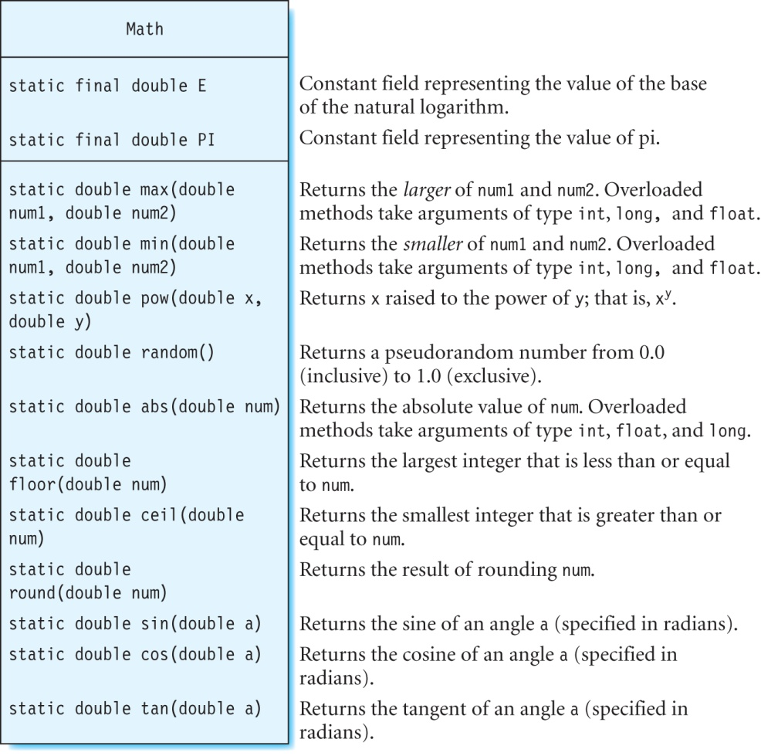
The Math Class

Slide 60
Exercise
What is the output of the following statements?
double n1 = -85.6, n2 = 70.4;
int angle = 45; // in degrees
System.out.println(String.format("The larger of %.2f and %.2f is %.2f ", n1, n2, +Math.max(n1, n2)));
System.out.println(String.format("The smaller of %.2f and %.2f is %.2f ", n1, n2, +Math.min(n1, n2)));
System.out.println(String.format("The value of %.2f raised to the power of 5 is %.2f ", n2, +Math.pow(n2, 5)));
System.out.println(String.format("abs(%.2f) = %.2f ", n1, +Math.abs(n1)));
System.out.println(String.format("floor(%.2f) = %.2f ", n1, +Math.floor(n1)));

Slide 61
The DrawingKit Class
Uses the Graphics2D class to draw and color shapes.
Uses the JFrame class is used to create a window with a title on the screen:
The following statement creates a JFrame called window with the title Lamp:
JFrame window = new JFrame("Lamp");
The drawing is done on a panel inside the window; this panel is created using the JPanel class:
An instance of this class is created as follows:
JPanel drawingSheet = new JPanel() {
public void paintComponent(Graphics g) {
Graphics2D myGraphics = (Graphics2D) g;
}
};

Slide 62
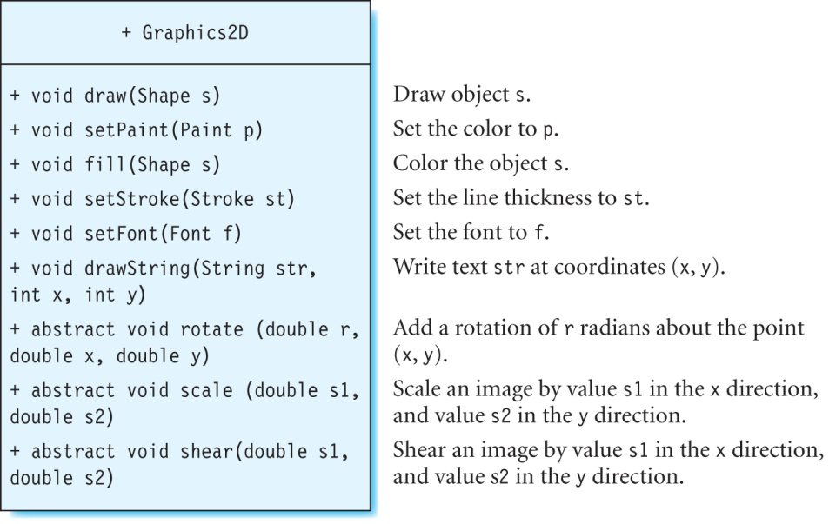
Class Graphics2D
DrawingKit provides a method called getGraphics that returns a Graphics2D object associated with the window created using this class:
public Graphics2D getGraphics();

Slide 63
Adding Method drawOutline to Class Lamp
Add these two fields to class Lamp:
Method drawOutline draws a lamp globe in the shape of a circle at a given point(x, y).
private Ellipse2D.Double circle;
private boolean visible = false;
public void drawOutline(int x, int y, Graphics2D myGraphics) {
int w = 20, z = 50;
visible = true;
myGraphics.setPaint(Color.black);
circle = new Ellipse2D.Double(x, y, diameter * w, diameter * w);
myGraphics.draw(circle);
Line2D line = new Line2D.Double(x + diameter * w/2, y, x + diameter * w/2, y - z);
myGraphics.draw(line);
}

Slide 64
Modifying Methods turnOn and turnOff in Class Lamp
Method turnOn colors circle yellow:
Method turnOff colors the circle gray:
public void turnOn(Graphics2D myGraphics) {
lighted = true;
if (visible) {
myGraphics.setPaint(Color.yellow);
myGraphics.fill(circle);
}
}
public void turnOff(Graphics2D myGraphics) {
lighted = false;
if (visible) {
myGraphics.setPaint(Color.gray);
myGraphics.fill(circle);
}
}

Slide 65
The Javadoc Tool
Documentation for a class describes what the purpose of the class is, and how its constructors and methods can be used.
Java has a special syntax that can be used to create comments in a class.
These comments can then be extracted automatically from the source file by a tool called Javadoc to create the documentation for that class.
Javadoc stores the comments in an HTML file that can be viewed in a web browser.
By default, Javadoc only generates comments for the protected and public members of a class.

Slide 66
Class Comments
Summarize the purpose of the class, and are inserted right before the class definition.
Can contain one or more author tags labeled @author to provide information about the author of the code.
Example:
/** The Lamp class defines a lamp object that can be drawn in
* a window, and lighted or turned off. The wattage of the
* bulb and the diameter of the lamp globe can also be
* specified.
*
* @author Radhika Grover
* @author programwithjava.com
*/
public class Lamp {
// rest of the code
}

Slide 67
Constructor Comments
Explain what the constructor does, and are placed before each constructor definition.
Can include parameter tags labeled @param and are used as shown:
@param parameter-name description
A separate @param tag is used for each parameter. Example:
/** Constructor to create a lamp with the specified shade
* diameter, wattage and turned on or off.
*
* @param dia the shade diameter.
* @param watt the bulb wattage.
* @param light true if the lamp is turned on, otherwise false.
*/
public Lamp(double dia, int watt, boolean light) {
// code
}

Slide 68
Method Comments
Describe what a method does, and are placed right before a method definition.
Contain parameter tags if the method has one or more parameters.
May also contain a return tag called @return that describes the value returned by the method:
@return description
Example:
/** Method to get lamp wattage.
*
* @return the wattage of the bulb.
*/
public int getWattage() {
return wattage;
}

Slide 69
Field Comments
Describe the fields in a class.
Example:
Because this field diameter is private, Javadoc will ignore this comment.
/** diameter of lamp globe */
private double diameter;

Slide 70
The javadoc Command
Generates the documentation for the specified files as HTML files.
The name of the HTML file is the same as the source file, but the extension is .html.
You can specify the destination directory for the HTML file using the -d flag.
For example, this will store the documentation for Lamp.java in the Lamp.html file in the doc.userdefinedclasses package:
C:\JavaBook> javadoc -d doc src\userdefinedclasses\Lamp.java
The subdirectory doc\userdefinedclasses is generated automatically inside src.

Slide 71
The Java API
Is the documentation for the Java language.
It is a part of the Java Standard Edition documentation.
The API for Java Standard Edition 6 is at:
http://download.oracle.com/javase/6/docs/api/

Slide 72
Summary
We discussed:
How to create classes
Write constructors and methods
Use of the keyword this
Organizing .java files in packages
Access modifiers
Static variables and methods
DrawingKit, Graphics2D, Jframe, and JPanel
What’s next:
Inheritance

