Slide 1

Chapter 6
Inheritance

Slide 2
Outline
What Is Inheritance?
The extends Keyword
Types of Inheritance
Access Modifiers
Overriding Methods
Overloaded Methods
Constructor Chaining
Abstract Classes
The Final keyword
Animation
Computers in Business: Credit Card Finance Charge Calculator
Summary

Slide 3
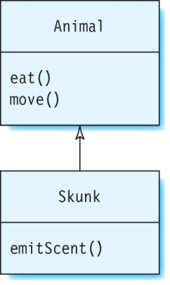
What Is Inheritance?
A class gets some fields and methods from another class.
Allows a new class to reuse code from existing classes.
Advantages?
Example:
Skunk is called the child class or subclass, and Animal is called the parent class or superclass.

Slide 4
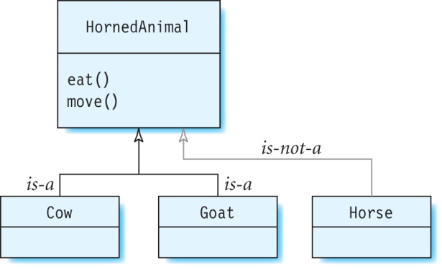
When Is Inheritance Used?
A class X can inherit code from another class Y when there is a special type of “is-a” relationship between these two classes.
The “is-a” relationship means that X is a specialization of Y.
Example:
Cow and Goat can inherit from HornedAnimal but Horse must not:

Slide 5
Types of Inheritance
Single-level
Multilevel
Hierarchical

Slide 6
The extends Keyword
The keyword extends is used to denote that one class inherits from another class.
Class Skunk inherits from Animal:
The Animal class implements the methods eat and move, which are inherited by Skunk:
public class Skunk extends Animal {
public void emitScent() {
System.out.println("Emit scent");
}
}
public class Animal {
public void eat() {
System.out.println("Eat");
}
public void move() {
System.out.println("Move");
}
}

Slide 7
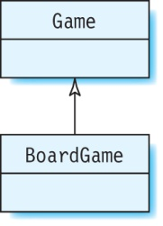
Single-level Inheritance
Only two classes are involved: one superclass and a subclass.
Example:
class BoardGame inherits from class Game.
Therefore, Game is a superclass and BoardGame is a subclass of Game.

Slide 8
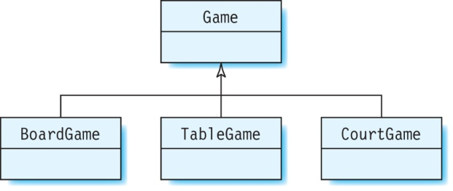
Hierarchical Inheritance
Many classes inherit from the same superclass.
Example:
BoardGame, TableGame, and CourtGame inherit fields and methods from Game:

Slide 9
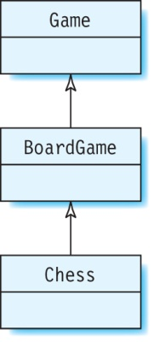
Multilevel Inheritance
A class that acts as both a superclass and a subclass is present.
Example: BoardGame is a superclass of Chess and a subclass of Game.
There can be any number of classes in the multilevel inheritance path.

Slide 10
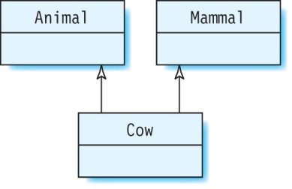
Multiple Inheritance
A class can have more than one superclass.
Not supported in Java.
Example:
class Cow has two superclasses, Animal and Mammal.

Slide 11
Access Modifiers
public: All public fields and methods of the parent class are inherited by its child class.
private: Fields and methods that are declared private cannot be inherited by a subclass.
Package-private or default : Fields and methods that have a package access modifier are inherited by a subclass only if it is in the same package as the superclass.
protected: Fields and methods declared as protected are inherited by a subclass even if it is in a different package from its superclass.

Slide 12
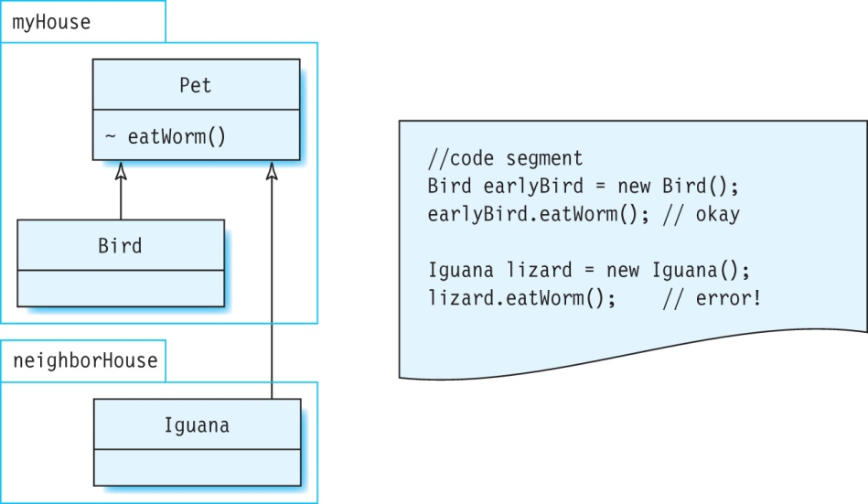
Exercise
Can Bird or Iguana access the package-private method eatWorm in Pet?

Slide 13
The Vehicle Class
Class Vehicle:
Class Airplane:
Declare a class Car that is derived from Vehicle.
package inheritance;
import java.awt.*;
public class Vehicle {
// method to draw shape of Vehicle
public void drawShape(Graphics2D myGraphics) {
}
}
package inheritance;
public class Car extends Vehicle {
}

Slide 14
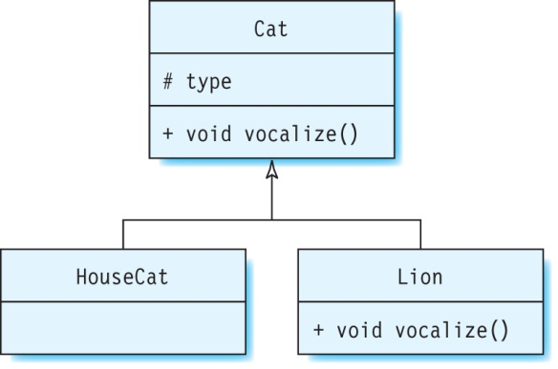
Overriding Methods
An overriding method has:
the same signature (method name, number of parameters and their types) as a method M in the superclass, and
the same return type as M, and
a different body from M.

Slide 15
Example of Overriding Method
The Cat class contains the method vocalize:
Overriding method in the Lion class, which is derived from Cat:
What is printed out by the following —“Meow” or “ROAR!”?
Lion lion = new Lion();
lion.vocalize();
// vocalize method in Cat
public void vocalize() {
System.out.println("Meow");
}
// vocalize method in Lion
public void vocalize() {
System.out.println("ROAR!");
}

Slide 16
Hidden Fields
Fields that are inherited from the superclass do not have to be overridden because instances can select different values for the same field.
A hidden field is a field in the subclass with the same name as a field inherited from the superclass.
The superclass field is not visible to the subclass even if the types of the two fields are different.
Fields should not be hidden because it makes the code confusing.

Slide 17
Upcasting
An object can be assigned to a reference variable of its superclass—this is known as upcasting.
An object of type HouseCat can be assigned to the reference variable cat2 of type Cat (Class HouseCat is derived from class Cat).
Cat cat2 = new HouseCat();
We cannot assign an object of Cat to a reference variable of type HouseCat:
HouseCat cat3 = new Cat(); // error!
Can cast cat2 to type HouseCat because it references an object of type HouseCat:
HouseCat cat3 = (HouseCat) cat2; // okay
A cast cannot be used with two unrelated classes:
Vehicle v = (Vehicle) new Animal(); // error

Slide 18
Polymorphism Via Overriding Methods
Polymorphism is an object’s ability to select a particular behavior based on its type while the program is executing.
Example of polymorphism via method overriding:
The program output is:
ROAR!
Meow
Since lion references an object of type Lion, it calls the vocalize method of Lion, and not Cat – example of polymorphism.
public static void main(String[] args) {
Cat lion = new Lion();
lion.vocalize();
Cat housecat = new HouseCat();
housecat.vocalize();
}

Slide 19
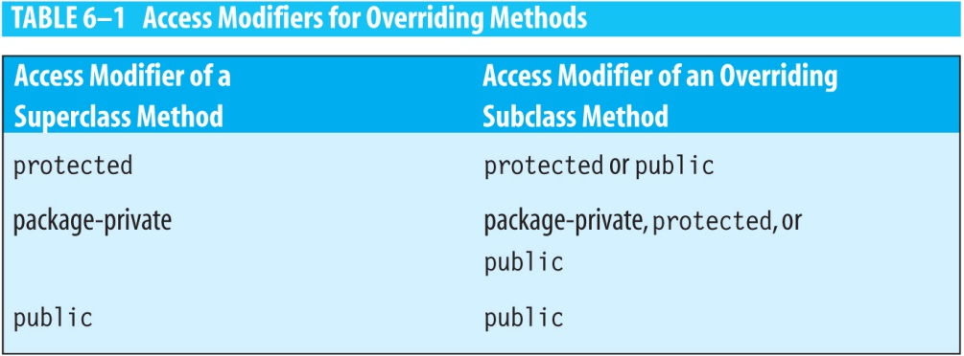
Access Modifiers for Overriding Methods
An overriding method in the subclass cannot be less visible than the corresponding method in the superclass.

Slide 20
Exercise
Consider two classes Bank and OnlineBank, where OnlineBank is a subclass of Bank:
Which methods in OnlineBank override the superclass method correctly?
class Bank {
public void deposit(float amount) { }
protected void withdraw(float amount) { }
void name() { };
private void update() { };
}
class OnlineBank extends Bank {
private void deposit(float amount) { }
private void withdraw(float amount) { }
protected void name() { }
private void update() { }
}

Slide 21
Exercise continued
Solution:
class OnlineBank extends Bank {
private void deposit(float amount); // error!
private void withdraw(float amount); // error!
protected void name(); // overrides method name in Bank
private void update(); // does not override update in Bank
}

Slide 22
Covariant Return Types
The return type of the overriding method can be a subclass of the return type of its superclass method.
public class Zoo {
private Animal myAnimal;
public Animal getAnimal() {
return myAnimal;
}
}
public class PettingZoo extends Zoo {
// some code
// allowed because Goat is a subclass of Animal.
public Goat getAnimal() {
return billy;
}
}

Slide 23
Adding an Overriding Method to class Car
The drawShape method of Vehicle is empty:
The drawShape method of Car overrides that of Vehicle:
public class Vehicle {
protected float x = 30, y = 300; // vehicle's position
// method to draw shape of Vehicle
public void drawShape(Graphics2D myGraphics) {
}
}
public class Car extends Vehicle {
public void drawShape(Graphics2D myGraphics) {
// Graphics statements to draw the shape of a car
}
}

Slide 24
Advantage of Overriding Methods
The decision of which of these methods should be used can be put off until runtime.
For example v is of reference variable of type Vehicle:
v.drawShape(myGraphics);
At runtime, depending on whether v references an object of type Car or Airplane, the corresponding drawShape method of that class is invoked.

Slide 25
The super Keyword
The subclass can call the overridden method in its superclass by using the super keyword.
Hidden fields can also be accessed in the subclass by using super.
Remember that, in general, fields should not be hidden.

Slide 26
The super Keyword continued
Class PieRecipe:
Class BlueberryPieRecipe:
How to access the overridden superclass method from the subclass method?
public class PieRecipe {
public void getDirections() {
System.out.println("To prepare crust, roll out dough and chill in pie pan.");
}
}
public class BlueberryPieRecipe extends PieRecipe {
// overriding method in BlueberryPieRecipe
public void getDirections() {
System.out.println("To prepare filling, combine blueberries, flour, lemon juice and sugar and put in pie pan, then cover with extra dough and bake.");
}
}

Slide 27
The super Keyword continued
Use super to access the overridden superclass method:
// modified method in BlueberryPieRecipe
public void getDirections() {
super.getDirections();
System.out.println("To prepare filling, combine blueberries, flour, lemon juice and sugar and put in pie pan, then cover with extra dough and bake.");
}

Slide 28
Overloaded Methods
An overloaded method has:
the same name as another method M within the class or in a superclass, and
a different parameter list from M.
The return types of overloaded methods do not have to be the same.
Example: The Rectangle class has four overloaded methods called contains:
public boolean contains(int x, int y)
public boolean contains(int x, int y, int w, int h)
public boolean contains(Point p)
public boolean contains(Rectangle r)

Slide 29
Exercise
Which of the following are valid declarations of the overloaded method compute in class Abacus?
class Abacus {
public int compute(int a, double b, int c) {
/* some code */
}
private long compute(double a, long b) {
/* some code */
}
public float compute(double b, int a, int c) {
/* some code */
}
public double compute(double a1, long b1) {
/* some code */
}
}

Slide 30
Constructors
A class does not inherit the constructors from its superclass.
The first line of any constructor is a call to another constructor:
Java automatically calls the superclass constructor.
Programmer explicitly calls a superclass constructor or another constructor in the same class.

Slide 31
Java Calls the Superclass Constructor
To create an object of a class Y, all the objects in the inheritance hierarchy of Y, starting at the parent class, have to be created.
Java calls the superclass constructor by inserting this statement automatically in the first line of the constructor body:
super();
Calls the default constructor of the superclass if the superclass does not have any constructors; otherwise, it calls the constructor without parameters.

Slide 32
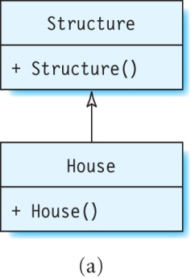
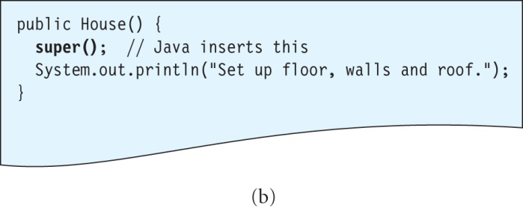
Java Calls the Superclass Constructor
Java inserts a call to the superclass constructor inside House’s constructor using the super keyword.
This calls Structure’s constructor to create an object of this class first, and then House’s constructor will execute.

Slide 33
The Object Class
Java contains a class called Object from which all classes are derived.
Object does not have a superclass.
Even if a class does not declare that it is derived from another class, it is implicitly derived from Object.
Object contains a constructor without parameters.

Slide 34
Constructor Chaining
To create an object of a class (say House), all superclass constructors are called, up to the topmost class Object.
Then the constructors are executed in reverse order, from top to bottom; that is, starting from constructor of Object down to the constructor of House.

Slide 35
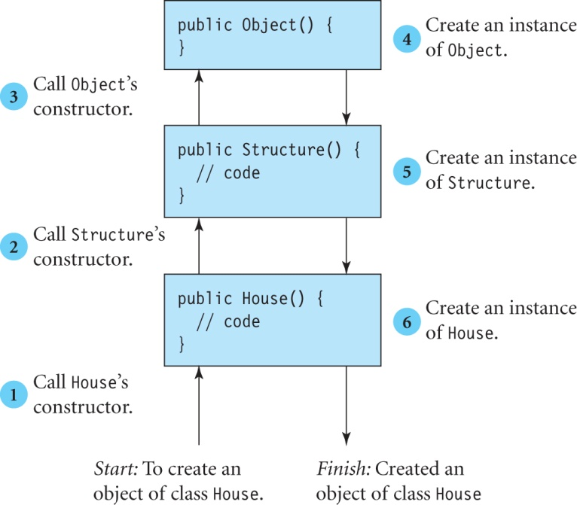
Example Of Constructor Chaining

Slide 36
Limitations of super to Call Superclass Constructor
The super statement cannot call a superclass constructor with parameters.
Additionally, it can call the default constructor of the superclass only if there is no other constructor in the superclass.

Slide 37
A Program With an Error
Can you spot the error in the following code?
Solution: The (implicit) super statement in FixerUpper’s constructor cannot call the constructor with parameters in the superclass AnotherStructure. It cannot call the default constructor, as there is already a constructor present in AnotherStructure.
public class AnotherStructure {
// constructor with parameters
public AnotherStructure(String type) {
System.out.println("Build foundation of type " +type);
}
}
public class FixerUpper extends AnotherStructure {
public FixerUpper() {
System.out.println("Set up floor, walls and roof.");
}
}

Slide 38
Programmer Explicitly Calls a Constructor
To call a superclass constructor with parameters, the programmer must make this call explicitly by calling super with arguments:
super(argument 1, argument 2, …, argument n);
Example:
Modify FixerUpper’s constructor to call explicitly the superclass constructor AnotherStructure(String):
// FixerUpper fixed!
public FixerUpper() {
super("Slab"); // calls the superclass constructor
System.out.println("Set up floor, walls and roof.");
}

Slide 39
Abstract Classes
A class that should not be instantiated can be made abstract by prefixing the keyword abstract before the class declaration.
An abstract class is used primarily to create subclasses.
An abstract class may contain special methods called abstract methods.
Example:
Declare Subject as an abstract class:
public abstract class Subject {
}
This means an object of this class cannot be created:
Subject subject = new Subject(); // error!

Slide 40
Abstract Methods
Do not have a body.
Declared using the keyword abstract.
The subclass can implement an abstract method by providing a body for it.
For example:
Subject has an abstract method called getSyllabus:
Subclass Science implements this abstract method:
public abstract class Subject {
public abstract void getSyllabus();
}
public class Science extends Subject{
public void getSyllabus() {
/* some code */
}
}

Slide 41
Abstract Methods continued
A subclass must implement all abstract methods in its parent class; otherwise, it has to be declared as abstract.
This is another reason for creating an abstract class – to force its subclasses to implement the abstract methods.
For example, if the class Science did not implement the method getSyllabus, it would have to be declared abstract or a compilation error occurs.

Slide 42
Polymorphism Via Abstract Methods
Polymorphism can also be achieved using abstract methods.
Example:
The following statements call the getSyllabus method of the subclass object that subject references at the time the program is run:
Subject subject;
subject = new Science();
// gets the Science syllabus
subject.getSyllabus();
// English extends Subject and implements getSyllabus
subject = new English();
// gets the syllabus of the subject English
subject.getSyllabus();

Slide 43
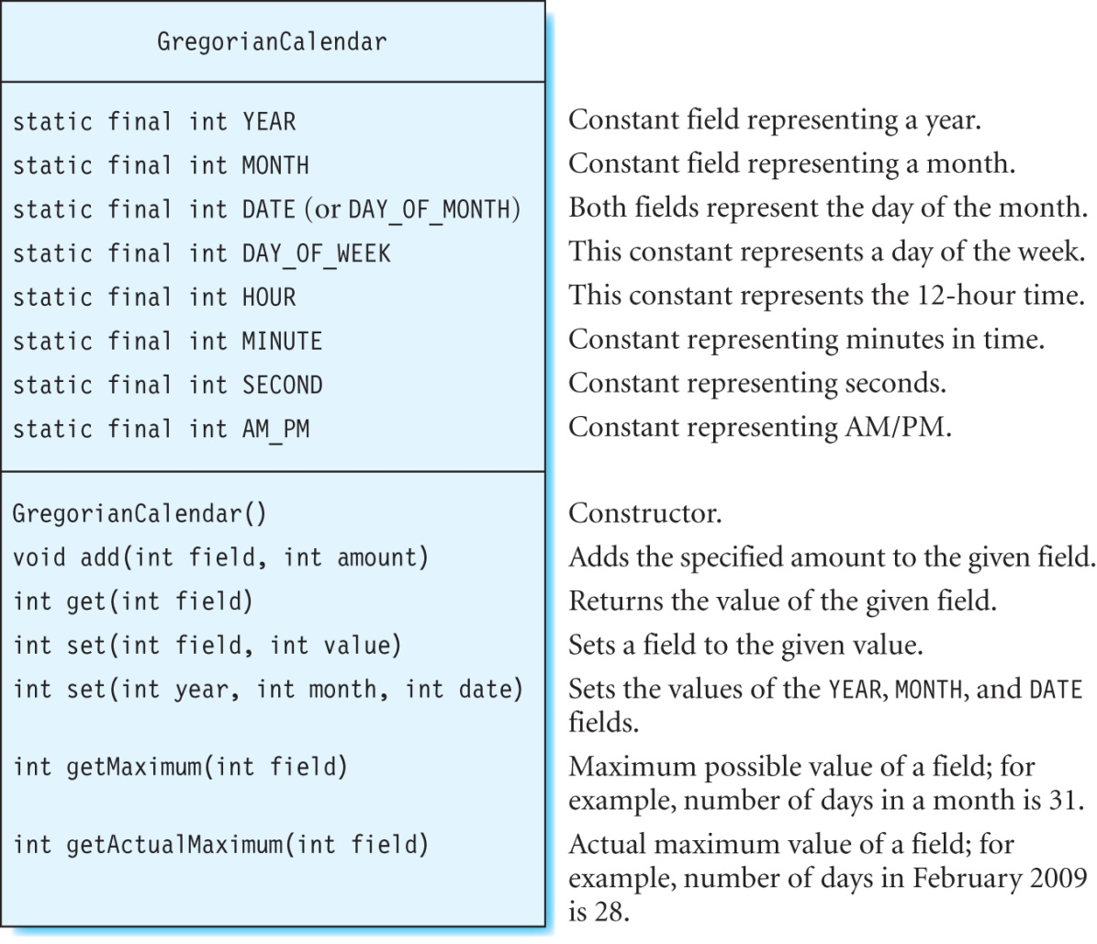
The GregorianCalendar Class
The class GregorianCalendar extends the abstract class Calendar.

Slide 44
Exercise
What is the output?
// create a new GregorianCalendar
Calendar calendar = new GregorianCalendar();
calendar.set(2008, 06, 16);
calendar.add(Calendar.MONTH, 1);
System.out.println("Month = " +calendar.get(Calendar.MONTH));
calendar.add(Calendar.DATE, -10);
System.out.println("Day = " +calendar.get(Calendar.DATE));
System.out.println("Maximum days in a month = " +calendar.getMaximum(Calendar.DAY_OF_MONTH));
calendar.set(Calendar.YEAR, 2009);
calendar.set(Calendar.MONTH, Calendar.FEBRUARY);
System.out.println("Maximum days in February 2009 is " +calendar.getActualMaximum(Calendar.DAY_OF_MONTH));

Slide 45
Exercise continued
Solution:
The program output is:
Month = 7
Day = 6
Maximum days in a month = 31
Maximum days in February 2009 is 28

Slide 46
Vehicle as an Abstract Class
public abstract class Vehicle {
protected float x = 30, y = 300; // vehicle's position
// constructor updates x and y to specific values
public Vehicle() {
this(0, 0);
}
// constructor updates x and y to values passed in as arguments
public Vehicle(float xValue, float yValue) {
x = xValue;
y = yValue;
}
// method to draw shape of Vehicle
public abstract void drawShape(Graphics2D myGraphics);
}

Slide 47
Implementing An Abstract Method
Class Car already implements the drawShape method of Vehicle, but Airplane does not.
Because drawShape has been made abstract in the superclass, we must either implement this method in Airplane or declare it as an abstract class.
Implement method drawShape in Airplane:
public class Airplane extends Vehicle {
// other code
public void drawShape(Graphics2D myGraphics) {
// Graphics statements to draw an airplane
}
}

Slide 48
Example of Polymorphism
A car or airplane will appear depending on the value of the random variable vehicleType:
Vehicle myVehicle;
// assign vehicleType a random number equal to 0 or 1
Random rand = new Random();
int vehicleType = rand.nextInt(2);
// if vehicleType is 0, create an object of type Car
if(vehicleType == 0)
myVehicle = new Car();
else
myVehicle = new Airplane();
// This will draw the corresponding shape of the
// object based on its type determined at run time.
myVehicle.drawShape(myGraphics);

Slide 49
The Final Keyword
Keyword final is used for creating:
Final methods
Final classes
Final variables

Slide 50
Final Methods
Are methods whose implementations cannot be changed.
Cannot be overridden by a subclass method.
Example:
Class E contains a final method called computeSquare:
public class E {
public final int computeSquare(int x) {
return x*x;
}
}

Slide 51
Final Classes
Cannot be used to create subclasses.
None of the methods in this class can be overridden; that is, all of its methods are final.
Example:
public final class G {
// some code
}
// error: G cannot be subclassed
public class H extends G {
}

Slide 52
Final Classes continued
A class can be declared final for either of the following reasons:
None of the methods in the class should be overridden.
The class should not be extended further.
Examples of final classes in the Java API:
Float
Double
Integer
Boolean
String

Slide 53
Final Variables
A final variable can be assigned a value only once.
Example:
This declares a variable called ANGLE:
final int ANGLE = 10;
Reassigning to ANGLE again results in an error:
ANGLE = 20; // error, ANGLE has been already assigned.
Difference between constants and final variables?
Constants are class variables, as they are declared with the static modifier.
Final variables are instance variables.

Slide 54
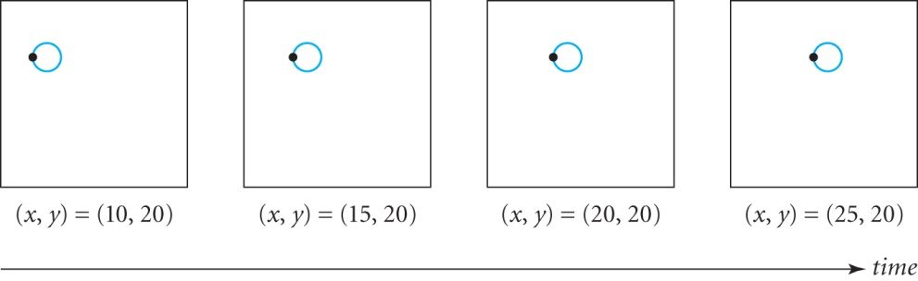
Animation
Animation is the art of making things appear to change with time.
Idea: Display a sequence of pictures with incremental changes over a short time to produce an impression of continuous movement.

Slide 55
Animation continued
In order to give an impression of a moving object, the following steps are needed:
Clear the window.
Draw an image in the window at location (x, y).
Change the position (x, y).
Repeat steps 1 – 3.

Slide 56
Adding Animation To Vehicle
Add an abstract method step method to Vehicle:
Implement the step method in Airplane:
Also, implement the step method in Car.
// abstract method in class Vehicle
protected abstract void step();
// change the (x,y) position of the airplane
protected void step() {
y = y - 1.5f;
x = x + 2.5f;
}

Slide 57
Adding Animation to Airplane
Use the two classes Controller and View provided in the package com.programwithjava.animation:
The Controller class controls the animation.
The View class displays the animation.
Use the following main in the Airplane class:
You can change the model (while keeping the view and controller unchanged) to animate a different vehicle.
public static void main(String[] args) {
Airplane topGun = new Airplane(); // the model
View v = new View(topGun); // the view
Controller ct = new Controller(topGun, v); // the controller
v.setVisible(true); // make the view visible
}

Slide 58
Model View Controller Architecture
Separates an object’s design (the model) from its display (the view) so that we can change the code for the model with affecting the view, and vice versa.
The controller links the model to a view.
For example, the code in Airplane or Car does not specify how the object will be displayed.
The code in View class creates the window, buttons, etc.
The code in Controller passes the user actions (such as mouse clicks) from the view to the model.

Slide 59
Computers In Business
Accounting software
Stock market software
Personal finance software
Statistical software

Slide 60
Terminology
Whenever you make a purchase using a credit card, you put a balance on the card.
Credit card companies charge interest on this balance called finance charge.
APR is a numeric value provided by the company that is used to calculate the finance charge.

Slide 61

Calculating the Finance Charge
Average daily balance is sum of the charges made on the card during a billing period divided by the number of days in that billing period.
The daily periodic rate (DPR) is given by (APR/100) divided by the number of days in a year:
Finance charge for a billing period N (typically one month) :

Slide 62


Example
For example, suppose that you charge $100.0, $305.50, and $50.0 on your credit card on 1st, 7th and 25th of January respectively. Assume that card has an APR of 15%. What is the average daily balance and finance charge?
Solution:
The finance charge of $4.56 is added to the balance of $455.50, and so the new balance for February is $460.06.
The finance charge for February will be calculated similarly.

Slide 63
Accuracy of Numerical Calculations
Do not use float or double to represent money.
Examples:
A solution: the BigDecimal Class
double num1 = 0.101 + 0.001 + 0.201;
System.out.println(num1 == 0.303); // prints out false
float val = 0.65f * 0.3f;
System.out.println(val); // prints out 0.19500001

Slide 64
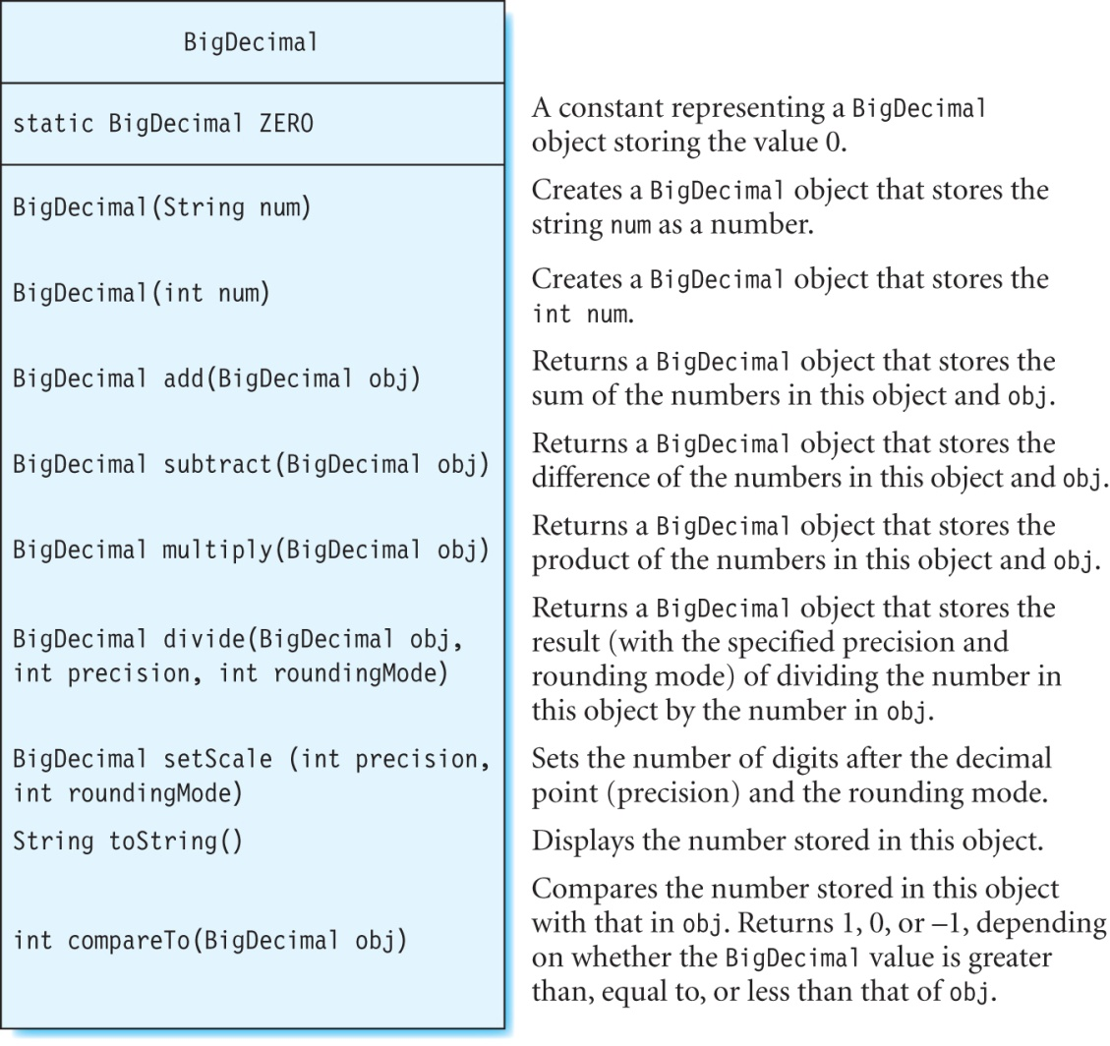
The BigDecimal Class
Stores values accurately with the precision that you specify.

Slide 65
Adding Numbers Using the BigDecimal Class
Adding numbers 0.02, 0.14, and 0.3:
This will print out the correct value of 0.46:
System.out.println(num1.toString());
Multiplication and division are similar.
BigDecimal num1 = new BigDecimal("0.02");
BigDecimal num2 = new BigDecimal("0.14");
BigDecimal num3 = new BigDecimal("0.3");
num1 = num1.add(num2).add(num3);

Slide 66
Comparing Numbers Using the BigDecimal Class
Check if the BigDecimal num1 is equal to 0 :
if (num1.compareTo(BigDecimal.ZERO) == 0)
System.out.println("The two numbers are equal");
else if (num1.compareTo(BigDecimal.ZERO) < 0)
System.out.println("num1 is less than 0");
else if (num1.compareTo(BigDecimal.ZERO) > 0)
System.out.println("num1 is greater than 0");

Slide 67
Specifying Precision and Rounding of Numbers
Use the setScale method.
Example:
To display a number with two decimal places and rounded up, use:
Other rounding modes include ROUND_UP (rounds towards 0) and ROUND_DOWN (rounds away from 0).
BigDecimal num4 = new BigDecimal("1234.56789");
num4 = num4.setScale(2, RoundingMode.HALF_UP);
System.out.println(num4.toString()); // prints out 1234.57

Slide 68
Non-terminating Numbers
Non-terminating numbers (with an infinite number of digits) cannot be represented exactly as BigDecimal numbers.
For example, dividing 1 by 3 results in a non-terminating decimal and causes a runtime error:
Upon running the program, the following error message is issued:
Exception in thread "main" java.lang.ArithmeticException: Non-terminating decimal expansion; no exact representable decimal result at java.math.BigDecimal.divide(BigDecimal.java:1594)
BigDecimal one = new BigDecimal("1");
BigDecimal three = new BigDecimal("3");
BigDecimal nonterm = one.divide(three); // 0.3333…

Slide 69
Non-terminating Numbers continued
In the divide operation, specify the precision and the rounding mode of the result.
Example:
Set the number of decimal places in the result to 20 and the rounding mode to HALF_UP:
BigDecimal term = one.divide(three, 20, RoundingMode.HALF_UP);
This shows that the number stored in term has a precision of 20:
System.out.println(term.toString()); // displays 0.33333333333333333333

Slide 70
Example: Program To Calculate Time To Pay Off Balance
Write a program to calculate the total time needed to pay off the balance on a card by making fixed monthly payments on it. For example, suppose that you have a credit card with an APR of 15% and a balance of $1000. You would like to make a payment of $500 on the first day of each month and put no new charges on the card, starting January 1, 2008 (a leap year), until it is fully paid off.

Slide 71
Example: Program To Calculate Time To Pay Off Balance continued
Step 1: Starting balance = $1000
Payment on January 1 = $500
New balance on January 1 = $500
Since no new charges are made to the card, the average daily balance is $500.
Finance Charge = $6.35
Step 2: Add the finance charge to the previous balance. The balance on February 1 = $506.35
Payment on February 1 = $500
New balance on February 1 = $6.35
Finance Charge = $0.08
Step 3: Balance on March 1 = $6.43
Payment on March 1= $6.43
New balance on March 1 = $0.0
The total payment made in 3 months is $1006.43, and the net finance charges are $6.43.

Slide 72
Algorithm
Algorithm for the problem to calculate total finance charges and time to pay off card by making fixed monthly payments on it:
while balance > 0 {
Calculate average daily balance after monthly payment is made at start of month
Calculate DPR
Calculate finance charge
Print out the balance and finance charge for this month
Update running totals of finance charges and monthly payments
Increment month to next
Add finance charge to balance to obtain new balance at start of this month
}

Slide 73
Class FinancialCalculator
public abstract class FinancialCalculator {
// calendar
protected Calendar calendar;
// returns the number of days for the current month set on calendar
protected int getDaysInMonth() {
return calendar.getActualMaximum(Calendar.DAY_OF_MONTH);
}
// returns the number of days in the current year set on calendar
protected int getDaysInYear() {
return calendar.getActualMaximum(Calendar.DAY_OF_YEAR);
}
protected abstract void getUserInput();
protected abstract void compute();
}

Slide 74
Fields in Class CreditCardInterestCalculator
// monthly credit card payment
private BigDecimal monthlyPayment;
// starting month from which to calculate interest
private int startMonth;
// starting year from which to calculate interest
private int startYear;
// annual percentage rate
private BigDecimal apr;
// current balance
private BigDecimal balance;
// number of months taken to pay off balance
private int numMonths;
// monthly finance charge
private BigDecimal financeCharge;
// total finance charges until balance is paid
private BigDecimal totalFinanceCharge;
// total payments made until balance is paid off
private BigDecimal totalPayment;
Note that this class extends the FinancialCalculator class.

Slide 75
Constructor in Class CreditCardInterestCalculator
public CreditCardInterestCalculator() {
calendar = new GregorianCalendar();
totalFinanceCharge = new BigDecimal("0");
totalPayment = new BigDecimal("0");
}

Slide 76
Method to Calculate User Input
This implements the abstract getUserInput method in the FinancialCalculator class:
public void getUserInput() {
Scanner scanner = new Scanner(System.in);
System.out.print("Enter balance on credit card (in dollars):");
balance = new BigDecimal(scanner.next());
System.out.print("Enter credit card APR (%):");
apr = new BigDecimal(scanner.next());
System.out.print("Enter your monthly payment (in dollars):");
monthlyPayment = new BigDecimal(scanner.next());
System.out.print("Enter the starting month and year[Example, 1 2009 for January 2009]:");
startMonth = scanner.nextInt();
startYear = scanner.nextInt();
}

Slide 77
Method to Calculate Average Daily Balance
This method in class CreditCardInterestCalculator calculates the average daily balance:
private BigDecimal calculateAverageDailyBalance() {
// check if balance is less that monthlyPayment
if (balance.compareTo(monthlyPayment) < 0)
monthlyPayment = balance;
balance = balance.subtract(monthlyPayment);
return balance;
}

Slide 78
Method to Calculate Daily Periodic Rate
This method in class CreditCardInterestCalculator calculates the daily periodic rate:
// Daily periodic rate (dpr) = APR/(100 * number of days in year)
private BigDecimal calculateDailyPeriodicRate() {
BigDecimal percent = new BigDecimal("100");
BigDecimal numDaysInYear = new BigDecimal(getDaysInYear());
BigDecimal dpr = apr.divide(percent).divide(numDaysInYear, precision, RoundingMode.HALF_UP);
return dpr;
}

Slide 79
Method to Calculate Finance Charge for One Month
This method in class CreditCardInterestCalculator calculates the monthly finance charge:
// finance charge = average daily balance * dpr * num days in month
private BigDecimal calculateMonthlyFinanceCharge(){
BigDecimal averageDailyBalance = calculateAverageDailyBalance();
BigDecimal dpr = calculateDailyPeriodicRate();
BigDecimal numDaysInMonth = new BigDecimal(getDaysInMonth());
financeCharge = averageDailyBalance.multiply(dpr).multiply(numDaysInMonth);
return financeCharge;
}

Slide 80
Method to Calculate Total Finance Charge and Time to Pay Off Card
public void compute() {
// initialize calendar
calendar.set(startYear, startMonth - 1, 1);
// print out table header
System.out.println("Month Year" +" Balance ($) " +"Interest ($)");
BigDecimal monthlyFinanceCharge;
while(balance.compareTo(BigDecimal.ZERO) > 0){
// calculate finance charges for each month
monthlyFinanceCharge = calculateMonthlyFinanceCharge();
// round monthlyFinanceCharge and balance up to two decimal places
monthlyFinanceCharge = monthlyFinanceCharge.setScale(2, RoundingMode.HALF_UP );
balance = balance.setScale(2, RoundingMode.HALF_UP );
// print out monthly finance charge and balance
System.out.println(String.format("%3d %5d %10s %10s ", calendar.get(Calendar.MONTH)+1, calendar.get(Calendar.YEAR), balance.toString(), monthlyFinanceCharge.toString()));

Slide 81
Method to Calculate Total Finance Charge and Time to Pay Off Card continued
// running total of credit card finance charges
totalFinanceCharge = totalFinanceCharge.add(monthlyFinanceCharge);
// running total of credit card payments
totalPayment = totalPayment.add(monthlyPayment);
// increment month by 1
calendar.add(Calendar.MONTH, 1);
numMonths++;
// calculate new balance at the start of next month
balance = balance.add(monthlyFinanceCharge);
}
// round up to two decimal places and print
totalFinanceCharge = totalFinanceCharge.setScale(2, RoundingMode.HALF_UP );
totalPayment = totalPayment.setScale(2, RoundingMode.HALF_UP );
System.out.println("Total payment in " +numMonths +" months: $" +totalPayment.toString() + " Total Finance Charges paid: $" +totalFinanceCharge.toString());
}

Slide 82
Summary
We discussed:
What is inheritance and how to use it
Overriding methods
Abstract classes and abstract methods
Implementing abstract methods
The this keyword
Final classes and methods
Animation
Model View Controller Framework
Computers in Business
What’s next:
Arrays and Strings

