Slide 1

Chapter 7
Arrays and Strings

Slide 2
Outline
Creating and using Arrays
Multidimensional Arrays
The Arrays Class
Enums
The ArrayList Class
Strings and The StringBuilder Class
Primitive Wrapper Classes
Command Line Arguments
The Crystals Game
Computers in Science: Human DNA
Summary

Slide 3
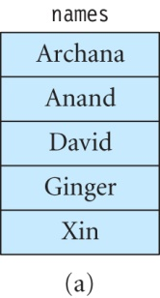
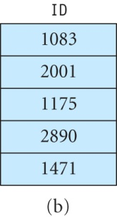

What is an Array?
A data structure used to store related data in a program, such as numbers, characters, strings or objects.
Advantage is that we can use a single name to reference all the data in the array.
An array has a fixed size that is decided when the array is created.

Slide 4
Array Indices
The data values stored in the array are called its elements.
Each element of the array is at a specific position referred to its index or subscript.
The first element is at index 0.
For an array containing n elements, the indices range from 0 to n − 1.
Example:
marks[0] refers to the first element of the marks array,
marks[1] refers its second element, and so on.

Slide 5
Creating an Array
Declare the array:
type[] newArray;
Create the array of the given size:
newArray = new type[size];
The array size cannot be changed after it has been created.

Slide 6
Examples
A valid declaration:
int array1[];
Declare and create the array using a single statement:
int[] array2 = new int[3];
Cannot specify size when the array is declared:
int[100] array4; // compile-time error
Necessary to specify the size when the new operator is used:
int[] array4 = new int[]; // error!

Slide 7
Array Initialization
Arrays are initialized to the following default values when they are created:
0 for int
0.0f for float
0.0 for double
\u0000 for char
null for reference types
false for boolean

Slide 8
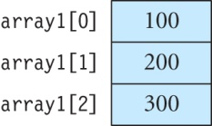
Changing Array Values
Example:
Store the numbers 100, 200 and 300 in array1 as follows:
Arrays are usually modified using loops.
int array1 = new int[3];
array1[0] = 100;
array1[1] = 200;
array1[2] = 300;

Slide 9
Using An Initializer List
An initializer list contains values separated by commas placed within braces.
Initialize the arrays with initializer lists:
int[] array2 = {200, -30, -400, 50};
char[] vowels = {'a', 'e', 'i', 'o', 'u'};
String[] daysOfWeek = {"Sunday", "Monday", "Tuesday", "Wednesday", "Thursday", "Friday", "Saturday"};

Slide 10
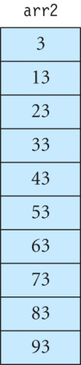
Exercise
Give the contents of the following array after these statements are executed:
Solution:
int[] arr2 = new int[10];
for (int i = 0; i < 10; i++)
arr2[i] = i * 10 + 3;

Slide 11
The length Field
Every array contains an instance field called length that stores the array size.
Examples:
Print out the length of array test1:
System.out.println(test1.length);
Use the length field in a for loop to iterate over all the array elements:
for (int i = 0; i < test1.length; i++)
// do something here
Note that the last element of test1 has index test1.length − 1.

Slide 12
Enhanced For Statement
Loops through each element of an array and stores the element into a given variable.
This has the form shown below:
Example:
for (type data : myArray) {
// do something here
}
char[] vowels = {'a', 'e', 'i', 'o', 'u'};
for (char value : vowels)
// use the element stored in the variable value

Slide 13
Creating Arrays Of Objects
Declare an array to hold objects of type Book:
Book[] books;
Create an array to hold 10 Book objects:
books = new Book[10];
Store an instance of Book at index 0 in the books array:
books[0] = new Book();

Slide 14
Retrieving Data from Arrays Of Objects
Suppose that Book has a public field called name. Access this field in the first element of array books as:
books[0].name
Access this field in the first element of Book using accessor method getName in Book:
books[0].getName()

Slide 15
Exercise
Create an online catalogue of paintings. The Painting class is defined as:
public class Painting {
private String name;
private String artist;
private int year;
// constructor
public Painting(String name, String artist, int year) {
this.name = name;
this.artist = artist;
this.year = year;
}
// code for methods getName(), getArtist(), and getYear()
}
}

Slide 16
Exercise continued
Create an array called catalog to store information about three paintings:
Painting[] catalog = new Painting[3];
Insert information about three paintings into this array:
catalog[0] = new Painting("Impression, Sunrise", "Claude Monet", 1873);
catalog[1] = new Painting("Mona Lisa", "Leonardo da Vinci", 1505);
catalog[2] = new Painting("Three Musicians", "Pablo Picasso", 1921);

Slide 17
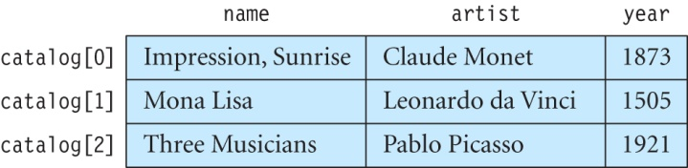
Exercise continued
Show how the array catalog looks after the information is stored in it.
Using an enhanced for loop print out the name and artist of each painting stored in the array catalog.
for (Painting p : catalog)
System.out.println("Painting name = " +p.getName() +" Artist = " +p.getArtist());

Slide 18
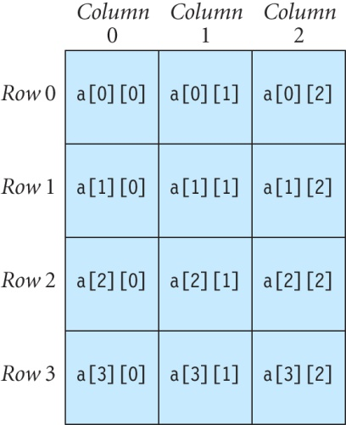
Multidimensional Arrays
A multi-dimensional array contains several rows and columns.
A two-dimensional array with four rows and three columns:
An element in this array has two indices, where the first index is the row number and the second is the column number.

Slide 19
Creating Two-dimensional Arrays
Declare a two-dimensional array named a:
int[][] a;
Create the array:
a = new int[10][3]; // a has 10 rows and 3 columns
It is not necessary to give the number of columns, but not specifying the number of rows causes a compilation error:
a = new int[5][]; // okay, array has 5 rows
a = new int[][3]; // error, number of rows missing
a = new int[][]; // error, number of rows missing

Slide 20
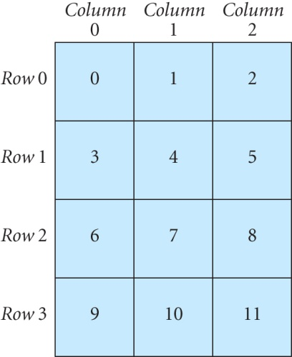
Creating Two-dimensional Arrays continued
Using an initializer list:
int[][] numArray = { {0, 1, 2},
{3, 4, 5},
{6, 7, 8},
{9, 10, 11}
};

Slide 21
Exercise
Using a nested for loop increment the values of all elements in numArray (see slide 20) by 5.
Solution:
for (int row = 0; row < 4; row++)
for (int column = 0; column < 3; column++)
numArray[row][column] += 5;

Slide 22
The Crystals Game
Players create patterns on a grid of squares by taking turns to color individual squares on the grid.
Each colored square is called an atom.
A crystal consists of a group of atoms such that each atom is joined to at least one other atom along one side.
A perfect crystal must have the following properties:
contain at least four atoms
be symmetrical
not contain any holes

Slide 23
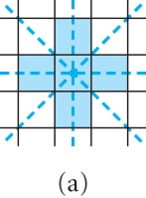
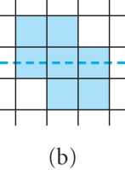
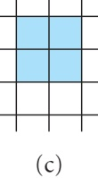
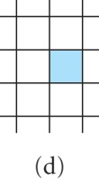
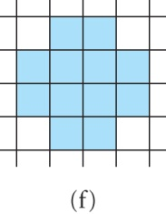
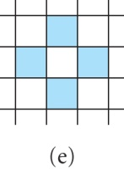
The Crystals Game: Examples of Crystals
(a), (c), and (f) are perfect crystals

Slide 24
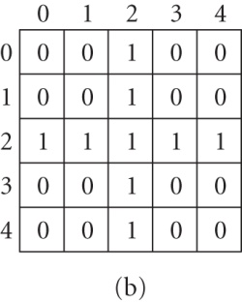
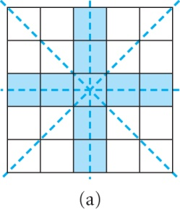
The Crystals Game: Storing a Crystal in an Array
A crystal can be stored in a two-dimensional array (we call thid array grid).
If an atom is present in the grid, it is stored as a 1 in the corresponding position in the array.
Otherwise, a 0 is stored in that array location.

Slide 25
The Crystals Game: Checking a Crystal for Symmetry
Check that pattern in array (on previous slide) is symmetrical about horizontal, vertical and two diagonal lines.
For vertical symmetry:
grid[0][0] == grid[0][4]
grid[0][1] == grid[0][3]
grid[1][0] == grid[1][4]
grid[1][1] == grid[1][3], and so on.
Check for vertical symmetry in grid with width + 1 columns and rows:
Similarly, formulate equations to check for other types of symmetry.
for (int row = 0; row <= width; row++)
for (int column = 0; column <= width; column++)
if (grid[row][column] != grid[row][width - column])
return false;

Slide 26
Passing Arrays as Arguments to Methods
Arrays can be passed as arguments to a method.
Like other objects, arrays are also passed by reference.
The contents of the array can be modified in that method.

Slide 27
Exercise
What is the output?
public class TestArray {
public static void print(int[] array) {
for (int value : array)
System.out.println(value);
}
public static void increment(int[] array) {
for (int i = 0; i < array.length; i++)
array[i]++; // add 1 to data value at index i
}
public static void main(String[] args) {
int[] newArray = {10, -9, 8, -7, 6};
TestArray.increment(newArray);
TestArray.print(newArray);
}
}

Slide 28
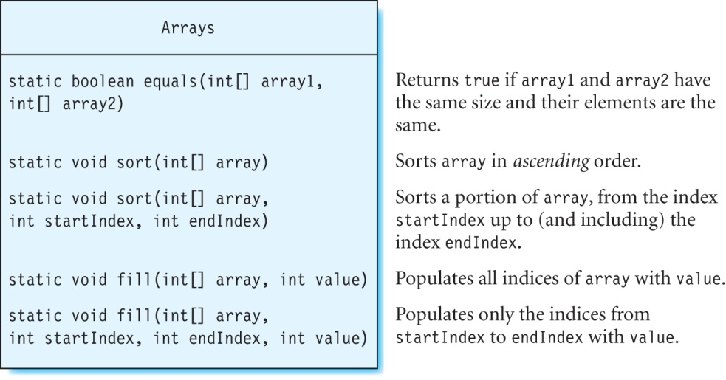
The Arrays Class
Defined in the java.util package.
Contains overloaded versions of these methods with arguments of type char, float, long, double.

Slide 29
Exercise
Create an integer array and use the sort method of the Arrays class to sort its elements in ascending order. Print out the resulting array.
Solution: The program to sort the elements is:
import java.util.Arrays;
public class TestArray {
public static void main(String[] args) {
int[] arr = {10, -9, 8, -7, 6};
Arrays.sort(arr);
for (int value : arr)
System.out.println(value);
}
}
The program output is:
-9
-7
6
8
10

Slide 30
Enum
Like classes, an enum creates a new reference type.
An enum can contain fields and methods.
There are two important differences from classes:
An enum contains a fixed array of enum objects.
An enum implicitly extends the Enum class in the java.lang package.
A enum can contain only enum objects (usually called enum constants).

Slide 31
Creating Enums
Declare an enum using the enum keyword.
Example:
An enum called EnumColor with enum objects RED, CYAN, and MAGENTA:
Objects cannot be created outside an enum using the new operator:
EnumColor e = new EnumColor(); // error
Use uppercase letters for enum objects.
public enum EnumColor {
RED,
CYAN,
MAGENTA;
}

Slide 32
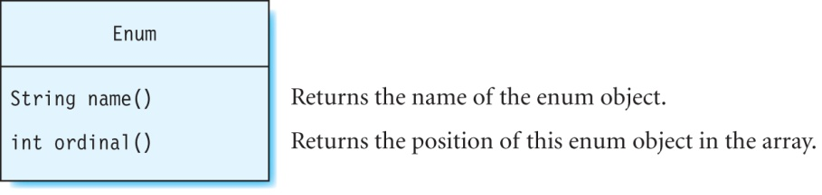
The Enum Class
Enums inherit the methods of the Enum class.
The Enum class is in the java.lang package.
The ordinal is the position of an enum object.
The first enum object in an enum is at ordinal 0.

Slide 33
Exercise
What is the output of the following code?
Solution:
CYAN has ordinal 1
public enum EnumColor {
RED,
CYAN,
MAGENTA;
public static void main(String[] args) {
EnumColor color = CYAN;
System.out.println(color.name() +" has ordinal "+color.ordinal());
}
}

Slide 34
The values() Method
Static method that returns an array of the objects in the enum.
Example:
This returns an enum object with ordinal 0 in enum e:
e.values()[0]
Prints out the number of objects in the enum e using the length field:
e.values().length

Slide 35
Exercise
What is the output of the following program?
The program output is:
RED
CYAN
MAGENTA
public enum EnumColor {
RED,
CYAN,
MAGENTA;
public static void main(String[] args) {
for (int i = 0; i < EnumColor.values().length; i++)
System.out.println(EnumColor.values()[i]);
}
}

Slide 36
Adding Methods to an Enum
You can add methods to an enum.
All enum objects inherit these methods.
It is necessary for each enum object to implement a method declared abstract.
An enum object can also have other methods of its own, that are not present in other enum objects.
An enum object cannot define static methods of its own.

Slide 37
Example: An Enum With Methods
The enum objects implement the abstract method getColor:
public enum EnumColor {
RED {
public Color getColor() {
return Color.RED;
}
},
CYAN {
public Color getColor() {
return Color.CYAN;
}
},
MAGENTA {
public Color getColor() {
return Color.MAGENTA;
}
};
public abstract Color getColor();
}

Slide 38
Adding Fields and Constructors to an Enum
You can add fields and constructors can be added to an enum.
The constructors generate the enum objects automatically and cannot be invoked by the programmer.
The objects in an enum can also be created with arguments.
The enum constructor can be declared as private or package-private but not as public or protected.

Slide 39
An Enum With Fields and Constructors
Example:
An enum with four shape objects:
public enum EnumShape {
RECTANGLE,
ELLIPSE,
CIRCLE,
SQUARE;
}
To create each shape of a fixed width and height, add these two fields and constructor to this enum:
int width, height;
EnumShape(int w, int h) {
width = w;
height = h;
}
Create the enum objects using the preceding constructor:
RECTANGLE(width, height)
ELLIPSE(width, height)

Slide 40
The EnumShape Enum
public enum EnumShape {
RECTANGLE(200, 100) {
Shape createShape() {
return (Shape) ( new Rectangle2D.Float(50, 100, width, height) );
}
},
ELLIPSE(200, 300) {
Shape createShape() {
return (Shape) ( new Ellipse2D.Float(50, 100, width, height) );
}
},
// code for enum objects CIRCLE and SQUARE
}; // note the semicolon here
int width, height;
EnumShape(int w, int h) {
width = w;
height = h;
}
abstract Shape createShape();
}

Slide 41
The Crystals Game: The Enum Direction
Gives the coordinates of the squares that are to the north, south, east and west of a particular square on the grid.
Contains four enum objects: NORTH, SOUTH, EAST, and WEST.
Example:
For the square at row 10 and column 0 (10, 0):
NORTH returns (9, 0),
SOUTH return (11, 0),
EAST returns (10, 1), and
WEST returns null respectively.
Convenient to represent the coordinates of a point using the java.awt.Point class.

Slide 42
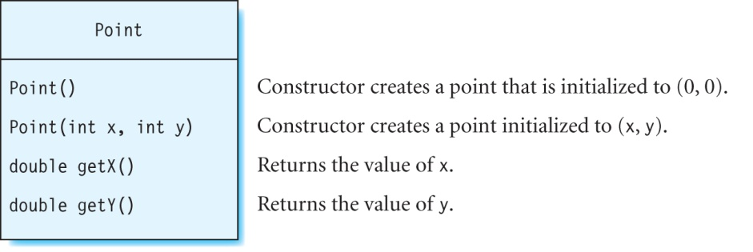
The Point Class
Java 2D class provided in the java.awt package.

Slide 43
The Crystals Game: The Direction Enum
The code for enum object NORTH in the enum Direction:
public enum Direction {
NORTH {
Point index(int r, int c) {
if (r > 0)
return new Point(r-1, c);
else
return null;
}
},
// code for enums SOUTH, EAST, and WEST
}

Slide 44
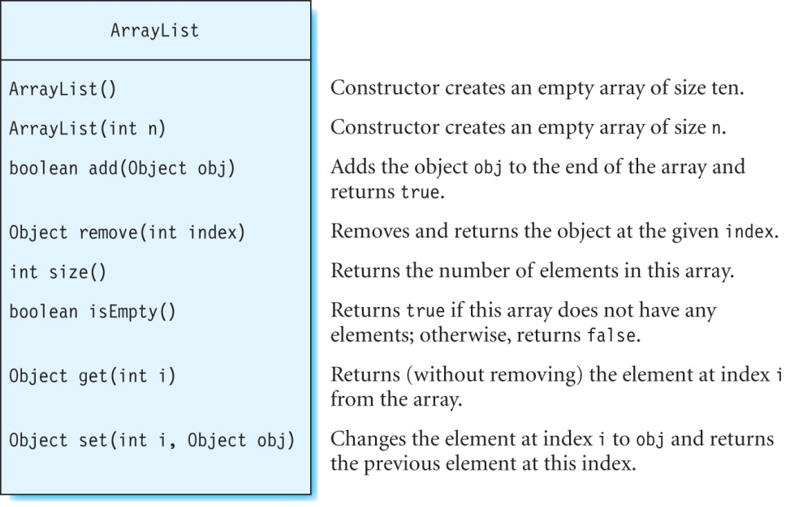
The ArrayList Class
Resides in the java.util package.
Used for arrays whose size changes while the program executes.

Slide 45
Examples
Using the add method in the ArrayList class:
This prints out the size of list:
System.out.println(list.size());
Note that the length field is used to obtain the array size for a regular array, whereas the size method is used for an instance of the ArrayList class.
This removes the element at index 1:
list.remove(1);
ArrayList list = new ArrayList();
list.add(100);
list.add(200);
list.add(300);

Slide 46
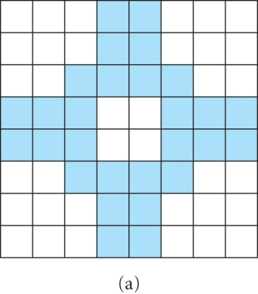
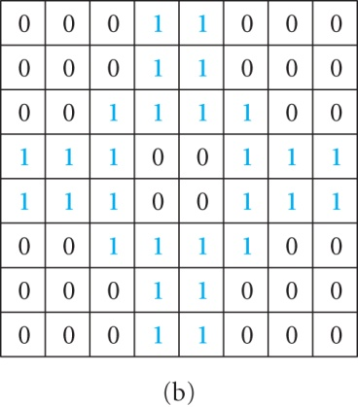
The Crystals Game: Checking for Holes
Initially, empty squares = 0, atoms = 1

Slide 47
The Crystals Game: Checking for Holes continued
A perfect crystal must not have any holes.
Observation: an empty square along the edge of the grid (called space) cannot be a hole.
Any empty square that is connected to a space along a side will also be a space, and the spaces are thus grown by connecting them together.
Any empty squares left unconnected are holes.

Slide 48
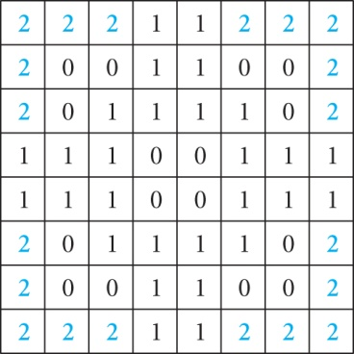
The Crystals Game: Algorithm To Find Holes
Find all squares that are not atoms along the along the edges of the grid and mark them as SPACE (value 2) in the array.
Create an ArrayList called spacesArray and store the coordinates of each space as a Point object in spacesArray.

Slide 49
The Crystals Game: Algorithm To Find Holes continued
Code in method isHoley in class Crystals for algorithm on previous slide:
// check for spaces along the four edges of the grid
// and mark each space as "SPACE"
for (int row = 0; row <= width; row++)
for (int column = 0; column <= width; column++)
if( row == 0 || row == width || column == 0 || column == width) {
if (grid[row][column] != turn) {
grid[row][column] = SPACE;
spacesArray.add(new Point(row, column));
}
}

Slide 50
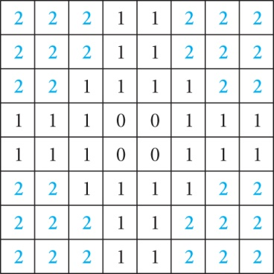
The Crystals Game: Algorithm To Find Holes (continued)
“Grow” the spaces by marking all empty squares connected to a space along a side as a space.
If spacesArray is not empty, remove its first element, and mark each empty square (not marked as SPACE) to its north, south, east or west as SPACE and add it to spacesArray.
Repeat until spacesArray is empty.
Empty squares that are not marked as SPACE are holes (holes have value 0).

Slide 51
The Crystals Game: Algorithm To Find Holes continued
Code in method isHoley in class Crystals for algorithm on previous slide:
// find all spaces adjacent to the spaces found above
while (!spacesArray.isEmpty()) {
Point neighbor;
Point p = (Point) spacesArray.remove(0);
// get the row and column number of Point p
int row = (int) p.getX();
int column = (int) p.getY();
// find spaces to the north, south, east and west of p
for (Direction dir : Direction.values())
if ( (neighbor = dir.index(row, column)) != null)
addSpace((int) neighbor.getX(), (int) neighbor.getY(), spacesArray);
}

Slide 52
The Crystals Game: Algorithm To Find Holes continued
Code in method addSpace in class Crystals for algorithm on slide 50:
// mark cell at (row, column) as SPACE if is not an atom
// or already marked as SPACE
public static void addSpace(int row, int column, ArrayList spacesArray) {
if (grid[row][column] != turn && grid[row][column] != SPACE) {
grid[row][column] = SPACE;
spacesArray.add(new Point(row, column));
}
}

Slide 53
The Crystals Game: Algorithm To Find Holes continued
Code in method isHoley in class Crystals for algorithm on slide 50:
// any cell that is not an atom or not marked as SPACE is a hole
for (int row = 0; row <= width; row++)
for (int column = 0; column <= width; column++)
if (grid[row][column] != turn && grid[row][column] != SPACE)
return true; // found a hole

Slide 54
The Crystals Game: Finding a Perfect Crystal
Partial listing of method isPerfect in class Crystal to determine if a crystal is perfect:
// check if square
if (width != height) {
return false; // not a perfect crystal
}
// check that number of atoms is 4 or greater
if (getNumberOfAtoms() < 4) {
return false;
}

Slide 55
The Crystals Game: Finding a Perfect Crystal (continued)
// check if symmetrical
if ( !isSymmetrical() ) {
return false;
}
// check for holes
if( isHoley() ) {
return false;
}
// perfect crystal
return true;
}
Note: Method getNumberOfAtoms returns the number of atoms in the crystal.

Slide 56
Strings
A string is an instance of the String class defined in the java.lang package.
There are two ways to create a string – using a string literal (preferred) or using a constructor.
This statement creates a string called s1 by using a string literal:
String s1 = "This is a string literal";
Create strings by using the constructor:
String s2 = new String("This is another string");
char[] charArray = {'J', 'u', 'l', 'y'};
String s4 = new String(charArray);

Slide 57
Strings continued
An object of the String class cannot be changed after it has been created.
Suppose that s1 and s2 reference the same string “A string”.
Modify s2:
s2 = s2 + " that has been modified";
Check whether s1 has changed:
System.out.println(s1); // prints out "A string"
However, s2 is now assigned to a new object as shown by the output of this statement:
System.out.println(s2); // prints out "A string that // has been modified"

Slide 58
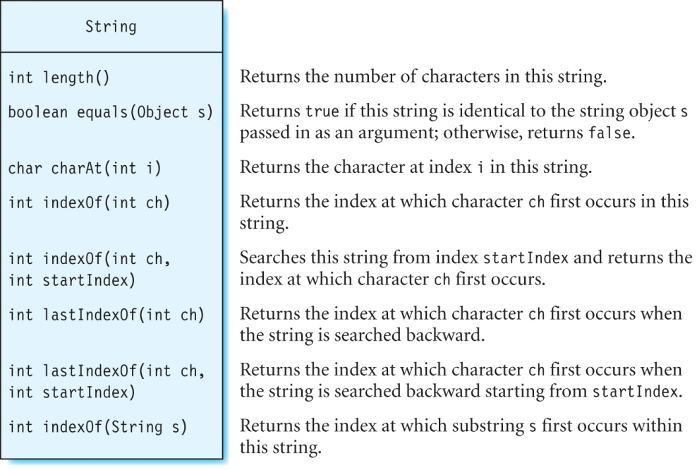
Some Methods in Class String

Slide 59
Length of a String
The length method is used to print out the length of a string.
This is different from the field length used to print out the length of an array.
For example, print the length of the string city:
String city = "New York";
System.out.println(city.length()); // prints out 8

Slide 60
Comparing Strings
Use the equals method to determine if two strings are identical.
The equals sign should not be used to compare strings.
Example:
Two strings str1 and str2
String str1 = new String("How now brown cow?");
String str2 = new String("How now brown cow?");
Since the string literals are identical, the equals method returns true:
str1.equals(str2); // returns true
Using equals sign returns false:
str1 == str1 // condition is false
The equals method will return false if the argument passed to it is not of type String.

Slide 61
Methods That Use/Retrieve an Index
Use charAt method to find out which character occurs at a particular index in a string:
Finding the index of the specified character in a string:
String city = "New York";
char ch = city.charAt(2); // ch is assigned the value "w“
String ocean = "Atlantic Ocean";
int index1 = ocean.indexOf('a'); // index1 = 3
int index2 = ocean.lastIndexOf('a'); // index2 = 12
int index3 = ocean.indexOf('a', 4); // index3 = 12
int index4 = ocean.lastIndexOf('a', 0);// index 4 = -1

Slide 62
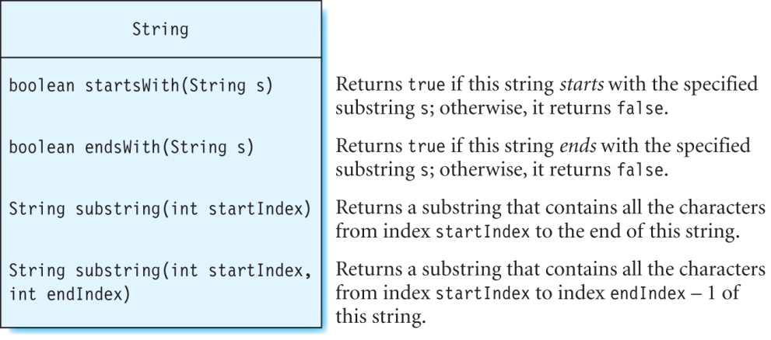
Methods For Substrings
Examples:
String city = "San Francisco";
city.startsWith("San F"); // returns true
city.startsWith("Francisco"); // returns false
city.endsWith("sco"); // returns true
city.endsWith("esco"); // returns false
city.startsWith("San Francisco"); // returns true
city.endsWith("San Francisco"); // returns true

Slide 63
Exercise
What is returned by each call to method substring?
String word = "meteorological";
word.substring(7);
word.substring(0, 6);
word.substring(5, 0);

Slide 64
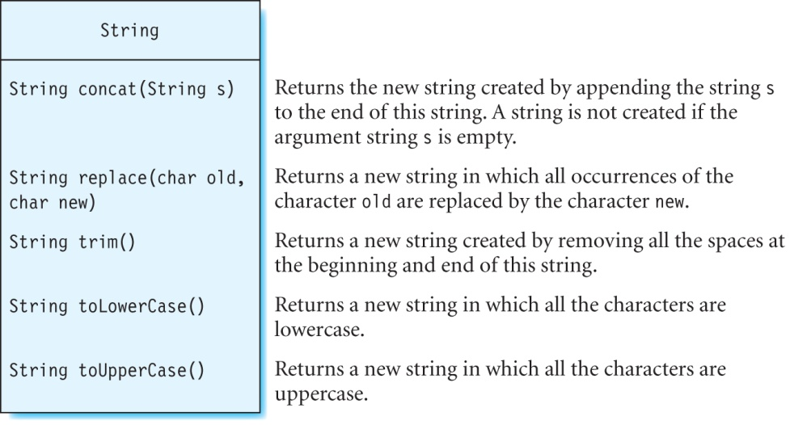
More Methods in Class String

Slide 65
Concatenating Strings
Use method concat to combine strings.
Examples:
String s1 = "Par";
String s2 = s1.concat("is");
System.out.println(s2); // prints out “Paris”
String s3 = " is the capital of France.";
String s4 = s2.concat(s3);
System.out.println(s4); // prints “Paris is the capital of France”

Slide 66
Replacing/Removing Characters
The replace and trim methods substitute and remove particular characters, respectively, from the string.
Example:
word1 references the new string “binyin”, and word2 references “pinyin”.
Use method trim to remove spaces at the beginning and the end of a string :
String pie = " apple pie ".trim();
String word1 = "banyan".replace('a', 'i');
String word2 = word1.replace('b', 'p');

Slide 67
Converting to Uppercase or Lowercase
Use methods toLowerCase and toUpperCase.
Examples:
"frieNd".toLowerCase(); // returns the string "friend"
"frieNd".toUpperCase(); // returns the string "FRIEND"

Slide 68
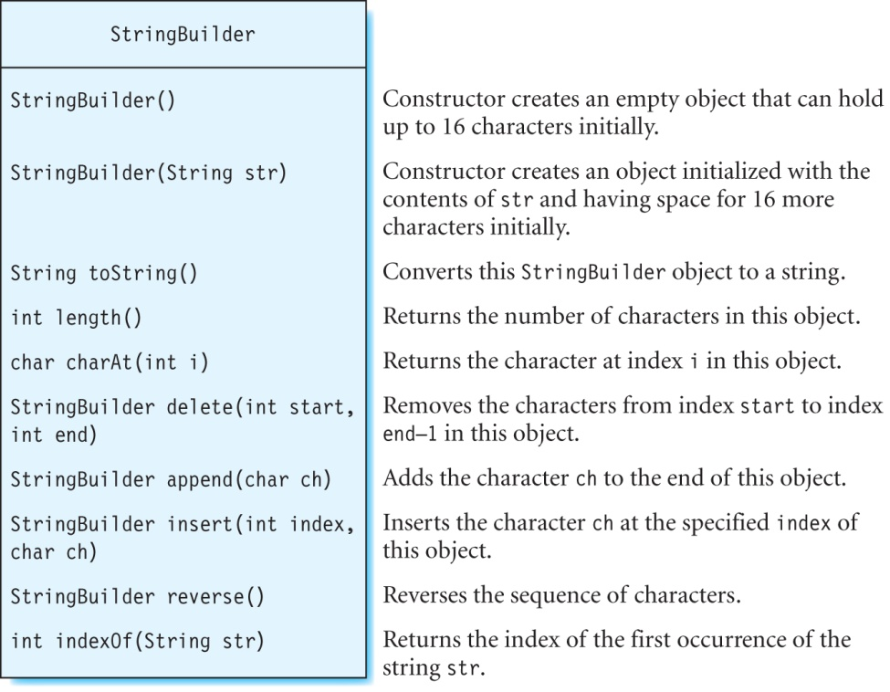
The StringBuilder Class continued

Slide 69
The StringBuilder Class
Examples:
StringBuilder sb = new StringBuilder("warts");
sb.reverse(); // sb contains "straw"
sb.length(); // returns 5
sb.charAt(3); // returns 'a'
sb.insert(0, 'l'); // sb contains "lstraw"
sb.insert(1, 'a'); // sb contains "lastraw"
sb.insert(2, 's'); // sb contains "lasstraw"
sb.insert(3, 't'); // sb contains "laststraw"
sb.insert(4, ' '); // sb contains "last straw"
sb.indexOf("raw"); // returns 7
sb.delete(1, 8); // sb contains "law"

Slide 70
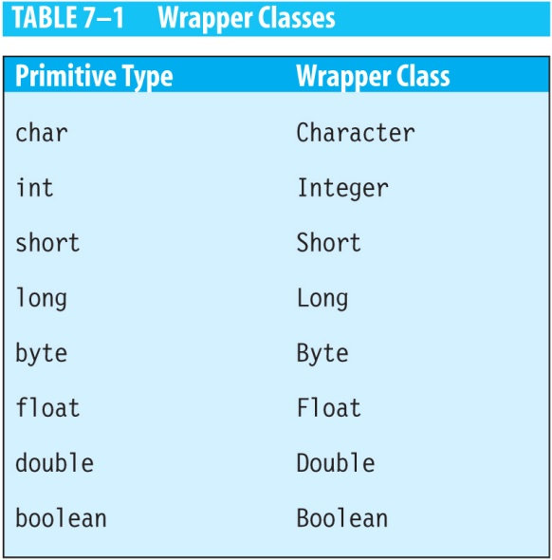
Primitive Wrapper Classes
There are eight wrapper classes defined for each of the primitives in the java.lang package.

Slide 71
Primitive Classes continued
Examples:
Character charA = new Character('A');
// int10 is of type Integer
Integer int10 = new Integer(10);
double d1 = 3.8;
// dvalue is of type Double
Double dvalue = new Double(d1);

Slide 72
Boxing
The compiler can automatically put the primitive inside its wrapper class – this is called boxing.
Character ch;
Integer val1, val2;
ch = 'b'; // boxing
val1 = 20; // boxing
val2 = 30; // boxing

Slide 73
Unboxing
Compiler can extract the primitive from its wrapper – caled unboxing.
Example:
The compiler extracts the integer values of val1 and val2 and multiplies them together:
Integer val1, val2;
// store data in val1 and val2
int mult = val1 * val2; // unboxing

Slide 74
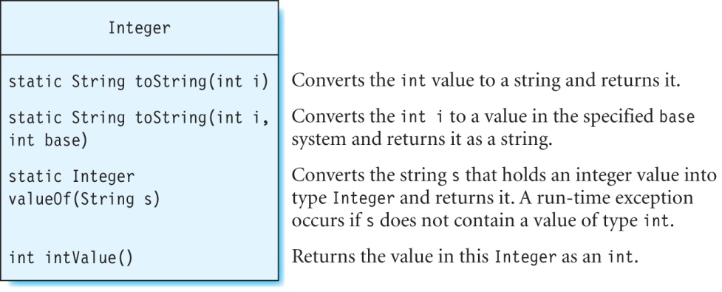
The Integer Class
These methods are defined similarly in the other wrapper classes.

Slide 75
The Wrapper Classes
Method toString method converts a numeric value to a string:
Method valueOf converts a string into a wrapper class:
Integer.toString(10); // returns 10 as a string
Double.toString(3.5); // returns 3.5 as a string
Float.toString(1.5f); // return 1.5 as string
float valf = 10.5f;
String strf = Float.toString(valf); // strf = "10.5f"
Float objf = Float.valueOf(strf); // objf holds 10.5
System.out.println(objf); // prints out 10.5

Slide 76
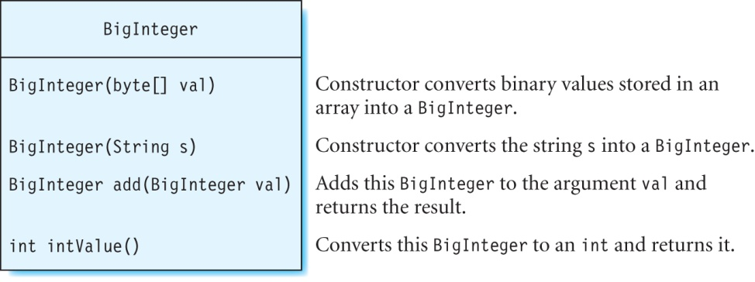
The BigInteger Class
Example:
BigInteger bigInt1 = new BigInteger("5000");
BigInteger result1 = bigInt.add(bigInt1);
// result1 = 92233720368547763081

Slide 77
Command-Line Arguments
The main method is declared as shown below:
You can supply data values on the command line that are known as command-line arguments and are read into the program during execution.
These arguments are stored in the String array (called args) of the main method.
Any number of command-line arguments can be given to a program.
public static void main(String[] args) {
// your program goes here
}

Slide 78
Example
Program that uses command-line arguments:
Compile the program as usual. The command line arguments are given when the program is run:
C:\JavaBook> java -classpath bin arraysandstrings.DisplayPicture image/space.jpg 100 100
public class DisplayPicture {
public static void main(String[] args) {
if (args.length < 3)
// display error messages
DrawingKit dk = new DrawingKit(1000, 1000);
// the filename is stored in args[0]
BufferedImage pict = dk.loadPicture(args[0]);
// draw pict on the screen at the coordinates in args[1] and args[2]
dk.drawPicture(pict,Integer.valueOf(args[1]),Integer.valueOf(args[2])); }
}

Slide 79
Computers in Science : Human DNA
Human DNA forms the building block for each cell in the human body.
Human Genome Project completed in 2003.
Maps the human DNA using an alphabet of four letters: A, C, G, and T.

Slide 80
Human DNA
DNA consists of two strands joined together in the shape of a spiral staircase.
The rungs of this staircase are formed by combining oxygen, nitrogen, hydrogen and phosphorus atoms into four types of bases:
A (adenine)
C (cytosine)
G (guanine)
T (thymine)
Each rung contains two bases bonded together.
3 million base pairs describe the DNA in each cell.

Slide 81
Proteins
Proteins are responsible for different functions in human body.
DNA creates RNA, which creates proteins.
RNA is made of four bases:
A (adenine)
C (cytosine)
G (guanine)
U (uracil)
Uses two steps to create a protein:
Transcription
Translation

Slide 82
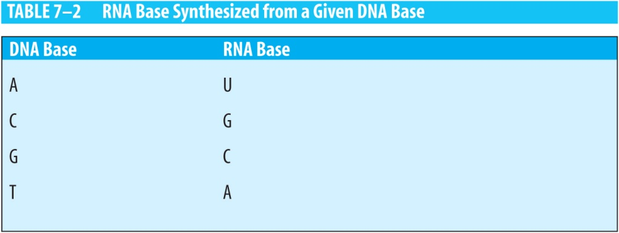
Transcription
Creates RNA from DNA:
The two DNA strands separate partially from each other, exposing their bases.
RNA strand is created by pairing the RNA bases with exposed bases of one of the two DNA strands (use the following table)
Example:
(DNA sequence) T A C G A T A A G A A A T T C C C A A T T
(RNA sequence) A U G C U A U U C U U U A A G G G U U A A

Slide 83
Translation
Generates proteins from the RNA sequence.
A codon (such as AUG (start), UUU, and UAA (stop)) is a set of three RNA bases that code a particular type of amino acid.
Long chains comprising of thousands of amino acids make up a specific protein.
See the table of codons and their corresponding amino acids on next slide.
Example:
(RNA sequence) A U G C U A U U C U U U A A G G G U U A A
The protein is composed of the following amino acids:
(protein) methionine - leucine - phenylalanine - phenylalanine - lysine - glysine

Slide 84
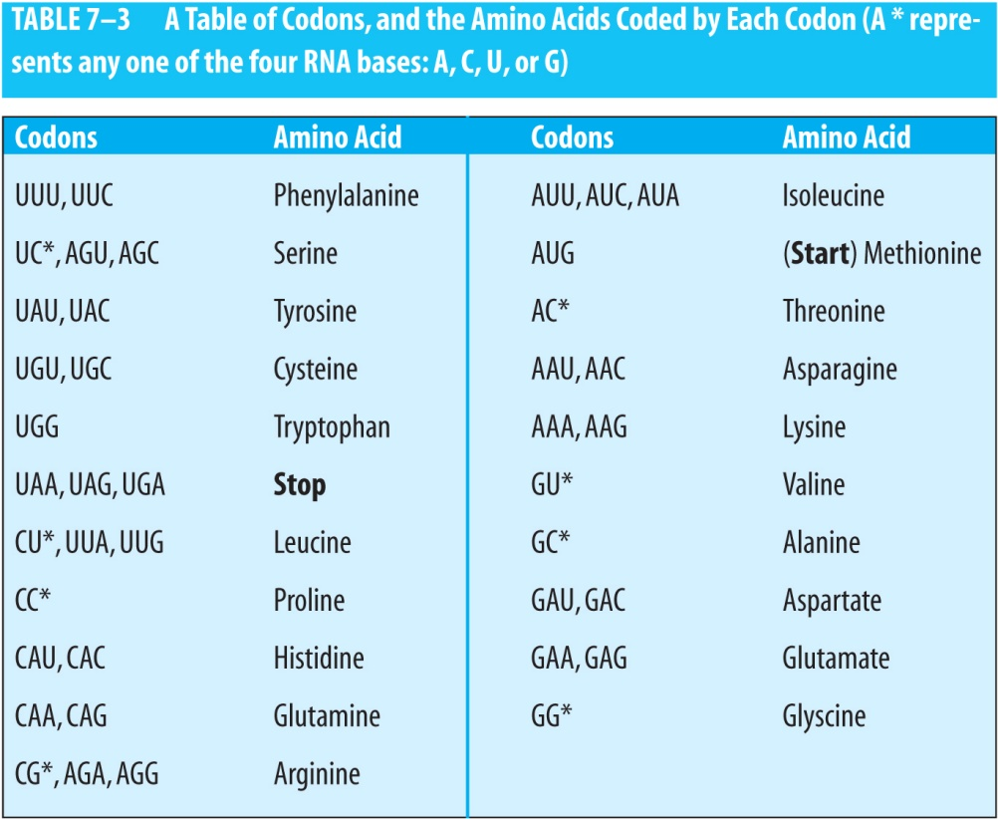
Table of Codons and Corresponding Amino Acids

Slide 85
Exercise
Calculate the protein for the following DNA strand:
(DNA strand) T T T A C T T T G T T G C A A G T A C C A T C G G
Solution:
The RNA bases synthesized from the above sequence are:
(RNA strand) A A A U G A A A C A A C G U U C A U G G U A G C C
The protein created has these amino acids:
(protein) methionine – lysine – glutamine – arginine – serine – tryptophan

Slide 86
Class ProteinSynthesisDemo
public class ProteinSynthesisDemo {
Scanner scanner;
String dnaStrand; // DNA strand entered by the user
StringBuilder rnaStrand; // corresponding RNA strand
StringBuilder protein; // amino acids in the protein
static String[][] codonToAminoAcid = { {"GC", "alanine"}, {"UUU", "phenylalanine"}, {"UUC", "phenylalanine"}, {"UUA", "leucine"}, {"UUG", "leucine"}, {"CU", "leucine"}, {"CC", "proline"}, {"AC", "threonine"}, {"GG", "glycine"}, {"UC", "serine"}, {"UAU", "tyrosine"}, {"UAC", "tyrosine"}, ...
};
ProteinSynthesisDemo () {
scanner = new Scanner(System.in);
rnaStrand = new StringBuilder();
protein = new StringBuilder();
}
// code for methods getUserInput, transcribe,
// translate, getAminoAcid, and main
}

Slide 87
Class ProteinSynthesisDemo continued
Method getUserInput:
// prompts the user to enter the bases in a DNA strand
public void getUserInput() {
System.out.print("Enter the bases (A, C, G, T) in a DNA strand: ");
dnaStrand = scanner.next();
}

Slide 88
Class ProteinSynthesisDemo continued
// Builds the RNA from the DNA
public void transcribe() {
int index = 0;
char ch;
// clear the previous contents of StringBuilder rnaStrand
rnaStrand.delete(0, rnaStrand.length());
while (index < dnaStrand.length()) {
ch = dnaStrand.charAt(index);
switch(ch) {
case 'A' : rnaStrand.append('U');
break;
case 'C' : rnaStrand.append('G');
break;
case 'G' : rnaStrand.append('C');
break;
case 'T' : rnaStrand.append('A');
break;
default : System.out.println("Invalid base. Only A, C, G and T are allowed.");
System.exit(1);
break;
}
index++;
}
System.out.println("The corresponding mRNA strand is:" +rnaStrand);
}

Slide 89
Class ProteinSynthesisDemo continued
// returns the protein coded by the given codon
public String getAminoAcid(String codon) {
for (int i = 0; i < codonToAminoAcid.length; i++) {
if (codon.startsWith(codonToAminoAcid[i][0]))
return codonToAminoAcid[i][1];
}
System.out.println("Error: Amino acid not found for codon" +codon);
return null;
}

Slide 90
Class ProteinSynthesisDemo continued
// finds all the amino acids that make up the protein
// starting from the start codon AUG to a stop codon.
public void translate() {
int codonLength = 3; // a codon has 3 characters
boolean stopCodonFound = false;
// clear the previous contents of StringBuilder proteins
protein.delete(0, protein.length());
// find the index where the starting codon "AUG" occurs
int index = rnaStrand.indexOf("AUG");
if (index != -1) {
// get protein for this codon "AUG"
protein.append(getAminoAcid("AUG"));
protein.append(" ");
} else {
System.out.println("Starting codon AUG not found");
System.exit(1);
}
}

Slide 91
Class ProteinSynthesisDemo continued
// method translate continued
// find the remaining codons until a stop codon is reached
do {
// get index of next codon
index += codonLength;
if (index + codonLength <= rnaStrand.length()) {
// get next codon and determine if it is stop codon
String codon = rnaStrand.substring(index, index + codonLength);
stopCodonFound = ( codon.equals("UAA") || codon.equals("UAG") || codon.equals("UGA") );
// get amino acid coded by this codon and add it to StringBuilder protein
if (!stopCodonFound) {
protein.append(getAminoAcid(codon));
protein.append(" ");
}
} else {
System.out.println("Stop codon UAA, UAG or UGA not found");
System.exit(1);
}
} while (!stopCodonFound);
System.out.println("The protein is: " +protein);
}

Slide 92
Class ProteinSynthesisDemo
Method main:
A sample output:
Enter the bases (A, C, G, T) in a DNA strand: TACTTTGTTGCAAGTACCATCCGG
The corresponding mRNA strand is:AUGAAACAACGUUCAUGGUAGGCC
The protein is: methionine lysine glutamine arginine serine tryptophan
public static void main(String[] args) {
ProteinSynthesisDemo demo = new ProteinSynthesisDemo();
demo.getUserInput();
demo.transcribe();
demo.translate();
}

Slide 93
Summary
We discussed:
How to create and use arrays and strings.
How to create an enum and add constructors and methods to it.
The Arrays class that contains static methods to sort the contents of an array, determine whether two arrays are equal, etc.
The ArrayList class used to create arrays whose size changes dynamically as the program executes.
The Strings class that contains methods to get the length of a string, manipulate substrings, among others.
The StringBuilder class used to create a string that can be modified.
A program to calculate proteins synthesized by the human DNA.
What’s next:
Interfaces and nested classes

