Slide 1

Chapter 10
Exception Handling

Slide 2
Outline
The try and catch Blocks
The Exception class
Methods That Throw Exceptions
Using multiple catch blocks
Run-time Exceptions
The finally Block

Slide 3
What Is An Exception?
An exception refers to an error that occurs while a program is running.
This type of error does not appear while a program is being compiled.
For example, suppose that a program needs to read the contents of a file that does not exist.
Does the program compile fine?
What happens when the program is executed?
Java has an in-built exception handling mechanism.

Slide 4
Try-Catch Blocks
A try block followed by a catch block:
The program code is placed within the try block.
An exception occurs if something goes wrong while the code in this block is being executed.
The catch block specifies the action that must be taken to handle the exception when it occurs, and is called the exception handler.
try {
// program code
} catch (Exception identifier) {
// exception handling code
}

Slide 5
Example: Class BakeACake
Program to bake a cake:
public class BakeACake {
public void mixIngredients() {
System.out.println("Mix cake batter");
}
public void putCakeInOven() {
System.out.println("Put cake in oven");
}
public void setOvenTimer(int time) {
System.out.println("Oven will be turned on for " +time +" minutes");
}
public void turnOvenOff() {
System.out.println("Oven turned off");
}
}

Slide 6
Example: Class BakeACake (continued)
What is the problem with this main in BakeACake?
A fire may occur if timer is broken and does not turn oven off.
Need to write this using exception handling.
public static void main(String[] args) {
BakeACake eChef = new BakeACake();
eChef.mixIngredients();
eChef.putCakeInOven();
eChef.setOvenTimer(45);
}

Slide 7
Example: Class BakeACake (continued)
Adding a try-catch block to main:
public static void main(String[] args) {
BakeACake eChef = new BakeACake();
try {
eChef.mixIngredients();
eChef.putCakeInOven();
eChef.setOvenTimer(45);
} catch (Exception brokenTimer) {
eChef.turnOvenOff();
}
}

Slide 8
Program HelloWorld With Exception Handling
Throws an “Image not found” exception if the file blimp.png is not in the working directory when the program is executed:
public class HelloWorld {
public static void main(String[] args) {
try {
File image = new File("blimp.png");
if (!image.exists())
throw new Exception("Image not found");
JFrame frame = new JFrame("My First Program");
frame.getContentPane().add(new JLabel(new ImageIcon("blimp.png")));
frame.pack();
frame.setVisible(true);
} catch (Exception error) {
System.out.println(error.getMessage());
}
}
}

Slide 9
The throw Keyword
This statement creates a new exception object carrying the message “Image not found”, and sends it to the JVM using the throw keyword (this is called throwing an exception):
throw new Exception("Image not found");
The exception handler in the catch block is then executed (called catching an exception).
The rest of the code following the throw statement in the try block is not executed after the exception is thrown.

Slide 10
Termination Model vs. Resumption Model
Termination model: the program terminates after the exception handler has executed.
Resumption model: the exception handler attempts to correct the problem that caused the exception, and then the program resumes execution from where it had left off.

Slide 11
The Exception Class
Used to create different types of exceptions.
Contains many subclasses.
An exception is an instance of any one of these classes.
You can also write your own exception class by extending Exception or its subclasses.

Slide 12
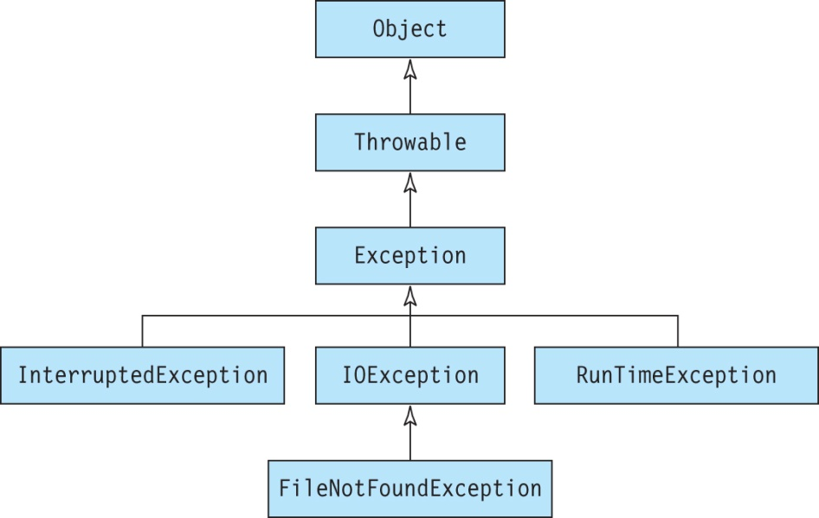
Inheritance Tree for the Exception Class

Slide 13
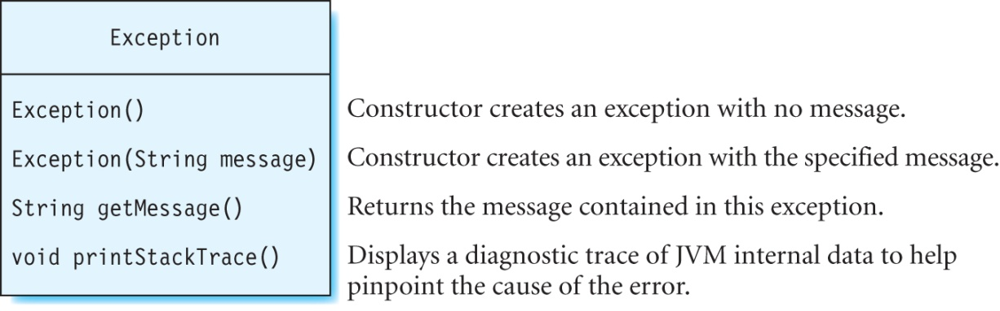
Some Constructors and Methods in the Exception Class

Slide 14
Methods That Throw Exceptions
A method must declare that it throws an exception using a throws keyword followed by the type of the exception in the method declaration:
public void checkIfImageExists() throws Exception {
File image = new File("blimp.png");
if (!image.exists())
throw new Exception("Image not found");
}

Slide 15
Methods That Throw Exceptions continued
Suppose that method X declares that it throws an exception.
A method Y that calls X must either handle this exception OR declare that it also throws this exception.
The calling method may or may not provide a suitable exception handler.
If the exception is thrown by the main method, then the program crashes with a runtime error.

Slide 16
Handling Exceptions
This method handles the exception thrown by checkIfImageExists:
public void displayImageInWindow() {
try {
checkIfImageExists();
JFrame frame = new JFrame("My First Program");
frame.getContentPane().add(new JLabel(new ImageIcon("blimp.png")));
frame.pack();
frame.setVisible(true);
} catch (Exception error) {
error.printStackTrace();
}
}

Slide 17
Handling Exceptions continued
This method does not handle the exception thrown by checkIfImageExists; therefore, it must declare that it throws the exception:
public void displayImageInWindow() throws Exception {
checkIfImageExists();
JFrame frame = new JFrame("My First Program");
frame.getContentPane().add(new JLabel(new ImageIcon("blimp.png")));
frame.pack();
frame.setVisible(true);
}

Slide 18
Unhandled Exception
This exception is sent to the console and the JVM will terminate:
Known as an unhandled exception since it is not caught by the program when it occurs.
public static void main(String[] args) throws Exception {
HelloWorldAgain hw = new HelloWorldAgain();
hw.displayImageInWindow();
}

Slide 19
Using Multiple catch Blocks
When the methods in the try block throw different types of exceptions, you should write a different catch block for each exception type:
try {
// different type of exceptions are thrown here
} catch (ExceptionType1 e1) {
// exception handler for ExceptionType1
} catch (ExceptionType2 e2) {
// exception handler for ExceptionType2
} catch (ExceptionType3 e3) {
// exception handler for ExceptionType3
}
//…continue adding as many catch blocks as needed

Slide 20
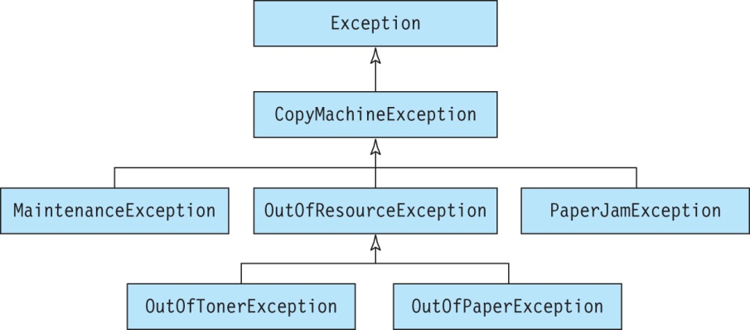
Example: Class CopyMachine
Inheritance tree showing the exceptions thrown by a copy machine:

Slide 21
Example: Creating Custom Exception Classes
Provide constructors inside the class:
Alternately, use the default constructor:
class CopyMachineException extends Exception {
public CopyMachineException() {
this("Copy Machine Exception");
}
public CopyMachineException(String message) {
super(message);
}
}
class OutOfResourceException extends CopyMachineException {}

Slide 22
Example: A Class That Throws Multiple Exceptions
The makeCopies method in this class throws multiple exceptions.
Specify these exceptions in the throws clause with commas separating them:
public class CopyMachine {
public void makeCopies() throws OutOfTonerException, OutOfPaperException, PaperJamException {
// Code for this method.
}

Slide 23
Example: Catching Multiple Exceptions
The main method for this class calls the makeCopies method in the try block and uses multiple catch blocks to handle all the exceptions thrown by this method:
public static void main(String[] args) {
try {
CopyMachine copier = new CopyMachine();
copier.makeCopies();
} catch (OutOfTonerException ex1) {
System.out.println(ex1.getMessage());
} catch (OutOfPaperException ex2) {
System.out.println(ex2.getMessage());
} catch (PaperJamException ex3) {
System.out.println(ex3.getMessage());
}
}

Slide 24
Example: Catching Multiple Exceptions
An exception type in the catch block can be replaced with its super type:
try {
CopyMachine copier = new CopyMachine();
copier.makeCopies();
} catch (OutOfResourceException ex1) {
ex1.printStackTrace();
} catch (PaperJamException ex2) {
ex2.printStackTrace();
}

Slide 25
Example: Catching Multiple Exceptions
To only provide an exception handler for OutOfPaperException, use CopyMachineException for the others:
The order of the catch blocks is important here.
If we move the CopyMachineException block before the OutOfPaperException block, the latter will never be executed. Why?
Would it result in a compilation or run-time error?
try {
CopyMachine copier = new CopyMachine();
copier.makeCopies();
} catch (OutOfPaperException ex1) {
ex1.printStackTrace();
} catch (CopyMachineException ex2) {
ex2.printStackTrace();
}

Slide 26
Run-time Exceptions
A run-time exception is caused by errors within the program.
An example of this is using an invalid index to access an array element.
This program does not give a compilation error but causes an exception when run:
package exceptionhandling;
public class ExceptionDemo {
public static void main(String[] args) {
char[] array = {'a', 'e', 'i', 'o', 'u'};
String s = new String(array, 0, 6);
System.out.println(s);
}
}

Slide 27
Run-time Exceptions continued
Check your code thoroughly to remove errors.
Do not rely on run-time exceptions to notify you when something goes wrong.
Run-time exceptions are not checked by the compiler.
Also called unchecked exceptions because they are not checked by the compiler, whereas all other types of exceptions are known as checked exceptions.

Slide 28
The finally Block
Used to hold code that must always be executed at the end of the program.
There can be only one finally block associated with a try-catch block and its use is optional:
try {
// different type of exceptions are thrown here
} catch (ExceptionType1 e1) {
// exception handler for ExceptionType1
} catch (ExceptionType2 e2) {
// exception handler for ExceptionType2
} catch (ExceptionType3 e3) {
// exception handler for ExceptionType3
} finally {
// cleanup code
}

Slide 29
Exercise
Suppose that the cake pan should always be cleaned at the end even if the cake was not baked. What is the error in this code segment?
try {
eChef.mixIngredients();
eChef.putCakeInOven();
eChef.setOvenTimer(45);
eChef.cleanCakePan();
} catch (Exception brokenTimer) {
eChef.turnOvenOff();
}

Slide 30
Example: Using the finally Block
The cake pan will be cleaned even if an exception occurs:
try {
eChef.mixIngredients();
eChef.putCakeInOven();
eChef.setOvenTimer(45);
} catch (Exception brokenTimer) {
eChef.turnOvenOff();
} finally {
eChef.cleanCakePan();
}

Slide 31
Summary
We discussed:
How exceptions are thrown and caught in a program using the try-catch block.
An exception does not have to be handled in the method in which it is thrown; instead an exception handler can be provided in the calling method.
You can extend the Exception class to create a custom exception class to meet the needs of a specific application.
A runtime exception is caused by an error in the program.
Runtime exceptions are not checked by the compiler and need not be handled by the programmer.
What’s next:
File I/O

