Slide 1
Charts
Midterm Progress Report
Benjamin Johnson

Slide 2
Introduction
Desktop application for creating and sharing musical chord charts / backing tracks
Small music library to handle notes, chords, etc.
Cross Platform Support
Linux, Mac, Windows
Tools:
Qt 6.7 (Qt Widgets UI, QApplication Framework)
FluidSynth 2 (MIDI sequencer & playback library)
C++17
Online sharing feature w/ central DB

Slide 3
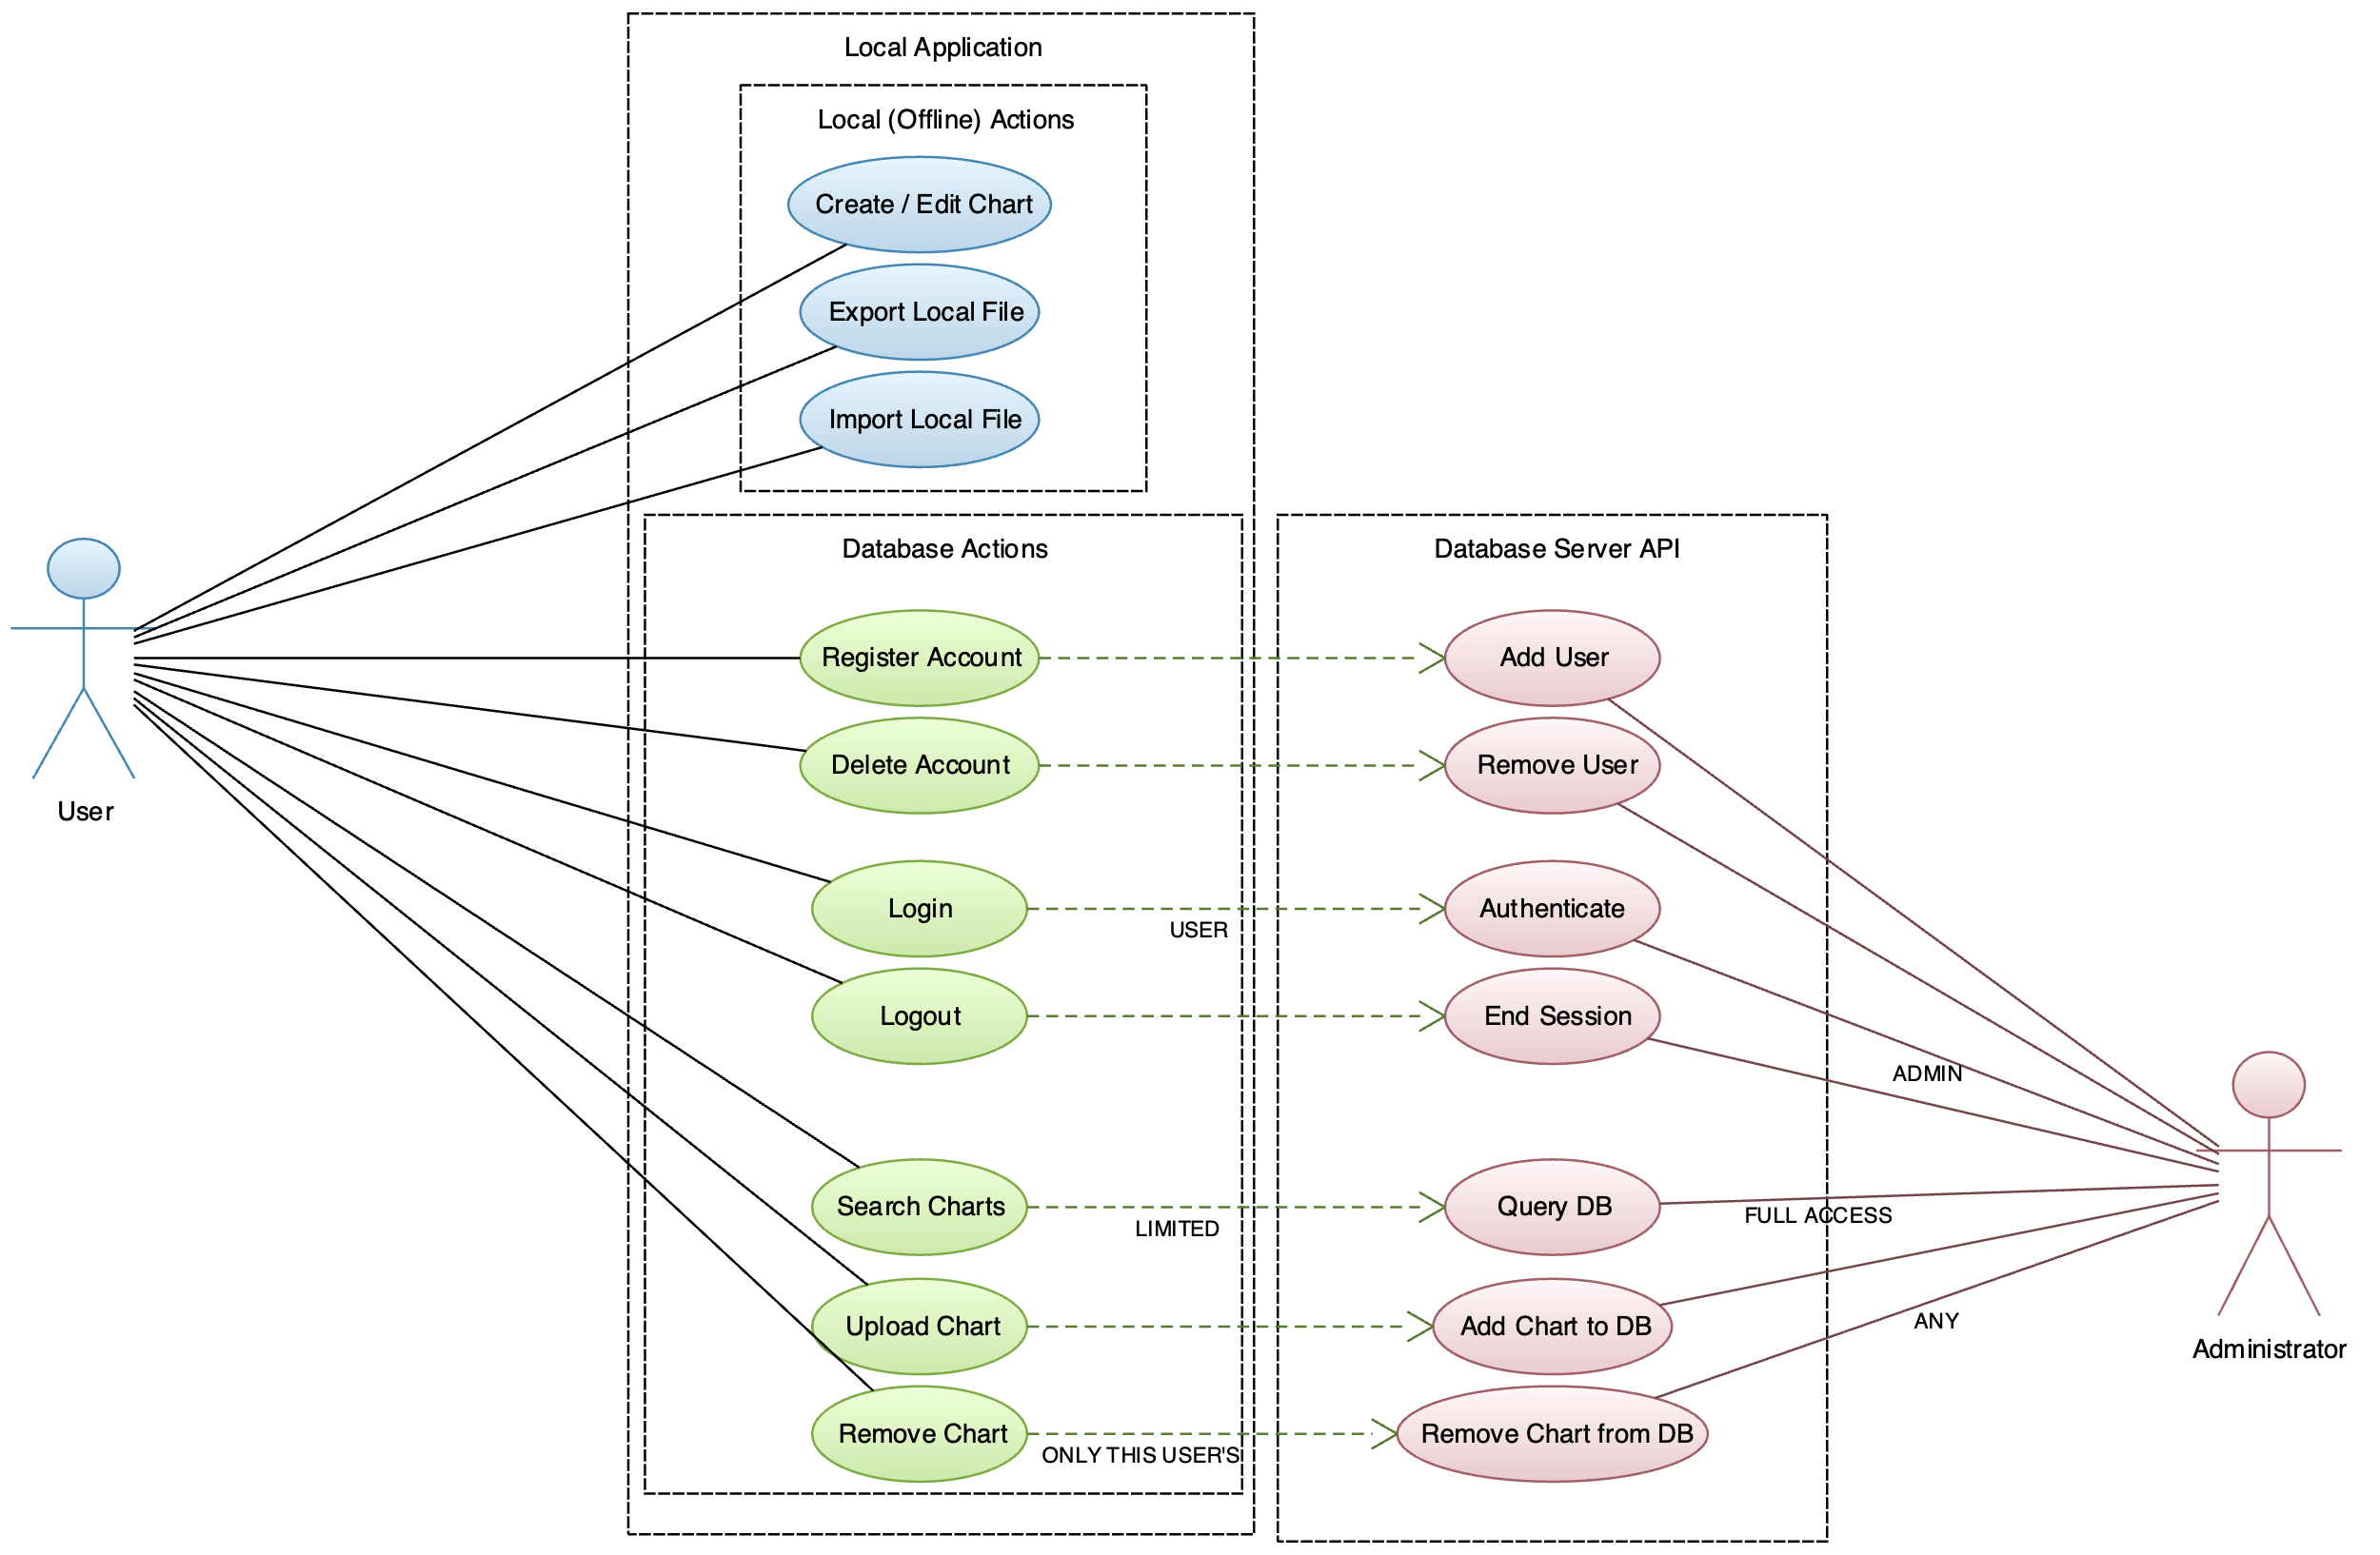
Use Case Diagram

Slide 4
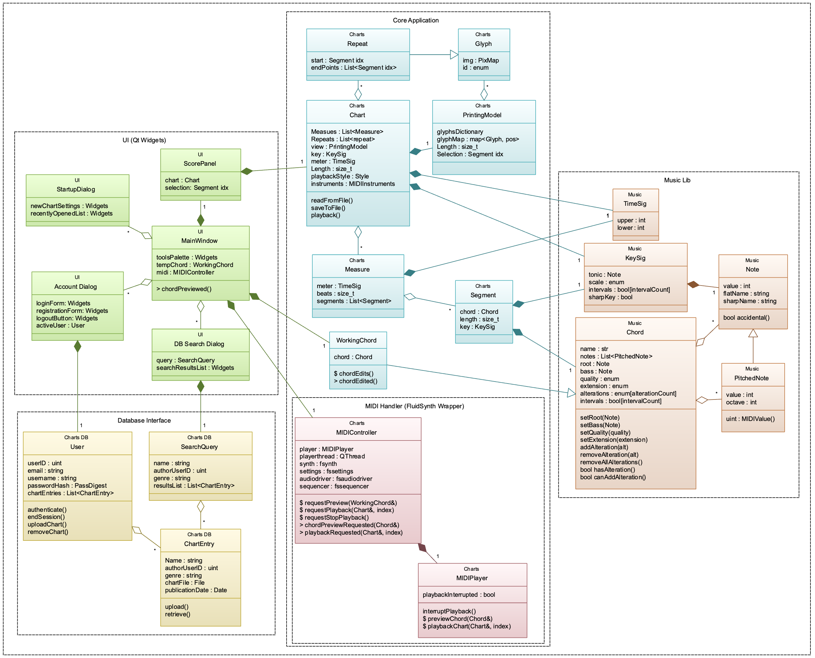
Object Diagram

Slide 5
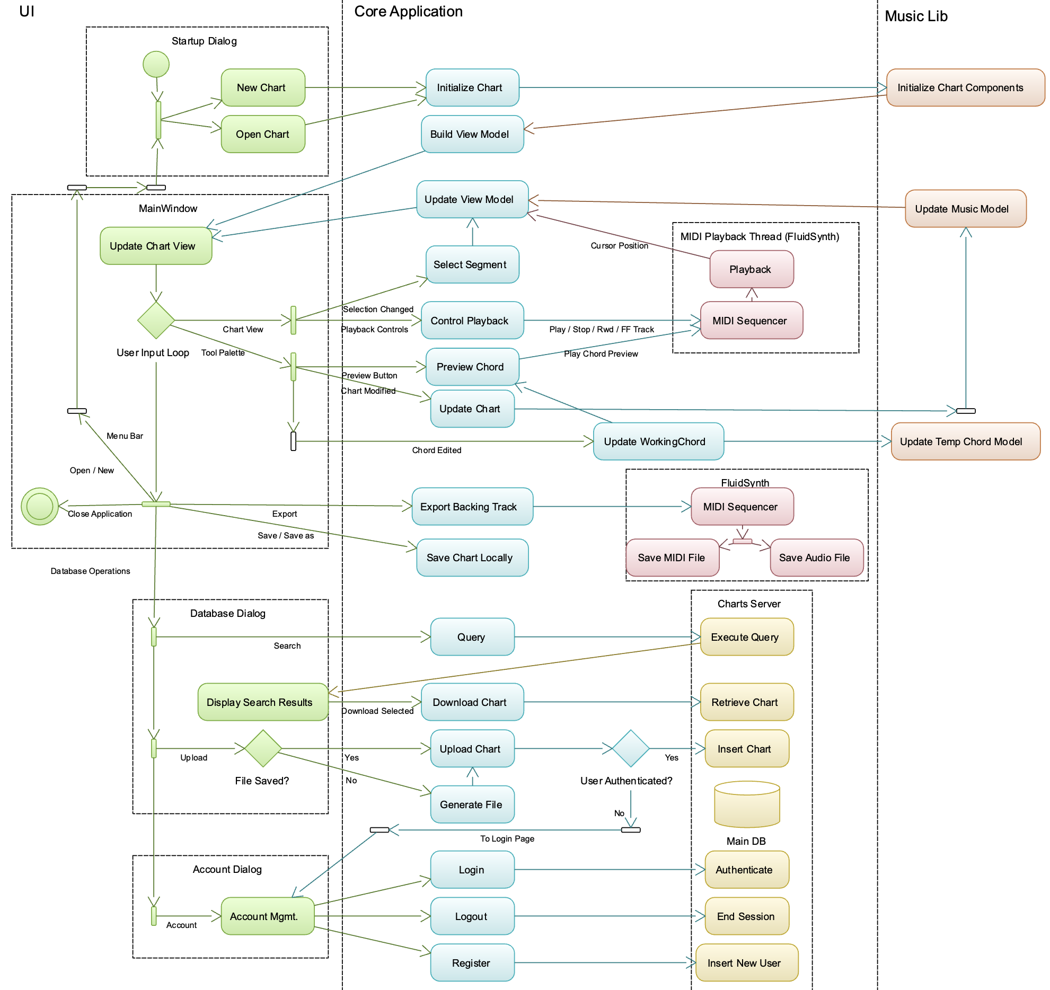
Activity Diagram
or delete if authenticated

Slide 6
Completion Progress
User Interface
~75% - progress and changes will be made as application code is fleshed out and features can be integrated
Music Utils
~99%? - everything modeled has been implemented; may need to add / change small things
Core App
~50% - UI integration with chord builder & MIDI library complete (it makes sounds!)
Server / Database
“concepts of a plan”

Slide 7
Process Model
Looking more and more like waterfall every day…
UI & Music Utils are almost done being implemented -> moving to testing stage
Core Application in implementation stage

Slide 8
Timeline
Early October:
Finalize requirements
UI design & front-end implementation
Late October:
Front-end refinements
Client-side back-end implementation
Early November:
Finish client-side application
Client-side app testing
Server-side back-end implementation
Late November:
Finish server-side
Integration testing

Slide 9
Challenges
Cross-Platform Development
Everyone has different problems…
Linking / general inconsistency
macOS SDK
MSVC / “DLL not found”
Car metaphor
Making the “right” choices
Chord representation: interval set vs. pitch set vs. complete enumeration

Slide 10
Risk Analysis
Slow start, but making good progress
Time spent in research phase is paying off
Should be fully functional by final presentation
Focusing on the big picture - Changes from initial plan:
Web app build postponed
Focus on the big 3 desktop platforms
Tutorials may be minimal in the initial release
Implementation has been smooth so far

