Slide 1
Charts
Benjamin Johnson

Slide 2
Overview
Application for creating and sharing musical charts / lead sheets / backing tracks
Allow users to edit harmony & rhythm of a song to be played back by virtual rhythm section
Midi playback
Export to multiple formats
Familiar interface layout for users of existing musical notation software
Desktop and Web based

Slide 3
Stakeholders
Musicians
Tool for practicing performance / improvisation
Learn new music
Songwriting
Easily share charts with other musicians
Learn more about music theory

Slide 4
Requirements
Functional
Allow users to create, playback, and share song charts / backing tracks
Sharing through online DB with login system
In-depth rhythmic & harmonic editing system with preset styles
Multiple methods for chord input (Nashville system, bass note, chord suggestions, build-a-chord)
Custom rhythm entry for orchestrated hits
Easily change key, meter, tempo, swing, etc.
Support for custom soundfonts & exporting to multiple formats (PDF, MIDI)
Include tutorials for new users and those looking to learn about music theory
Non-Functional
Simple, intuitive UI layout with easy-to-follow tutorials
Quick, responsive interface & playback system
Least lag / latency possible
Stutters during playback are unacceptable
Secure web integration
Unintrusive login system -- basic email signup to authenticate for sharing

Slide 5
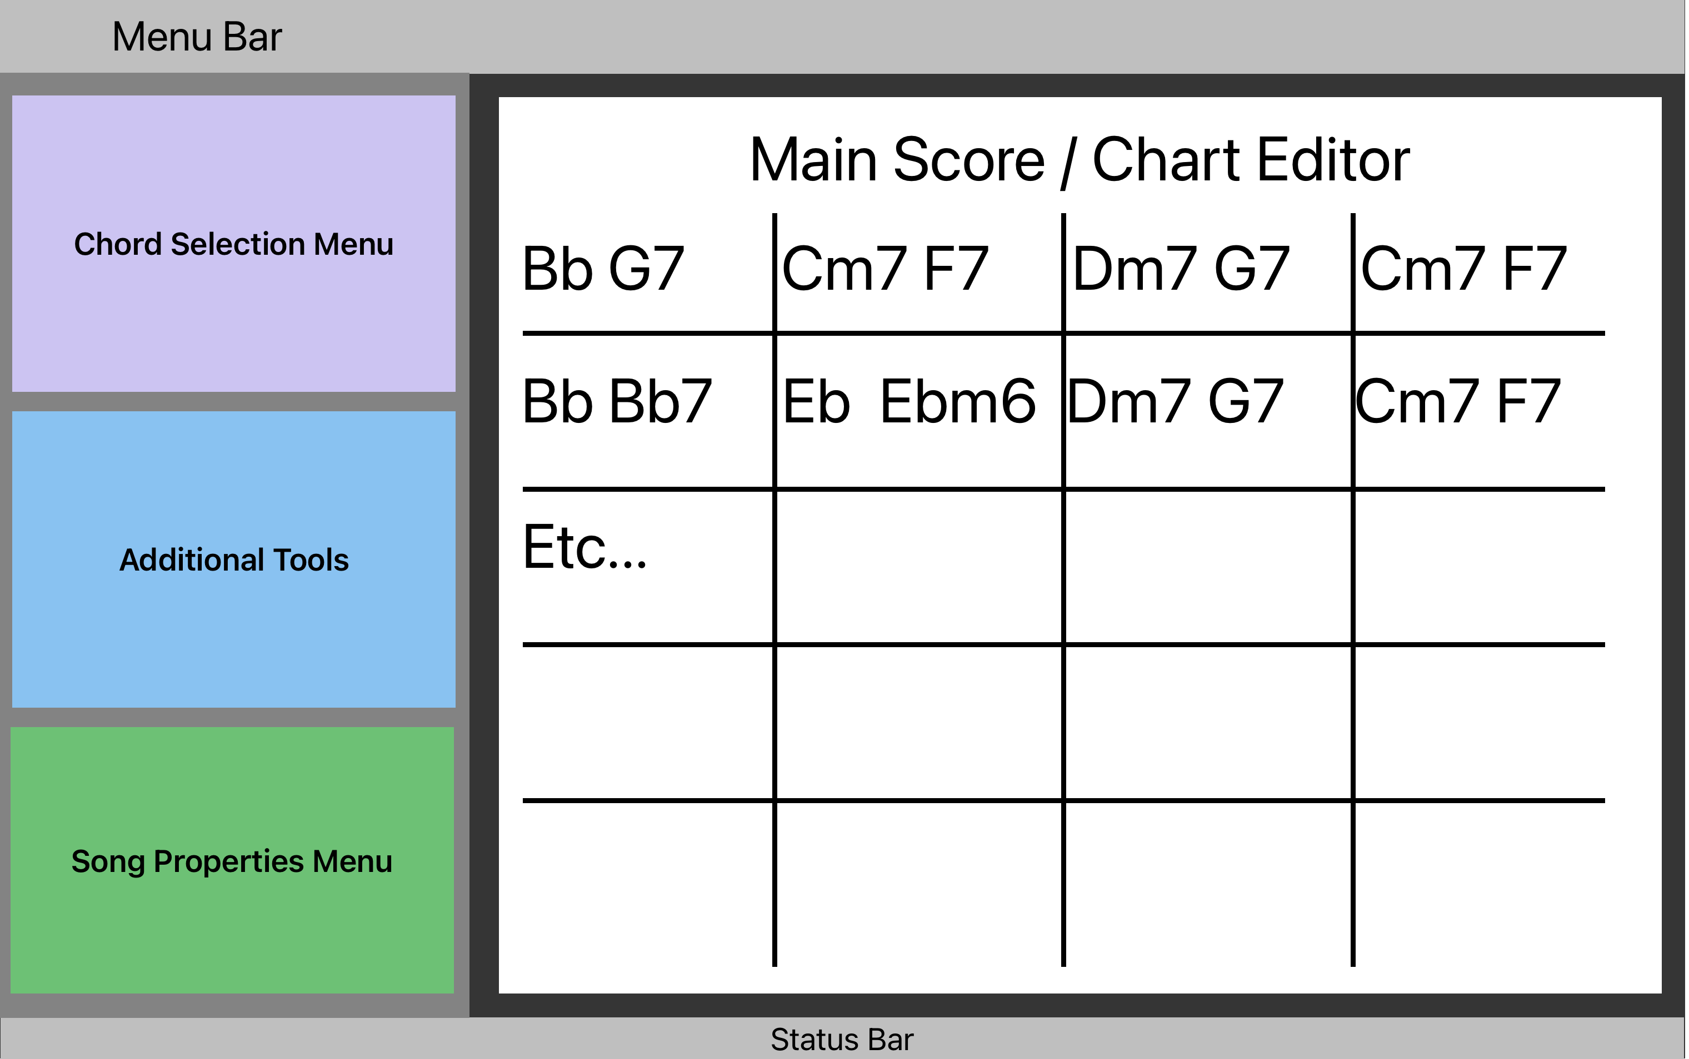
Rough UI Mockup

Slide 6
Development Process
Agile
Develop and test each aspect of the software individually, then integrate
Refine implementation of requirements according to time constraints
Can fall back to Waterfall process if things aren’t moving quickly enough

Slide 7
Prospective Timeline
Early October:
Finalize requirements
UI design & front-end implementation
Late October:
Front-end refinements
Client-side back-end implementation
Early November:
Finish client-side application
Client-side app testing
Server-side back-end implementation
Late November:
Finish server-side
Integration testing

Slide 8
Risk Analysis
Time constraints
Work in order from most critical components to least
Potential technical hurdles
Implementing some features may introduce complications
Chord suggestion algorithm
Support for exporting to different formats
Real-time playback performance
Unfamiliarity / Inexperience
May need more time than expected to learn new systems

Slide 9
Backup Plan
Potential Issues
Networking / Login
Create, at the least, a minimal implementation of the functional requirements without login/sharing functionality
Playback performance
Focus on creation of charts and ability to export to formats that can be read by other software
Cross-platform support
Focus on developing desktop application first and foremost

