Slide 1





Advancing Cloud Computing Capabilities on gem5 by Implementing the RISC-V Hypervisor Extension
George-Marios Fragkoulis d
George Papadimitriou
Nikos Karystinos
D Dimitris Gizopoulos
University of Athens, Greece
CARRV 2024
Sunday, 3 November

Slide 2

Background: the gem5 simulator
gem5 is a state-of-the-art microarchitectural simulator
Utilized in academia and industry (AMD, Arm)
Simulates many ISAs like Arm, x86 and RISC-V
Simulations without OS (Syscall Emulation) and with OS (Full System)
Many configurable hardware components like
CPU models (In Order, Out of Order)
Caches (capacity, associativity, topologies)
Peripherals (UART, Network Adapter)
DRAM

Slide 3
Background: RISC-V in gem5
[CARRV 2017] RV64G ISA implemented (base instruction set) Alec Roelke, Mircea R. Stan (University of Virginia)
[CARRV 2021] RISC-V FS simulation support Peter Yuen Ho Hin, Liao Xiongfei, et. al. (Huawei)
Extensions relevant to cloud-computing
[2022] Bit Manipulation (Zb) Jerin Joy
[2023] Cryptography (Zk) Roger Chang
[2023] Vector (Zv) Adrià Armejach, Xuan Hu, Jerin Joy, Roger Chang, Hoa Nguyen and others
The missing piece: H (hypervisor) extension Cannot run guest VMs efficiently without this!!!

Slide 4

Background: RISC-V Hypervisor (H) Extension
H extension supports the efficient hosting of a guest OS
Virtualizes the supervisor-level architecture
Registers
26 new CSRs
Interrupts & Exceptions
9 new exception codes (4 new interrupts + 5 new exceptions)
Two-stage Translation
G-stage Walking for guest physical to host physical translation
Hypervisor Instructions
20 new instructions including memory fences and special memory instructions for hypervisor

Slide 5
Background: RISC-V Hypervisor (H) Extension
Virtualized Environment
Non-Virtualized Environment
0
User Space
U
0
VU
Guest User Space
Host User Space
U
1
OS
S
1
VS
Guest OS
2
Hypervisor
HS
3
Firmware
M
3
Firmware
M
Without H-extension
With H-extension

Slide 6
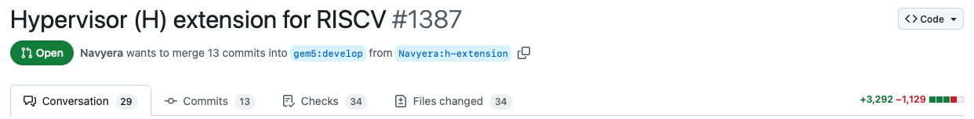
Contributions
We implement the H extension into the latest gem5 (v24.0)
Pull request is currently under review
We assess the functional correctness of our implementation
H extension tests behave equivalently on Spike (reference ISA simulator)
Ran Xvisor (a type-1 hypervisor) and guest VMs
We provide insights into the H extension’s impact on performance

Slide 7
Implementation
Registers
26 new CSRs
Interrupts & Exceptions
9 new exception codes (4 new interrupts + 5 new exceptions)
Two-stage Translation
G-stage Walking for guest physical to host physical translation
Hypervisor Instructions
20 new instructions including memory fences and special memory instructions for hypervisor

Slide 8
Implementation Methodology: Registers
64 bits (gem5 physical register)
16 bits (MIP CSR)
16 bits (HIP CSR)
63
15
13
12
11
10
9
8
7
6
5
4
3
2
1
0
…
000
sgeip
vstip
0
0
0
0
meip
0
vseip
seip
0
mtip
0
stip
0
msip
0
0
0
0
vssip
ssip
0
Problem: HIP should see purple bits only
Solution: Read/Write masks nullify the rest
of the bits!
Original bits
Physical Register
Additional H extension bits
Control Status Register (CSR)

Slide 9

Implementation Methodology: Registers
Read sstatus
OK!
csrr t2, sstatus
t2 = sstatus;
Linux (native – S mode)
OK!
☺
Read sstatus
csrr t2, sstatus
t2 = vsstatus;
Linux (guest – VS mode)

Slide 10
Implementation
Registers
26 new CSRs
Interrupts & Exceptions
9 new exception codes (4 new interrupts + 5 new exceptions)
Two-stage Translation
G-stage Walking for guest physical to host physical translation
Hypervisor Instructions
20 new instructions including memory fences and special memory instructions for hypervisor

Slide 11
Implementation Methodology: Exceptions
Created new fault types
Virtual Supervisor and Guest interrupts
Guest-Page Faults
Virtual Ecall
Extended gem5’s fault handling functionality
Handled faults in the correct privilege levels based on values of new delegation registers (e.g. hideleg, hedeleg)

Slide 12
Implementation
Registers
26 new CSRs
Interrupts & Exceptions
9 new exception codes (4 new interrupts + 5 new exceptions)
Two-stage Translation
G-stage Walking for guest physical to host physical translation
Hypervisor Instructions
20 new instructions including memory fences and special memory instructions for hypervisor

Slide 13
Background: RISC-V Address Translation
Supports classic paged virtual memory
different address width translation schemes: Sv32, Sv39, Sv48
gem5 implements Sv39 (39-bit virtual addresses) for now
H extension adds another translation stage (G-stage)

Slide 14
Background: Sv39 Scheme
38
30
29
21
20
12
11
0
VPN₂
VPN₁
VPN₀
offset
Virtual Address
9 bits
9 bits
Physical Address
(Lives in RAM)
9 bits
data
PA
L1 PTE
L2 PTE
L0 PTE
L2 Page Table
4KB Page
satp
L1 Page Table
PFN (44 bits)
L0 Page Table

Slide 15
Background: Two-Stage translation
VS-stage (1st stage)
38
30
29
21
20
12
11
0
39-bit Guest Virtual Address
gVPN₂
gVPN₁
gVPN₀
offset
9 bits
9 bits
9 bits
L1 gPTE
data
L2 gPTE
Guest Virtual Address
vsatp
L0 gPTE
L2 Page Table
4KB Page
L1 Page Table
gPFN (44 bits)
Guest Physical Address (Host Virtual Address)
L0 Page Table
Guest Virtual Address
12
0
21
11
29
20
G-stage (2nd stage)
40
30
Host Virtual Address
gPPN₂
gPPN₁
gPPN₀
Host Physical Address (Lives in RAM)
L1 PTE
L2 PTE
hgatp
L0 PTE
PFN (44 bits)

Slide 16
Implementation Methodology: Translation
Extended page walking logic to support new types of walks
G-stage
Two-stage
Virtual First Stage (guest virtual → guest physical)
G-stage as Second Stage (guest physical → host physical)
Extended permission checking based on effective prv and V
G-stage accesses are always checked as if prv == PRV_U
Special Hypervisor memory instructions are executed as if V == true
New page-fault types (e.g. guest load page fault)

Slide 17
Implementation
Registers
26 new CSRs
Interrupts & Exceptions
9 new exception codes (4 new interrupts + 5 new exceptions)
Two-stage Translation
G-stage Walking for guest physical to host physical translation
Hypervisor Instructions
20 new instructions including memory fences and special memory instructions for hypervisor

Slide 18
Implementation Methodology: Instructions
Extended ISA specification files with the new instruction implementations
new fences (HFENCE, HINVAL) → selectively flushes TLB entries
new loads & stores (HLV, HLVX, HSV) → hypervisor accesses memory as if the request originates from a virtualized guest
New memory instruction formats for hypervisor loads & stores

Slide 19
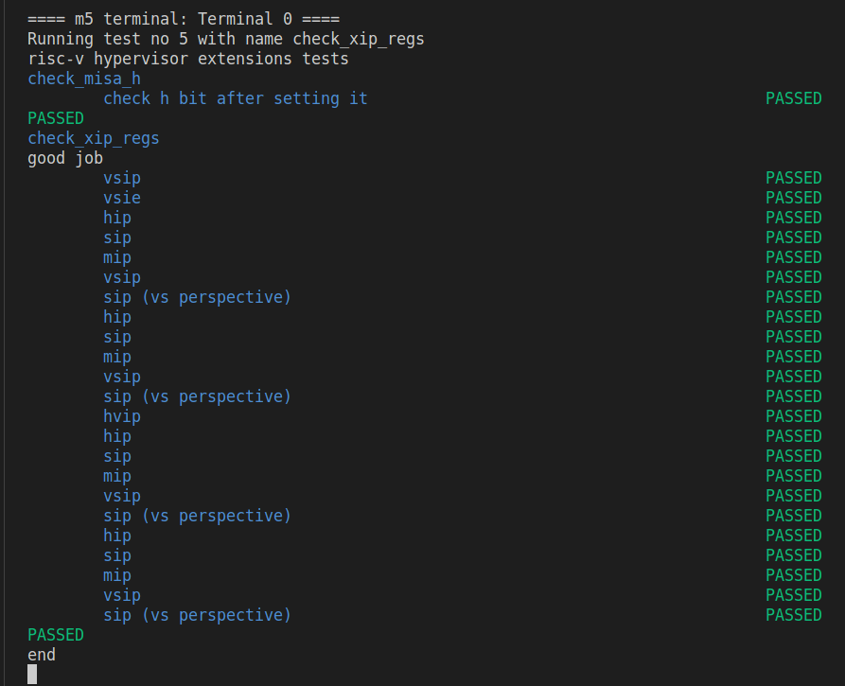
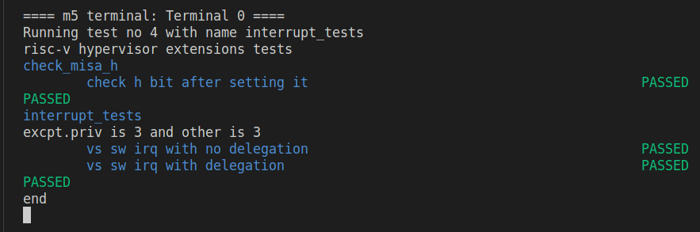
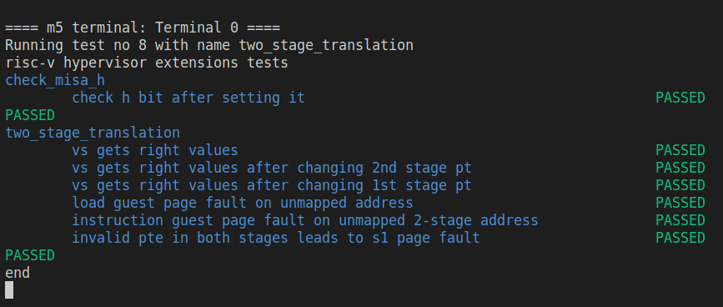
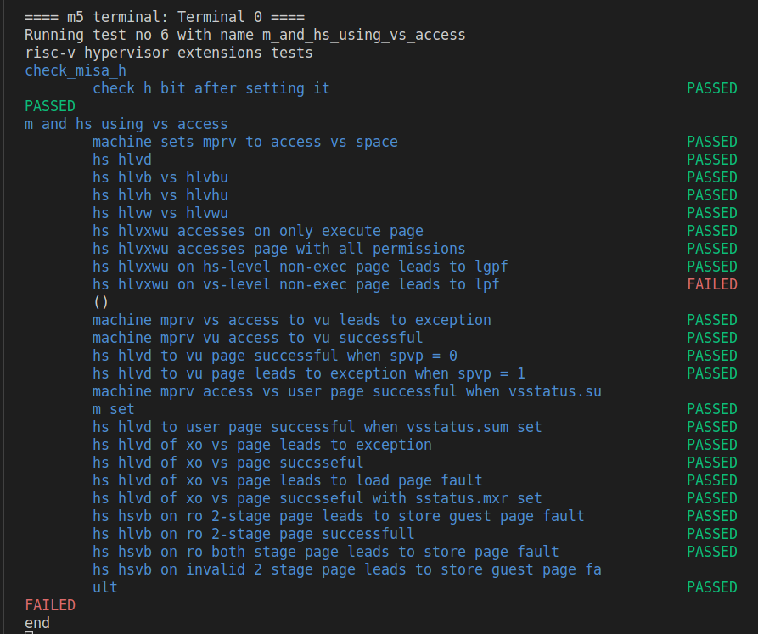
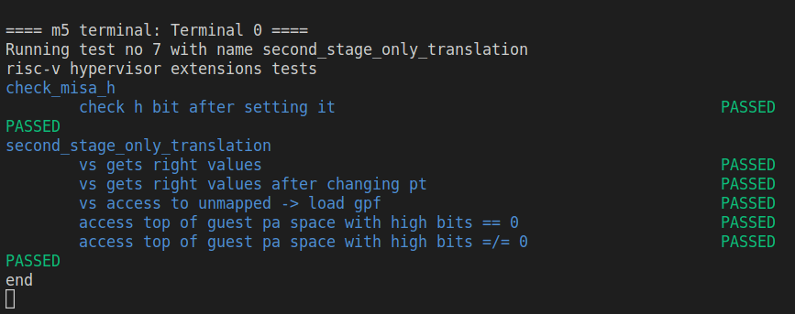
Implementation Methodology: Validation
Public Tests for H extension
Registers
Exceptions & HLV/HSV
Two-Stage Translation

Slide 20

Implementation Methodology: Validation
Run a hypervisor and a guest VM
If the guest VM’s OS boots up and can execute programs
we gain strong confidence in the correctness of our implementation
We choose to run Xvisor (a type-1 or baremetal hypervisor)
Xvisor Mascot

Slide 21
Implementation Methodology: Validation
Xvisor boot video
Notes:
Xvisor boot video

Slide 22
Experimental Results
We obtain results from nine benchmarks from MiBench Suite
The programs’ full-system execution is simulated in gem5
Natively (no virtualization)
In a VM (virtualized environment)
We examine the following three types of simulation overheads
Simulation Time overhead
Instruction overhead
Exception Handling overhead

Slide 23
Experimental Results: Time Overhead
~50% slowdown on average

Slide 24
Experimental Results: Instructions Overhead
~5% more instructions on average

Slide 25
Experimental Results: Exceptions Overhead
Exceptions handled in S in native execution and in VS during guest execution
are equivalent

Slide 26
Conclusion & Future Work
H extension implementation in gem5 is functional and stable
It will be merged in some next version of gem5
Future Work
Support all simulated CPU types of gem5
Run various other hypervisors (e.g. type-2 hypervisor like KVM)
This further validates our implementation
Evaluate performance tradeoffs
Perform comprehensive microarchitectural design space exploration for cloud deployments

Slide 27
Thank you! Questions?
George-Marios Fragkoulis d
George Papadimitriou
Nikos Karystinos
D Dimitris Gizopoulos
University of Athens, Greece
CARRV 2024
Sunday, 3 November

