Slide 1

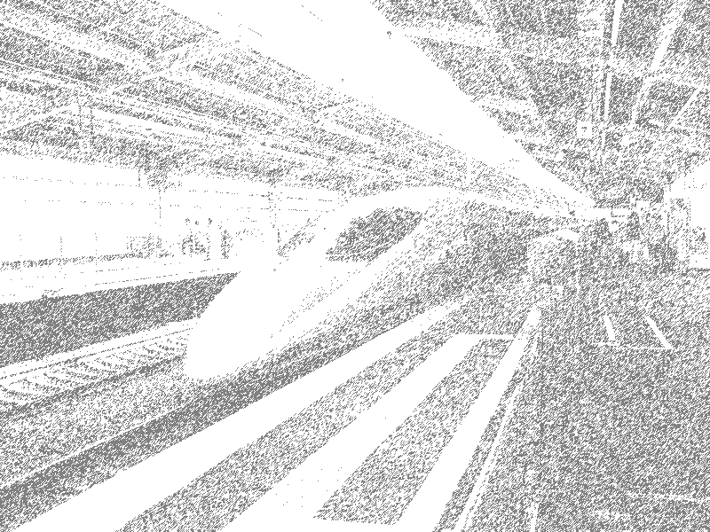
Eclipse Performance
Chris Laffra
Rational Performance Engineering Team

Slide 2
Introduction

Slide 3
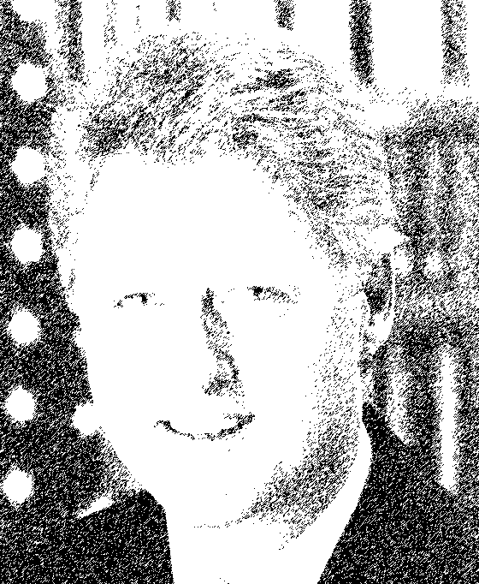
“Considering the current sad state of our computer programs, software development
is clearly still a black
art, and cannot yet
be called an
engineering discipline.”
-- Bill Clinton

Slide 4
The Problem

Slide 5
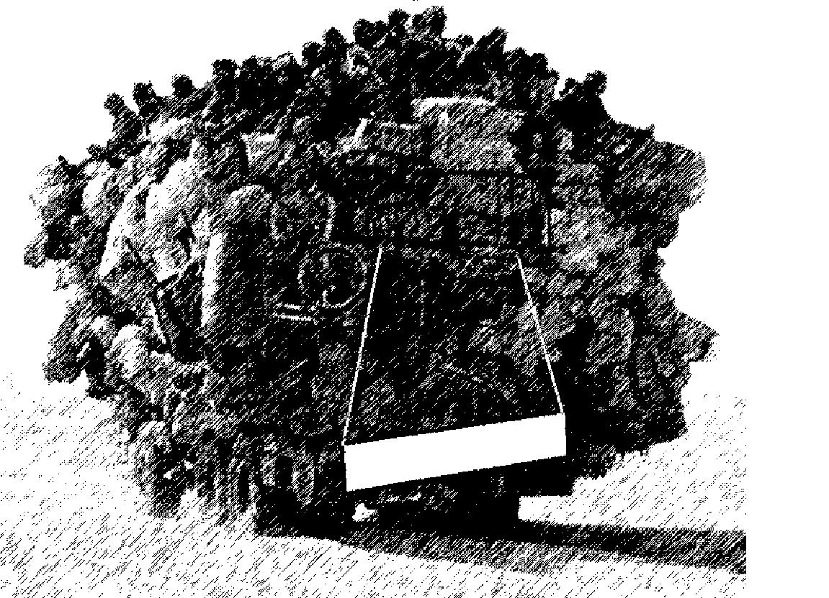
Eclipse
Too Slow…
Too Big…

Slide 6
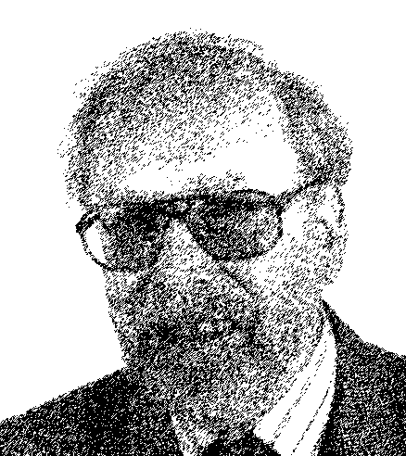
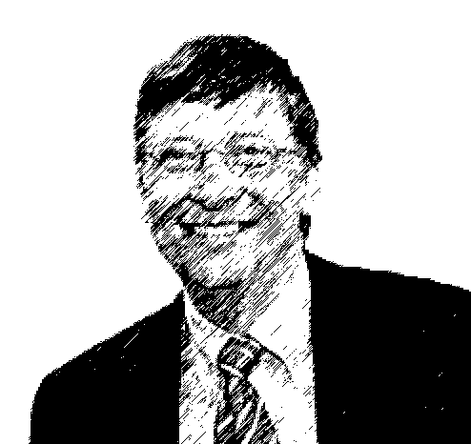
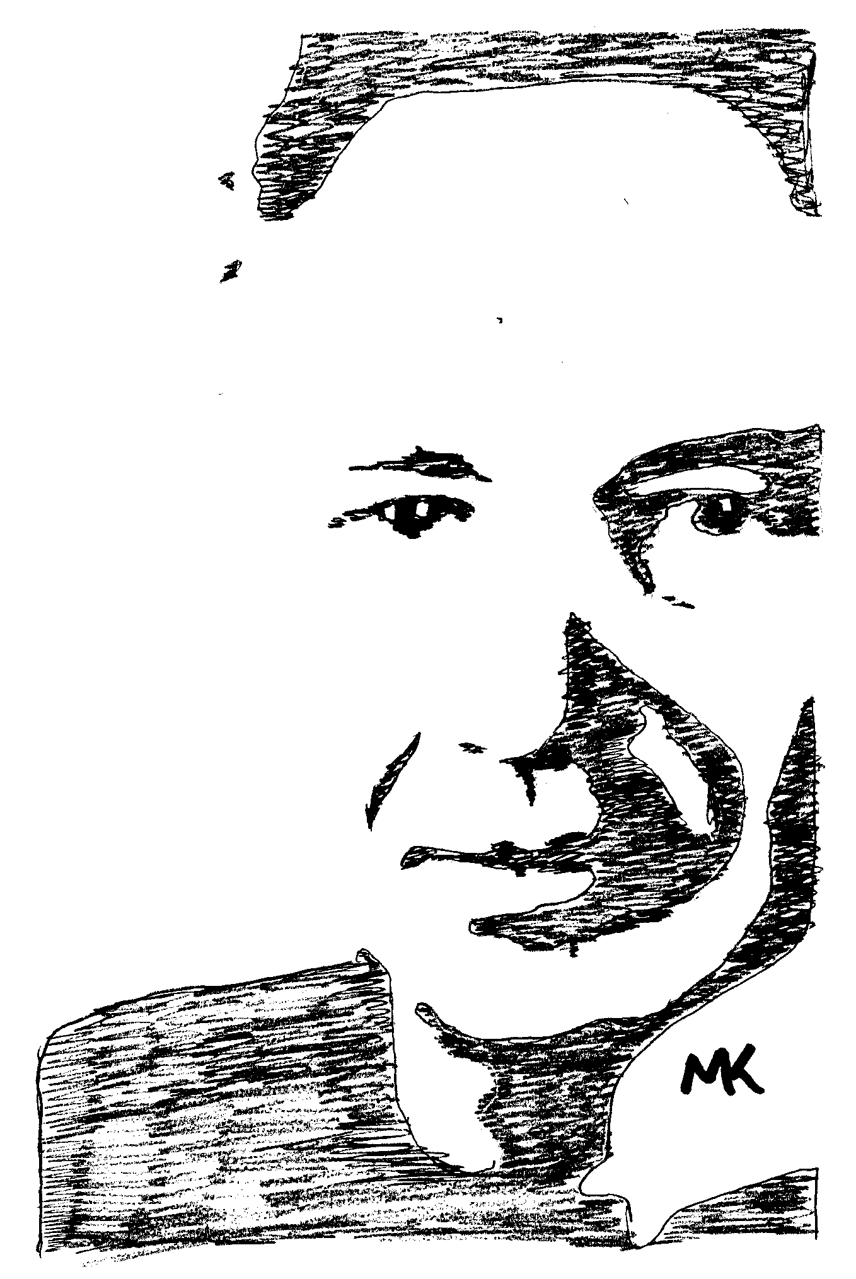
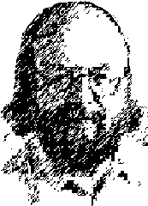
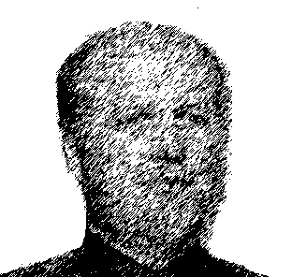
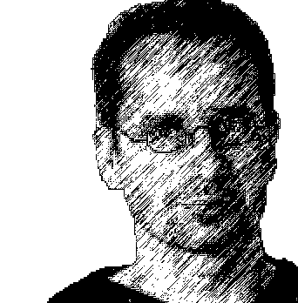
“Wirth's Law: Software gets slower faster than hardware gets faster.” -- Nicklaus Wirth
“What Andy giveth’, Bill taketh’ away”
“What Bill gives,
Gossling, Bray &
Gamma take away”

Slide 7
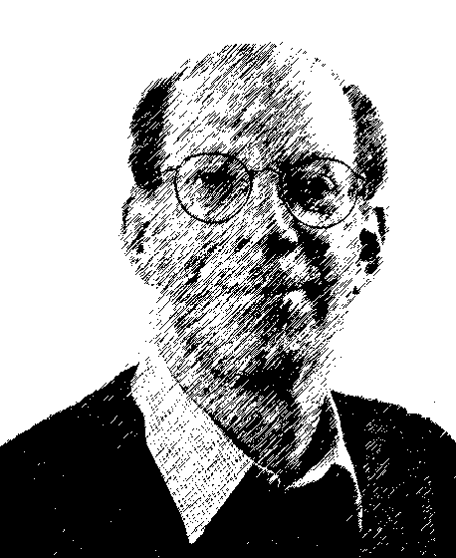
“ The nice thing about standards is that there are so many of them to choose from.”
-- Andrew S. Tanenbaum

Slide 8
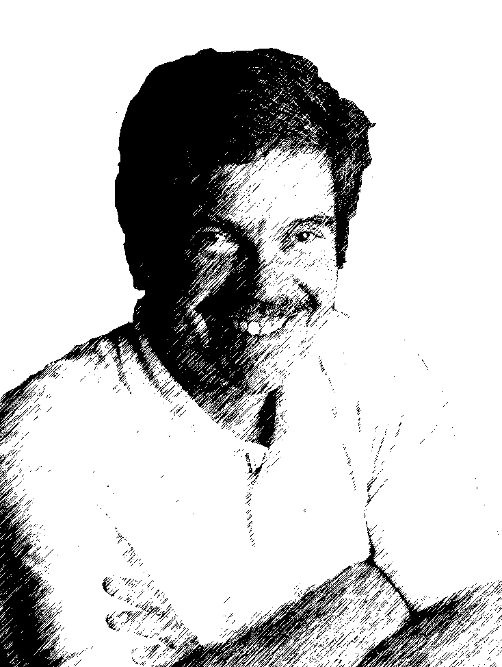
“I invented the term Object-Oriented, and I
can tell you I
did not have
C++ in mind.”
-- Alan Kay

Slide 9
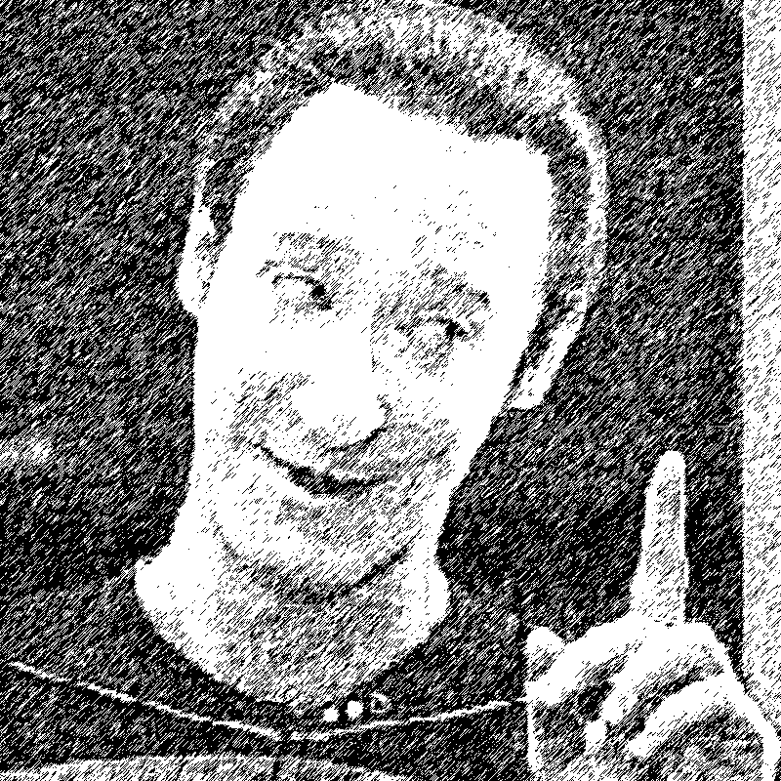
“I have found that humans
often use
Smalltalk
during
awkward
moments.”
-- Data

Slide 10
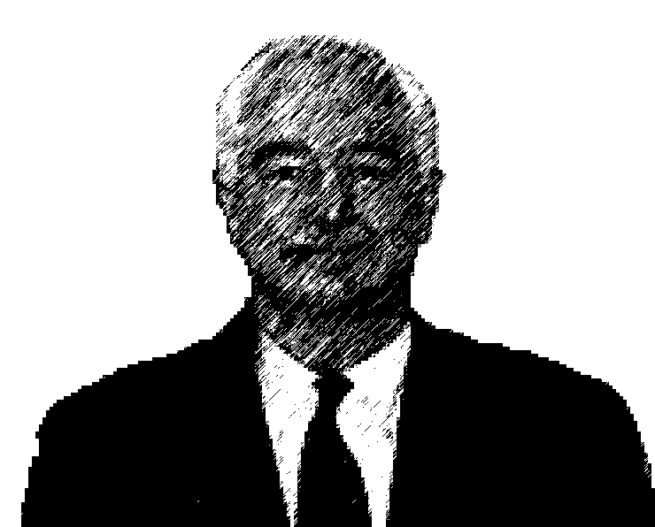
“Java: the elegant
simplicity of C++
and the blazing
speed of
Smalltalk.”
-- Roland Turner

Slide 11
Eclipse == OS
Eclipse manages resources:
  - Workspaces, Projects, Programs, Files
  - UI Real Estate, Views, Editors, Menus
  - Version Management, Team Sharing
  - OS resources (File, GDI handles)
  - CPU (Threads, Competition)
  - Memory (Lots of it, GC)

Slide 12
Complexity

Slide 13
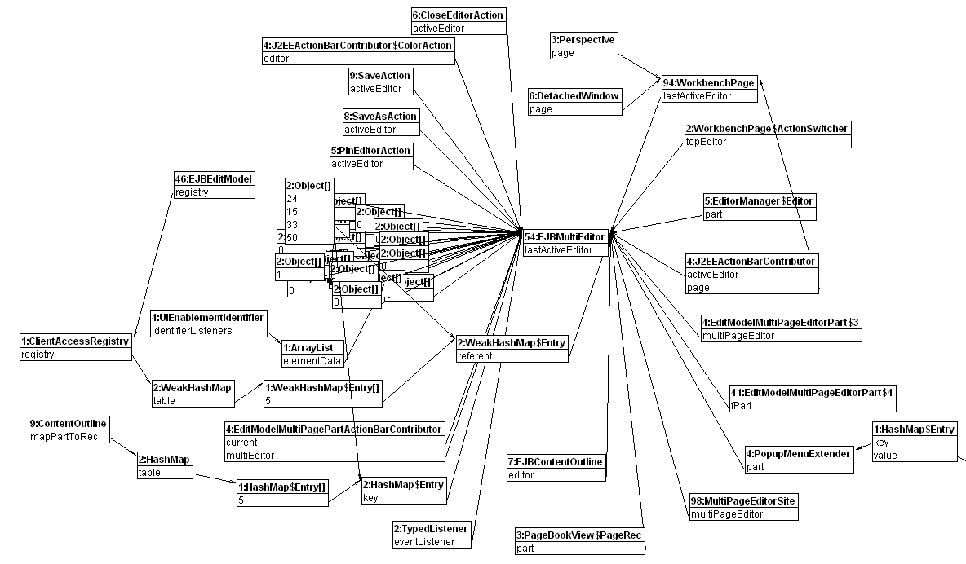
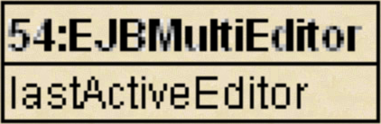
Links to Current Editor

Slide 14
Numerology
RAD workspace with 2 EJB projects:
  - Build takes 150 million method calls
  - Stacks are 300 calls deep
  - Things run for up to 30 minutes
  - Profiling tools fall over
Without effort, RSA grows to 600MB
Some customers need 2.4GB memory

Slide 15
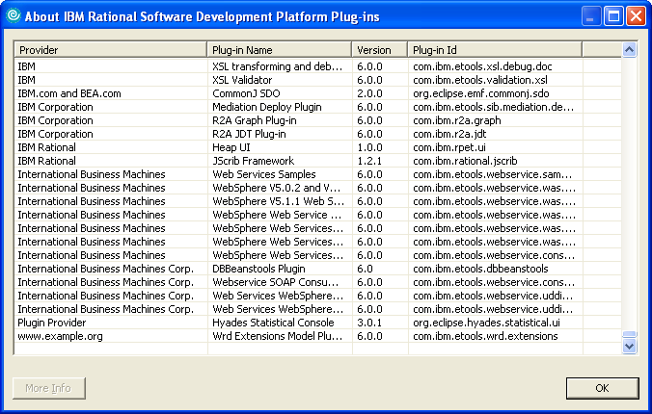
Value is in Composition

Slide 16
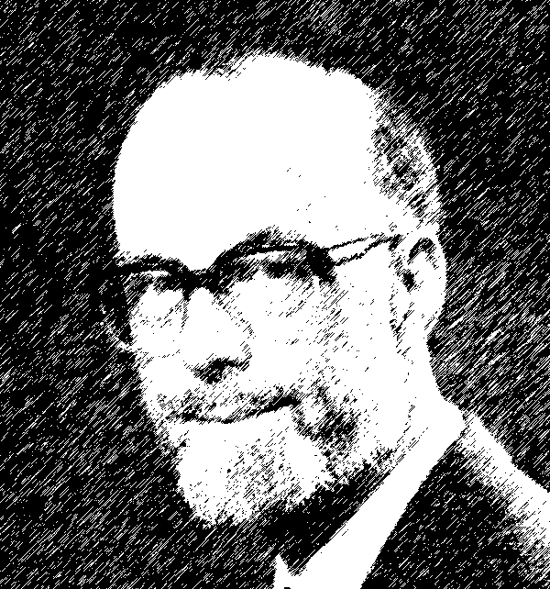
“There are two ways of constructing a software design:
Make it so simple that
there are obviously no
deficiencies, or
Make it so complicated
that there are no
obvious deficiencies.”
-- Tony Hoare

Slide 17
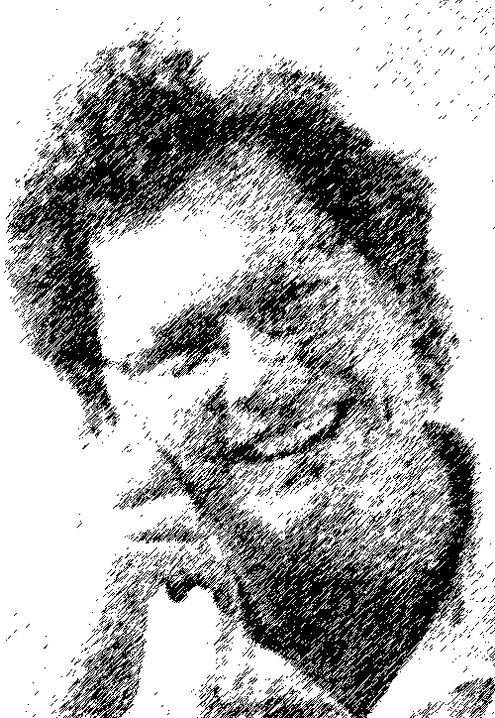
“I fear the new object-oriented systems may suffer the fate of LISP, in that they can do many things,
but the complexity
of the class hierarchies
may cause them to
collapse under their
own weight.”
Bill Joy

Slide 18
Dealing with complexity

Slide 19
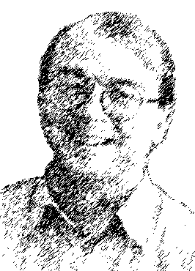
“Lloyd's Hypothesis: Everything worth understanding about
a complex system, can
be understood in terms
of how it processes
information.”
-- Seth Lloyd

Slide 20
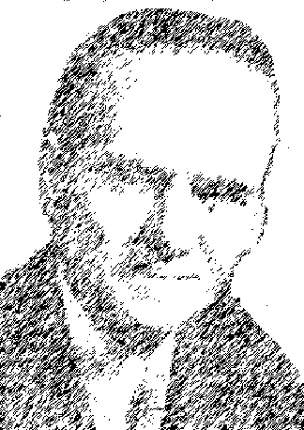
“Today, most software exists, not to solve a problem, but to interface with other software.”
-- I. O. Angell

Slide 21
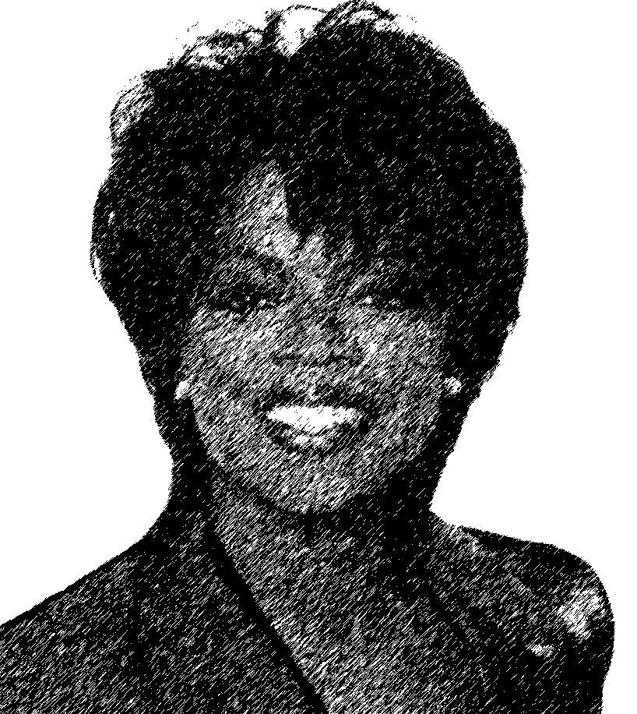
“The secrets to weight loss are
to watch your diet,
to exercise, to set
reasonable goals, and
to measure regularly.”
-- Oprah Winfrey
[this is not a real quote]

Slide 22
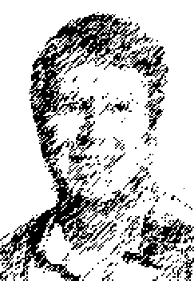
“A specification, design, procedure, or test plan that will not fit on one page of
8.5-by-11 inch paper
cannot be
understood.”
-- Mark Ardis

Slide 23
Design for Performance
Define and enforce budgets for:
  - CPU consumption
  - Memory consumption
Design for caching (a very important space/time tradeoff)
Design for persistence life-cycle
Design for scalability

Slide 24
Why do we write such big software?

Slide 25
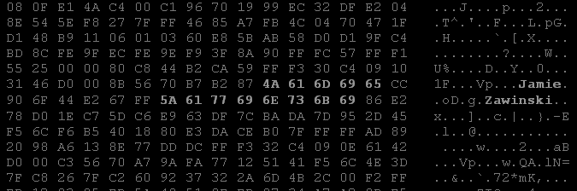
“Zawinski's Law: Every program attempts to expand until it can read mail. Those programs which cannot so expand are replaced by ones which can.”
-- Jamie Zawinski

Slide 26
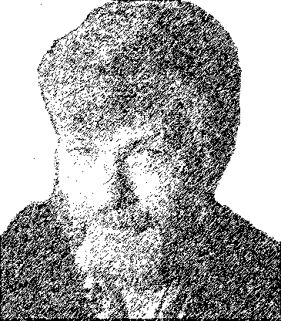
“Any technology which is distinguishable
from magic is
insufficiently
advanced.”
-- Gregory Benford

Slide 27
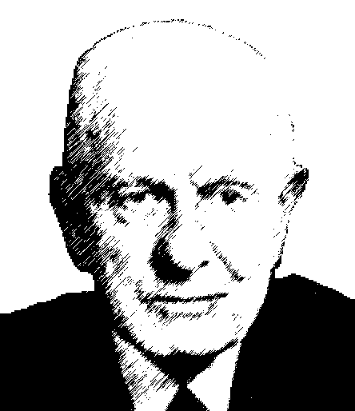
"The way to
succeed is to
double your
error rate.“
-- Thomas J. Watson

Slide 28

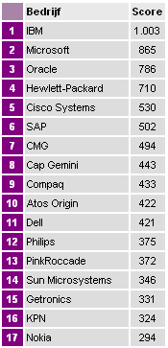
The Most Innovative Company
IBM #1 in 2002 survey:
Functionality (24%)
Innovative Solutions (23%)
Skilled People (18%)
Flexible Solutions (13%)
“Effective Solution Provider”

Slide 29
What to do?

Slide 30
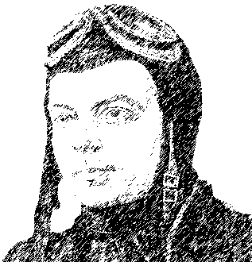
“Perfection is achieved not when there is nothing more
to add, but rather
when there is nothing
more to take away.”
-- Antoine de Saint-Exupery

Slide 31
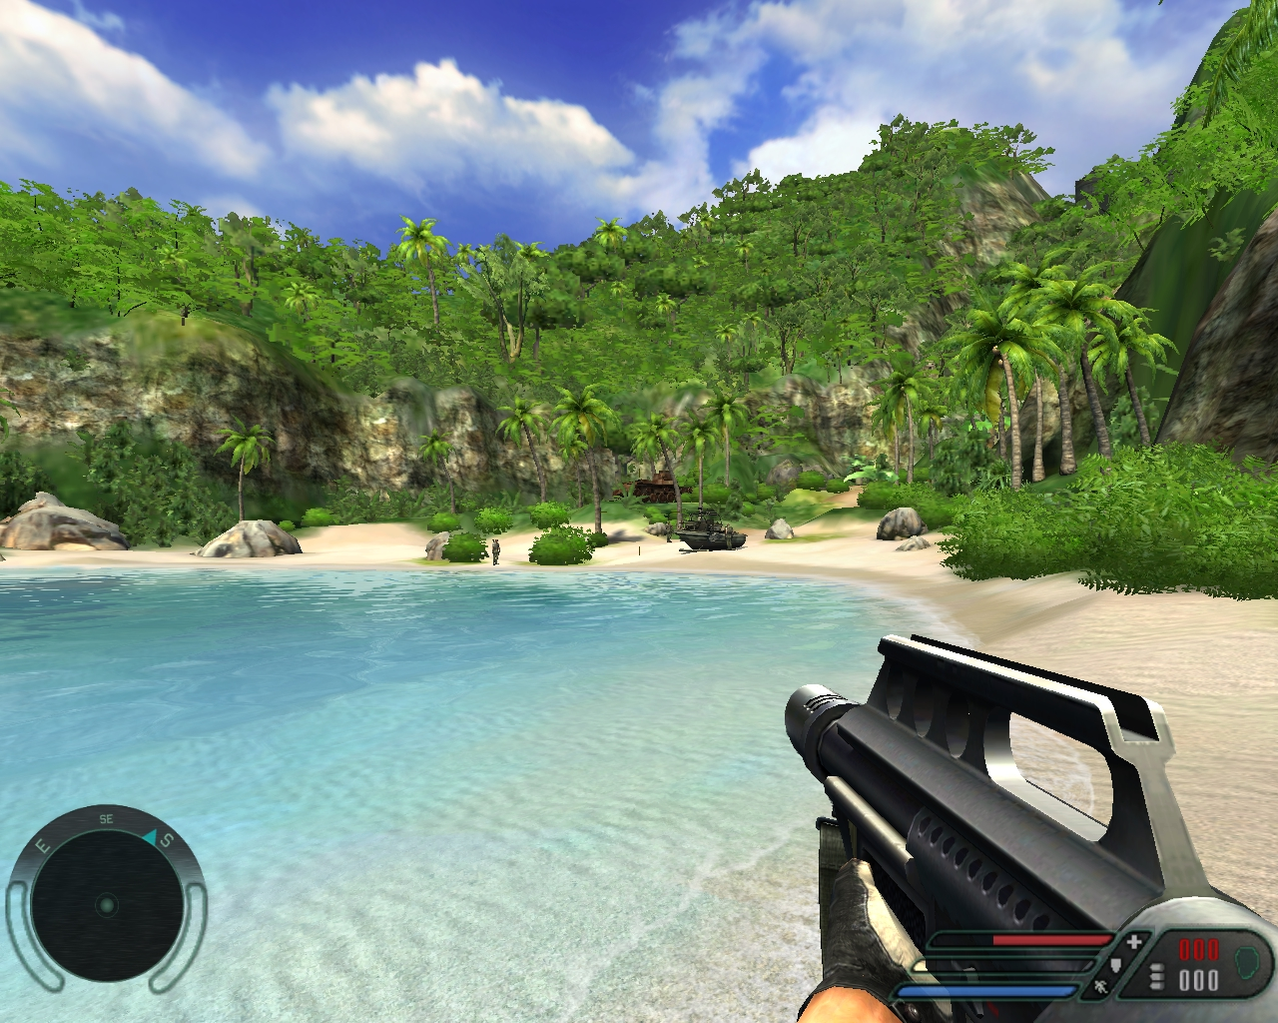

Slide 32
Games
Treat our software likes games
  No manual
  Need to “unlock” features
  Real-time based (rendering, etc.)
  AI built in
  Maximize use of hardware

Slide 33
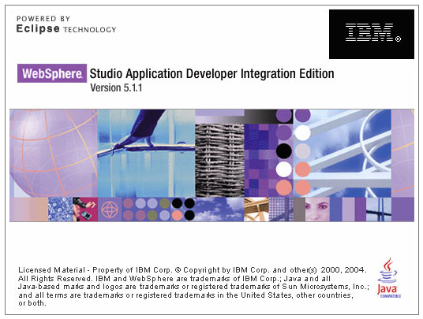
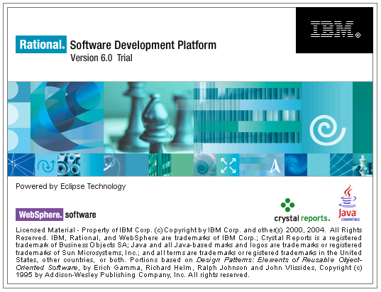
Splash Screen Design
“With all the plug-ins, WSAD can take 30 seconds to start up. I stare at the splash screen a lot.”
http://blog.vikdavid.com/2005/05/whats_with_the_.html

Slide 34
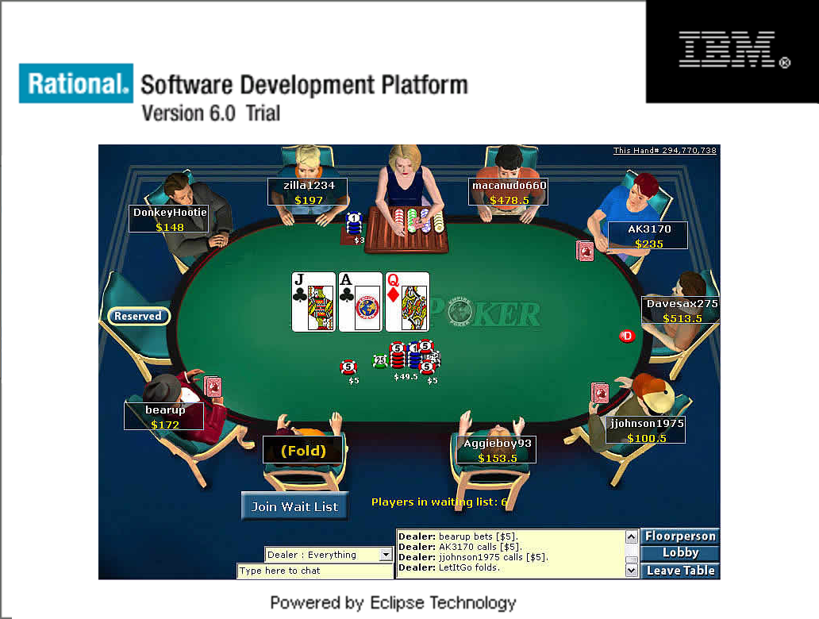
Proposal mock-up – not an actual program

Slide 35
Our Approach?

Slide 36
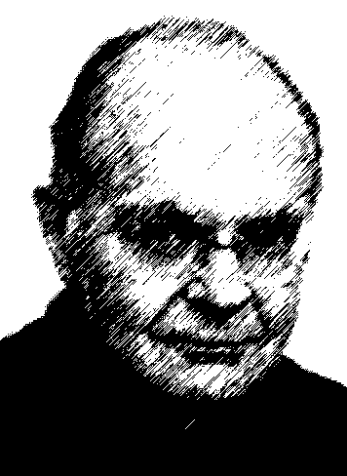
“Premature optimization is the root of all evil.”
--Donald Knuth

Slide 37
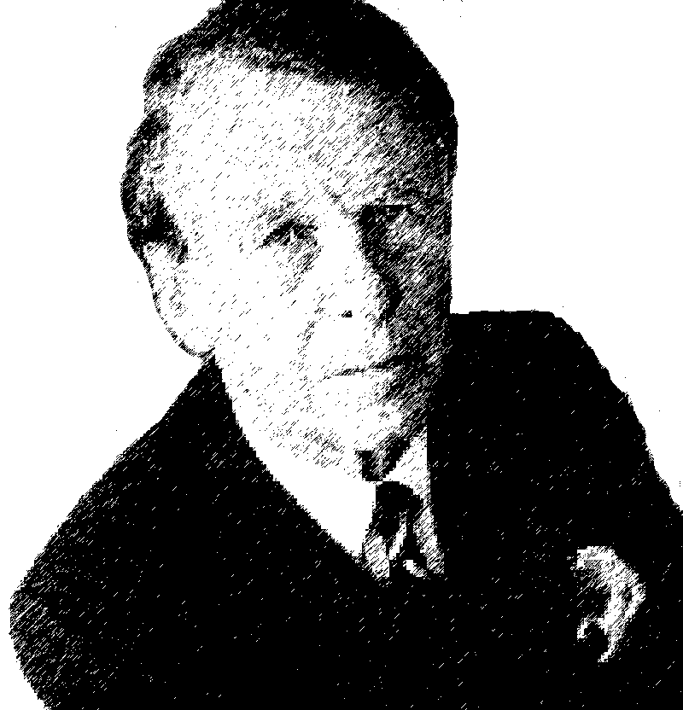
“Never stop testing,
and your products
never stop improving.”
-- David Ogilvy

Slide 38
A Practical Approach
Fix stuff that has a real impact:
  - Things that are really slow
  - Things that are used all the time
  - Key problem reports
Pay attention to memory leaks
Keep an eye out for regressions

Slide 39
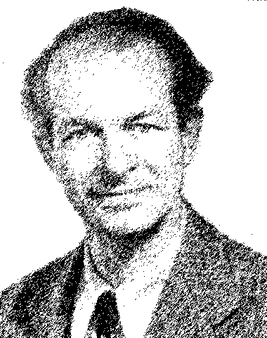
“The best way
to have a good
idea is to have
many of them.”
-- Linus Pauling

Slide 40
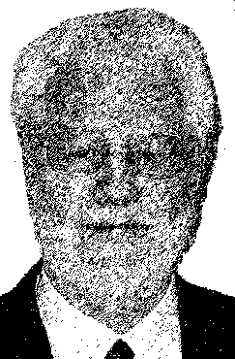
“Successful visionaries start from where they are,
what they have, and
what their customers
have.”
-- Tom Gilb

Slide 41
Analyzing Performance

Slide 42
The 3 Step Approach
Run profiler →
find bottleneck → fix
Run profiler →
find bottleneck → fix
Run profiler…

Slide 43
Which Profiler?
Pick one. Any is better than none
Some choices:
  YourKit, JProbe, Purify/Quantify
  XRay (just moved to Eclipse TPTP)
  System.out.println
  Eclipse instrumentation

Slide 44
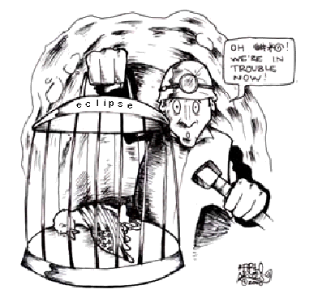
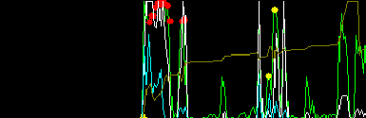
XRay
Xray is modeled after “Task Manager”
Minimal overhead
Use one single graph
& human pattern
recognition
Reports with screendumps

Slide 45
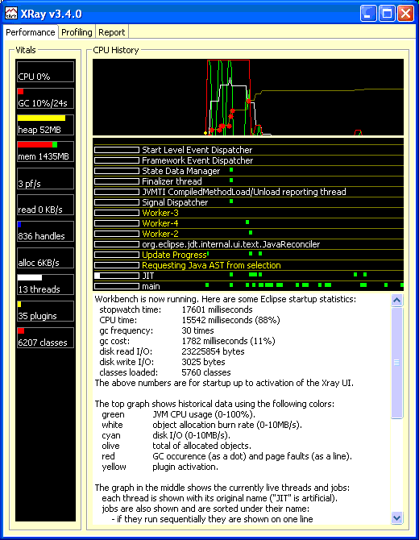
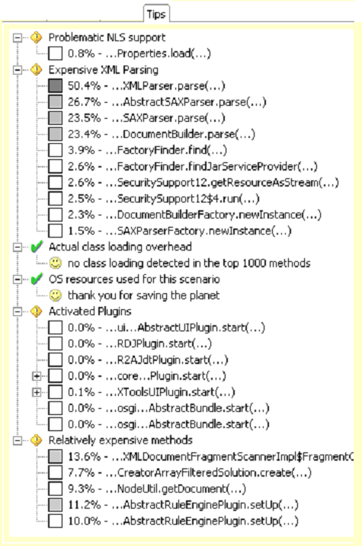
XRay

Slide 46

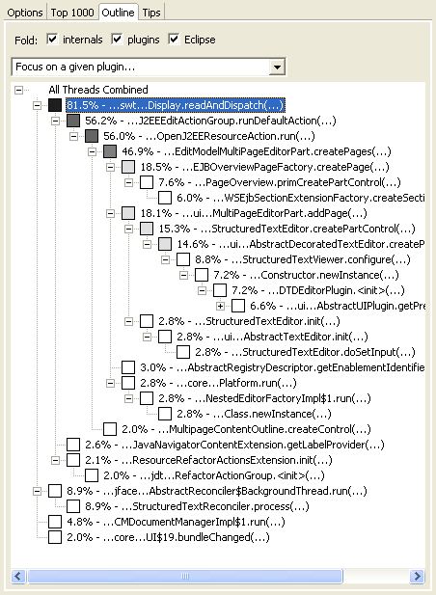
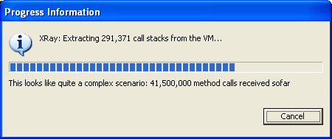
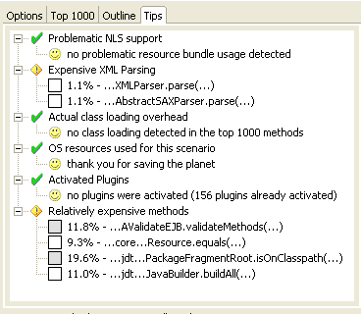
demo

Slide 47
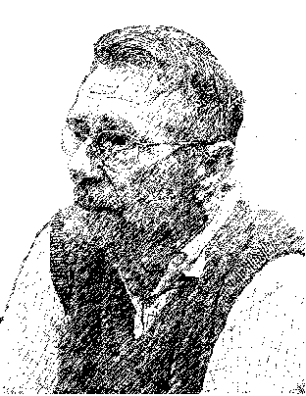
“Simplicity and elegance are unpopular because they require hard work and discipline to achieve
and education
to be appreciated.”
  -- Edsger Dijkstra

Slide 48
Thanks.

