Slide 1

Giraph
A Codebase Comprehension Tool (HA!)

Slide 2
WTF?
Visualization
New contributors/employees get up to speed
Debug large projects, especially ones that use garbage tooling (Like Nuxt/Vue!)
Engineering
“Design linter”

Slide 3
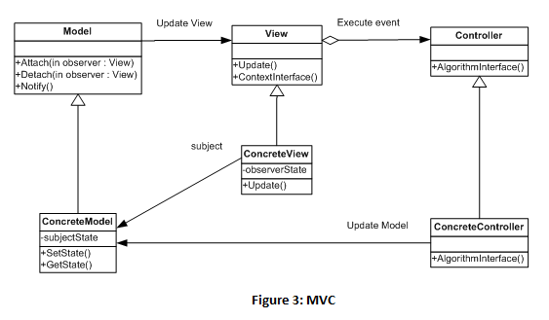
Examples

Slide 4
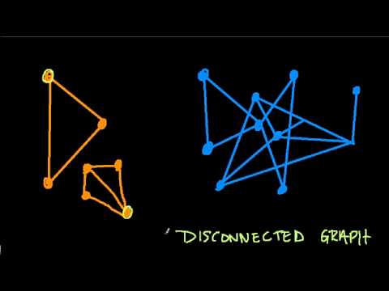
Examples

Slide 5
Implementation Goals
Open source (open core?)
  distributed
Lightweight, single binary
Modular
  Use different frontends
Embedded graph database

Slide 6
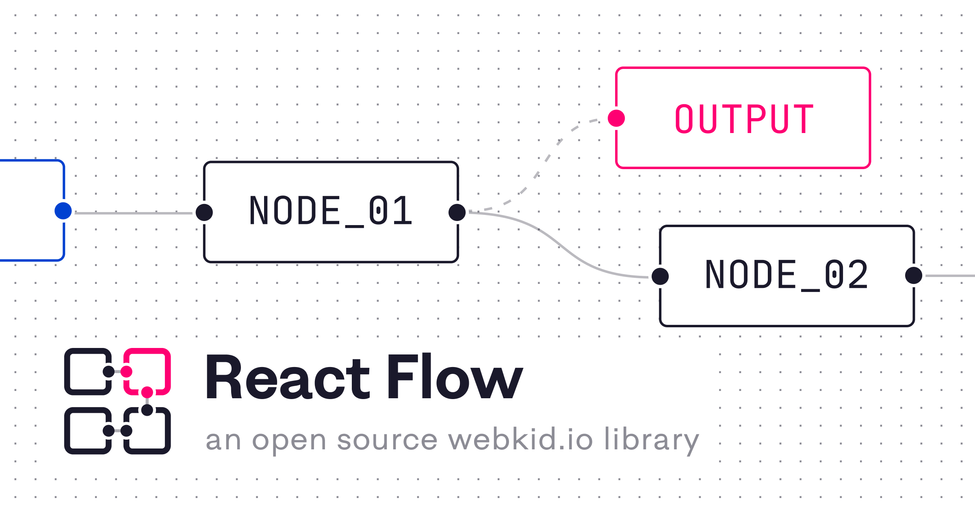






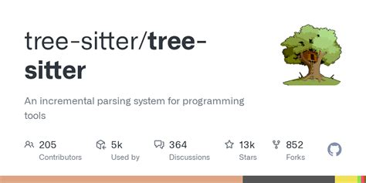
Design
(for hosted services)

Slide 7
Testimonials
This is even better than Git!
  Linus Torvalds, probably

