Slide 1
Project 01: Analysis of Voltage, Current, Power, and Energy Waveforms for a Capacitor
By: Carson Murray
USC ID: P01763257
Email: cam50@email.sc.edu

Slide 2
Project Objectives
Utilize MATLAB to graph multiple waveforms (voltage, current, power, and energy
Establish relationships between the different functions
Illustrate how a capacitor is affected by voltage, current, power, and energy

Slide 3

Equations used
Voltage Piecewise function: $v(t)=\left\{\begin{aligned}{0 t≤0 \atop k_{0}t 0≤t≤2} \\ {V_{0} 2≤t≤4 \atop {−k_{0}t+b 4≤t≤5 \atop C_{0} t≥5}}\end{aligned}\right.$
Capacitor Law: $i(t)=C\frac{dv}{dt}$
Power for capacitors: $p\left(t\right)=Cv\frac{dv}{dt}$
Energy for capacitors: $ω\left(t\right)=\frac{1}{2}Cv^{2}$

Slide 4



Simulated Waveforms

Slide 5
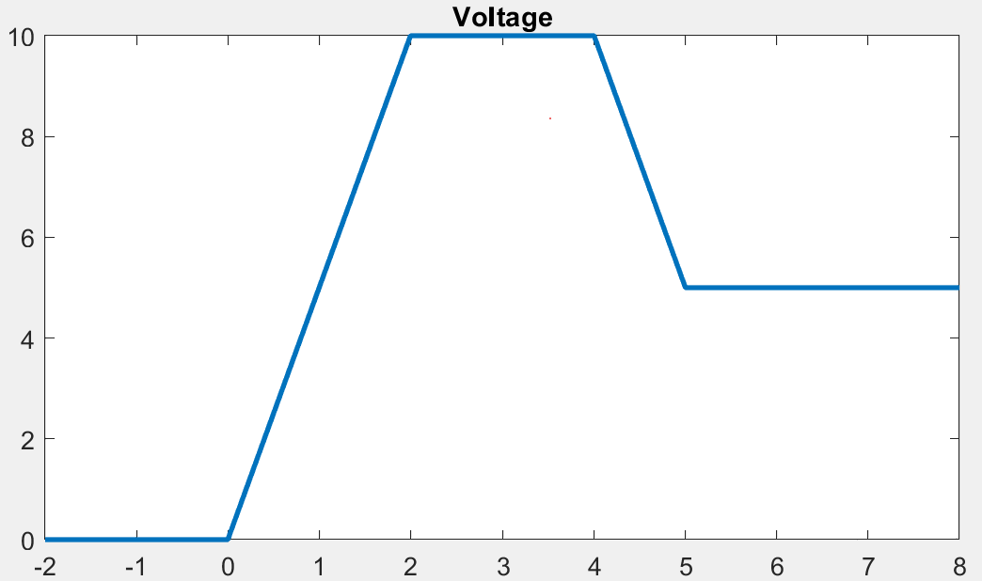

Voltage Waveform
$v(t)=\left\{\begin{aligned}{0 t≤0 \atop k_{0}t 0≤t≤2} \\ {V_{0} 2≤t≤4 \atop {−k_{0}t+b 4≤t≤5 \atop C_{0} t≥5}}\end{aligned}\right.$

Slide 6
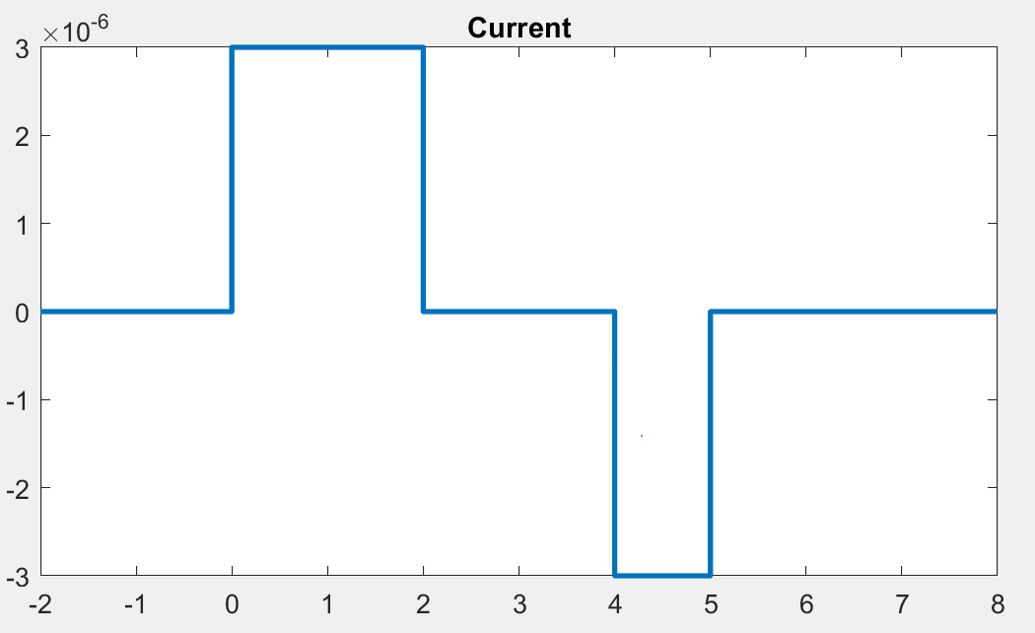

Current waveform
$i(t)=\left\{\begin{aligned}{0 t≤0 \atop k_{0}∗C 0≤t≤2} \\ {0 2≤t≤4 \atop {−k_{0}∗C 4≤t≤5 \atop 0 t≥5}}\end{aligned}\right.$

Slide 7
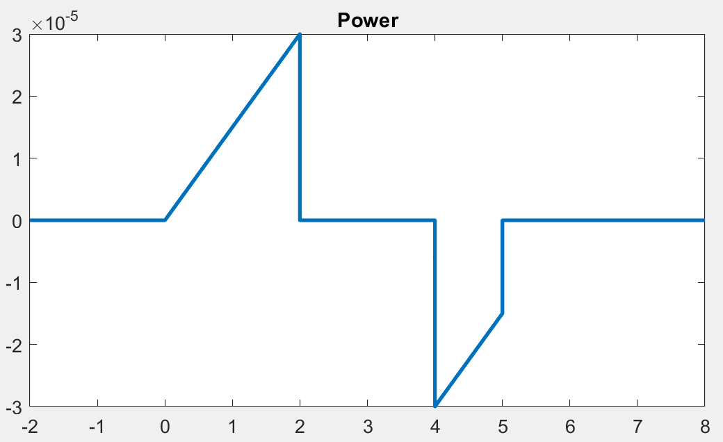

Power Waveform
$p(t)=\left\{\begin{aligned}{0 t≤0 \atop k_{0}t∗C∗k_{0} 0≤t≤2} \\ {0 2≤t≤4 \atop {\left(−k_{0}t+b\right)∗C∗{−k}_{0} 4≤t≤5 \atop 0 t≥5}}\end{aligned}\right.$

Slide 8
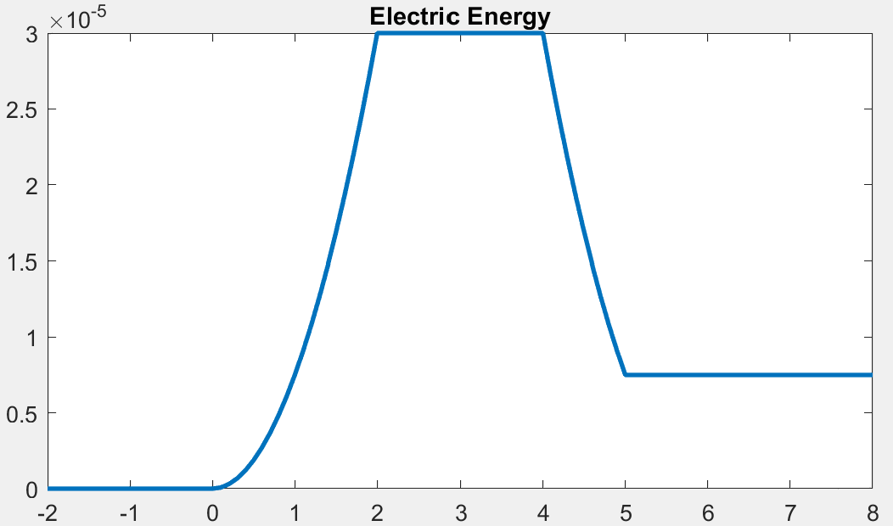

Energy Waveform
$ω(t)=\left\{\begin{aligned}{0 t≤0 \atop \frac{{{(k}_{0}t)}^{2}∗C}{2} 0≤t≤2} \\ {\frac{{V_{0}}^{2}∗C}{2} 2≤t≤4 \atop {\frac{{(−k_{0}t+b)}^{2}}{2} 4≤t≤5 \atop \frac{{C_{0}}^{2}∗C}{2} t≥5}}\end{aligned}\right.$

Slide 9

Discussion
Current flowing through the capacitor: $3μA$
Power flowing into capacitor: $30μW$
Power flowing out of capacitor: $22.5μW$
The capacitor stored $30μJ$ of energy at the most, but stored $7.5μJ$ after the capacitor discharged

Slide 10
Conclusions
The voltage across a capacitor has a direct correlation to the capacitor’s current flow, power dissipation, and energy storage
Power and current begin and end at the same value whereas voltage and energy end at a larger value then when they started.
The value of a capacitor can affect the magnitude of the power and current waveforms

Slide 11
References
01 First Order Circuits PowerPoint (From Blackboard)
https://www.mathworks.com/help/matlab/creating_plots/combine-multiple-plots.html

