Slide 1
Project 2: Op-Amp Integrator Circuit
By: Carson Murray
USC ID: P01763257
Email: Cam50@email.sc.edu

Slide 2
Project Objectives
Determine the values of capacitor, resistor, and Vcc used the circuit derived from the LTspice circuit simulation.
Develop an analytical solution for the circuit, and use MATLAB to generate the input and output waveforms, and validate the LTspice simulation.
Generate accurate input and output voltage waveforms for the designed circuit.

Slide 3

Project Technology
The Programs LTSpice and MATLAB were used to simulate an op-amp circuit for this project.
LTSpice was utilized to create a circuit simulation as well as perform a transient analysis on the circuit created.
MATLAB was utilized to compare to LTSpice’s transient analysis output.
Equation used to find RC values: $v_{out}=−\frac{1}{RC}\int_{t_{0}}^{t}{v_{i}dt+ v_{out}(t_{0})}$.

Slide 4

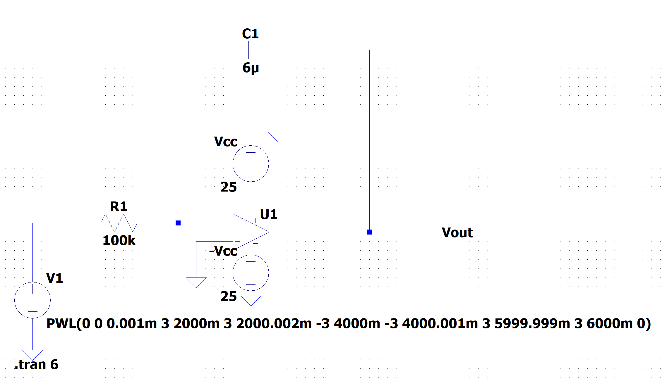
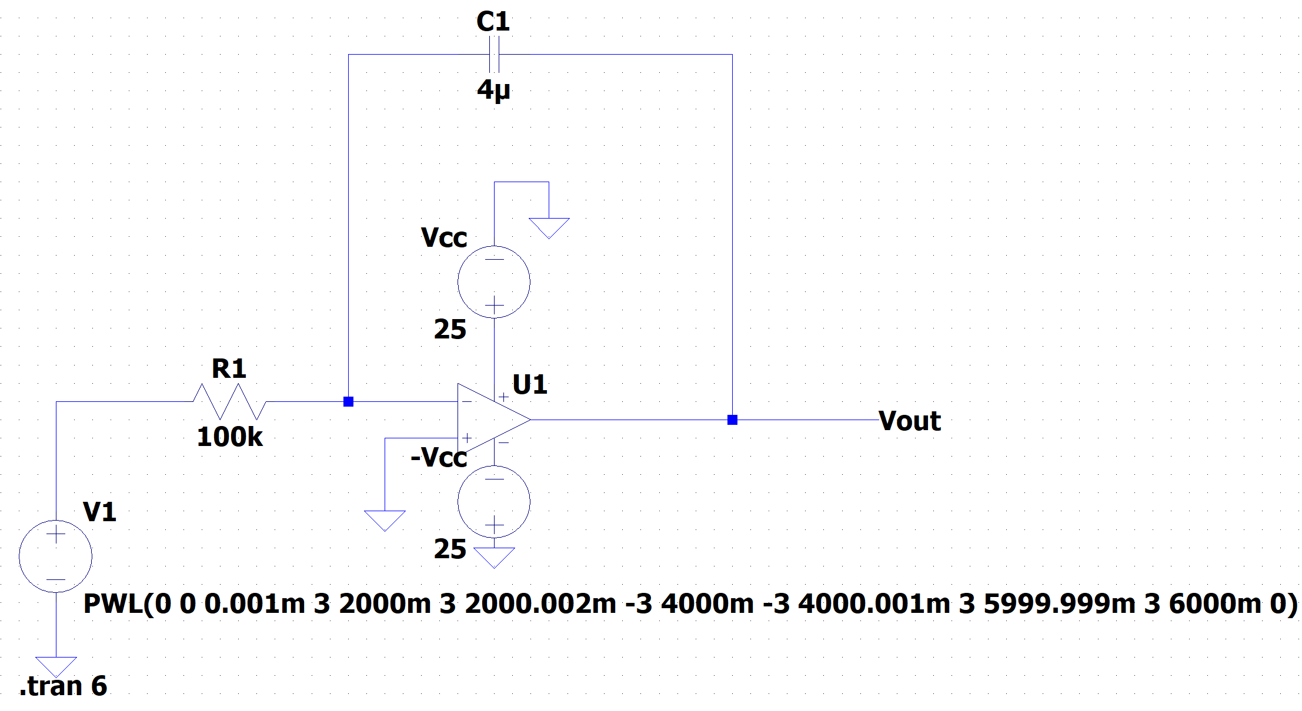
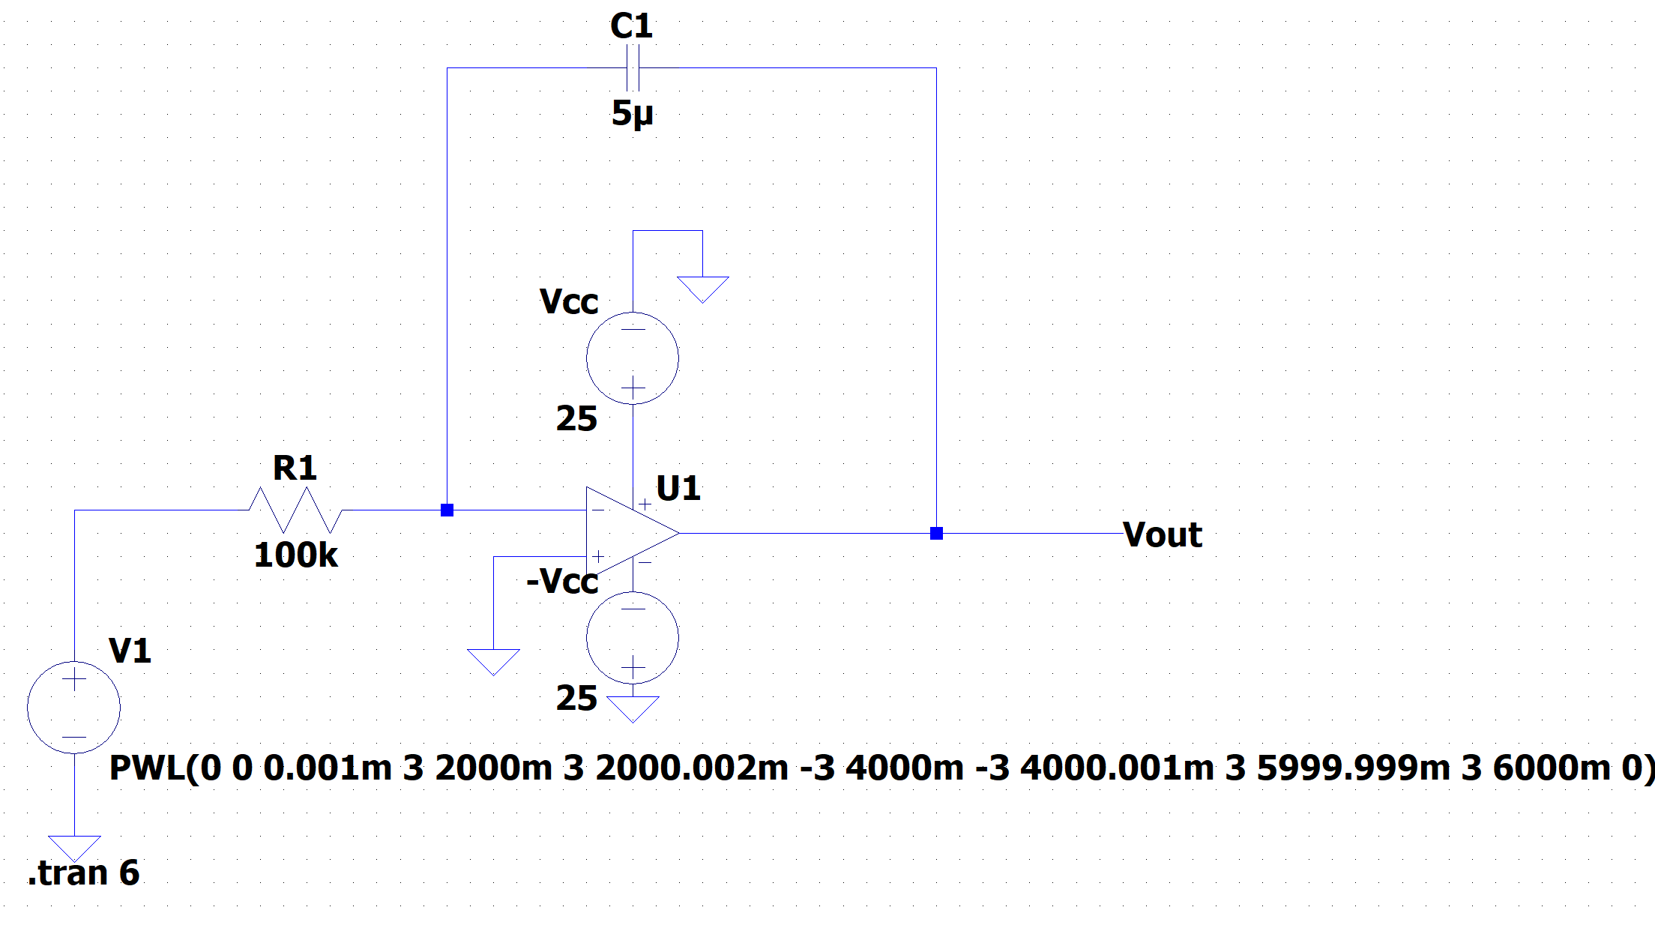
Circuit Diagrams
10V
15V
12V

Slide 5

Simulation and Graphical Results

Slide 6
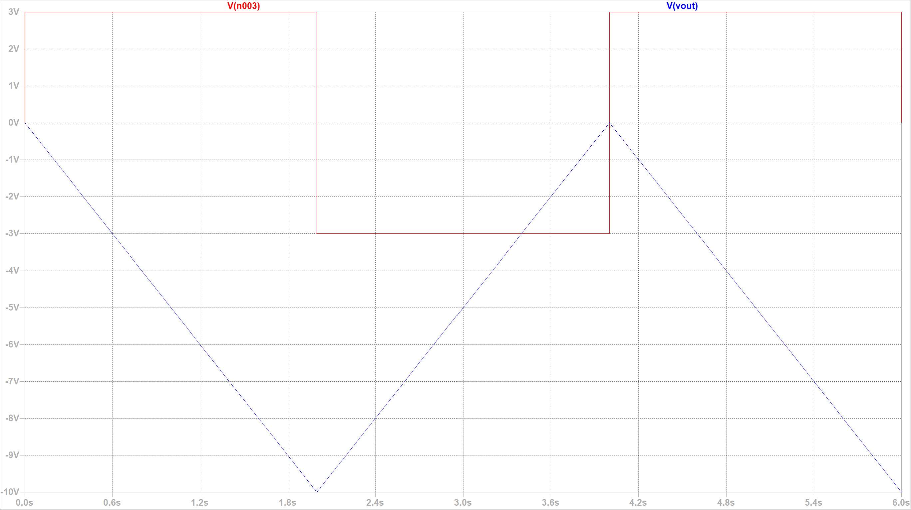
10V Transient Response

Slide 7
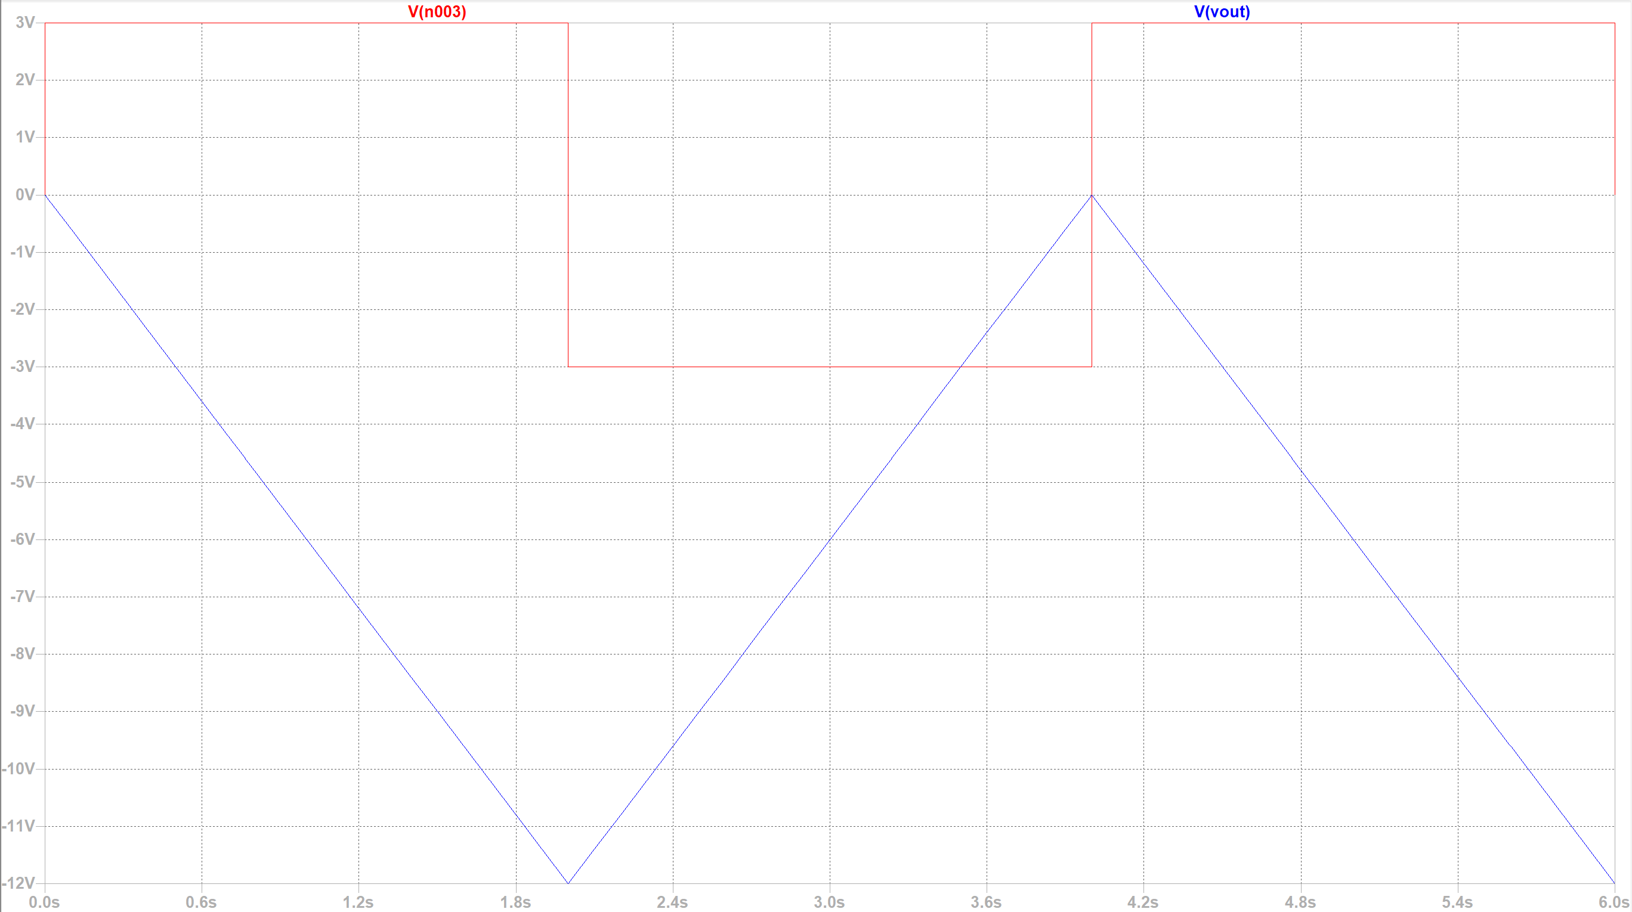
12v Transient Response

Slide 8
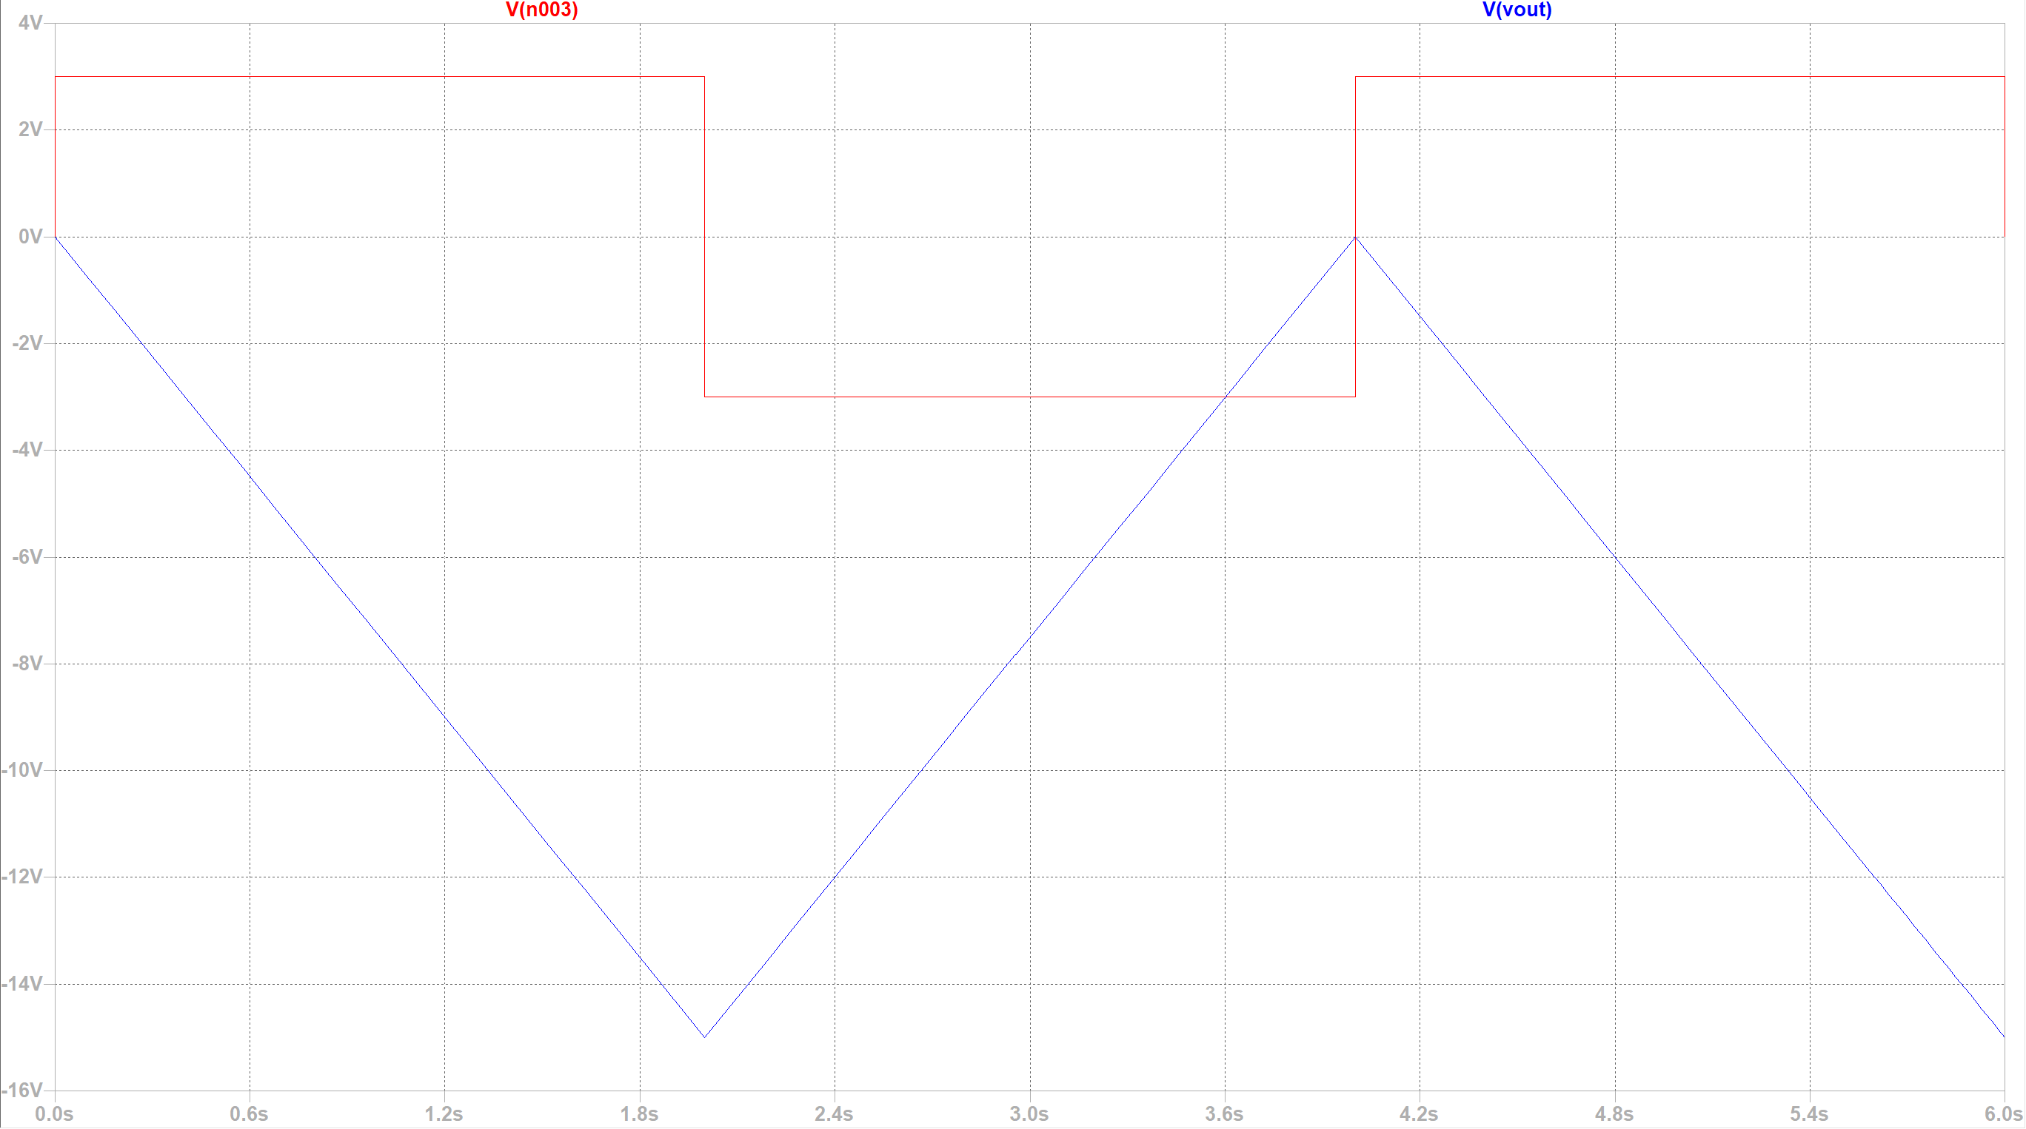
15V transient Response

Slide 9
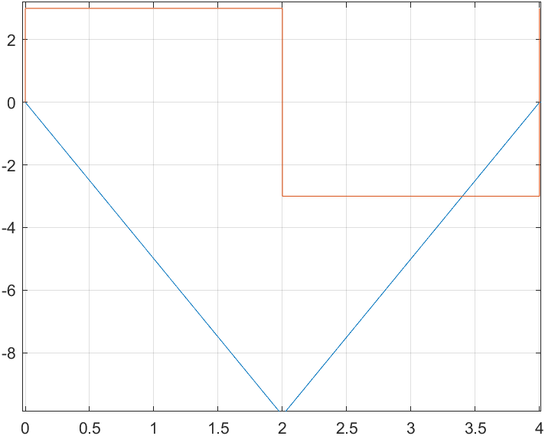
LTSpice Transient Response and MATLAB comparison
As you can see, the LTSpice transient response (top picture) matches very closely to the MATLAB plot (bottom picture). The MATLAB code plot also allows you to see the input pulse and how it relates to the output waveform. These screenshots are for a desired 10V output, but the graphs for the other two outputs (12V, and 15V) show the same similarities.

Slide 10
Discussion and Conclusions

Slide 11

Discussion
I was able to find resistor and capacitor values for each of the desired voltage outputs by using the following equation: $v_{out}=−\frac{1}{RC}\int_{t_{0}}^{t}{v_{i}dt+ v_{out}(t_{0})}$.
10V:
100kΩ, and 6µF
12V:
100kΩ, and 5µF
15V:
100kΩ, and 4µF
I chose a Vcc of 25 Volts so none of the desired output voltages would be clipped.

Slide 12
Discussion cont.
Both programs show that the output voltage peaks at the desired voltage for each respective circuit.
I believe the results generated by both MATLAB and LTSpice are accurate because both results from each program seem to align very closely.
Also, because each program presented a different way of simulated the Op-Amp circuit, it is safe to say that these results are accurate.

Slide 13
Conclusions
In conclusion, MATLAB and LTSpice were both able to accurately simulate an Op-Amp integrator circuit.
Simulation of circuits is very helpful in understanding how circuits operate.

Slide 14
References
Op-Amp Fundamentals PowerPoint (Blackboard Course Content)

