Slide 1
Project 3: Convolution Analysis of Rc Circuit
By: Carson Murray
ID: p01763257
Email: cam50@email.sc.edu

Slide 2
Project Objectives
Graphically represent the input voltage signal Vin(t)
Graphically represent the impulse response h(t)
Graphically represent the output voltage signal Vout(t)
Calculate and graphically represent the electric energy stored in the capacitor, w(t)

Slide 3
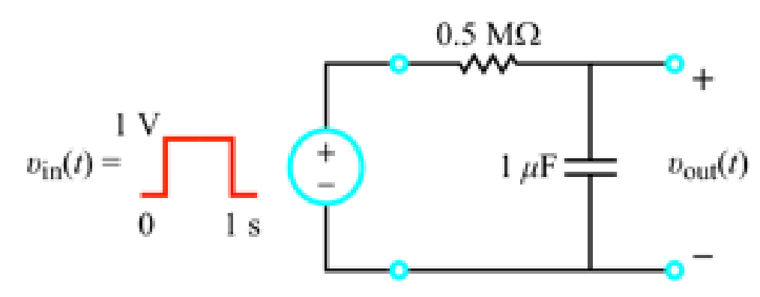

Project Technology
Equations used for this project were:
Impulse Response of RC Circuit: $h\left(t\right)=\frac{1}{τ_{c}}e^{\frac{−t}{τ_{c}}} ∗u(t)$
Convolution: $y\left(t\right)= \int_{−∞}^{∞}{x\left(τ\right)h\left(t−τ\right)dτ}$
Input Voltage Signal: $u\left(t\right)−u(t−1)$
Electric Energy: $w\left(t\right)= \frac{1}{2}Cv^{2}$
The following circuit schematic was used for this project:

Slide 4
Simulation and Graphical Results

Slide 5
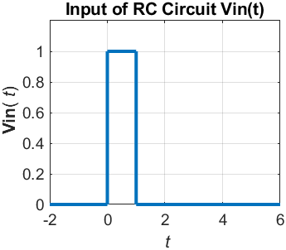
Input Voltage: vin(t)

Slide 6
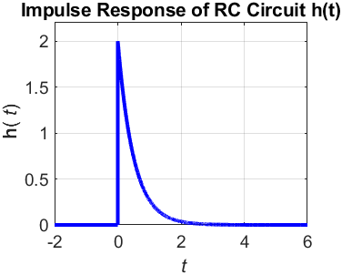
Impulse Response: h(T)

Slide 7
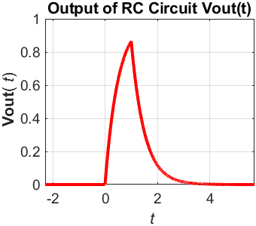
Output Voltage: Vout(T)

Slide 8
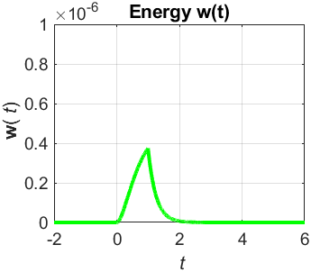
Electric Energy: W(t)

Slide 9

Discussion
The results of this project accurately depict the input voltage, impulse response, output voltage, and electric energy stored by the capacitor.
The convolution of the input voltage as and the impulse response create the graph of the output voltage.
Electric energy was calculated by inputting the output voltage into the electric energy equation ($w\left(t\right)= \frac{1}{2}Cv^{2}$)

Slide 10
Conclusion
MATLAB is an efficient and accurate tool that is very useful for plotting waveforms.
This project shows the connectivity of the input voltage, impulse response, output voltage, and electric energy.
Convolution is also illustrated graphically, which helps the student to better understand its importance and how it functions.

Slide 11
references
Systems Responses and Convolution Implementation using MATLAB PowerPoint
RC and RL First Order Circuits PowerPoint

