Slide 1

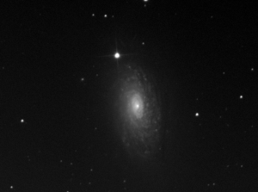

-
/
light frames
light frames
minus bad pixels
light frames
minus master dark
average light
frame
final corrected
frame
stretched image
dark frames
dark frames
minus bad pixels
master dark frame
-
Legend
flatfield frames
flatfield frames
minus bad pixels
flatfield frames
minus master dark
average flatfield
frame
Bad pixel interpolation
Average image
-
Subtract image
/
Divide image
flatfield dark
frames
flatfield dark
frames minus bad pixels
flatfield master
dark frame
Stretch image

