Slide 1
Functional Style Programming in JavaScript

Slide 2
Whats the goal of this talk?
Get a basic understanding of functional programming
Get you interested in functional style JavaScript
Show real life use cases and examples

Slide 3
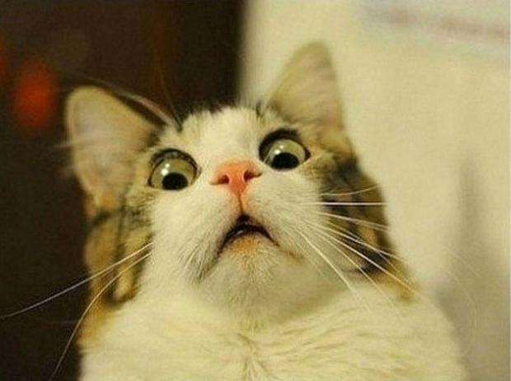

Slide 4


Slide 5
Why should I care about Functional Programming?

Slide 6
Functional code tends to be…
Easier to test
Easier to read
More concise
More predictable
Less prone to bugs
More fun to write
More declarative

Slide 7
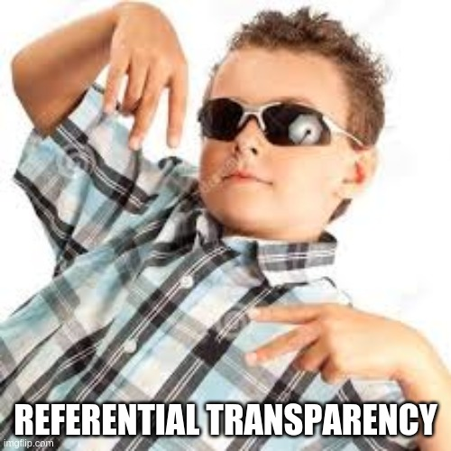
Arrow Functions, Unary, Pure Functions, Function Composition, Side Effects, Higher-Order Function, Currying, Pipe, Compose, Partial Application, Closure, Lexical, Paradigm, Arity, Unpure Function, Hidden Input, Lenses, Monads, Mustard, Mapping, Immutability, Mixins, Point-free Style, First Class Functions, Lambda, Functor,
Lazy Evaluation, Monoids

Slide 8
What is Functional Programming?

Slide 9
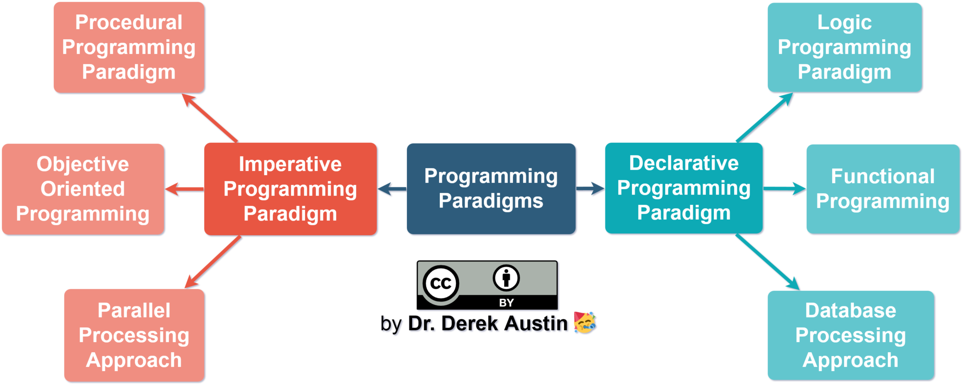
Functional programming is a programming paradigm!

Slide 10
Declarative vs. Imperative
Declarative:
The programmer merely declares properties of the desired result, but not how to compute it.
What
Imperative:
The programmer instructs the machine how to change its state.
How

Slide 11
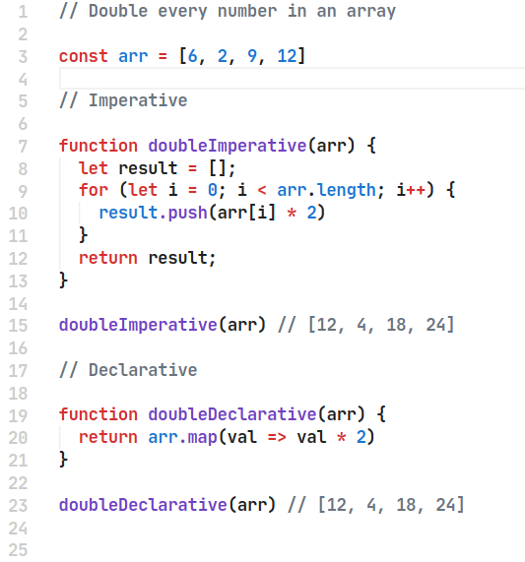

Slide 12
Higher-Order Function

Slide 13
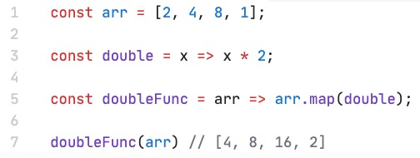

Slide 14

Map
Find
ForEach
Filter
Reduce

Slide 15
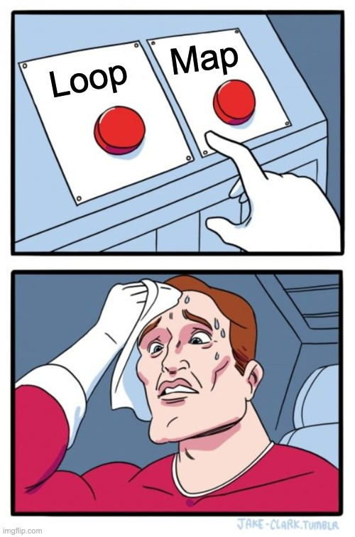

Slide 16
What is Functional Programming?
Functional programming is a programming paradigm where applications are composed using pure functions, avoiding shared mutable state and side effects.

Slide 17
What is Functional Programming?
Pure functions
Function composition
Avoid shared state
Avoid mutating state
Avoid side effects
Declarative

Slide 18
Functional Programming Languages
Haskell
Clojure
Scala
Lisp

Slide 19
What is Functional Style JavaScript?
The borrowing of functional programming concepts into JavaScript.

Slide 20
What is a pure function?
Functions that produce no side effects and have the same output given the same input are called “pure”.

Slide 21
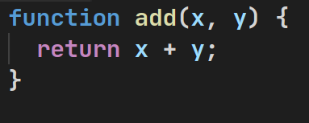

Slide 22
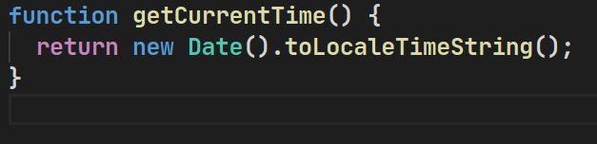

Slide 23
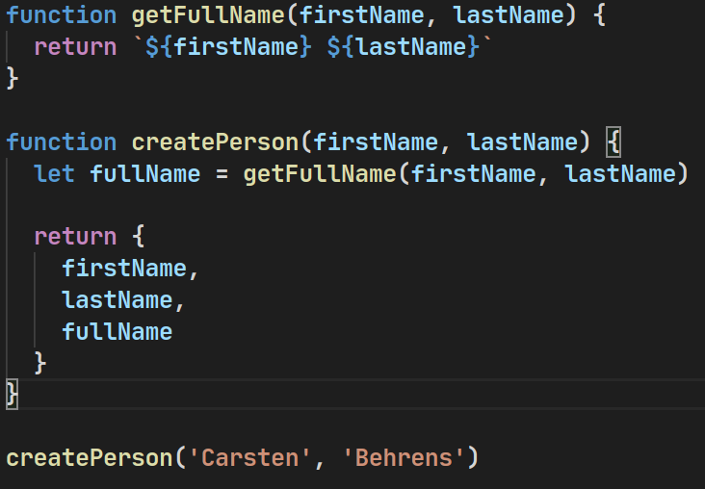

Slide 24
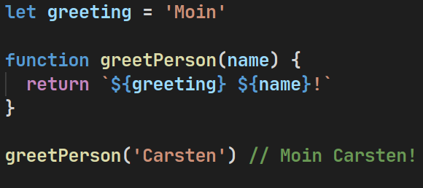

Slide 25
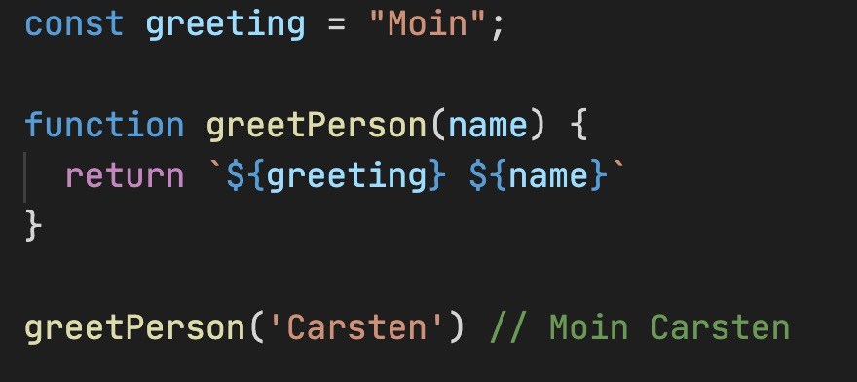

Slide 26
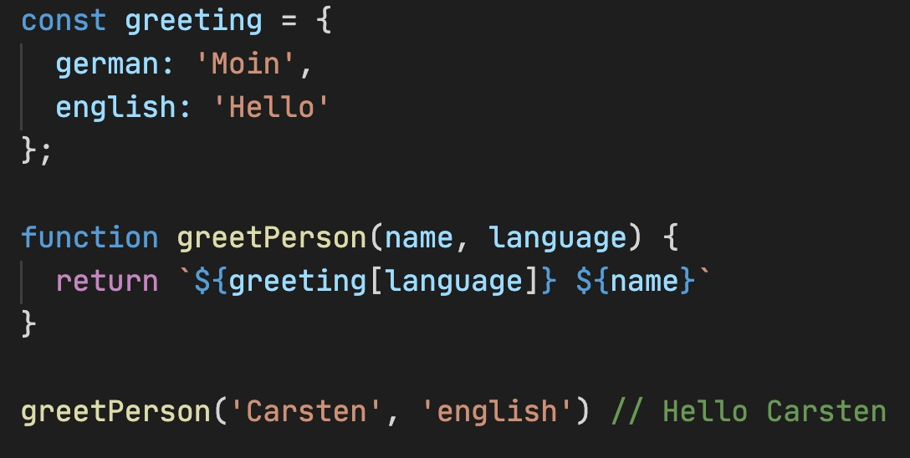

Slide 27
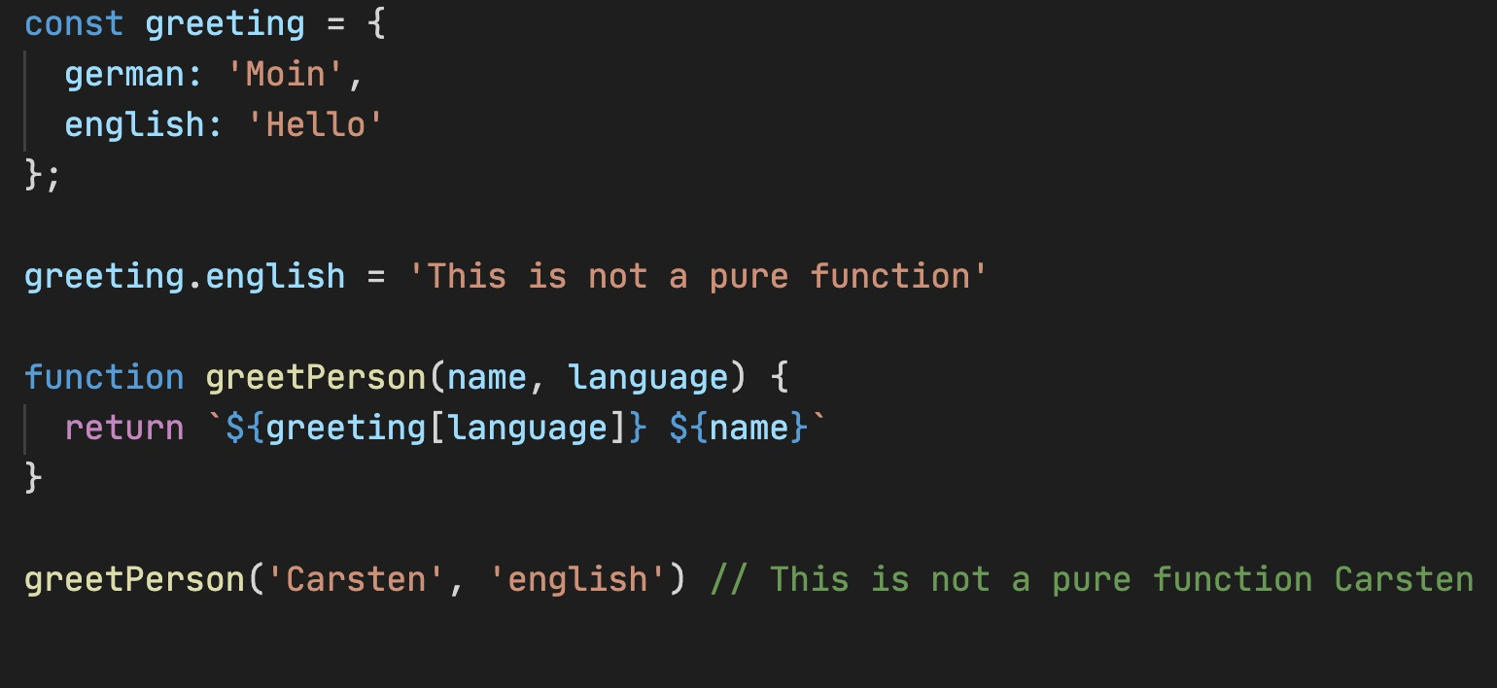

Slide 28
Free Variables
A free variable is a variable used in a function that is neither a local variable nor a parameter of the function.
Pure functions can access free variables if they are constants.
A constant is a variable declared with const and storing an immutable value.

Slide 29
Advantages of Pure Functions
Deterministic function (easy to test)
Easy to understand
Referential transparency (allows memoization)
“A function has referential transparency if it can be replaced with its output value and the application behavior doesn’t change”
For example:
console.log(add(2, 2))
console.log(4)

Slide 30
Currying

Slide 31
What is currying?

Slide 32
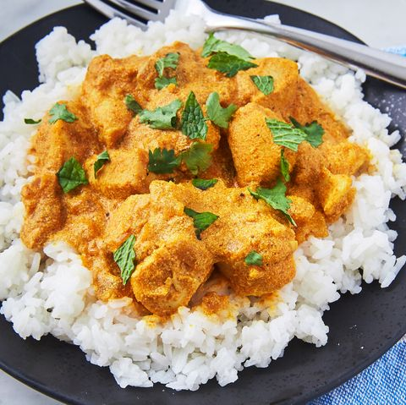

Slide 33

Haskell Brooks Curry

Slide 34
What is currying?
Currying transforms a function that takes multiple arguments into a sequence of functions where each takes one argument.

Slide 35
What is a curried function?
A curried function is a function that takes multiple arguments one at a time.

Slide 36
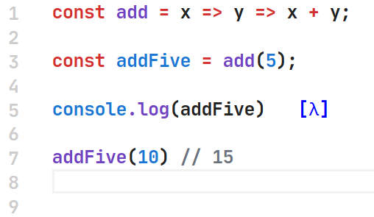

Slide 37
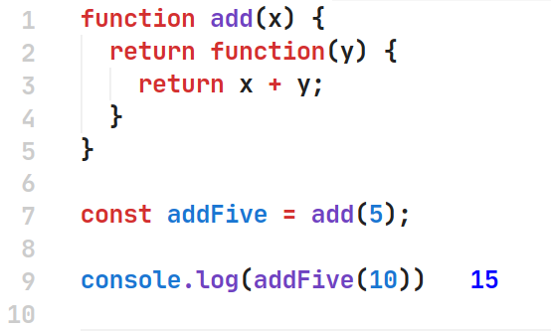
Partial application

Slide 38
Partial application lets us create specialized functions from generalized ones.

Slide 39
Partial application transforms a function with multiple arguments in a function with fewer arguments
Currying transforms a function with multiple arguments in a sequence of functions each taking one argument.

Slide 40
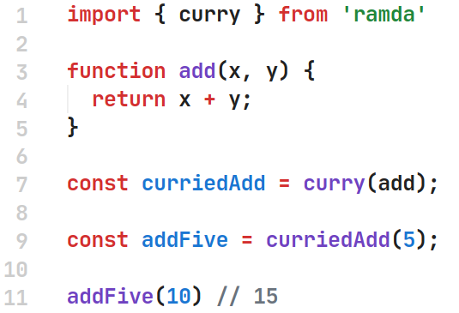

Slide 41
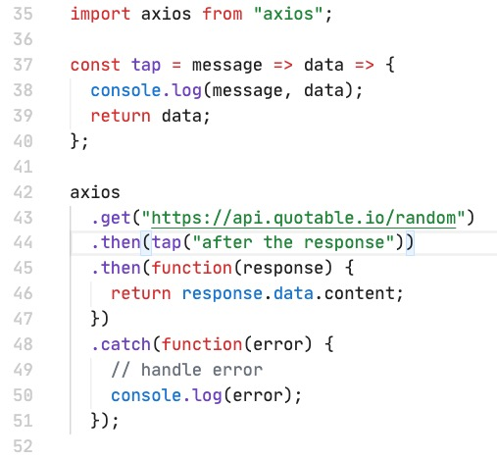
Real world example
Point-free style

Slide 42
Closure
A closure is the combination of a function bundled together (enclosed) with references to its surrounding state (the lexical environment).
In other words, a closure gives you access to an outer function’s scope from an inner function.
In JavaScript, closures are created every time a function is created, at function creation time.

Slide 43
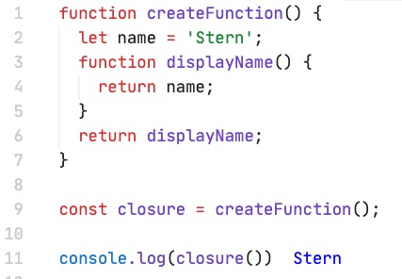
Closure

Slide 44
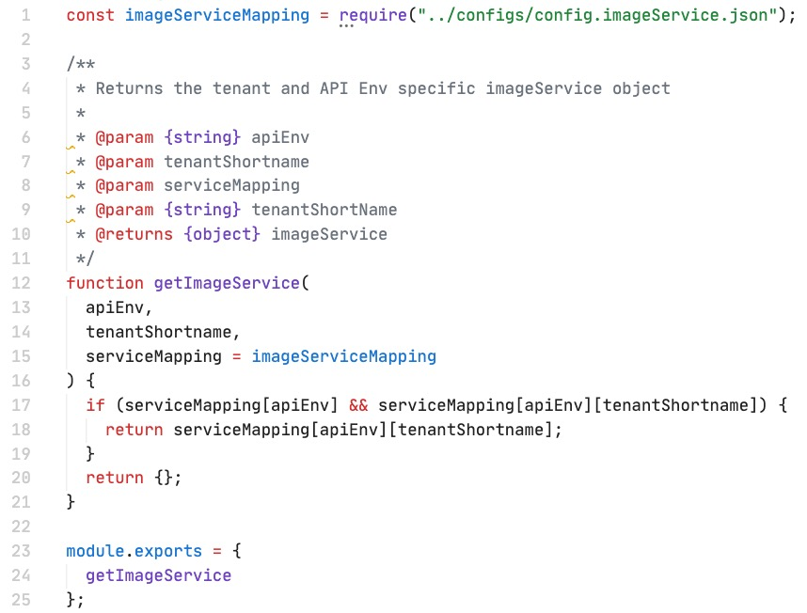
Real world example

Slide 45
Function Composition
Function composition is a technique of passing the output of a function as the input of another function

Slide 46
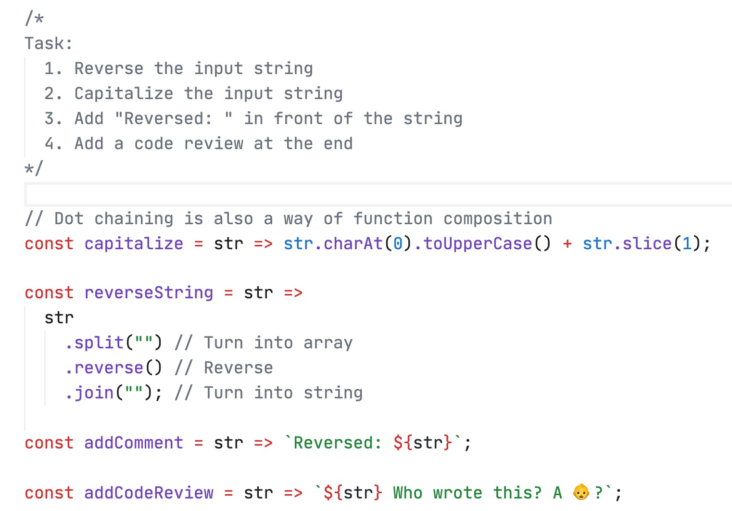

Slide 48
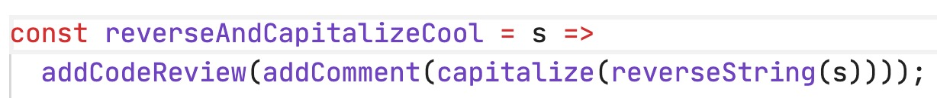

Slide 49
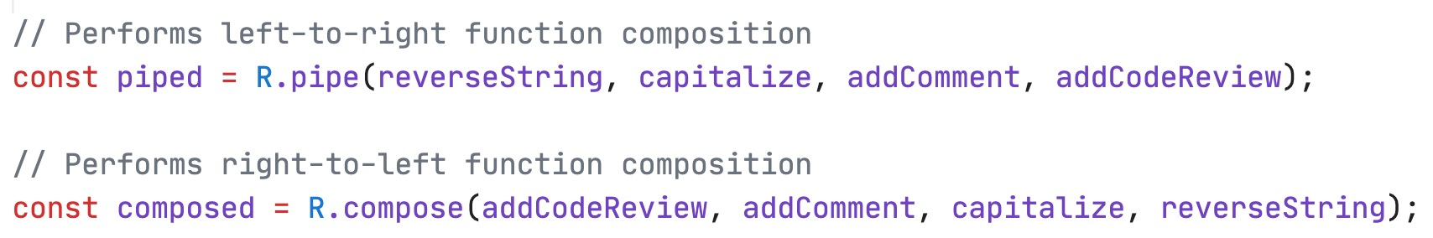
Pipe & Compose

Slide 50
Advantages of Function Composition
With function composition we eliminate intermediary variables.
Pipelines make data transformation more expressive.

Slide 51
Point-free style (Tacit style)
Point-free is a technique that improves readability by eliminating unnecessary arguments

Slide 52
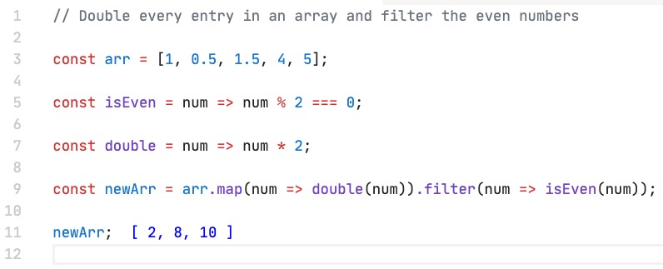

Slide 53
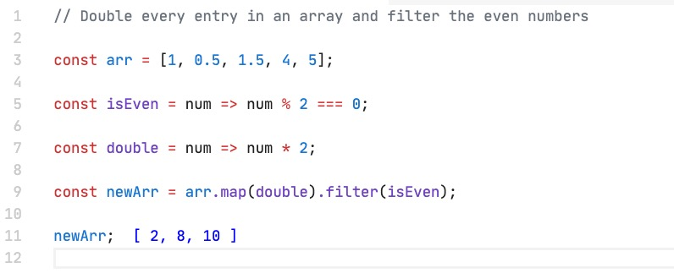

Slide 54
Summery
Declarative vs. Imperative
Pure functions
Higher order functions
Partial application
Currying
Closure
Function composition
Point-free style

Slide 55
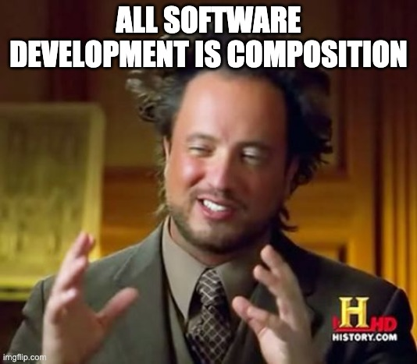

Slide 56
https://github.com/carstenbehrens/Functional-Programming-Talk

