Slide 1
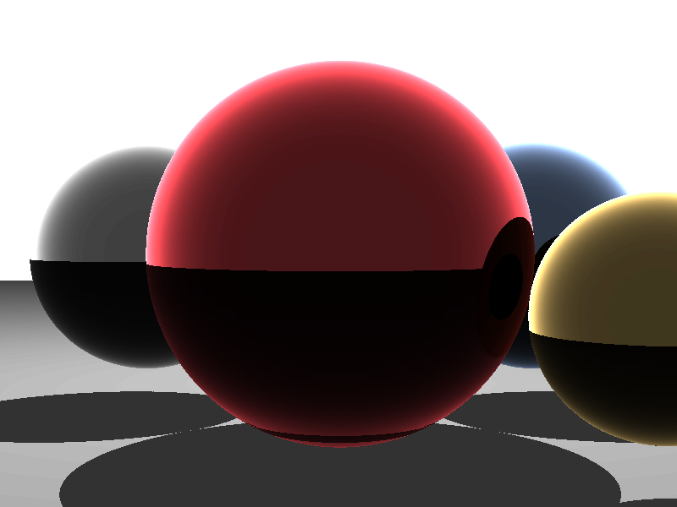

Final project
Raytracing
ECE 528
December 18th, 2015
The University of
British Columbia Holguer Becerra, Carsten Bruns

Slide 2
Outline
Raytracing basics
Decision of parallelization techniques
PC implementation
  Sequential
  pthreads
  OpenMP
  OpenCL
NIOS ll implementation
  base implementation
  manually accelerated with custom instructions
  HLS
Results & Conclusion

Slide 3
Raytracing
Goal: generate a 2D image from a 3D scene description
generate a ray from the camera center through the pixel plane
test for intersection with all objects
  closest one is seen
calculate light and reflections for this point
  light usually done by ray to all light sources, check if it intersects with other objects (shadow) or not
  for reflections generate secondary ray starting from seen point in direction of reflection
  → perform the same algorithm (recursive)
final color can be calculated by object color, light and incoming reflected light values

Slide 4
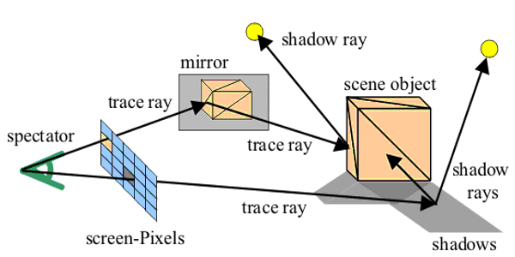
Raytracing
https://www.ice.rwth-aachen.de/fileadmin/user_upload/forschungsprojekte/tools/GRACE/raytracing.gif

Slide 5
Raytracing - Parallelism
some fine grained parallelism included (e.g. lots of 3 element vector operations)
tracing of each pixel independent of all others
  huge amount of parallelism at this level (800x600 pixels → 480.000 independent calculations
  calculations can take very short (ray hits no object) to very long (ray gets reflected multiple times)
  same scene data is read

Slide 6
Decision of parallelization techniques
We need processing units with independent control flow (→ not SIMD but MIMD)
E.g. vector processor not very well suited
use coarse parallelization techniques
  pthreads
  OpenMP
  OpenCL
  (OpenMPI)
to compare we wanted to see how well accelerating critical functions can speed up the computation...and we wanted to play with FPGAs :)

Slide 7
Sequential implementation
goal of the project not to implement Raytracing but to make it faster!
use existing code as base
  supports only Spheres as objects
convert to suit our needs
  structs instead of C++ classes (OpenCL)
  iterative instead of recursive (OpenCL)
  fixed-point arithmetic instead of floating point (NIOS ll / custom hardware)

Slide 8

pthreads
No dependencies between the elements!
implementation gets simple
  put scene into global access (shared) memory
  each thread calculates part of the pixels
calculation can vary large in time
  dynamic assignment of pixels to threads
  selection of next pixels has to be synchronized with other threads
  → assign one line each time to limit overhead

Slide 9

OpenMP
similar approach as in pthreads
instead of doing assignment by hand let OpenMP handle work division
no dependencies → just annote loop over rows
“#pragma omp parallel for”
set options (thread count, dynamic assignment)

Slide 10

OpenCL
convert trace function to OpenCL kernel,
pass scene data
C code needs to load and compile kernel at startup
run a work-item for each pixel
kernel knows position and can therefore calculate the pixel color
  store result in the right framebuffer position (in the OpenCL device)
fetch result image and show it

Slide 11
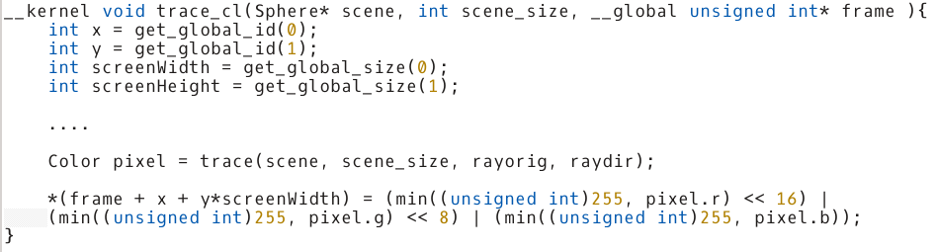
OpenCL - kernel

Slide 12
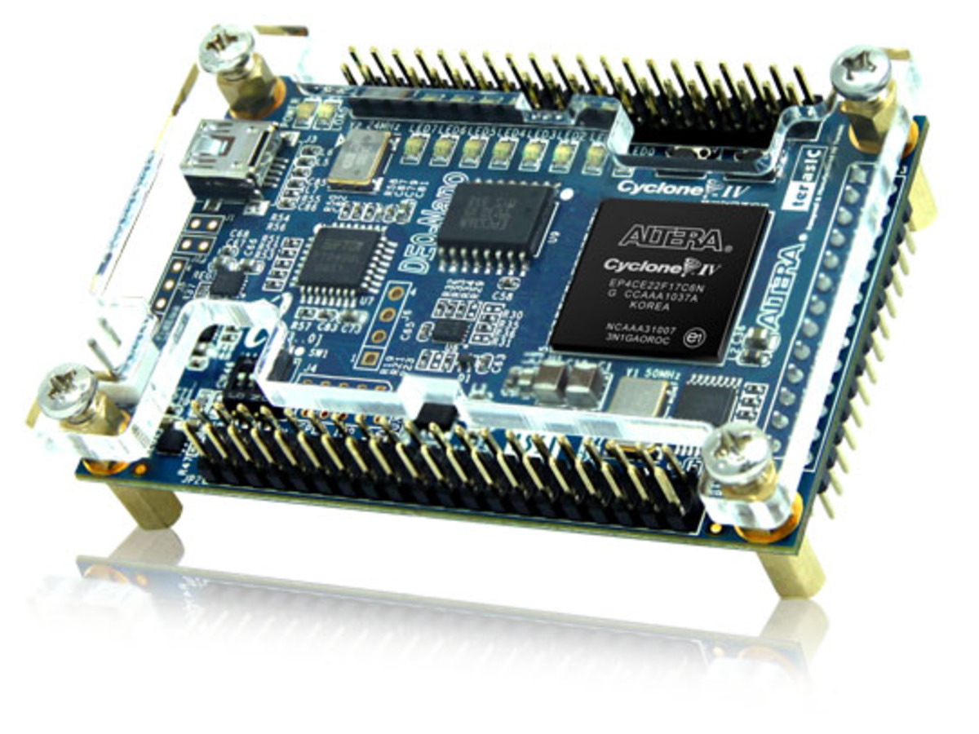
NIOS ll
convert code to work on NIOS ll processor (Altera FPGA)
  we already coded it to be easily portable
  use fixed-point as NIOS has no FP hardware and FP is complex in hardware
output of image has to be changed
  use HDMI or VGA output device, render in framebuffer
https://www.adafruit.com/images/1200x900/451-00.jpg

Slide 13
Hardware accelerators
accelerate critical functions only
→ many intersect tests with complex calculations
  faster development
  complex control flow handled by NIOS
possible to put multiple cores in parallel to work on the same frame
manual (hand coded) accelerator | High-level-synthesis
time consuming | fast
outcome largely depends on programming skills | independent of programmer
optimizations by hand | optimizations by heuristics
(hopefully) better performance | good performance?

Slide 14
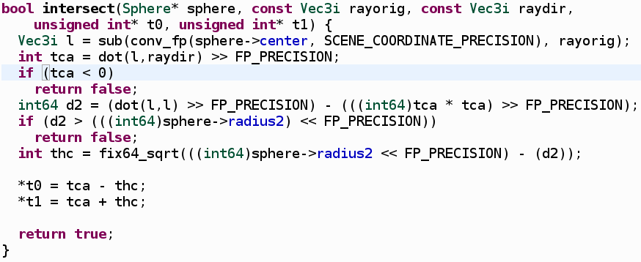
Intersect method

Slide 15
Performance results
800x600 pixels
Version | Dell XPS 12 (Core i7-3537U) | Speed-up | G32 | Speed-up
Sequential | 2.49 fps | 1.00 | 2.38 fps | 1.00
pthreads | 6.94 fps | 2.79 | 71.43 fps | 30.01
OpenMP | 5.26 fps | 2.11 | 45.45 fps | 19.10
OpenCL | 26.31 fps | 10.57 | ----- | -----

Slide 16
Conclusions
Good speed-up's close the theoretical maximum achieved
  possible since lots of parallelism in algorithm
  low sequential portion
for OpenCL a lot higher than just number of computing elements
  other optimizations improved behavior as side effect of parallelization
HLS easy to use, fast development
custom implementation got better performance
→ evaluate if best possible speed-up is necessary or large improvement close to that is already sufficient

Slide 17
Thank you!
http://www.scratchapixel.com/lessons/3d-basic-rendering/introduction-to-ray-tracing/ray-tracing-practical-example
Questions?
Have a look at our project!
https://sites.google.com/site/finaleece528
https://github.com/carstenbru/eece528_final

