Slide 1
Network Augmentation
9-24-2018

Slide 2
Network Augmentation
Given manually curated KEGG pathway
How can we use GAIL to suggest additional genes?
How can we control errors (both Type-I and Type-II)?

Slide 3
Approach 1
1) Given ”core” gene set (KEGG) with nodes {c1,…,cn} = C
2) Let {g1,…,gk} = G be all GAIL genes not in C
3) Compute cosine similarities S_{ij} for all pairs (c_{i}, g_{j})
4) Add to network the gene g_{j} with max{S_{ij}}

Slide 4
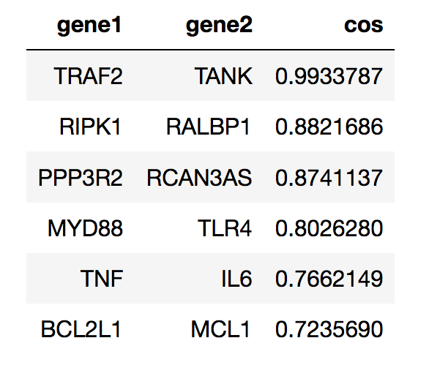
Application: Apoptosis

Slide 5
Application: Apoptosis
TANK: TRAF family member associated NFKB activator HGNC:11562
RALBP1: RALBP1 ralA binding protein 1 HGNC:9841
RALBP1: REPS1 RALBP1 associated Eps domain containing 1 HGNC:15578
RCAN3AS: RCAN3AS RCAN3 antisense RNA HGNC:39009
TLR4: TLR4 toll like receptor 4 HGNC:11850
IL6: IL6 interleukin 6 HGNC:6018
MCL1: MCL1 MCL1, BCL2 family apoptosis regulator HGNC:6943

Slide 6
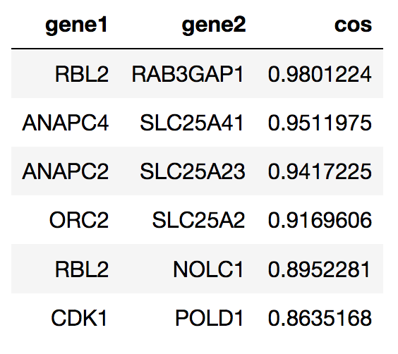
Application: Cell Cycle

Slide 7
Approach 2
Start with steps 1-3 of Approach 1
For each pair (c_{i}, g_{j}) , let e_{ij} = 1_{Sij > cutoff}
For each g_{j} compute n_{j} = sum_{i}(e_{ij}), the number of edges to core net
Add g_{j} to current network and repeat

Slide 8
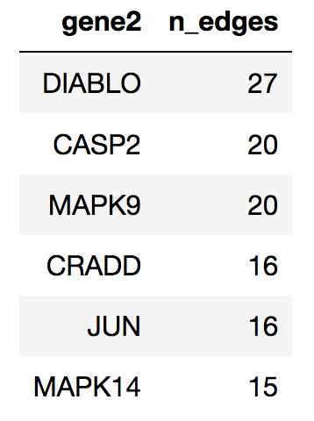
Application: Apoptosis

Slide 9
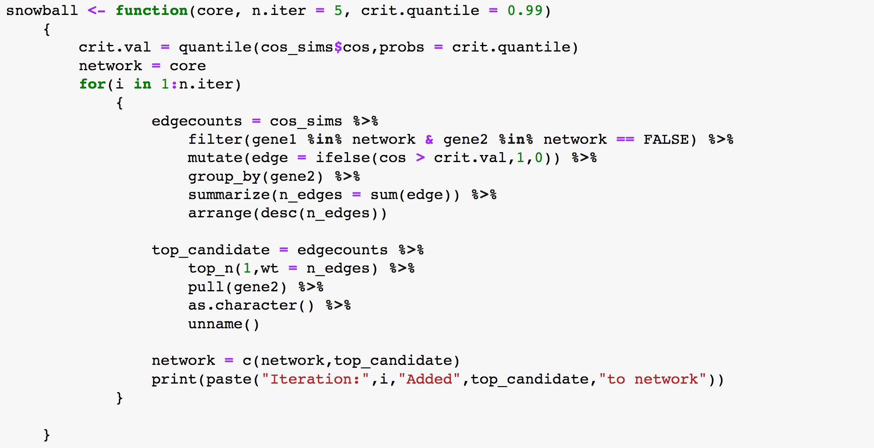

Slide 10
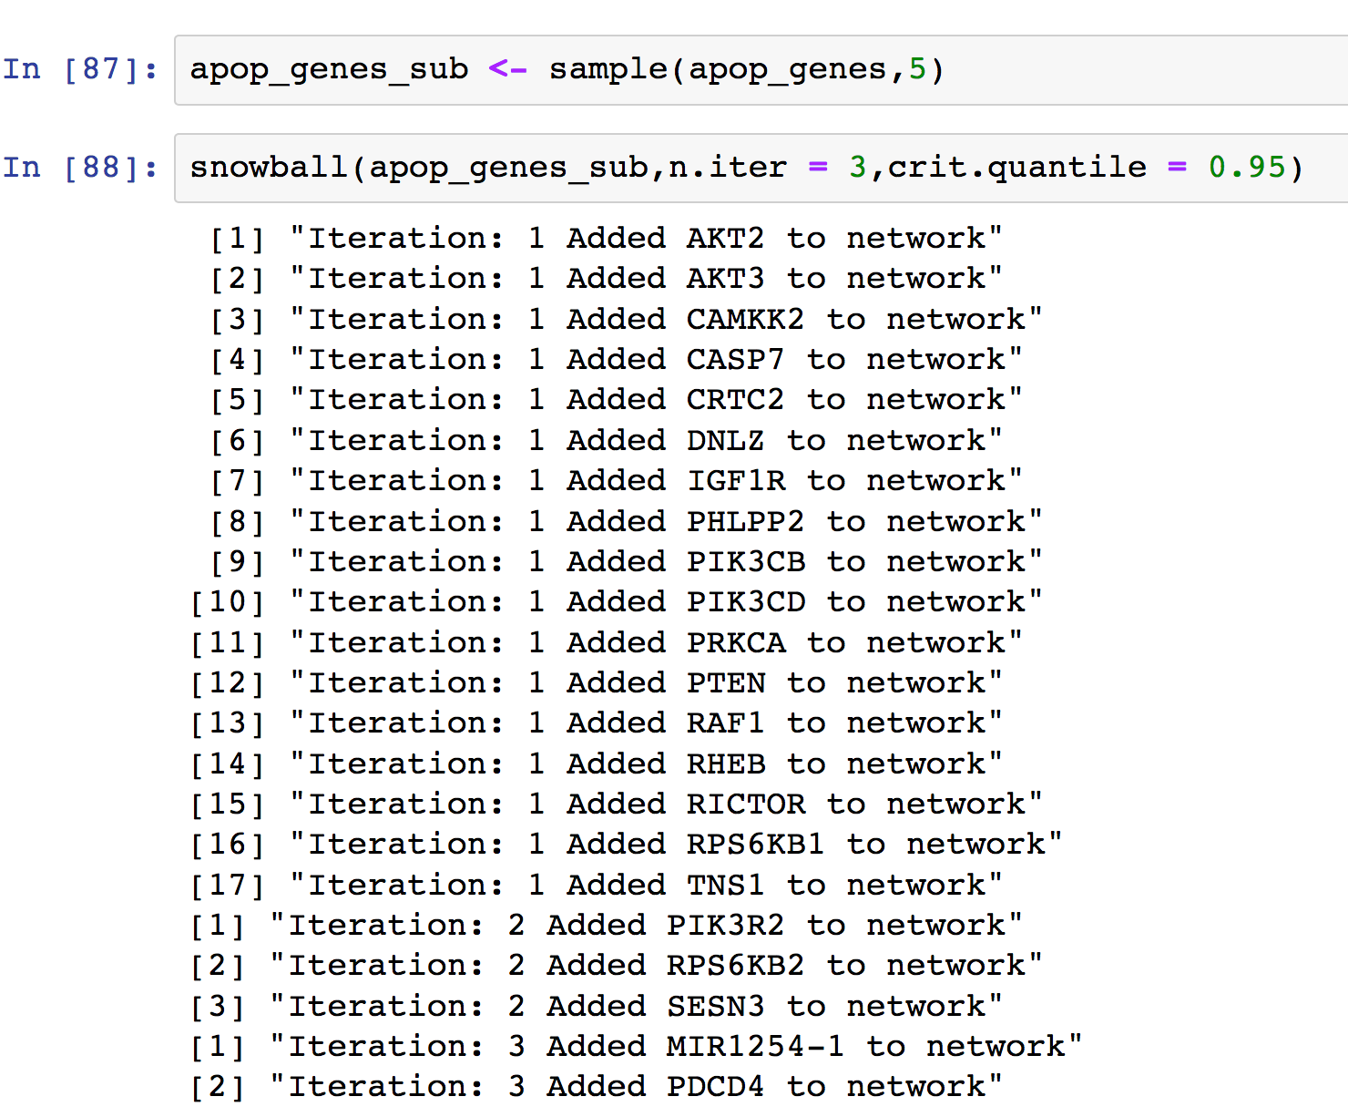
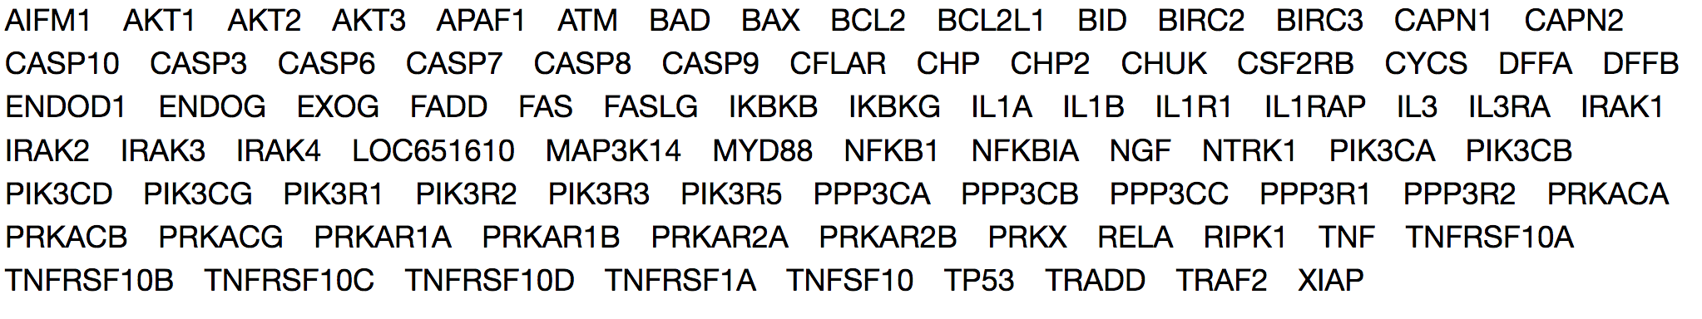
Subset Analysis

Slide 11
Next steps
Statistical properties of cosine similarity threshold
Error rates
How do we define each kind of error?

