Slide 1
Cosine Similarity Validation

Slide 2
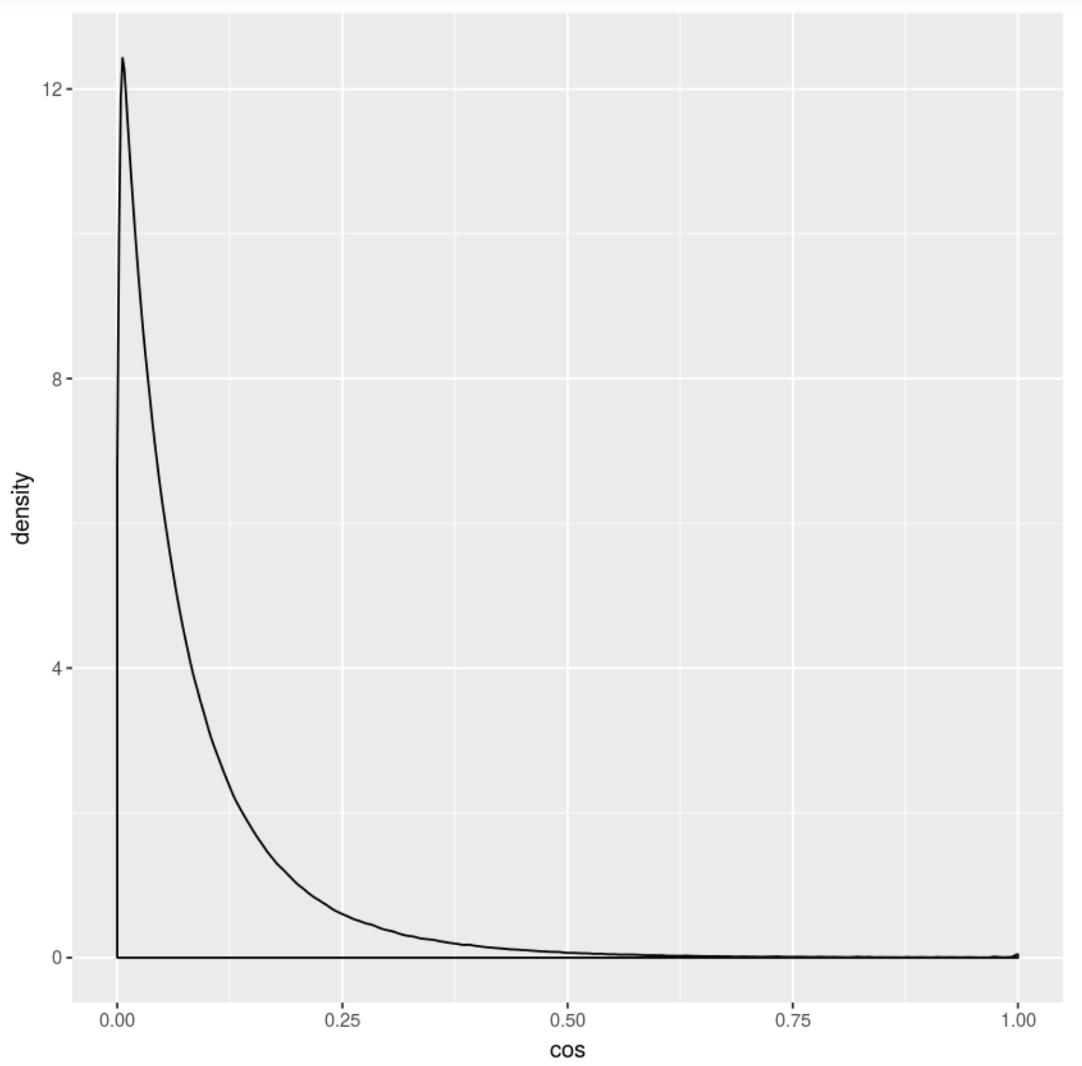
Distribution of Cosine Sim.
Approximately Beta(0.57,5.92)
Using method of moments estimation
Percentiles
25%: 0.02
50%: 0.05
75%: 0.12
95%: 0.29
97.5%: 0.37
99%: 0.49

Slide 3
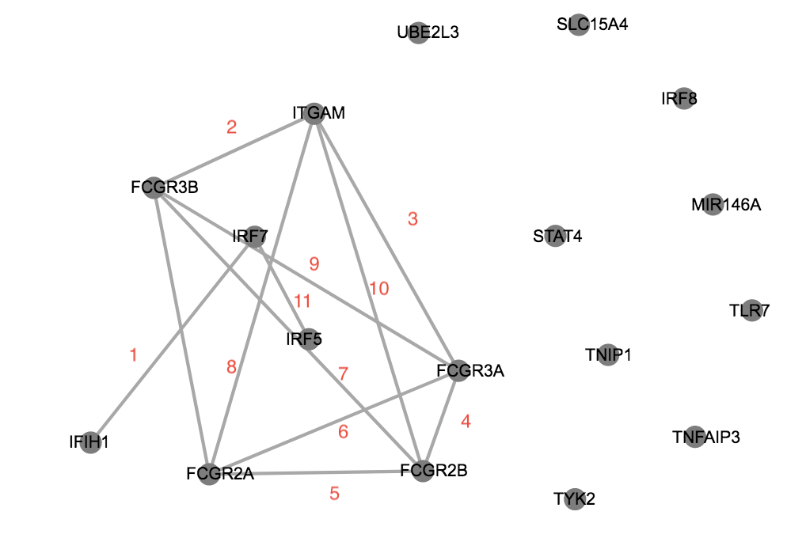
Network Query Example
Cutoff = 0.49
P(cos > 0.49) = 0.01
E[# of edges] = 18C2 * 0.01 = 1.5
Number of edges found = 11
P-value = 1-pbinom(11,153,2) = 0

Slide 4
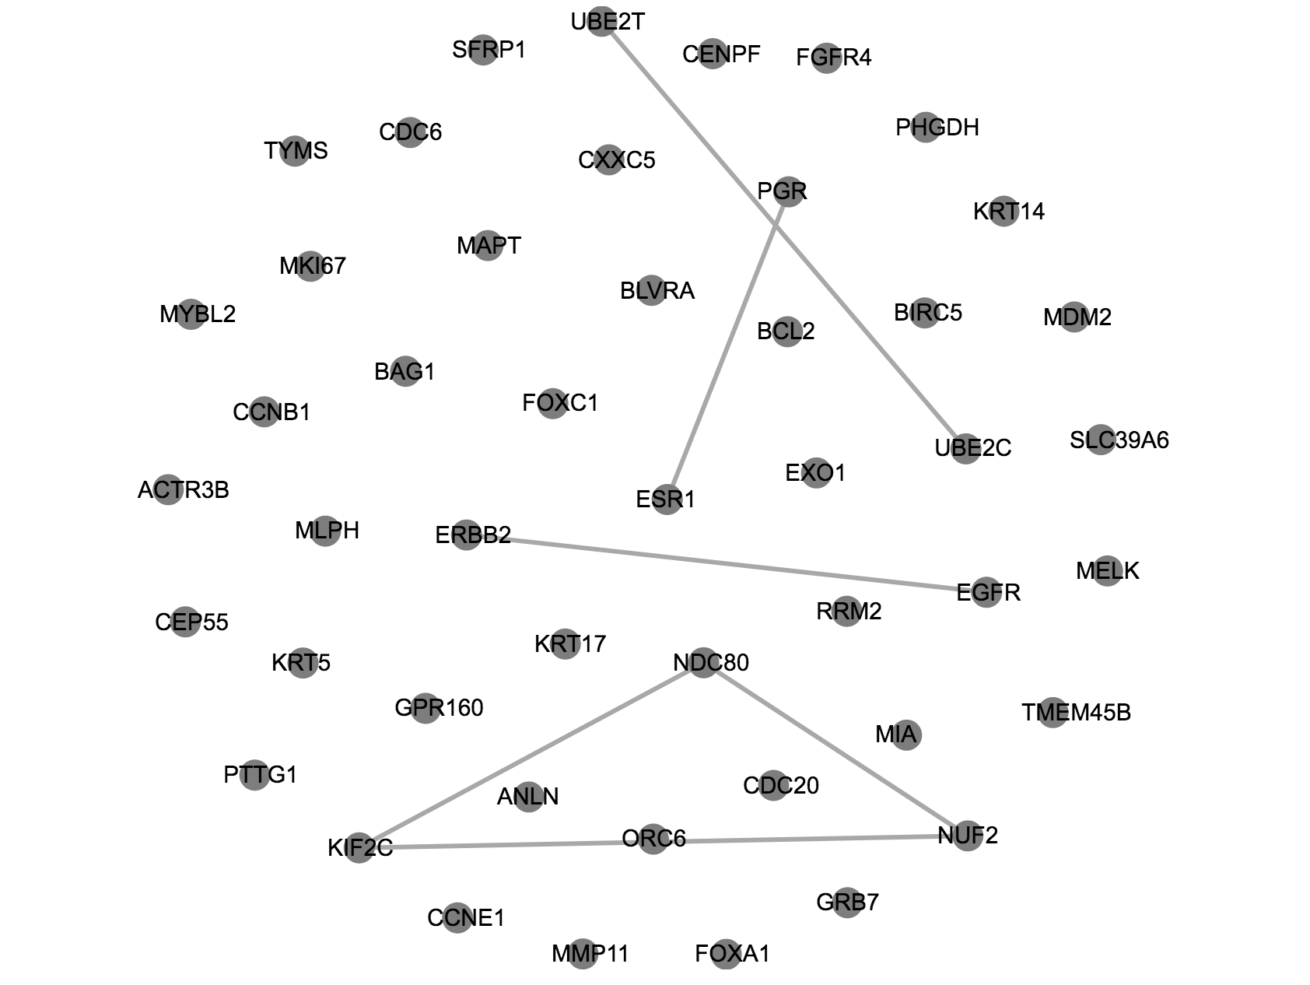
Pam50 Example
50C2 = 1225 possible pairs
Only 288 pairs are non-missing
E[# of edges] = 0.01 * 288 =2.88
# of edges found = 6
P-value = 0.03

