Slide 1
little_lemon_data_visualisation_workbook
File created on: 2024-06-29 5:24:45 PM

Slide 2
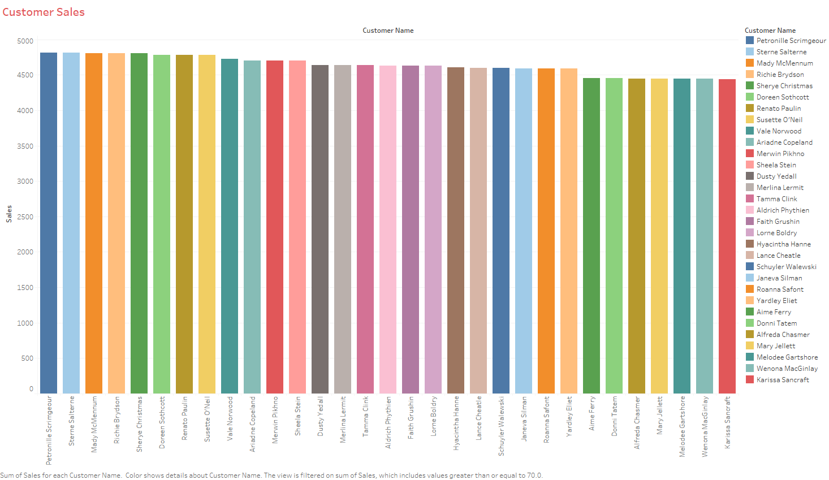

Slide 3
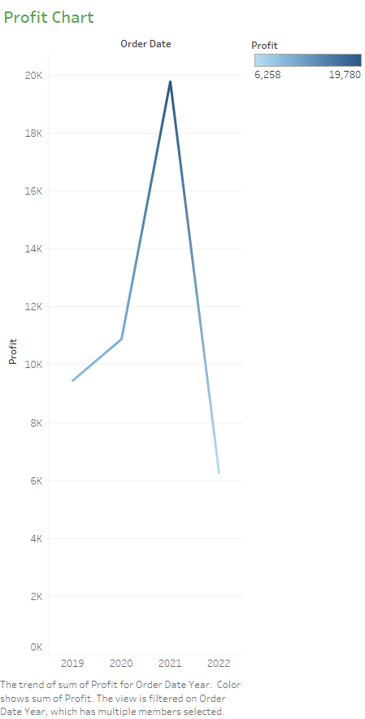

Slide 4
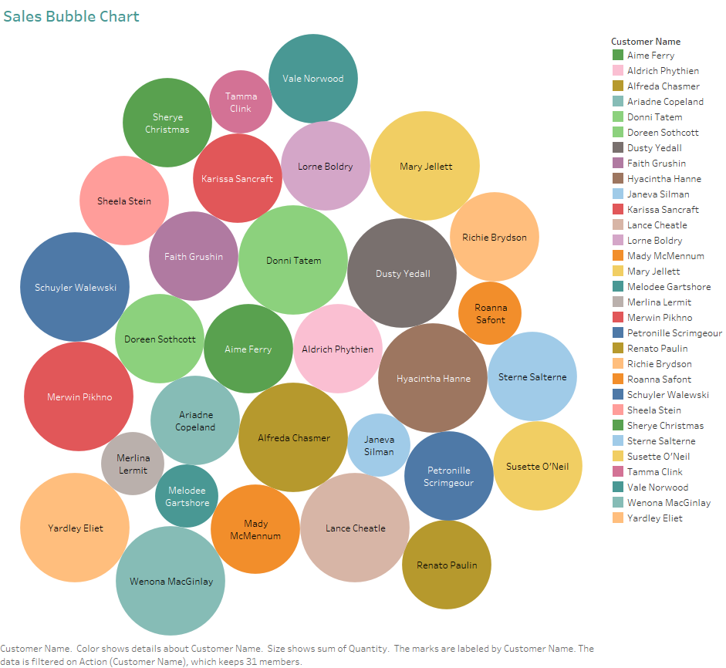

Slide 5
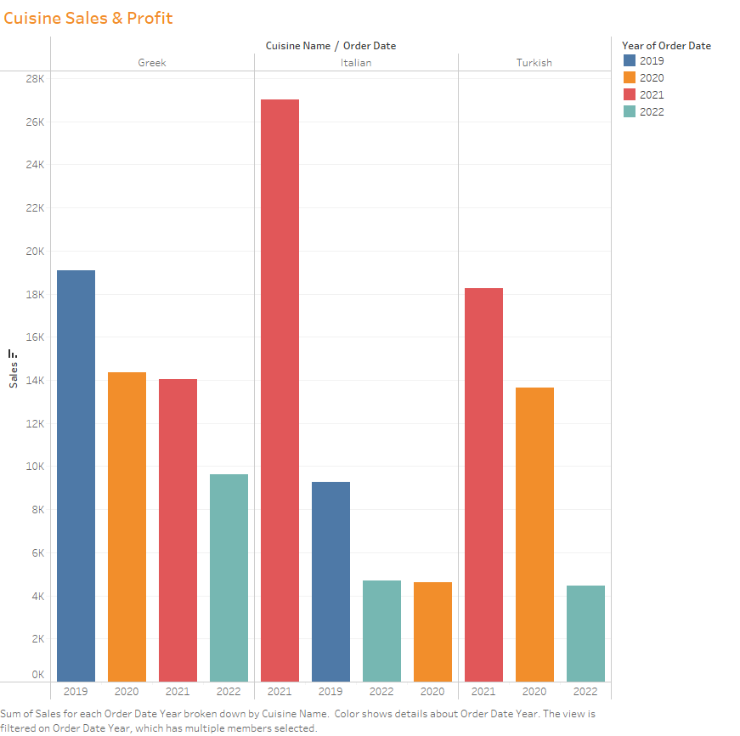

Slide 6
