Slide 1

LINQ

Slide 2
LINQ
Language Integrated Query (LINQ)
Gives the capability to query objects in C#

Slide 3
LINQ
We use LINQ to query the following:
Objects in memory, i.e. collections (LINQ to Objects)
SQL Server Databases (LINQ to Entities (Entity Framework))
XML documents (LINQ to XML)
ADO.NET Data Sets (LINQ to Data Sets)
Notes:
XML: eXtensible Markup Language that is designed to store and transport data (markup language like HTML)
ADO.NET: ActiveX Data Objects; software components that can be used to access data and data services from a database

Slide 4
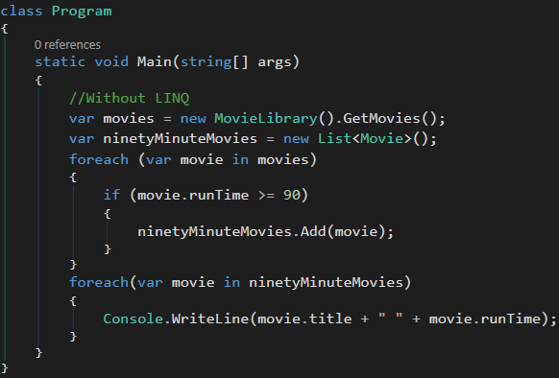
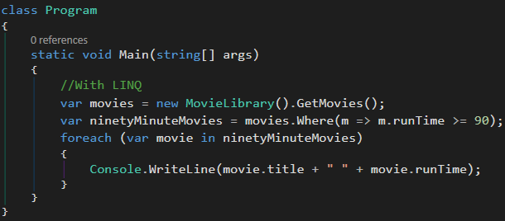
LINQ Extension Methods
LINQ extension methods are built-in methods that we can use to query

Slide 5
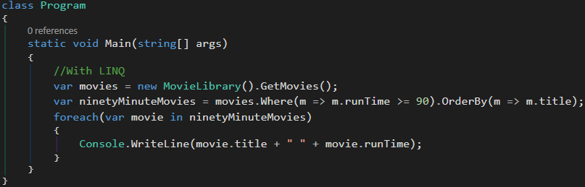
LINQ Extension Methods: Chaining LINQ Methods
It is possible to chain multiple LINQ methods together
//Output The Dark Knight 92 The Departed 91

Slide 6
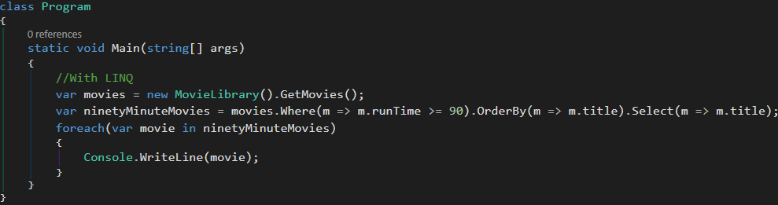
LINQ Extension Methods: Using Select
Using Select, we can iterate over the movies and convert them to another object or select a movie property as a string
In our example, what started out as a collection of type Movie is now treated as a collection of type string
In our example, we are filtering (Where), sorting (OrderBy), and selecting (Select) a property

Slide 7
Coming Full Circle With Delegates
From the previous example:
.Where(Func<Movie, bool>)
.OrderBy(Func<Movie, TKey>)
.Select(Func<Movie, TResult>)
Notes:
Func<>: Last input parameter is always the output return type of the method

Slide 8
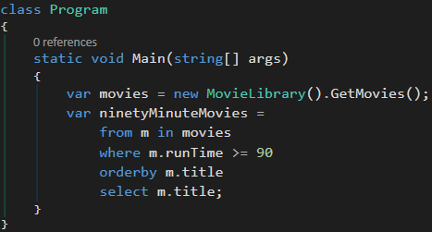
LINQ Query Operators
LINQ query operators looks similar to writing SQL code
LINQ query operators always start with ‘from’ and end with ‘select;

Slide 9
Which Should You Use?
It comes down to personal preference whether to use LINQ extension methods or LINQ query operators
With that said, LINQ extension methods are more powerful and flexible because:
All of the query operator keywords translate to extension methods under the hood
There are more LINQ extension methods than LINQ query operators.

Slide 10
Database Models
Use model classes when implementing the code first approach to databases in .NET applications
Models are class representations of a table in the application’s database
Each model represents a single record or “row” of data in that table
The table’s columns are determined by the properties in the class model

Slide 11
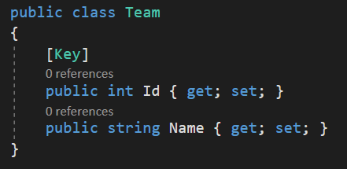
Model Example

Slide 12

“Key” Data Annotation
The “Key” property annotation defines the column below it as the primary key column for the table
Each model is required to have a primary key or a composite key
This must be defined by you within the model class

Slide 13
ApplicationDbContext
When using the database first approach in .NET applications, there is a need for a database “context” class
This represents the “portal” into the database and its tables
The database context class will contain database connection information as well as “DbSet<T>” properties
For each model class you create you will need a DbSet property on the context class
Inherits from “IdentityDbContext” or “DbContext”

Slide 14
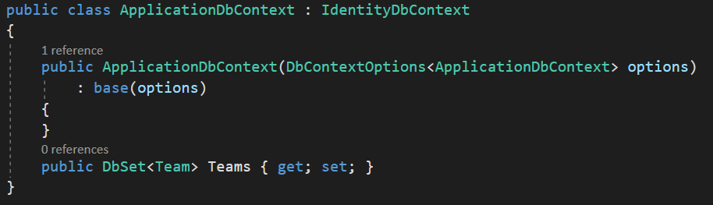
ApplicationDbContext

Slide 15
Using the Context Class for Querying
Must instantiate the context class into an object for use
Use dot notation to access DbSet (tables) properties
Best practice for querying is to use LINQ extension methods

Slide 16
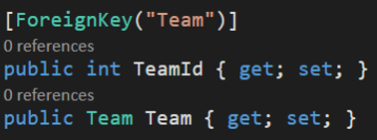
Database Models w/ Foreign Keys
Models can contain foreign keys to other models
Must include three distinct parts when creating a foreign key relationship between model classes
Foreign Key Data Annotation
Foreign Model Class Id Property
Foreign Model Class Property

Slide 17
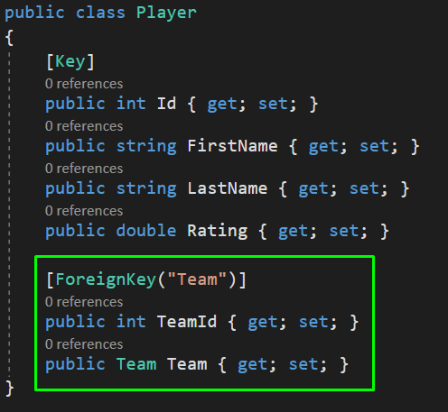
Model w/ Foreign Key

Slide 18
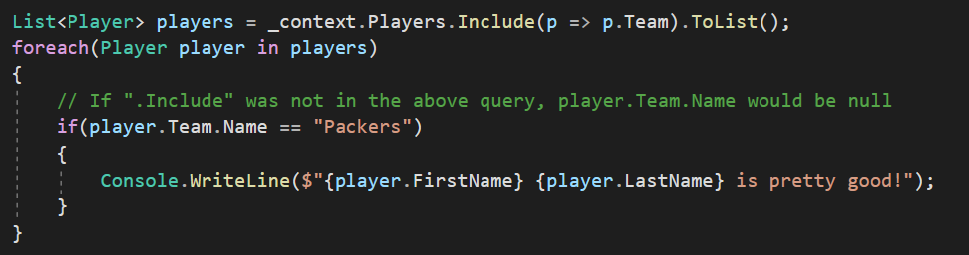
.Include
We can use the LINQ extension method “.Include()” to specify that we want the foreign key relationship data to come back in the query
Without .Include the query will not come back with the nested foreign key relationship data

