Slide 1

STAT512 Group 14 Final Presentation
Ethan Carter, Zach Davis, Jiya Dutta, Saksham Gupta
Notes:
Saksham

Slide 2
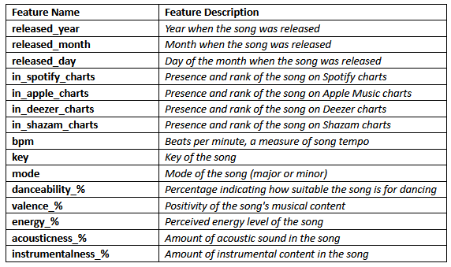
Our Data: Most Streamed Spotify Songs of 2023
Formatting: Zach
Content: Saksham
Notes:
Saksham
Explain everything in detail. Eg. Charts have 0 = not on chart.

Slide 3
Project background
Formatting: Zach
Content: Saksham
Music streaming is popular and important
What makes songs popular with these services?
Research Questions 1-3:
What makes a song perform well on music charts?
Important to understand when making songs you want to be popular
Research Question 4:
What is the relationship between rankings in different charts?
When an artist wants to make a song for streaming services, they would want to know if a song would do well on all of them or just on one.
Notes:
Saksham
All questions are exploratory

Slide 4
Our Research Questions (1):
Formatting and Content: Zach
All our Research Questions focus on one thing: What impacts the position of a song on Spotify Charts/How many streams a song has on Spotify?
Jiya: How does the release timing of a song impact its number of streams?
Hypothesis: Songs released earlier in the year have more streams on Spotify
Ethan: Do songs in the major key with high danceability rank higher on Spotify's charts?
Hypothesis: There is an interaction effect between the mode a song is in and its bpm on the Spotify Charts
Notes:
Jiya, Ethan

Slide 5
Our Research Questions (2):
Formatting and Content: Zach
Saksham: How does the energy of a song affect its positioning in Shazam charts?
Hypothesis: Energy will have an impact on a song's ranking on Shazam Chart given valance and acousticness are already in the model.
Zach: Does the presence of a song on Deezer's charts have any predicting power on its position on Spotify's charts?
Hypothesis: Songs that are not on Deezer's charts and songs that are have the same average Spotify chart ranking for any ranking in Shazam's and Apple Music's charts.
Notes:
Saksham, Zach

Slide 6
RQ1: How does the release timing of a song (year, month, and day) impact its streaming statistics and presence on various music platforms?
Formatting and Content: Jiya
Hypothesis: Songs released earlier in the year (considering month and day) are likely to have more streams on Spotify.
Why is this significant: Understanding how the timing of a song's release influences its popularity and performance on streaming platforms is crucial for the music industry.
Notes:
Jiya: The first research question is as follows: How does the release timing of a song (year, month, and day) impact its streaming statistics and presence on various music platforms? Significantly, understanding how release timings of songs influences popularity and chart peroformance is an important metric for revenue generation in the music industry. We hypothesized that songs released earlier in the year (considering month and day) are likely to have more streams on Spotify.

Slide 7
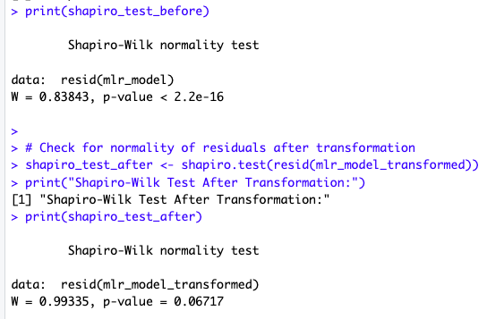
RQ1: Model Building (1)
Formatting: Zach​
Content: Jiya
Before Box-Cox transformation, model has non-normal residuals
After Box-Cox residuals are normal.
Y: Streams
X1: Release Year
X2: Release Month
X3: Release Day
X4: Spotify Chart
Before Box-Cox
After Box-Cox
Notes:
Jiya: After constructing a multiple linear regression (MLR) model was constructed, including the release year, month, day, and Spotify chart position as shown on this slide.
To assess the individual impact of each predictor, separate single linear regression (SLR) models were fitted for each predictor against the dependent variable (streams).
The Shapiro-Wilks normality test assesses whether the residuals of a regression model follow a normal distribution. Given the remarkably small p-value as shown in the before portion, the residuals were non-normal and thus a box-cox transformation had to be conducted on the response variable (streams) to achieve normality, with the p-value increasing to 0.06717 as shown in the after portion.

Slide 8
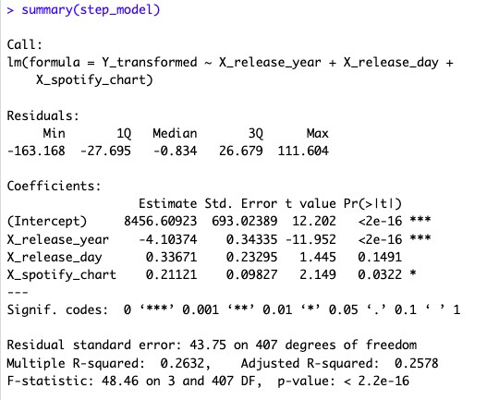

RQ1: Model Building (2)
Formatting and Content: Jiya
18 influential points
No major multicollinearity issues
Model Selection:
The stepwise regression using the Bayesian Information Criterion (BIC) for model selection resulted in a model with three predictor variables: release year, release day, and Spotify chart presence.
Notes:
Jiya: Variance inflation factors (VIF) were computed to evaluate multicollinearity among predictors. In this case, the VIF values for the predictors are all close to 1, suggesting that these predictors are not highly correlated with each other. Hence, there is no substantial risk of multicollinearity influencing the stability and reliability of the regression coefficients. The stepwise elimination process involved iteratively testing the removal of each predictor to minimize the BIC, with the final model achieving an AIC of 3109.9. Notably, the negative coefficient for release year implies that, on average, newer songs have fewer streams. Release day, with a positive coefficient, suggests that songs released later in the month tend to have more streams. The adjusted R-squared value of 0.2578 indicates that approximately 25.78% of the variability in the transformed streaming statistics is explained by the predictors in the model. The F-statistic with a p-value less than 2.2e-16 further supports the overall significance of the model. In summary, the selected model, derived through stepwise regression, provides a statistically significant representation of the relationship between release timing variables and song streaming statistics.

Slide 9
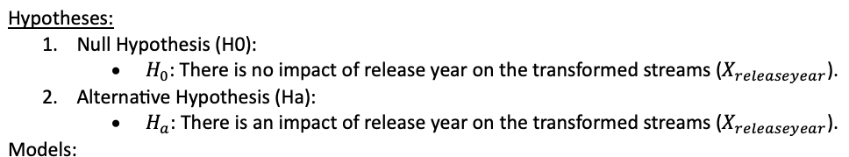

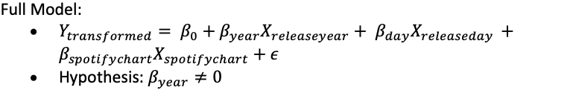
RQ1 Results (1)
Formatting and Content: Jiya
Notes:
Jiya: To test, the null and alternative hypothesis tests are as shown on the slide, with the reduced model considers only the impact of release day and Spotify chart position on transformed streams.

Slide 10
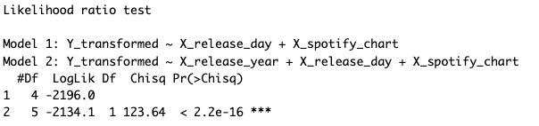
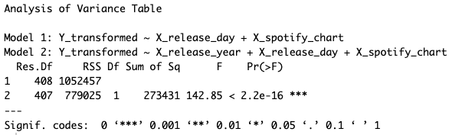
RQ1 Results (2)
Formatting: Zach
Content: Jiya
The full model, including release year, release day, and Spotify chart position, is superior in explaining the variability in the transformed streaming data compared to the reduced model without release year.
Notes:
Jiya: The likelihood ratio test(EXPLAIN THIS IN DETAIL) compares two models, one including only release day and Spotify chart position and the other incorporating release year. The resulting chi-squared statistic of 123.64, with a p-value well below the significance threshold, strongly supports the full model with release year. This implies that the inclusion of release year significantly improves the model's ability to explain variations in streaming statistics. The ANOVA results reinforce this, indicating that the full model, including release year, release day, and Spotify chart position, is superior in explaining the variability in the transformed streaming data compared to the reduced model without release year.

Slide 11
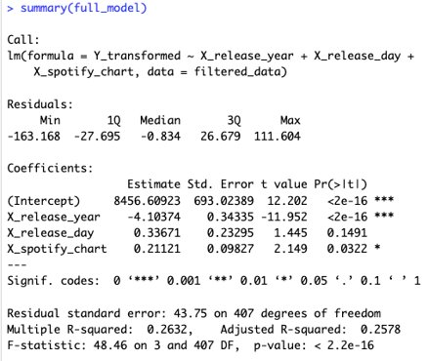
RQ1 Results (3)
Formatting: Zach
Content: Jiya
Interpretation:
Holding other factors constant, a one-unit increase in the release day is associated with a 0.34 increase in streams, and a one-unit increase in Spotify chart position is associated with a 0.21 increase in streams. The multiple R-squared value of 0.2632 suggests that the model explains approximately 26.32% of the variance in the streaming statistics.
Therefore, songs released later (day and year) generally have more streams.
Notes:
Jiya: As previously mentioned, the negative coefficient for release year (-4,103,740) suggests that, on average, newer songs experience fewer streams. In contrast, the positive coefficients for release day (0.33671) and Spotify chart position (0.21121) indicate that songs released later in the day and those with higher positions on the Spotify chart are associated with more streams. The release month did not exhibit a statistically significant impact on streaming statistics.
To quantify, the results indicate that, holding other factors constant, a one-unit increase in the release day is associated with a 0.34 increase in streams, and a one-unit increase in Spotify chart position is associated with a 0.21 increase in streams. ****EXPLAIN SIMPLY

Slide 12
RQ2: How do the audio attributes of a song (beats per minute, mode, energy, and danceability) influence its ranking on Spotify charts?
Hypothesis: Songs with higher BPM, major mode, and higher danceability percentage are likely to rank higher on Spotify charts
Why is this significant: Unveiling the significance of beats per minute, mode, energy, and danceability in song success can redefine the narrative of what captivates audiences and ascends to the top tiers of the ever-evolving music charts.
Formatting: Jiya
Content: Ethan
Notes:
Ethan

Slide 13
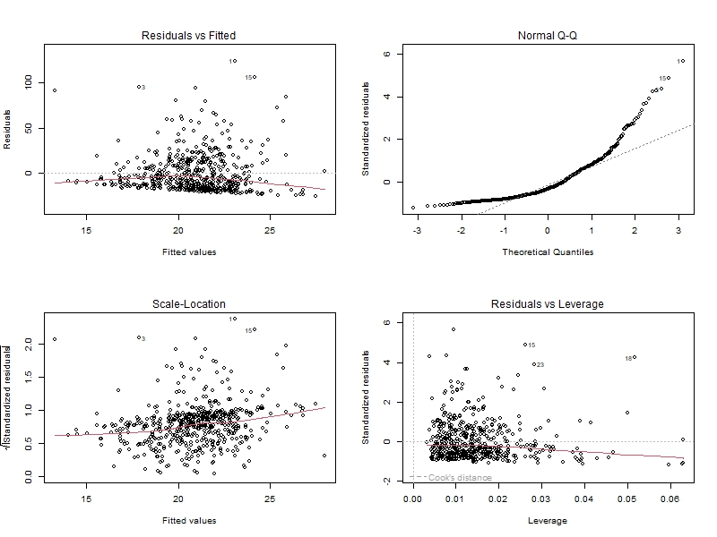
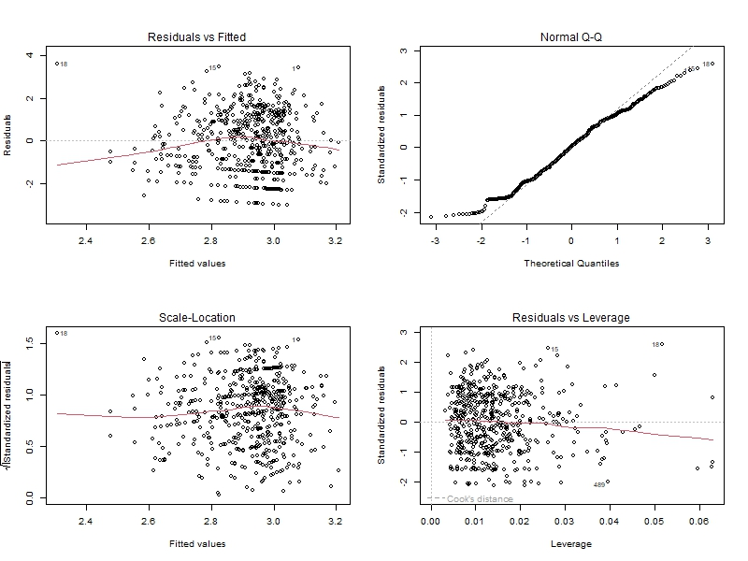


RQ2: Model Building
Formatting and
Content: Ethan
Before Box-Cox transformation, and Robust Regression model has non-normal residuals
After being processed residuals are normal.
Before Box-Cox
After Box-Cox
Y: Spotify Chart
X1: BPM
X2: Energy
X3: Danceability
X4: Mode
Notes:
Ethan

Slide 14
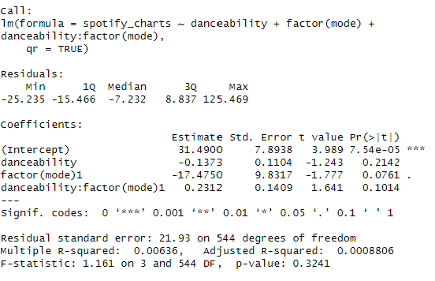
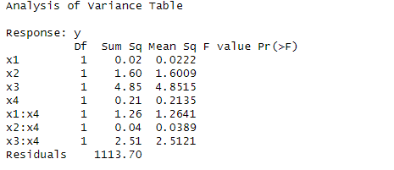
RQ2: Model Selection
Formatting and Content: Ethan
VIF of Processed Model
Notes:
Ethan

Slide 15
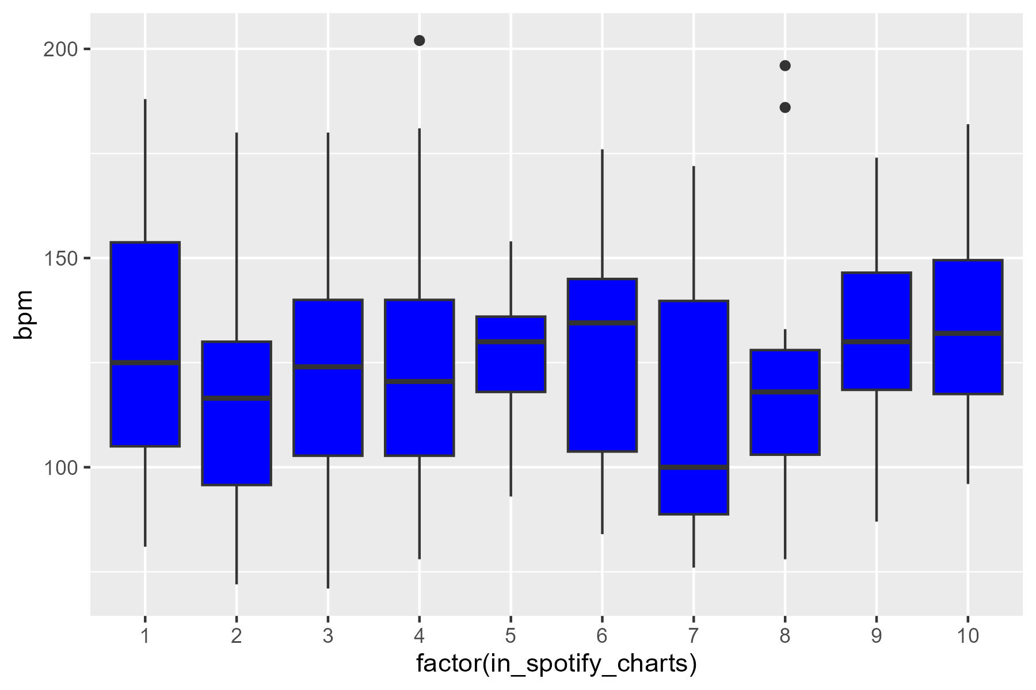
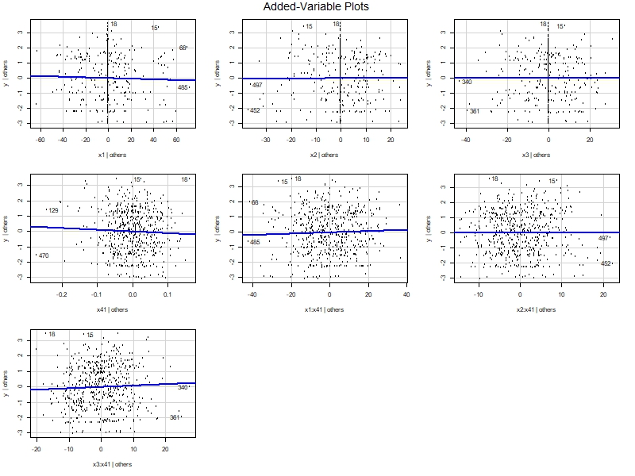
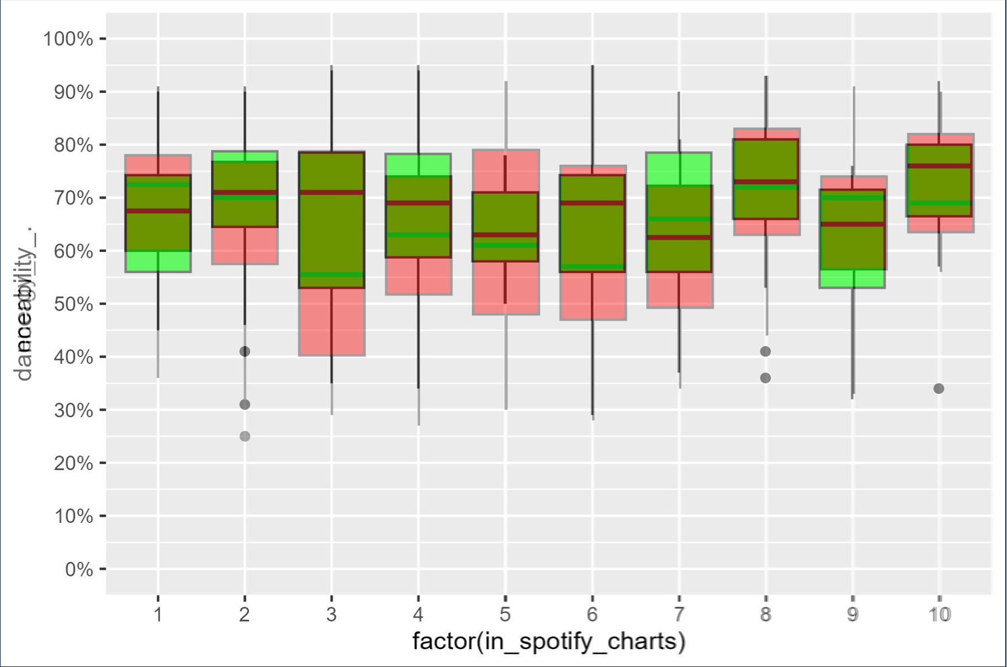
RQ2: Remedial Measures
Formatting and Content: Ethan
Notes:
Ethan

Slide 16
RQ2: Conclusion
Formatting and Content: Ethan
None of the 4 predictors considered in this analysis (BPM, Energy, Danceability, and Mode), can be considered statistically significant.
Out of these 4 the interaction between danceability and mode explains the largest amount of variance
An interpretation of this can be that the section of the music industry that is represented in the Spotify Charts is diverse and varied spanning many genres and moods.
(Kendrick Lamar, Daddy Yankee, Bad Bunny, Marshmello, Harry Styles, Lizzo, Taylor Swift, Charlie Puth)
Notes:
Ethan

Slide 17
RQ3:
Formatting: Zach
Content: Saksham
Reasoning:
High energy pop songs have been performing extremely well in music charts the past decade as they seem to appeal to a wide audience.
Hypothesis: Energy of a song has an impact on the song's ranking in Shazam's charts when Acousticness and Valance are already in the model.
H₀: β₃ = 0
Reduced model: Shazam Ranking = β₀ + β₁{Acousticness} + β₂{Valence} + β₃{Energy}
H_{a}: Not H₀
Full model: Shazam Ranking = β₀ + β₁{Acousticness} + β₂{Valence}
Notes:
Saksham

Slide 18
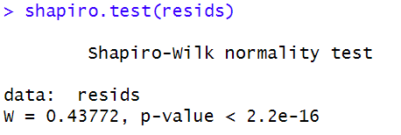
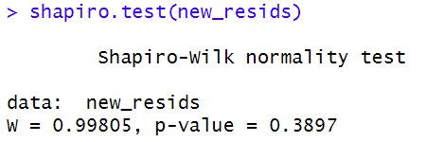
RQ3: Model Building (1)
Formatting: Zach​
Content: Saksham
Before Box-Cox transformation, model has non-normal residuals
After Box-Cox residuals are normal.
Y: Position in Shazam Charts
X1: Acousticness
X2: Valence
X3: Energy
Before Box-Cox
After Box-Cox
Notes:
Saksham

Slide 19
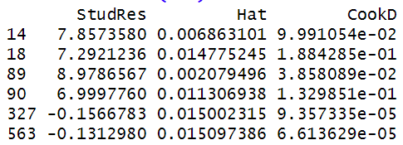

RQ3: Model Building (2)
Formatting: Zach​
Content: Saksham
There are 6 influence points, all with low Cook's Distance
VIF values show no multicollinearity
Influential points
After Box-Cox
Notes:
Saksham

Slide 20
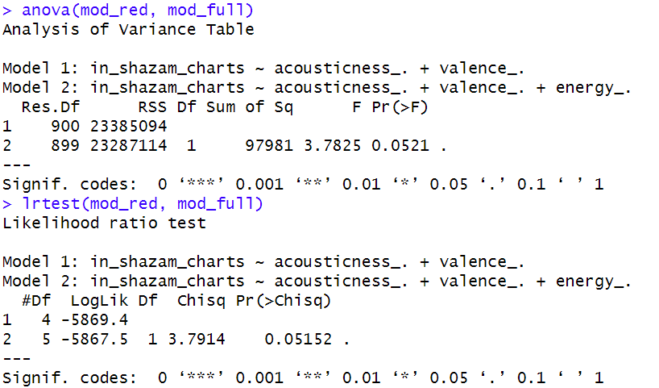
RQ3 Results
Formatting: Zach
Content: Saksham
Test performed:
Both test reject the Null Hypothesis at a 94.8% confidence interval.
Interpretation:
Overall, the full model is better.
Notes:
Saksham

Slide 21
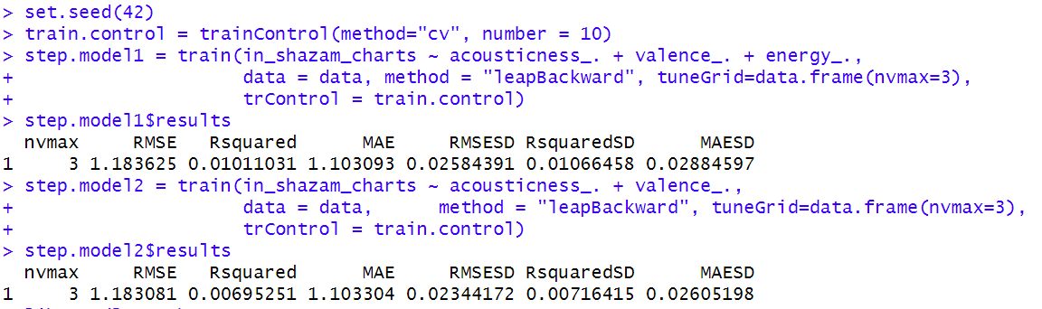
RQ3: Validation
Formatting: Zach​
Content: Saksham
K-fold cross validation results:
These show that the full model is better
Notes:
Saksham
Explain why SLR models where bad. Explain why models with 2 variables were bad
Mention ANOVA Type I

Slide 22
RQ4:
Formatting: Zach and Saksham
Content: Zach
Reasoning:
It would make sense that songs that are popular on Apple Music, Shazam, and Deezer would also be popular on Spotify.
Hypothesis: Songs that are not on Deezer's charts (X3=0) and songs that are (X3=1) have the same average Spotify chart ranking (Y) for any ranking in Apple Music's (X1) and Shazam's (X2) Charts
H0: β₅=β₆=β₇=0
Reduced model:
Y_{i}= β₀+β₁X_{i1}+β₂X_{i2}+β₃(X_{i1})²+β₄(X_{i2})²
Ha: Not H0
Full model: Y_{i}= β₀+β₁X_{i1}+β₂X_{i2}+β₃(X_{i1})²+β₄(X_{i2})²+β₅X_{i3}+β₆X_{i1}X_{i3}+β₇X_{i2}X_{i3}
Notes:
Zach

Slide 23
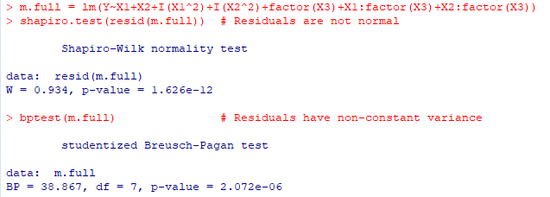
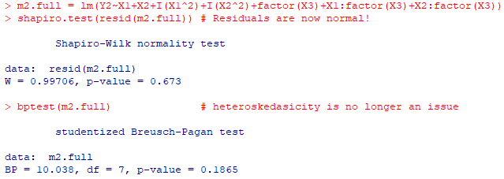
RQ4: Model Building (1)
Formatting and Content: Zach
Full model has non-normal and non-constant variance issue with the residuals
Box-Cox transformation with lambda=.262623, both are fixed
Y: Position in Spotify Charts
Y2: Y after a Box-Cox Transformation
X1: Position in Apple Charts
X2: Position in Shazam Charts
X3: Presence in Deezer Charts
Before Box-Cox
After Box-Cox
Notes:
Zach

Slide 24

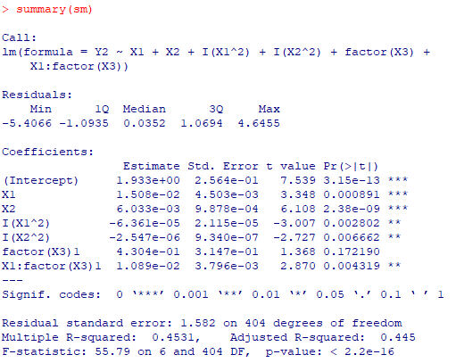
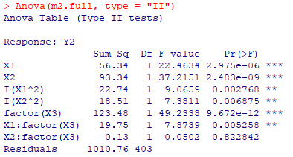
RQ4: Model Building (2)
Formatting and Content: Zach
12 influential points
No major multicollinearity issues
Type 2 ANOVA shows that only X2:factor(X3) has little marginal effect on the residuals
Since there is a categorical variable, we use stepwise model selection. Stepwise model selection only removes X2:factor(X3)
This agrees with the Type II ANOVA Table
Notes:
Zach

Slide 25
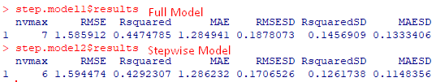
RQ4: Validation
Formatting and Content: Zach
Using K-fold cross validation, we can see:
Higher RMSE and lower R Squared values
But there are lower RMESD and R Squared SD values
Overall, the selected model is better
Notes:
Zach

Slide 26
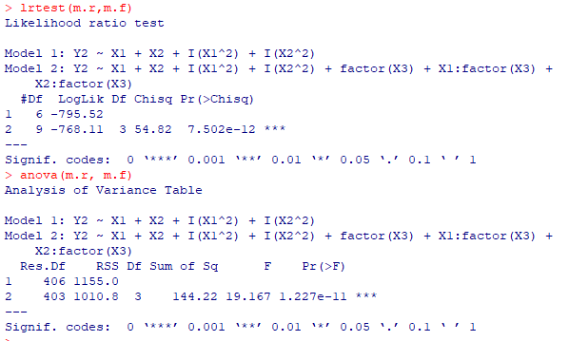
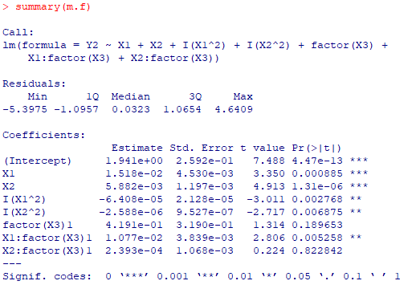
RQ4 Results
Formatting and Content: Zach
Test performed:
Both test reject the Null Hypothesis
Interpretation:
The presence of a song on Deezer's charts has significant linear impact on the song's placement in Spotify's Charts
According to the summary, the interaction effects are both positive, so we can say that they have a positive effect on the song's chart placement
Notes:
Zach

Slide 27
Conclusions
RQ1:
Newer songs garner fewer Spotify streams.
Late-year and month releases correlate with increased streaming.
RQ2:
Audio features like BPM, mode, energy pose challenges in predicting Spotify chart positions.
Potential influence of other predictors or diverse genres complicates predictions.
RQ3:
Song energy significantly influences Shazam chart rankings.
RQ4:
Presence on Deezer's charts is a consistent predictor of Spotify positions.
Formatting: Zach
Content: Jiya

Slide 28
Thank you!

