Slide 1
Matching Algorithms in Clinical Data: From Confounding to Causal Insight

Slide 2
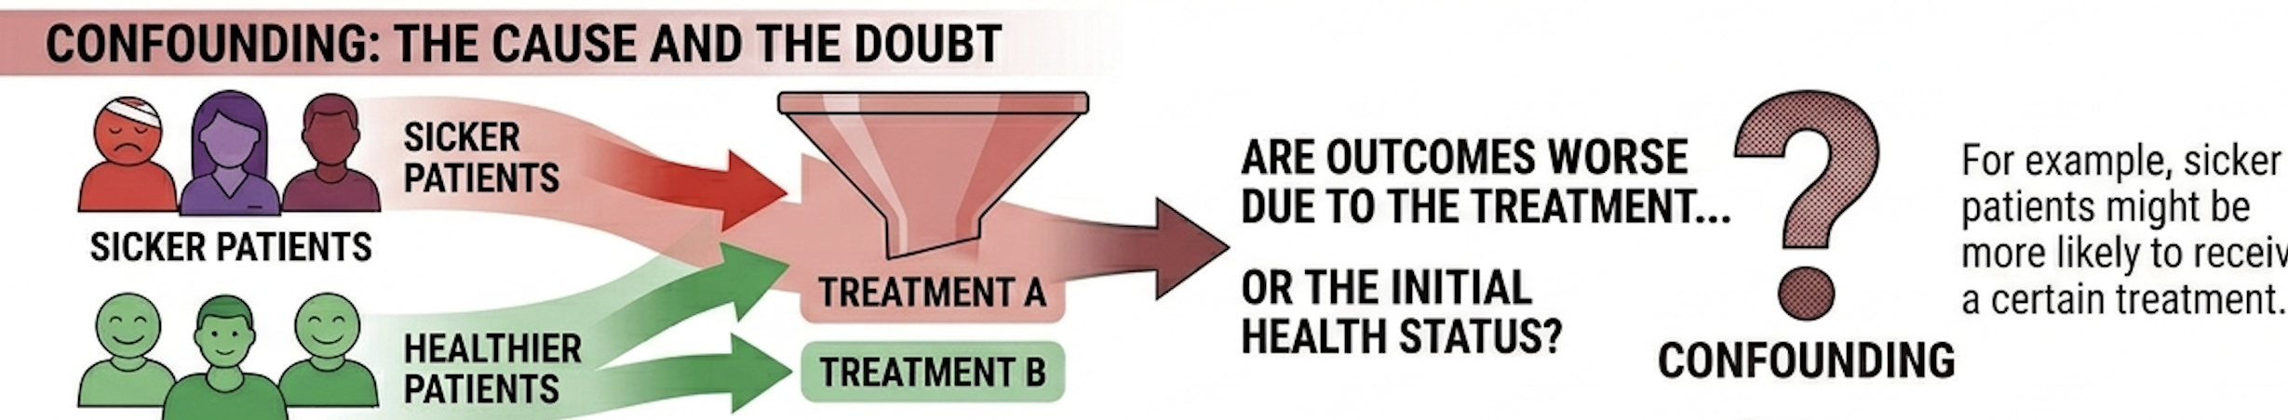
Why Matching Matters?
Clinical question framing:
“Does treatment A improve outcomes vs treatment B?”
Problem:
Randomized controlled trial ≠ Observational data
Confounding: The cause vs the doubt
Treatment assignment is not random.

Slide 3
Goal of matching
Create comparable groups to approximate a randomized controlled trial
Q: Can you think of an example in your own practice where treatment choice is biased?

Slide 4

Key Concepts
Treatment vs Control
Confounders: Variables influencing both treatment and outcome
Ask yourself: Would this variable influence my treatment decision AND patient prognosis?
If yes → it’s a confounder
Bias in observational data
Goal of matching: balance covariates between groups

Slide 5
Exact Matching (Strict criteria)
Match identical covariates
Same age/severity/comorbidities
Coarsened Exact Matching (CEM)
Groups variables into bins
Performs exact matching on those bins
Ex. age 30–40 instead of exact age
✔ Very interpretable
✘ Often impractical with many variables (data becomes sparse)

Slide 6
Matching methods have four key steps
Defining a distance measure
Implementing a matching method given that measure of closeness
Assessing the quality of the resulting matched samples
Analysis of the outcome of the treatment effect

Slide 7
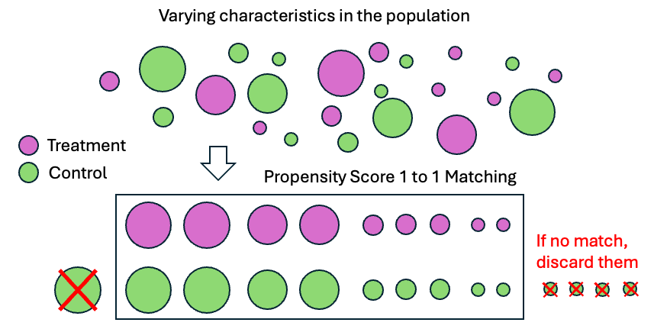
Propensity Score Matching
The probability that a patient receives treatment, given their characteristics
Logistic regression

Slide 8
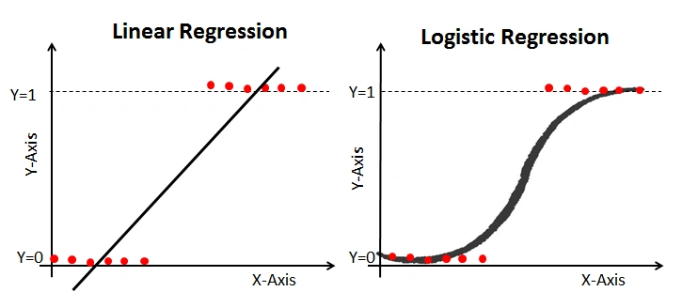
Logistic regression
Fundamental ML algorithm used for binary classification by modeling probabilities using a sigmoid function
Probability of receiving treated
Severity score

Slide 9
Mahalanobis Distance Matching: A ‘smart’ distance
Problem:
Not all variables are on the same scale
And some variables are correlated
For example: Age (range: 20-90), lab values (very different scales) or clinical scores
Clinical Interpretation
This is especially useful when:
Variables are correlated (e.g., BMI and diabetes)
Variables have very different scales
You want more precise matching

Slide 10
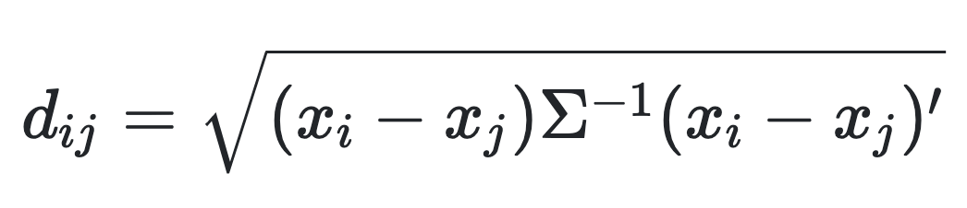
Mahalanobis Distance
The Mahalanobis distance is computed as
Where
i and j are two patients
Each represented by a vector x of variables
Σ is covariance matrix of the covariates

Slide 11
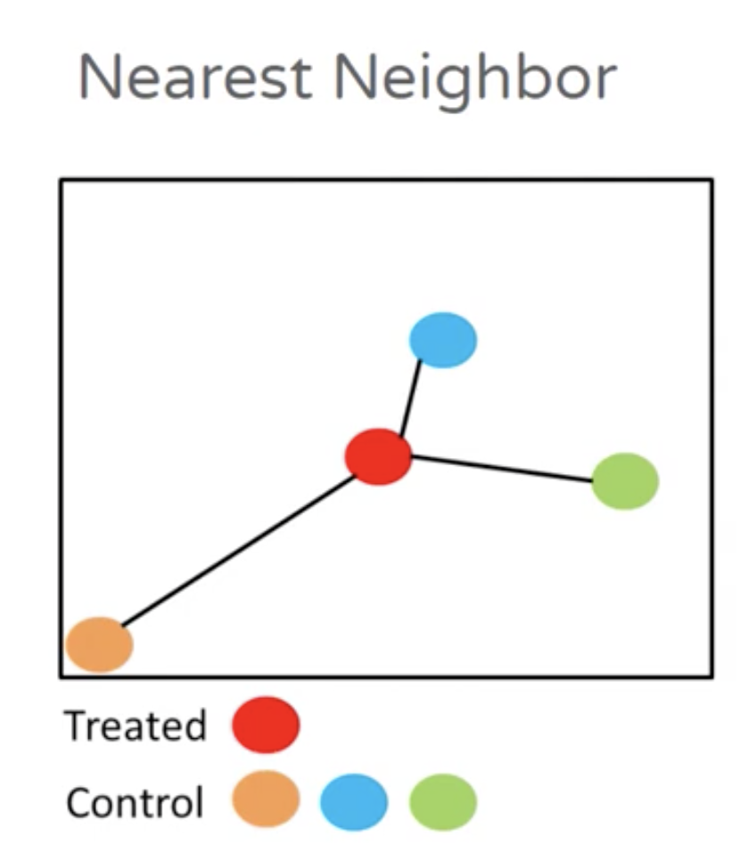
Nearest neighbor matching
1. Define similarity
You first decide how to measure “closeness”:
Difference in propensity scores (most common)
Or a multivariate distance like Mahalanobis Distance
2. For each treated patient:
Compute distance to all control patients
Select the control with the smallest distance
3. Form matched pairs (or sets)
1:1 matching → one control per treated
1:k matching → multiple controls per treated

Slide 12
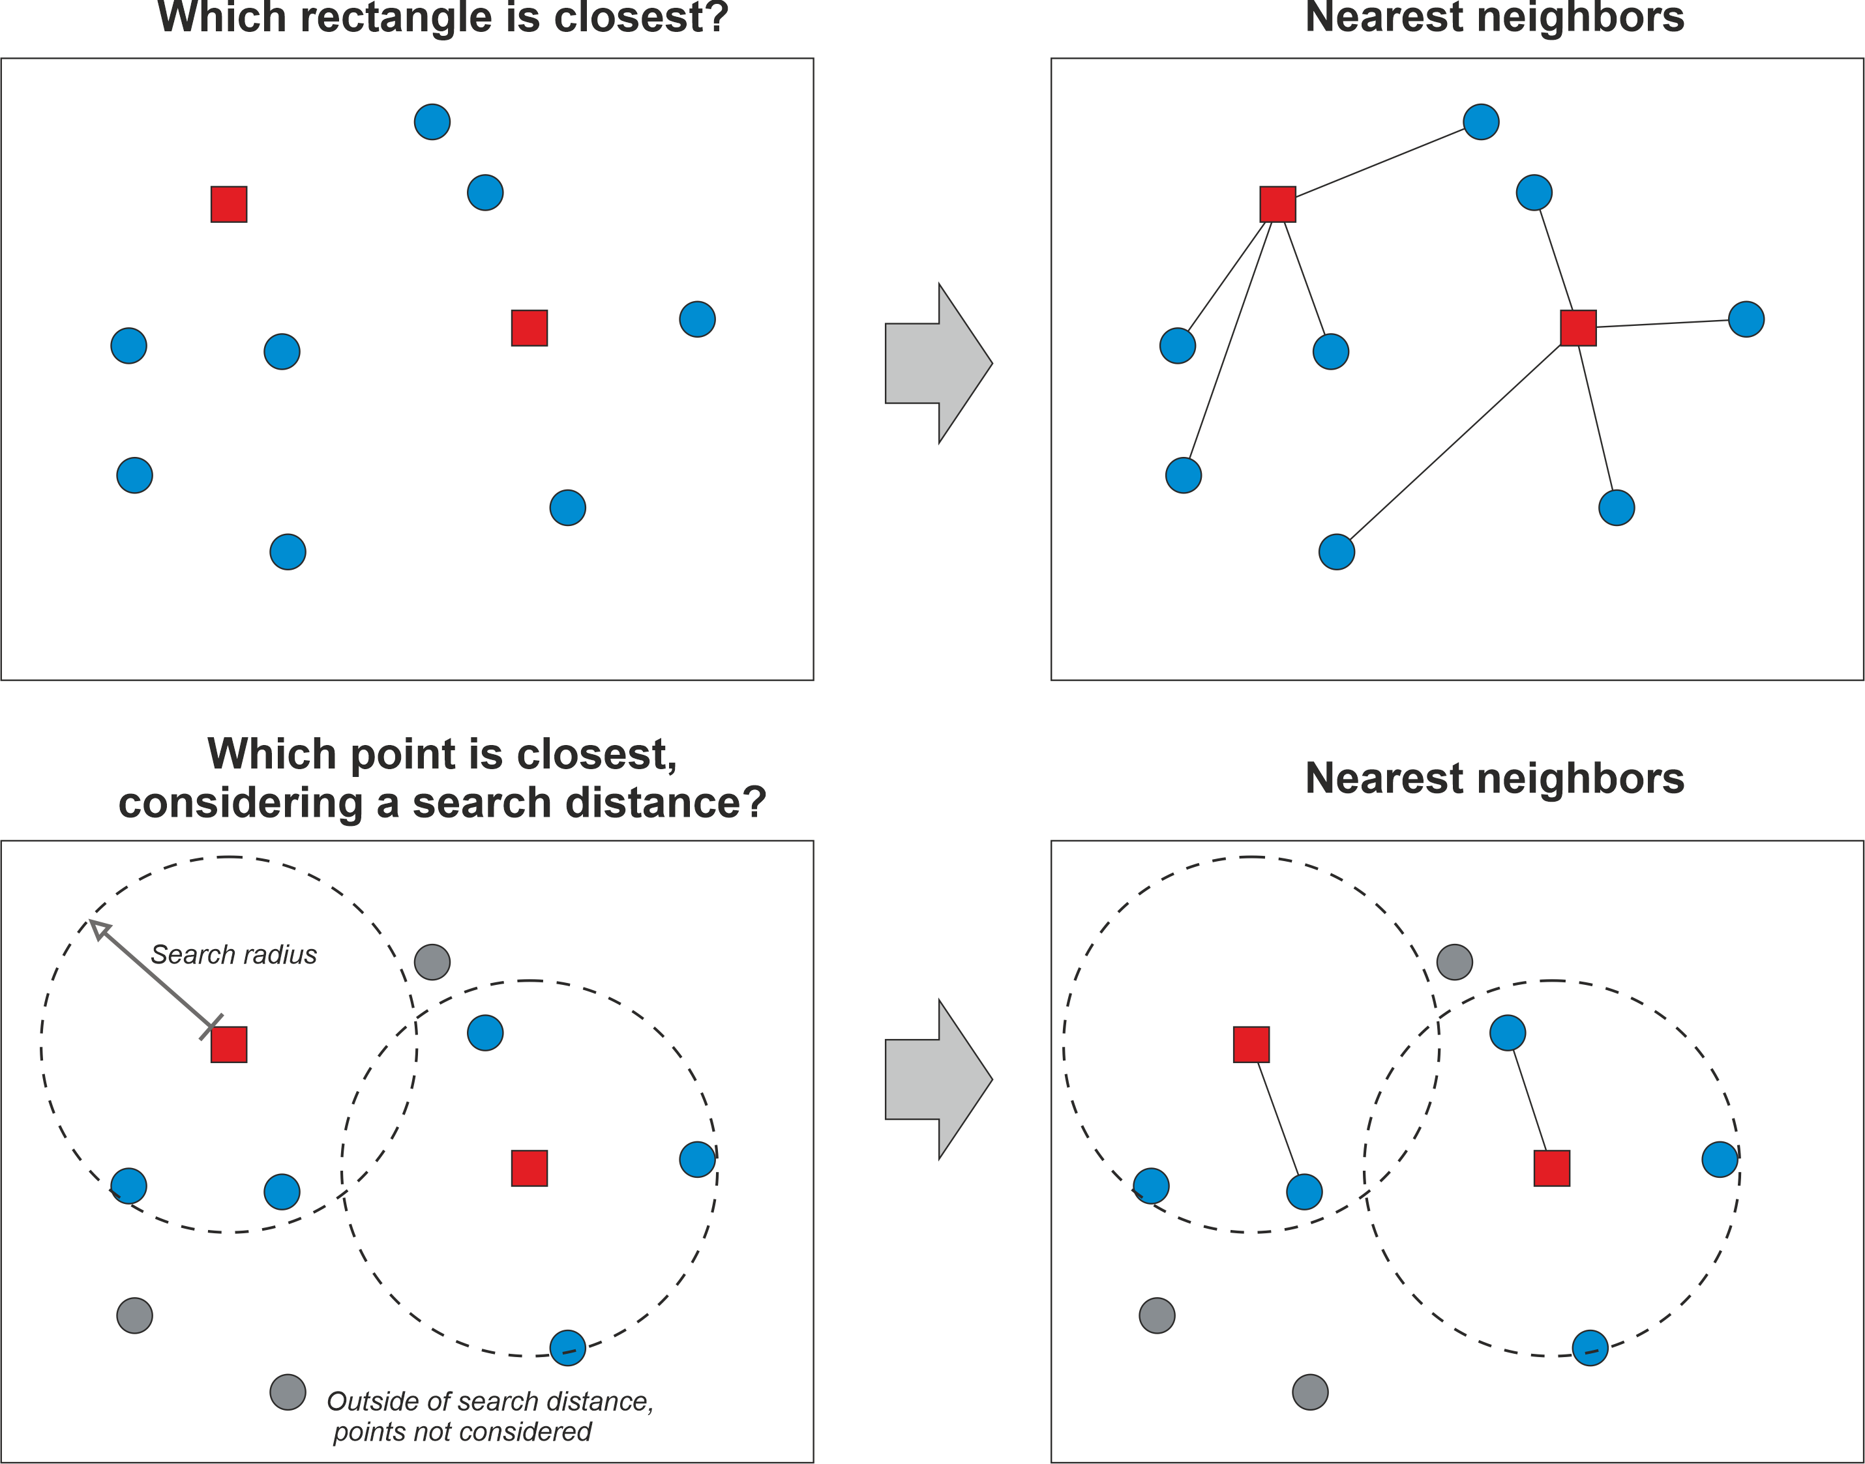
Nearest neighbor matching
Treated
Control

Slide 13
Advanced Matching Methods
Kernel Matching / Weighting
Instead of matching pairs, assigns weights to all controls based on similarity
Genetic Matching
Uses optimization algorithms to find the best balance across covariates
Iteratively improves matching quality
✔ Very powerful ✘ Computationally intensive

Slide 14
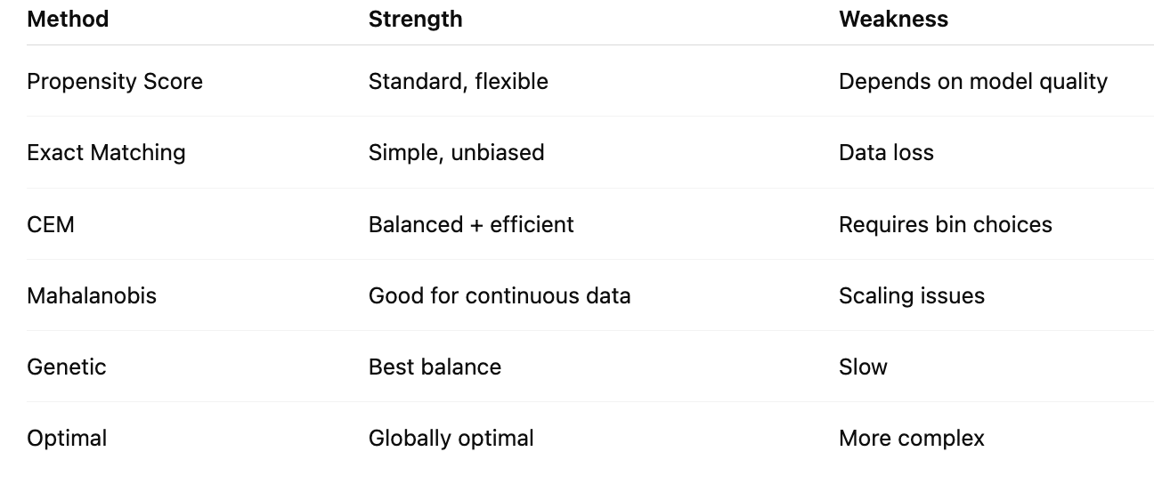
Quick summary

Slide 15
Workflow
Define treatment & outcome
Select covariates
Estimate propensity scores
Match
Check balance
Estimate effect

Slide 16
Hands-On Exercise: Match patients manually
Scenario: You are studying whether a new treatment improves outcomes
Dataset of 6 patients:
Patient | Treatment | Age | Severity | Outcome
1 | Yes | 70 | High | 0
2 | Yes | 65 | High | 1
3 | Yes | 60 | Medium | 1
4 | No | 40 | Low | 1
5 | No | 45 | Low | 1
6 | No | 50 | Medium | 1
Identify Bias:
What differences do you notice between groups?
Who is more likely to receive treatment?

Slide 17
Limitations
Unmeasured confounders
Poor overlap
Sample size reduction
Not perfect causal inference

Slide 18
Takeaways
Matching improves comparability
Always check balance
Use as a tool, not a conclusion

Slide 19
Setup for today’s exercise
Install RStudio
Go to https://posit.co/download/rstudio-desktop#download and follow step #2
2. Open RStudio and install the required packages with the following line of code:
install.packages(c('tidyverse', 'MatchIt', 'cobalt'))

