Slide 1
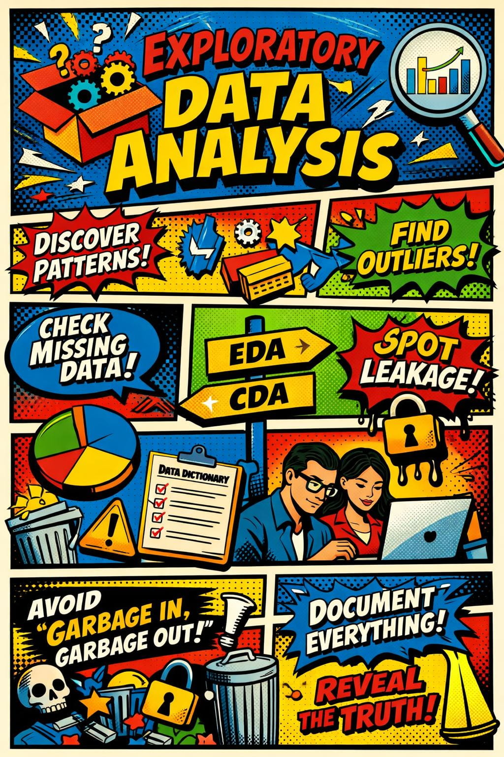
Exploratory Data Analysis (EDA)
Focused on genomics and retrospective clinical data analysis
Goal: The goal is to help you avoid the most common, and costly, mistakes before formal analysis even begins

Slide 2
EDA is not just “plots”
Avoid false discoveries
Detect bias and confounding
Guide modeling decisions

Slide 3
EDA Core Principles
1. Understand data structure
What are the basic characteristics of my dataset?
How many observations (rows) and variables (columns) are there?
What types of data are present (numerical, categorical, etc.)?
Do I need to convert any data type?

Slide 4
EDA Core Principles
2. Checking Data Quality
Are there missing values? If so, why might they be missing?
What percentage of the data is missing? Should I drop these rows or replace them with something like the mean?
Are missing values related to another column? If so, how does it affect the drop of missing values?
Are there duplicate records?
Are there any impossible values (e.g., negative ages)?

Slide 5
EDA Core Principles
3. Preparing the Data
Do I need to transform the data?
Should categorical variables be converted into dummy variables (one-hot encoding)?
Is the data scaled appropriately, or does it need normalization?

Slide 6
EDA Core Principles
4. Identifying Patterns
What’s the range, mean, median, and standard deviation of the data?
Are there any outliers?
Are there relationships between variables (e.g., correlations, covariation)?
Are there patterns or trends over time (e.g., seasonality or anomalies)?

Slide 7
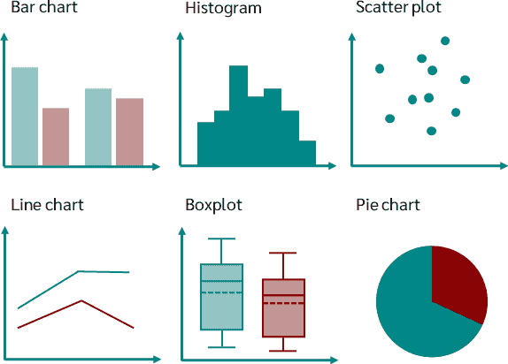
Core EDA Toolkit
Histograms & density plots → distributions
Boxplots & violin plots → group comparisons
Scatter plots → relationships
Correlation matrices → dependencies
Dimensionality reduction (PCA/UMAP) → structure in high dimensions

Slide 8
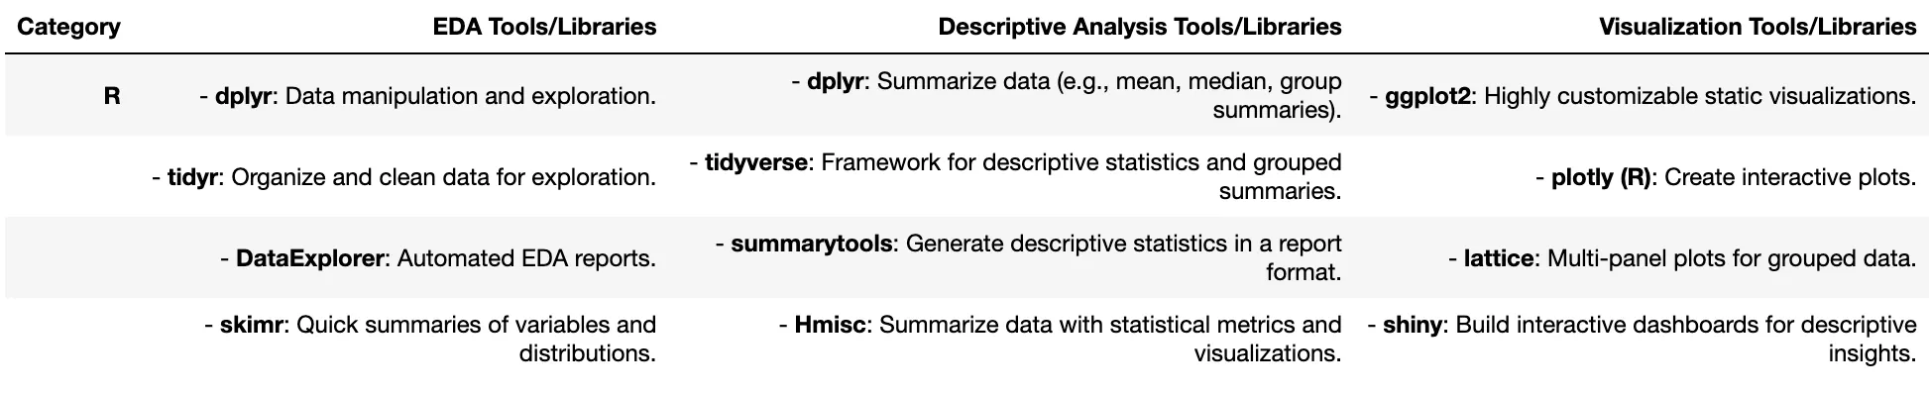
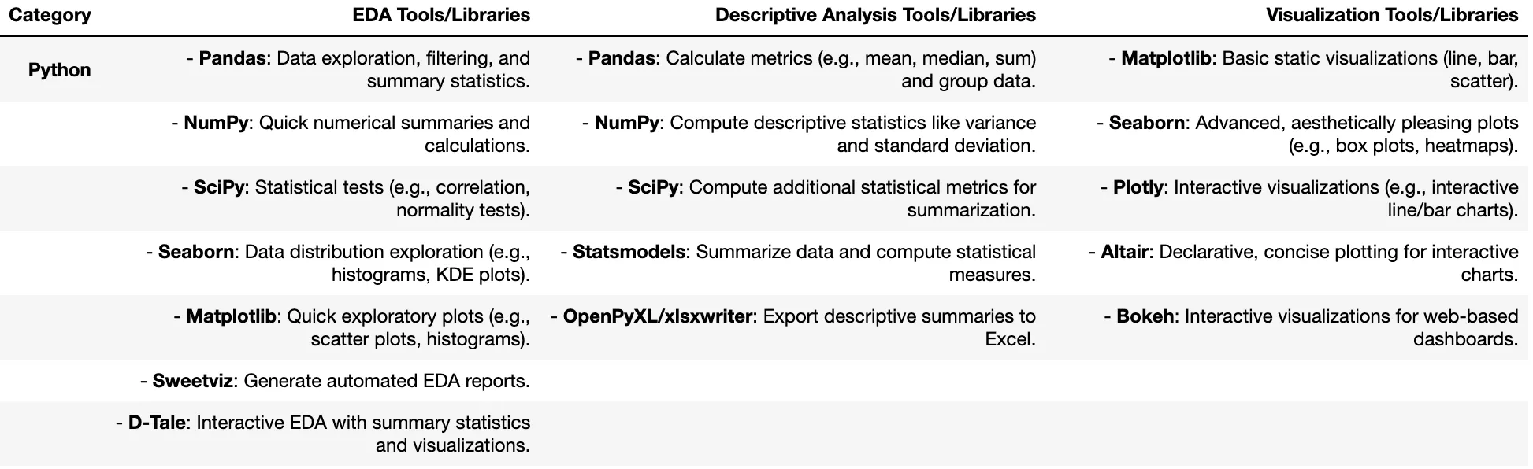
Helpful Tools for Data Analysis and Visualization
R tools
Python Tools

Slide 9
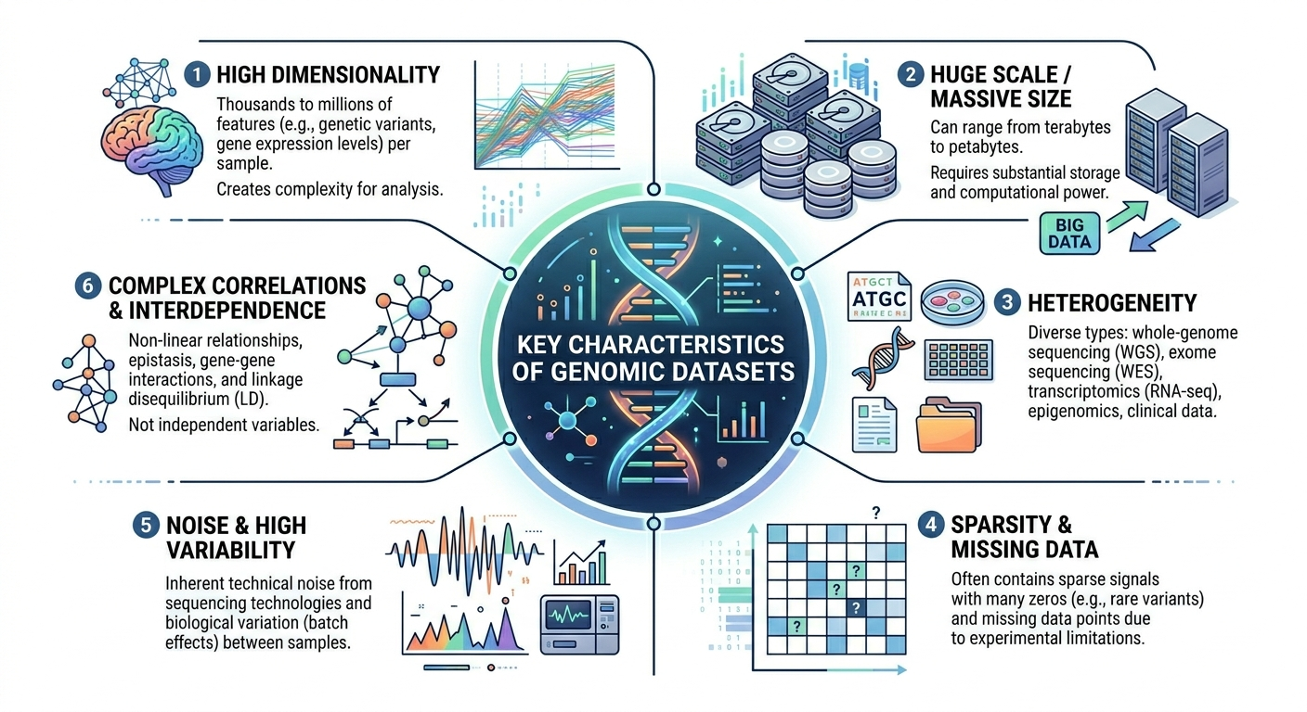
Genomics Data Context

Slide 10
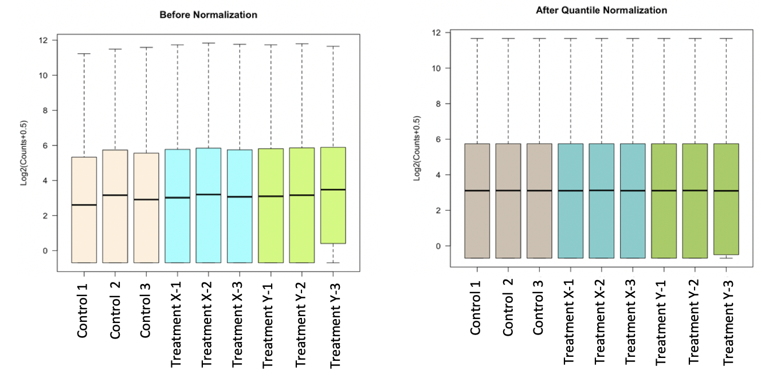
Genomics Data Context
Quality Control
Sequencing depth (library size)
Number of detected genes
Mitochondrial gene percentage in single-cell data
Normalization
Raw vs normalized counts
Log transformation
Distribution checks

Slide 11
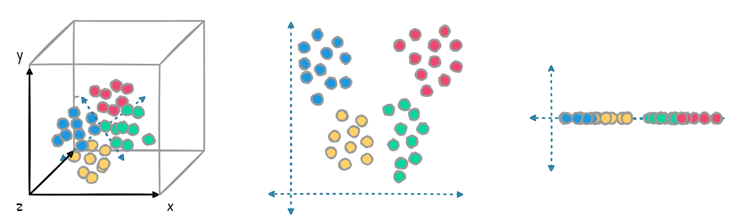
Genomics Data Context
Dimensionality reduction
Reduces the number of input variables in a dataset while retaining the most important information
PCA: Identifies orthogonal directions (principal components) that maximize variance
Ex: Detect outliers or batch effects vs biology

Slide 12
Genomics Data Exploration
Gene expression boxplots by condition
Heatmaps of variable genes
Candidate biomarkers

Slide 13
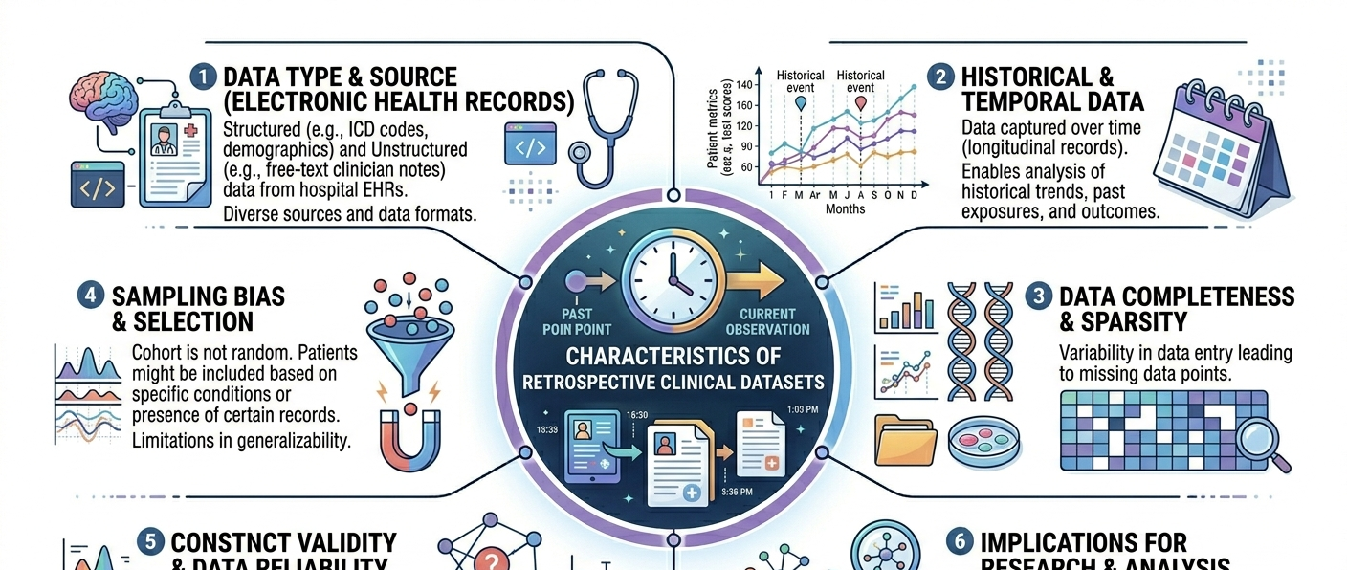
Clinical Data Context

Slide 14
Clinical: Cohort Description
Cohort Description
Age distribution, sex, and comorbidities
Missing data patterns
Group Comparability
Are they similar at baseline?
Outcomes
Kaplan-Meier curves (survival)
Event rates (frequency of clinical outcomes)
Censoring (unknown exact time-to-event)
Relationships
Scatter plots and correlations
Ex. Lab values vs outcome or Age vs treatment

Slide 15
Key Takeaways
EDA prevents false conclusions
Visualization guides modeling
Always question patterns → What else could explain this pattern?

Slide 16
Hands-On Exercise
Objective: In this exercise, you will apply what you learned in Module 3 to perform exploratory data analysis (EDA) on your own dataset(s). You may use any programming language (e.g., R or Python) and development environment (e.g., RStudio or Jupyter Notebook)
Goal: Identify key patterns and trends in your data, inform downstream analyses, and generate publication-quality figures that effectively describe your dataset

