Slide 1

Capstone 2: House Price Analysis
Presented to: Thinkful Team Stakeholders
Presented by: Jacob Carter

Slide 2

Analysis Goals
Investors are wanting to find out what factors drive home sale prices
The main goal of the analysis is to determine how the investors should allocate dollars earmarked for investment into mortgage-backed securities
The success of the analysis relies on the ability to identify good and bad investments

Slide 3

Research Questions
What factors affect the sale price of houses the most? The least?
What are the obvious factors that affect sale price?
How do we determine the correlation between the different factors and the sale price?
Based on domain knowledge, research and statistical testing, it will be easier to answer these questions to provide adequate recommendations

Slide 4
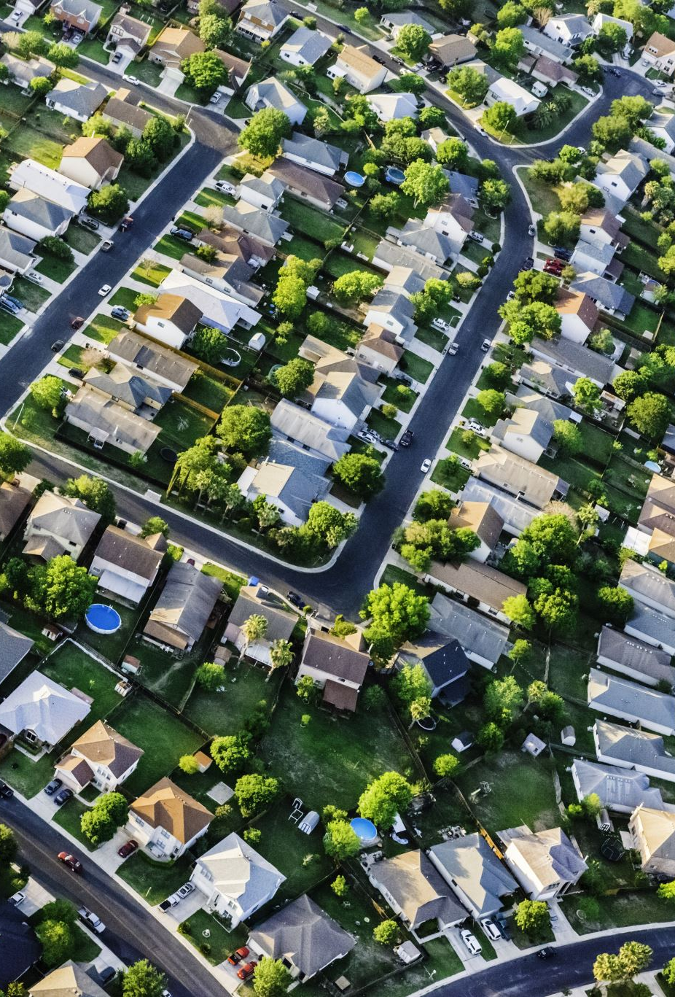
What is the data?
The dataset is a sample of 1,460 houses in Ames, Iowa that were sold between 2006 and 2010
There were a total of 81 columns, with each being a characteristic of a specific house
I utilized the train.csv dataset from Kaggle, which can be found here

Slide 5
Descriptive Statistics

Slide 6
Top Factors That Drive House Prices
These factors were found by utilizing Correlation testing in the Data Analysis ToolPak in Excel, T-tests, along with Pivot tables and visualizations

Slide 7
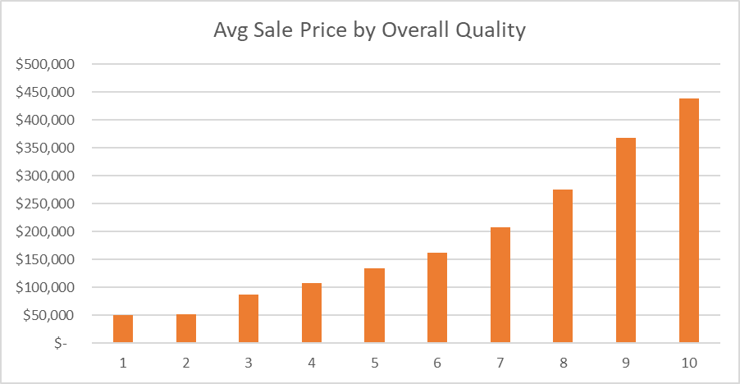
Overall Quality
Correlation of 0.95
T-test: H₀: p = 0, H₁: P < .05
Houses with quality score of 10 vs 8
P-Value = 0.0004
P < 0.5 at 0.0004
This P-value rejects the null hypothesis

Slide 8
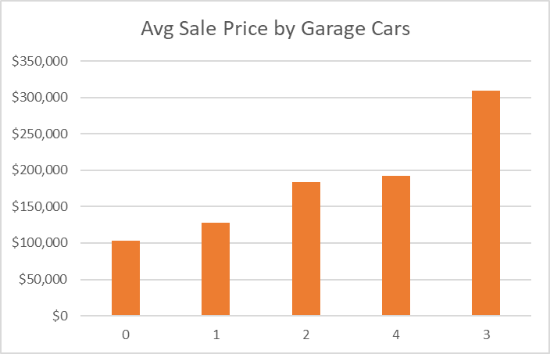
# of Garage Cars
Correlation: 0.64
T-test: H₀: p = 0, H₁: P < .05
Houses with 3 car garage vs 4 car garage
P-Value = 0.005
P < .05 at 0.005
This P-value rejects the null hypothesis

Slide 9
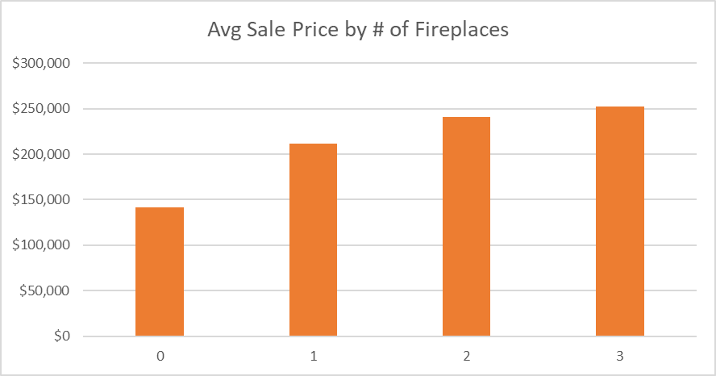
# of Fireplaces
Correlation: 0.93
T-test: H₀: p = 0, H₁: P < .05
Houses with 1 fireplace vs 2 fireplaces
P-Value = 0.01
P < .05 at 0.01
This P-value rejects the null hypothesis

Slide 10
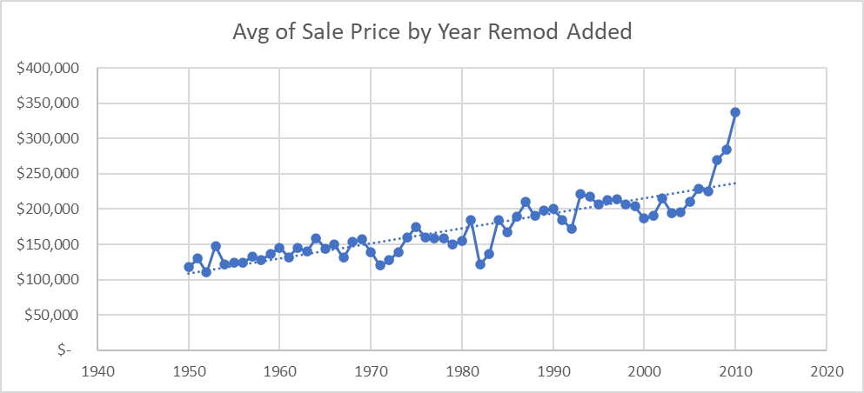
Year Remodeled
Correlation: 0.85
T-test: H₀: p = 0, H₁: P < .05
Houses remodeled in 2010 vs 2000
P-Value = 0.08
P > .05 at 0.08
This P-value fails to reject the null hypothesis
High correlation, but lower P value. You can see a gradual average sale price increase, followed by a sharp increase in the beginning of the century

Slide 11
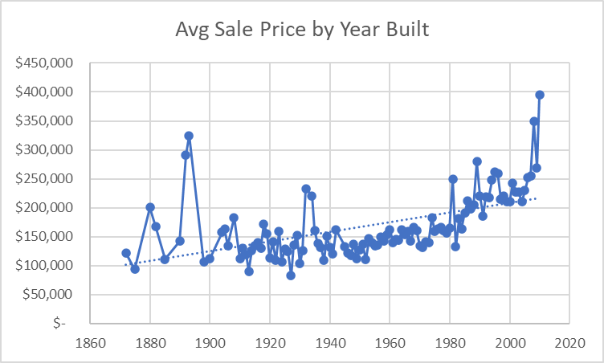
Year Built
Correlation: 0.53
T-test: H₀: p = 0, H₁: P < .05
Houses built between 1990-1999 vs 2000-2010
P-Value = 0.09
P > .05 at 0.09
This P-value fails to reject the null hypothesis
Moderate correlation, but lower P value. You can see a sharp increase in the beginning of the century

Slide 12

Business Recommendations
When allocating the firm’s investment dollars, prioritize investing in houses that have the following characteristics, as they have an impact on the average sale price (determined by my analysis):
A higher overall quality
A bigger garage that can hold more cars
More fireplaces
More recently remodeled
More recently built

Slide 13

Questions?
Thank you!

