Slide 1
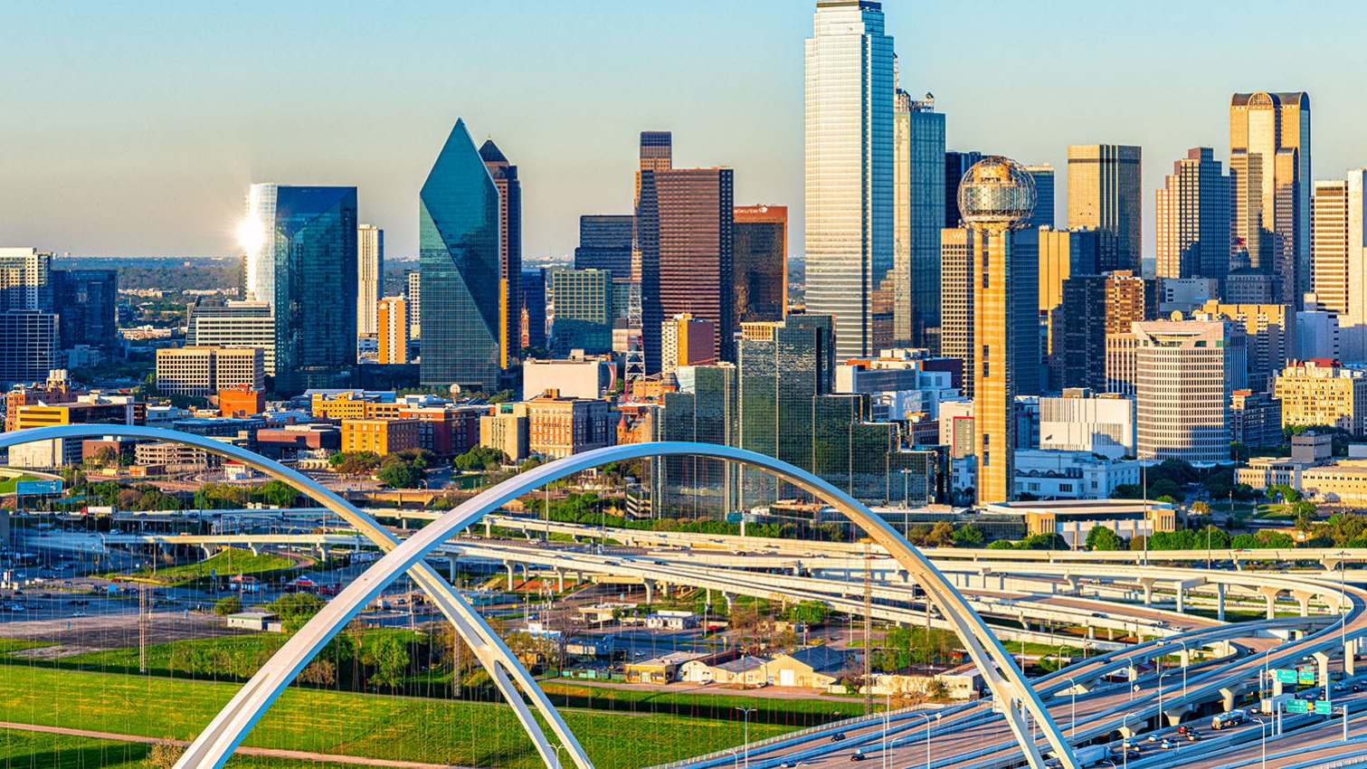
Mapping Vehicle Emission Exposure and Infrastructure Inequity Across Dallas-Fort Worth
GEOG 469 – Applications of Geographic Information Systems
Rei Almaraz, Micheal Robinson, Carter Jensen, Isaiah Jones, Trent Kiser
Notes:
Isaiah

Slide 2
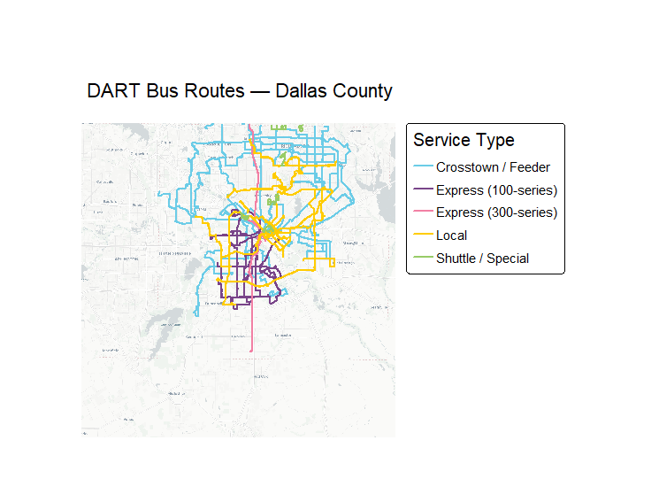
A Look at Existing DFW Transportation
Routes are mainly concentrated around central Dallas
Coverage becomes less connected the farther you go away from the city
Local and Feeder routes focus on neighborhood access
Express routes prioritize faster travel
Map shows that some areas have better transit access than others, making some communities more dependent on cars
Notes:
Rei

Slide 3
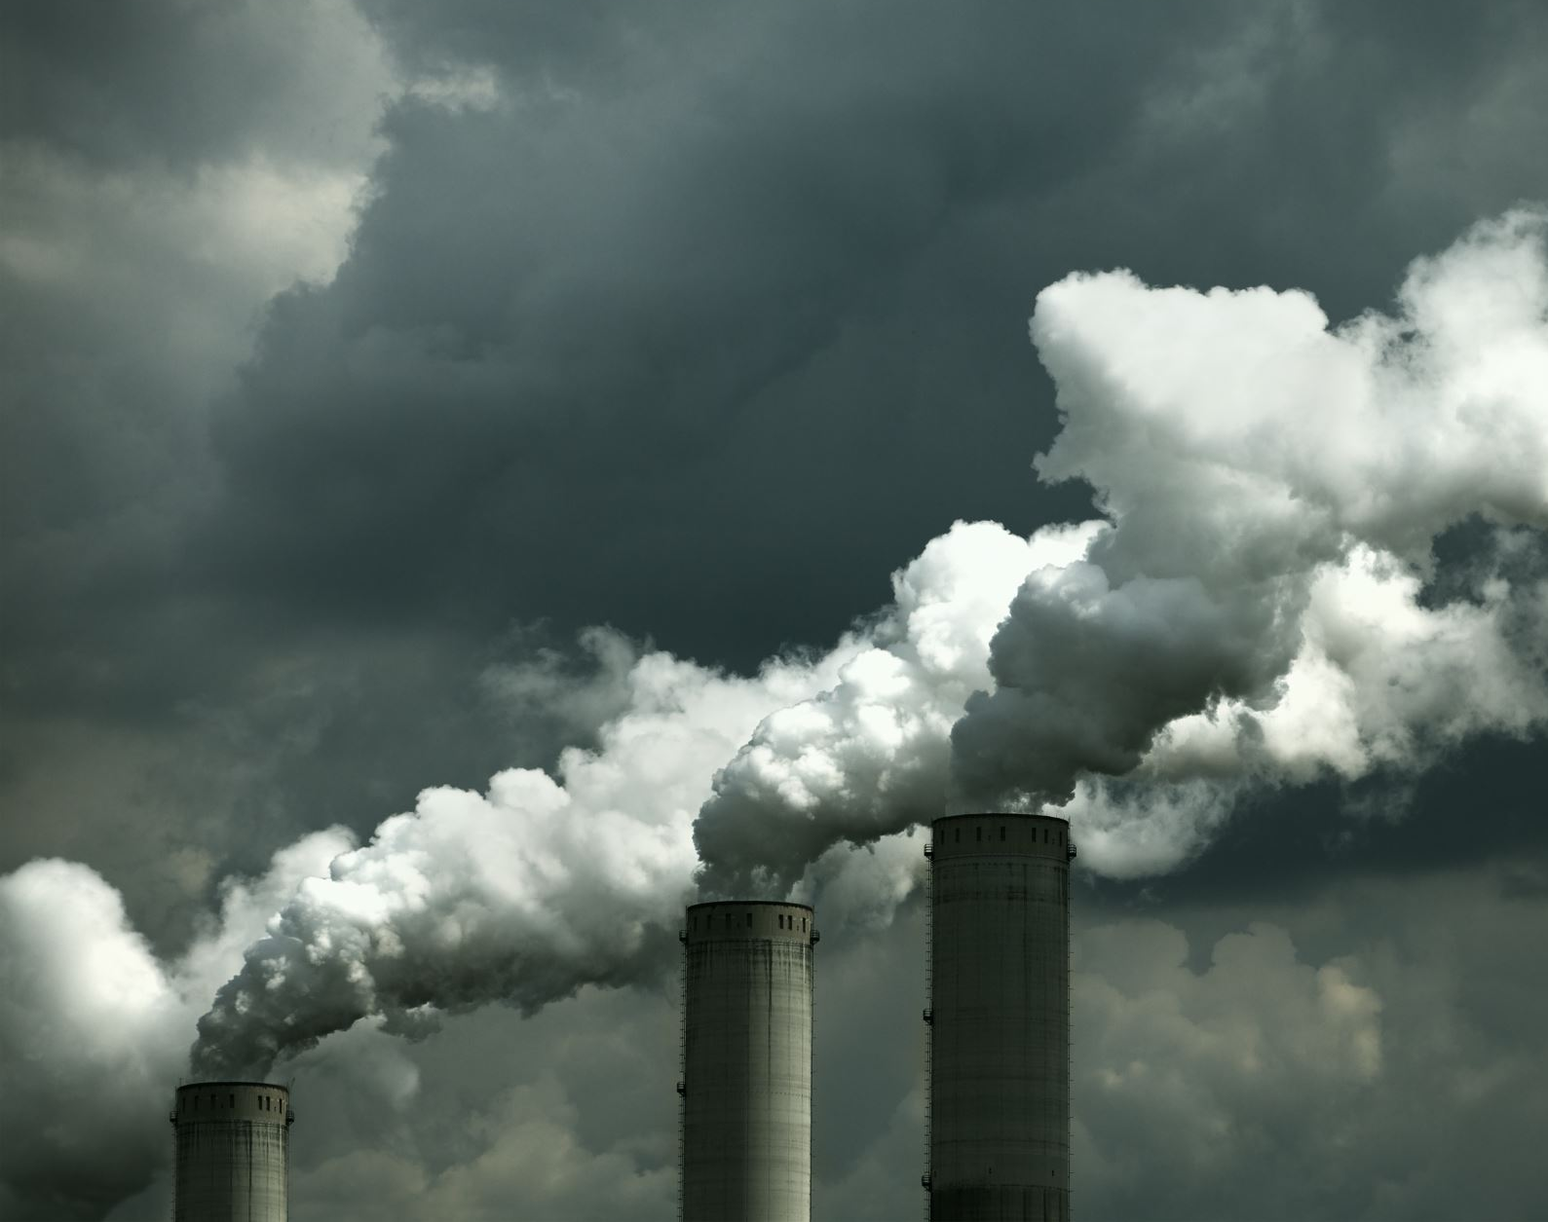
Regional Issues with Emissions
In 2021, the Dallas-Fort Worth area produced 23.8 million tons of carbon dioxide from cars, trucks and automobiles alone
Currently 3rd most carbon emitting metropolitan area, behind New York City and Los Angeles
The region is moving to decrease emissions, lead by the DFW airport on the path to net zero carbon emissions by 2030.
Notes:
https://fortworthreport.org/2023/10/30/does-dallas-fort-worth-rank-third-in-the-world-for-greenhouse-gas-emissions-from-cars/
Micheal

Slide 4

Research Questions
How do traffic volume and roadway density influence the distribution of vehicle emissions?
Which DFW communities are most exposed to these emissions?
How does exposure vary across socioeconomic groups ie. income, race, and population density?
Why are certain populations subject to greater vehicle emission exposure in the Dallas-Fort Worth area
Notes:
Carter

Slide 5
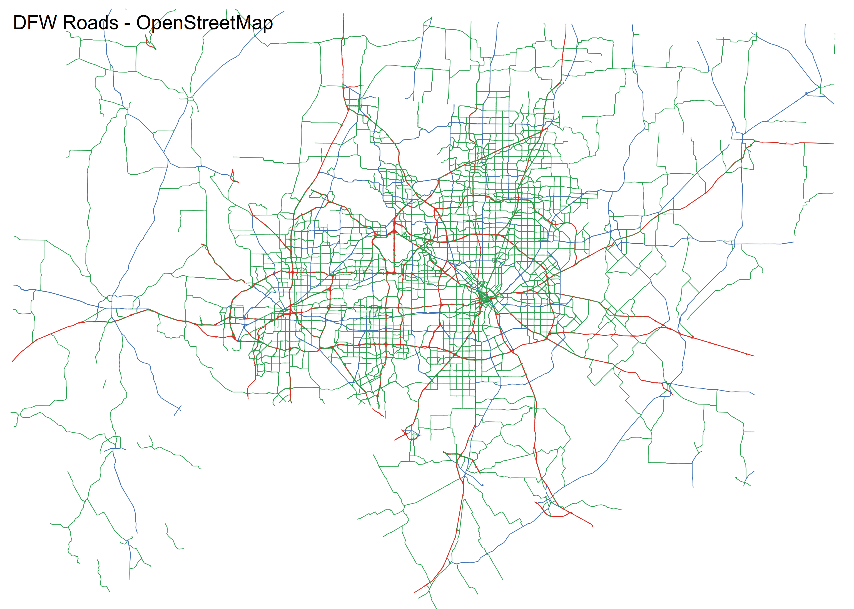
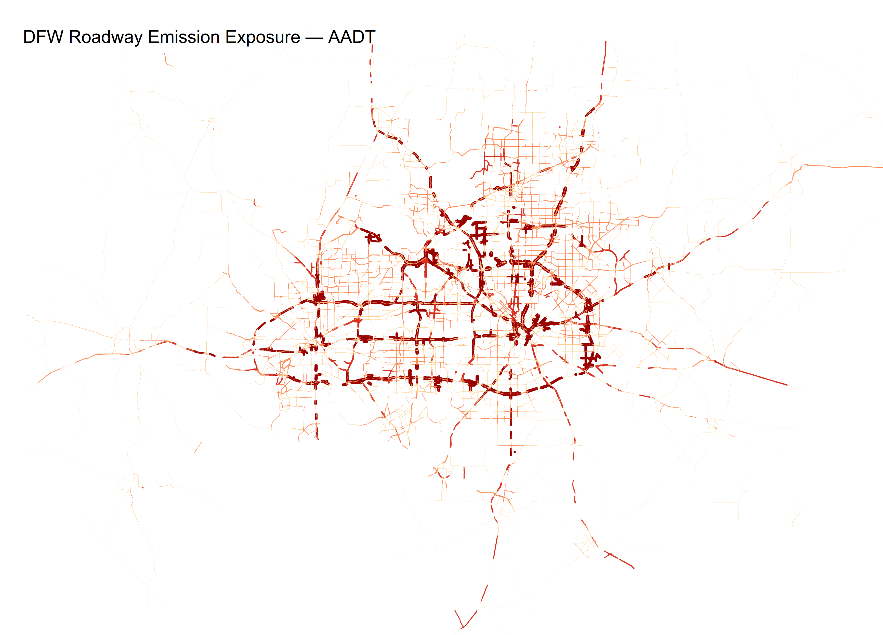
DFW Road Network & Traffic Volume Visualized
Data Sources
OpenStreetMap via osmdata (R) — motorway, primary, and secondary roads across 13 DFW counties
Traffic Volume as Emission Proxy
TxDOT AADT points spatially joined to road segments, higher AADT = higher estimated emission exposure
Road Classification
Highway → Primary Road → Secondary Road; color and line weight reflect traffic volume
Notes:
Carter

Slide 6

Demographics of the DFW Area
Notes:
Micheal

Slide 7
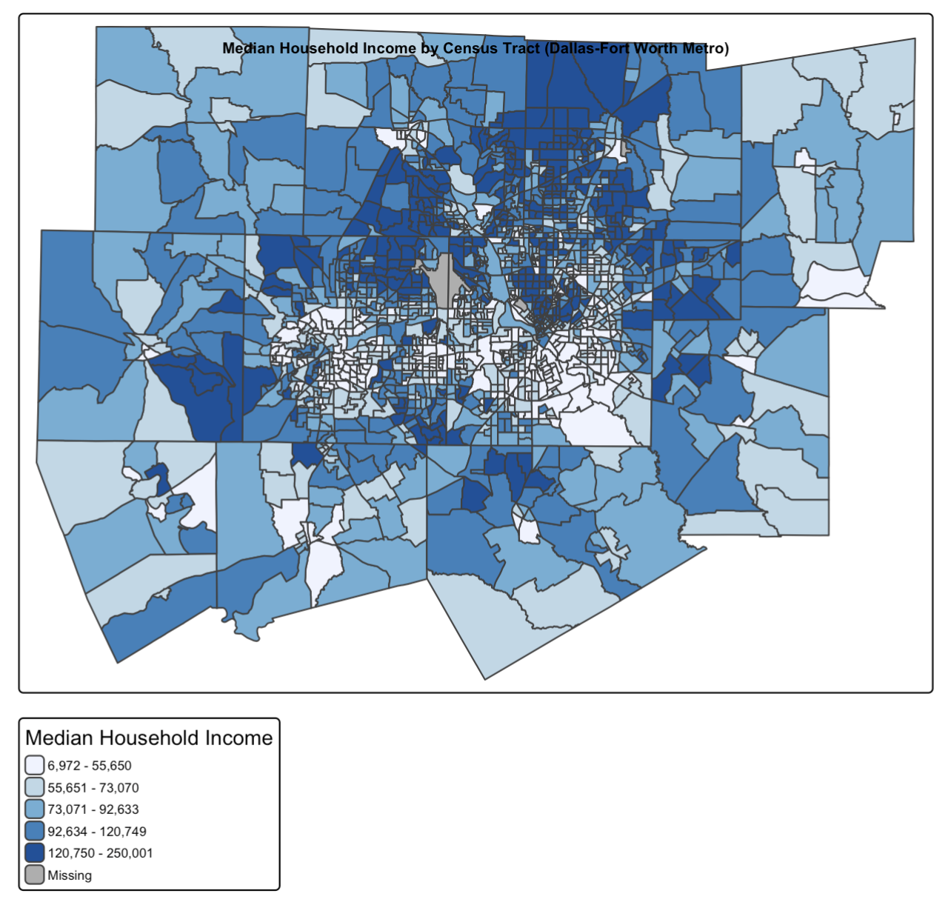
Mapping Census Data
Using Tidycensus package to use data from the US Census Bureau
  Swapping out variables to gain data for Household Income, Population (and density), and Race/Ethnicity
Examined on a census tract level for all 10 counties of the area
Mapped with tmap package as a basic baseline for future analysis/regressions
Notes:
Micheal

Slide 8
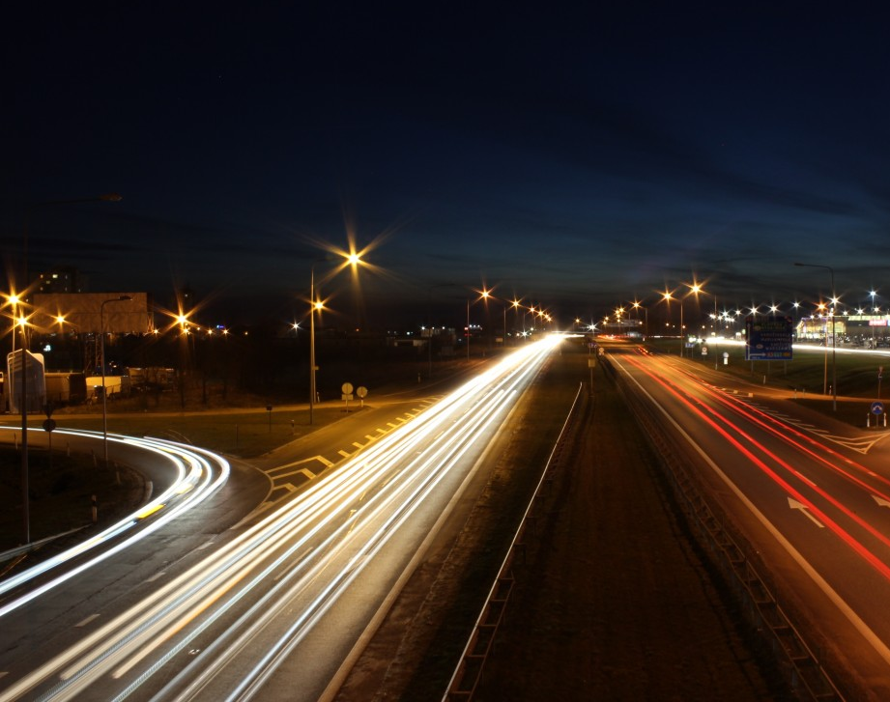
Correlating Census Data with Traffic Volumes
Using H3 cells AADT data from point collections
was extrapolated onto the DFW area with a resolution of 9.
These H3 cells were then overlaid with census tracts, to produce the following maps and graphs.
With this data, we can easily detect which DFW communities are most susceptible to traffic related emissions.
Notes:
Isaiah

Slide 9

Regression Analysis
Tested whether estimated traffic exposure varies across different socioeconomic groups.
Dependent Variable used:
  Estimated traffic exposure score
    based on AADT traffic count values
    summarized by census tract
Independent variables used:
- Median household income
- Population density
- Percent minority population
Notes:
Trent

Slide 10
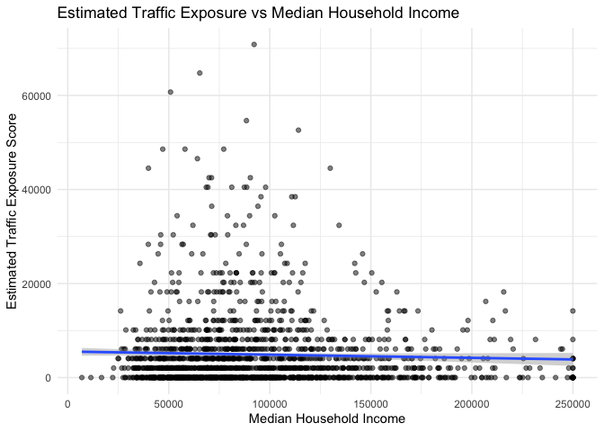
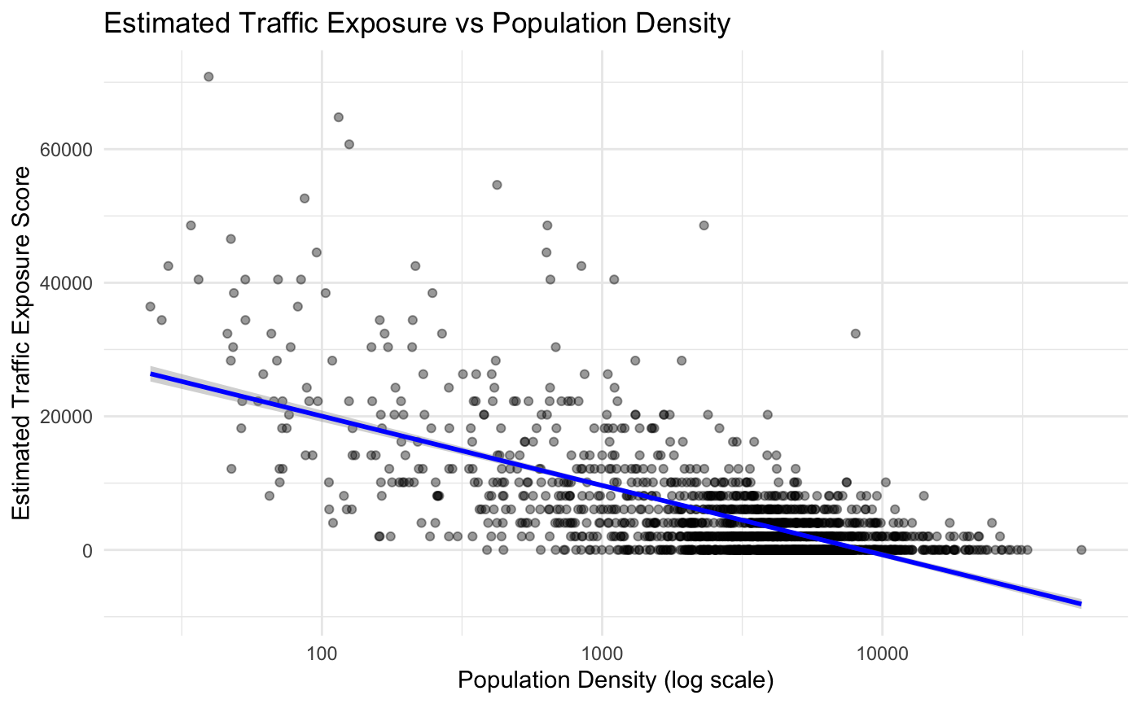
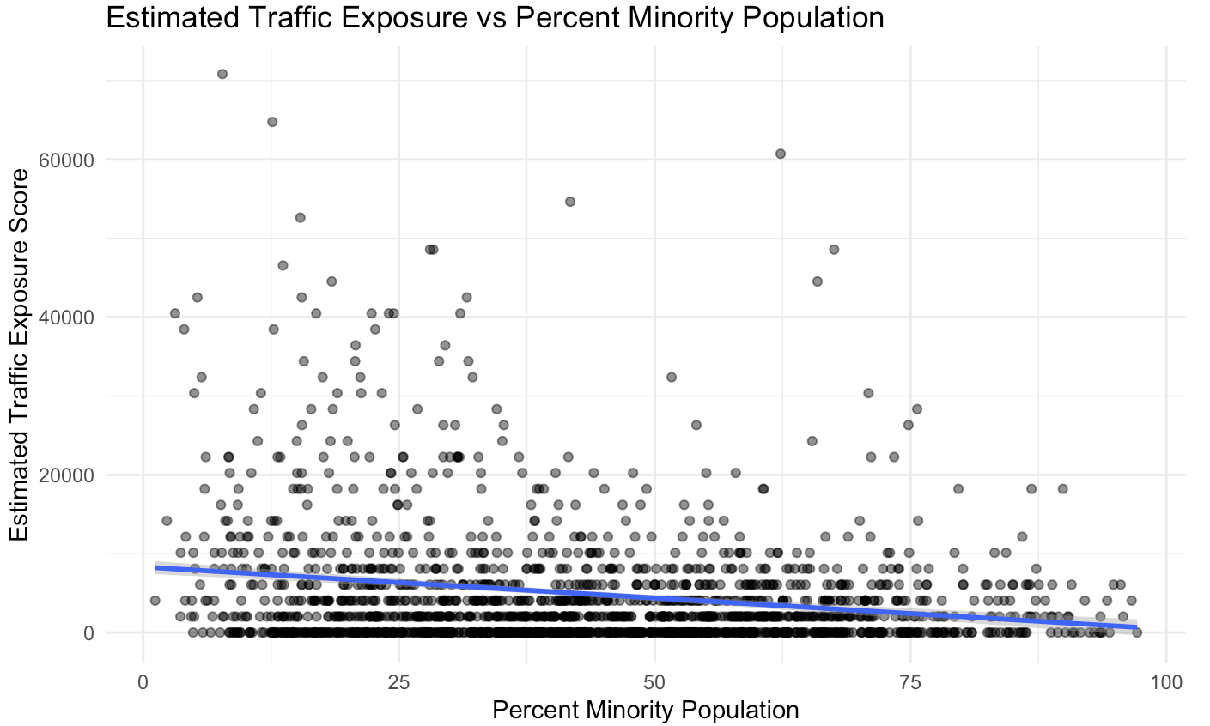
Traffic Exposure Regression Results
Income relationship:
Slight negative trend, relationship appears weak overall.
Notes:
Trent

Slide 11
Regression Conclusion
Regression was used to test whether estimated traffic exposure varied by socioeconomic characteristics.
Median income, population density, and percent minority population showed weak relationships with exposure.
The results do not show a strong socioeconomic pattern in exposure using this model.
Because exposure was estimated from AADT traffic counts, the results should be interpreted as potential exposure, not direct pollution measurement.
Notes:
Trent

Slide 12
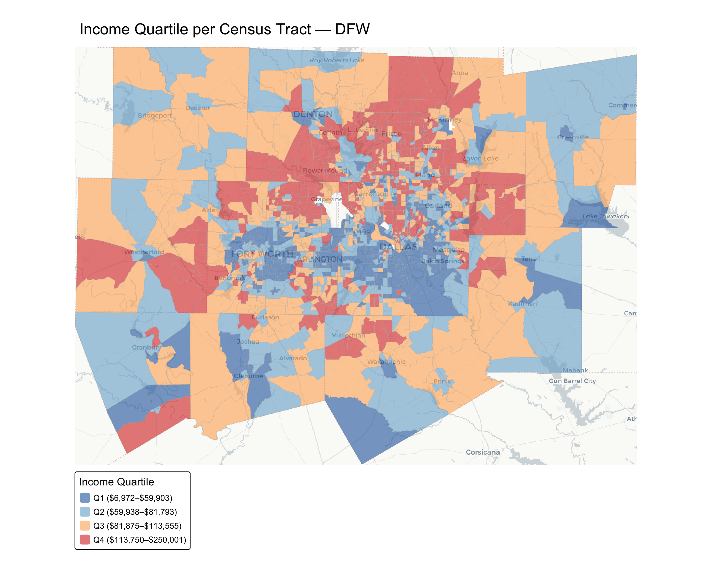
Inner city areas are generally lower income.
Notes:
Rei

Slide 13
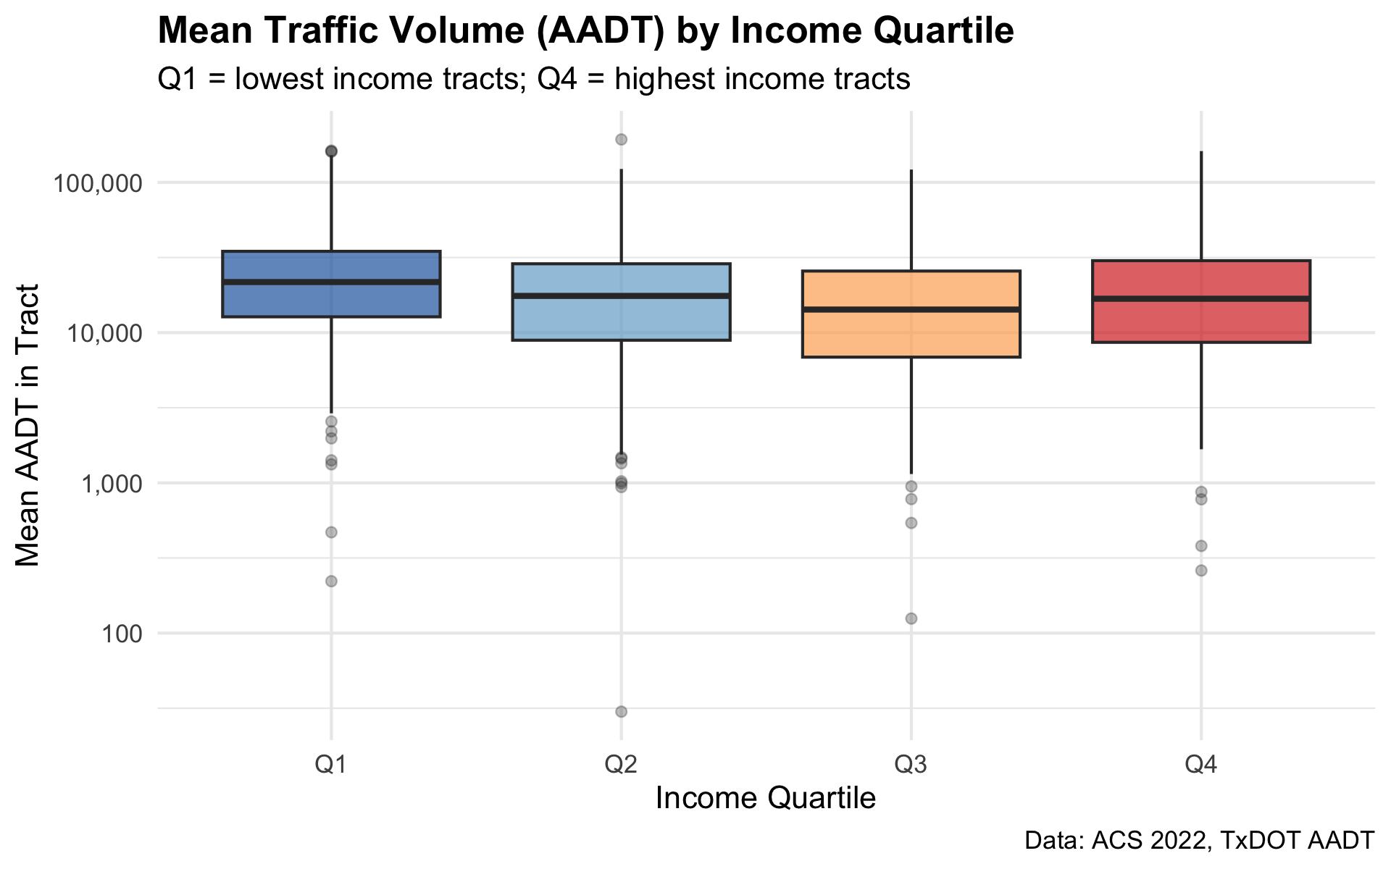
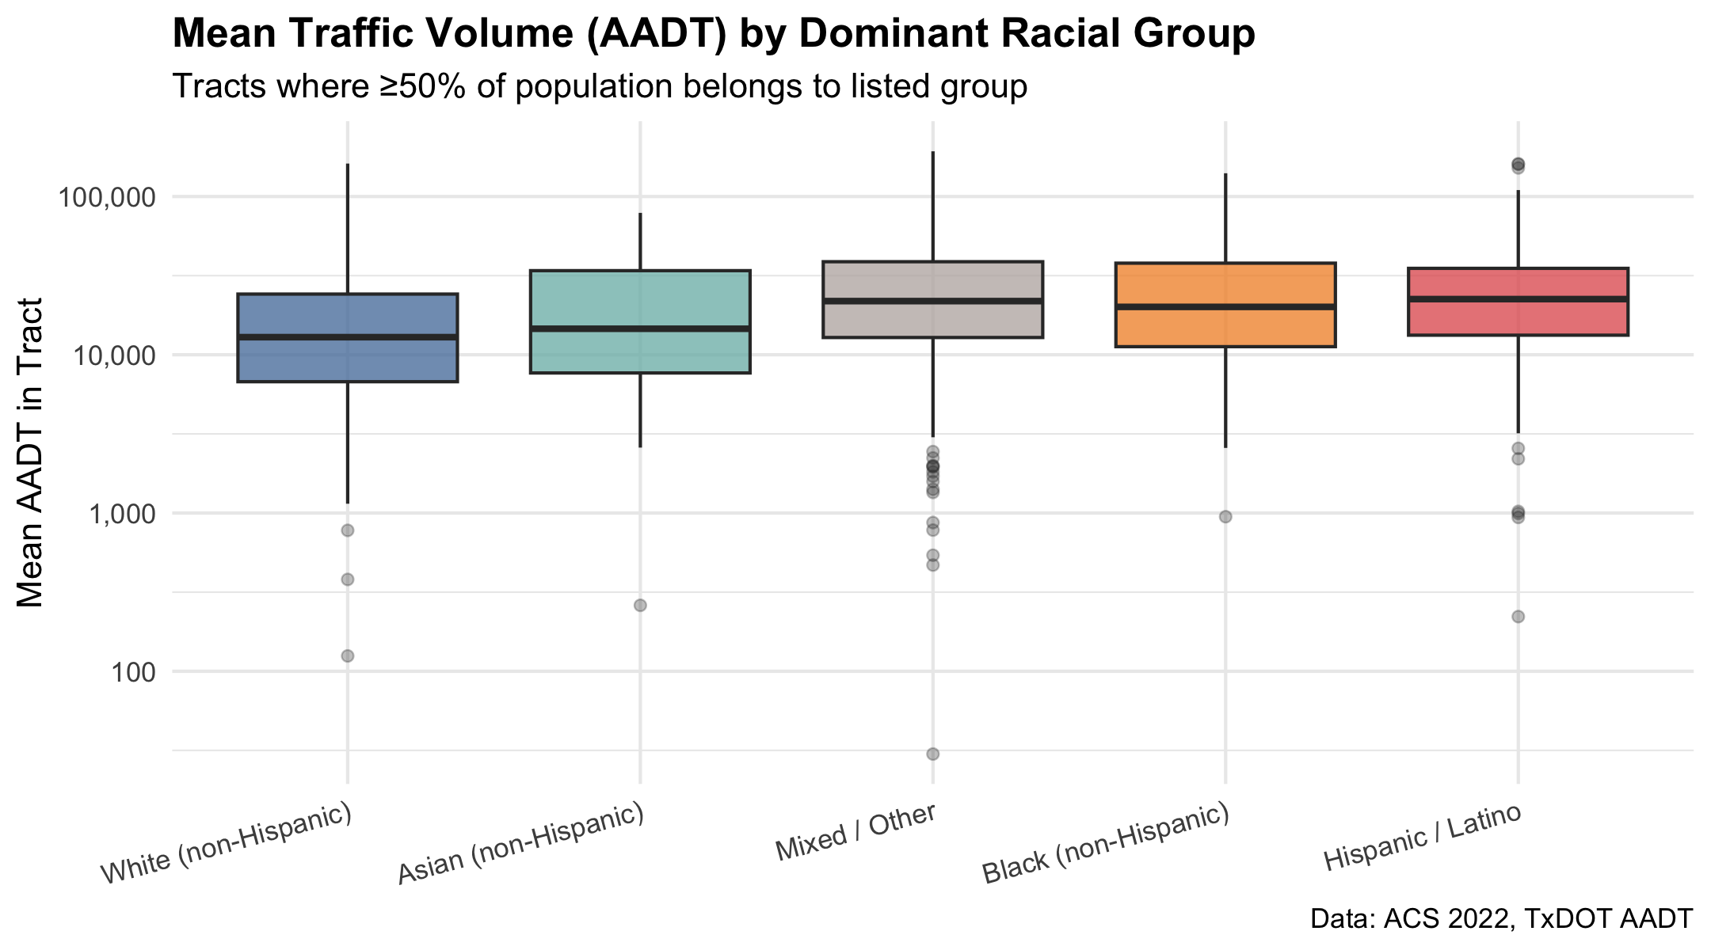
The 3rd and 2nd Income Quartile note a small decrease in traffic around them, while the 1st is the highest, with the 4th (Richest) not far behind.
White (non Hispanic) communities are of the least impacted. However, the spread is not by much.
Notes:
Isaiah

Slide 14
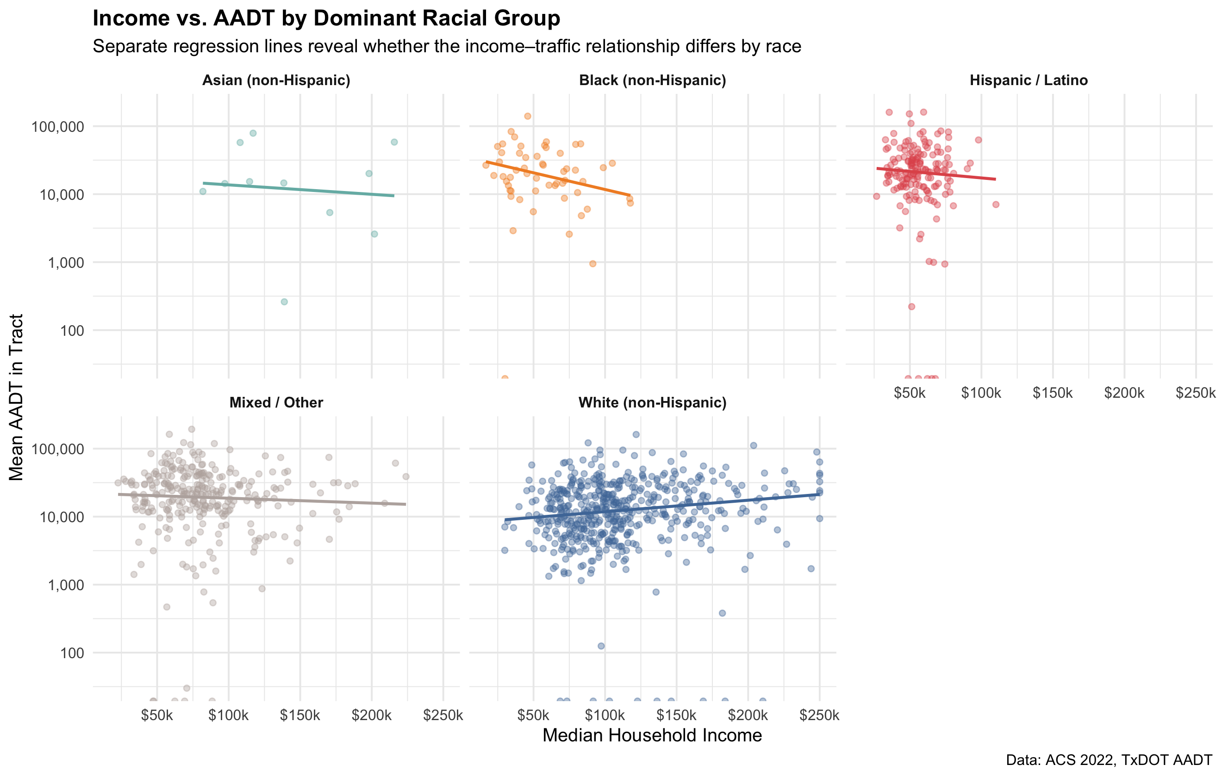
Correlation Analysis
Notes:
Isaiah

Slide 15
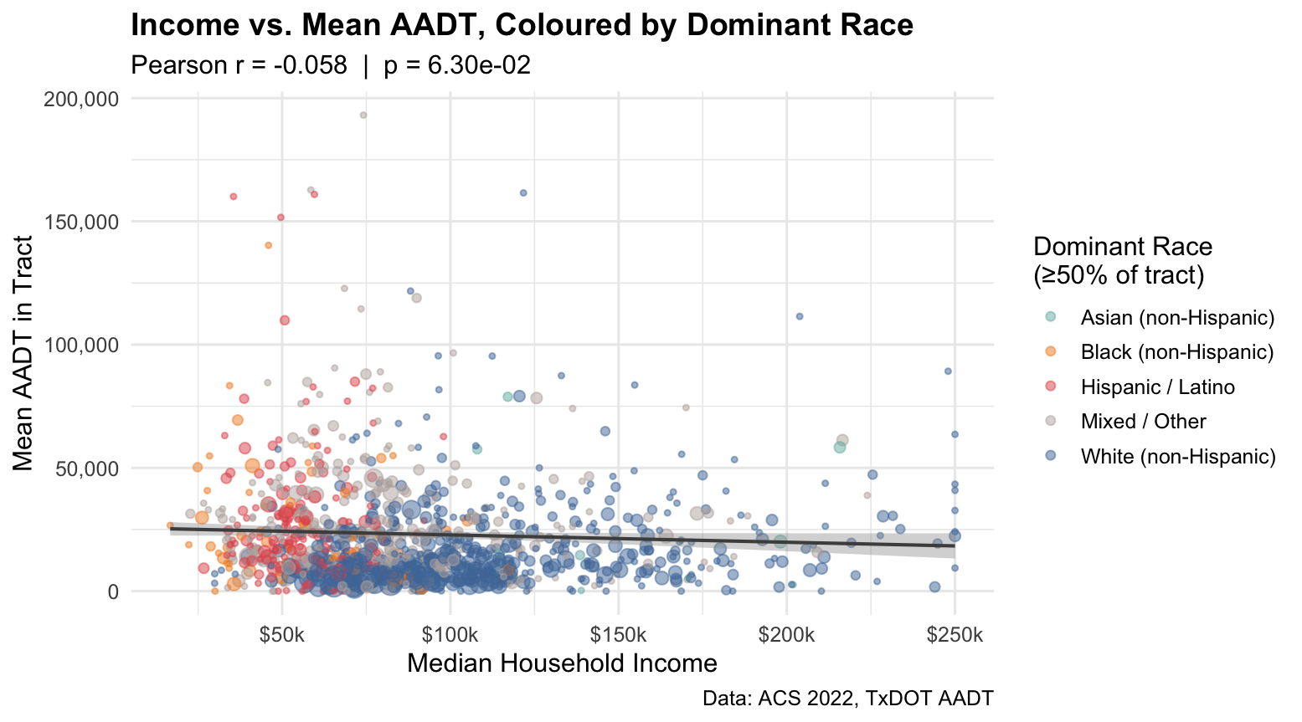
Notes:
Isaiah

Slide 16
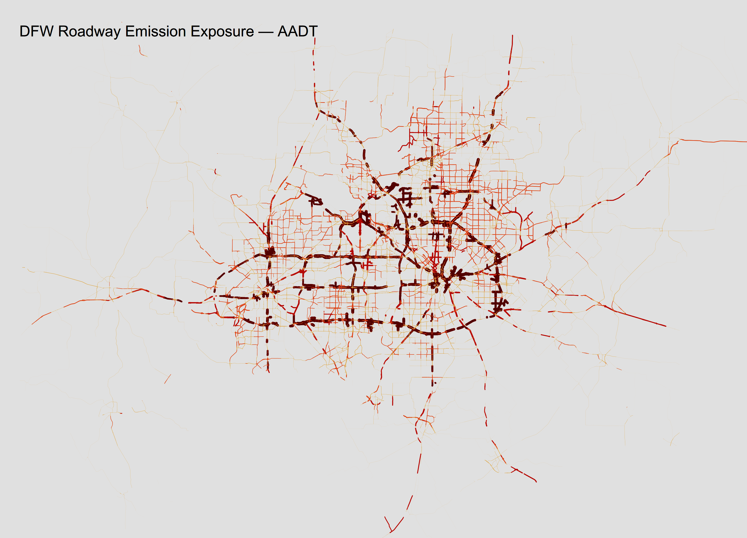
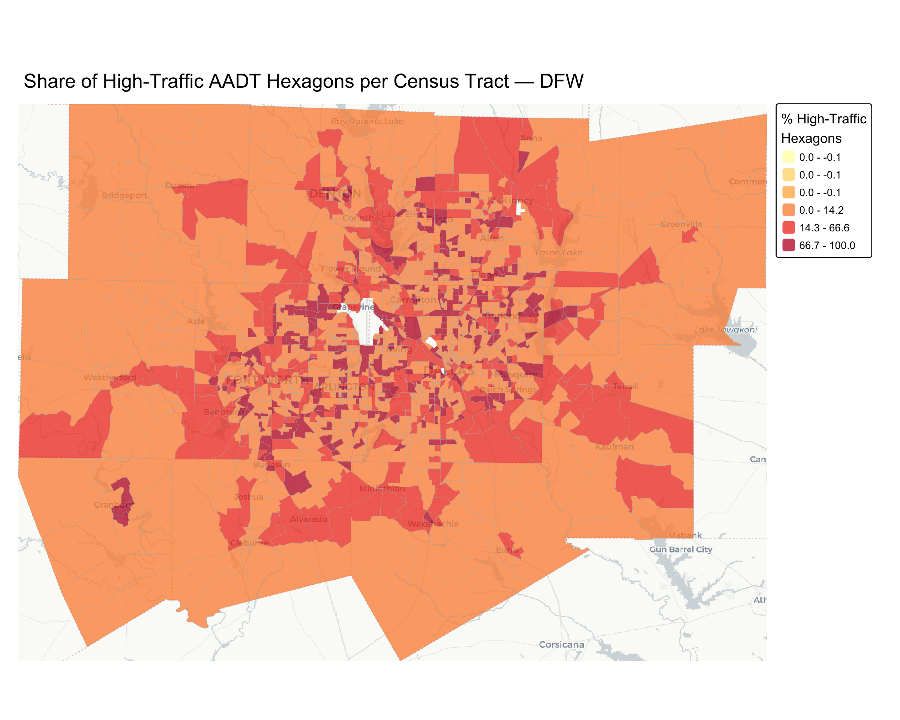
Summary and Findings
Income does not tell the whole story
  Higher income areas are slightly less exposed to emissions, but the relationship is weak
Low income, minority communities are affected the most
  Black & Hispanic communities are slightly more affected overall and show negative income-exposure relationships (lower income leads to much higher exposure)
  White communities a show flat income-exposure relationship
  Disparity shows minority communities face compounded exposure burden by income level
Population Density is the Strongest Predictor
  Highways are concentrated in peripheral zones not dense urban areas
Socioeconomic variables show useful but limited explanatory power
Notes:
Carter

Slide 17
Synthesis, Conclusions, and Limitations
Geography Drives Exposure
  Exposure determined by where highways are located in peripheral, low-density areas correlating to density being our strongest predictor
Two Mechanisms of Racial Inequity
  Spatial Location: Communities of color are slightly more disproportionately located in higher-exposure zones
  Economic Stratification: Within communities of color, lower-income residents face additional burden; white communities show no income-exposure relationship showing how minority communities could be stuck in high emissions zones while majority white communities are start in mainly low emissions zones and have freedom to move with higher income
Environmental Justice Reasoning
  DFW exhibits race-stratified exposure rooted in geography and history
  Exposure driven by where highways are built, not simply who is poor
Why Geography Drives Exposure: Highway Planning Decisions
  Interstate Highway System (1956–1980s) routed freeways through areas based on engineering efficiency and cost, not community benefit
  DFW's peripheral high-exposure zones correspond to freeways built decades ago and our high traffic hexagon per census tract map shows darkest red
Why Income-Stratification Differs by Race
  Historical redlining and discriminatory zoning may have concentrated communities of color in or near freeway corridors, while protecting white neighborhoods from industrial/highway adjacency
  Today, wealth provides some escape from exposure for all residents, but less so for communities of color, suggesting historical placement created persistent geographic constraints
  White communities show flat income-exposure relationships, indicating they were historically sited away from highways regardless of current income level
Critical Limitations
  We cannot prove historical causation with 2022 data alone; we need redlining maps, highway routing records, and zoning histories
  Our spatial analysis is at census-tract level, so we don't know exactly where within neighborhoods communities of color live relative to high-exposure zones
  AADT is a traffic proxy, not actual air pollution; we need EPA monitors and health outcome data (asthma, respiratory disease) to validate exposure → health pathway
Notes:
Carter

Slide 18
Citations
Samsel, H. (2023, October 30). Does Dallas-Fort Worth rank third in the world for greenhouse gas emissions from cars? Fort Worth Report. https://fortworthreport.org/2023/10/30/does-dallas-fort-worth-rank-third-in-the-world-for-greenhouse-gas-emissions-from-cars/
Load US Census Boundary and Attribute Data as tidyverse and sf-Ready Data Frames. (n.d.). Walker-Data.com. https://walker-data.com/tidycensus/
Traffic count maps. (n.d.). Www.txdot.gov. https://www.txdot.gov/data-maps/traffic-count-maps.html
OpenStreetMap Road Network Data OpenStreetMap Foundation. (2024). OpenStreetMap. Retrieved from https://www.openstreetmap.org/
TxDOT AADT Data Texas Department of Transportation (TxDOT). (2024). Annual Average Daily Traffic (AADT) - Historical Data. Traffic Operations Division. Retrieved from https://www.txdot.gov/business/information-requests/traffic-counts.html
Samsel, H. (2023) Does Dallas Fort Worth rank third in the world for Greenhouse Gas Emissions from Cars? Fort Worth Report. https://fortworthreport.org/2023/10/30/does-dallas-fort-worth-rank-third-in-the-world-for-greenhouse-gas-emissions-from-cars/

