Slide 1

$2,100/mo
Marketing plan
recovered in payroll leakage at S&W Waterproofing
Turn payroll leakage into the sales wedge.
California-first founder-led acquisition plan for Crewtrace.
June 2026

Slide 2
Current signal
The strongest evidence is not ad volume. It is trust.
Crewtrace has two real usage proofs: a paying general contractor and the waterproofing company it was originally built for.
1
$1k
$100/mo
paying GC customer
onboarding fee collected
current subscription
–
Cold email produced almost no response across roughly 2,000 contacts.
–
Manual LinkedIn created conversations, but no conversions.
Interpretation: the market buys this through credibility and owner-to-owner trust before it buys the website.
–
Industry contacts produced the only sale so far.
Repo and founder context: pricing, S&W proof, current funnel, current customer status.

Slide 3
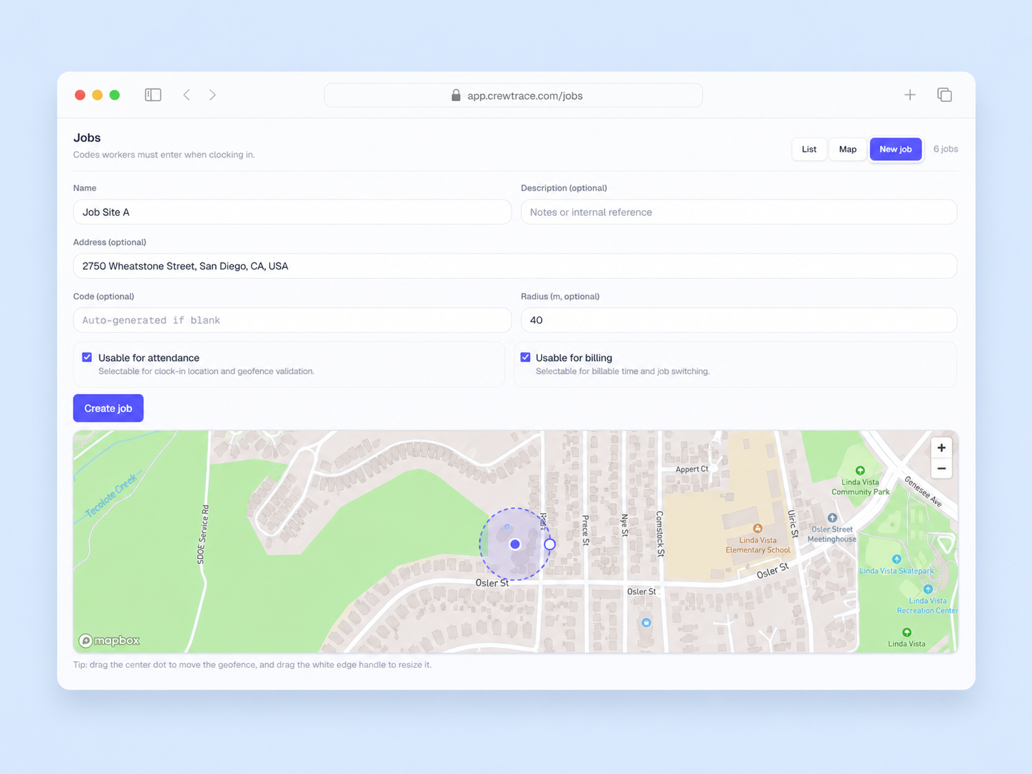
Beachhead
Start with California contractors who already feel payroll pain.
Not every contractor is the first target. The best first customer has enough crews, enough jobsites, and enough payroll mess for the problem to be visible.
Ideal first segment
California wedge
California contractors with 10–75 hourly field employees across multiple active jobsites.
Do not sell legal advice. Sell cleaner records before payroll closes.
–
General contractors with employees
–
Waterproofing, roofing, concrete, HVAC, electrical, plumbing, landscaping
–
Paper timesheets, spreadsheets, or basic clock apps
–
Owner suspects leakage but lacks proof
Source context: CA DIR/DOL recordkeeping and meal-period guidance; use as risk context, not legal claims.

Slide 4
Positioning
Do not sell time tracking. Sell payroll proof.
The category is crowded. Crewtrace needs a narrower promise that connects directly to owner pain.
Commodity framing
Construction time tracking software
Recommended message
Crewtrace helps California contractors stop payroll leakage with GPS-verified time records, jobsite geofencing, and payroll-ready exports.
Wedge framing
Stop paying for hours you cannot verify.
Crewtrace marketing plan | June 2026

Slide 5
Offer
Make onboarding the thing they buy first.
The product needs implementation to create the proof moment. Price that work explicitly.
Payroll Leakage Recovery Sprint
$1,000
In 14 days, review the current time process, configure active jobsites, onboard the crew, and show whether unverified hours are costing money before the next payroll run.
first-10 customer implementation
$150/mo
–
Time-process audit
recommended software floor
–
Jobsite/geofence setup
$250/mo
–
Crew onboarding
–
Payroll-review checkpoint
larger crews / scale plan
–
Owner-facing leakage summary
Do not make onboarding optional. It is the path to the outcome.
Pricing remains flexible; recommendation is to preserve paid implementation and simplify monthly tiers.

Slide 6
Channel mix
Make conversations the constraint, not traffic.
The next month is about creating qualified owner conversations and paid audits, not maximizing impressions.
Channel
Role
Owner
Priority
Partner-led calls
Contractor-to-contractor trust and close motion
Partner
P1
Warm intros
Use waterproofing reference and paying GC proof
Both
P1
Bookkeepers / QuickBooks
Referral channel from people who see payroll mess
You
P1
Google Search
Capture high-intent demand; route to calculator/call
You
P2
Demand Gen
Retargeting only until it proves booked-call value
You
P3
Crewtrace marketing plan | June 2026

Slide 7
Sales motion
Let the construction operator carry the first conversation.
Your partner's industry credibility is the channel advantage. Your role is to make every call easy to run and easy to follow up.
Partner owns
You own
–
Owner calls and warm intros
–
Target-account list
–
Peer-to-peer payroll pain conversation
–
Ads, landing pages, and calculator funnel
–
Waterproofing reference story
–
Call notes and follow-up materials
–
Closing the Recovery Sprint
–
Demo/product implementation support
Call opener: “I run a construction company too. We built Crewtrace because paper time and edited punches were costing us money. We helped one contractor find about $2,100/month in payroll leakage. Would it be worth a 10-minute look at whether the same thing is happening in your payroll?”
Crewtrace marketing plan | June 2026

Slide 8
Paid search
Keep Search narrow. Treat Demand Gen as unproven.
The campaign data is too early to declare failure, but it is clear enough to stop equating cheap clicks with qualified demand.
687
Action
–
Prioritize construction + GPS/geofence + time-clock terms.
Demand Gen clicks, 0 conversions
–
Send high-intent search to payroll-leakage/calculator path.
39
–
Pause or cap Demand Gen unless used for retargeting.
Search clicks, 0 conversions
–
Measure calculator completions and booked-call clicks, not impressions.
$294
Core terms: construction time tracking, construction time clock app, GPS time clock app, geofence time clock, contractor time tracking app, QuickBooks construction time tracking.
total ad spend reviewed
AdLoop snapshot: 2026-05-26 to 2026-06-01.

Slide 9
30-day plan
The goal is three paid Recovery Sprints.
If three contractors pay for implementation in 30 days, Crewtrace has a repeatable early sales signal.
Week 1
Week 2
Week 3
Week 4
Package the Sprint, fix credibility copy, build 150 target accounts.
Partner runs calls. Ask for warm intros. Start bookkeeper outreach.
Run audits, demo around their numbers, create trade-specific proof.
Close Sprints, review channel data, tighten the next-month playbook.
150
20
8
3
target accounts
real owner conversations
audits booked
paid Sprints sold
Crewtrace marketing plan | June 2026

