Slide 1
RealFakeStore
Website by Nick Carter

Slide 2
FakeRealStore is a mock store page to showcase server sided programming
The website includes
  Responsive homepage that changes based on what categories are displayed
  Responsive index page that changes based on the items inside a category
  Page to display a detailed description of an item, as well as its image, price, and quantity available
  A cart to store all the purchases a user wants to make
  A checkout page, that will store the users first and last name as well as their address.

Slide 3
There is also an admin side of the website to change any content within the webpage without having to access the database directly
These admin pages include
  Modifying, deleting, and creating categories
  Modifying, deleting, and creating items
  Ability to view orders places as well as change the status of those orders

Slide 4
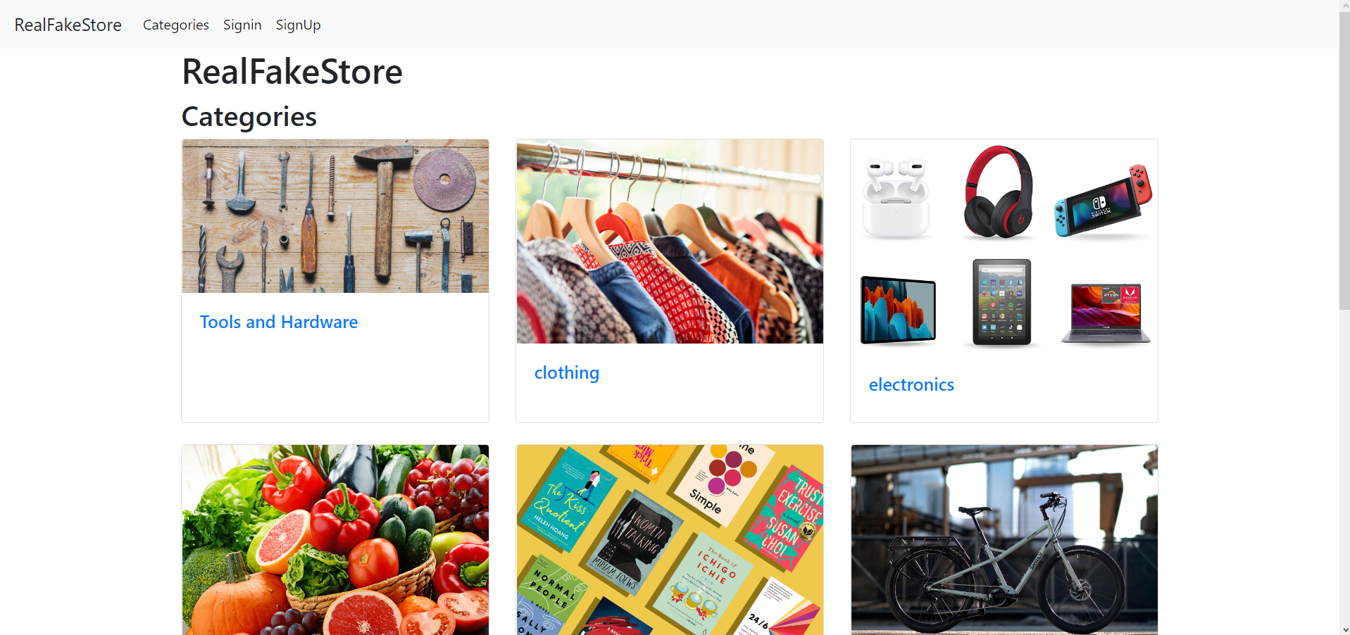
Home Page with a selection of Categories to view

Slide 5
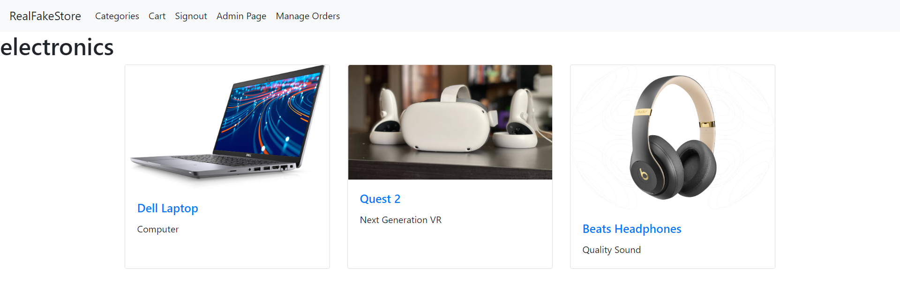
Items within a category as well as a light description of each

Slide 6
How to make the website work for you
First import the database located in the database folder into phpMyAdmin
Next change any settings needed in the settings.php file although you shouldn’t need to
In a web browser go to localhost/final/categories/index.php
From here the website should work and be completely functional

