Slide 1
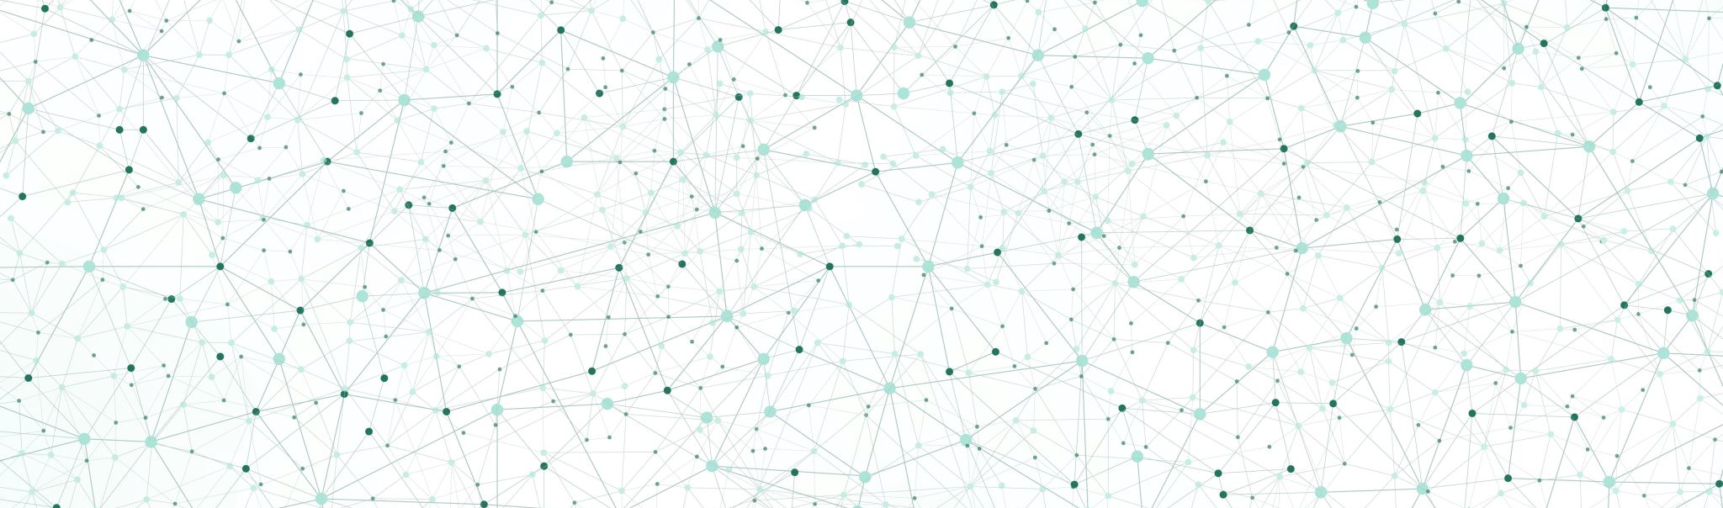
How is AI shaping RTOS?
Tyler Crabb
Carter Nettesheim

Slide 2
Introduction

Slide 3
AI is made application based – only trained for a certain application (for now)
Most of us have heard neural network, but what does it actually mean?
Training
Release

Slide 4
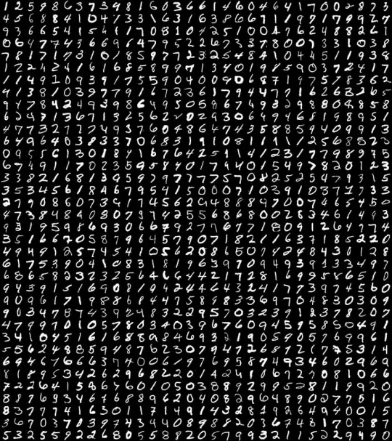
Hello World of AI
Notes:
You have all heard the term “neural network” before (because there was a presentation on it), but do you actually know what that means?
What is a neural network?
Let’s walk through one
- One of the most popular “Hello world” applications is called MNIST or as I like to call “MNIST”

Slide 5
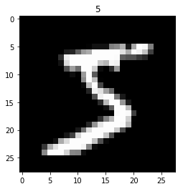
MNIST
Modified National Institute of Standards and Technology
Created public database of hand drawn images
60,000 training images
10,000 testing images
Notes:
MNIST is an AI that identifies handwritten numbers
The reason it’s popular is because all of the pictures and data are available to the public

Slide 6
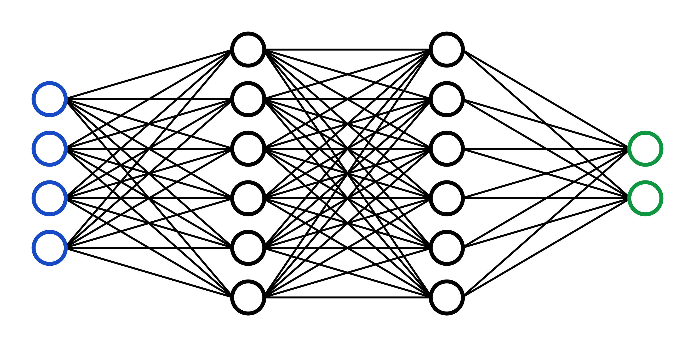
Neural Network
5
Notes:
- The problem
- The neural network will take in images and spit out what number the AI thinks the image is

Slide 7
INPUTS
OUTPUTS
0
1
2
3
4
5
6
7
8
9
?
= 10 outputs
Float value from 0 – 1
28 px x 28 px = 784 inputs
Notes:
What inputs could be taken in? These are often called “parameters”
How about outputs?
It’s important to identify the inputs and outputs of an AI system, because AI systems all have a specific purpose (at least for now) chat gpt vs craiyon
Lots of debate on neurons and neuron layers, not an exact science (at least what's been released on the web)
We’ve identified our I/O time to move on

Slide 8
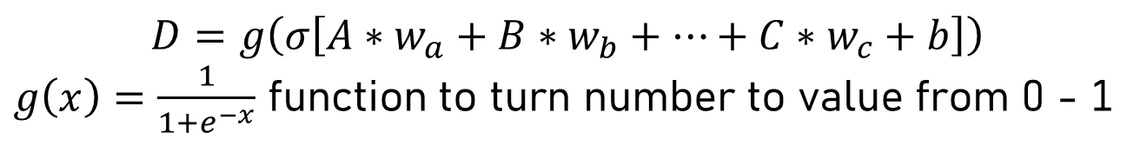
Neuron
A
w_a
w_b
B
D
Single float from 0 - 1
b
w
0.18
w_c
b = bias
w = weight
current value
C
$$D=g\left(σ\left[A∗w_{a}+B∗w_{b}+…+C∗w_{c}+b\right]\right)$$
$g\left(x\right)=\frac{1}{1+e^{−x}}$ function to turn number to value from 0 - 1
Notes:
3 main values to talk about
Lets create a small intermediate neural network and assign names and values
We know the first group of neurons are pixel values, but how do we calculate D?
We use a simple summation and a special function

Slide 9
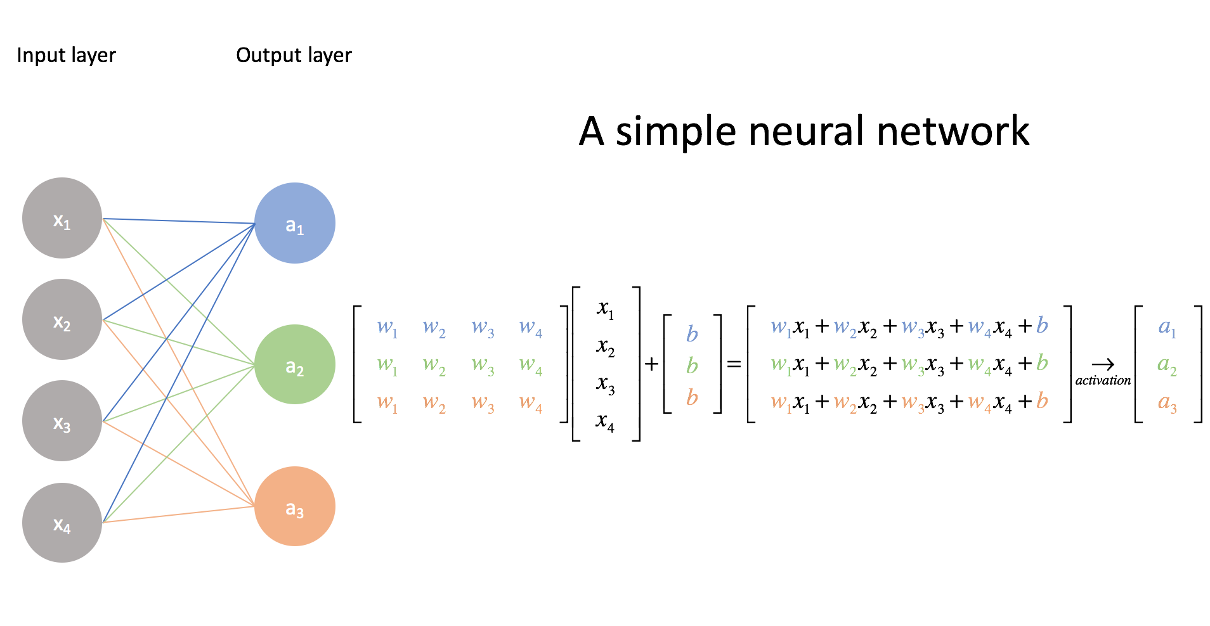
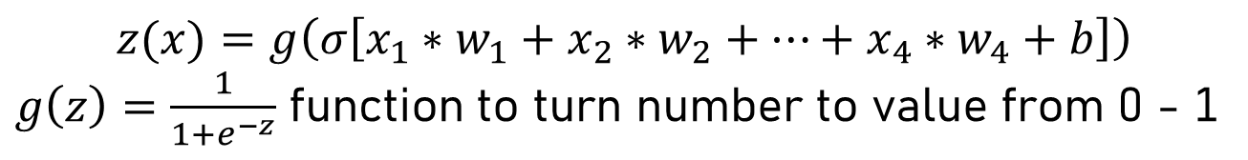
$$z(x)=g\left(σ\left[x_{1}∗w_{1}+x_{2}∗w_{2}+…+x_{4}∗w_{4}+b\right]\right)$$
$g\left(z\right)=\frac{1}{1+e^{−z}}$ function to turn number to value from 0 - 1
Notes:
Lots of calculations, lets use matrix math to add them up
Neural networks are actually trained best on GPUs because of how much matrix multiplication is used
Let’s now train our neural network

Slide 10
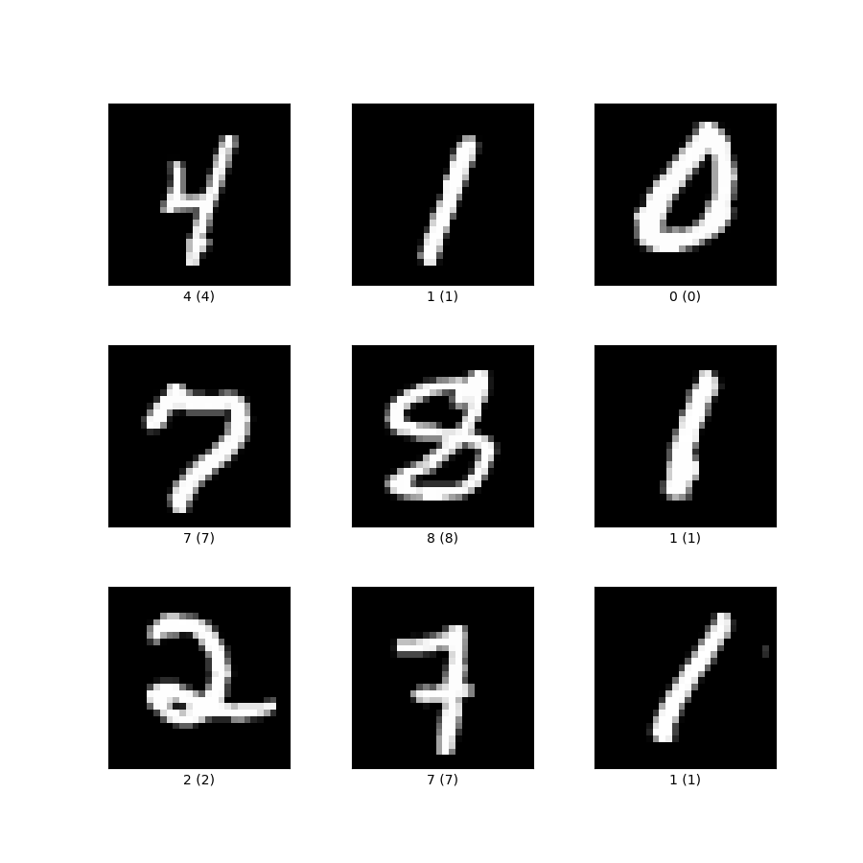
Training
Pixels
“hidden layers”
9 numbers
Reward
0.3
0.83
0.13
0.4
0.14
0.43
0.35
0.67
0.04
0.5
0.3
0.83
0.13
0.4
0.14
0.9
0.35
0.67
0.04
0.5
0
1
2
3
4
5
6
7
8
9
0
1
0
0
0
0
0
0
0
0
0
0
0
0
1
0
0
0
0
0
Back propagation changes weights and biases
Notes:
Start with random weights and biases (kindof)
Then we will try to recognize a 4
Identifies as a 5, and back-propagates changing all the weights and biases based on the reward received
Again with a 1
Repeat until the AI can correctly identify a picture according to your accuracy needs
It works a lot like simulated annealing
Once it’s trained, the same neural network can be used over and over to identify the correct picture

Slide 11



Bigger and Better
Chat GPT
Notes:
This was a very simple exercise, but it opened my eyes up to what parameters and outputs are needed for these companies
Gave me a better grasp on how AI is created

Slide 12
What does this have to do with RTOS?
Nvidia H100
Chip manufacturing
Producing features on a single gold atom
40x speed, 7x less power
AlexNet vs GPT-3 (GPT-4 is now out)
New Nvidia graphics cards specialized for training AI
If AI can be used to solve NP complete problems, RM and EDF could be solved faster

Slide 13
Conclusion

Slide 14

Nvidia’s GTC 2023 Keynote Intro Video
March 21, 2023 – Just 4 weeks ago

Slide 15


Slide 16

Questions?

Slide 17
References
https://www.technologyreview.com/2018/06/12/142361/ai-could-get-100-times-more-energy-efficient-with-ibms-new-artificial-synapses/
https://www.youtube.com/watch?v=aircAruvnKk&list=PLZHQObOWTQDNU6R1_67000Dx_ZCJB-3pi
https://www.youtube.com/watch?v=sxHFDKwJGGo
https://www.youtube.com/watch?v=SX08NT55YhA
https://www.youtube.com/watch?v=R9OHn5ZF4Uo
https://www.youtube.com/watch?v=DiGB5uAYKAg&t=1939s
https://stackoverflow.com/questions/45826184/what-image-format-are-mnist-images
https://victorzhou.com/series/neural-networks-from-scratch/
https://www.jeremyjordan.me/intro-to-neural-networks/
https://www.tensorflow.org/datasets/catalog/mnist
https://www.creativebloq.com/news/tesla-logo-IUD
https://justcreative.com/chatgpt-prompt-framework/
https://craiyon.teemill.com/

