Slide 1

How is AI shaping RTOS?
Tyler Crabb
Carter Nettesheim

Slide 2
Introduction

Slide 3
AI is made application based – only trained for a certain application (for now)
Most of us have heard neural network, but what does it actually mean?
Training
Release

Slide 4
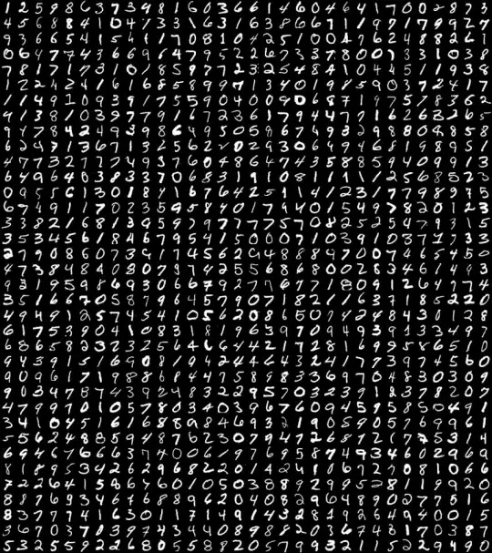
Hello World of AI

Slide 5
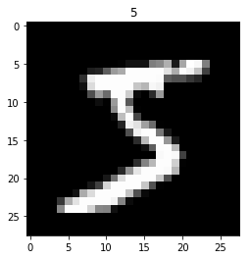
MNIST
Modified National Institute of Standards and Technology
Created public database of hand drawn images
60,000 training images
10,000 testing images

Slide 6
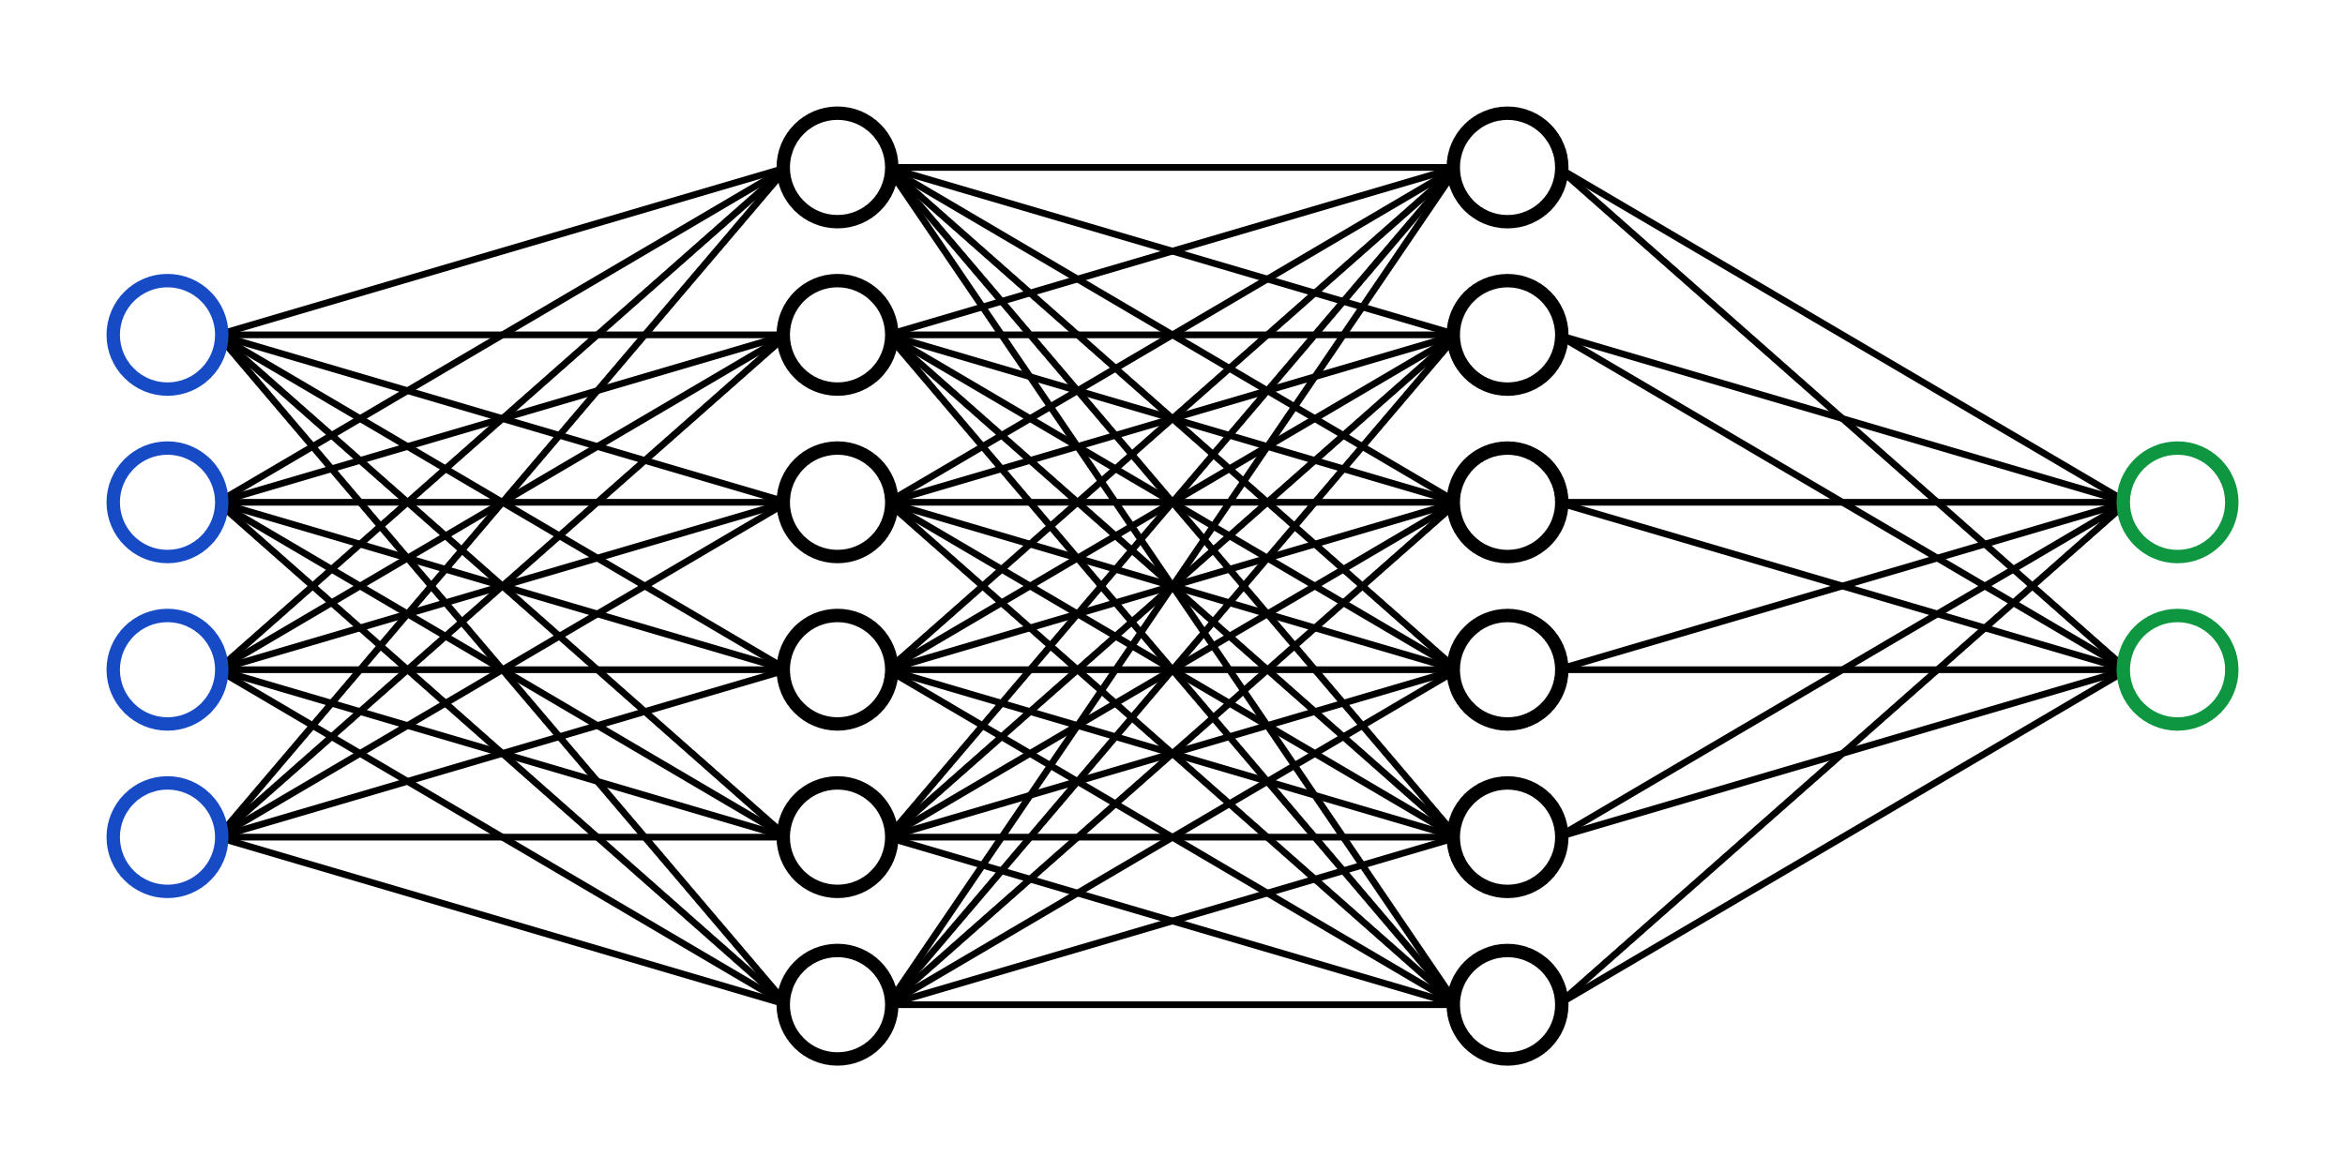
Neural Network
5

Slide 7
INPUTS
OUTPUTS
0
1
2
3
4
5
6
7
8
9
?
= 10 outputs
Float value from 0 – 1
28 px x 28 px = 784 inputs

Slide 8
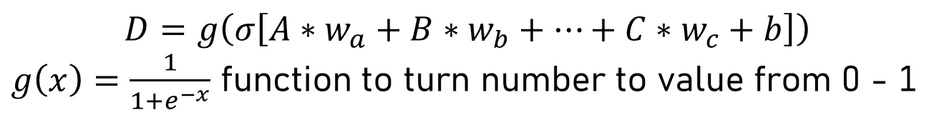
Neuron
A
w_a
w_a
B
D
Single float from 0 - 1
0.18
w_a
b = bias
w = weight
C
$$D=g\left(σ\left[A∗w_{a}+B∗w_{b}+…+C∗w_{c}+b\right]\right)$$
$g\left(x\right)=\frac{1}{1+e^{−x}}$ function to turn number to value from 0 - 1

Slide 9
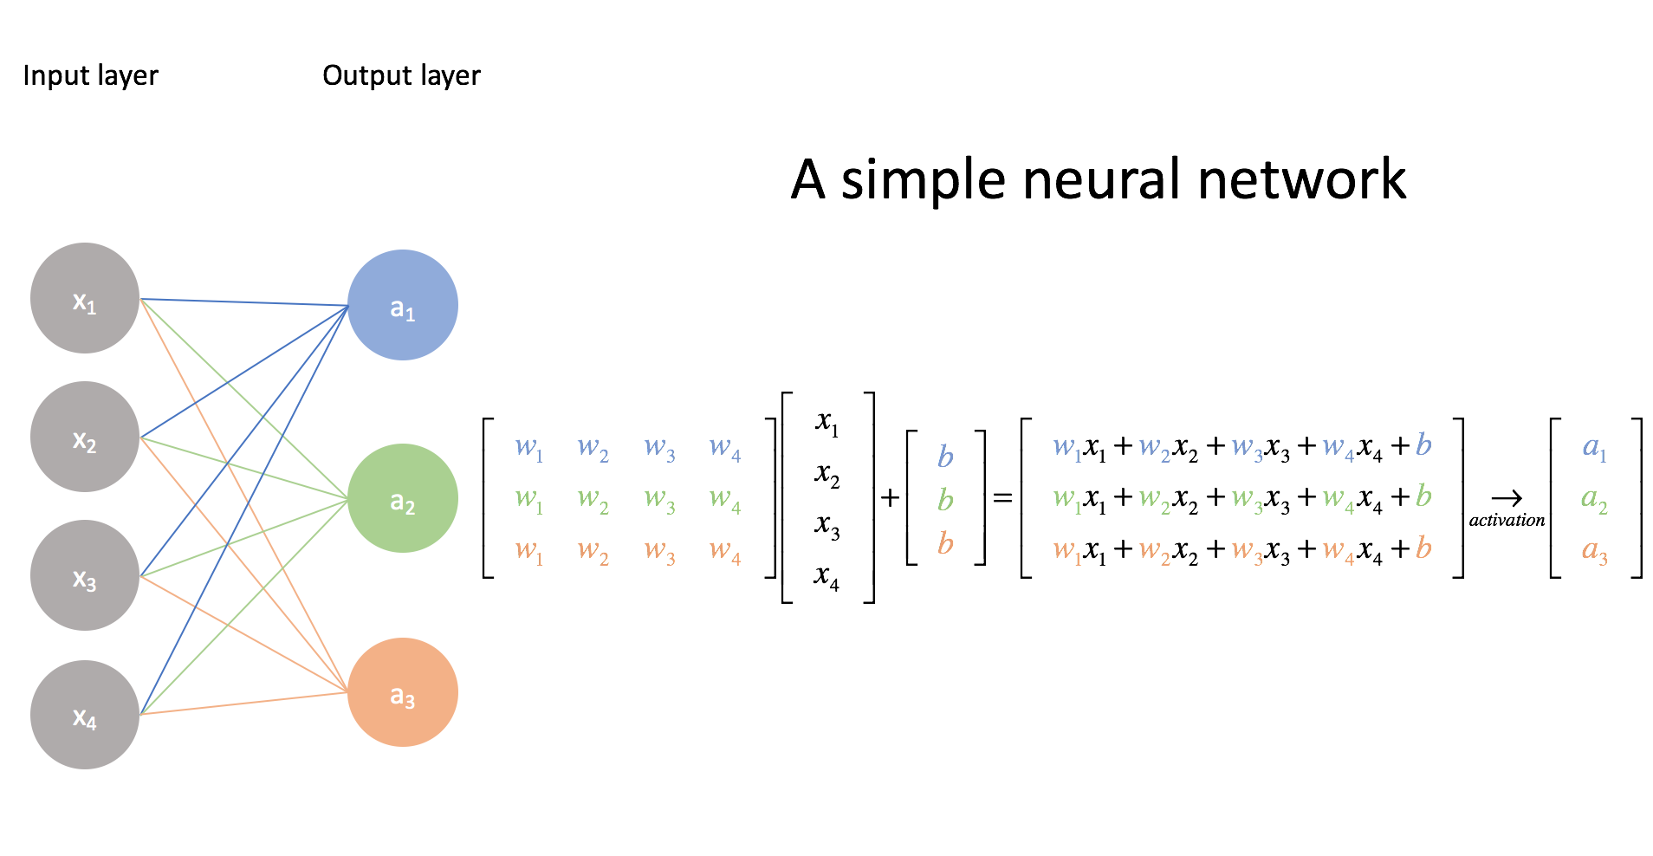
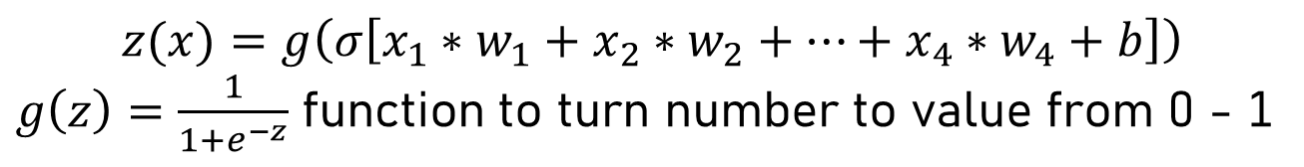
$$z(x)=g\left(σ\left[x_{1}∗w_{1}+x_{2}∗w_{2}+…+x_{4}∗w_{4}+b\right]\right)$$
$g\left(z\right)=\frac{1}{1+e^{−z}}$ function to turn number to value from 0 - 1

Slide 10
Hello World of AI
Introduce the problem – MNIST
Neural Network – “buzz word”
What happens in the middle?
Inputs/Outputs
Training/rewards
Neuron
Weights and Biases -> linear algebra and calculus

Slide 11
What does this have to do with RTOS?
Nvidia H100
Chip manufacturing
Producing features on a single gold atom
40x speed, 7x less power
AlexNet vs GPT-3 (GPT-4 is now out)
New Nvidia graphics cards specialized for training AI
If AI can be used to solve NP complete problems, RM and EDF could be solved faster

Slide 12
Conclusion

Slide 13

Nvidia’s GTC 2023 Keynote Intro Video
March 21, 2023 – Just 4 weeks ago

Slide 14


Slide 15

Questions?

Slide 16
References
https://www.technologyreview.com/2018/06/12/142361/ai-could-get-100-times-more-energy-efficient-with-ibms-new-artificial-synapses/
https://www.youtube.com/watch?v=aircAruvnKk&list=PLZHQObOWTQDNU6R1_67000Dx_ZCJB-3pi
https://www.youtube.com/watch?v=sxHFDKwJGGo
https://www.youtube.com/watch?v=SX08NT55YhA
https://www.youtube.com/watch?v=R9OHn5ZF4Uo
https://www.youtube.com/watch?v=DiGB5uAYKAg&t=1939s
https://stackoverflow.com/questions/45826184/what-image-format-are-mnist-images
https://victorzhou.com/series/neural-networks-from-scratch/
https://www.jeremyjordan.me/intro-to-neural-networks/

