Slide 1
Simple Ciphers Steve Carter CSC 260 Final Project

Slide 2
Version Control – GitHub Repo
My project repo can be found at:
https://github.com/cartersa79/simpleCiphers
I used GitHub as the version control software
You can get a GitHub Pro account (and a bunch more) for free!!!
https://education.github.com/pack
I used the Visual Studio 2019 extension
It made life easy…just a few button clicks to commit an update
https://visualstudio.github.com/
I also discovered GitHub Desktop too
https://desktop.github.com/

Slide 3
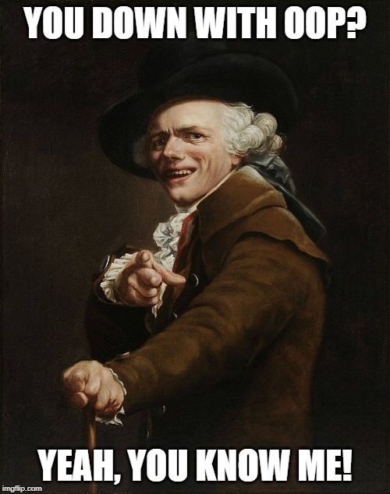
“OOPs”
This was not the best topic for an OOP project
I had to “shoe horn” a few OOP concepts in
Please bear with me ☺

Slide 4
Simple Ciphers…Why Choose This?
Coding, like a 2nd language, is perishable. You must practice!
My upcoming CSC classes don’t require much programming
This project can grow as time permits to keep my skills honed
I tried (and failed) to get my young daughter interested in coding
She likes codes and I hoped this would be a fun for her
The codes were fun for her…not the coding ☹
I intend to take future coursework involving encryption
This will hopefully give me a head start on those courses

Slide 5
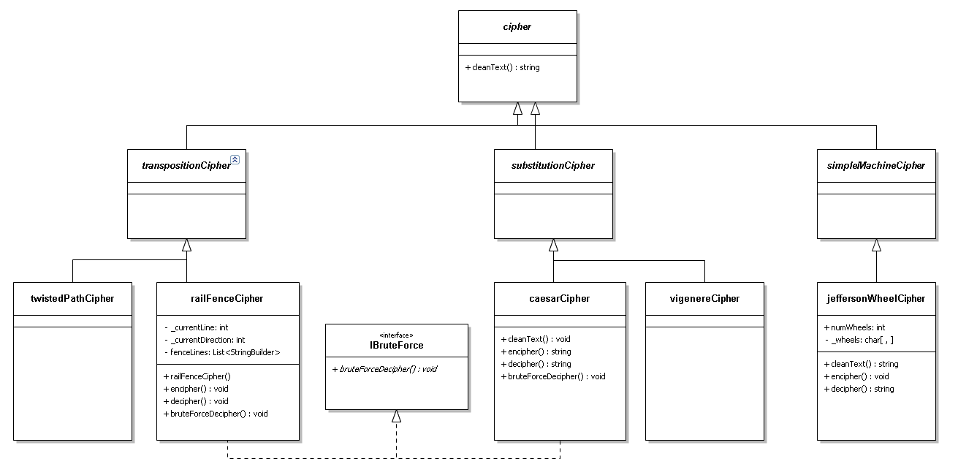
UML Diagram

Slide 6
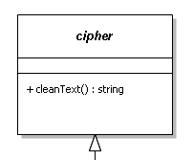
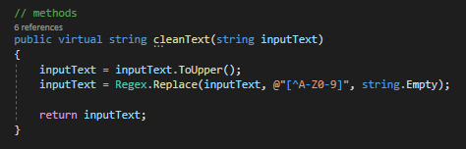
Ciphers
This is the base class from which the various cipher schemes inherit. It is common in the world of ciphers to eliminate characters such as spaces, punctuation, etc. from the plain text message. Keeping these in can make it much easier to break the cipher. For instance, if you know that every sentence ends in a punctuation mark followed by a space, you've given yourself a big head start on cracking the code.
The cleanText method makes everything uppercase and then uses regular expressions to remove anything that isn’t an “A-Z” or “0-9”
Notice that is a virtual function so that it can be overridden in subclasses

Slide 7
UML Diagram

Slide 8
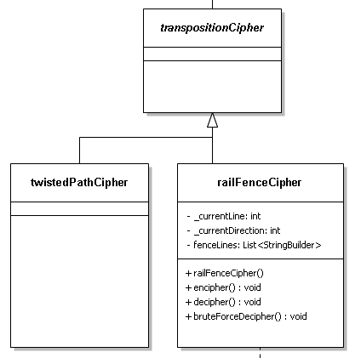
Transposition Ciphers
Transposition ciphers are ciphers in which none of the plaintext characters are changed, they are just re-ordered in such a way as to "jumble the message". The following is an example:
Plain Text: CSC260WASAGREATCLASS
Enciphered Text: SSALCTAERGASAW062CSC
This is a super easy cipher that nobody (except little kids trying to dupe their parents) would ever use. It is just the plain text string reversed. All you have to do is read from right to left.
This is an abstract class that inherits from the cipher base class. It is just an 'abstraction layer' to help organize the code hierarchy. It doesn't implement anything.

Slide 9
Twisted Path (or Route) Cipher
A twisted path cipher is a type of transposition cipher. The general idea is to fill a 2-D array with the plain text message and then follow the diagonals, right-to-left, bottom-right to top-left, etc. to re-write the message into an enciphered text. The following is an example of bottom-right up to top-left enciphering scheme:
Plain text: CSC260WASAGREATCLASS
Enciphered text: XAWSE0SR6AG2LACCSSTAC
There are a huge number of variations on this method. I didn’t implement this for the project. I want to implement it graphically. I think it would be best served with a GUI to select the path order. That is more work than I can handle for this project...it has been a busy semester.
C | S | C | 2 | 6 | 0 | W
A | S | A | G | R | E | A
T | C | L | A | S | S | X

Slide 10

Rail Fence Cipher
Rail Fence Ciphers are a type of transposition cipher. You decide how many rails are on the fence and just write every letter of the plain text in a diagonal pattern. The resulting rows are your enciphered text. The example is a 3-rail fence. It is easy to read, just read diagonally down, then up, down, up, etc.
Plain Text: CSC260WASAGREATCLASS
Enciphered Text: C6SELS20AARACASCWGTS
This cipher is a pretty easy cipher to break but it requires some work. Most people can't just look at it and break the code. It usually requires a pencil and paper (or handy dandy CS student to write a program).
C |  |  |  | 6 |  |  |  | S |  |  |  | E |  |  |  | L
 | S |  | 2 |  | 0 |  | A |  | A |  | R |  | A |  | C |  | A |  | S
 |  | C |  |  |  | W |  |  |  | G |  |  |  | T |  |  |  | S

Slide 11
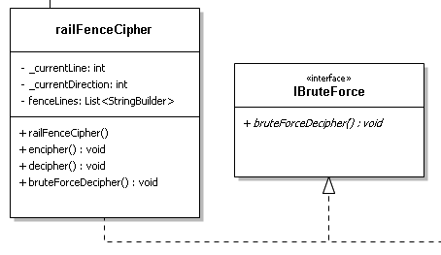
Rail Fence Cipher
Source code is on the next slide
You can also download from GitHub
I demonstrated an OOP concept (overloading) by writing two encipher methods
One is a default that uses a fence size of 2
The other takes fence size as a parameter
IBruteForce Interface is somewhat contrived
It tries to break the cipher without the key
Implementation in this class throws an out of bounds error that I haven’t been able to fix
It’ll be fixed in a future iteration of the software
Conceptually, it “works”!

Slide 12
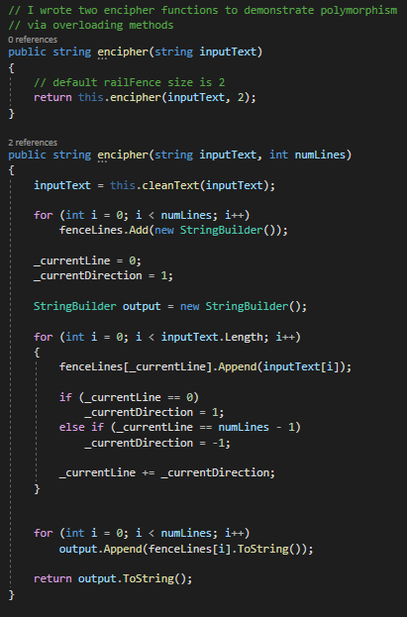
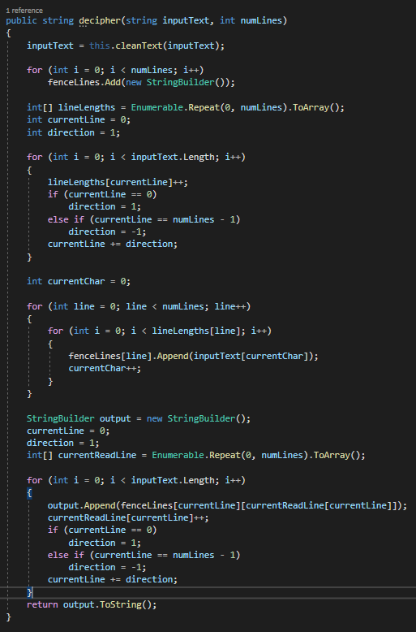
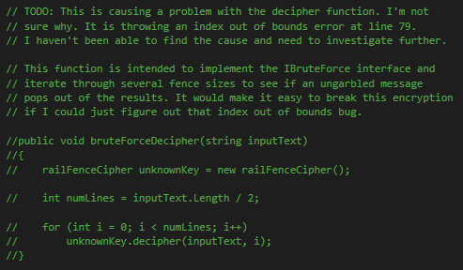
Rail Fence Cipher

Slide 13
UML Diagram

Slide 14
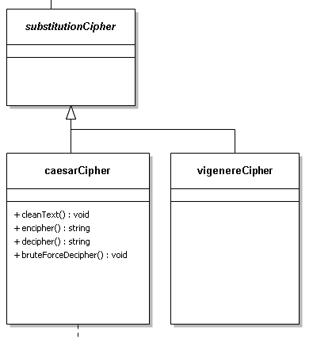
Substitution Ciphers
Substitution ciphers are ciphers in which the plain text characters are changed but their order stays the same. The following example shows how the letters are just each shifted forward by 1. Anyone a Stanley Kubrick fan?
Plain Text: HAL
Enciphered Text: IBM
These are relatively easy ciphers to break and aren't in use in situations that truly require security. There are many variations and some can be difficult to break with paper and pencil but are generally pretty easy with a computer.
This is an abstract class that inherits from the cipher base class. It is just an 'abstraction layer' to help organize the code hierarchy.

Slide 15
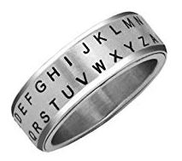
Caesar Cipher
Caesar ciphers simply shift the letters by an integer key value. For instance:
Key = 1
Plain Text: OOP
Enciphered Text: PPQ
These are really easy to encode, decode, and break. For this reason, they aren’t in use for anything that requires true security. They are fun to work on and are the building blocks for many other types of substitution ciphers.
Secret…Agent Man!

Slide 16
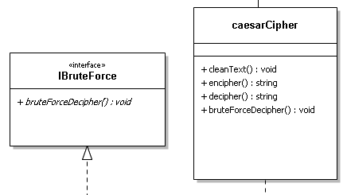
Caesar Cipher
Source code is in two slides
You can also download from GitHub
I demonstrated an OOP concept, overriding the cleanText method from the cipher class
Caesar Ciphers don’t handle numbers well in code because ASCII doesn’t have them adjacent to the letters so I just removed them from the regular expression
This implementation only handles uppercase
IBruteForce Interface is somewhat contrived
It breaks the cipher without being given the key
This works by looping through all 26 possible shifts
You have to visually choose the right one
However, it is a trivial task with only 26 options

Slide 17
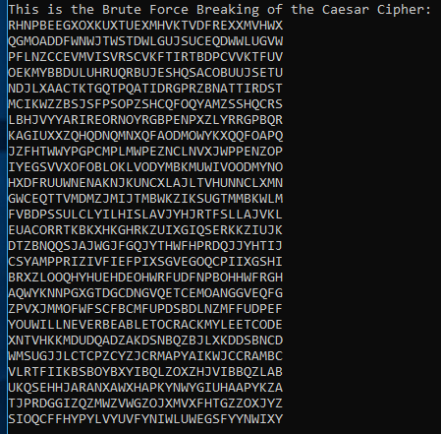


Caesar Cipher
Here’s another one…
Can you spot the correctly
deciphered message?

Slide 18
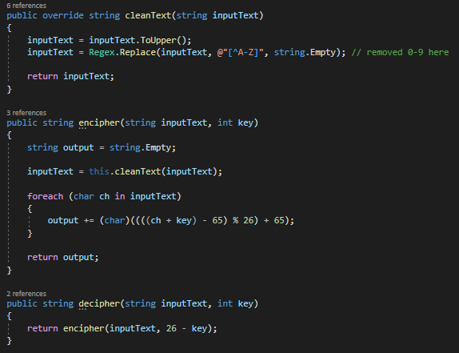
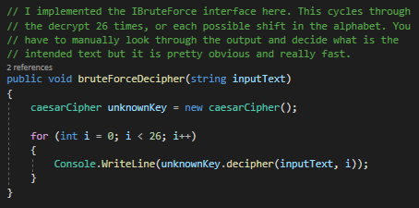
Caesar Cipher

Slide 19
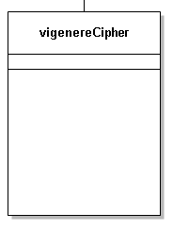
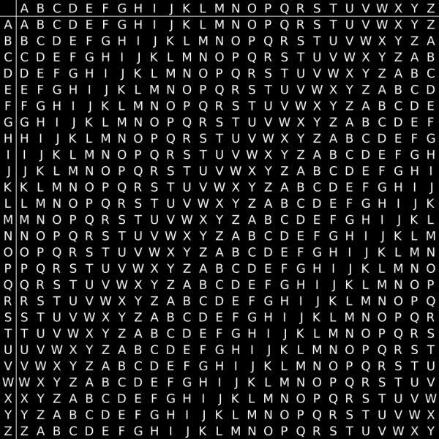
Vigenere Cipher
I didn’t implement the Vigenere cipher for this project
It is really just a slightly more complicated Caesar Cipher
It is planned for a future effort
I plan to include:
Encipher
Decipher
Break
It should be fun to learn to break it without the key

Slide 20
UML Diagram

Slide 21
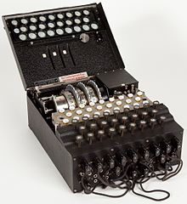
Simple Machine Ciphers
Machine ciphers use some sort of device to encipher and decipher text
Perhaps the most famous is the Enigma device used by the Nazis during WWII
These devices can have codes that are simple to break or codes that are incredibly difficult to crack
This is an abstract class that inherits from the cipher base class. It is just an 'abstraction layer' to help organize the code hierarchy. It doesn't implement anything.
Enigma

Slide 22
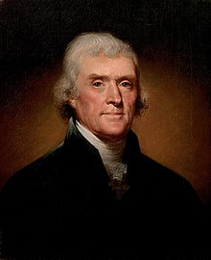
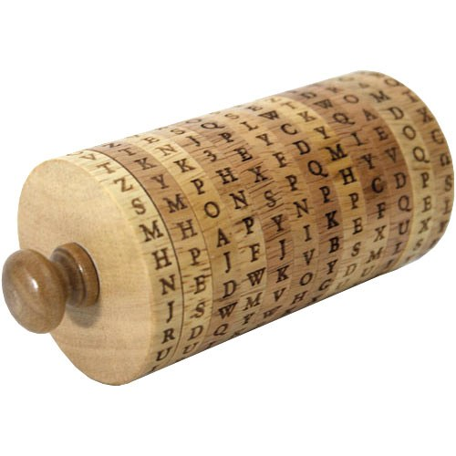
Jefferson Wheel Cipher
Technically, the Jefferson Wheel Cipher is a polyalphabetic substitution cipher. I put it in the simple machine category because I've only ever seen it actually used as a physical device. I was able to play with one at Thomas Jefferson’s home a few weeks back.
The original used 36 disks, each with the 26 letters of the alphabet randomly printed on the outside of the disk. The key is the order in which the disks are stacked. The sender and receiver must have them in the same order to successfully pass messages.
To encipher, the sender spins the wheels until the desired message is shown. The sender then picks any of the other 25 rows to use as the enciphered message. To decipher, the receiver reverses the process by spinning the wheels until the enciphered message is shown. The receiver then looks at the other 25 lines for a message that is readable.
My software implementation only uses one ordering of the disks. It can be expanded in the future to add the ability to change the ordering. It also only uses 10 wheels rather than TJ's original 36. It'd be easy enough to expand to 36.

Slide 23

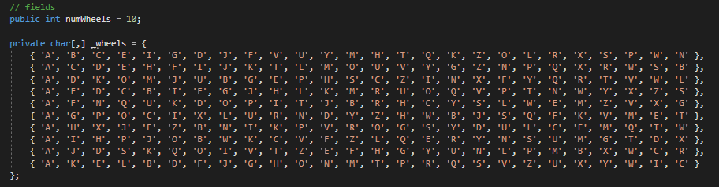
Jefferson Wheel Cipher
Source code is on this and the next slide
You can also download from GitHub
I demonstrated an OOP concept, overriding the cleanText method from the cipher class
I removed numbers as well as limited the length of the message to the number of wheels

Slide 24
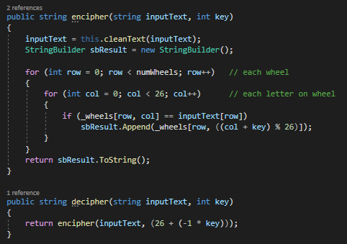
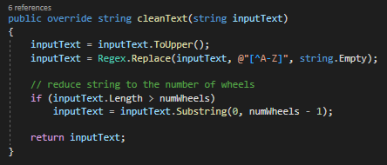
Jefferson Wheel Cipher

Slide 25
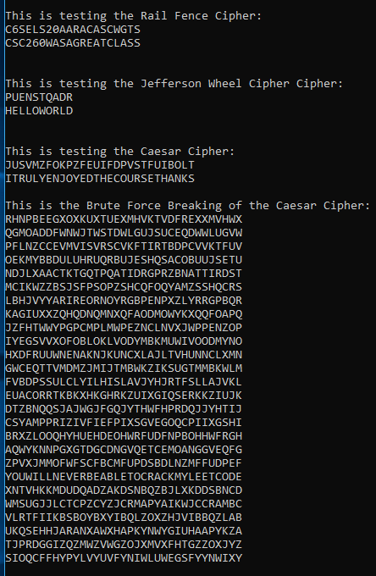
Testing & Results

Slide 26
TODO:
Future work includes the following:
Implement Twisted Path and Vigenere Ciphers
Fix bruteForceDecipher bug in Rail Fence Cipher
Expand Jefferson Wheel to accept different wheel arrangements

Slide 27
Questions?

