Slide 1
C1. Lab II
The Lift Tickets:
Aaron Mak, Juliette Meijaard, Sidney Moyer, Carter Smith
Group presentation video link: https://drive.google.com/file/d/1_2u8-Y9gklCJShJdl0y2zRCwcLp90INw/view?usp=sharing

Slide 2
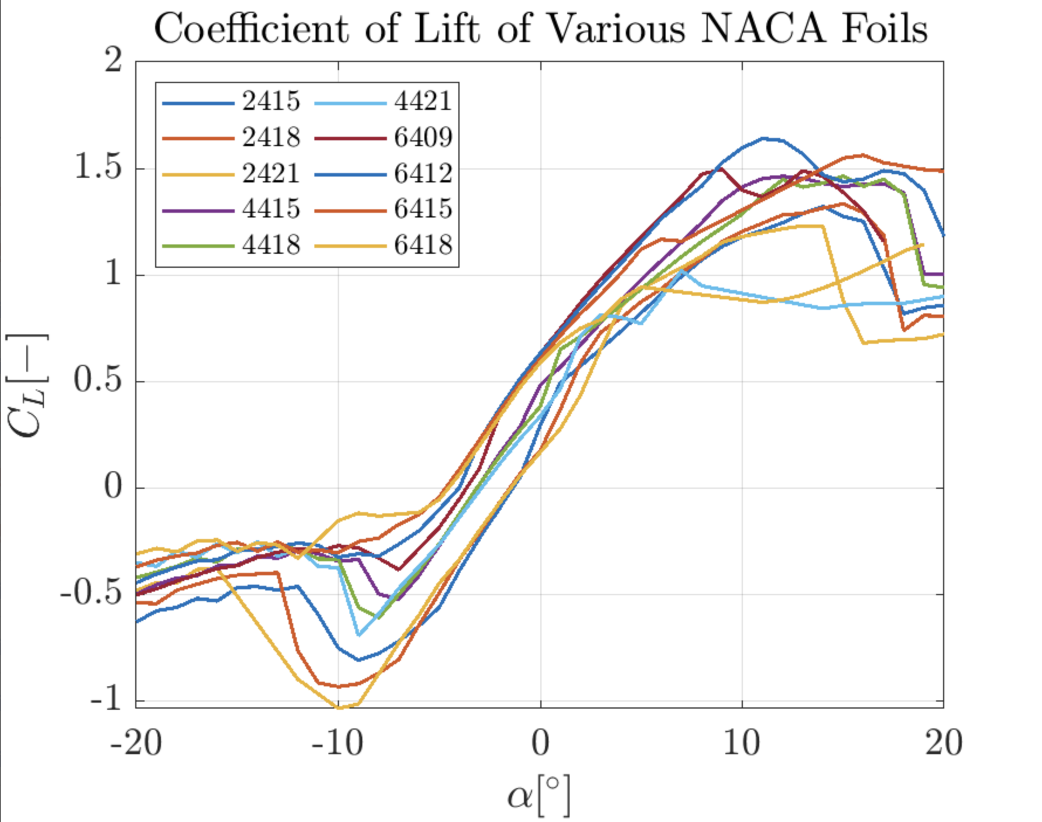
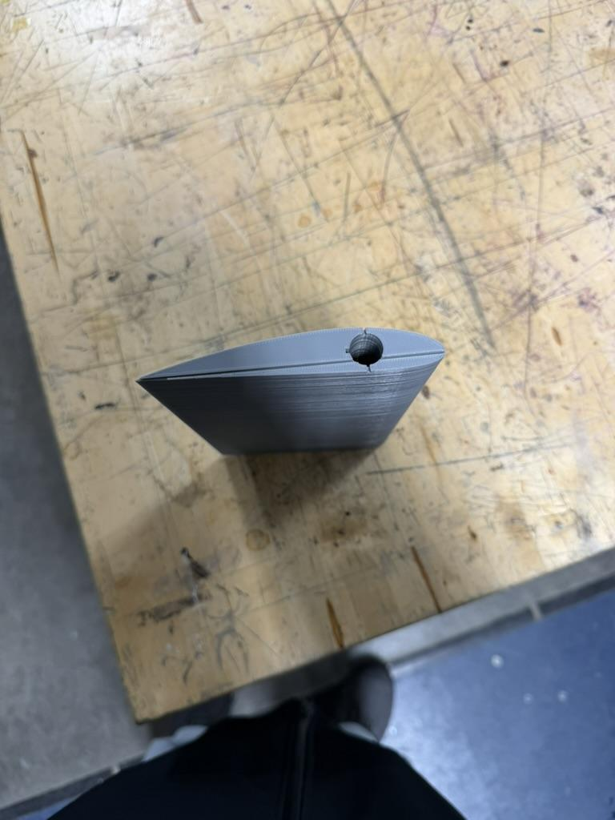
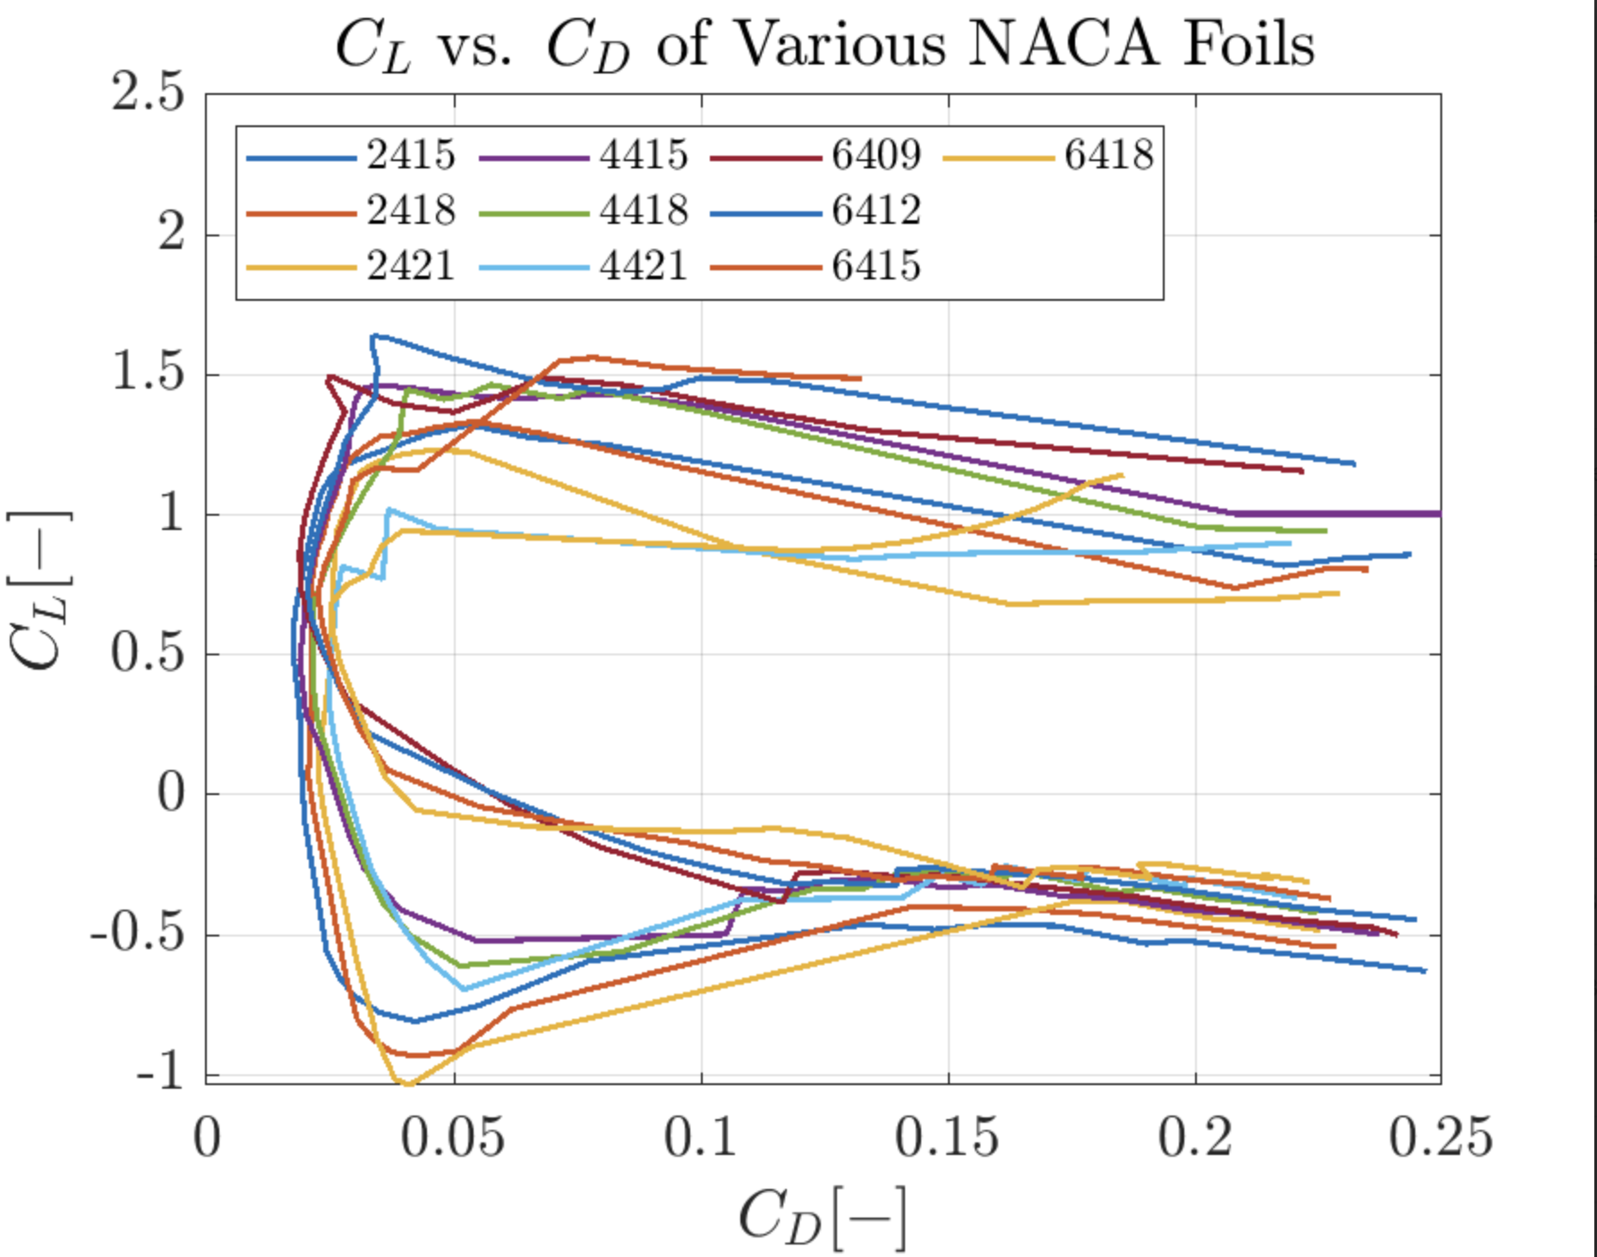
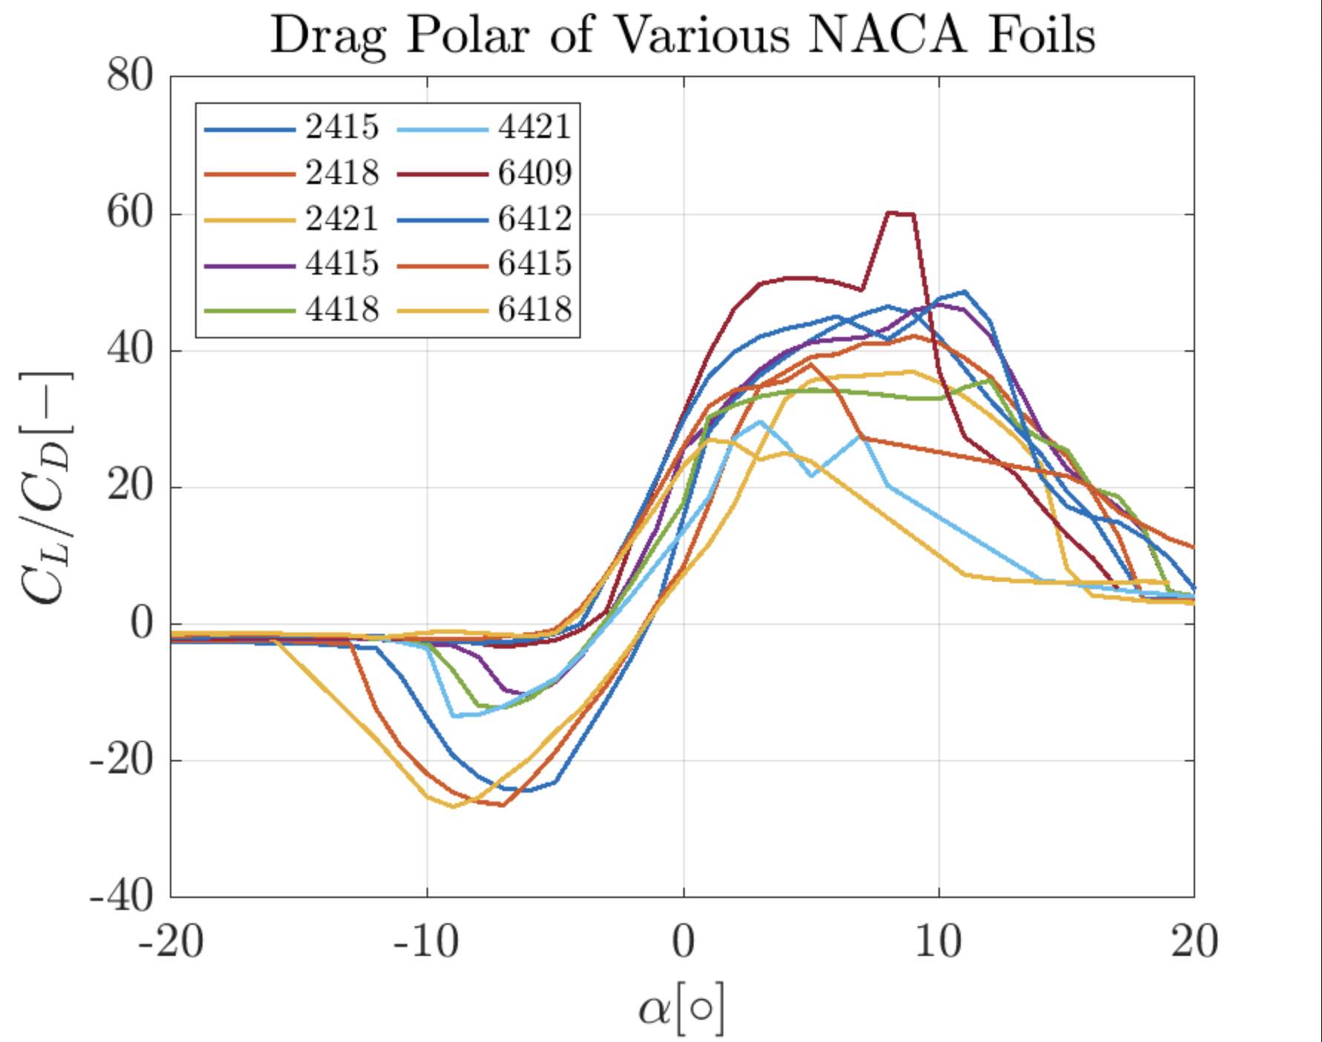
Design Process
Each group member selected a few airfoil designs, tested them in XFLR5, and compared results to determine which one had the best performance metrics
We looked to maximize lift before stall
We looked for longest stall, so we would see it in our experiment
As high of a peak in Cl as possible as early as possible
Image 1: Initial iteration of wing design

Slide 3
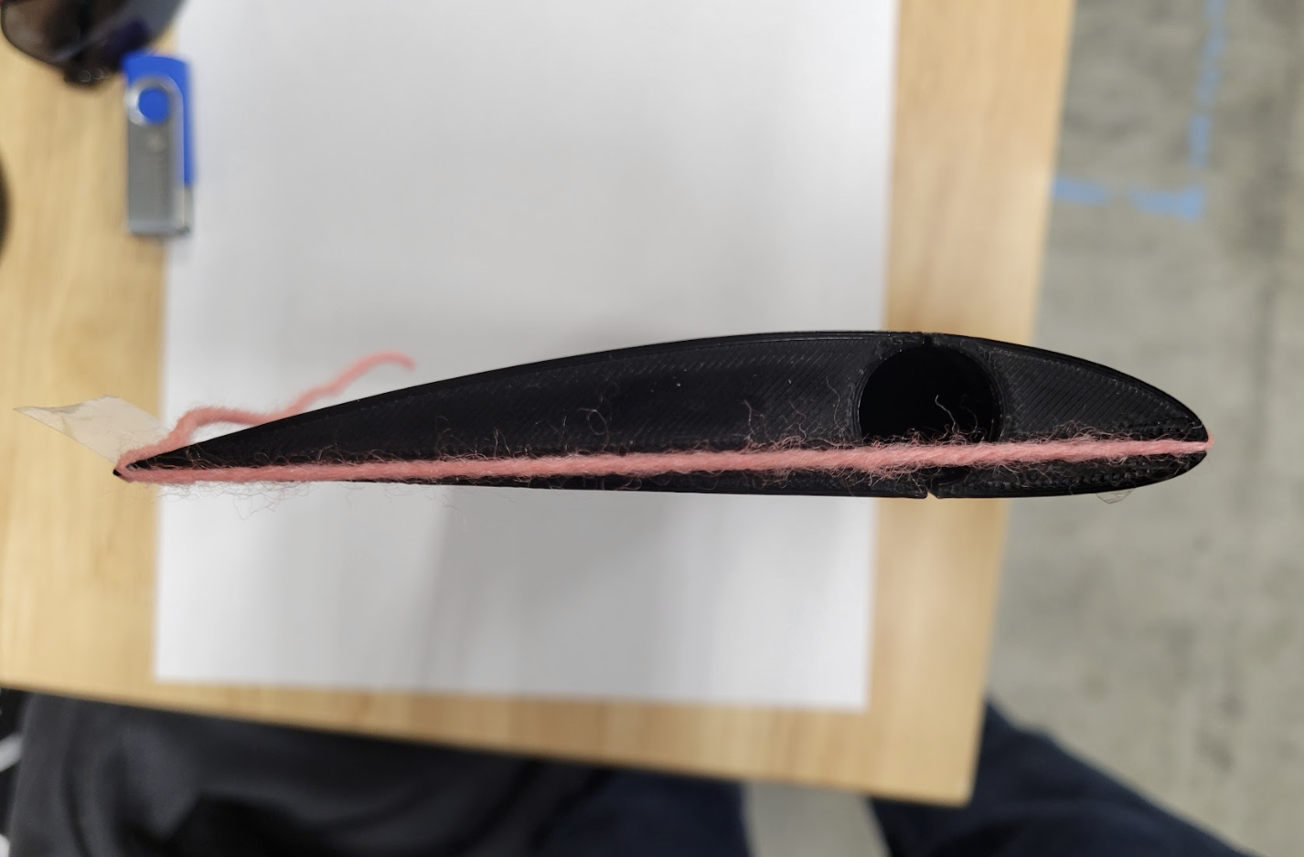
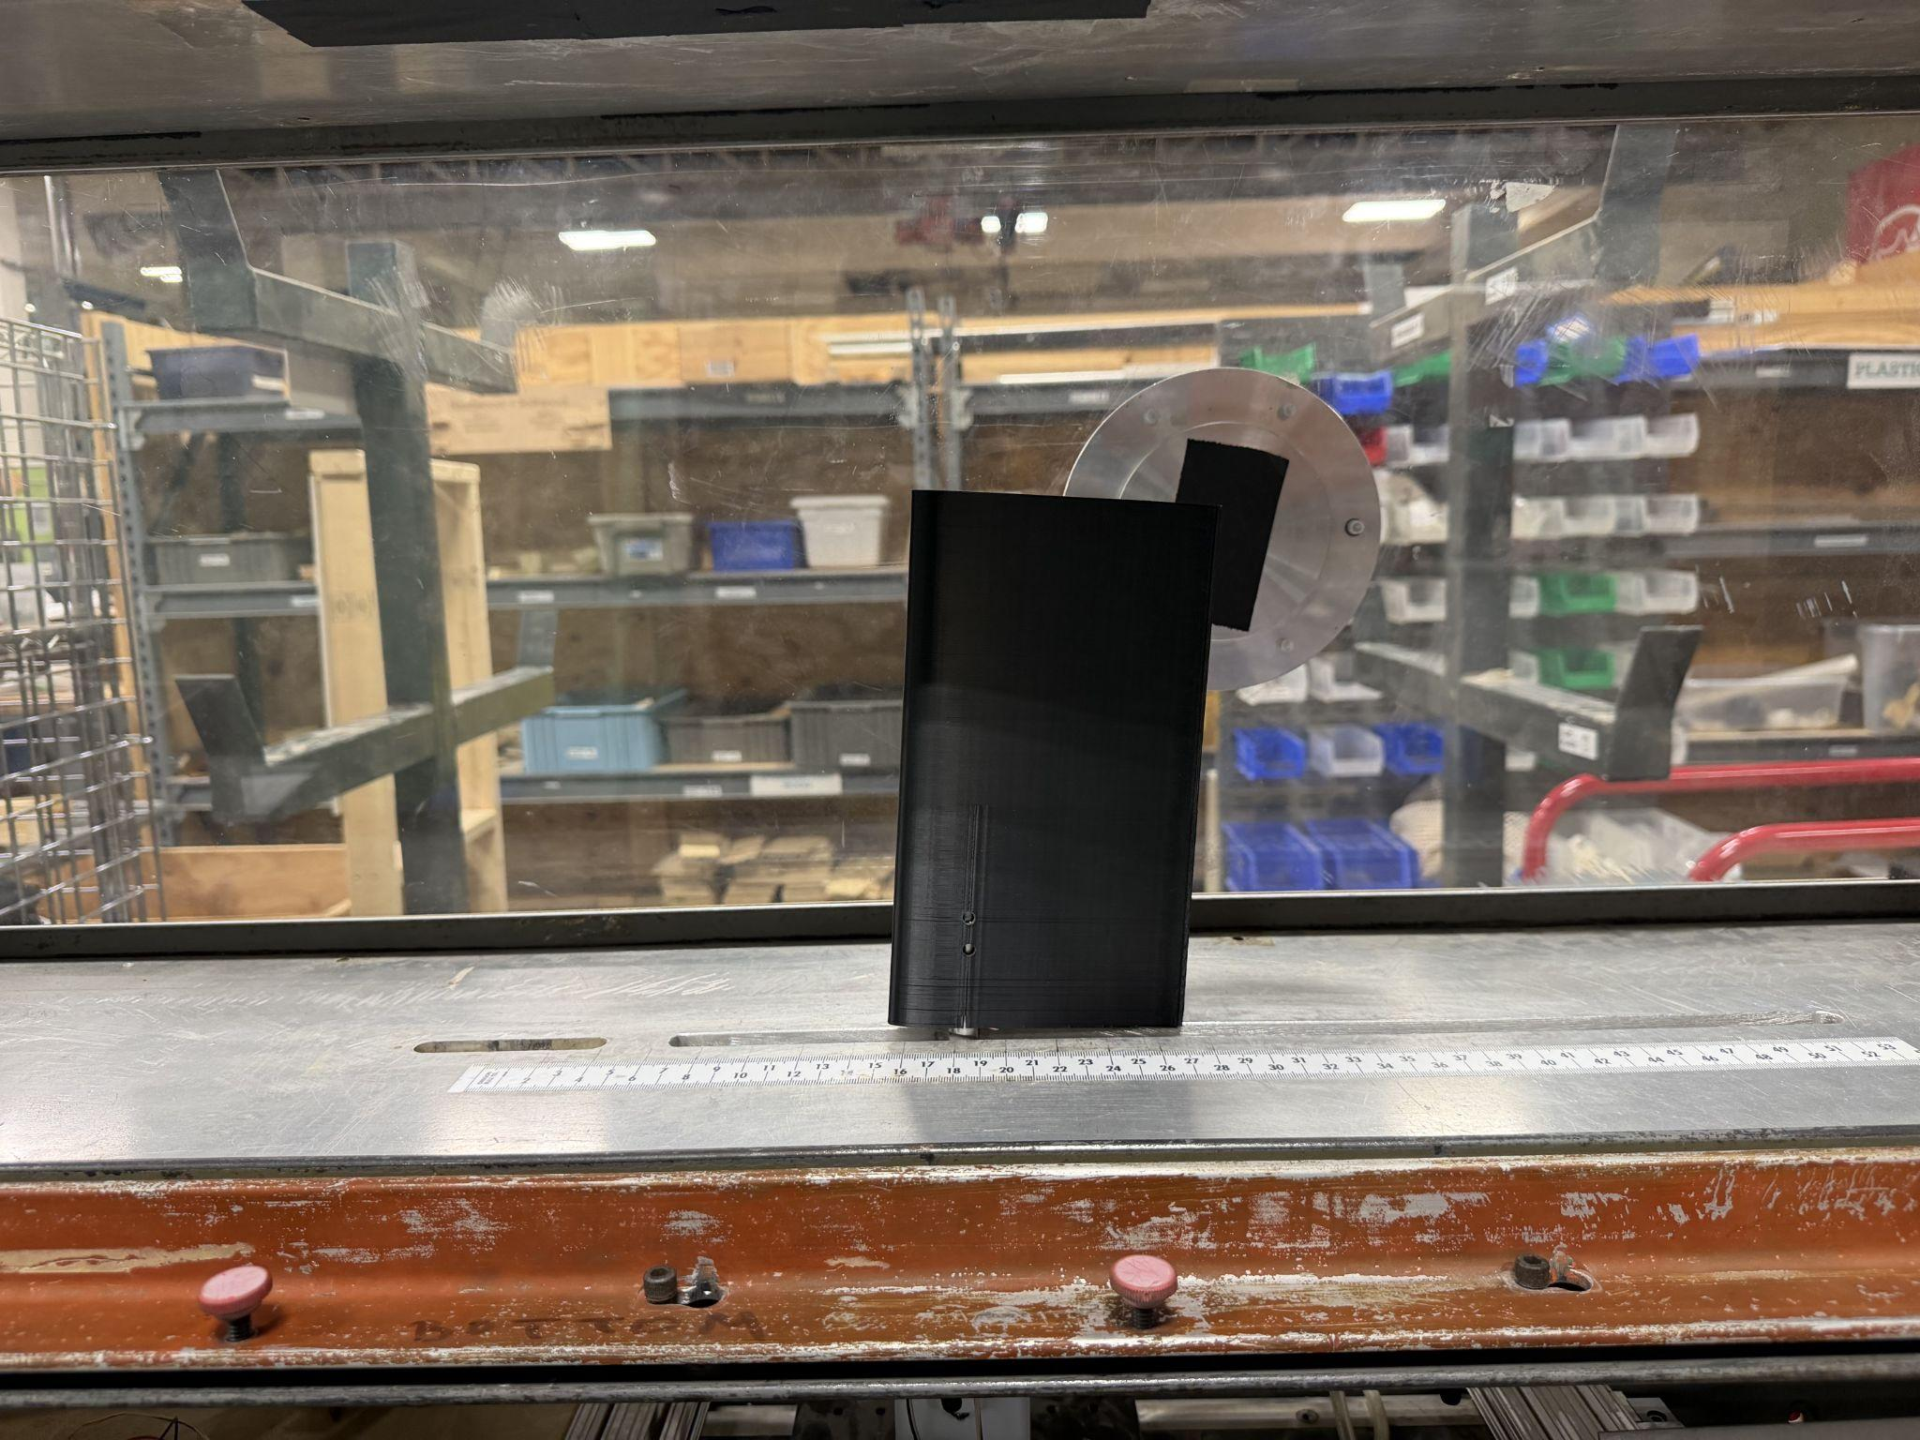
Wing Design Based on NACA 4415
Image 2: Final iteration of wing design
Image 3: Final iteration of wing design in wind tunnel

Slide 4
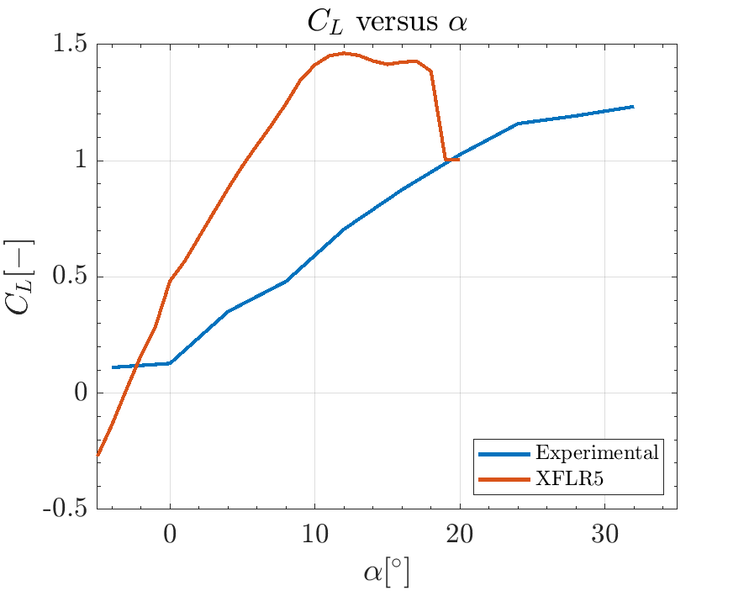
Lift vs Angle of Attack
Stall 𝛼 ≅ 32°
XFLR5 gave us an expected stall angle of 17 degrees, however, in testing, we did not see the stall angle of attack appear
Figure 1: Coefficient of Lift vs. Angle of Attack for XFLR5 model and Experimental Data

Slide 5
Final Performance Metrics
Stall angle of attack → 32°
Graph begins to plateau at this point, however a true stall point is not seen in our data
Curvature at stall → because we do not reach the true stall point in our experimental data, the curvature at stall cannot be determined
Lift coefficient → 1.23
Why this is different?
Our experimental wing has finite wing effects -> downwash and tip vortices
-> reduced effective angle of attack and reduced coefficient of lift
-> wing does not reach stall even at an angle as high as 30 degrees

Slide 6
Reflection
Different experimental setup would likely yield different design choice: constrained by strain gauge thickness
More emphasis on proper calibration and proper data collection
Time constraint - ideally print earlier and more to iterate more intently on our design. Explore more options as well (tapered wing, surface design, dimples, winglet, etc.)
Unexpected that we didn’t reach stall

