Slide 1
RBloggers
Tinghan Zhu

Slide 2

What is R-Bloggers.com?
R-Bloggers is about empowering bloggers to empower other R users. R-Bloggers.com is a blog aggregator of content contributed by bloggers who write about R (in English).
Notes:
The website helps R bloggers and users to connect and follow each other
.

Slide 3

Who started R-Bloggers (and why)?
R Bloggers was started by Tal Galili
“Make them find him”
Notes:
R Bloggers was started by Tal Galili. After searching for numerous R blogs, Tal (well, me) decided that there must be more R blogs out there than he knows about, and maybe the best way for finding them is to make them find him.

Slide 4
What does R-Bloggers offer you?
Discover (for all):
Follow (for people who don’t use RSS):
Connect (for facebook users):
Participate (for bloggers):
Notes:
Discover (for all): Find new R blogs you didn’t know about. And Search in them for content you want.
Follow (for people who don’t use RSS): Enter your e-mail and subscribe to receive a daily digest with teasers of new posts from participating blogs. You will more easily get a sense of hot topics in the R blogosphere.
Connect (for facebook users): Click on “Fan this site” to become a “fan” of R Bloggers. You can then “friend” other people and share thoughts on our wall. Or just by leaving comments on the original poster’s blog.
Participate (for bloggers): Add your R blog to get increased visibility (for readers and search engines) with permanent links on our Contributors section. Your blog will also gain visibility via our e-mail digest and through your presence on the main page with posts.

Slide 5
Statistics from R-bloggers
· Since 2014, there have been more than 160 posts per month (and up to as many as 250 in one month) aggregated on R-bloggers
· Most posts appear on Mondays and Tuesdays. Sunday is the quietest day for R bloggers.
· More than 1,000 authors have been published on the site.
· And (with more than a modicum of personal pride here), the top 10 authors on the site, measured by total engagement, are:

Slide 6

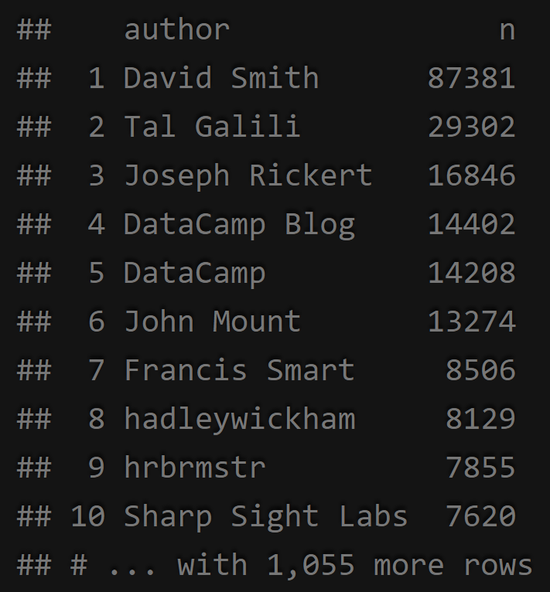
Top Bloggers: David Smith
Notes:
This site will aggregate feeds (only with permission!) from participating R blogs. The beginnings of each participating blog’s posts will automatically be displayed on the main page; inside every post there is a link to the original blog and links to other related articles. All participating blogs will have links in the “Contributors” section of our sidebar

Slide 7
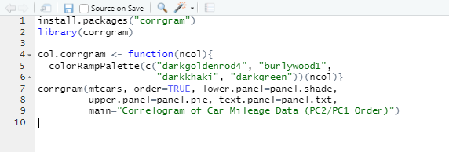
Example: Correlogram
Notes:
Basically, a corrgram is a graphical representation of the cells of a matrix of correlations. The idea is to display the pattern of correlations in terms of their signs and magnitudes using visual thinning and correlation-based variable ordering. Moreover, the cells of the matrix can be shaded or colored to show the correlation value.
It is very useful to highlight the most correlated variables in a data table. In this plot, correlation coefficients is colored according to the value. Correlation matrix can be also reordered according to the degree of association between variables.

Slide 8
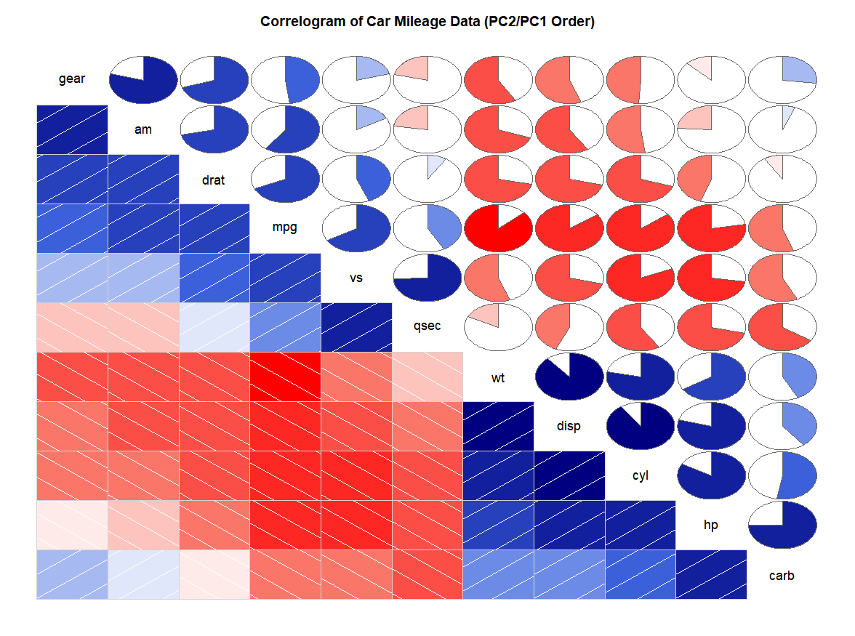

Slide 9
Thanks for Listening!
Questions?
Tinghan Zhu

