Slide 1
RBloggers
Tinghan Zhu

Slide 2

What is R-Bloggers.com?
R-Bloggers is about empowering bloggers to empower other R users. R-Bloggers.com is a blog aggregator of content contributed by bloggers who write about R (in English).
Notes:
The website helps R bloggers and users to connect and follow each other
.

Slide 3

Who started R-Bloggers (and why)?
R Bloggers was started by Tal Galili
“Make them find him”
Notes:
R Bloggers was started by Tal Galili. After searching for numerous R blogs, Tal decided that there must be more R blogs out there than he knows about, and he said maybe the best way for finding them is to make them find him (this website)

Slide 4
What does R-Bloggers offer you?
Discover (for all):
Follow (for people who don’t use RSS):
Connect (for facebook users):
Participate (for bloggers):
Notes:
Discover (for all): Find new R blogs you didn’t know about. And Search in them for content you want.
Follow (for people who don’t use RSS): Enter your e-mail and subscribe to receive a daily digest with teasers of new posts from participating blogs. You will more easily get a sense of hot topics in the R blogosphere.
Connect (for facebook users): Click on “Fan this site” to become a “fan” of R Bloggers. You can then “friend” other people and share thoughts on our wall. Or just by leaving comments on the original poster’s blog.
Participate (for bloggers): Add your R blog to get increased visibility (for readers and search engines) with permanent links on our Contributors section. Your blog will also gain visibility via our e-mail digest and through your presence on the main page with posts.

Slide 5
Statistics from R-bloggers
· Since 2014, there have been more than 160 posts per month (and up to as many as 250 in one month) aggregated on R-bloggers
· Most posts appear on Mondays and Tuesdays. Sunday is the quietest day for R bloggers.
· More than 1,000 authors have been published on the site.
· The top 10 authors on the site, measured by total engagement, are:

Slide 6

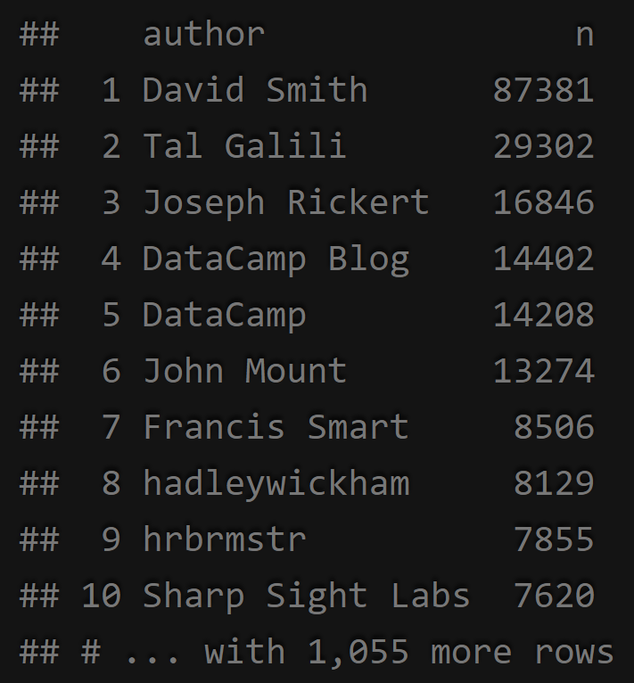
Top Bloggers: David Smith
Notes:
This site will aggregate feeds with permission!) from participating R blogs. The beginnings of each participating blog’s posts will automatically be displayed on the main page; inside every post there is a link to the original blog and links to other related articles. All participating blogs will have links in the “Contributors” section of our sidebar
Eighty seven thousand posts from him

Slide 7

Example: Correlogram
Notes:
I found this on RBloggers, which is a new kind of plot we did not cover in lecture. Basically, a corrgram is a graphical representation of the cells of a matrix of correlations. The idea is to display the pattern of correlations in terms of their signs and magnitudes using visual thinning and correlation-based variable ordering. Moreover, the cells of the matrix can be shaded or colored to show the correlation value.
It is very useful to highlight the most correlated variables in a data table.

Slide 8
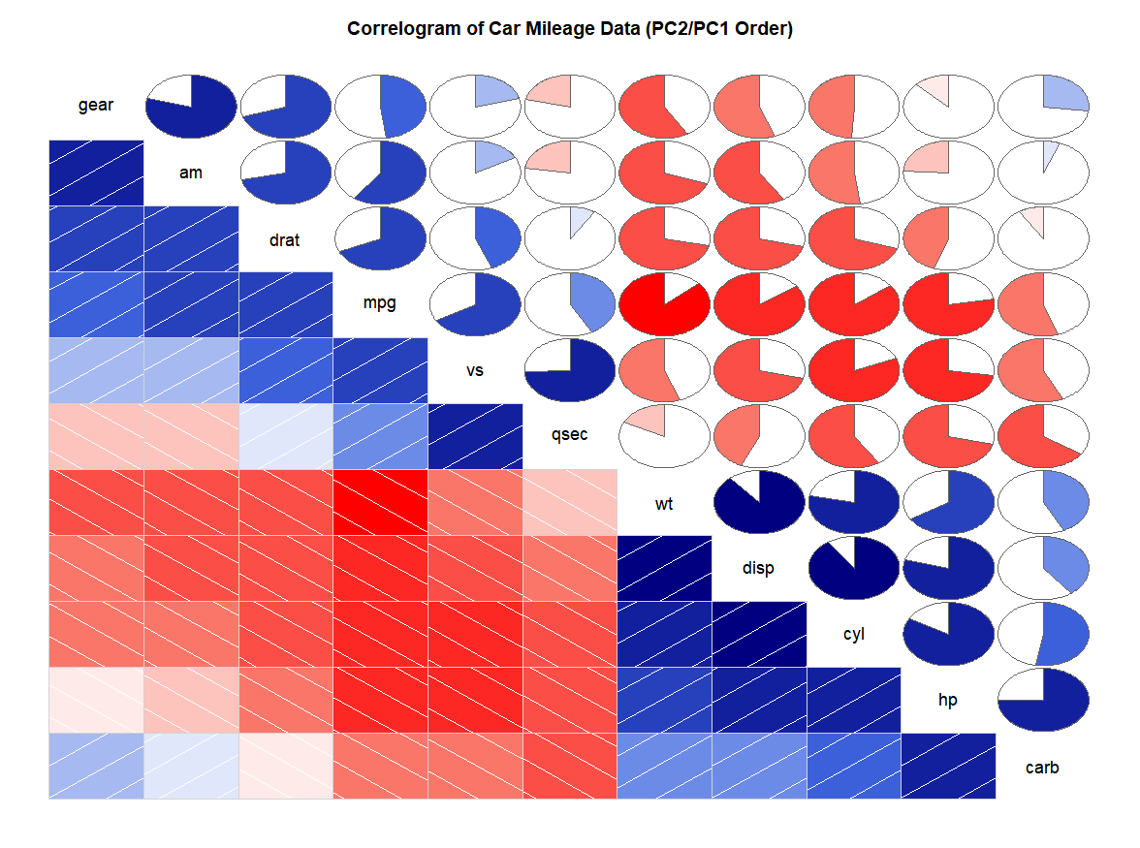
Notes:
In this plot, correlation coefficients is colored according to the value. Correlation matrix can be also reordered according to the degree of association between variables.
Darker the color, higher the co-relation between variables. Positive co-relations are displayed in blue and negative correlations in red color. Color intensity is proportional to the co-relation value.

Slide 9
Thanks for Listening!
Questions?
Tinghan Zhu

