Slide 1
Custom Signals for Uncoupled Design
Bruce Kroeze
bruce@ecomsmith.com

Slide 2
I’m going to show you how to get from this

Slide 3


Slide 4
To this

Slide 5
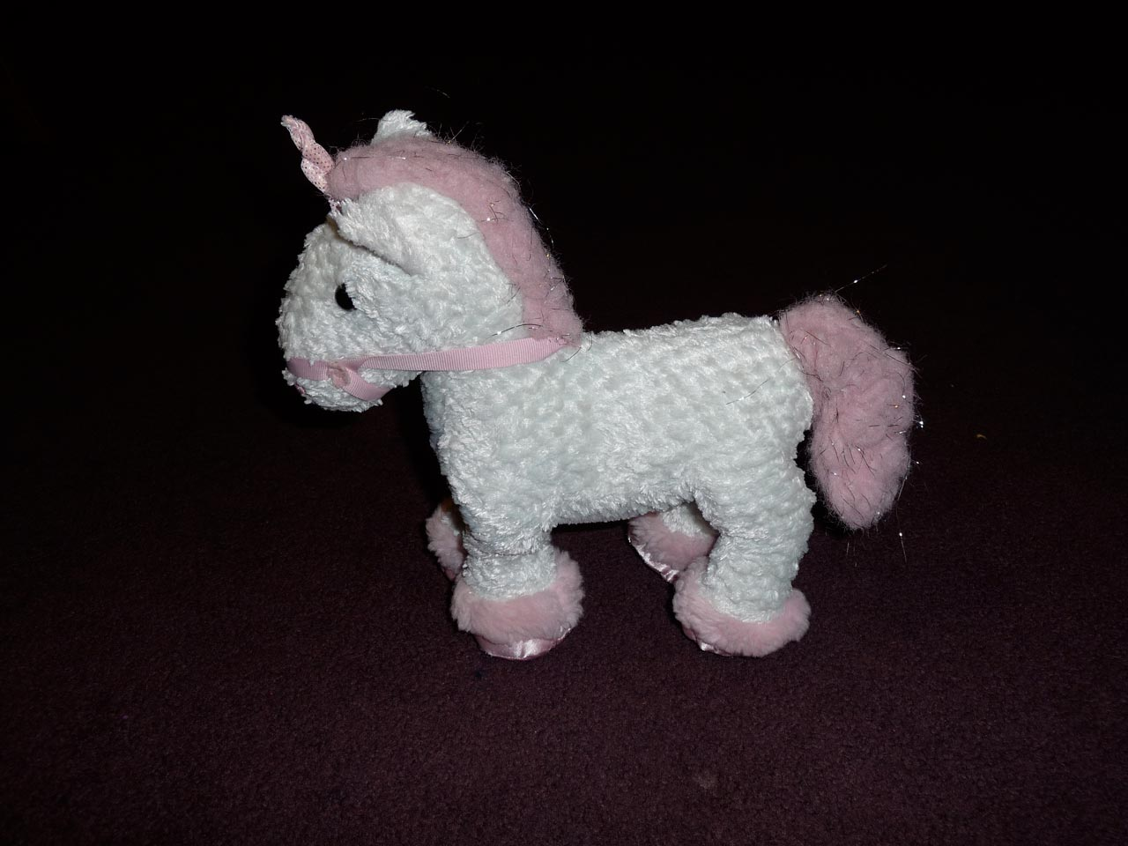

Slide 6
Without surgery

Slide 7
Or magic

Slide 8
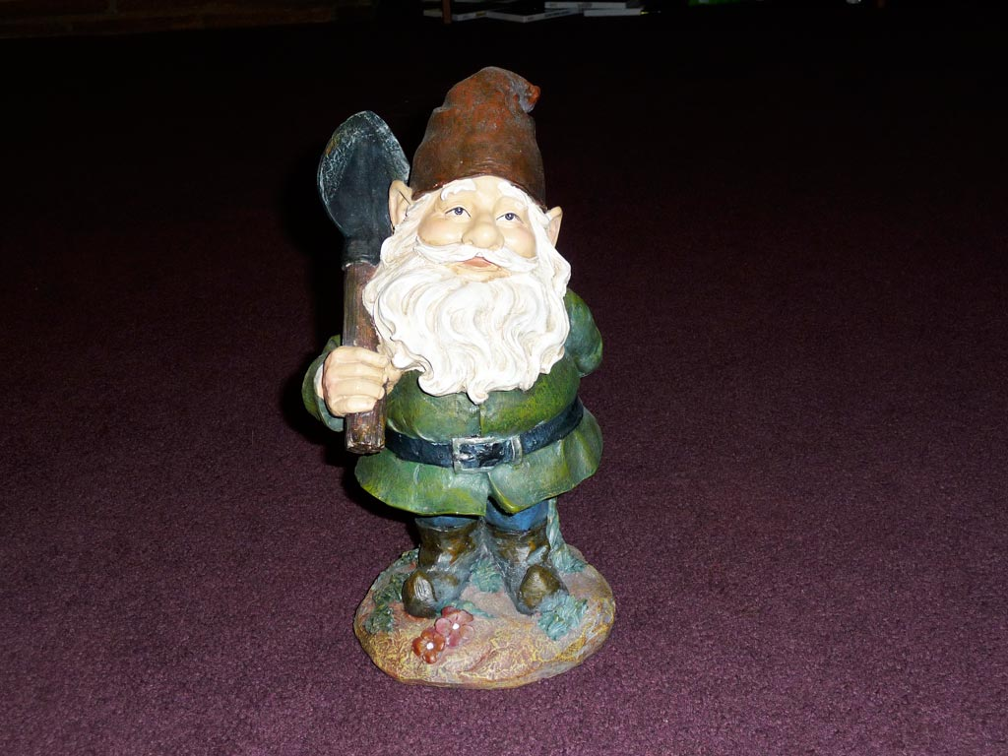

Slide 9
A real world example

Slide 10
(too boring)

Slide 11
A contrived example
class PonyForm(forms.Form): color=forms.CharField( label='Color', max_length=20, required=True, choices=PONY_COLORS)

Slide 12
Might look like
Color:
White
Submit

Slide 14
Adding form flexibility
def __init__(self, *args, **kwargs): super(PonyForm, self).__init__( *args, **kwargs) form_init.send( PonyForm, form=self)

Slide 15
The Unicorn App
def form_init_listener(sender, form=None, **kwargs): form.fields[’horn'] = \ forms.CharField(’Horn', required=True, max_length=20, choices=HORN_CHOICES)

Slide 16
Linking them
form_init.connect( form_init_listener, sender=PonyForm)

Slide 17
Might look like
Color:
Horn:
White
Silver
Submit

Slide 19
Promise kept!

Slide 20
The Challenge

Slide 21
Ideal Situation

Slide 22


Slide 23


Slide 24
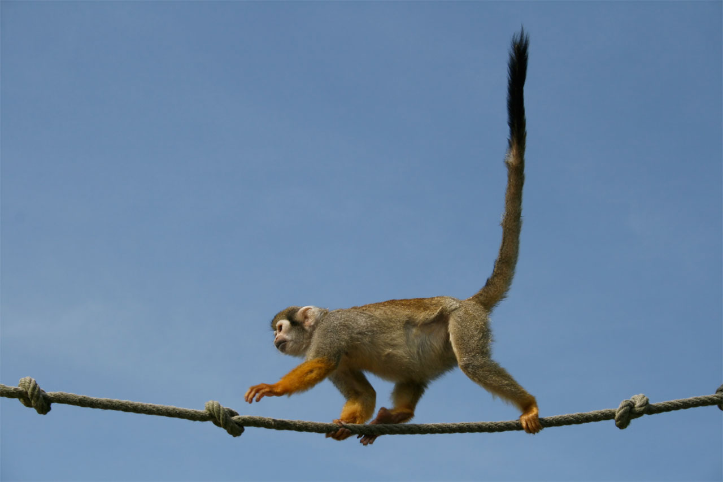

Slide 25


Slide 26
Custom Signals are a big part of the answer

Slide 27
Best Practices

Slide 28
File Names
Signals go in:
signals.py
Listeners go in:
listeners.py

Slide 29
Setup
Call “start_listening”
in listeners.py
from models.py
(helps localize imports)

Slide 30
Rules of Thumb
Most signals should go in:
Models
Forms
(not so much Views)

Slide 31
What about?
That pesky “caller” attribute?
If in doubt, use a string.
“mysignal.send(‘somelabel’)”
Strings are immutable

Slide 32


Slide 33
Examples

Slide 34
(there are going to be five)

Slide 35
Most of these use “Signals Ahoy”

Slide 36


Slide 37
Example 1: Searching

Slide 38


Slide 39
The View
def search(request):
data = request.GET
keywords = data.get('keywords', '').split(' ')
results = {}
application_search.send(“search”, request=request,
keywords=keywords, results=results)
context = RequestContext(request, {
'results': results,
'keywords' : keywords})
return render_to_response('search.html', context)

Slide 40
The Listener
def base_search_listener(sender, results={}, **kwargs):
results['base'] = 'Base search results'

Slide 41
Example 2: Url Manipulation

Slide 42
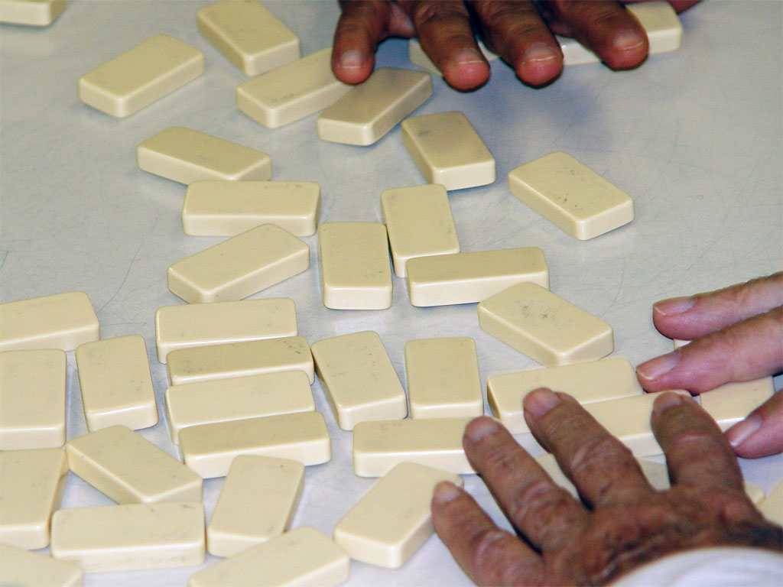

Slide 43
The Base Urls File
urlpatterns = patterns('tests.localsite.views',
(r’signalled_view/', ’signalled_view', {}),
)
collect_urls.send(sender=localsite, patterns=urlpatterns)

Slide 44
The Custom App Urls File
from django.conf.urls.defaults import *
custompatterns = patterns('tests.customapp.views',
(r'^collect_urls/$', 'collect_urls', {}),
(r'^async_note/$', 'async_note_create')
)

Slide 45
The Listener
from urls import custompatterns
def add_custom_urls(sender, patterns=(), **kwargs): patterns += custompatterns

Slide 46
Example 3: Views

Slide 47


Slide 48
The View
def signalled_view(request):
ctx = {
'data' : ‘Not modified'
}
view_prerender.send('signalled_view', context=ctx)
context = RequestContext(request, ctx)
return render_to_response(
‘signalled_view.html', context)

Slide 49
The Template
<div style=“text-align:center”>
{{ data }}
</div>

Slide 50
Unmodified View
Not modified

Slide 51
The Listener
def signalled_view_listener( sender, context={}, **kwargs):
context['data'] = “Modified”
def start_listening():
view_prerender.connect(
signalled_view_listener, sender=‘signalled_view’)

Slide 52
Modified View
Modified

Slide 53
Example 4: Asynchronous

Slide 54
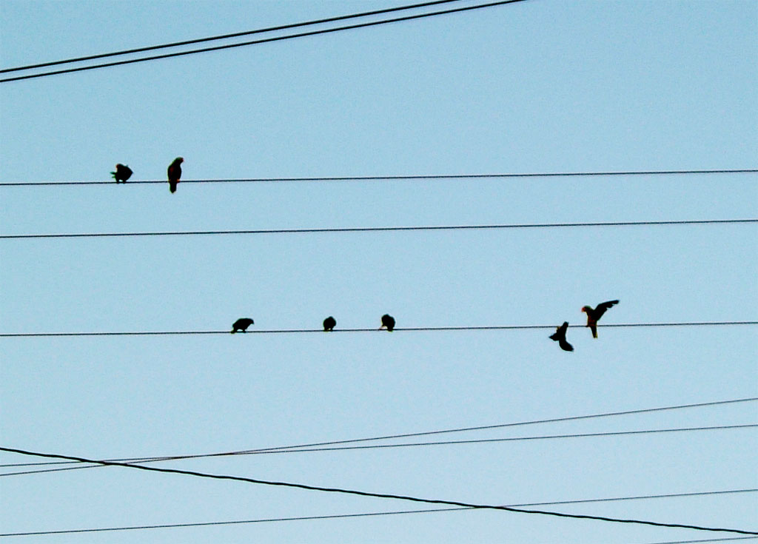

Slide 55
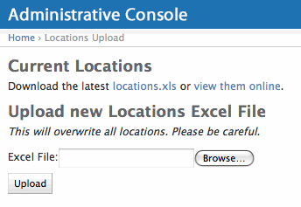
Importing a (big) XLS

Slide 56
The View
def locations_upload_xls(request, uuid = None):
if request.method == "POST":
data = request.POST.copy()
form = UploadForm(data, request.FILES)
if form.is_valid():
form.save(request.FILES['xls’], request.user)
return HttpResponseRedirect( '/admin/location_upload/%s' % form.uuid)
else:
form = UploadForm()
ctx = RequestContext(request, { 'form' : form})
return render_to_response( 'locations/admin_upload.html', ctx)

Slide 57
The Form
class UploadForm(forms.Form):
xls = forms.FileField(label="Excel File", required=True)
def save(self, infile, user):
outfile = tempfile.NamedTemporaryFile(suffix='.xls')
for chunk in infile.chunks():
outfile.write(chunk)
outfile.flush()
self.excelfile=outfile
form_postsave.send(self, form=self)
return True

Slide 58
The Listener
def process_excel_listener(sender, form=None, **kwargs):
parsed = pyExcelerator.parse_xls(form.excelfile.name)
# do something with the parsed data – it won’t block
processExcelListener = AsynchronousListener( process_excel_listener)
def start_listening():
form_postsave.connect( processExcelListener.listen, sender=UploadForm)

Slide 59
Example 5: Forms (the long one)

Slide 60


Slide 61
The View
def form_example(request):
data = {}
if request.method == "POST":
form = forms.ExampleForm(request.POST)
if form.is_valid():
data = form.save()
else:
form = forms.ExampleForm()
ctx = RequestContext(request, {
'form' : form,
'formdata' : data })
return render_to_response(‘form_example.html', ctx)

Slide 62
The Form
class ExampleForm(forms.Form):
name = forms.CharField(
max_length=30, label='Name', required=True)
def __init__(self, *args, **kwargs):
initial = kwargs.get('initial', {})
form_initialdata.send(
ExampleForm, form=self, initial=initial)
kwargs['initial'] = initial
super(ExampleForm, self).__init__(
*args, **kwargs)
signals.form_init.send(ExampleForm, form=self)

Slide 63
The Form (pt 2)
def clean(self, *args, **kwargs):
super(ExampleForm, self).clean(*args, **kwargs)
form_validate.send(ExampleForm, form=self)
return self.cleaned_data
def save(self):
data = self.cleaned_data
form_presave.send(ExampleForm, form=self)
form_postsave.send(ExampleForm, form=self)
return self.cleaned_data

Slide 64
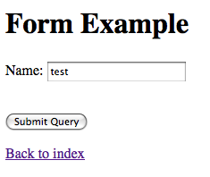
Unmodified page

Slide 65
The Listeners
def form_initialdata_listener(
sender, form=None, initial={}, **kwargs):
initial['email'] = "a@example.com"
initial['name'] = 'test'
def form_init_listener(
sender, form=None, **kwargs):
form.fields['email'] = forms.EmailField(
'Email', required=True)

Slide 66
The Listeners (pt2)
def form_validate_listener(
sender, form=None, **kwargs):
"""Do custom validation on form"""
data = form.cleaned_data
email = data.get('email', None)
if email != 'test@example.com':
errors = form.errors
if 'email' not in errors:
errors['email'] = []
errors['email'].append(
'Email must be "test@example.com"')

Slide 67
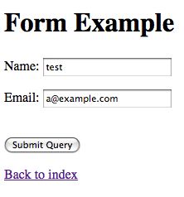
Modified page

Slide 68
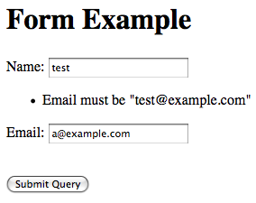
Validation page

Slide 69
Photo Credits
Pony/Unicorn: Bruce Kroeze (pony property of Mia Kroeze)
Gnome: Bruce Kroeze
Fork: Foxuman (sxc.hu)
Monkey: Lies Meirlaen
Air horns: Adrezej Pobiedzinski

Slide 70
Photo Credits 2
Pirate Ship: Crystal Woroniuk
Telescope: Orlando Pinto
Dominoes: Elvis Santana
San Miguel Panorama: Bruce Kroeze
Birds on wire: Jake P (sxc.hu)
Feedback Form, “Excellent”: Dominik Gwarek

Slide 71
Resources
Signals Ahoy: http://gosatchmo.com/apps/django-signals-ahoy
This presentation: http://ecomsmith.com/2009/speaking-at-djangocon-2009/

