Slide 1



Slide 2
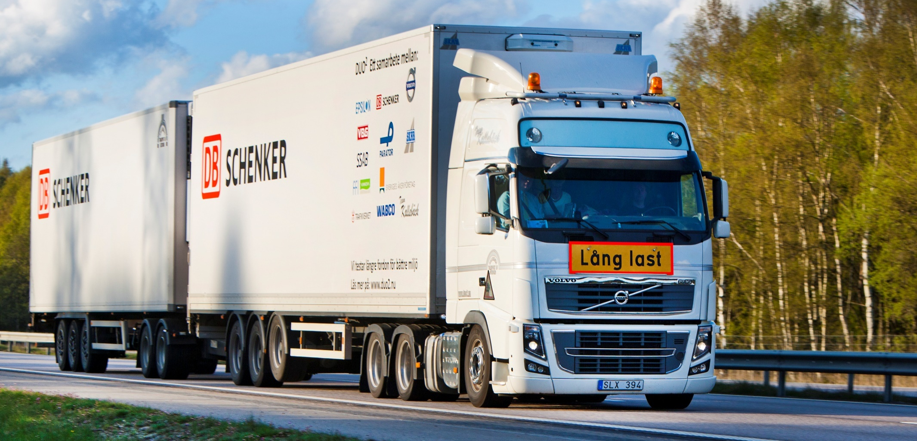
Optimization of Distributed Propulsion
In Long Heavy Vehicle Combinations
Notes:
2

Slide 3
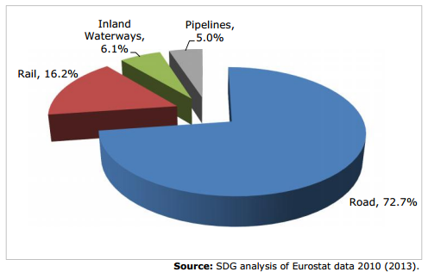
The freight transport problem
Notes:
Tonnage – 31%
Miles – 27%
Overall freight – 26% in 10 years from 2010 to 2020
3

Slide 4
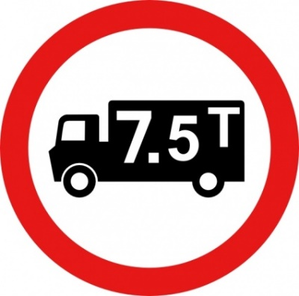

The freight transport problem
30%
27%
2020
2010
Notes:
Tonnage – 31%
Miles – 27%
Overall freight – 26% in 10 years from 2010 to 2020
4

Slide 5
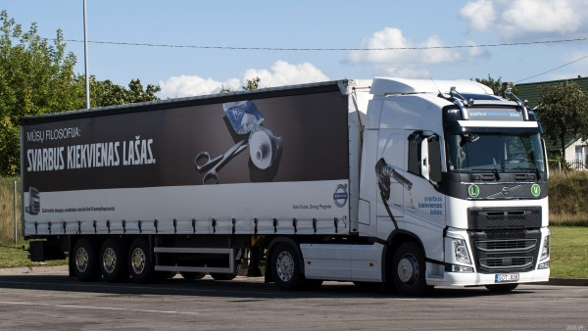
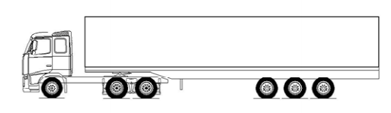
Freight transport today
Increased traffic
Higher emissions
Burgeoning operating costs
J. Aurell and T. Wadman. Vehicle combinations based on the modular concept. Tech. rep. Nordiska Vagtekniska F¨orbundet, 2007
2014

Slide 6
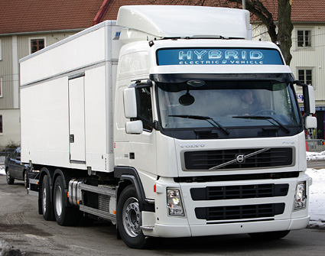
The way ahead
Technology
Reduced fuel consumption and emissions
Higher energy efficiency
Improved time efficiency
Sustainability
2014
2015
Notes:
Disadvantages – Still more traffic (more trucks on the road), higher operating costs, fleet management, maintenance etc higher

Slide 7
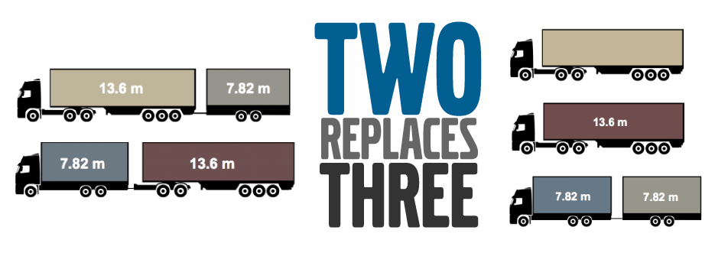
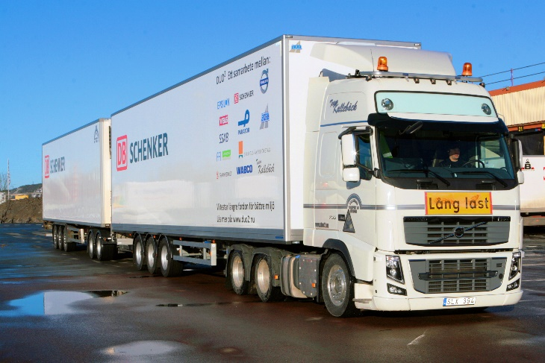
The way ahead
Policy
Reduced fuel consumption and emissions
Higher energy efficiency
Reduced traffic and congestion
Safer corridors
2014
2015
Notes:
Disadvantages – Lower gradeability, lower average speeds, lower manoeuvring control

Slide 8
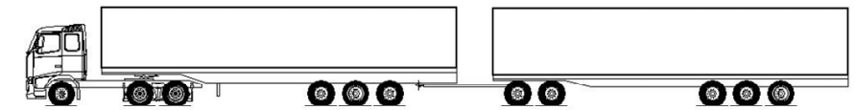

The way ahead
?
?
2014
2015
2020
2025
2030

Slide 9
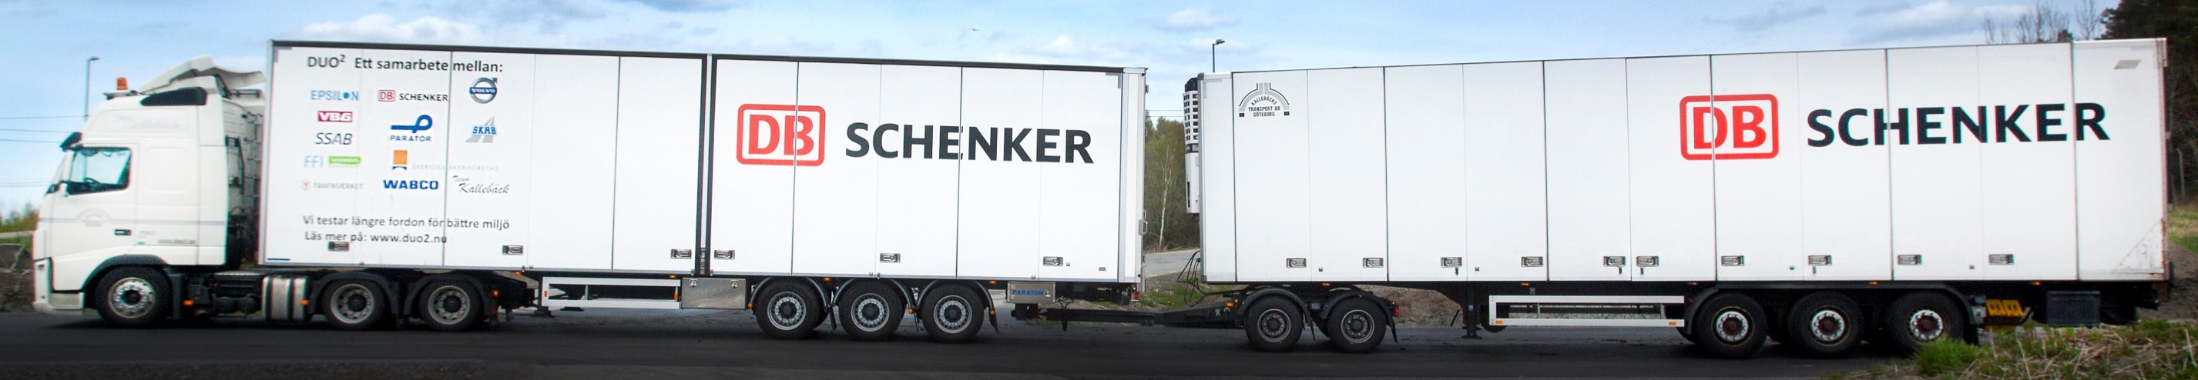
What combinations are possible?
D13

Slide 10
What combinations are possible?
D13
D11

Slide 11
What combinations are possible?
D13
D11
3 Engine Sizes X 3 Buffer Sizes X 3 Motor Sizes X 11 possible axles = 55296 combinations

Slide 12
How is each combination evaluated?
?
2014
2015
2020
2025
2030

Slide 13
How is each combination evaluated?
What is the best combination for the mission?
?
2014
2015
2020
2025
2030

Slide 14
How is each combination evaluated?
What is the best combination for the mission?
ProdCALC
2014
2015
2020
2025
2030

Slide 15
How is each combination evaluated?
What is the best combination for the mission?
ProdCALC
ProdOPT
2014
2015
2020
2025
2030

Slide 16
ProdCALC
Vehicle
Driver
Mission
Route
Payload

Slide 17





ProdCALC - Mission Productivity
Lifetime Revenues
Total cost of Operation

Slide 18





ProdCALC - Mission Productivity
Lifetime Revenues
Total cost of Operation

Slide 19


ProdCALC - Mission Productivity
Lifetime Revenues
Total cost of Operation

Slide 20
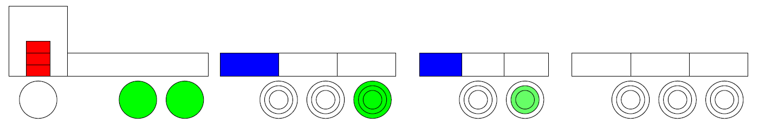
Vehicle Model in ProdCALC
Cruise speed
Traction
demand
Traction
output
Road Gradient
Notes:
Simple cruise control

Slide 21
Vehicle Model in ProdCALC
Traction achieved
Engine traction
Electric traction
Longitudinal vehicle dynamics

Slide 22
Vehicle Model in ProdCALC
Traction achieved
Engine traction
Electric traction
Longitudinal vehicle dynamics
Rule-based hybrid power management

Slide 23
Vehicle Model in ProdCALC
Traction achieved
Engine traction
Electric traction
Longitudinal vehicle dynamics
Rule-based hybrid power management
Distributed propulsion – energy buffers on each unit

Slide 24
Vehicle Model in ProdCALC
Traction achieved
Engine traction
Electric traction
Longitudinal vehicle dynamics
Rule-based hybrid power management
Distributed propulsion – energy buffers on each unit
Control allocation based on buffer availability

Slide 25
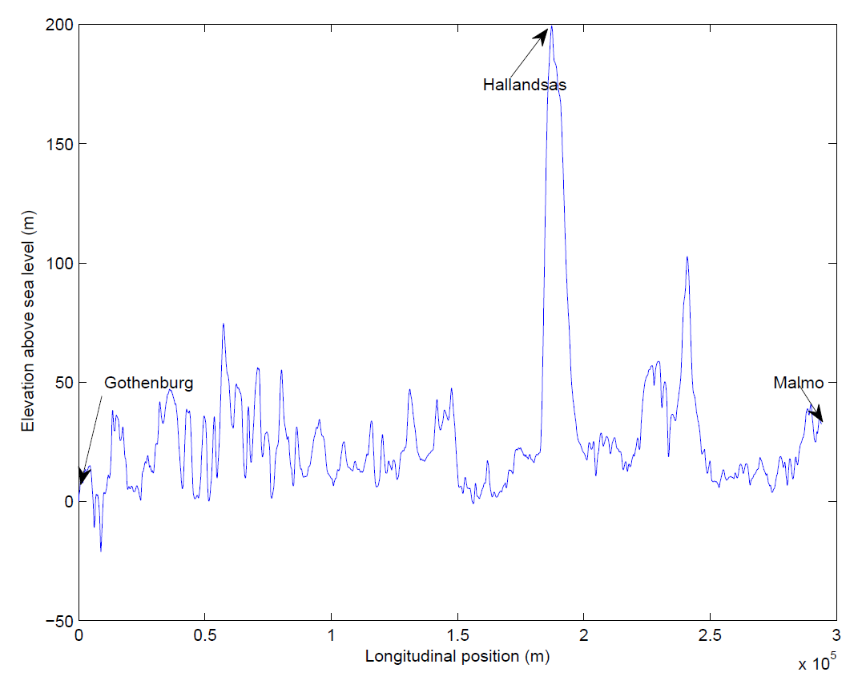
Vehicle Model in ProdCALC
Predictive Battery Energy Management

Slide 26
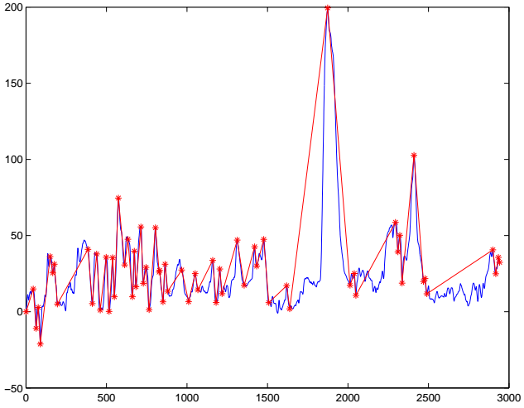

Vehicle Model in ProdCALC
Predictive Battery Energy Management
Longitudinal position (data points)

Slide 27
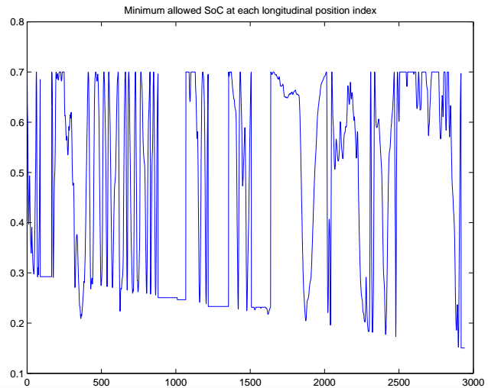
Vehicle Model in ProdCALC
Battery Energy Management - Predictive

Slide 28
ProdCALC
Vehicle
Lifetime Revenues
Mission
prodCALC
Mission Productivity =
Driver
Route
Total cost of Operation
Payload

Slide 29
ProdOPT
Optimization Tool
Productivity

Slide 30
ProdOPT
Optimization Tool - Evolutionary Algorithm

Slide 31
ProdOPT
Optimization Tool - Evolutionary Algorithm

Slide 32
ProdOPT
Optimization Tool - Evolutionary Algorithm

Slide 33
ProdOPT
Optimization Tool - Evolutionary Algorithm

Slide 34
ProdOPT
Optimization Tool - Evolutionary Algorithm

Slide 35
ProdOPT
Variants
3 different engines – D11, D13 and D16
3 electric buffer sizes – 5 kWh, 50 kWh and 91 kWh
3 electric motor sizes – 125kW, 230 Nm;
175kW, 400 Nm and
175kW, 800 Nm
Electric propulsion on any / all trailer axles

